Slide 1

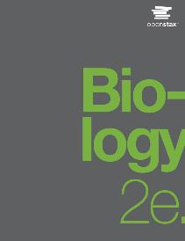
Biology 2e
Chapter 3 BIOLOGICAL MACROMOLECULES
PowerPoint Image Slide Show

Slide 2
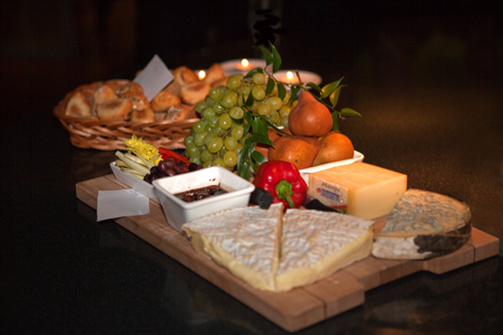
Figure 3.1
Foods such as bread, fruit, and cheese are rich sources of biological macromolecules.
(credit: modification of work by Bengt Nyman)
This OpenStax ancillary resource is © Rice University under a CC-BY 4.0 International license; it may be reproduced or modified but must be attributed to OpenStax, Rice University and any changes must be noted. Any images credited to other sources are similarly available for reproduction, but must be attributed to their sources.

Slide 3
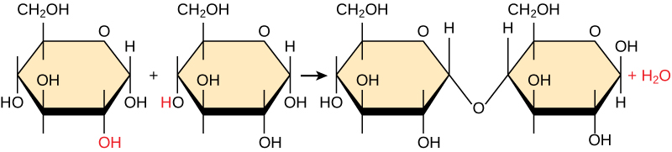
Figure 3.2
In the dehydration synthesis reaction depicted above, two molecules of glucose are linked together to form the dissacharide maltose. In the process, a water molecule is formed.
This OpenStax ancillary resource is © Rice University under a CC-BY 4.0 International license; it may be reproduced or modified but must be attributed to OpenStax, Rice University and any changes must be noted. Any images credited to other sources are similarly available for reproduction, but must be attributed to their sources.

Slide 4
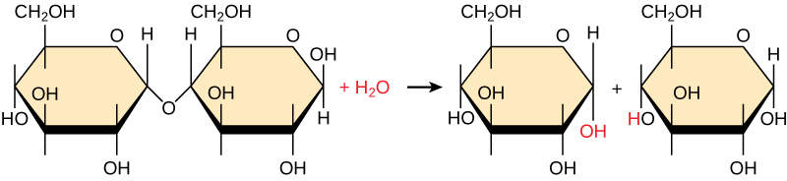
Figure 3.3
In the hydrolysis reaction shown here, the disaccharide maltose is broken down to form two glucose monomers with addition of water. Note that this reaction is the reverse of the synthesis reaction shown in Figure 3.2.
This OpenStax ancillary resource is © Rice University under a CC-BY 4.0 International license; it may be reproduced or modified but must be attributed to OpenStax, Rice University and any changes must be noted. Any images credited to other sources are similarly available for reproduction, but must be attributed to their sources.

Slide 5
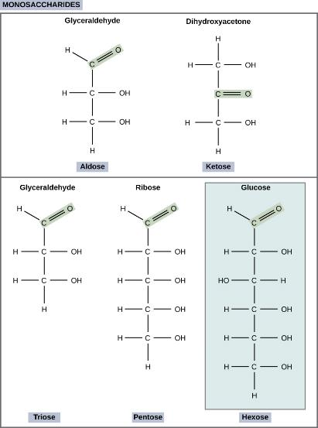
Figure 3.4
Scientists classify monosaccharides based on the position of their carbonyl group and the number of carbons in the backbone. Aldoses have a carbonyl group (indicated in green) at the end of the carbon chain, and ketoses have a carbonyl group in the middle of the carbon chain. Trioses, pentoses, and hexoses have three-, five-, and six- carbon backbones, respectively.
This OpenStax ancillary resource is © Rice University under a CC-BY 4.0 International license; it may be reproduced or modified but must be attributed to OpenStax, Rice University and any changes must be noted. Any images credited to other sources are similarly available for reproduction, but must be attributed to their sources.

Slide 6
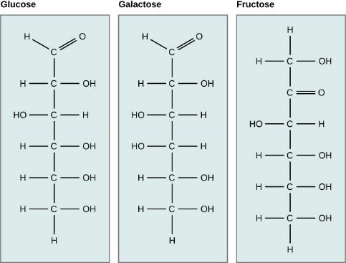
Figure 3.5
Glucose, galactose, and fructose are all hexoses. They are structural isomers, meaning they have the same chemical formula (C₆H₁₂O₆) but a different arrangement of atoms.
This OpenStax ancillary resource is © Rice University under a CC-BY 4.0 International license; it may be reproduced or modified but must be attributed to OpenStax, Rice University and any changes must be noted. Any images credited to other sources are similarly available for reproduction, but must be attributed to their sources.

Slide 7
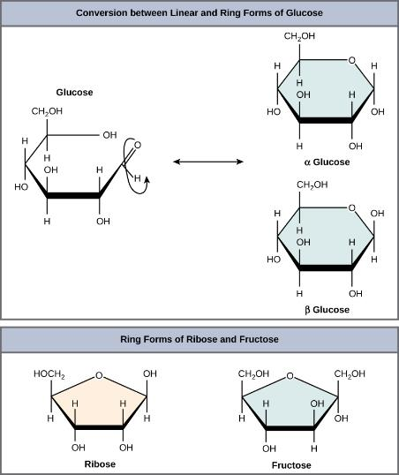
Figure 3.6
Five and six carbon monosaccharides exist in equilibrium between linear and ring forms. When the ring forms, the side chain it closes on is locked into an α or β position. Fructose and ribose also form rings, although they form five-membered rings as opposed to the six-membered ring of glucose.
This OpenStax ancillary resource is © Rice University under a CC-BY 4.0 International license; it may be reproduced or modified but must be attributed to OpenStax, Rice University and any changes must be noted. Any images credited to other sources are similarly available for reproduction, but must be attributed to their sources.

Slide 8
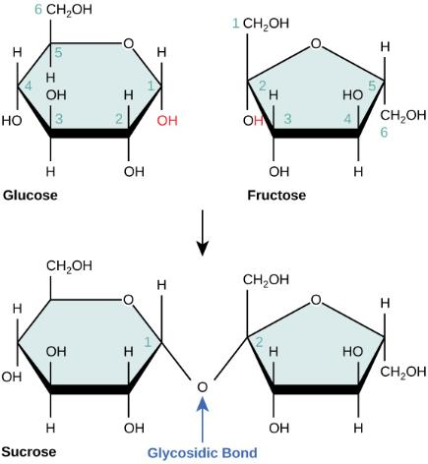
Figure 3.7
Sucrose is formed when a monomer of glucose and a monomer of fructose are joined in a dehydration reaction to form a glycosidic bond. In the process, a water molecule is lost. By convention, the carbon atoms in a monosaccharide are numbered from the terminal carbon closest to the carbonyl group. In sucrose, a glycosidic linkage is formed between carbon 1 in glucose and carbon 2 in fructose.
This OpenStax ancillary resource is © Rice University under a CC-BY 4.0 International license; it may be reproduced or modified but must be attributed to OpenStax, Rice University and any changes must be noted. Any images credited to other sources are similarly available for reproduction, but must be attributed to their sources.

Slide 9
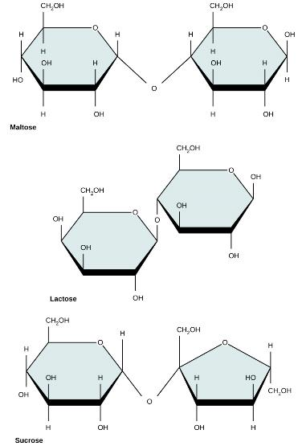
Figure 3.8
Common disaccharides include maltose (grain sugar), lactose (milk sugar), and sucrose (table sugar).
This OpenStax ancillary resource is © Rice University under a CC-BY 4.0 International license; it may be reproduced or modified but must be attributed to OpenStax, Rice University and any changes must be noted. Any images credited to other sources are similarly available for reproduction, but must be attributed to their sources.

Slide 10
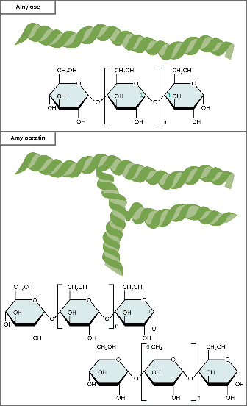
Figure 3.9
Amylose and amylopectin are two different forms of starch. Amylose is composed of unbranched chains of glucose monomers connected by α 1,4 glycosidic linkages. Amylopectin is composed of branched chains of glucose monomers connected by α 1,4 and α 1,6 glycosidic linkages. Because of the way the subunits are joined, the glucose chains have a helical structure. Glycogen (not shown) is similar in structure to amylopectin but more highly branched.
This OpenStax ancillary resource is © Rice University under a CC-BY 4.0 International license; it may be reproduced or modified but must be attributed to OpenStax, Rice University and any changes must be noted. Any images credited to other sources are similarly available for reproduction, but must be attributed to their sources.

Slide 11
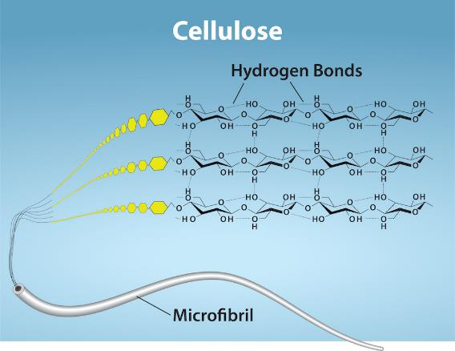
Figure 3.10
Cellulose is an organic compound composed of linear chains of hundreds to thousands of linked glucose molecules. The glucose monomers form hydrogen bonds, holding the chains firmly together side-by-side and form strong microfibrils. This rigidity is an important structural component of the cell walls found in plants.
(credit: Ryan, K. Rao, A. and Hawkins, A. Department of Biology, Texas A&M University)
This OpenStax ancillary resource is © Rice University under a CC-BY 4.0 International license; it may be reproduced or modified but must be attributed to OpenStax, Rice University and any changes must be noted. Any images credited to other sources are similarly available for reproduction, but must be attributed to their sources.

Slide 12
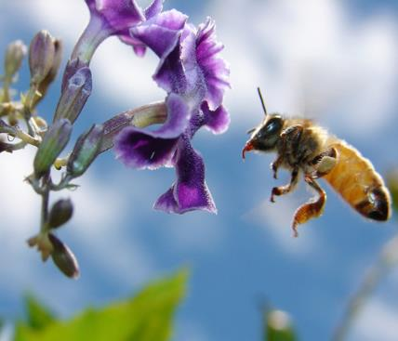
Figure 3.11
Insects have a hard outer exoskeleton made of chitin, a type of polysaccharide.
(credit: Louise Docker)
This OpenStax ancillary resource is © Rice University under a CC-BY 4.0 International license; it may be reproduced or modified but must be attributed to OpenStax, Rice University and any changes must be noted. Any images credited to other sources are similarly available for reproduction, but must be attributed to their sources.

Slide 13
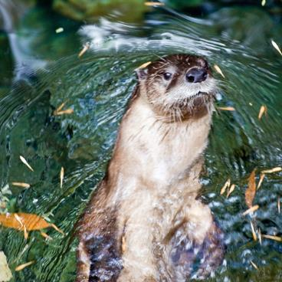
Figure 3.12
Hydrophobic lipids in the fur of aquatic mammals, such as this river otter, protect them from the elements.
(credit: Ken Bosma)
This OpenStax ancillary resource is © Rice University under a CC-BY 4.0 International license; it may be reproduced or modified but must be attributed to OpenStax, Rice University and any changes must be noted. Any images credited to other sources are similarly available for reproduction, but must be attributed to their sources.

Slide 14
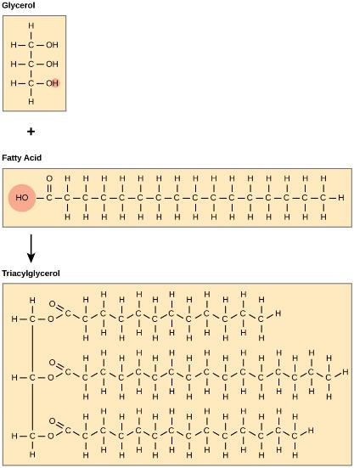
Figure 3.13
Joining three fatty acids to a glycerol backbone in a dehydration reaction forms triacylglycerol. Three water molecules release in the process.
This OpenStax ancillary resource is © Rice University under a CC-BY 4.0 International license; it may be reproduced or modified but must be attributed to OpenStax, Rice University and any changes must be noted. Any images credited to other sources are similarly available for reproduction, but must be attributed to their sources.

Slide 15
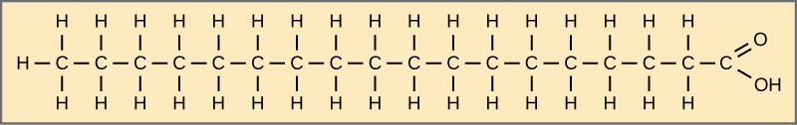
Figure 3.14
Stearic acid is a common saturated fatty acid.
This OpenStax ancillary resource is © Rice University under a CC-BY 4.0 International license; it may be reproduced or modified but must be attributed to OpenStax, Rice University and any changes must be noted. Any images credited to other sources are similarly available for reproduction, but must be attributed to their sources.

Slide 16
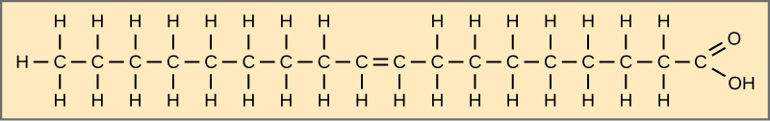
Figure 3.15
Oleic acid is a common unsaturated fatty acid.
This OpenStax ancillary resource is © Rice University under a CC-BY 4.0 International license; it may be reproduced or modified but must be attributed to OpenStax, Rice University and any changes must be noted. Any images credited to other sources are similarly available for reproduction, but must be attributed to their sources.

Slide 17
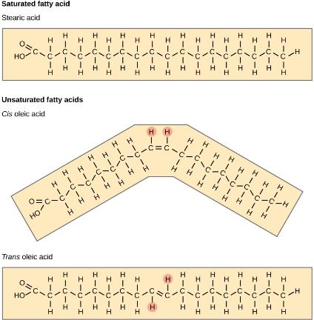
Figure 3.16
Saturated fatty acids have hydrocarbon chains connected by single bonds only. Unsaturated fatty acids have one or more double bonds. Each double bond may be in a cis or trans configuration. In the cis configuration, both hydrogens are on the same side of the hydrocarbon chain. In the trans configuration, the hydrogens are on opposite sides. A cis double bond causes a kink in the chain.
This OpenStax ancillary resource is © Rice University under a CC-BY 4.0 International license; it may be reproduced or modified but must be attributed to OpenStax, Rice University and any changes must be noted. Any images credited to other sources are similarly available for reproduction, but must be attributed to their sources.

Slide 18
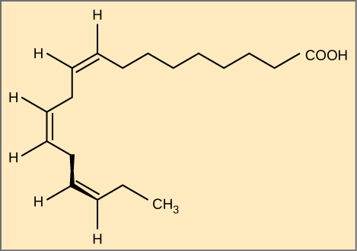
Figure 3.17
Alpha-linolenic acid is an example of an omega-3 fatty acid. It has three cis double bonds and, as a result, a curved shape. For clarity, the carbons are not shown. Each singly bonded carbon has two hydrogens associated with it, also not shown.
This OpenStax ancillary resource is © Rice University under a CC-BY 4.0 International license; it may be reproduced or modified but must be attributed to OpenStax, Rice University and any changes must be noted. Any images credited to other sources are similarly available for reproduction, but must be attributed to their sources.

Slide 19
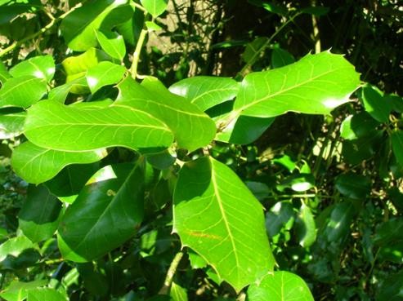
Figure 3.18
Lipids comprise waxy coverings on some leaves.
(credit: Roger Griffith)
This OpenStax ancillary resource is © Rice University under a CC-BY 4.0 International license; it may be reproduced or modified but must be attributed to OpenStax, Rice University and any changes must be noted. Any images credited to other sources are similarly available for reproduction, but must be attributed to their sources.

Slide 20
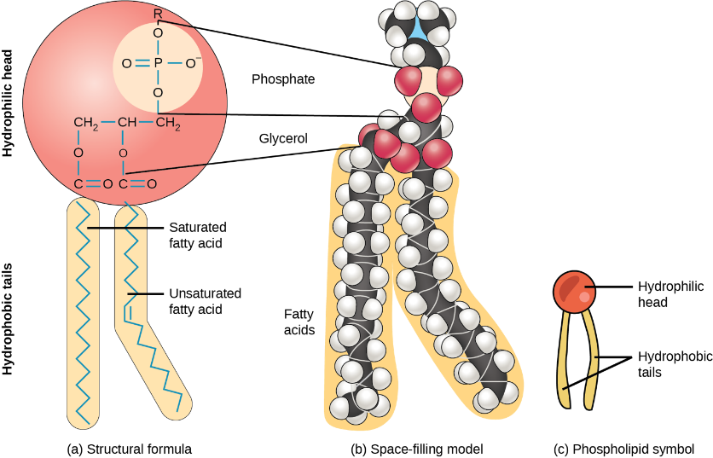
Figure 3.19
A phospholipid is a molecule with two fatty acids and a modified phosphate group attached to a glycerol backbone. Adding a charged or polar chemical group may modify the phosphate.
This OpenStax ancillary resource is © Rice University under a CC-BY 4.0 International license; it may be reproduced or modified but must be attributed to OpenStax, Rice University and any changes must be noted. Any images credited to other sources are similarly available for reproduction, but must be attributed to their sources.

Slide 21
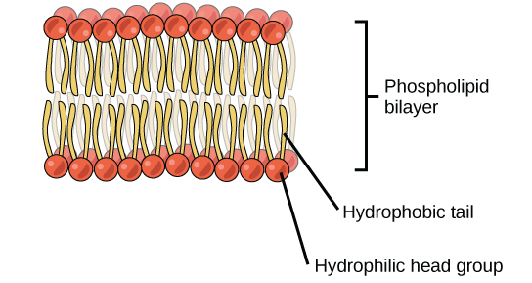
Figure 3.20
The phospholipid bilayer is the major component of all cellular membranes. The hydrophilic head groups of the phospholipids face the aqueous solution. The hydrophobic tails are sequestered in the middle of the bilayer.
This OpenStax ancillary resource is © Rice University under a CC-BY 4.0 International license; it may be reproduced or modified but must be attributed to OpenStax, Rice University and any changes must be noted. Any images credited to other sources are similarly available for reproduction, but must be attributed to their sources.

Slide 22
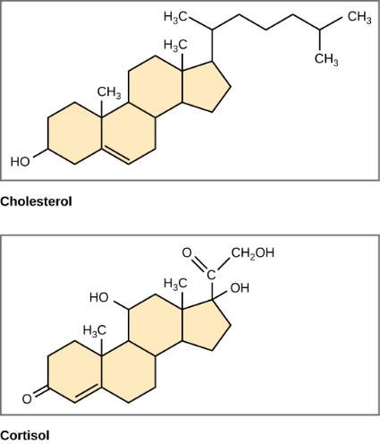
Figure 3.21
Four fused hydrocarbon rings comprise steroids such as cholesterol and cortisol.
This OpenStax ancillary resource is © Rice University under a CC-BY 4.0 International license; it may be reproduced or modified but must be attributed to OpenStax, Rice University and any changes must be noted. Any images credited to other sources are similarly available for reproduction, but must be attributed to their sources.

Slide 23
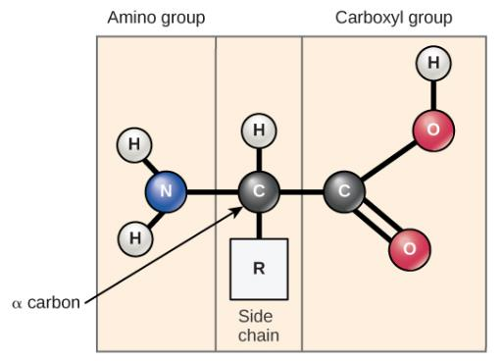
Figure 3.22
Amino acids have a central asymmetric carbon to which an amino group, a carboxyl group, a hydrogen atom, and a side chain (R group) are attached.
This OpenStax ancillary resource is © Rice University under a CC-BY 4.0 International license; it may be reproduced or modified but must be attributed to OpenStax, Rice University and any changes must be noted. Any images credited to other sources are similarly available for reproduction, but must be attributed to their sources.

Slide 24
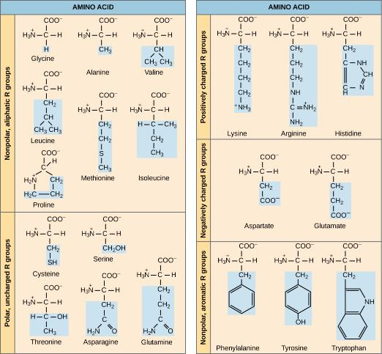
Figure 3.23
There are 20 common amino acids found in proteins, each with a different R group (variant group) that determines its chemical nature.
This OpenStax ancillary resource is © Rice University under a CC-BY 4.0 International license; it may be reproduced or modified but must be attributed to OpenStax, Rice University and any changes must be noted. Any images credited to other sources are similarly available for reproduction, but must be attributed to their sources.

Slide 25
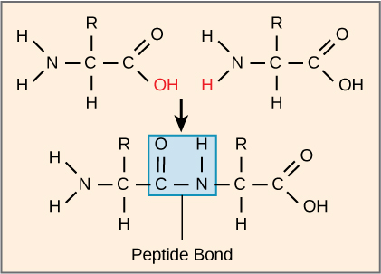
Figure 3.24
Peptide bond formation is a dehydration synthesis reaction. The carboxyl group of one amino acid is linked to the amino group of the incoming amino acid. In the process, it releases a water molecule.
This OpenStax ancillary resource is © Rice University under a CC-BY 4.0 International license; it may be reproduced or modified but must be attributed to OpenStax, Rice University and any changes must be noted. Any images credited to other sources are similarly available for reproduction, but must be attributed to their sources.

Slide 26
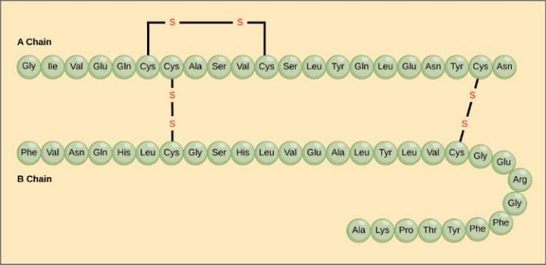
Figure 3.25
Bovine serum insulin is a protein hormone made of two peptide chains, A (21 amino acids long) and B (30 amino acids long). In each chain, primary structure is indicated by three-letter abbreviations that represent the names of the amino acids in the order they are present. The amino acid cysteine (cys) has a sulfhydryl (SH) group as a side chain. Two sulfhydryl groups can react in the presence of oxygen to form a disulfide (S-S) bond. Two disulfide bonds connect the A and B chains together, and a third helps the A chain fold into the correct shape. Note that all disulfide bonds are the same length, but are drawn different sizes for clarity.
This OpenStax ancillary resource is © Rice University under a CC-BY 4.0 International license; it may be reproduced or modified but must be attributed to OpenStax, Rice University and any changes must be noted. Any images credited to other sources are similarly available for reproduction, but must be attributed to their sources.

Slide 27
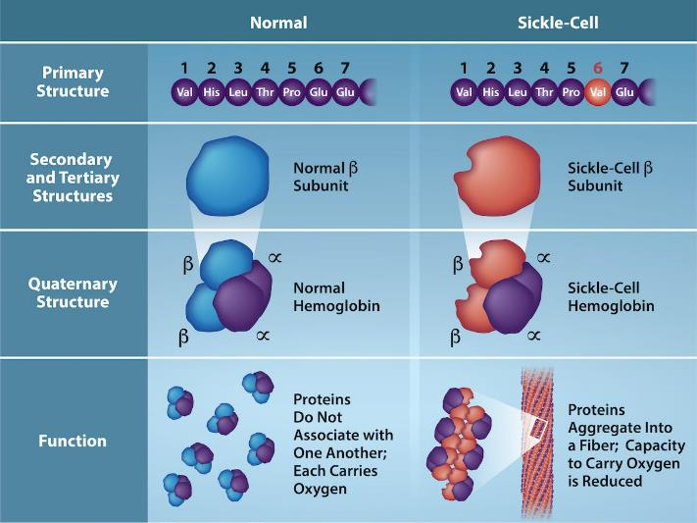
Figure 3.26
credit: Rao, A., Tag, A. Ryan, K. and Fletcher, S. Department of Biology, Texas A&M University
This OpenStax ancillary resource is © Rice University under a CC-BY 4.0 International license; it may be reproduced or modified but must be attributed to OpenStax, Rice University and any changes must be noted. Any images credited to other sources are similarly available for reproduction, but must be attributed to their sources.
Notes:
Because of this change of one amino acid in the chain, hemoglobin molecules form long fibers that distort the biconcave, or disc-shaped, red blood cells and causes them to assume a crescent or “sickle” shape, which clogs blood vessels (Figure 3.27). The beta (β)- chain of hemoglobin is 147 amino acids in length, yet a single amino acid substitution in the primary sequence leads changes in secondary, tertiary, and quaternary structures and sickle cell anemia. In normal hemoglobin, the amino acid at position six is glutamate. In sickle cell hemoglobin glutamate is replaced by valine.

Slide 28
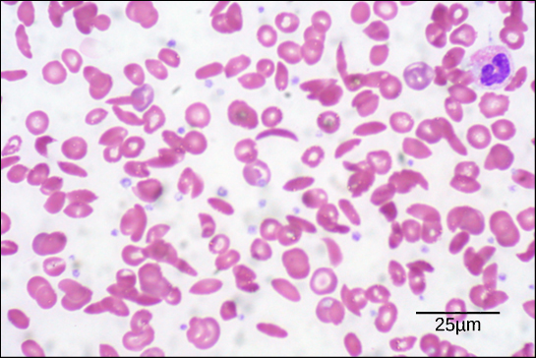
Figure 3.27
In this blood smear, visualized at 535× magnification using bright field microscopy, sickle cells are crescent shaped, while normal cells are disc-shaped.
(credit: modification of work by Ed Uthman; scale-bar data from Matt Russell)
This OpenStax ancillary resource is © Rice University under a CC-BY 4.0 International license; it may be reproduced or modified but must be attributed to OpenStax, Rice University and any changes must be noted. Any images credited to other sources are similarly available for reproduction, but must be attributed to their sources.

Slide 29
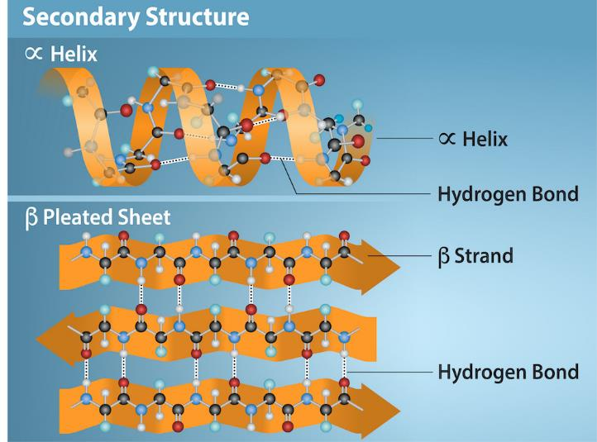
Figure 3.28
credit: Rao, A., Tag, A. Ryan, K. and Fletcher, S. Department of Biology, Texas A&M University
This OpenStax ancillary resource is © Rice University under a CC-BY 4.0 International license; it may be reproduced or modified but must be attributed to OpenStax, Rice University and any changes must be noted. Any images credited to other sources are similarly available for reproduction, but must be attributed to their sources.
Notes:
The α-helix and β-pleated sheet are secondary protein structures formed when hydrogen bonds form between the carbonyl oxygen and the amino hydrogen in the peptide backbone. Certain amino acids have a propensity to form an α-helix while others favor β-pleated sheet formation. Black = carbon, White = hydrogen, Blue = nitrogen, and Red = oxygen.

Slide 30
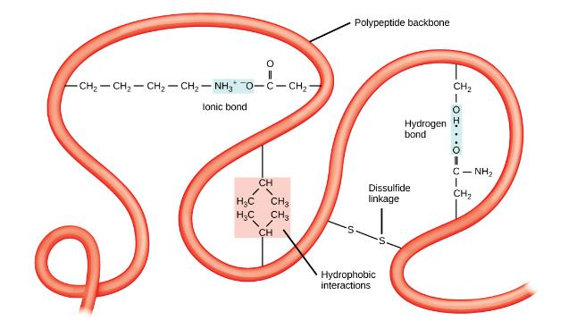
Figure 3.29
A variety of chemical interactions determine the proteins' tertiary structure. These include hydrophobic interactions, ionic bonding, hydrogen bonding, and disulfide linkages.
This OpenStax ancillary resource is © Rice University under a CC-BY 4.0 International license; it may be reproduced or modified but must be attributed to OpenStax, Rice University and any changes must be noted. Any images credited to other sources are similarly available for reproduction, but must be attributed to their sources.

Slide 31
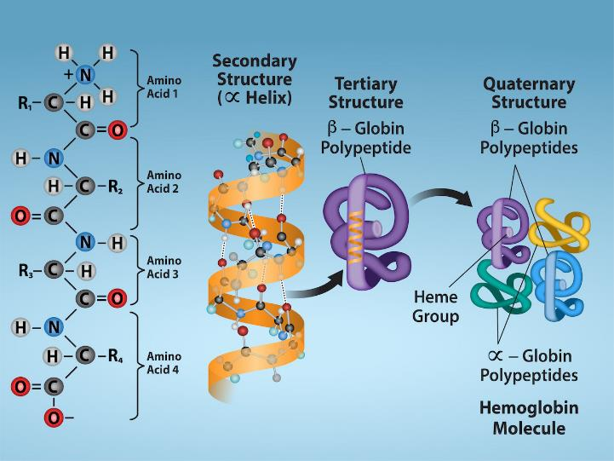
Figure 3.30
credit: Rao, A., Tag, A. Ryan, K. and Fletcher, S. Department of Biology, Texas A&M University
This OpenStax ancillary resource is © Rice University under a CC-BY 4.0 International license; it may be reproduced or modified but must be attributed to OpenStax, Rice University and any changes must be noted. Any images credited to other sources are similarly available for reproduction, but must be attributed to their sources.
Notes:
Observe the four levels of protein structure in these illustrations.

Slide 32
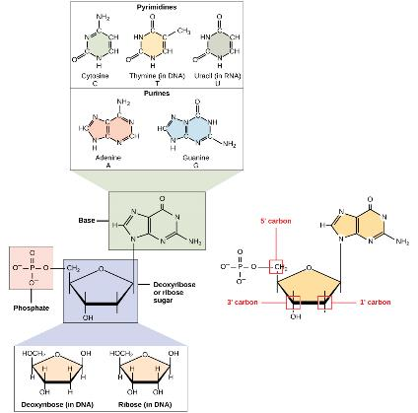
Figure 3.31
A nucleotide is made up of three components: a nitrogenous base, a pentose sugar, and one or more phosphate groups. Carbon residues in the pentose are numbered 1′ through 5′ (the prime distinguishes these residues from those in the base, which are numbered without using a prime notation). The base is attached to the 1′ position of the ribose, and the phosphate is attached to the 5′ position. When a polynucleotide is formed, the 5′ phosphate of the incoming nucleotide attaches to the 3′ hydroxyl group at the end of the growing chain. Two types of pentose are found in nucleotides, deoxyribose (found in DNA) and ribose (found in RNA). Deoxyribose is similar
in structure to ribose, but it has an H instead of an OH at the 2′ position. Bases can be divided into two categories: purines and pyrimidines. Purines have a double ring structure, and pyrimidines have a single ring.
This OpenStax ancillary resource is © Rice University under a CC-BY 4.0 International license; it may be reproduced or modified but must be attributed to OpenStax, Rice University and any changes must be noted. Any images credited to other sources are similarly available for reproduction, but must be attributed to their sources.

Slide 33
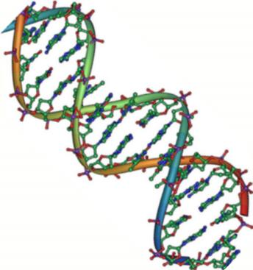
Figure 3.32
Native DNA is an antiparallel double helix. The phosphate backbone (indicated by the curvy lines) is on the outside, and the bases are on the inside. Each base from one strand interacts via hydrogen bonding with a base from the opposing strand.
(credit: Jerome Walker/Dennis Myts)
This OpenStax ancillary resource is © Rice University under a CC-BY 4.0 International license; it may be reproduced or modified but must be attributed to OpenStax, Rice University and any changes must be noted. Any images credited to other sources are similarly available for reproduction, but must be attributed to their sources.

Slide 34
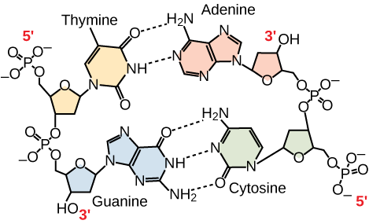
Figure 3.33
In a double stranded DNA molecule, the two strands run antiparallel to one another so that one strand runs 5′ to 3′ and the other 3′ to 5′. The phosphate backbone is located on the outside, and the bases are in the middle. Adenine forms hydrogen bonds (or base pairs) with thymine, and guanine base pairs with cytosine.
This OpenStax ancillary resource is © Rice University under a CC-BY 4.0 International license; it may be reproduced or modified but must be attributed to OpenStax, Rice University and any changes must be noted. Any images credited to other sources are similarly available for reproduction, but must be attributed to their sources.

Slide 35
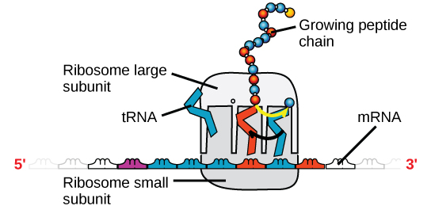
Figure 3.34
A ribosome has two parts: a large subunit and a small subunit. The mRNA sits in between the two subunits. A tRNA molecule recognizes a codon on the mRNA, binds to it by complementary base pairing, and adds the correct amino acid to the growing peptide chain.
This OpenStax ancillary resource is © Rice University under a CC-BY 4.0 International license; it may be reproduced or modified but must be attributed to OpenStax, Rice University and any changes must be noted. Any images credited to other sources are similarly available for reproduction, but must be attributed to their sources.

