Slide 1


Biology 2e
Chapter 4 CELL STRUCTURE
PowerPoint Image Slide Show

Slide 2
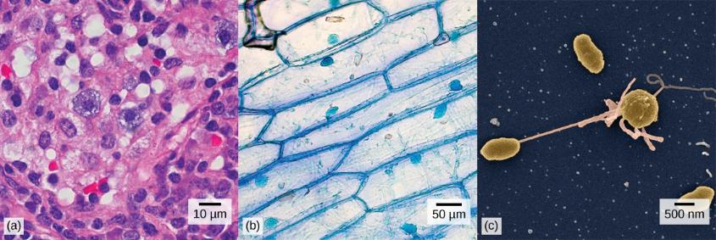
Figure 4.1
(a) Nasal sinus cells (viewed with a light microscope), (b) onion cells (viewed with a light microscope), and (c) Vibrio tasmaniensis bacterial cells (seen through a scanning electron microscope) are from very different organisms, yet all share certain characteristics of basic cell structure.
(credit a: modification of work by Ed Uthman, MD; credit b: modification of work by Umberto Salvagnin; credit c: modification of work by Anthony D'Onofrio, William H. Fowle, Eric J. Stewart, and Kim Lewis of the Lewis Lab at Northeastern University; scale-bar data from Matt Russell)
This OpenStax ancillary resource is © Rice University under a CC-BY 4.0 International license; it may be reproduced or modified but must be attributed to OpenStax, Rice University and any changes must be noted. Any images credited to other sources are similarly available for reproduction, but must be attributed to their sources.

Slide 3
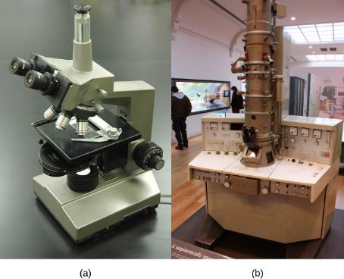
Figure 4.2
(a) Most light microscopes used in a college biology lab can magnify cells up to approximately 400 times and have a resolution of about 200 nanometers. (b) Electron microscopes provide a much higher magnification, 10,0000x, and a have a resolution of 50 picometers.
(credit a: modification of work by "GcG"/Wikimedia Commons; credit b: modification of work by Evan Bench)
This OpenStax ancillary resource is © Rice University under a CC-BY 4.0 International license; it may be reproduced or modified but must be attributed to OpenStax, Rice University and any changes must be noted. Any images credited to other sources are similarly available for reproduction, but must be attributed to their sources.

Slide 4
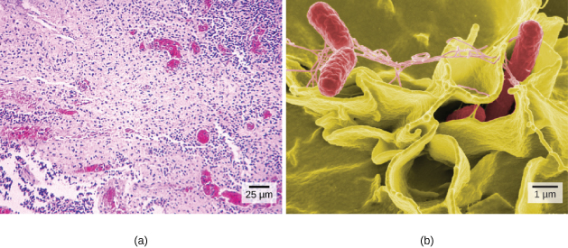
Figure 4.3
(a)
(b)
(a) These Salmonella bacteria appear as tiny purple dots when viewed with a light microscope. (b) This scanning electron microscope micrograph shows Salmonella bacteria (in red) invading human cells (yellow). Even though subfigure (b) shows a different Salmonella specimen than subfigure (a), you can still observe the comparative increase in magnification and detail.
(credit a: modification of work by CDC/Armed Forces Institute of Pathology, Charles N. Farmer, Rocky Mountain Laboratories; credit b: modification of work by NIAID, NIH; scale-bar data from Matt Russell)
This OpenStax ancillary resource is © Rice University under a CC-BY 4.0 International license; it may be reproduced or modified but must be attributed to OpenStax, Rice University and any changes must be noted. Any images credited to other sources are similarly available for reproduction, but must be attributed to their sources.

Slide 5
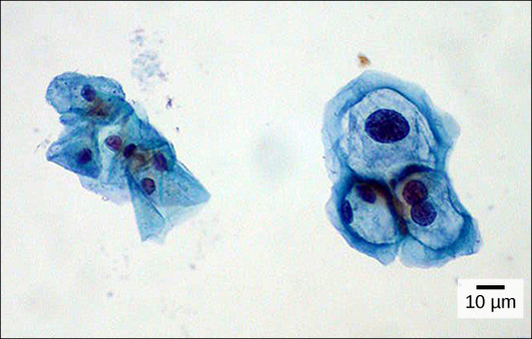
Figure 4.4
These uterine cervix cells, viewed through a light microscope, were obtained from a Pap smear. Normal cells are on the left. The cells on the right are infected with human papillomavirus (HPV). Notice that the infected cells are larger; also, two of these cells each have two nuclei instead of one, the normal number.
(credit: modification of work by Ed Uthman, MD; scale-bar data from Matt Russell)
This OpenStax ancillary resource is © Rice University under a CC-BY 4.0 International license; it may be reproduced or modified but must be attributed to OpenStax, Rice University and any changes must be noted. Any images credited to other sources are similarly available for reproduction, but must be attributed to their sources.

Slide 6
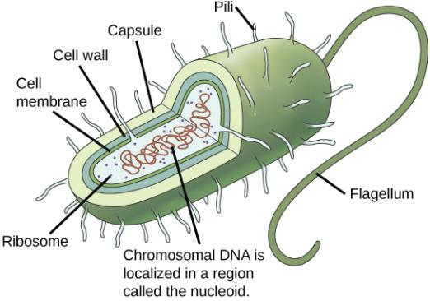
Figure 4.5
This figure shows the generalized structure of a prokaryotic cell. All prokaryotes have chromosomal DNA localized in a nucleoid, ribosomes, a cell membrane, and a cell wall. The other structures shown are present in some, but not all, bacteria.
This OpenStax ancillary resource is © Rice University under a CC-BY 4.0 International license; it may be reproduced or modified but must be attributed to OpenStax, Rice University and any changes must be noted. Any images credited to other sources are similarly available for reproduction, but must be attributed to their sources.

Slide 7
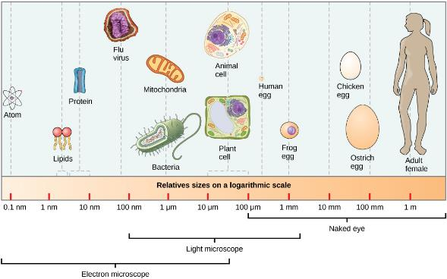
Figure 4.6
This figure shows relative sizes of microbes on a logarithmic scale (recall that each unit of increase in a logarithmic scale represents a 10-fold increase in the quantity being measured).
This OpenStax ancillary resource is © Rice University under a CC-BY 4.0 International license; it may be reproduced or modified but must be attributed to OpenStax, Rice University and any changes must be noted. Any images credited to other sources are similarly available for reproduction, but must be attributed to their sources.

Slide 8
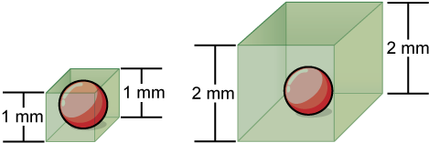
Figure 4.7
Notice that as a cell increases in size, its surface area-to-volume ratio decreases. When there is insufficient surface area to support a cell’s increasing volume, a cell will either divide or die. The cell on the left has a volume of 1 mm³ and a surface area of 6 mm², with a surface area-to-volume ratio of 6 to 1, whereas the cell on the right has a volume of 8 mm³ and a surface area of 24 mm², with a surface area-to-volume ratio of 3 to 1.
This OpenStax ancillary resource is © Rice University under a CC-BY 4.0 International license; it may be reproduced or modified but must be attributed to OpenStax, Rice University and any changes must be noted. Any images credited to other sources are similarly available for reproduction, but must be attributed to their sources.

Slide 9
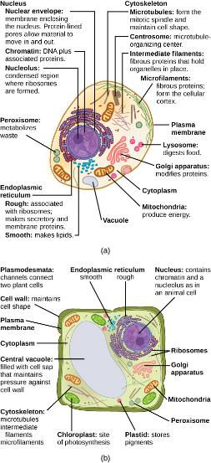
Figure 4.8
These figures show the major organelles and other cell components of (a) a typical animal cell and (b) a typical eukaryotic plant cell. The plant cell has a cell wall, chloroplasts, plastids, and a central vacuole—structures not found in animal cells. Plant cells do not have lysosomes or centrosomes.
This OpenStax ancillary resource is © Rice University under a CC-BY 4.0 International license; it may be reproduced or modified but must be attributed to OpenStax, Rice University and any changes must be noted. Any images credited to other sources are similarly available for reproduction, but must be attributed to their sources.

Slide 10
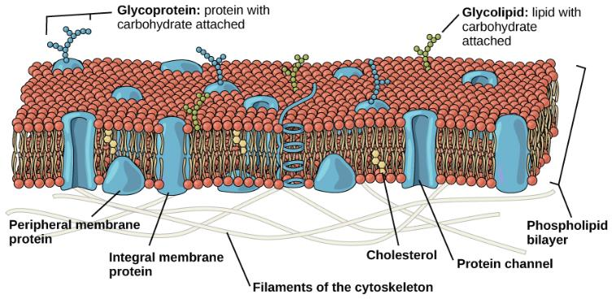
Figure 4.9
The eukaryotic plasma membrane is a phospholipid bilayer with proteins and cholesterol embedded in it.
This OpenStax ancillary resource is © Rice University under a CC-BY 4.0 International license; it may be reproduced or modified but must be attributed to OpenStax, Rice University and any changes must be noted. Any images credited to other sources are similarly available for reproduction, but must be attributed to their sources.

Slide 11
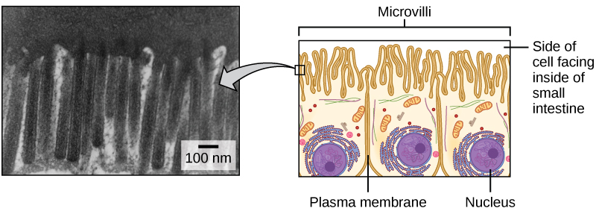
Figure 4.10
Microvilli, shown here as they appear on cells lining the small intestine, increase the surface area available for absorption. These microvilli are only found on the area of the plasma membrane that faces the cavity from which substances will be absorbed.
(credit "micrograph”: modification of work by Louisa Howard)
This OpenStax ancillary resource is © Rice University under a CC-BY 4.0 International license; it may be reproduced or modified but must be attributed to OpenStax, Rice University and any changes must be noted. Any images credited to other sources are similarly available for reproduction, but must be attributed to their sources.

Slide 12
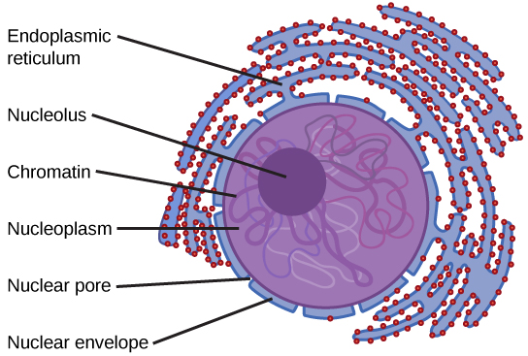
Figure 4.11
The nucleus stores chromatin (DNA plus proteins) in a gel-like substance called the nucleoplasm. The nucleolus is a condensed region of chromatin where ribosome synthesis occurs. The boundary of the nucleus is called the nuclear envelope. It consists of two phospholipid bilayers: an outer membrane and an inner membrane. The nuclear membrane is continuous with the endoplasmic reticulum. Nuclear pores allow substances to enter and exit the nucleus.
This OpenStax ancillary resource is © Rice University under a CC-BY 4.0 International license; it may be reproduced or modified but must be attributed to OpenStax, Rice University and any changes must be noted. Any images credited to other sources are similarly available for reproduction, but must be attributed to their sources.

Slide 13
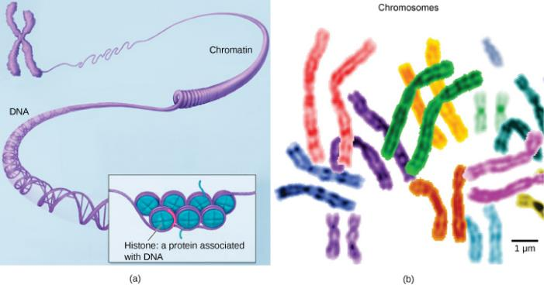
Figure 4.12
(a) This image shows various levels of the organization of chromatin (DNA and protein). (b) This image shows paired chromosomes.
(credit b: modification of work by NIH; scale-bar data from Matt Russell)
This OpenStax ancillary resource is © Rice University under a CC-BY 4.0 International license; it may be reproduced or modified but must be attributed to OpenStax, Rice University and any changes must be noted. Any images credited to other sources are similarly available for reproduction, but must be attributed to their sources.

Slide 14
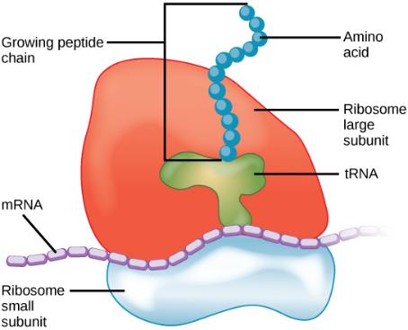
Figure 4.13
Ribosomes are made up of a large subunit (top) and a small subunit (bottom). During protein synthesis, ribosomes assemble amino acids into proteins.
This OpenStax ancillary resource is © Rice University under a CC-BY 4.0 International license; it may be reproduced or modified but must be attributed to OpenStax, Rice University and any changes must be noted. Any images credited to other sources are similarly available for reproduction, but must be attributed to their sources.

Slide 15
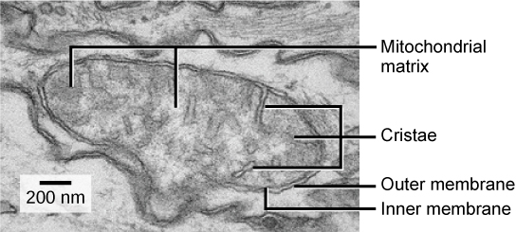
Figure 4.14
This electron micrograph shows a mitochondrion as viewed with a transmission electron microscope. This organelle has an outer membrane and an inner membrane. The inner membrane contains folds, called cristae, which increase its surface area. The space between the two membranes is called the intermembrane space, and the space inside the inner membrane is called the mitochondrial matrix. ATP synthesis takes place on the inner membrane.
(credit: modification of work by Matthew Britton; scale-bar data from Matt Russell)
This OpenStax ancillary resource is © Rice University under a CC-BY 4.0 International license; it may be reproduced or modified but must be attributed to OpenStax, Rice University and any changes must be noted. Any images credited to other sources are similarly available for reproduction, but must be attributed to their sources.

Slide 16
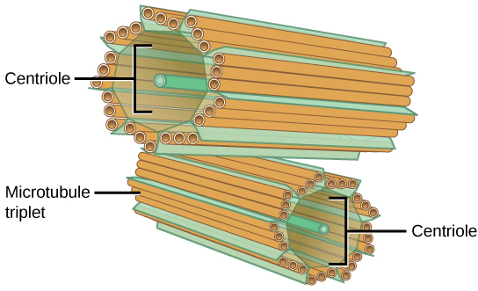
Figure 4.15
The centrosome consists of two centrioles that lie at right angles to each other. Each centriole is a cylinder made up of nine triplets of microtubules. Nontubulin proteins (indicated by the green lines) hold the microtubule triplets together.
This OpenStax ancillary resource is © Rice University under a CC-BY 4.0 International license; it may be reproduced or modified but must be attributed to OpenStax, Rice University and any changes must be noted. Any images credited to other sources are similarly available for reproduction, but must be attributed to their sources.

Slide 17
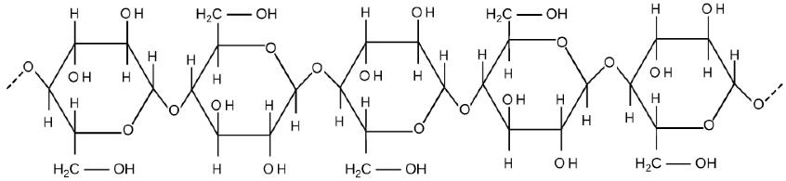
Figure 4.16
Cellulose is a long chain of β-glucose molecules connected by a 1-4 linkage. The dashed lines at each end of the figure indicate a series of many more glucose units. The size of the page makes it impossible to portray an entire cellulose molecule.
This OpenStax ancillary resource is © Rice University under a CC-BY 4.0 International license; it may be reproduced or modified but must be attributed to OpenStax, Rice University and any changes must be noted. Any images credited to other sources are similarly available for reproduction, but must be attributed to their sources.

Slide 18
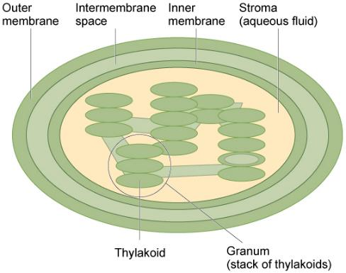
Figure 4.17
The chloroplast has an outer membrane, an inner membrane, and membrane structures called thylakoids that are stacked into grana. The space inside the thylakoid membranes is called the thylakoid space. The light harvesting reactions take place in the thylakoid membranes, and the synthesis of sugar takes place in the fluid inside the inner membrane, which is called the stroma. Chloroplasts also have their own genome, which is contained on a single circular chromosome.
This OpenStax ancillary resource is © Rice University under a CC-BY 4.0 International license; it may be reproduced or modified but must be attributed to OpenStax, Rice University and any changes must be noted. Any images credited to other sources are similarly available for reproduction, but must be attributed to their sources.

Slide 19
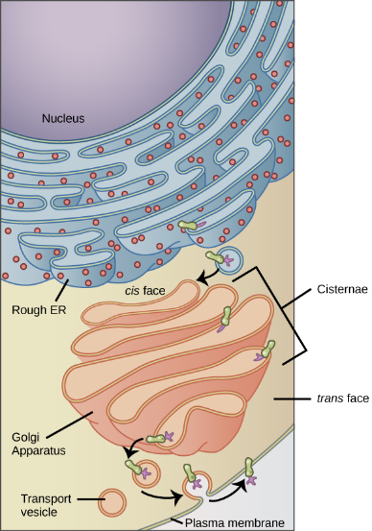
Figure 4.18
Membrane and secretory proteins are synthesized in the rough endoplasmic reticulum (RER). The RER also sometimes modifies proteins. In this illustration, a (green) integral membrane protein is modified by attachment of a (purple) carbohydrate in the ER. Vesicles bud from the ER and fuse with the cis face of the Golgi apparatus. As the protein passes through the Golgi’s cisternae, it is further modified by the addition of more carbohydrates. After its synthesis is complete, it exits via vesicles that bud from the Golgi’s trans face and fuses with the cell membrane.
(credit: modification of work by Magnus Manske)
This OpenStax ancillary resource is © Rice University under a CC-BY 4.0 International license; it may be reproduced or modified but must be attributed to OpenStax, Rice University and any changes must be noted. Any images credited to other sources are similarly available for reproduction, but must be attributed to their sources.

Slide 20
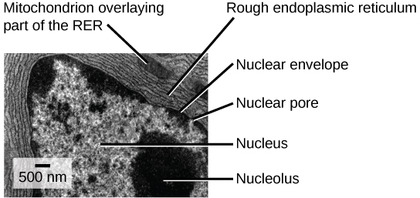
Figure 4.19
This transmission electron micrograph shows the rough endoplasmic reticulum and other organelles in a pancreatic cell.
(credit: modification of work by Louisa Howard)
This OpenStax ancillary resource is © Rice University under a CC-BY 4.0 International license; it may be reproduced or modified but must be attributed to OpenStax, Rice University and any changes must be noted. Any images credited to other sources are similarly available for reproduction, but must be attributed to their sources.

Slide 21
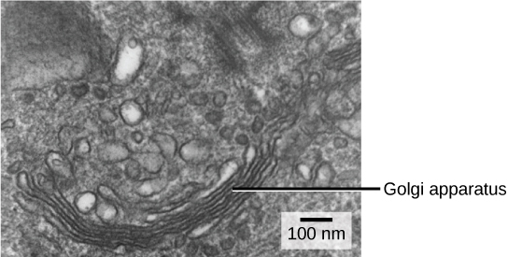
Figure 4.20
The Golgi apparatus in this white blood cell is visible as a stack of semicircular, flattened rings in the lower portion of the image. You can see several vesicles near the Golgi apparatus.
(credit: modification of work by Louisa Howard)
This OpenStax ancillary resource is © Rice University under a CC-BY 4.0 International license; it may be reproduced or modified but must be attributed to OpenStax, Rice University and any changes must be noted. Any images credited to other sources are similarly available for reproduction, but must be attributed to their sources.

Slide 22
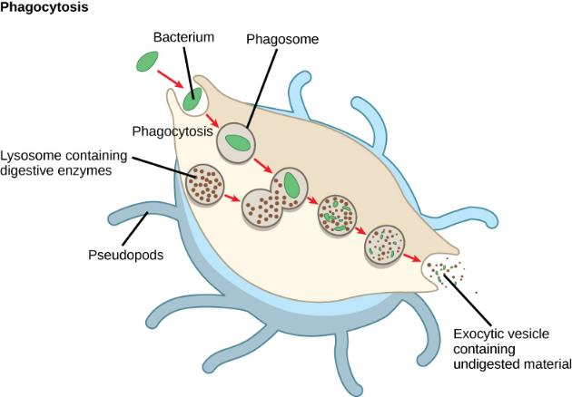
Figure 4.21
A macrophage has engulfed (phagocytized) a potentially pathogenic bacterium and then fuses with a lysosomes within the cell to destroy the pathogen. Other organelles are present in the cell but for simplicity are not shown.
This OpenStax ancillary resource is © Rice University under a CC-BY 4.0 International license; it may be reproduced or modified but must be attributed to OpenStax, Rice University and any changes must be noted. Any images credited to other sources are similarly available for reproduction, but must be attributed to their sources.

Slide 23
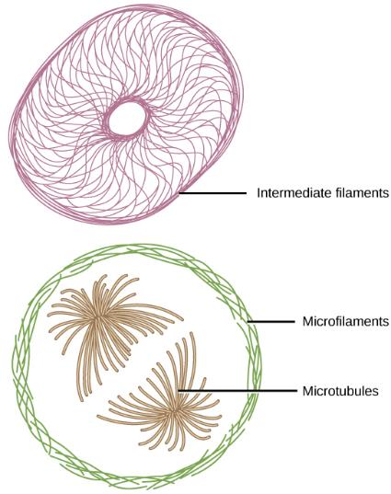
Figure 4.22
Microfilaments thicken the cortex around the cell's inner edge. Like rubber bands, they resist tension. There are microtubules in the cell's interior where they maintain their shape by resisting compressive forces. There are intermediate filaments throughout the cell that hold organelles in place.
This OpenStax ancillary resource is © Rice University under a CC-BY 4.0 International license; it may be reproduced or modified but must be attributed to OpenStax, Rice University and any changes must be noted. Any images credited to other sources are similarly available for reproduction, but must be attributed to their sources.

Slide 24
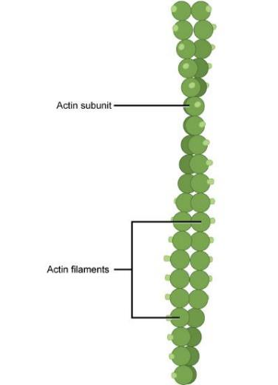
Figure 4.23
Two intertwined actin strands comprise microfilaments.
This OpenStax ancillary resource is © Rice University under a CC-BY 4.0 International license; it may be reproduced or modified but must be attributed to OpenStax, Rice University and any changes must be noted. Any images credited to other sources are similarly available for reproduction, but must be attributed to their sources.

Slide 25
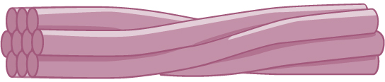
Figure 4.24
Intermediate filaments consist of several intertwined strands of fibrous proteins.
This OpenStax ancillary resource is © Rice University under a CC-BY 4.0 International license; it may be reproduced or modified but must be attributed to OpenStax, Rice University and any changes must be noted. Any images credited to other sources are similarly available for reproduction, but must be attributed to their sources.

Slide 26
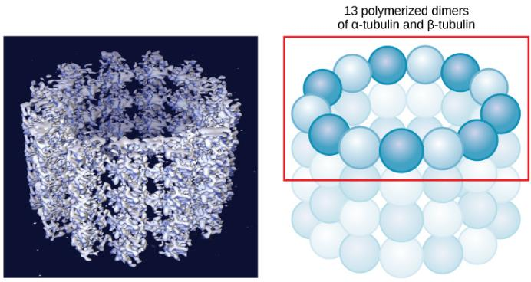
Figure 4.25
Microtubules are hollow. Their walls consist of 13 polymerized dimers of α-tubulin and β-tubulin (right image). The left image shows the molecular structure of the tube.
This OpenStax ancillary resource is © Rice University under a CC-BY 4.0 International license; it may be reproduced or modified but must be attributed to OpenStax, Rice University and any changes must be noted. Any images credited to other sources are similarly available for reproduction, but must be attributed to their sources.

Slide 27
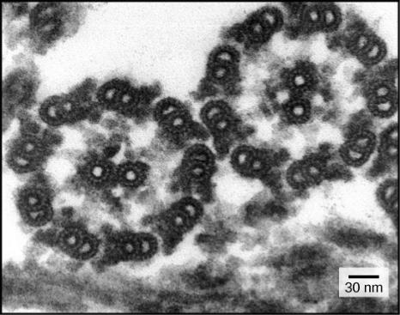
Figure 4.26
This transmission electron micrograph of two flagella shows the 9 + 2 array of microtubules: nine microtubule doublets surround a single microtubule doublet.
(credit: modification of work by Dartmouth Electron Microscope Facility, Dartmouth College; scale-bar data from Matt Russell)
This OpenStax ancillary resource is © Rice University under a CC-BY 4.0 International license; it may be reproduced or modified but must be attributed to OpenStax, Rice University and any changes must be noted. Any images credited to other sources are similarly available for reproduction, but must be attributed to their sources.

Slide 28
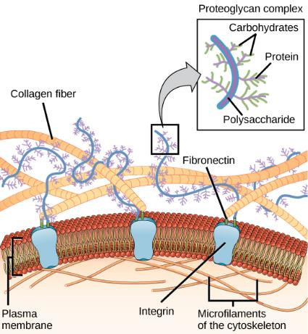
Figure 4.27
The extracellular matrix consists of a network of proteins and carbohydrates.
This OpenStax ancillary resource is © Rice University under a CC-BY 4.0 International license; it may be reproduced or modified but must be attributed to OpenStax, Rice University and any changes must be noted. Any images credited to other sources are similarly available for reproduction, but must be attributed to their sources.

Slide 29
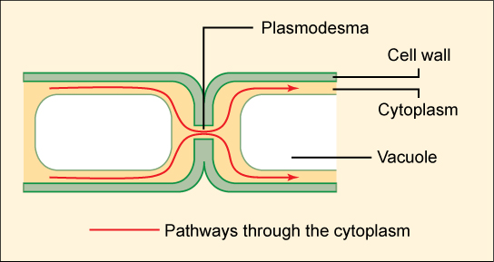
Figure 4.28
A plasmodesma is a channel between two adjacent plant cells' cell walls. Plasmodesmata allow materials to pass from one plant cell's cytoplasm to an adjacent cell's cytoplasm.
This OpenStax ancillary resource is © Rice University under a CC-BY 4.0 International license; it may be reproduced or modified but must be attributed to OpenStax, Rice University and any changes must be noted. Any images credited to other sources are similarly available for reproduction, but must be attributed to their sources.

Slide 30
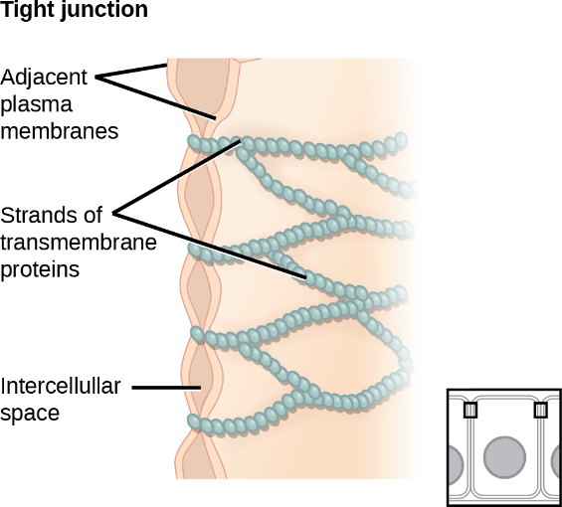
Figure 4.29
Tight junctions form watertight connections between adjacent animal cells. Proteins create tight junction adherence.
(credit: modification of work by Mariana Ruiz Villareal)
This OpenStax ancillary resource is © Rice University under a CC-BY 4.0 International license; it may be reproduced or modified but must be attributed to OpenStax, Rice University and any changes must be noted. Any images credited to other sources are similarly available for reproduction, but must be attributed to their sources.

Slide 31
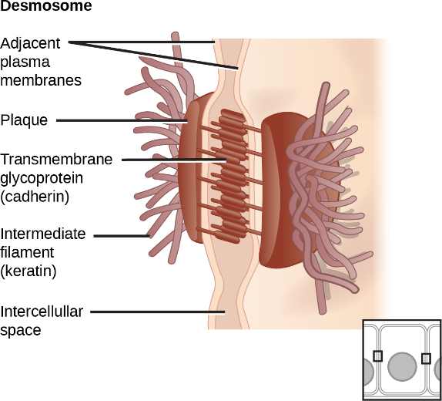
Figure 4.30
A desmosome forms a very strong spot weld between cells. It is created by the linkage of cadherins and intermediate filaments.
(credit: modification of work by Mariana Ruiz Villareal)
This OpenStax ancillary resource is © Rice University under a CC-BY 4.0 International license; it may be reproduced or modified but must be attributed to OpenStax, Rice University and any changes must be noted. Any images credited to other sources are similarly available for reproduction, but must be attributed to their sources.

Slide 32
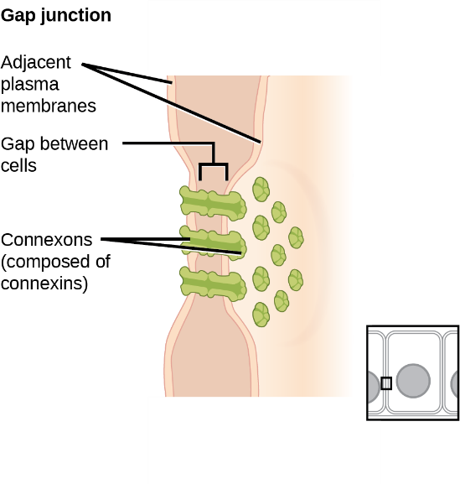
Figure 4.31
A gap junction is a protein-lined pore that allows water and small molecules to pass between adjacent animal cells.
(credit: modification of work by Mariana Ruiz Villareal)
This OpenStax ancillary resource is © Rice University under a CC-BY 4.0 International license; it may be reproduced or modified but must be attributed to OpenStax, Rice University and any changes must be noted. Any images credited to other sources are similarly available for reproduction, but must be attributed to their sources.

