Slide 1


Biology for AP® Courses
Chapter 5 STRUCTURE AND FUNCTION OF PLASMA MEMBRANES
PowerPoint Image Slide Show

Slide 2
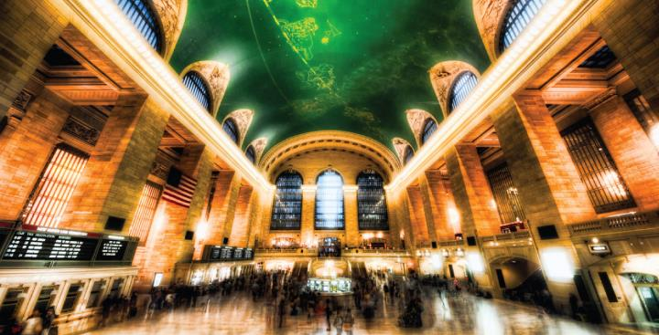
Figure 5.1
Despite its seeming hustle and bustle, Grand Central Station functions with a high level of organization: People and objects move from one location to another, they cross or are contained within certain boundaries, and they provide a constant flow as part of larger activity. Analogously, a plasma membrane’s functions involve movement within the cell and across boundaries in the process of intracellular and intercellular activities.
(credit: modification of work by Randy Le’Moine)
This OpenStax ancillary resource is © Rice University under a CC-BY 4.0 International license; it may be reproduced or modified but must be attributed to OpenStax, Rice University and any changes must be noted. Any images credited to other sources are similarly available for reproduction, but must be attributed to their sources.

Slide 3
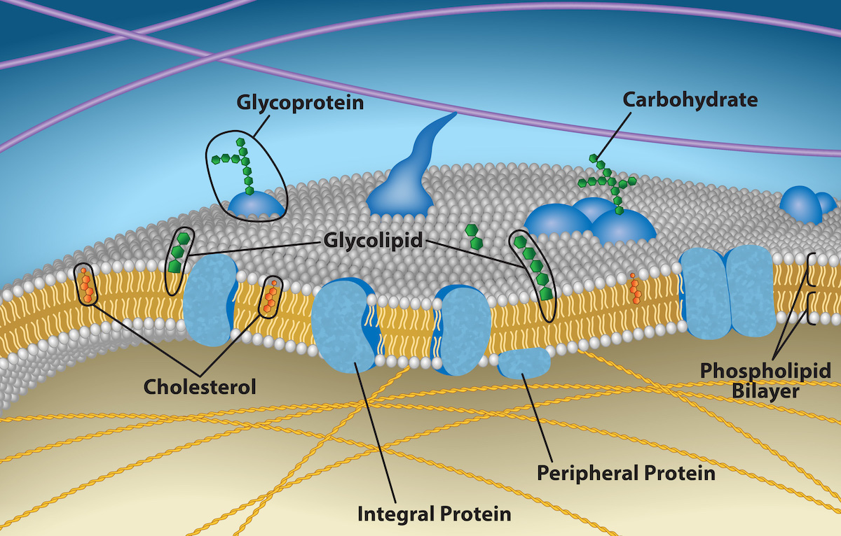
Figure 5.2
The plasma membrane fluid mosaic model describes the plasma membrane as a fluid combination of phospholipids, cholesterol, and proteins. Carbohydrates attached to lipids (glycolipids) and to proteins (glycoproteins) extend from the membrane's outward-facing surface.
(credit: Rao, A., Ryan, K., Fletcher, S., Hawkins, A. and Tag, A. Department of Biology, Texas A&M University)
This OpenStax ancillary resource is © Rice University under a CC-BY 4.0 International license; it may be reproduced or modified but must be attributed to OpenStax, Rice University and any changes must be noted. Any images credited to other sources are similarly available for reproduction, but must be attributed to their sources.

Slide 4
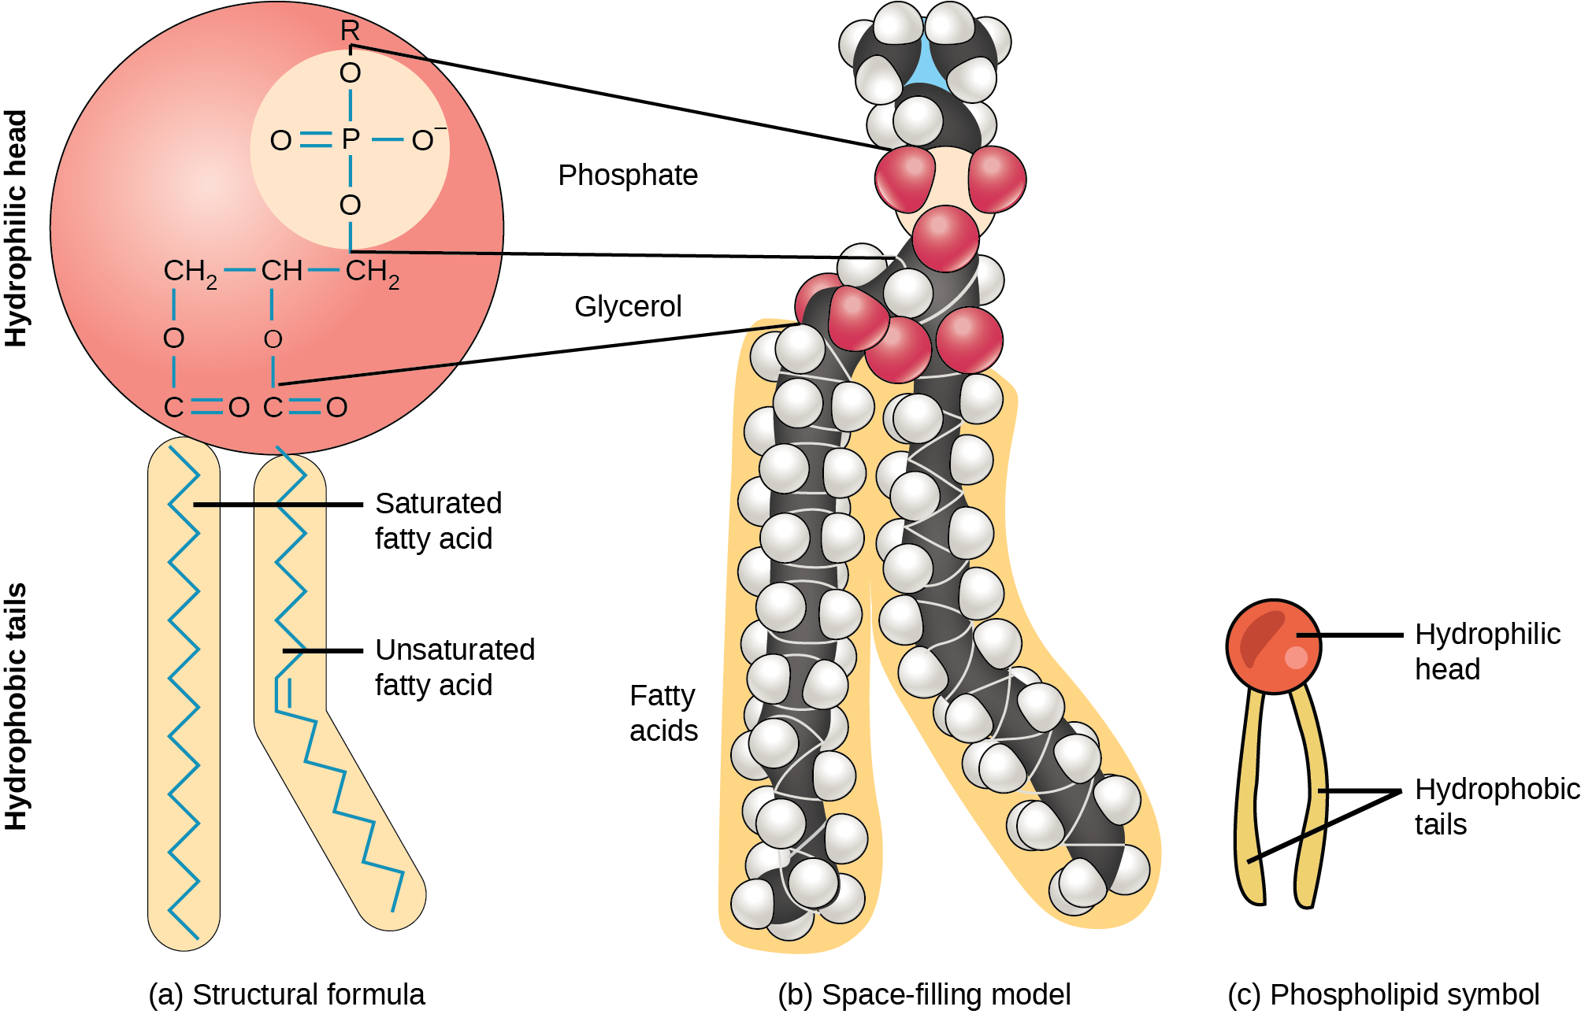
Figure 5.3
A hydrophilic head and two hydrophobic tails comprise this phospholipid molecule. The hydrophilic head group consists of a phosphate-containing group attached to a glycerol molecule. The hydrophobic tails, each containing either a saturated or an unsaturated fatty acid, are long hydrocarbon chains.
This OpenStax ancillary resource is © Rice University under a CC-BY 4.0 International license; it may be reproduced or modified but must be attributed to OpenStax, Rice University and any changes must be noted. Any images credited to other sources are similarly available for reproduction, but must be attributed to their sources.

Slide 5
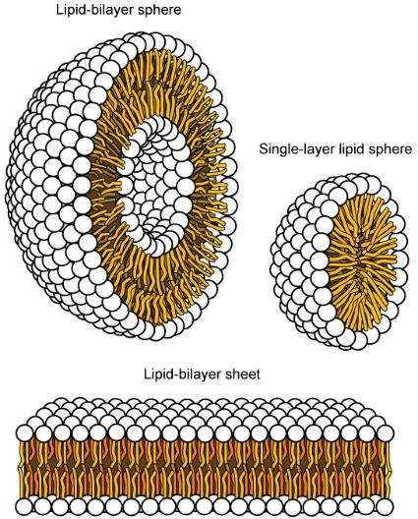
Figure 5.4
In an aqueous solution, phospholipids tend to arrange themselves with their polar heads facing outward and their hydrophobic tails facing inward.
(credit: modification of work by Mariana Ruiz Villareal)
This OpenStax ancillary resource is © Rice University under a CC-BY 4.0 International license; it may be reproduced or modified but must be attributed to OpenStax, Rice University and any changes must be noted. Any images credited to other sources are similarly available for reproduction, but must be attributed to their sources.

Slide 6
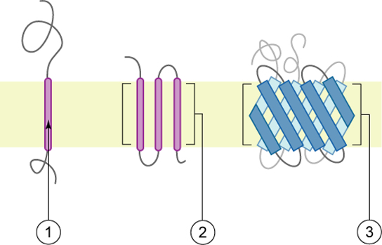
Figure 5.5
Integral membranes proteins may have one or more alpha-helices that span the membrane (examples 1 and 2), or they may have beta-sheets that span the membrane (example 3).
(credit: “Foobar”/Wikimedia Commons)
This OpenStax ancillary resource is © Rice University under a CC-BY 4.0 International license; it may be reproduced or modified but must be attributed to OpenStax, Rice University and any changes must be noted. Any images credited to other sources are similarly available for reproduction, but must be attributed to their sources.

Slide 7
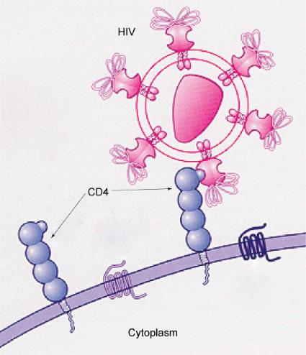
Figure 5.6
HIV binds to the CD4 receptor, a glycoprotein on the surfaces of T cells.
(credit: modification of work by NIH, NIAID)
This OpenStax ancillary resource is © Rice University under a CC-BY 4.0 International license; it may be reproduced or modified but must be attributed to OpenStax, Rice University and any changes must be noted. Any images credited to other sources are similarly available for reproduction, but must be attributed to their sources.

Slide 8
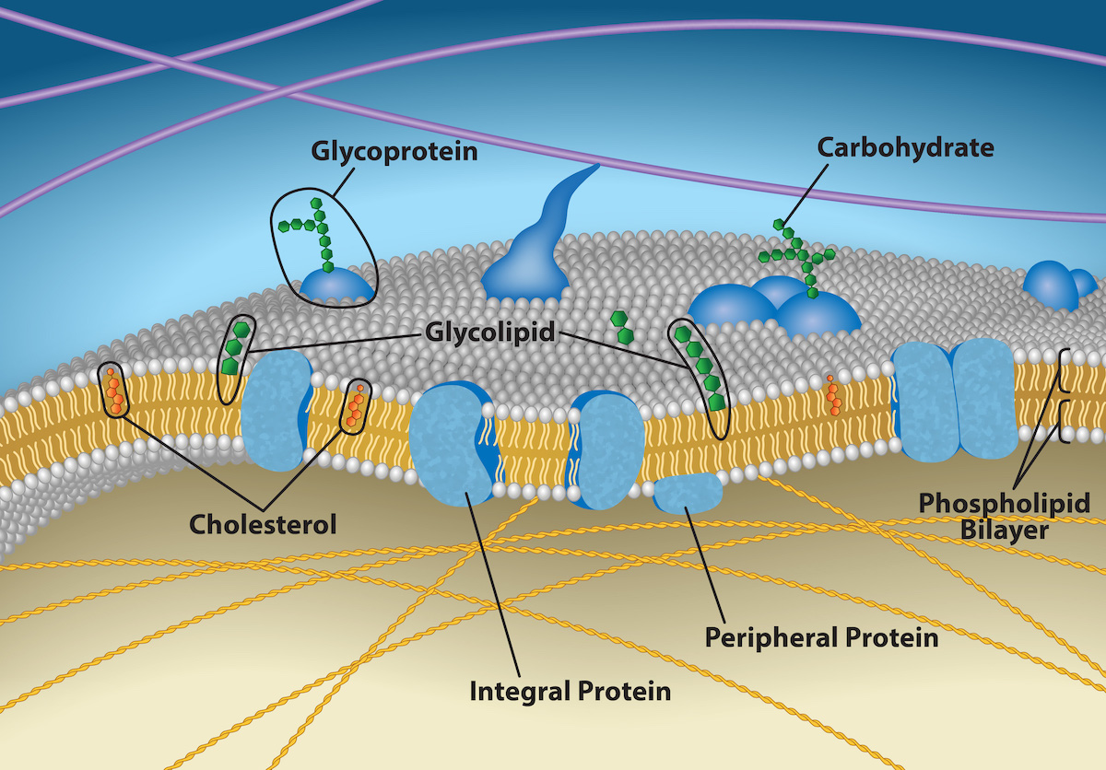
Figure 5.7
The exterior surface of the plasma membrane is not identical to the interior surface of the same membrane.
(credit: Rao, A., Ryan, K., Fletcher, S., Hawkins, A. and Tag, A. Department of Biology, Texas A&M University)
This OpenStax ancillary resource is © Rice University under a CC-BY 4.0 International license; it may be reproduced or modified but must be attributed to OpenStax, Rice University and any changes must be noted. Any images credited to other sources are similarly available for reproduction, but must be attributed to their sources.

Slide 9
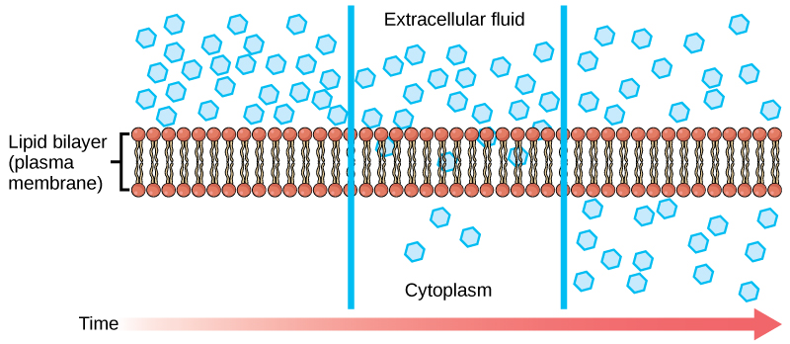
Figure 5.8
Diffusion through a permeable membrane moves a substance from an area of high concentration (extracellular fluid, in this case) down its concentration gradient (into the cytoplasm).
(credit: modification of work by Mariana Ruiz Villareal)
This OpenStax ancillary resource is © Rice University under a CC-BY 4.0 International license; it may be reproduced or modified but must be attributed to OpenStax, Rice University and any changes must be noted. Any images credited to other sources are similarly available for reproduction, but must be attributed to their sources.

Slide 10
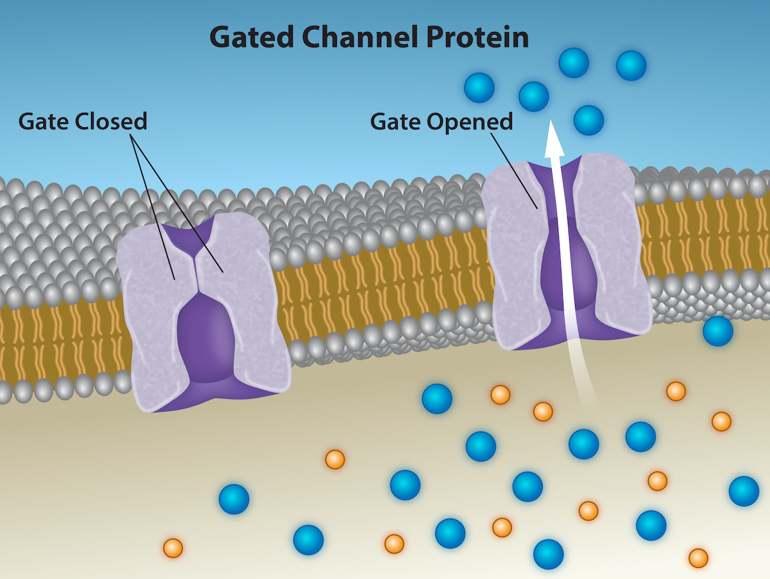
Figure 5.9
Ion channel proteins are gated. When they are closed, no ions can pass through them. However, when a channel opens, select ions diffuse through the channel. Channel proteins are highly specific, letting only a specific ion or subset of ions pass.
(credit: Rao, A., Ryan, K., Tag, A. and Fletcher, S. Department of Biology, Texas A&M University)
This OpenStax ancillary resource is © Rice University under a CC-BY 4.0 International license; it may be reproduced or modified but must be attributed to OpenStax, Rice University and any changes must be noted. Any images credited to other sources are similarly available for reproduction, but must be attributed to their sources.

Slide 11
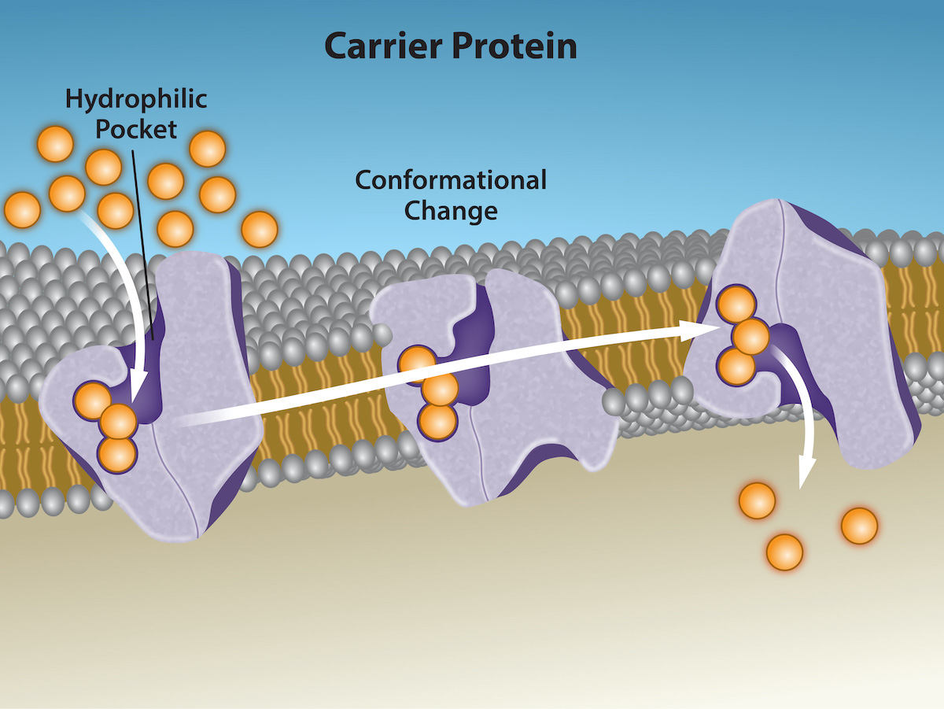
Figure 5.10
Some substances are able to move down their concentration gradient across the plasma membrane with the aid of carrier proteins. Carrier proteins change shape as they move molecules across the membrane.
(credit: modification of work by Mariana Ruiz Villareal)
This OpenStax ancillary resource is © Rice University under a CC-BY 4.0 International license; it may be reproduced or modified but must be attributed to OpenStax, Rice University and any changes must be noted. Any images credited to other sources are similarly available for reproduction, but must be attributed to their sources.

Slide 12
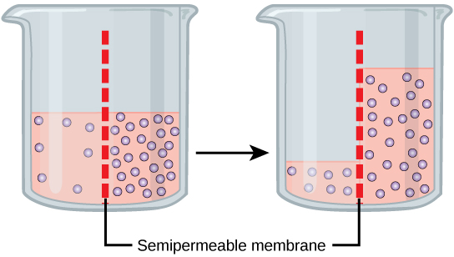
Figure 5.11
In osmosis, water always moves from an area of higher water concentration to one of lower concentration. In the diagram shown, the solute cannot pass through the selectively permeable membrane, but the water can.
This OpenStax ancillary resource is © Rice University under a CC-BY 4.0 International license; it may be reproduced or modified but must be attributed to OpenStax, Rice University and any changes must be noted. Any images credited to other sources are similarly available for reproduction, but must be attributed to their sources.

Slide 13
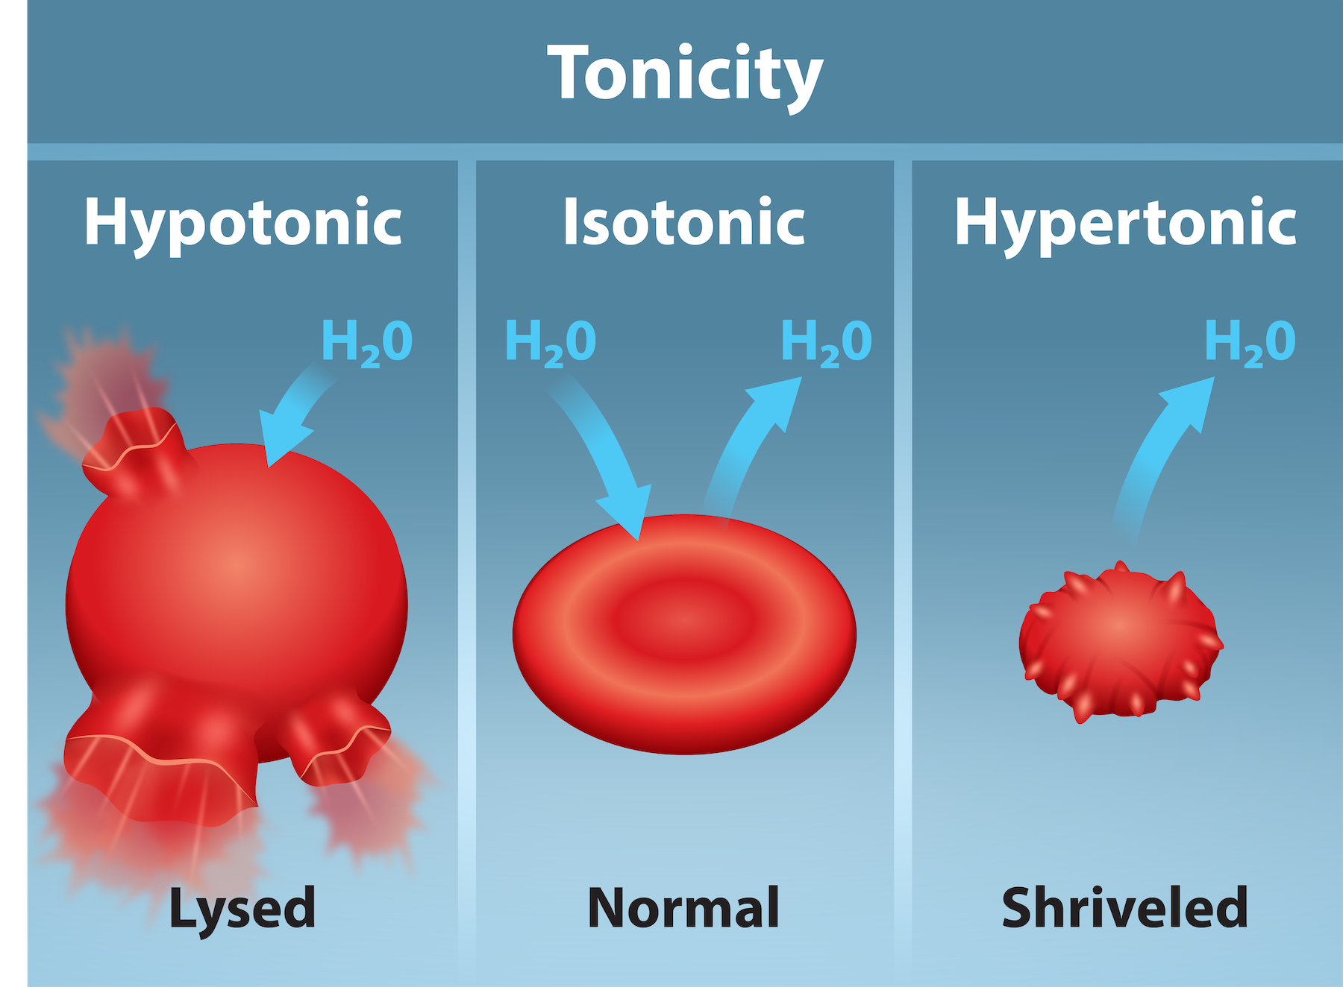
Figure 5.12
(credit: Tag, A., Rao, A., Hawkins, A and Fletcher, S. Department of Biology, Texas A&M University)
This OpenStax ancillary resource is © Rice University under a CC-BY 4.0 International license; it may be reproduced or modified but must be attributed to OpenStax, Rice University and any changes must be noted. Any images credited to other sources are similarly available for reproduction, but must be attributed to their sources.
Notes:
Three different scenarios involving red blood cells (RBC) are shown. Left: A RBC placed in a hypotonic solution, where the concentration of solutes in the surrounding fluid is lower than those in the cell, will cause water to rush into the RBC and lead to lysis of the cell. Middle: there is no net water movement into or out of the cell as the concentration of the solutes inside the cell equal or is isotonic to that of the surrounding fluid. Right: a RBC placed in a hypertonic solution, where the concentration of solutes in the surrounding fluid is greater than that in the cell will cause water to rush out of the cell and into the surrounding fluid. This will cause the RBC to shrivel.

Slide 14
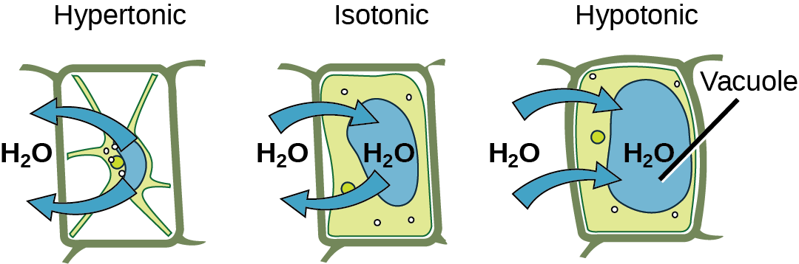
Figure 5.13
The turgor pressure within a plant cell depends on the tonicity of the solution that it is bathed in.
(credit: modification of work by Mariana Ruiz Villareal)
This OpenStax ancillary resource is © Rice University under a CC-BY 4.0 International license; it may be reproduced or modified but must be attributed to OpenStax, Rice University and any changes must be noted. Any images credited to other sources are similarly available for reproduction, but must be attributed to their sources.

Slide 15
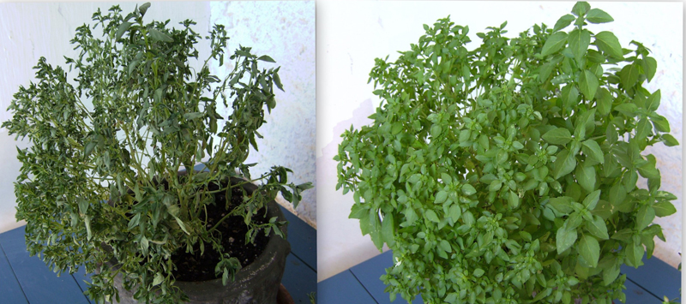
Figure 5.14
Without adequate water, the plant on the left has lost turgor pressure, visible in its wilting; the turgor pressure is restored by watering it (right).
(credit: Victor M. Vicente Selvas)
This OpenStax ancillary resource is © Rice University under a CC-BY 4.0 International license; it may be reproduced or modified but must be attributed to OpenStax, Rice University and any changes must be noted. Any images credited to other sources are similarly available for reproduction, but must be attributed to their sources.

Slide 16
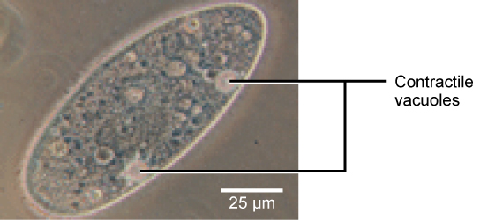
Figure 5.15
A paramecium’s contractile vacuole, here visualized using bright field light microscopy at 480x magnification, continuously pumps water out of the organism’s body to keep it from bursting in a hypotonic medium.
(credit: modification of work by NIH; scale-bar data from Matt Russell)
This OpenStax ancillary resource is © Rice University under a CC-BY 4.0 International license; it may be reproduced or modified but must be attributed to OpenStax, Rice University and any changes must be noted. Any images credited to other sources are similarly available for reproduction, but must be attributed to their sources.

Slide 17
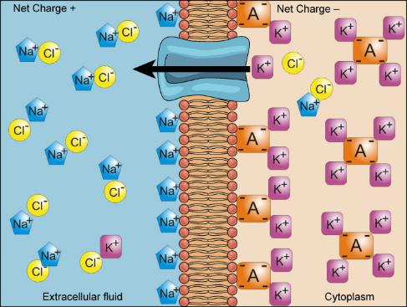
Figure 5.16
Electrochemical gradients arise from the combined effects of concentration gradients and electrical gradients. Structures labeled A represent proteins.
(credit: “Synaptitude”/Wikimedia Commons)
This OpenStax ancillary resource is © Rice University under a CC-BY 4.0 International license; it may be reproduced or modified but must be attributed to OpenStax, Rice University and any changes must be noted. Any images credited to other sources are similarly available for reproduction, but must be attributed to their sources.

Slide 18
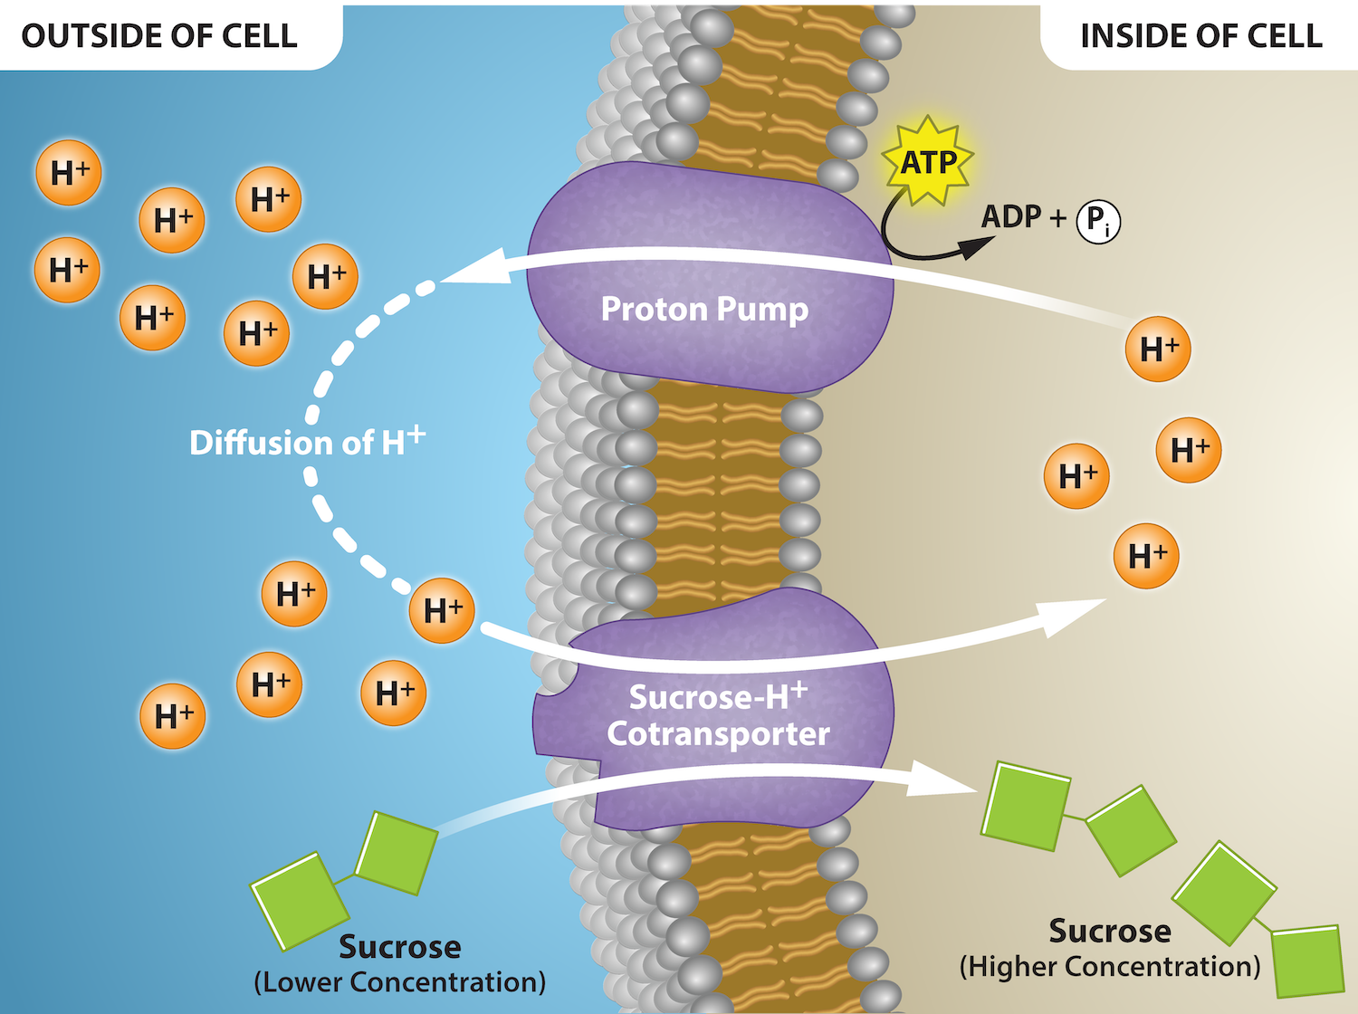
Figure 5.17
(credit: Rao, A. Tag, A. and Ryan, K. Department of Biology, Texas A&M University)
This OpenStax ancillary resource is © Rice University under a CC-BY 4.0 International license; it may be reproduced or modified but must be attributed to OpenStax, Rice University and any changes must be noted. Any images credited to other sources are similarly available for reproduction, but must be attributed to their sources.
Notes:
Proton Gradient provides energy for a secondary active transporter. The proton pump creates an electrochemical gradient of protons (hydrogen ions, H+) using ATP to drive primary active transport. This gradient allows for cotransport/secondary transport of sucrose against its concentration gradient as protons come down their concentration gradient via their membrane cotransporter protein.

Slide 19
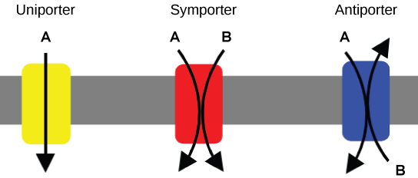
Figure 5.18
A uniporter carries one molecule or ion. A symporter carries two different molecules or ions, both in the same direction. An antiporter also carries two different molecules or ions, but in different directions.
(credit: modification of work by “Lupask”/Wikimedia Commons)
This OpenStax ancillary resource is © Rice University under a CC-BY 4.0 International license; it may be reproduced or modified but must be attributed to OpenStax, Rice University and any changes must be noted. Any images credited to other sources are similarly available for reproduction, but must be attributed to their sources.

Slide 20
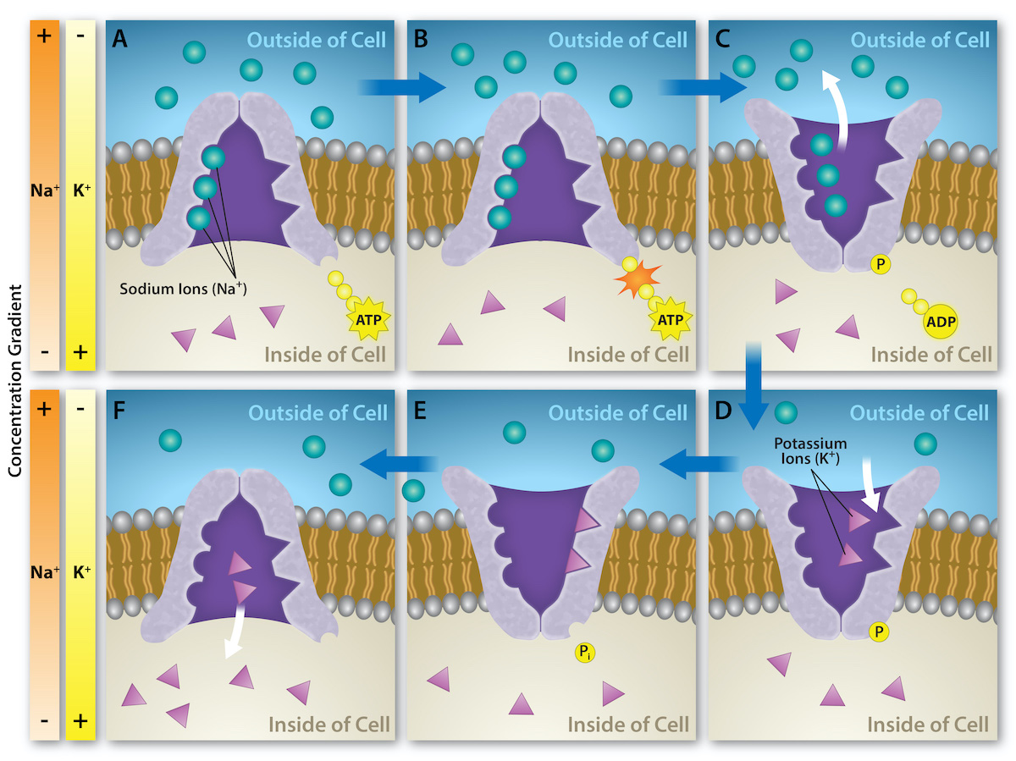
Figure 5.19
(credit: Rao, A. Tag, A. and Ryan, K. Department of Biology, Texas A&M University)
This OpenStax ancillary resource is © Rice University under a CC-BY 4.0 International license; it may be reproduced or modified but must be attributed to OpenStax, Rice University and any changes must be noted. Any images credited to other sources are similarly available for reproduction, but must be attributed to their sources.
Notes:
The sodium-potassium pump is an example of primary active transport that moves ions, sodium and potassium ions in this instance, across a membrane against their concentration gradients. The energy is provided by the hydrolysis of ATP. Three sodium ions are moved out of the cell for every 2 potassium ions that are brought into the cell. This creates an electrochemical gradient that is crucial for living cells.

Slide 21
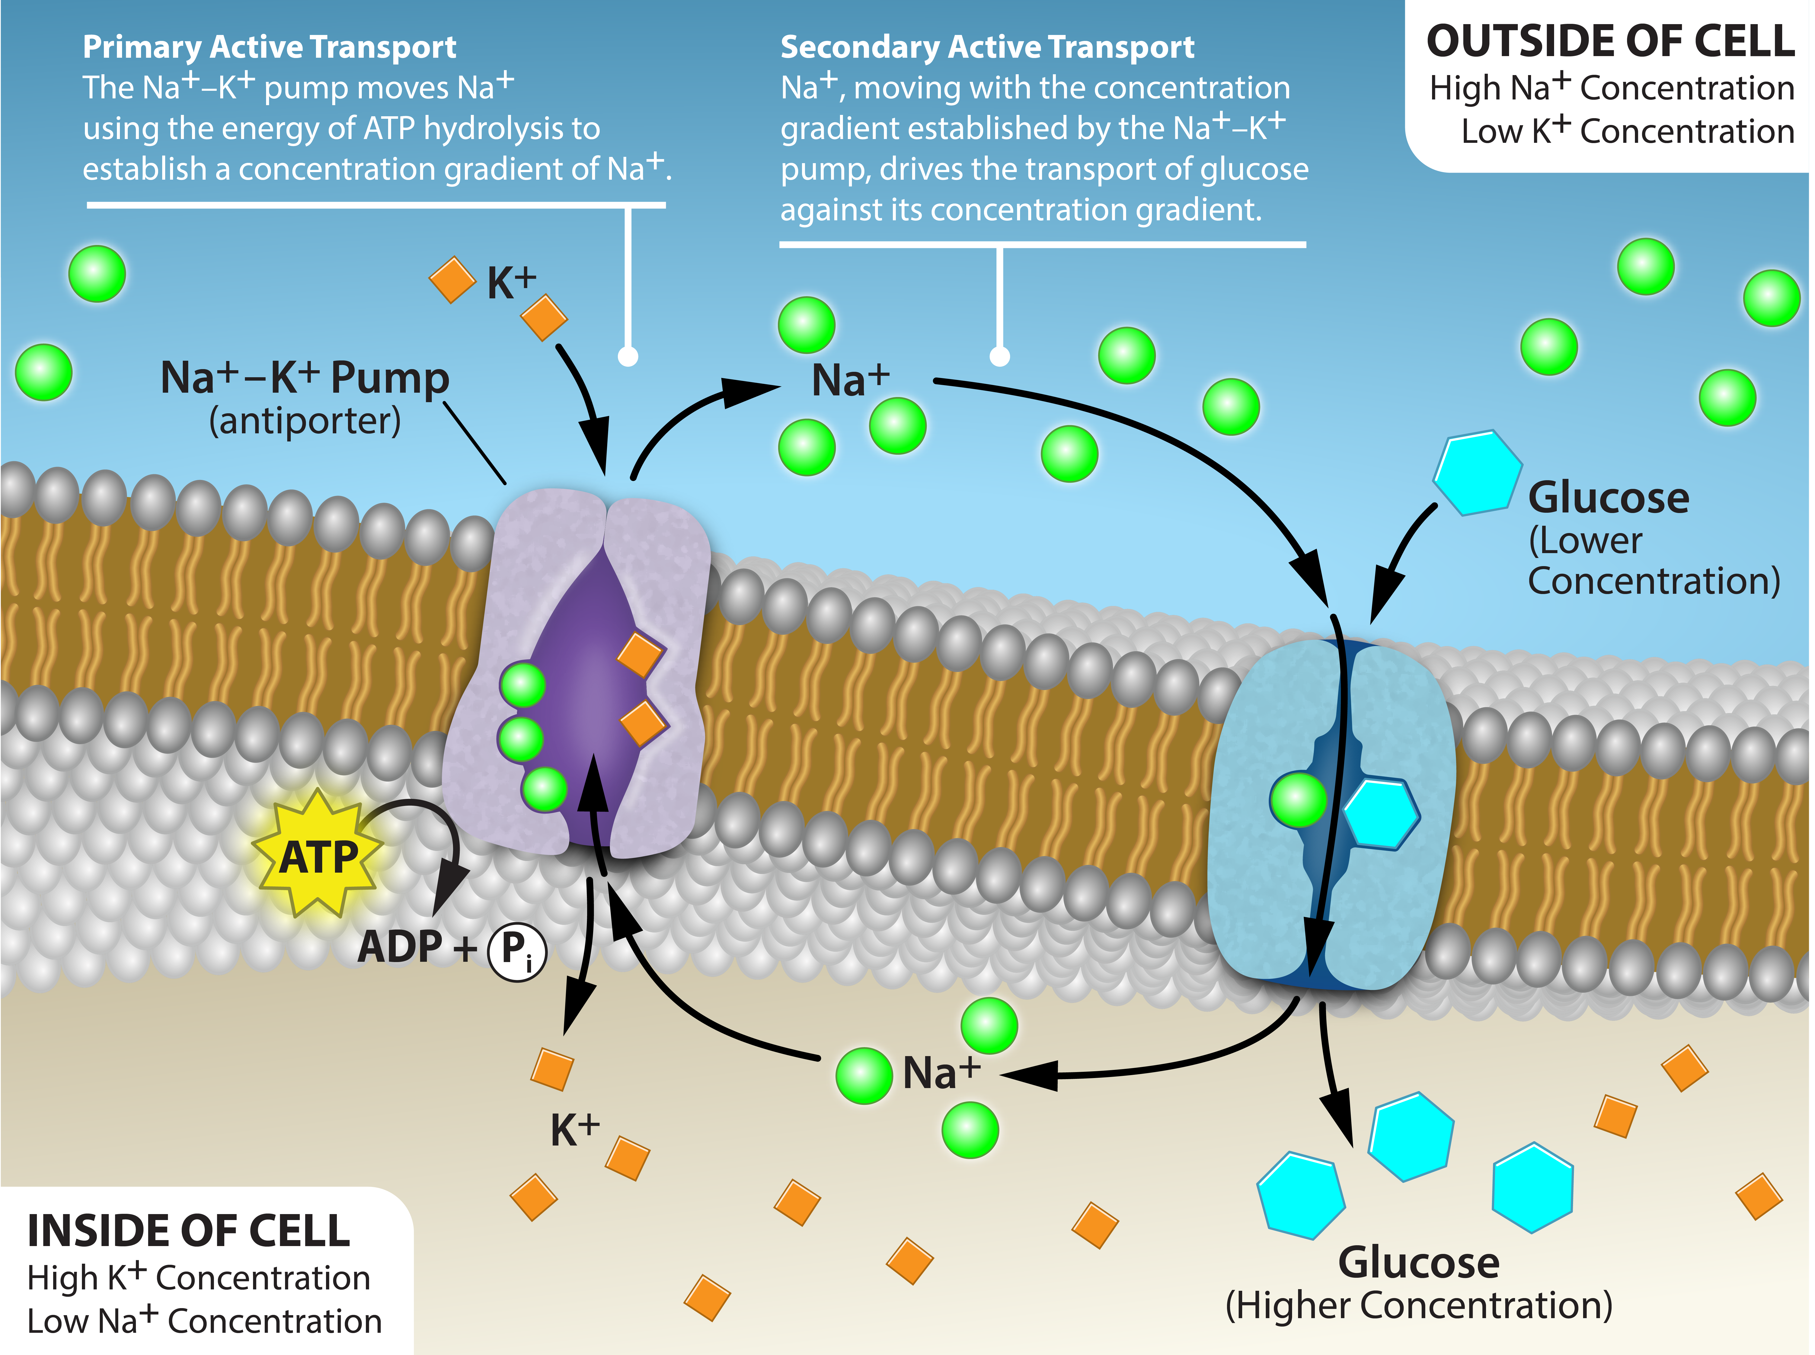
Figure 5.20
(credit: Rao, A. Tag, A. and Ryan, K. Department of Biology, Texas A&M University)
This OpenStax ancillary resource is © Rice University under a CC-BY 4.0 International license; it may be reproduced or modified but must be attributed to OpenStax, Rice University and any changes must be noted. Any images credited to other sources are similarly available for reproduction, but must be attributed to their sources.
Notes:
An electrochemical gradient (Na⁺ concentration - green), is generated by primary active transport. The energy stored in the Na⁺ gradient provides the energy to move other substances against their concentration gradients (Glucose - blue), a process called co-transport or secondary active transport.

Slide 22
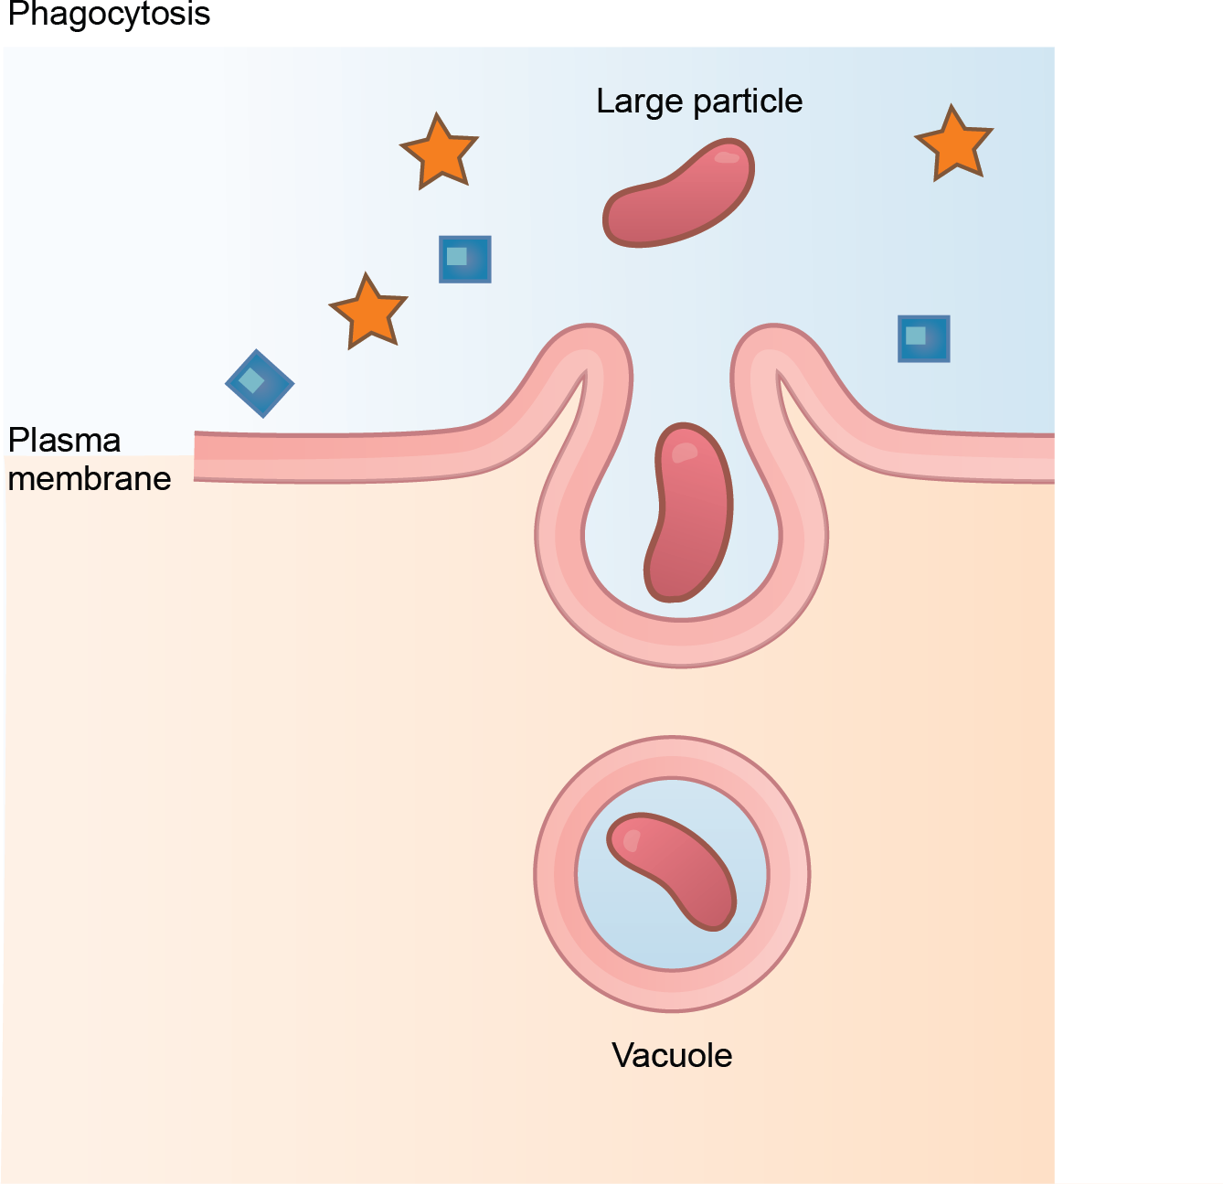
Figure 5.21
In phagocytosis, the cell membrane surrounds the particle and engulfs it.
(credit: modification of work by Mariana Ruiz Villareal)
This OpenStax ancillary resource is © Rice University under a CC-BY 4.0 International license; it may be reproduced or modified but must be attributed to OpenStax, Rice University and any changes must be noted. Any images credited to other sources are similarly available for reproduction, but must be attributed to their sources.

Slide 23
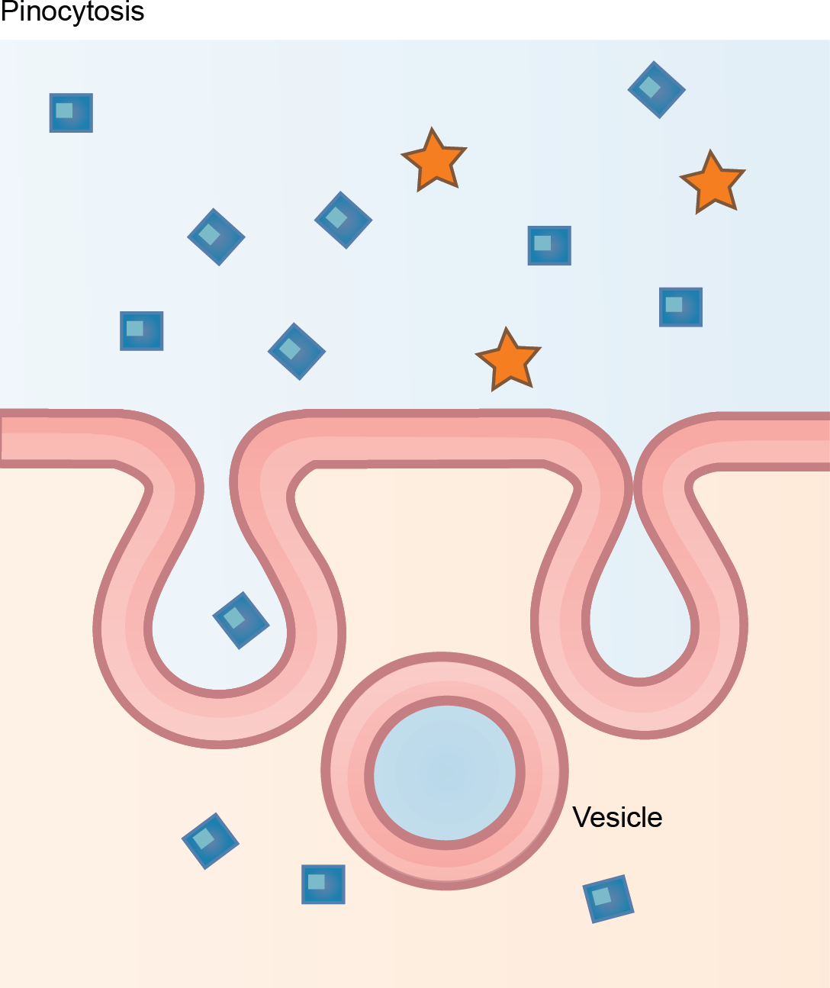
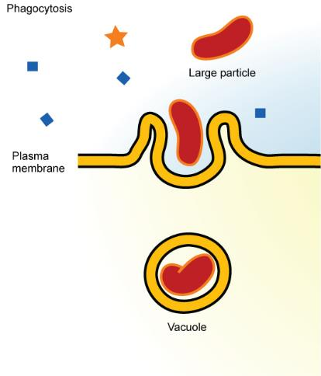
Figure 5.22
In pinocytosis, the cell membrane invaginates, surrounds a small volume of fluid, and pinches off.
(credit: modification of work by Mariana Ruiz Villareal)
This OpenStax ancillary resource is © Rice University under a CC-BY 4.0 International license; it may be reproduced or modified but must be attributed to OpenStax, Rice University and any changes must be noted. Any images credited to other sources are similarly available for reproduction, but must be attributed to their sources.

Slide 24
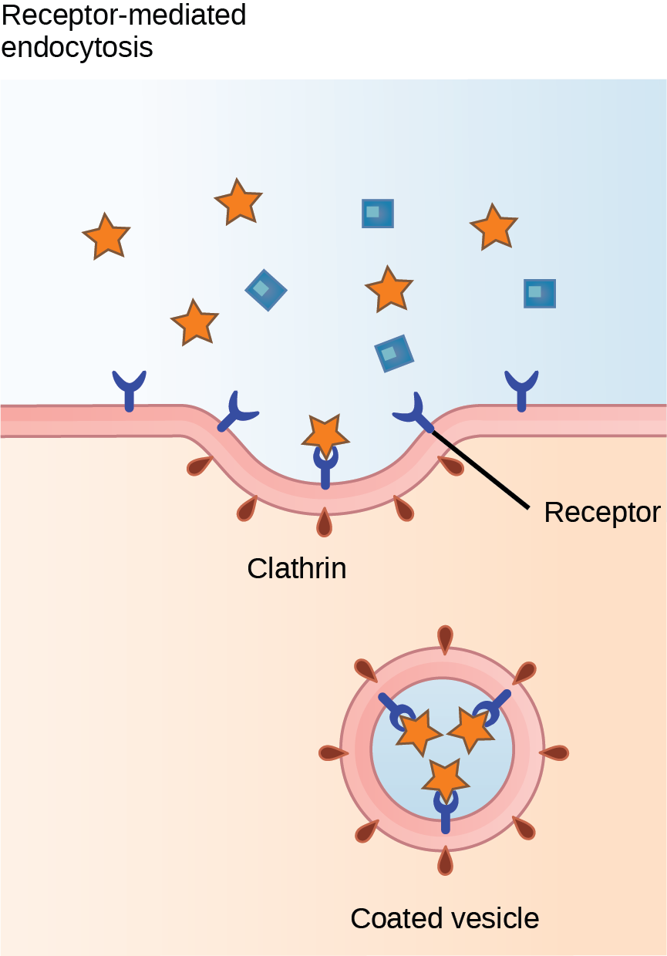
Figure 5.23
In receptor-mediated endocytosis, the cell's uptake of substances targets a single type of substance that binds to the receptor on the cell membrane's external surface.
(credit: modification of work by Mariana Ruiz Villareal)
This OpenStax ancillary resource is © Rice University under a CC-BY 4.0 International license; it may be reproduced or modified but must be attributed to OpenStax, Rice University and any changes must be noted. Any images credited to other sources are similarly available for reproduction, but must be attributed to their sources.

Slide 25
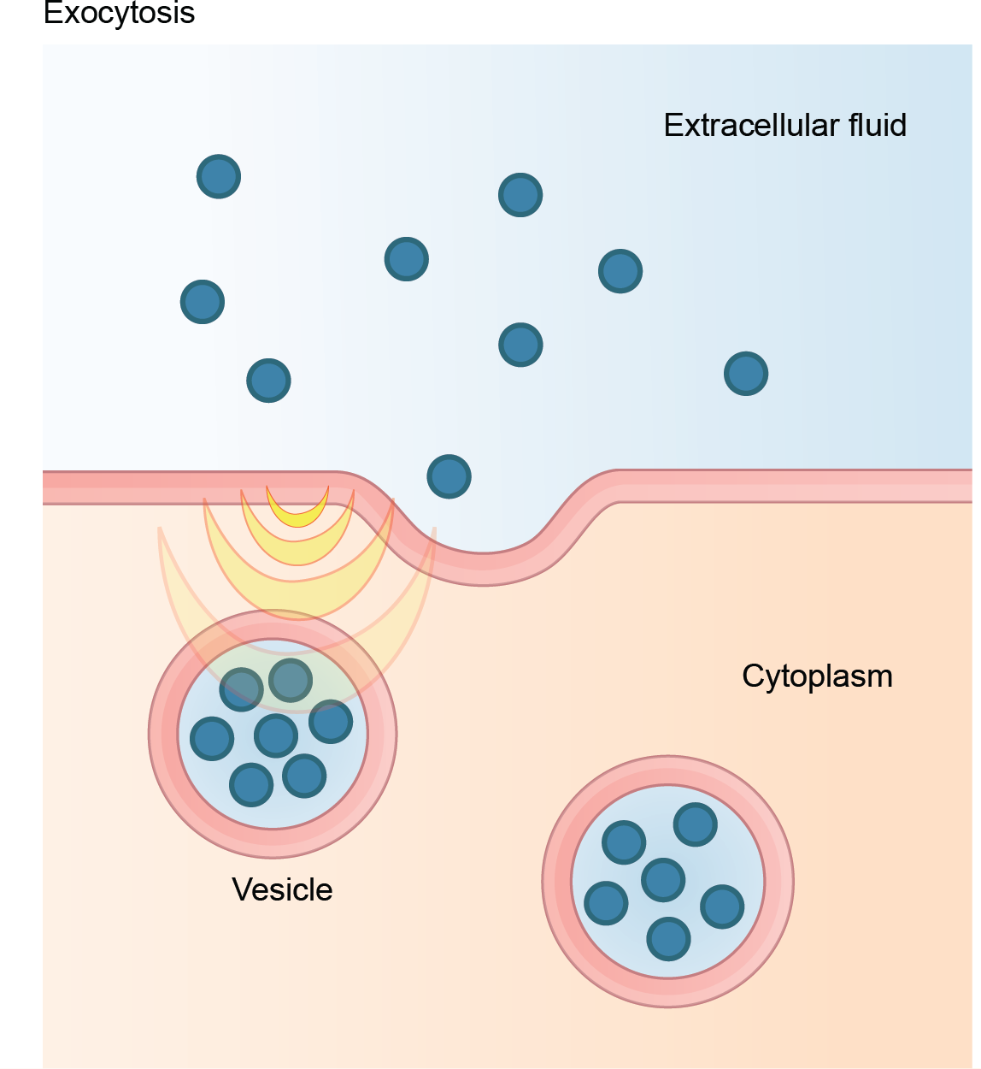
Figure 5.24
In exocytosis, vesicles containing substances fuse with the plasma membrane. The contents then release to the cell's exterior.
(credit: modification of work by Mariana Ruiz Villareal)
This OpenStax ancillary resource is © Rice University under a CC-BY 4.0 International license; it may be reproduced or modified but must be attributed to OpenStax, Rice University and any changes must be noted. Any images credited to other sources are similarly available for reproduction, but must be attributed to their sources.

