Slide 1


Biology 2e
Chapter 6 METABOLISM
PowerPoint Image Slide Show

Slide 2
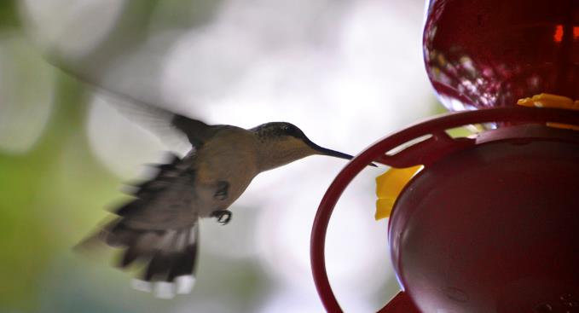
Figure 6.1
A hummingbird needs energy to maintain prolonged periods of flight. The bird obtains its energy from taking in food and transforming the nutrients into energy through a series of biochemical reactions. The flight muscles in birds are extremely efficient in energy production.
(credit: modification of work by Cory Zanker)
This OpenStax ancillary resource is © Rice University under a CC-BY 4.0 International license; it may be reproduced or modified but must be attributed to OpenStax, Rice University and any changes must be noted. Any images credited to other sources are similarly available for reproduction, but must be attributed to their sources.

Slide 3
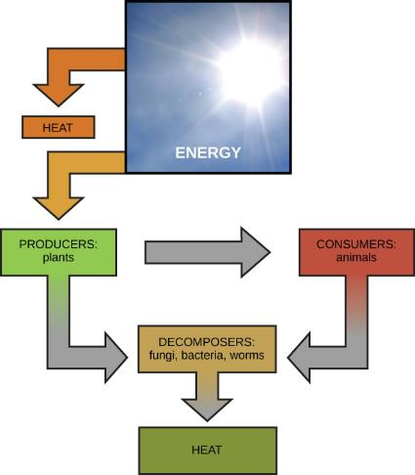
Figure 6.2
Most life forms on earth get their energy from the sun. Plants use photosynthesis to capture sunlight, and herbivores eat those plants to obtain energy. Carnivores eat the herbivores, and decomposers digest plant and animal matter.
This OpenStax ancillary resource is © Rice University under a CC-BY 4.0 International license; it may be reproduced or modified but must be attributed to OpenStax, Rice University and any changes must be noted. Any images credited to other sources are similarly available for reproduction, but must be attributed to their sources.

Slide 4
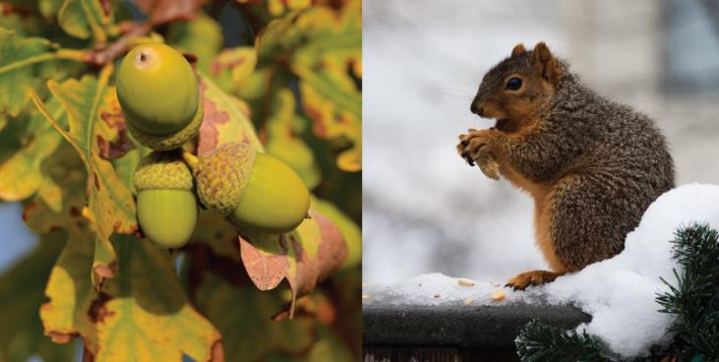
Figure 6.3
Plants, like this oak tree, use energy from sunlight to make sugar and other organic molecules. Both plants and animals, like this squirrel, use cellular respiration to derive energy from the organic molecules originally produced by plants.
(credit “acorn”: modification of work by Noel Reynolds; credit “squirrel”: modification of work by Dawn Huczek)
This OpenStax ancillary resource is © Rice University under a CC-BY 4.0 International license; it may be reproduced or modified but must be attributed to OpenStax, Rice University and any changes must be noted. Any images credited to other sources are similarly available for reproduction, but must be attributed to their sources.

Slide 5
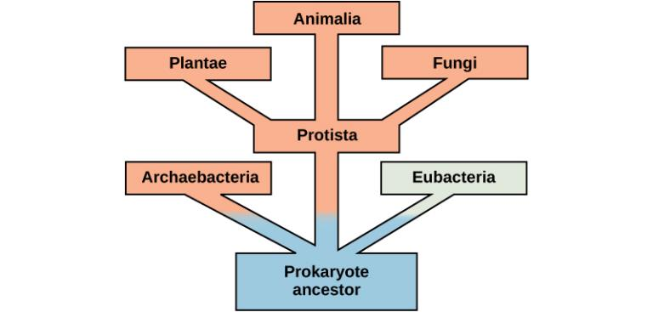
Figure 6.4
This tree shows the evolution of the various branches of life. The vertical dimension is time. Early life forms, in blue, used anaerobic metabolism to obtain energy from their surroundings.
This OpenStax ancillary resource is © Rice University under a CC-BY 4.0 International license; it may be reproduced or modified but must be attributed to OpenStax, Rice University and any changes must be noted. Any images credited to other sources are similarly available for reproduction, but must be attributed to their sources.

Slide 6
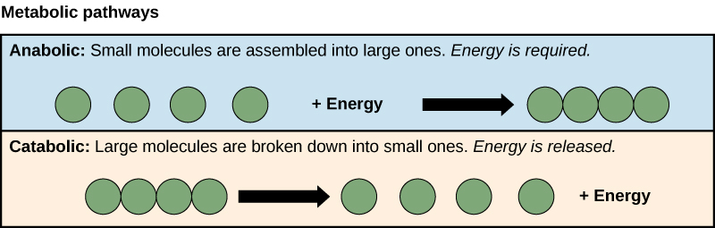
Figure 6.5
Anabolic pathways are those that require energy to synthesize larger molecules. Catabolic pathways are those that generate energy by breaking down larger molecules. Both types of pathways are required for maintaining the cell’s energy balance.
This OpenStax ancillary resource is © Rice University under a CC-BY 4.0 International license; it may be reproduced or modified but must be attributed to OpenStax, Rice University and any changes must be noted. Any images credited to other sources are similarly available for reproduction, but must be attributed to their sources.

Slide 7
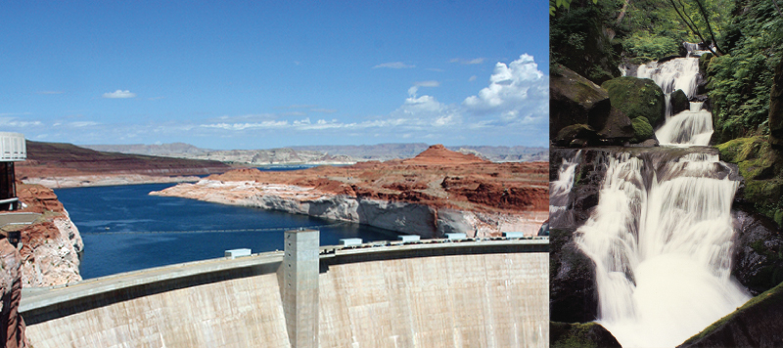
Figure 6.6
Water behind a dam has potential energy. Moving water, such as in a waterfall or a rapidly flowing river, has kinetic energy.
(credit “dam”: modification of work by "Pascal"/Flickr; credit “waterfall”: modification of work by Frank Gualtieri)
This OpenStax ancillary resource is © Rice University under a CC-BY 4.0 International license; it may be reproduced or modified but must be attributed to OpenStax, Rice University and any changes must be noted. Any images credited to other sources are similarly available for reproduction, but must be attributed to their sources.

Slide 8
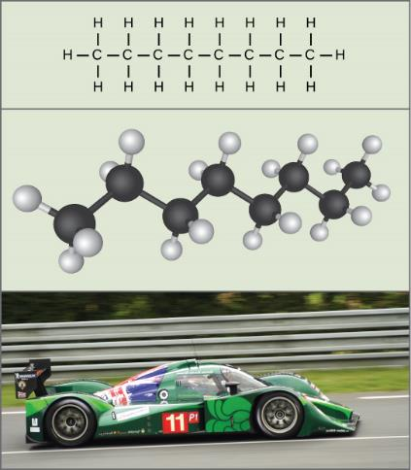
Figure 6.7
The molecules in gasoline (octane, the chemical formula shown) contain chemical energy within the chemical bonds. This energy is transformed into kinetic energy that allows a car to race on a racetrack.
(credit “car”: modification of work by Russell Trow)
This OpenStax ancillary resource is © Rice University under a CC-BY 4.0 International license; it may be reproduced or modified but must be attributed to OpenStax, Rice University and any changes must be noted. Any images credited to other sources are similarly available for reproduction, but must be attributed to their sources.

Slide 9
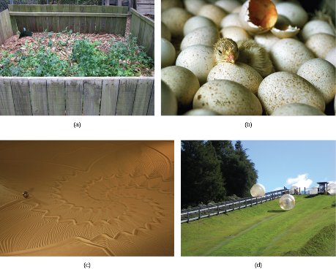
Figure 6.8
Shown are some examples of endergonic processes (ones that require energy) and exergonic processes (ones that release energy). These include (a) a compost pile decomposing, (b) a chick hatching from a fertilized egg, (c) sand art being destroyed, and (d) a ball rolling down a hill.
(credit a: modification of work by Natalie Maynor; credit b: modification of work by USDA; credit c: modification of work by “Athlex”/Flickr; credit d: modification of work by Harry Malsch)
This OpenStax ancillary resource is © Rice University under a CC-BY 4.0 International license; it may be reproduced or modified but must be attributed to OpenStax, Rice University and any changes must be noted. Any images credited to other sources are similarly available for reproduction, but must be attributed to their sources.

Slide 10
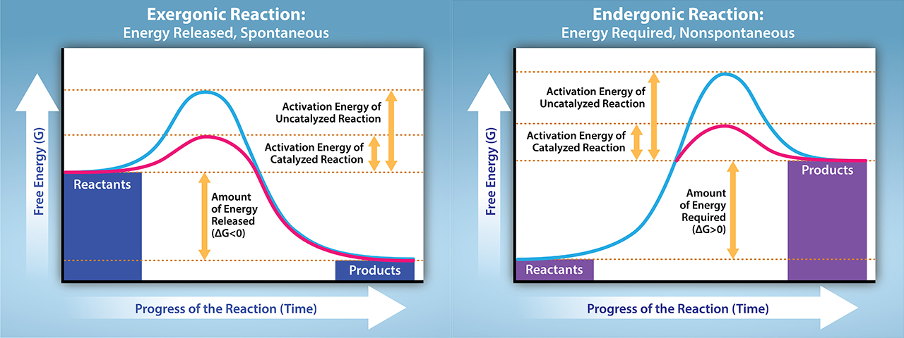
Figure 6.9
Exergonic and endergonic reactions result in changes in Gibbs free energy. Exergonic reactions release energy; endergonic reactions require energy to proceed.
(credit: Tag, A., Rao, A., Fletcher, S. and Ryan, A. Department of Biology, Texas A&M University)
This OpenStax ancillary resource is © Rice University under a CC-BY 4.0 International license; it may be reproduced or modified but must be attributed to OpenStax, Rice University and any changes must be noted. Any images credited to other sources are similarly available for reproduction, but must be attributed to their sources.

Slide 11
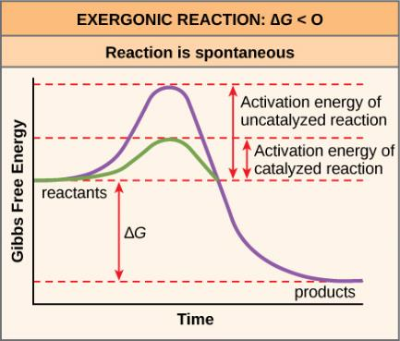
Figure 6.10
Activation energy is the energy required for a reaction to proceed, and it is lower if the reaction is catalyzed. The horizontal axis of this diagram describes the sequence of events in time.
This OpenStax ancillary resource is © Rice University under a CC-BY 4.0 International license; it may be reproduced or modified but must be attributed to OpenStax, Rice University and any changes must be noted. Any images credited to other sources are similarly available for reproduction, but must be attributed to their sources.

Slide 12
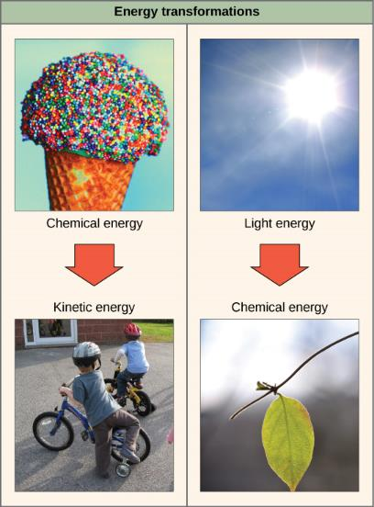
Figure 6.11
Shown are two examples of energy being transferred from one system to another and transformed from one form to another. Humans can convert the chemical energy in food, like this ice cream cone, into kinetic energy (the energy of movement to ride a bicycle). Plants can convert electromagnetic radiation (light energy) from the sun into chemical energy.
(credit “ice cream”: modification of work by D. Sharon Pruitt; credit “kids on bikes”: modification of work by Michelle Riggen-Ransom; credit “leaf”: modification of work by Cory Zanker)
This OpenStax ancillary resource is © Rice University under a CC-BY 4.0 International license; it may be reproduced or modified but must be attributed to OpenStax, Rice University and any changes must be noted. Any images credited to other sources are similarly available for reproduction, but must be attributed to their sources.

Slide 13
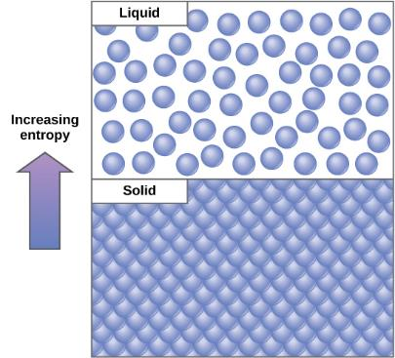
Figure 6.12
Entropy is a measure of randomness or disorder in a system. Gases have higher entropy than liquids, and liquids have higher entropy than solids.
This OpenStax ancillary resource is © Rice University under a CC-BY 4.0 International license; it may be reproduced or modified but must be attributed to OpenStax, Rice University and any changes must be noted. Any images credited to other sources are similarly available for reproduction, but must be attributed to their sources.

Slide 14
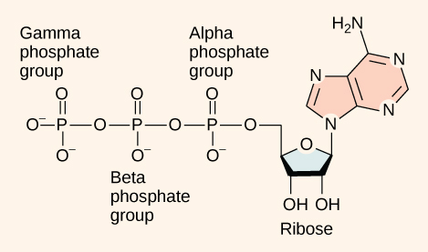
Figure 6.13
ATP is the primary energy currency of the cell. It has an adenosine backbone with three phosphate groups attached.
This OpenStax ancillary resource is © Rice University under a CC-BY 4.0 International license; it may be reproduced or modified but must be attributed to OpenStax, Rice University and any changes must be noted. Any images credited to other sources are similarly available for reproduction, but must be attributed to their sources.

Slide 15
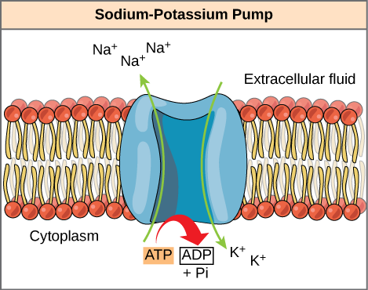
Figure 6.14
The sodium-potassium pump is an example of energy coupling. The energy derived from exergonic ATP hydrolysis is used to pump sodium and potassium ions across the cell membrane.
This OpenStax ancillary resource is © Rice University under a CC-BY 4.0 International license; it may be reproduced or modified but must be attributed to OpenStax, Rice University and any changes must be noted. Any images credited to other sources are similarly available for reproduction, but must be attributed to their sources.

Slide 16
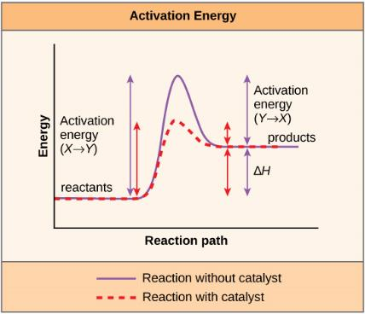
Figure 6.15
Enzymes lower the activation energy of the reaction but do not change the free energy of the reaction.
This OpenStax ancillary resource is © Rice University under a CC-BY 4.0 International license; it may be reproduced or modified but must be attributed to OpenStax, Rice University and any changes must be noted. Any images credited to other sources are similarly available for reproduction, but must be attributed to their sources.

Slide 17
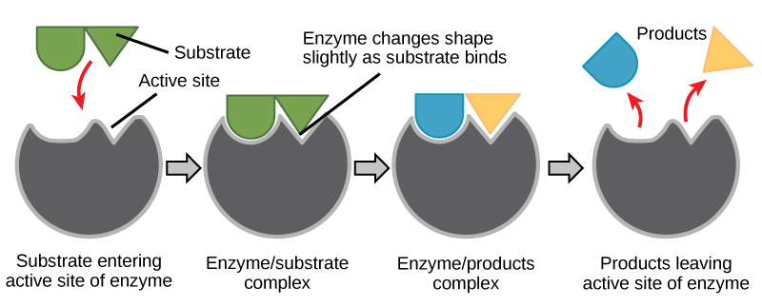
Figure 6.16
According to the induced-fit model, both enzyme and substrate undergo dynamic conformational changes upon binding. The enzyme contorts the substrate into its transition state, thereby increasing the rate of the reaction.
This OpenStax ancillary resource is © Rice University under a CC-BY 4.0 International license; it may be reproduced or modified but must be attributed to OpenStax, Rice University and any changes must be noted. Any images credited to other sources are similarly available for reproduction, but must be attributed to their sources.

Slide 18
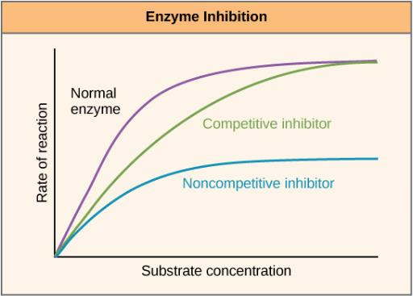
Figure 6.17
Competitive and noncompetitive inhibition affect the rate of reaction differently. Competitive inhibitors affect the initial rate but do not affect the maximal rate, whereas noncompetitive inhibitors affect the maximal rate.
This OpenStax ancillary resource is © Rice University under a CC-BY 4.0 International license; it may be reproduced or modified but must be attributed to OpenStax, Rice University and any changes must be noted. Any images credited to other sources are similarly available for reproduction, but must be attributed to their sources.

Slide 19
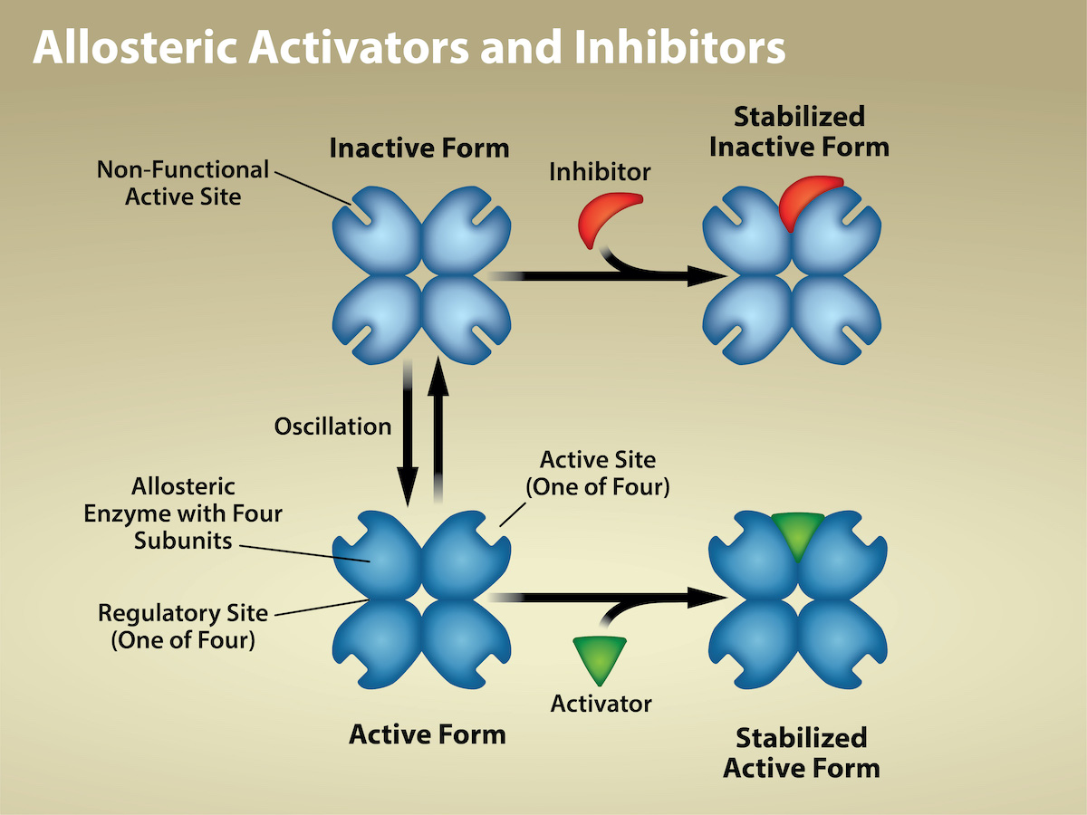
Figure 6.18
(credit: Rao, A., Hawkins, A., Fletcher, S. and Tag, A. Department of Biology, Texas A&M University)
This OpenStax ancillary resource is © Rice University under a CC-BY 4.0 International license; it may be reproduced or modified but must be attributed to OpenStax, Rice University and any changes must be noted. Any images credited to other sources are similarly available for reproduction, but must be attributed to their sources.
Notes:
Allosteric inhibitors modify the enzyme's active site so that substrate binding is reduced or prevented. In contrast, allosteric activators modify the enzyme's active site so that the affinity for the substrate increases.

Slide 20
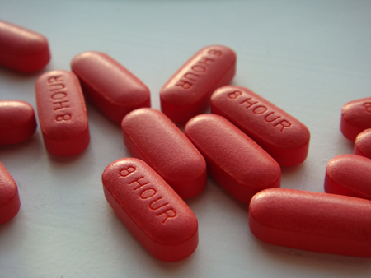
Figure 6.19
Have you ever wondered how pharmaceutical drugs are developed?
(credit: Deborah Austin)
This OpenStax ancillary resource is © Rice University under a CC-BY 4.0 International license; it may be reproduced or modified but must be attributed to OpenStax, Rice University and any changes must be noted. Any images credited to other sources are similarly available for reproduction, but must be attributed to their sources.

Slide 21
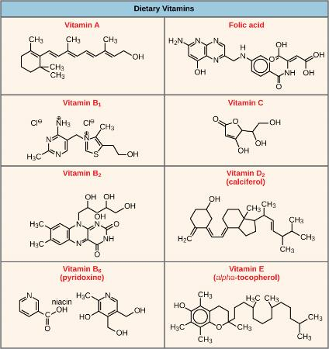
Figure 6.20
Vitamins are important coenzymes or precursors of coenzymes, and are required for enzymes to function properly. Multivitamin capsules usually contain mixtures of all the vitamins at different percentages.
This OpenStax ancillary resource is © Rice University under a CC-BY 4.0 International license; it may be reproduced or modified but must be attributed to OpenStax, Rice University and any changes must be noted. Any images credited to other sources are similarly available for reproduction, but must be attributed to their sources.

Slide 22
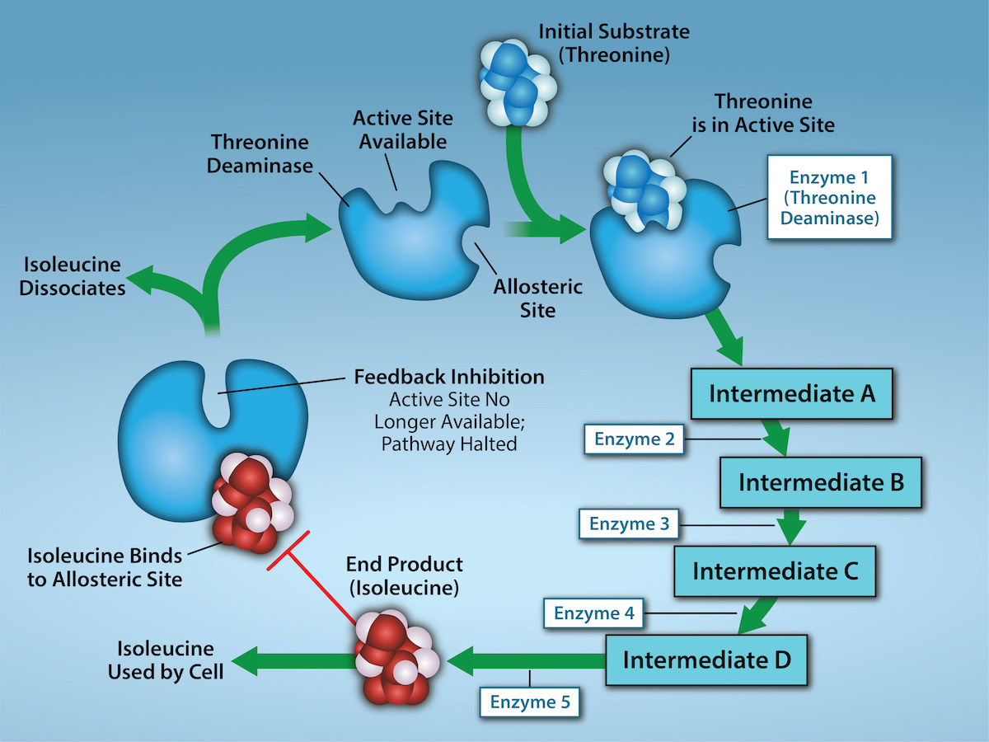
Figure 6.21
(credit: Rao, A., Ryan, K., Tag, A., Hawkins, A. and Fletcher S. Department of Biology, Texas A&M University)
This OpenStax ancillary resource is © Rice University under a CC-BY 4.0 International license; it may be reproduced or modified but must be attributed to OpenStax, Rice University and any changes must be noted. Any images credited to other sources are similarly available for reproduction, but must be attributed to their sources.
Notes:
Metabolic pathways are a series of reactions that multiple enzymes catalyze. Feedback inhibition, where the pathway's end product inhibits an upstream step, is an important regulatory mechanism in cells. Metabolic pathways are a series of reactions catalyzed by multiple enzymes (Intermediates A – D, Enzymes 1 – 5). Feedback inhibition occurs when the pathway's end product (here isoleucine) inhibits an upstream enzyme (indicated by red bar). In this example, isoleucine will bind to Threonine Deaminase (at the allosteric site) and prevent threonine from binding to this enzyme’s active site, effectively blocking this metabolic pathway. When isoleucine levels decrease, Threonine will then bind to Threonine Deaminase’s active site and the metabolic pathway will resume. This is an important regulatory mechanism in cells to inhibit the overproduction of a product.

