Slide 1

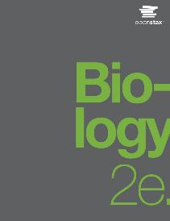
Biology 2e
Chapter 7 CELLULAR RESPIRATION
PowerPoint Image Slide Show

Slide 2
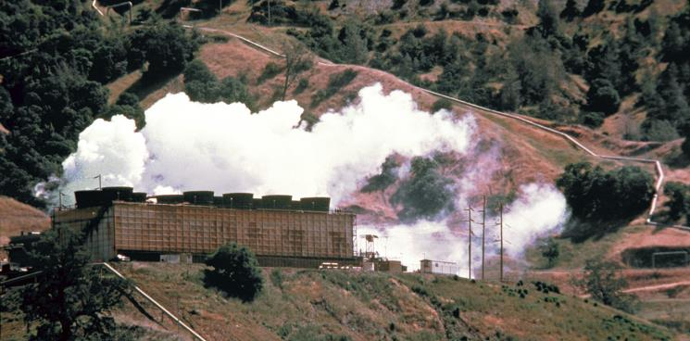
Figure 7.1
This geothermal energy plant transforms thermal energy from deep in the ground into electrical energy, which can be easily used.
(credit: modification of work by the U.S. Department of Defense)
This OpenStax ancillary resource is © Rice University under a CC-BY 4.0 International license; it may be reproduced or modified but must be attributed to OpenStax, Rice University and any changes must be noted. Any images credited to other sources are similarly available for reproduction, but must be attributed to their sources.

Slide 3
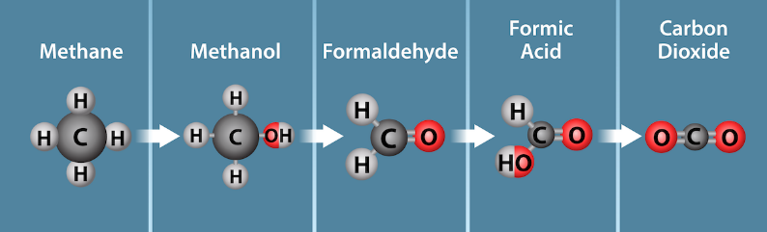
Figure 7.2
Oxidation
Reduction
Stages of oxidation/reduction of a single carbon. Electrons are lost from carbon as methane is oxidized to carbon dioxide. The loss of electrons is also accompanied by the loss of energy. Electrons are gained during the reduction of carbon dioxide to methane. The gain of an electron is accompanied by a gain in potential energy and often by the addition of a proton (H⁺).
(credit: Ryan, K., Rao, A.and Fletcher, S. Department of Biology, Texas A&M University)
This OpenStax ancillary resource is © Rice University under a CC-BY 4.0 International license; it may be reproduced or modified but must be attributed to OpenStax, Rice University and any changes must be noted. Any images credited to other sources are similarly available for reproduction, but must be attributed to their sources.

Slide 4
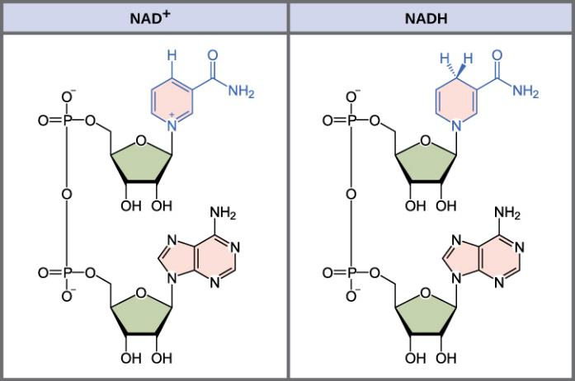
Figure 7.3
The oxidized form of the electron carrier (NAD⁺) is shown on the left, and the reduced form (NADH) is shown on the right. The nitrogenous base in NADH has one more hydrogen ion and two more electrons than in NAD⁺.
This OpenStax ancillary resource is © Rice University under a CC-BY 4.0 International license; it may be reproduced or modified but must be attributed to OpenStax, Rice University and any changes must be noted. Any images credited to other sources are similarly available for reproduction, but must be attributed to their sources.

Slide 5
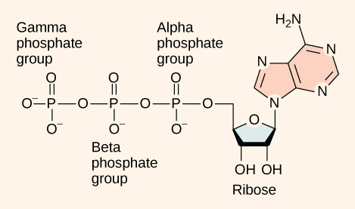
Figure 7.4
ATP (adenosine triphosphate) has three phosphate groups that can be removed by hydrolysis (addition of H₂O) to form ADP (adenosine diphosphate) or AMP (adenosine monophosphate). The negative charges on the phosphate group naturally repel each other, requiring energy to bond them together and releasing energy when these bonds are broken.
This OpenStax ancillary resource is © Rice University under a CC-BY 4.0 International license; it may be reproduced or modified but must be attributed to OpenStax, Rice University and any changes must be noted. Any images credited to other sources are similarly available for reproduction, but must be attributed to their sources.

Slide 6
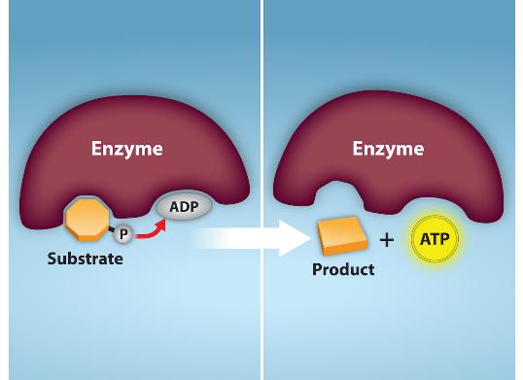
Figure 7.5
In phosphorylation reactions, the gamma (third) phosphate of ATP is attached to a protein. In substrate-level phosphorylation, a phosphate group that is covalently attached to another molecule is transferred to ADP to form ATP.
(credit: Rao, A., Ryan, K. and Fletcher, S. Department of Biology, Texas A&M University)
This OpenStax ancillary resource is © Rice University under a CC-BY 4.0 International license; it may be reproduced or modified but must be attributed to OpenStax, Rice University and any changes must be noted. Any images credited to other sources are similarly available for reproduction, but must be attributed to their sources.

Slide 7
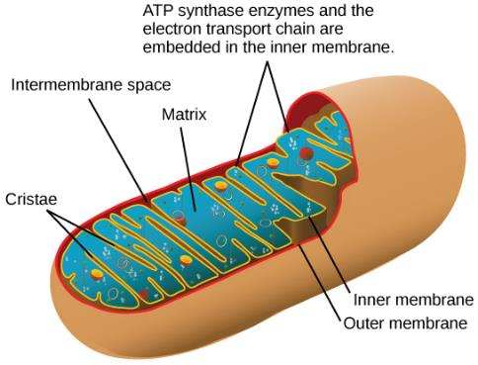
Figure 7.6
In eukaryotes, oxidative phosphorylation takes place in mitochondria. In prokaryotes, this process takes place in the plasma membrane.
(credit: modification of work by Mariana Ruiz Villareal)
This OpenStax ancillary resource is © Rice University under a CC-BY 4.0 International license; it may be reproduced or modified but must be attributed to OpenStax, Rice University and any changes must be noted. Any images credited to other sources are similarly available for reproduction, but must be attributed to their sources.

Slide 8
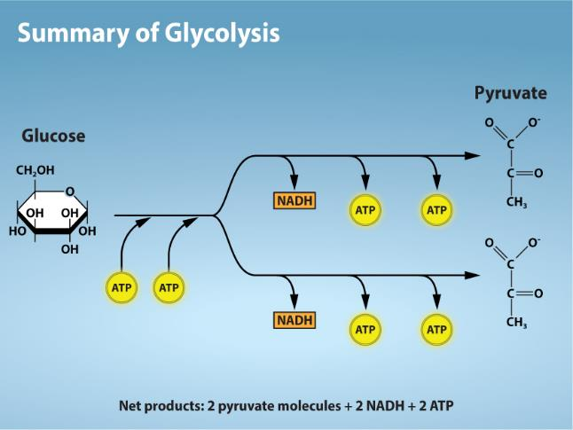
Figure 7.7
(credit: Rao, A. and Ryan, K. Department of Biology, Texas A&M University)
This OpenStax ancillary resource is © Rice University under a CC-BY 4.0 International license; it may be reproduced or modified but must be attributed to OpenStax, Rice University and any changes must be noted. Any images credited to other sources are similarly available for reproduction, but must be attributed to their sources.
Notes:
Glycolysis begins with an energy investment phase which requires 2 ATP to phosphorylate the starting glucose molecule. The 6-carbon intermediate is then split into 2, 3-carbon sugar molecules. In the energy recovery phase, each 3-carbon sugar is then oxidized to pyruvate with the energy transferred to form NADH and 2 ATP.

Slide 9
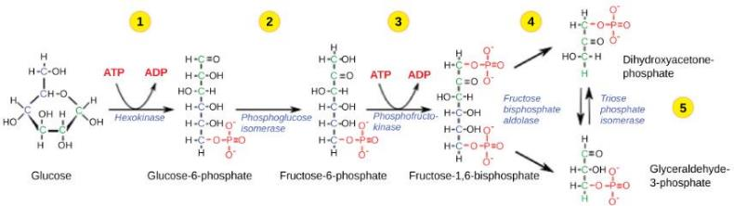
Figure 7.8
The first half of glycolysis uses two ATP molecules in the phosphorylation of glucose, which is then split into two three-carbon molecules.
This OpenStax ancillary resource is © Rice University under a CC-BY 4.0 International license; it may be reproduced or modified but must be attributed to OpenStax, Rice University and any changes must be noted. Any images credited to other sources are similarly available for reproduction, but must be attributed to their sources.

Slide 10
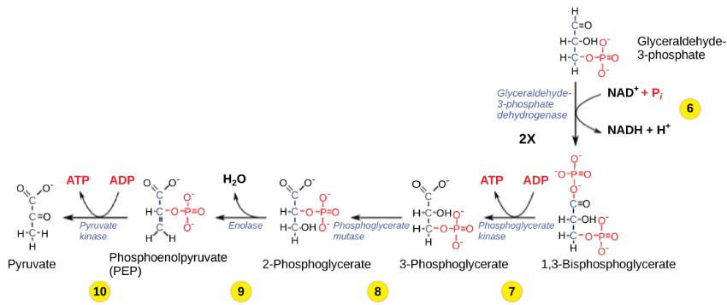
Figure 7.9
The second half of glycolysis involves phosphorylation without ATP investment (step 6) and produces two NADH and four ATP molecules per glucose.
This OpenStax ancillary resource is © Rice University under a CC-BY 4.0 International license; it may be reproduced or modified but must be attributed to OpenStax, Rice University and any changes must be noted. Any images credited to other sources are similarly available for reproduction, but must be attributed to their sources.

Slide 11
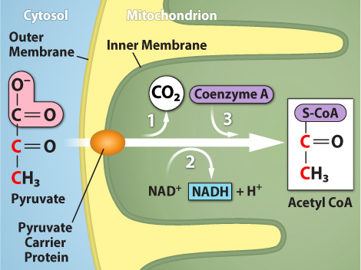
Figure 7.10
(credit: Rao, A., Ryan, K. and Tag, A. Department of Biology, Texas A&M University)
This OpenStax ancillary resource is © Rice University under a CC-BY 4.0 International license; it may be reproduced or modified but must be attributed to OpenStax, Rice University and any changes must be noted. Any images credited to other sources are similarly available for reproduction, but must be attributed to their sources.
Notes:
Upon entering the mitochondrial matrix, a multi-enzyme complex converts pyruvate into acetyl CoA. In the process, carbon dioxide is released and one molecule of NADH is formed.

Slide 12
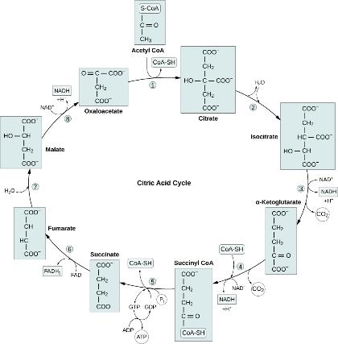
Figure 7.11
In the citric acid cycle, the acetyl group from acetyl CoA is attached to a four-carbon oxaloacetate molecule to form a six-carbon citrate molecule. Through a series of steps, citrate is oxidized, releasing two carbon dioxide molecules for each acetyl group fed into the cycle. In the process, three NAD⁺ molecules are reduced to NADH, one FAD molecule is reduced to FADH₂, and one ATP or GTP (depending on the cell type) is produced (by substrate-level phosphorylation). Because the final product of the citric acid cycle is also the first reactant, the cycle runs continuously in the presence of sufficient reactants.
(credit: Rao, A., Ryan, K., Tag, A., and Fletcher, S. Department of Biology, Texas A&M University)
This OpenStax ancillary resource is © Rice University under a CC-BY 4.0 International license; it may be reproduced or modified but must be attributed to OpenStax, Rice University and any changes must be noted. Any images credited to other sources are similarly available for reproduction, but must be attributed to their sources.

Slide 13
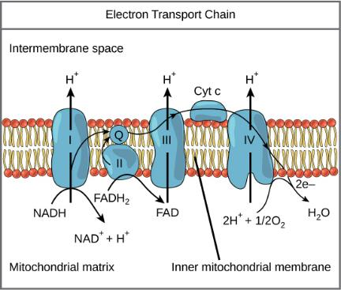
Figure 7.12
The electron transport chain is a series of electron transporters embedded in the inner mitochondrial membrane that shuttles electrons from NADH and FADH₂ to molecular oxygen. In the process, protons are pumped from the mitochondrial matrix to the intermembrane space, and oxygen is reduced to form water.
This OpenStax ancillary resource is © Rice University under a CC-BY 4.0 International license; it may be reproduced or modified but must be attributed to OpenStax, Rice University and any changes must be noted. Any images credited to other sources are similarly available for reproduction, but must be attributed to their sources.

Slide 14
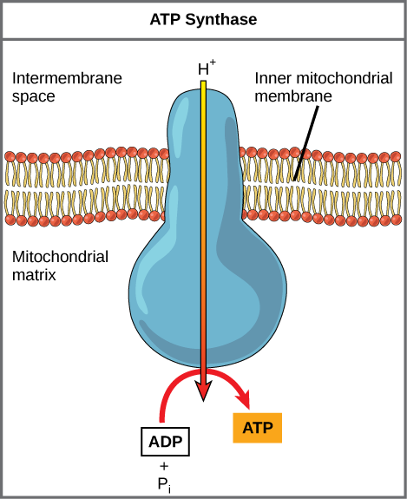
Figure 7.13
ATP synthase is a complex, molecular machine that uses a proton (H⁺) gradient to form ATP from ADP and inorganic phosphate (Pi).
(credit: modification of work by Klaus Hoffmeier)
This OpenStax ancillary resource is © Rice University under a CC-BY 4.0 International license; it may be reproduced or modified but must be attributed to OpenStax, Rice University and any changes must be noted. Any images credited to other sources are similarly available for reproduction, but must be attributed to their sources.

Slide 15
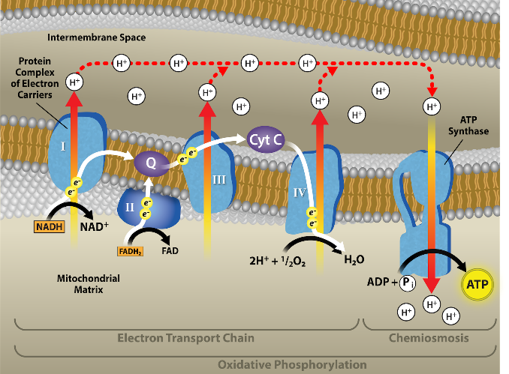
Figure 7.14
(credit: Rao, A., Ryan, K., Fletcher, S. and Tag, A. Department of Biology, Texas A&M University)
This OpenStax ancillary resource is © Rice University under a CC-BY 4.0 International license; it may be reproduced or modified but must be attributed to OpenStax, Rice University and any changes must be noted. Any images credited to other sources are similarly available for reproduction, but must be attributed to their sources.
Notes:
In oxidative phosphorylation, the pH gradient formed by the electron transport chain is used by ATP synthase to form ATP.

Slide 16
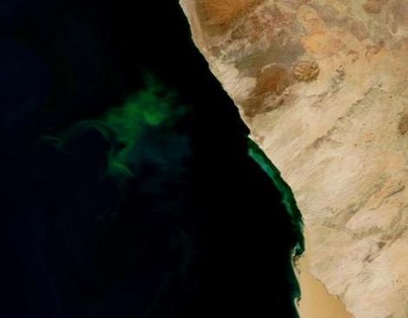
Figure 7.15
The green color seen in these coastal waters is from an eruption of hydrogen sulfide-producing bacteria. These anaerobic, sulfate-reducing bacteria release hydrogen sulfide gas as they decompose algae in the water.
(credit: modification of work by NASA/Jeff Schmaltz, MODIS Land Rapid Response Team at NASA GSFC, Visible Earth Catalog of NASA images)
This OpenStax ancillary resource is © Rice University under a CC-BY 4.0 International license; it may be reproduced or modified but must be attributed to OpenStax, Rice University and any changes must be noted. Any images credited to other sources are similarly available for reproduction, but must be attributed to their sources.

Slide 17
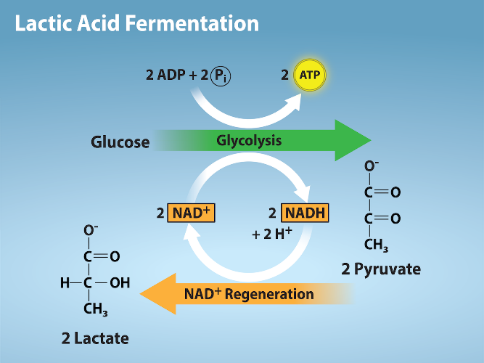
Figure 7.16
(credit: Rao, A., Ryan, K., Fletcher, S. and Tag, A. Department of Biology, Texas A&M University)
This OpenStax ancillary resource is © Rice University under a CC-BY 4.0 International license; it may be reproduced or modified but must be attributed to OpenStax, Rice University and any changes must be noted. Any images credited to other sources are similarly available for reproduction, but must be attributed to their sources.
Notes:
During glycolysis, glucose is oxidized to pyruvate while NAD+ is reduced to NADH. Two molecules of ATP are also produced by substrate level phosphorylation. In the absence of oxygen in some cell types, fermentation allows the reduction of pyruvate to lactate and the reoxidation of NADH to NAD+. The regeneration of NAD+ allows glycolysis to continue to make ATP by substrate level phosphorylation.

Slide 18
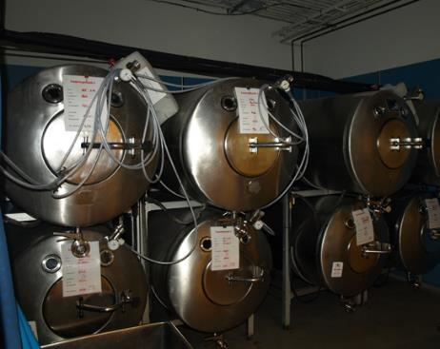
Figure 7.17
Fermentation of grape juice into wine produces CO₂ as a byproduct. Fermentation tanks have valves so that the pressure inside the tanks created by the carbon dioxide produced can be released.
This OpenStax ancillary resource is © Rice University under a CC-BY 4.0 International license; it may be reproduced or modified but must be attributed to OpenStax, Rice University and any changes must be noted. Any images credited to other sources are similarly available for reproduction, but must be attributed to their sources.

Slide 19
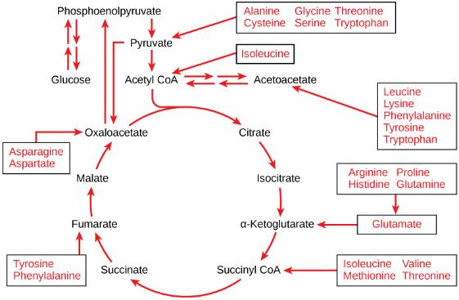
Figure 7.18
The carbon skeletons of certain amino acids (indicated in boxes) derived from proteins can feed into the citric acid cycle.
(credit: modification of work by Mikael Häggström)
This OpenStax ancillary resource is © Rice University under a CC-BY 4.0 International license; it may be reproduced or modified but must be attributed to OpenStax, Rice University and any changes must be noted. Any images credited to other sources are similarly available for reproduction, but must be attributed to their sources.

Slide 20
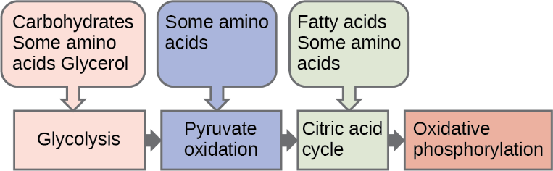
Figure 7.19
Glycogen from the liver and muscles, hydrolyzed into glucose-1-phosphate, together with fats and proteins, can feed into the catabolic pathways for carbohydrates.
This OpenStax ancillary resource is © Rice University under a CC-BY 4.0 International license; it may be reproduced or modified but must be attributed to OpenStax, Rice University and any changes must be noted. Any images credited to other sources are similarly available for reproduction, but must be attributed to their sources.

Slide 21
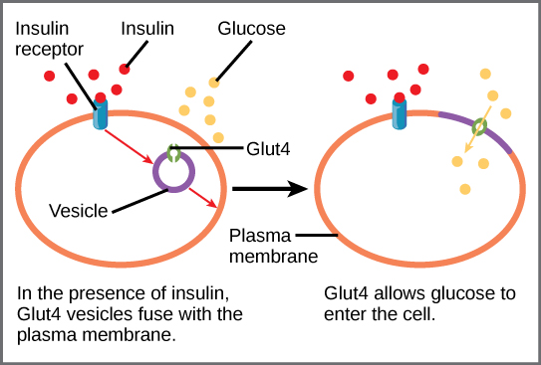
Figure 7.20
GLUT4 is a glucose transporter that is stored in vesicles. A cascade of events that occurs upon insulin binding to a receptor in the plasma membrane causes GLUT4-containing vesicles to fuse with the plasma membrane so that glucose may be transported into the cell.
This OpenStax ancillary resource is © Rice University under a CC-BY 4.0 International license; it may be reproduced or modified but must be attributed to OpenStax, Rice University and any changes must be noted. Any images credited to other sources are similarly available for reproduction, but must be attributed to their sources.

Slide 22
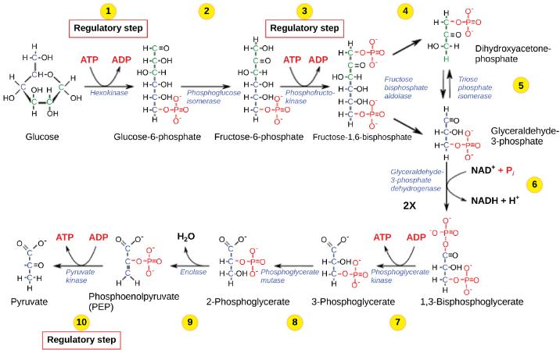
Figure 7.21
The glycolysis pathway is primarily regulated at the three key enzymatic steps (1, 2, and 7) as indicated. Note that the first two steps that are regulated occur early in the pathway and involve hydrolysis of ATP.
This OpenStax ancillary resource is © Rice University under a CC-BY 4.0 International license; it may be reproduced or modified but must be attributed to OpenStax, Rice University and any changes must be noted. Any images credited to other sources are similarly available for reproduction, but must be attributed to their sources.

