Slide 1

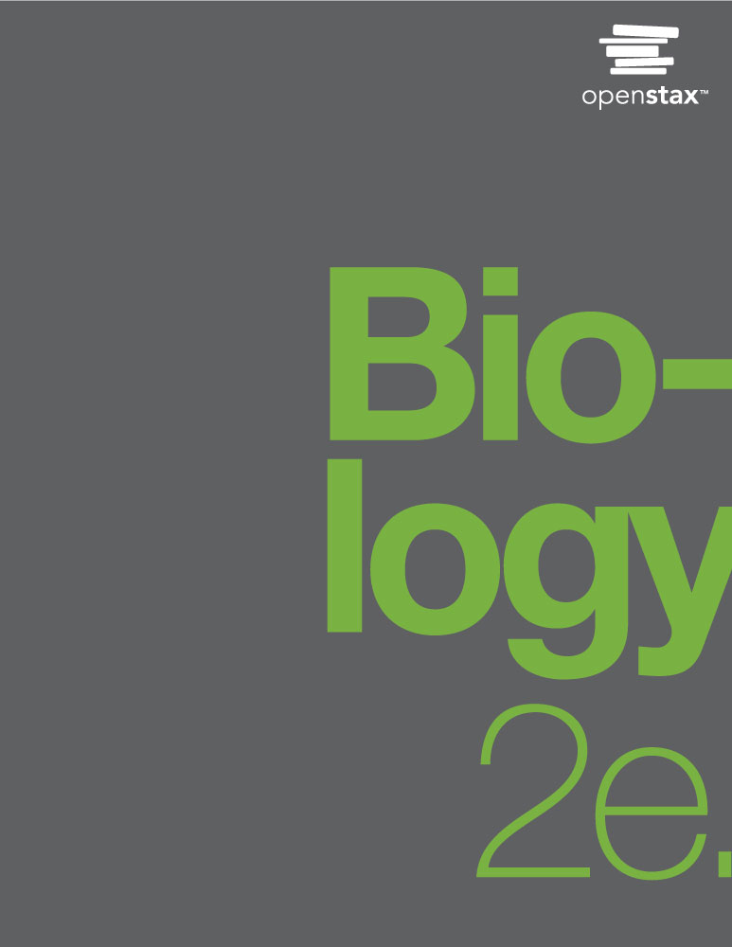
Biology 2e
Chapter 8 PHOTOSYNTHESIS
PowerPoint Image Slide Show

Slide 2
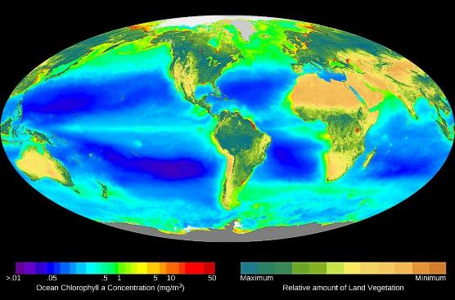
Figure 8.1
This world map shows Earth’s distribution of photosynthesis as seen via chlorophyll a concentrations. On land, this is evident via terrestrial plants, and in oceanic zones, via phytoplankton.
(credit: modification of work by SeaWiFS Project, NASA/Goddard Space Flight Center and ORBIMAGE)
This OpenStax ancillary resource is © Rice University under a CC-BY 4.0 International license; it may be reproduced or modified but must be attributed to OpenStax, Rice University and any changes must be noted. Any images credited to other sources are similarly available for reproduction, but must be attributed to their sources.

Slide 3
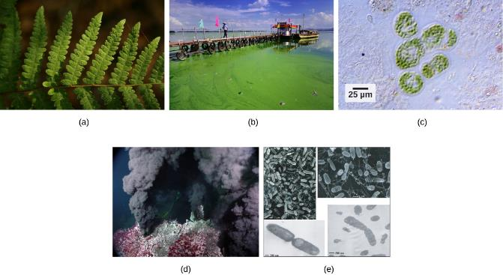
Figure 8.2
Photoautotrophs, including (a) plants, (b) algae, and (c) cyanobacteria, synthesize their organic compounds via photosynthesis using sunlight as an energy source. In a (d) deep sea vent, chemoautotrophs, such as these (e) thermophilic bacteria, capture energy from inorganic compounds to produce organic compounds.
(credit a: modification of work by Steve Hillebrand, U.S. Fish and Wildlife Service; credit b: modification of work by "eutrophication&hypoxia"/Flickr; credit c: modification of work by NASA; credit d: University of Washington, NOAA; credit e: modification of work by Mark Amend, West Coast and Polar Regions Undersea Research Center, UAF, NOAA)
This OpenStax ancillary resource is © Rice University under a CC-BY 4.0 International license; it may be reproduced or modified but must be attributed to OpenStax, Rice University and any changes must be noted. Any images credited to other sources are similarly available for reproduction, but must be attributed to their sources.

Slide 4
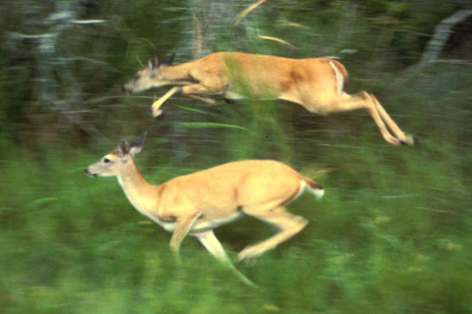
Figure 8.3
The energy stored in carbohydrate molecules from photosynthesis passes through the food chain. The predator that eats these deer receives a portion of the energy that originated in the photosynthetic vegetation that the deer consumed.
(credit: modification of work by Steve VanRiper, U.S. Fish and Wildlife Service)
This OpenStax ancillary resource is © Rice University under a CC-BY 4.0 International license; it may be reproduced or modified but must be attributed to OpenStax, Rice University and any changes must be noted. Any images credited to other sources are similarly available for reproduction, but must be attributed to their sources.

Slide 5
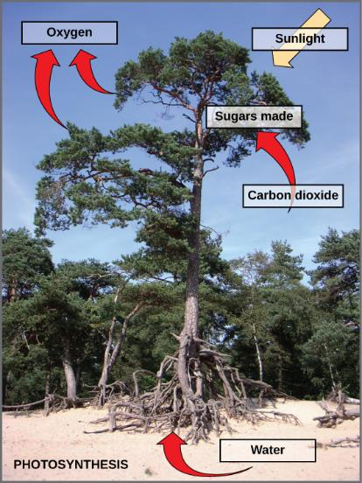
Figure 8.4
Photosynthesis uses solar energy, carbon dioxide, and water to produce energy-storing carbohydrates. Oxygen is generated as a waste product of photosynthesis.
This OpenStax ancillary resource is © Rice University under a CC-BY 4.0 International license; it may be reproduced or modified but must be attributed to OpenStax, Rice University and any changes must be noted. Any images credited to other sources are similarly available for reproduction, but must be attributed to their sources.

Slide 6
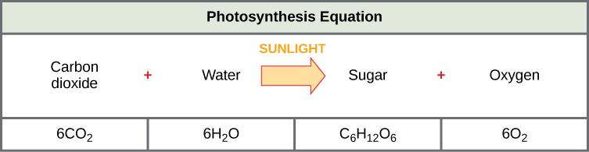
Figure 8.5
The basic equation for photosynthesis is deceptively simple. In reality, the process takes place in many steps involving intermediate reactants and products. Glucose, the primary energy source in cells, is made from two three-carbon GA3Ps.
This OpenStax ancillary resource is © Rice University under a CC-BY 4.0 International license; it may be reproduced or modified but must be attributed to OpenStax, Rice University and any changes must be noted. Any images credited to other sources are similarly available for reproduction, but must be attributed to their sources.

Slide 7
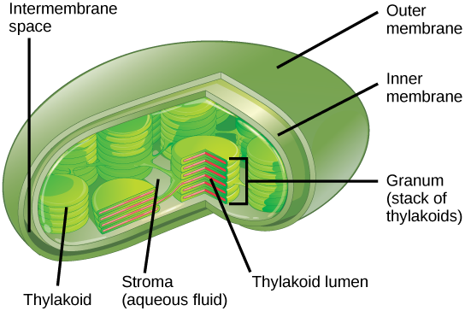
Figure 8.6
Photosynthesis takes place in chloroplasts, which have an outer membrane and an inner membrane. Stacks of thylakoids called grana form a third membrane layer.
This OpenStax ancillary resource is © Rice University under a CC-BY 4.0 International license; it may be reproduced or modified but must be attributed to OpenStax, Rice University and any changes must be noted. Any images credited to other sources are similarly available for reproduction, but must be attributed to their sources.

Slide 8
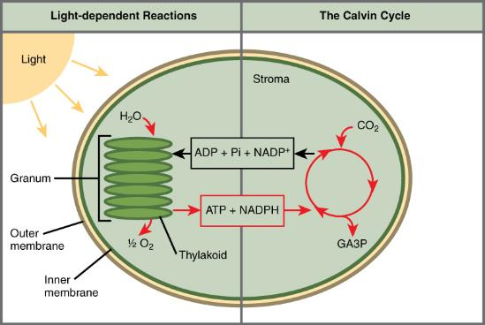
Figure 8.7
Photosynthesis takes place in two stages: light dependent reactions and the Calvin cycle. Light-dependent reactions, which take place in the thylakoid membrane, use light energy to make ATP and NADPH. The Calvin cycle, which takes place in the stroma, uses energy derived from these compounds to make GA3P from CO₂.
This OpenStax ancillary resource is © Rice University under a CC-BY 4.0 International license; it may be reproduced or modified but must be attributed to OpenStax, Rice University and any changes must be noted. Any images credited to other sources are similarly available for reproduction, but must be attributed to their sources.

Slide 9
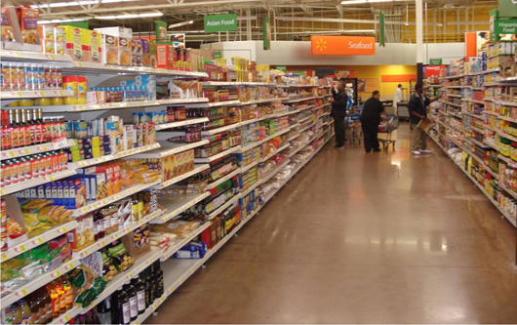
Figure 8.8
Foods that humans consume originate from photosynthesis.
(credit: Associaçäo Brasileira de Supermercados)
This OpenStax ancillary resource is © Rice University under a CC-BY 4.0 International license; it may be reproduced or modified but must be attributed to OpenStax, Rice University and any changes must be noted. Any images credited to other sources are similarly available for reproduction, but must be attributed to their sources.

Slide 10
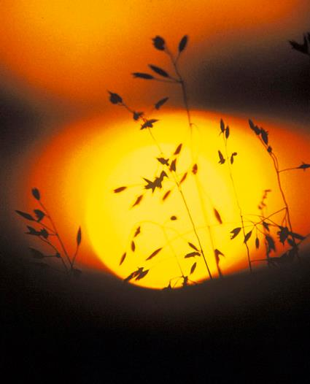
Figure 8.9
Photoautotrophs can capture light energy from the sun, converting it into the chemical energy used to build food molecules.
(credit: Gerry Atwell)
This OpenStax ancillary resource is © Rice University under a CC-BY 4.0 International license; it may be reproduced or modified but must be attributed to OpenStax, Rice University and any changes must be noted. Any images credited to other sources are similarly available for reproduction, but must be attributed to their sources.

Slide 11
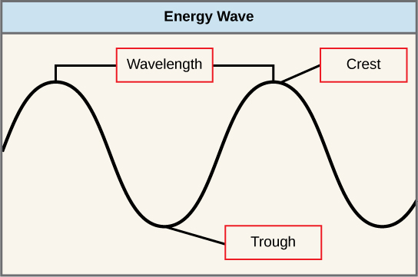
Figure 8.10
The wavelength of a single wave is the distance between two consecutive points of similar position (two crests or two troughs) along the wave.
This OpenStax ancillary resource is © Rice University under a CC-BY 4.0 International license; it may be reproduced or modified but must be attributed to OpenStax, Rice University and any changes must be noted. Any images credited to other sources are similarly available for reproduction, but must be attributed to their sources.

Slide 12
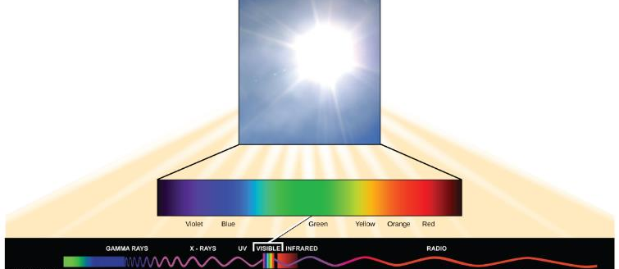
Figure 8.11
The sun emits energy in the form of electromagnetic radiation. This radiation exists at different wavelengths, each of which has its own characteristic energy. All electromagnetic radiation, including visible light, is characterized by its wavelength.
This OpenStax ancillary resource is © Rice University under a CC-BY 4.0 International license; it may be reproduced or modified but must be attributed to OpenStax, Rice University and any changes must be noted. Any images credited to other sources are similarly available for reproduction, but must be attributed to their sources.

Slide 13
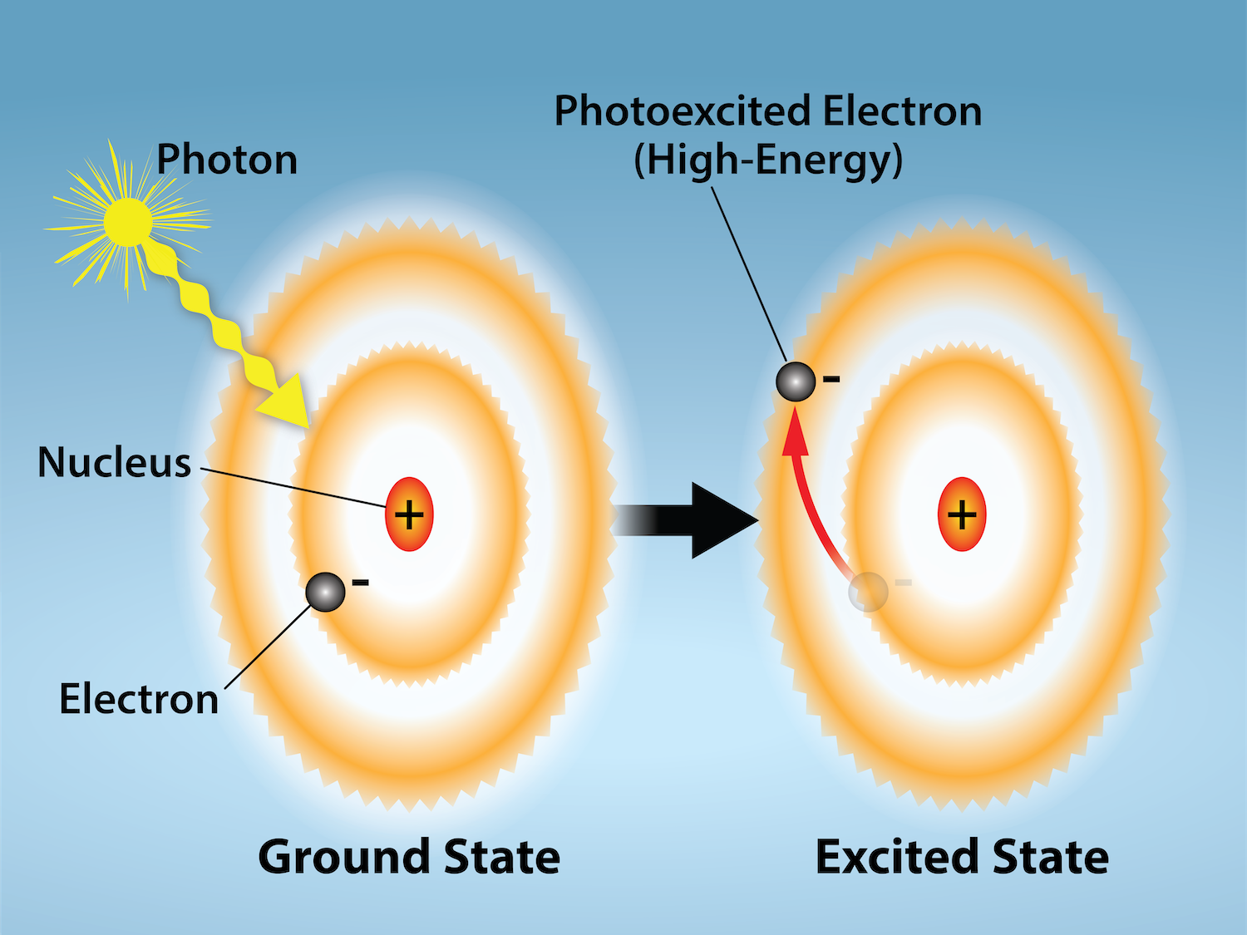
Figure 8.12
(credit: Rao, A. and Ryan, K. Department of Biology, Texas A&M University)
This OpenStax ancillary resource is © Rice University under a CC-BY 4.0 International license; it may be reproduced or modified but must be attributed to OpenStax, Rice University and any changes must be noted. Any images credited to other sources are similarly available for reproduction, but must be attributed to their sources.
Notes:
Light energy can excite electrons. When a photon of light energy interacts with an electron, the electron may absorb the energy and jump from its lowest energy ground state to an excited state.

Slide 14
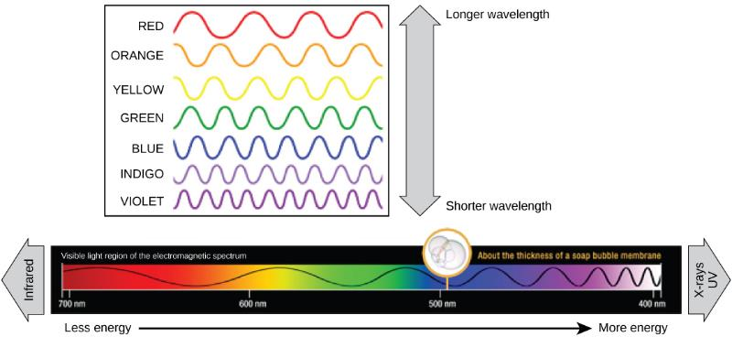
Figure 8.13
The colors of visible light do not carry the same amount of energy. Violet has the shortest wavelength and therefore carries the most energy, whereas red has the longest wavelength and carries the least amount of energy.
(credit: modification of work by NASA)
This OpenStax ancillary resource is © Rice University under a CC-BY 4.0 International license; it may be reproduced or modified but must be attributed to OpenStax, Rice University and any changes must be noted. Any images credited to other sources are similarly available for reproduction, but must be attributed to their sources.

Slide 15
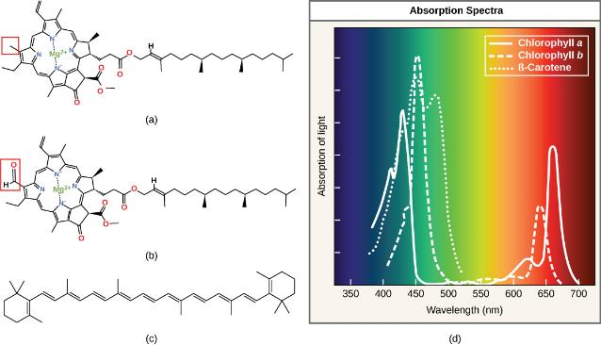
Figure 8.14
(a) Chlorophyll a, (b) chlorophyll b, and (c) β-carotene are hydrophobic organic pigments found in the thylakoid membrane. Chlorophyll a and b, which are identical except for the part indicated in the red box, are responsible for the green color of leaves. β-carotene is responsible for the orange color in carrots. Each pigment has (d) a unique absorbance spectrum.
This OpenStax ancillary resource is © Rice University under a CC-BY 4.0 International license; it may be reproduced or modified but must be attributed to OpenStax, Rice University and any changes must be noted. Any images credited to other sources are similarly available for reproduction, but must be attributed to their sources.

Slide 16
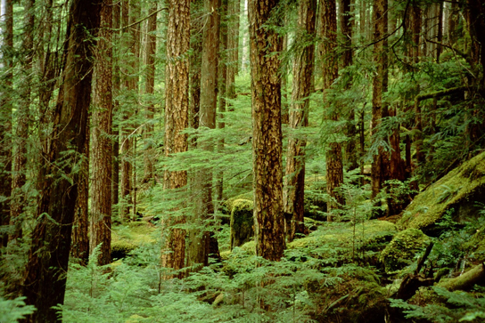
Figure 8.15
Plants that commonly grow in the shade have adapted to low levels of light by changing the relative concentrations of their chlorophyll pigments.
(credit: Jason Hollinger)
This OpenStax ancillary resource is © Rice University under a CC-BY 4.0 International license; it may be reproduced or modified but must be attributed to OpenStax, Rice University and any changes must be noted. Any images credited to other sources are similarly available for reproduction, but must be attributed to their sources.

Slide 17
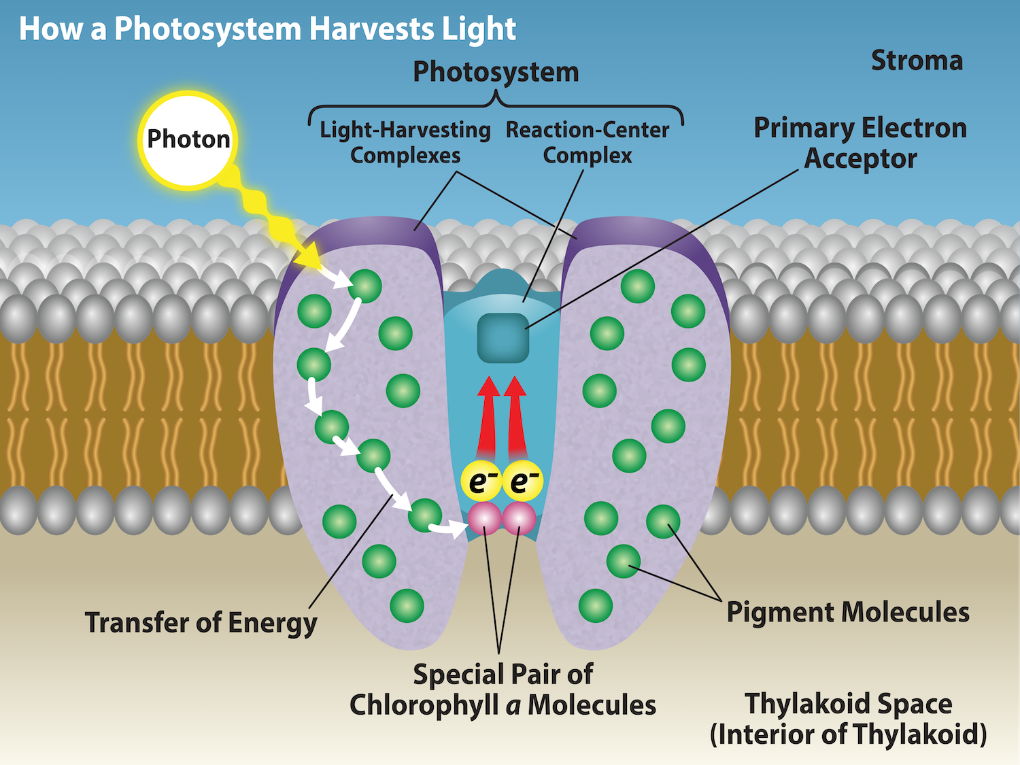
Figure 8.16
(credit: Rao, A., Ryan, K., Fletcher, S. and Hawkins, A. Department of Biology, Texas A&M University)
This OpenStax ancillary resource is © Rice University under a CC-BY 4.0 International license; it may be reproduced or modified but must be attributed to OpenStax, Rice University and any changes must be noted. Any images credited to other sources are similarly available for reproduction, but must be attributed to their sources.
Notes:
A photosystem consists of 1) a light-harvesting complex and 2) a reaction center. Pigments in the light-harvesting complex pass light energy to two special chlorophyll a molecules in the reaction center. The light excites an electron from the chlorophyll a pair, which passes to the primary electron acceptor. The excited electron must then be replaced.

Slide 18
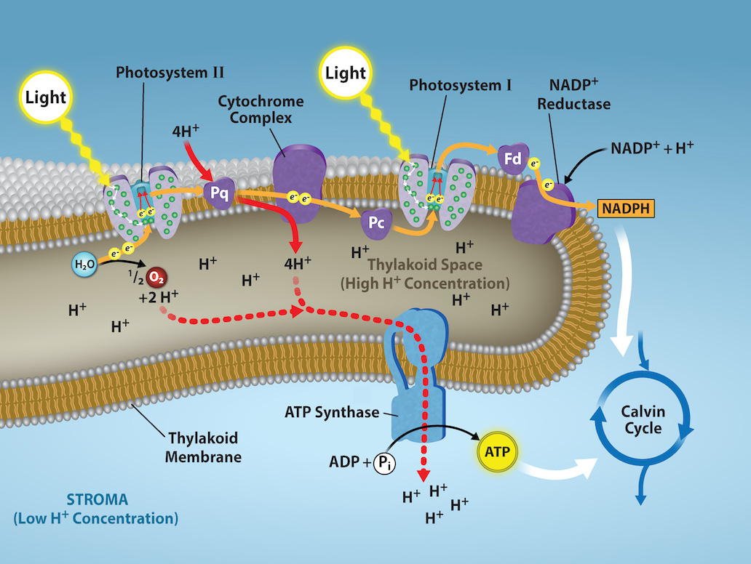
Figure 8.17
(credit: Rao, A., Ryan, K., Fletcher, S. Department of Biology, Texas A&M University)
This OpenStax ancillary resource is © Rice University under a CC-BY 4.0 International license; it may be reproduced or modified but must be attributed to OpenStax, Rice University and any changes must be noted. Any images credited to other sources are similarly available for reproduction, but must be attributed to their sources.
Notes:
In the photosystem II (PSII) reaction center, energy from sunlight is used to extract electrons from water. The electrons travel through the chloroplast electron transport chain to photosystem I (PSI), which reduces NADP⁺ to NADPH. The electron transport chain moves protons across the thylakoid membrane into the lumen. At the same time, splitting of water adds protons to the lumen, and reduction of NADPH removes protons from the stroma. The net result is a low pH in the thylakoid lumen, and a high pH in the stroma. ATP synthase uses this electrochemical gradient to make ATP.

Slide 19
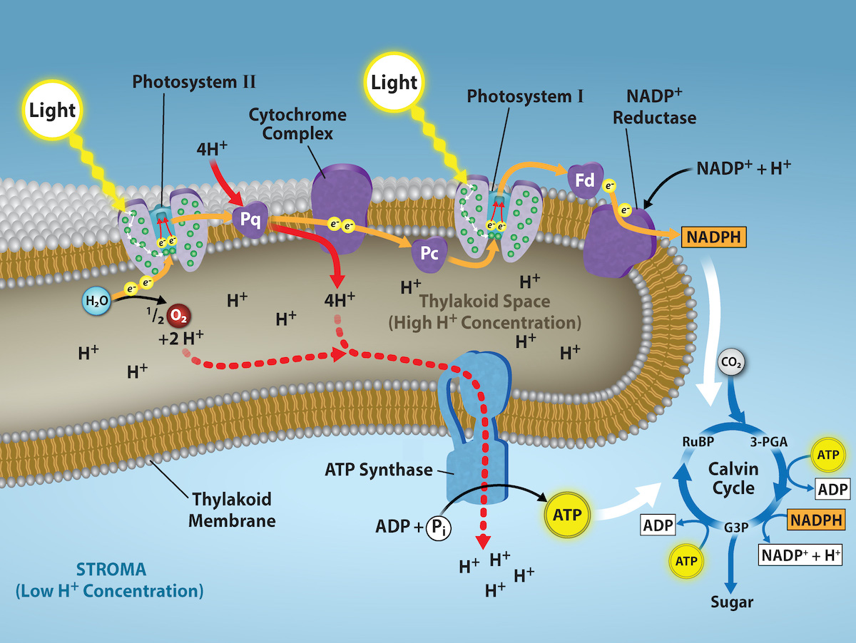
Figure 8.18
(credit: Rao, A., Ryan, K., Tag, A., Fletcher, S. and Hawkins, A. Department of Biology, Texas A&M University)
This OpenStax ancillary resource is © Rice University under a CC-BY 4.0 International license; it may be reproduced or modified but must be attributed to OpenStax, Rice University and any changes must be noted. Any images credited to other sources are similarly available for reproduction, but must be attributed to their sources.
Notes:
Light reactions harness energy from the sun to produce chemical bonds, ATP, and NADPH. These energy-carrying molecules are made in the stroma where carbon fixation takes place.

Slide 20
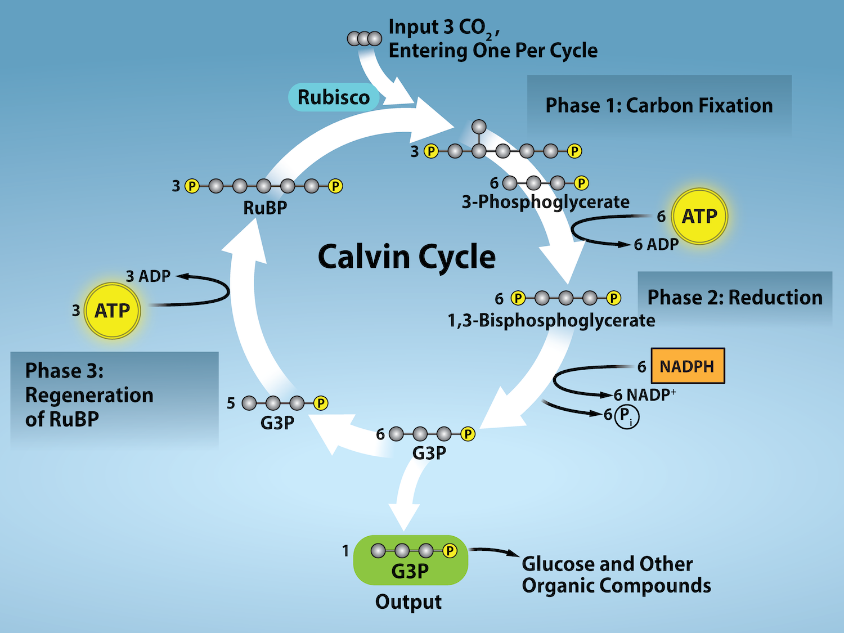
Figure 8.19
(credit: Rao, A., Ryan, K., Tag, A., Fletcher, S. and Hawkins, A. Department of Biology, Texas A&M University)
This OpenStax ancillary resource is © Rice University under a CC-BY 4.0 International license; it may be reproduced or modified but must be attributed to OpenStax, Rice University and any changes must be noted. Any images credited to other sources are similarly available for reproduction, but must be attributed to their sources.
Notes:
The Calvin cycle has three stages. In stage 1, the enzyme RuBisCO incorporates carbon dioxide into an organic molecule, 3-PGA. In stage 2, the organic molecule is reduced using electrons supplied by NADPH. In stage 3, RuBP, the molecule that starts the cycle, is regenerated so that the cycle can continue. Only one carbon dioxide molecule is incorporated at a time, so the cycle must be completed three times to produce a single three-carbon G3P molecule, and six times to produce a six-carbon glucose molecule.

Slide 21
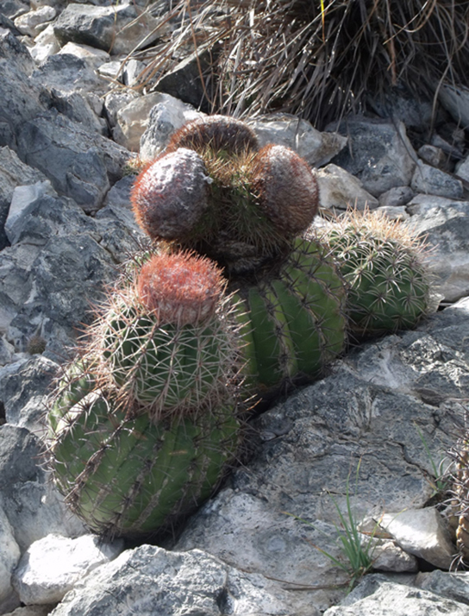
Figure 8.20
The harsh conditions of the desert have led plants like these cacti to evolve variations of the light-independent reactions of photosynthesis. These variations increase the efficiency of water usage, helping to conserve water and energy.
(credit: Piotr Wojtkowski))
This OpenStax ancillary resource is © Rice University under a CC-BY 4.0 International license; it may be reproduced or modified but must be attributed to OpenStax, Rice University and any changes must be noted. Any images credited to other sources are similarly available for reproduction, but must be attributed to their sources.

Slide 22
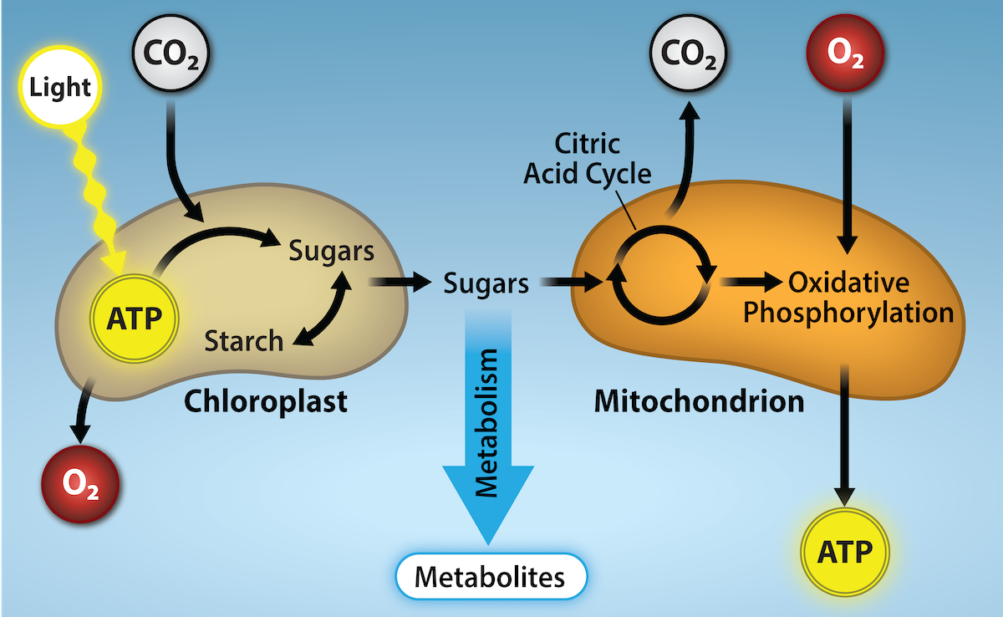
Figure 8.21
Connection between Photosynthesis and Respiration Photosynthesis in chloroplasts is the process by which light energy is converted to chemical energy and stored in sugars. Initially, the light energy is converted into chemical energy during ATP synthesis in a process that gives off oxygen. The energy in ATP is then used to reduce CO2 to simple sugars. In contrast, cellular respiration is the process in which the chemical energy stored in sugars is converted into ATP, a source of chemical energy that can be used by the rest of the cell. In the process of converting the energy stored in the sugars to ATP, CO2 is released and oxygen is consumed.
(credit: Rao, A., Ryan, and Tag, A. Department of Biology, Texas A&M University)
This OpenStax ancillary resource is © Rice University under a CC-BY 4.0 International license; it may be reproduced or modified but must be attributed to OpenStax, Rice University and any changes must be noted. Any images credited to other sources are similarly available for reproduction, but must be attributed to their sources.

Slide 23
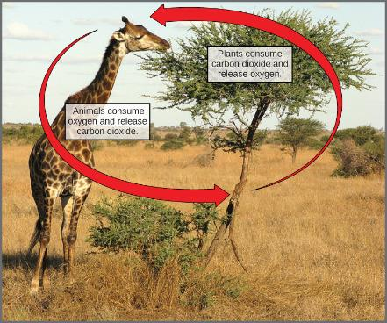
Figure 8.22
Photosynthesis consumes carbon dioxide and produces oxygen. Aerobic respiration consumes oxygen and produces carbon dioxide. These two processes play an important role in the carbon cycle.
(credit: modification of work by Stuart Bassil)
This OpenStax ancillary resource is © Rice University under a CC-BY 4.0 International license; it may be reproduced or modified but must be attributed to OpenStax, Rice University and any changes must be noted. Any images credited to other sources are similarly available for reproduction, but must be attributed to their sources.

