Slide 1


Biology 2e
Chapter 9 CELL COMMUNICATION
PowerPoint Image Slide Show

Slide 2

Figure 9.1
Have you ever become separated from a friend while in a crowd? If so, you know the challenge of searching for someone when surrounded by thousands of other people. If you and your friend have cell phones, your chances of finding each other are good. A cell phone’s ability to send and receive messages makes it an ideal communication device.
(credit: modification of work by Vincent and Bella Productions)
This OpenStax ancillary resource is © Rice University under a CC-BY 4.0 International license; it may be reproduced or modified but must be attributed to OpenStax, Rice University and any changes must be noted. Any images credited to other sources are similarly available for reproduction, but must be attributed to their sources.

Slide 3
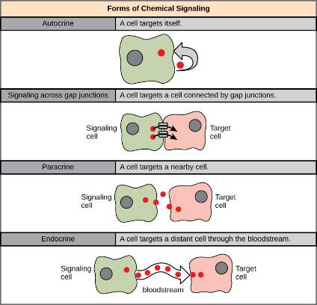
Figure 9.2
In chemical signaling, a cell may target itself (autocrine signaling), a cell connected by gap junctions, a nearby cell (paracrine signaling), or a distant cell (endocrine signaling). Paracrine signaling acts on nearby cells, endocrine signaling uses the circulatory system to transport ligands, and autocrine signaling acts on the signaling cell. Signaling via gap junctions involves signaling molecules moving directly between adjacent cells.
This OpenStax ancillary resource is © Rice University under a CC-BY 4.0 International license; it may be reproduced or modified but must be attributed to OpenStax, Rice University and any changes must be noted. Any images credited to other sources are similarly available for reproduction, but must be attributed to their sources.

Slide 4
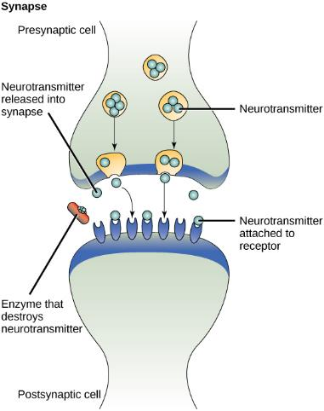
Figure 9.3
The distance between the presynaptic cell and the postsynaptic cell—called the synaptic gap—is very small and allows for rapid diffusion of the neurotransmitter. Enzymes in the synaptic cleft degrade some types of neurotransmitters to terminate the signal.
This OpenStax ancillary resource is © Rice University under a CC-BY 4.0 International license; it may be reproduced or modified but must be attributed to OpenStax, Rice University and any changes must be noted. Any images credited to other sources are similarly available for reproduction, but must be attributed to their sources.

Slide 5
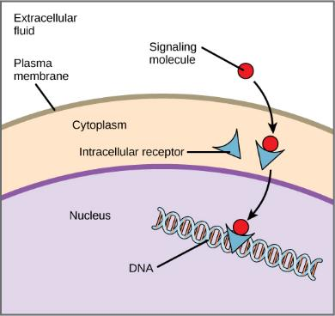
Figure 9.4
Hydrophobic signaling molecules typically diffuse across the plasma membrane and interact with intracellular receptors in the cytoplasm. Many intracellular receptors are transcription factors that interact with DNA in the nucleus and regulate gene expression.
This OpenStax ancillary resource is © Rice University under a CC-BY 4.0 International license; it may be reproduced or modified but must be attributed to OpenStax, Rice University and any changes must be noted. Any images credited to other sources are similarly available for reproduction, but must be attributed to their sources.

Slide 6
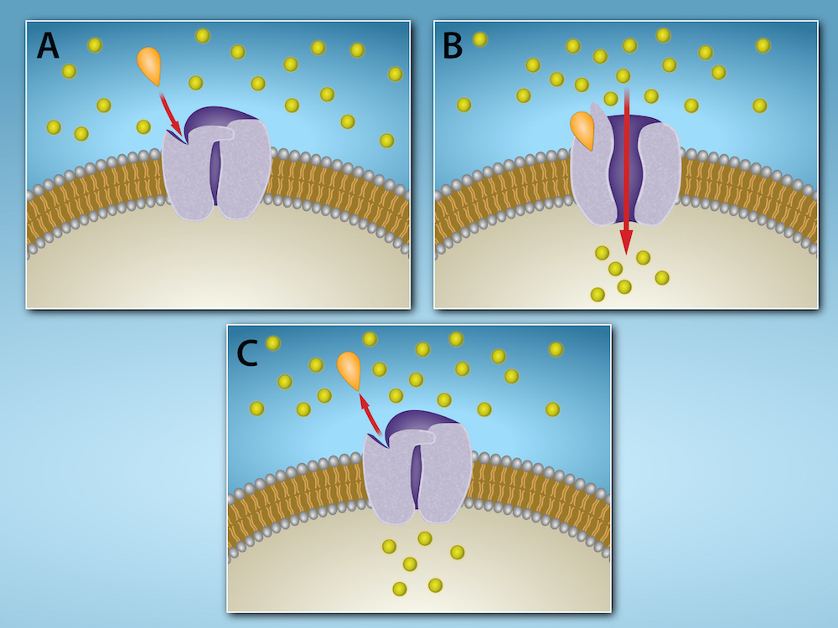
Figure 9.5
Gated ion channels located in the plasma membrane allow for the controlled flow of ions into and out of the cell. The channel proteins remain closed until a signaling molecule (orange teardrop) binds to the channel protein. Then the channel protein changes conformation and allows ions (yellow circles) to flow into (or out of) the cell. When the signaling molecule is released, the channel protein resumes its closed conformation, preventing ion flow.
(credit: Rao, A. and Fletcher, S. Department of Biology, Texas A&M University)
This OpenStax ancillary resource is © Rice University under a CC-BY 4.0 International license; it may be reproduced or modified but must be attributed to OpenStax, Rice University and any changes must be noted. Any images credited to other sources are similarly available for reproduction, but must be attributed to their sources.

Slide 7
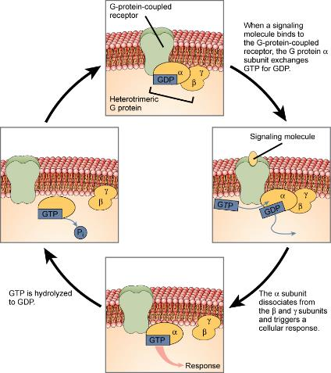
Figure 9.6
Heterotrimeric G proteins have three subunits: α, β, and γ. When a signaling molecule binds to a G-protein-coupled receptor in the plasma membrane, a GDP molecule associated with theα subunit is exchanged for GTP. The β and γ subunits dissociate from the α subunit, and a cellular response is triggered either by the α subunit or the dissociated βγ pair. Hydrolysis of GTP to GDP terminates the signal.
This OpenStax ancillary resource is © Rice University under a CC-BY 4.0 International license; it may be reproduced or modified but must be attributed to OpenStax, Rice University and any changes must be noted. Any images credited to other sources are similarly available for reproduction, but must be attributed to their sources.

Slide 8

Figure 9.7
Transmitted primarily through contaminated drinking water, cholera is a major cause of death in the developing world and in areas where natural disasters interrupt the availability of clean water. Modern sanitation eliminates the threat of cholera outbreaks, such as the one that swept through New York City in 1866. This poster from that era shows how, at that time, the way that the disease was transmitted was not understood.
(credit: New York City Sanitary Commission)
This OpenStax ancillary resource is © Rice University under a CC-BY 4.0 International license; it may be reproduced or modified but must be attributed to OpenStax, Rice University and any changes must be noted. Any images credited to other sources are similarly available for reproduction, but must be attributed to their sources.

Slide 9
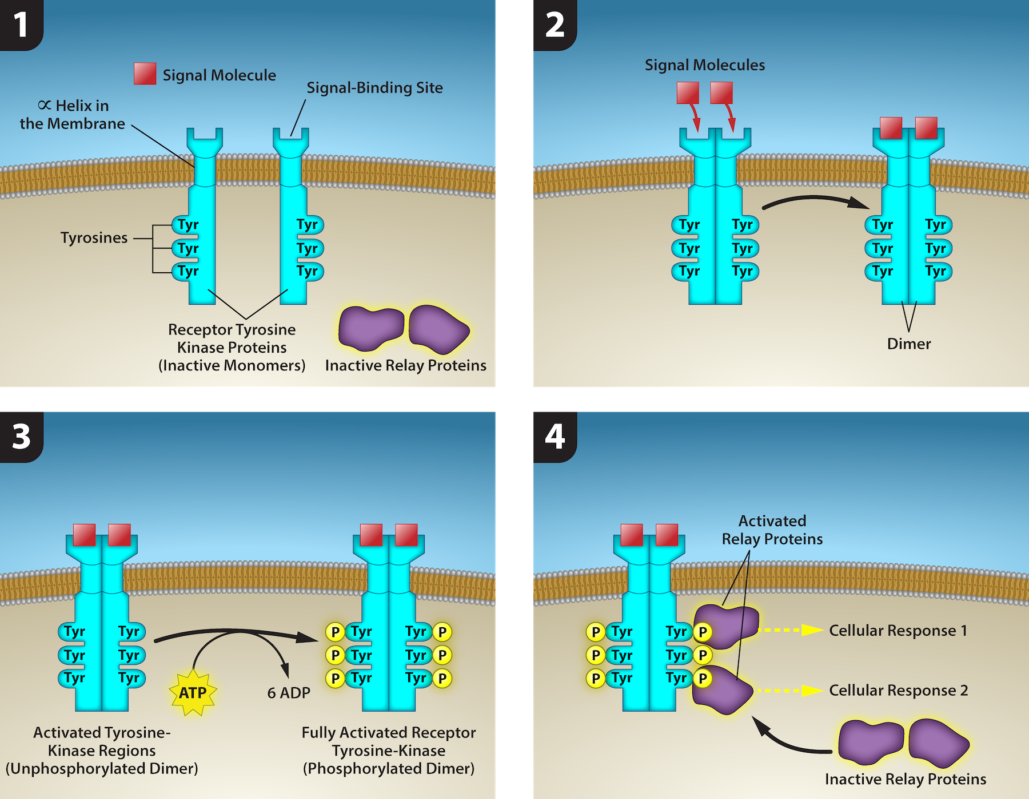
Figure 9.8
(credit: Rao, A., Ryan, K., Tag, A., Fletcher, S. and Hawkins, A. Department of Biology, Texas A&M University)
This OpenStax ancillary resource is © Rice University under a CC-BY 4.0 International license; it may be reproduced or modified but must be attributed to OpenStax, Rice University and any changes must be noted. Any images credited to other sources are similarly available for reproduction, but must be attributed to their sources.
Notes:
A receptor tyrosine kinase is an enzyme-linked receptor with a single helical transmembrane region, and extracellular and intracellular domains. 2) Binding of a signaling molecule to the extracellular domain causes the receptor to dimerize. 3) Tyrosine residues on the intracellular domain are then autophosphorylated, 4) triggering a downstream cellular response. The signal is terminated by a phosphatase that removes the phosphates from the phosphotyrosine residues.

Slide 10
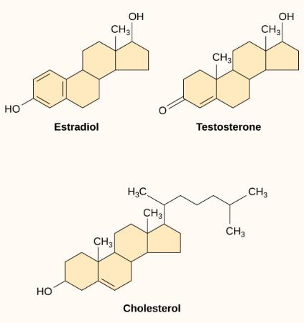
Figure 9.9
Steroid hormones have similar chemical structures to their precursor, cholesterol. Because these molecules are small and hydrophobic, they can diffuse directly across the plasma membrane into the cell, where they interact with internal receptors.
This OpenStax ancillary resource is © Rice University under a CC-BY 4.0 International license; it may be reproduced or modified but must be attributed to OpenStax, Rice University and any changes must be noted. Any images credited to other sources are similarly available for reproduction, but must be attributed to their sources.

Slide 11
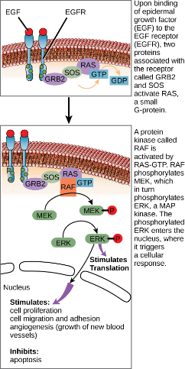
Figure 9.10
The epidermal growth factor (EGF) receptor (EGFR) is a receptor tyrosine kinase involved in the regulation of cell growth, wound healing, and tissue repair. When EGF binds to the EGFR, a cascade of downstream events causes the cell to grow and divide. If EGFR is activated at inappropriate times, uncontrolled cell growth may occur.
This OpenStax ancillary resource is © Rice University under a CC-BY 4.0 International license; it may be reproduced or modified but must be attributed to OpenStax, Rice University and any changes must be noted. Any images credited to other sources are similarly available for reproduction, but must be attributed to their sources.

Slide 12
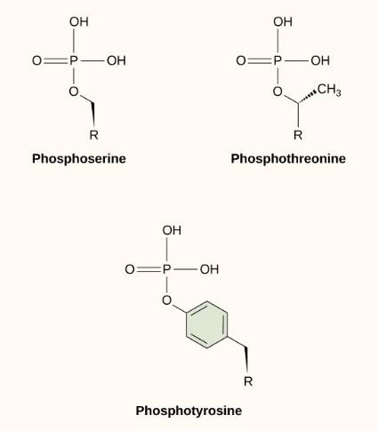
Figure 9.11
In protein phosphorylation, a phosphate group (PO₄⁻³ ) is added to residues of the amino acids serine, threonine, and tyrosine.
This OpenStax ancillary resource is © Rice University under a CC-BY 4.0 International license; it may be reproduced or modified but must be attributed to OpenStax, Rice University and any changes must be noted. Any images credited to other sources are similarly available for reproduction, but must be attributed to their sources.

Slide 13
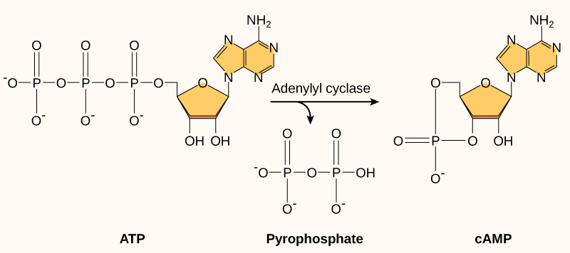
Figure 9.12
This diagram shows the mechanism for the formation of cyclic AMP (cAMP). cAMP serves as a second messenger to activate or inactivate proteins within the cell. Termination of the signal occurs when an enzyme called phosphodiesterase converts cAMP into AMP.
This OpenStax ancillary resource is © Rice University under a CC-BY 4.0 International license; it may be reproduced or modified but must be attributed to OpenStax, Rice University and any changes must be noted. Any images credited to other sources are similarly available for reproduction, but must be attributed to their sources.

Slide 14
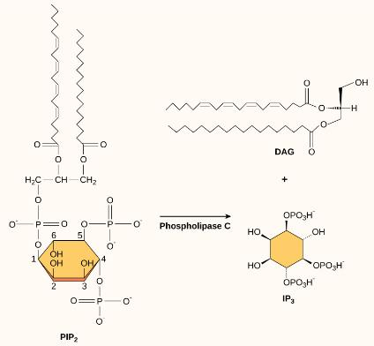
Figure 9.13
The enzyme phospholipase C breaks down PIP₂ into IP₃ and DAG, both of which serve as second messengers.
This OpenStax ancillary resource is © Rice University under a CC-BY 4.0 International license; it may be reproduced or modified but must be attributed to OpenStax, Rice University and any changes must be noted. Any images credited to other sources are similarly available for reproduction, but must be attributed to their sources.

Slide 15
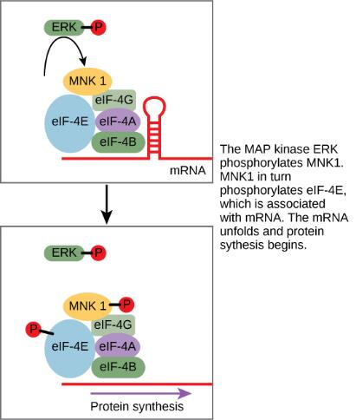
Figure 9.14
ERK is a MAP kinase that activates translation when it is phosphorylated. ERK phosphorylates MNK1, which in turn phosphorylates eIF-4E, an elongation initiation factor that, with other initiation factors, is associated with mRNA. When eIF-4E becomes phosphorylated, the mRNA unfolds, allowing protein synthesis in the nucleus to begin. (See Figure 9.10 for the phosphorylation pathway that activates ERK.)
This OpenStax ancillary resource is © Rice University under a CC-BY 4.0 International license; it may be reproduced or modified but must be attributed to OpenStax, Rice University and any changes must be noted. Any images credited to other sources are similarly available for reproduction, but must be attributed to their sources.

Slide 16
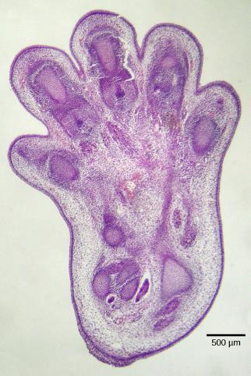
Figure 9.15
The histological section of a foot of a 15-day-old mouse embryo, visualized using light microscopy, reveals areas of tissue between the toes, which apoptosis will eliminate before the mouse reaches its full gestational age at 27 days.
(credit: modification of work by Michal Mañas)
This OpenStax ancillary resource is © Rice University under a CC-BY 4.0 International license; it may be reproduced or modified but must be attributed to OpenStax, Rice University and any changes must be noted. Any images credited to other sources are similarly available for reproduction, but must be attributed to their sources.

Slide 17
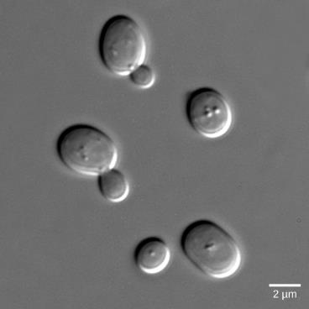
Figure 9.16
Budding Saccharomyces cerevisiae yeast cells can communicate by releasing a signaling molecule called mating factor. In this micrograph, they are visualized using differential interference contrast microscopy, a light microscopy technique that enhances the contrast of the sample.
This OpenStax ancillary resource is © Rice University under a CC-BY 4.0 International license; it may be reproduced or modified but must be attributed to OpenStax, Rice University and any changes must be noted. Any images credited to other sources are similarly available for reproduction, but must be attributed to their sources.

Slide 18
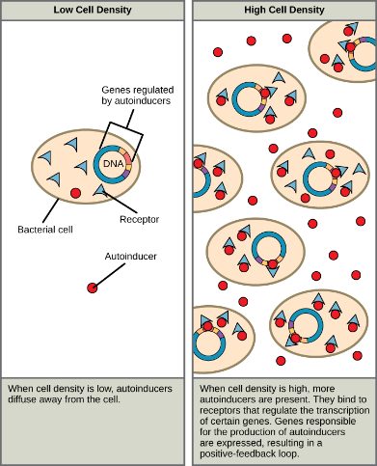
Figure 9.17
Autoinducers are small molecules or proteins produced by bacteria that regulate gene expression.
This OpenStax ancillary resource is © Rice University under a CC-BY 4.0 International license; it may be reproduced or modified but must be attributed to OpenStax, Rice University and any changes must be noted. Any images credited to other sources are similarly available for reproduction, but must be attributed to their sources.

Slide 19
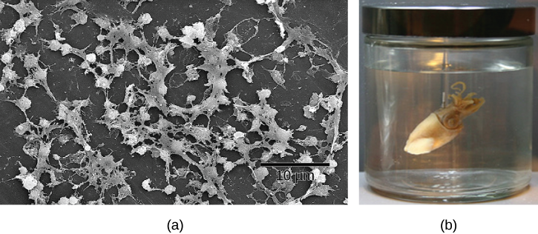
Figure 9.18
Cell-cell communication enables these (a) Staphylococcus aureus bacteria to work together to form a biofilm inside a hospital patient’s catheter, seen here via scanning electron microscopy. S. aureus is the main cause of hospital-acquired infections. (b) Hawaiian bobtail squid have a symbiotic relationship with the bioluminescent bacteria Vibrio fischeri. The luminescence makes it difficult to see the squid from below because it effectively eliminates its shadow. In return for camouflage, the squid provides food for the bacteria. Free-living V. fischeri do not produce luciferase, the enzyme responsible for luminescence, but V. fischeri living in a symbiotic relationship with the squid do. Quorum sensing determines whether the bacteria should produce the luciferase enzyme.
(credit a: modifications of work by CDC/Janice Carr; credit b: modifications of work by Cliff1066/Flickr)
This OpenStax ancillary resource is © Rice University under a CC-BY 4.0 International license; it may be reproduced or modified but must be attributed to OpenStax, Rice University and any changes must be noted. Any images credited to other sources are similarly available for reproduction, but must be attributed to their sources.

