Slide 1

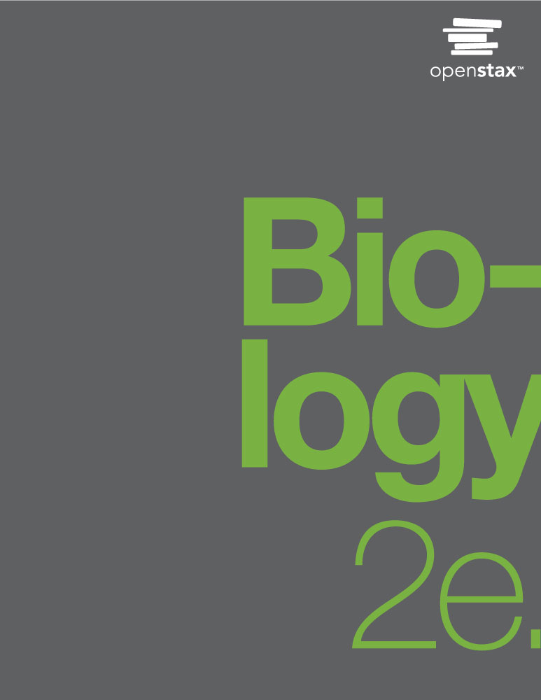
Biology 2e
Chapter 10 CELL REPRODUCTION
PowerPoint Image Slide Show

Slide 2
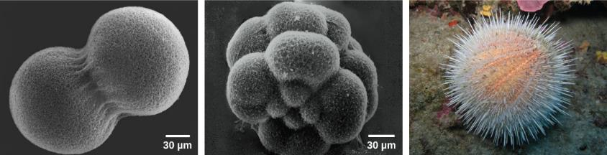
Figure 10.1
A sea urchin begins life as a single cell that (a) divides to form two cells, visible by scanning electron microscopy. After four rounds of cell division, (b) there are 16 cells, as seen in this SEM image. After many rounds of cell division, the individual develops into a complex, multicellular organism, as seen in this (c) mature sea urchin.
(credit a: modification of work by Evelyn Spiegel, Louisa Howard; credit b: modification of work by Evelyn Spiegel, Louisa Howard; credit c: modification of work by Marco Busdraghi; scale-bar data from Matt Russell)
This OpenStax ancillary resource is © Rice University under a CC-BY 4.0 International license; it may be reproduced or modified but must be attributed to OpenStax, Rice University and any changes must be noted. Any images credited to other sources are similarly available for reproduction, but must be attributed to their sources.

Slide 3
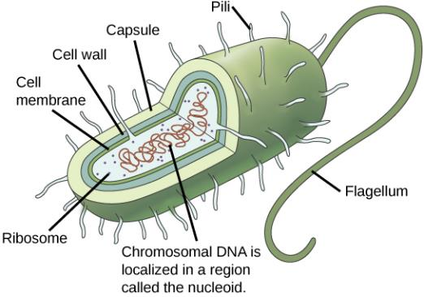
Figure 10.2
Prokaryotes, including bacteria and archaea, have a single, circular chromosome located in a central region called the nucleoid.
This OpenStax ancillary resource is © Rice University under a CC-BY 4.0 International license; it may be reproduced or modified but must be attributed to OpenStax, Rice University and any changes must be noted. Any images credited to other sources are similarly available for reproduction, but must be attributed to their sources.

Slide 4
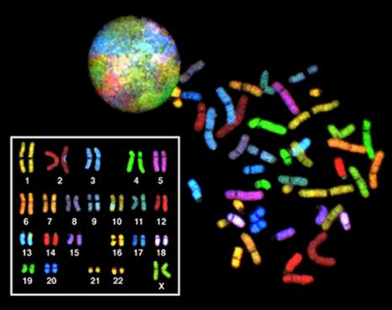
Figure 10.3
There are 23 pairs of homologous chromosomes in a female human somatic cell. The chromosomes are viewed within the nucleus (top), removed from a cell in mitosis and spread out on a slide (right), and artificially arranged according to length (left); an arrangement like this is called a karyotype. In this image, the chromosomes were exposed to fluorescent stains for differentiation of the different chromosomes. A method of staining called “chromosome painting” employs fluorescent dyes that highlight chromosomes in different colors.
(credit: National Human Genome Project/NIH)
This OpenStax ancillary resource is © Rice University under a CC-BY 4.0 International license; it may be reproduced or modified but must be attributed to OpenStax, Rice University and any changes must be noted. Any images credited to other sources are similarly available for reproduction, but must be attributed to their sources.

Slide 5
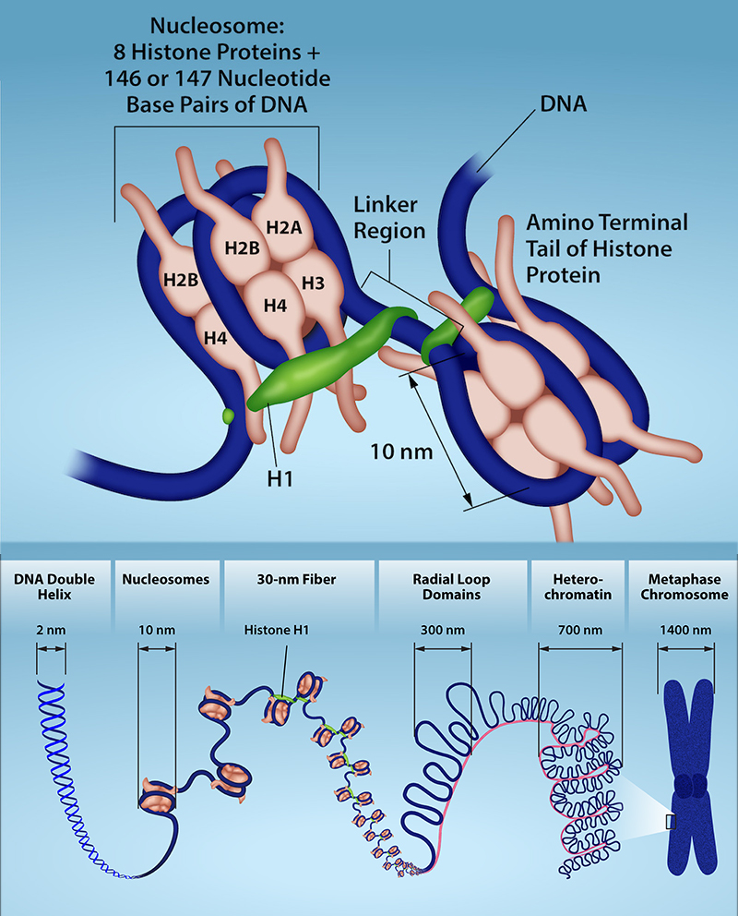
Figure 10.4
Each linear chromosome in a eukaryotic cell is packaged into chromatin, a combination of DNA and proteins. The double-stranded DNA helix associates with the core histones to form nucleosomes. These nucleosomes are further organized into a 30 nm fiber by the linker histone, H1. The fiber then associates with additional proteins to form loops and higher-order heterochromatin packing. DNA packing reaches its most condensed state during metaphase in mitosis in preparation for chromosome separation. Chromatin packing is dynamic and undergoes reversible changes in response to changes in gene expression and the cell cycle.
(credit: Rao, A., Ryan, K. Fletcher, S. Hawkins, A. and Tag, A. Department of Biology, Texas A&M University)
This OpenStax ancillary resource is © Rice University under a CC-BY 4.0 International license; it may be reproduced or modified but must be attributed to OpenStax, Rice University and any changes must be noted. Any images credited to other sources are similarly available for reproduction, but must be attributed to their sources.

Slide 6
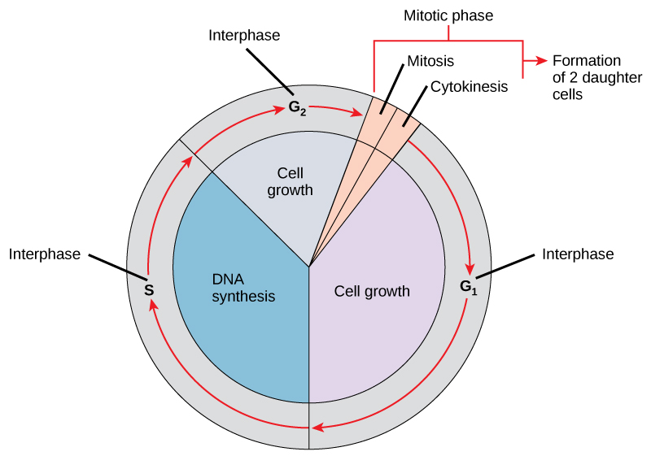
Figure 10.5
The cell cycle consists of interphase and the mitotic phase. During interphase, the cell grows and the nuclear DNA is duplicated. Interphase is followed by the mitotic phase. During the mitotic phase, the duplicated chromosomes are segregated and distributed into daughter nuclei. The cytoplasm is usually divided as well, resulting in two daughter cells.
This OpenStax ancillary resource is © Rice University under a CC-BY 4.0 International license; it may be reproduced or modified but must be attributed to OpenStax, Rice University and any changes must be noted. Any images credited to other sources are similarly available for reproduction, but must be attributed to their sources.

Slide 7
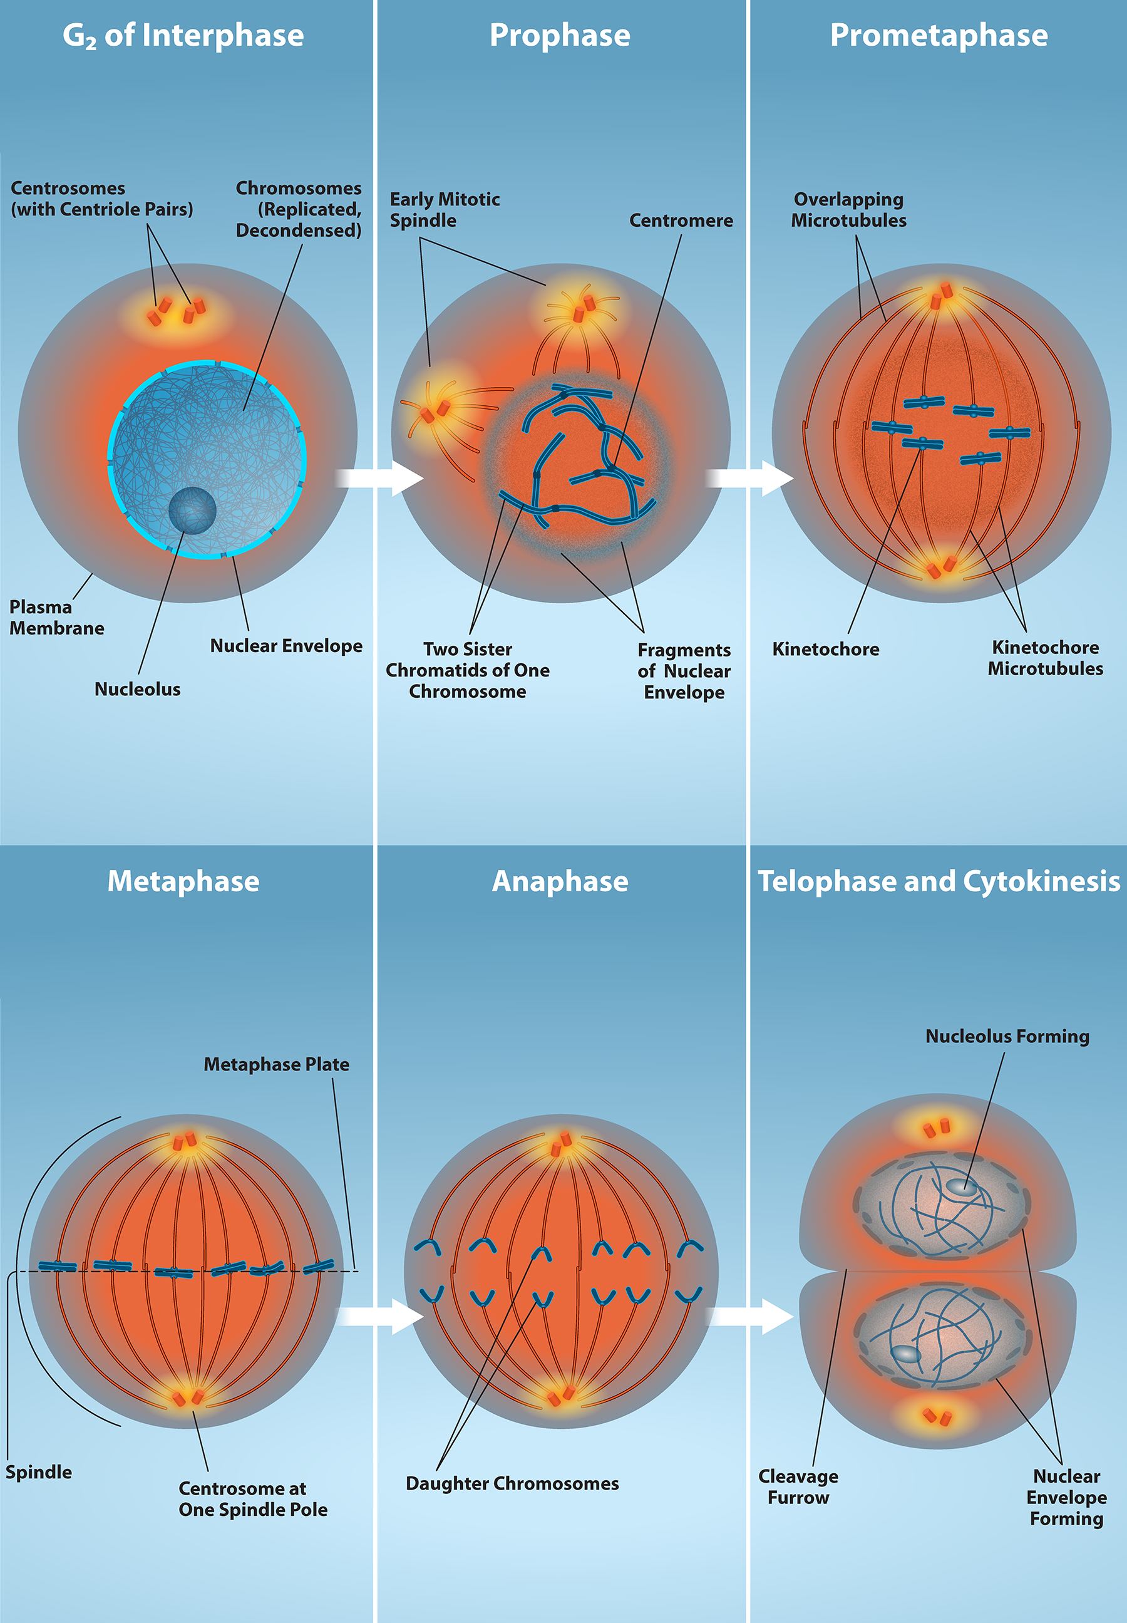
Figure 10.6
The last stage of interphase is the second gap period, G2. During this stage, cells grow, replenish energy and synthesize needed macromolecules, such as proteins and lipids.
(credit: Rao, A., Ryan, K. Fletcher, S. Hawkins, A. and Tag, A. Department of Biology, Texas A&M University)
This OpenStax ancillary resource is © Rice University under a CC-BY 4.0 International license; it may be reproduced or modified but must be attributed to OpenStax, Rice University and any changes must be noted. Any images credited to other sources are similarly available for reproduction, but must be attributed to their sources.
Notes:
Mitosis - When G2 is complete, the cell will enter mitosis. Although there are 5 phases in mitosis, with the exception of the metaphase to anaphase transition, these phases are not discrete and happen as a continuous process. Prophase is the first stage in mitosis. The nuclear envelope begins to break down and chromosomes condense and are now visible. Spindle fibers start to appear and centrosomes begin to move towards opposite poles.
Prometaphase - Chromosomes continue to condense and are more visible. Kinetochores appear at the centromere and kinetochore microtubules attach. Centrosomes continue to move towards opposite poles.
Metaphase – The mitotic spindle is fully developed and centrosomes are at opposite poles. Chromosomes are aligned at the “equatorial plate”, and each sister chromatid rests on one side of the plate, with spindle fibers attached to them.
Anaphase - Sister chromatids are pulled apart by spindle fibers and are separated from each other. Each chromatid is now a chromosome.
Telophase and Cytokinesis - Chromosomes arrive at opposite poles and start to decondense and become less visible. The nuclear envelope reassembles and begins to surround each new set of chromosomes. The mitotic spindle assembly breaks down and the division of the cytoplasm begins via cytokinesis. This physical separation into two cells are remarkably different processes in plant and animal cells.

Slide 8
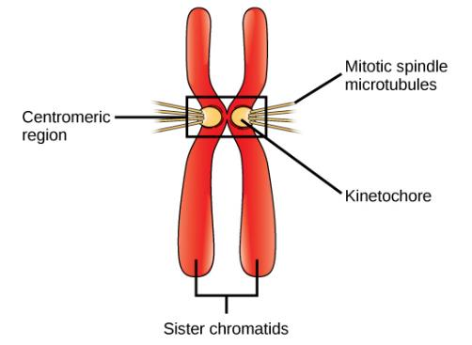
Figure 10.7
During prometaphase, mitotic spindle microtubules from opposite poles attach to each sister chromatid at the kinetochore. In anaphase, the connection between the sister chromatids breaks down, and the microtubules pull the chromosomes toward opposite poles.
This OpenStax ancillary resource is © Rice University under a CC-BY 4.0 International license; it may be reproduced or modified but must be attributed to OpenStax, Rice University and any changes must be noted. Any images credited to other sources are similarly available for reproduction, but must be attributed to their sources.

Slide 9
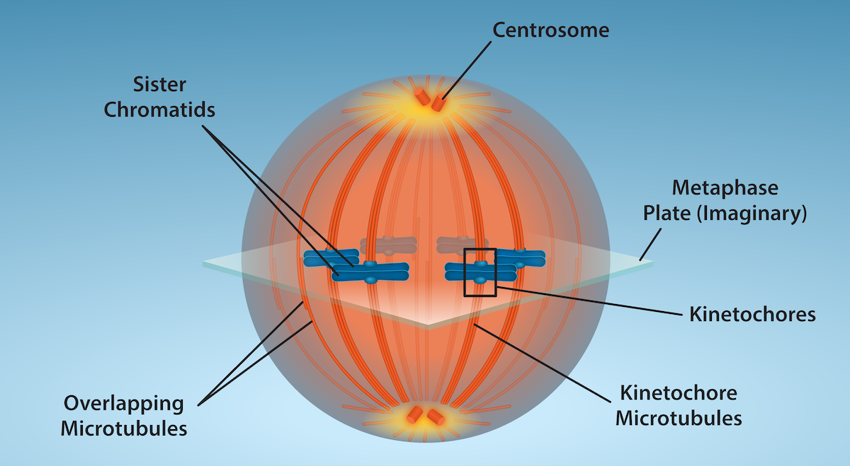
Figure 10.8
Mitotic Cell at Metaphase: The microtubule spindle has completed the alignment of chromosomes at the metaphase plate in preparation for the separation of sister chromatids during anaphase.
(credit: Fletcher, S., Ryan, K. and Rao, A., Department of Biology, Texas A&M University)
This OpenStax ancillary resource is © Rice University under a CC-BY 4.0 International license; it may be reproduced or modified but must be attributed to OpenStax, Rice University and any changes must be noted. Any images credited to other sources are similarly available for reproduction, but must be attributed to their sources.

Slide 10
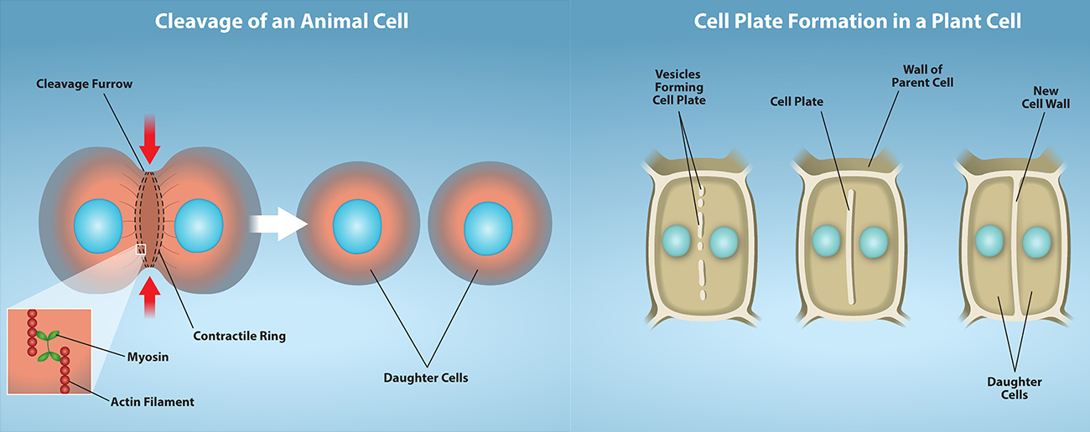
Figure 10.9
a
b
(a) Contraction of actin filaments by myosin pull the “equator” of the cell causing an invagination of the cell (a fissure called a cleavage furrow). The cleavage furrow gets continuously deeper until it eventually divides the cell into two new, independent daughter cells. (b) A mixture of enzymes, proteins, and glucose molecules are transported via vesicles to the center of the cell. These vesicles continuously build upon each other until a completely new cell wall has emerged and two new cells are formed, independent of one another.
(credit: Fletcher, S., Ryan, K. and Rao, A., Department of Biology, Texas A&M University)
This OpenStax ancillary resource is © Rice University under a CC-BY 4.0 International license; it may be reproduced or modified but must be attributed to OpenStax, Rice University and any changes must be noted. Any images credited to other sources are similarly available for reproduction, but must be attributed to their sources.

Slide 11
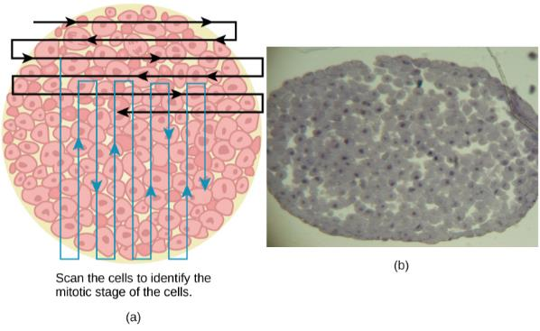
Figure 10.10
Slowly scan whitefish blastula cells with the high-power objective as illustrated in image (a) to identify their mitotic stage. (b) A microscopic image of the scanned cells is shown.
(credit “micrograph”: modification of work by Linda Flora; scale-bar data from Matt Russell)
This OpenStax ancillary resource is © Rice University under a CC-BY 4.0 International license; it may be reproduced or modified but must be attributed to OpenStax, Rice University and any changes must be noted. Any images credited to other sources are similarly available for reproduction, but must be attributed to their sources.

Slide 12
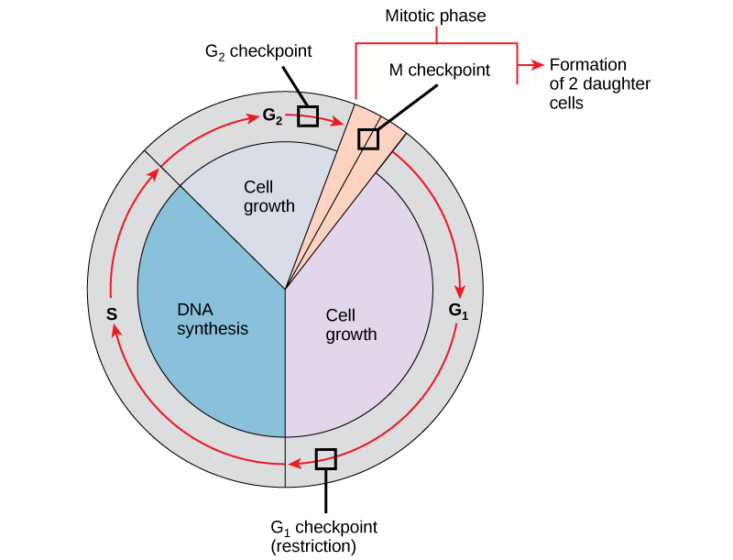
Figure 10.11
The cell cycle is controlled at three checkpoints. The integrity of the DNA is assessed at the G₁ checkpoint. Proper chromosome duplication is assessed at the G₂ checkpoint. Attachment of each kinetochore to a spindle fiber is assessed at the M checkpoint.
This OpenStax ancillary resource is © Rice University under a CC-BY 4.0 International license; it may be reproduced or modified but must be attributed to OpenStax, Rice University and any changes must be noted. Any images credited to other sources are similarly available for reproduction, but must be attributed to their sources.

Slide 13
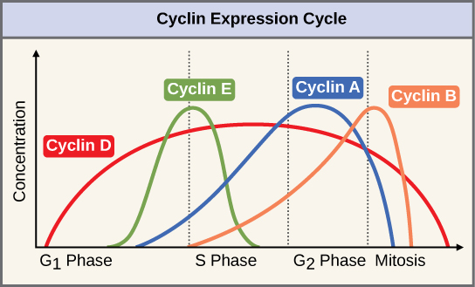
Figure 10.12
The concentrations of cyclin proteins change throughout the cell cycle. There is a direct correlation between cyclin accumulation and the three major cell cycle checkpoints. Also note the sharp decline of cyclin levels following each checkpoint (the transition between phases of the cell cycle), as cyclin is degraded by cytoplasmic enzymes.
(credit: modification of work by “WikiMiMa”/Wikimedia Commons)
This OpenStax ancillary resource is © Rice University under a CC-BY 4.0 International license; it may be reproduced or modified but must be attributed to OpenStax, Rice University and any changes must be noted. Any images credited to other sources are similarly available for reproduction, but must be attributed to their sources.

Slide 14
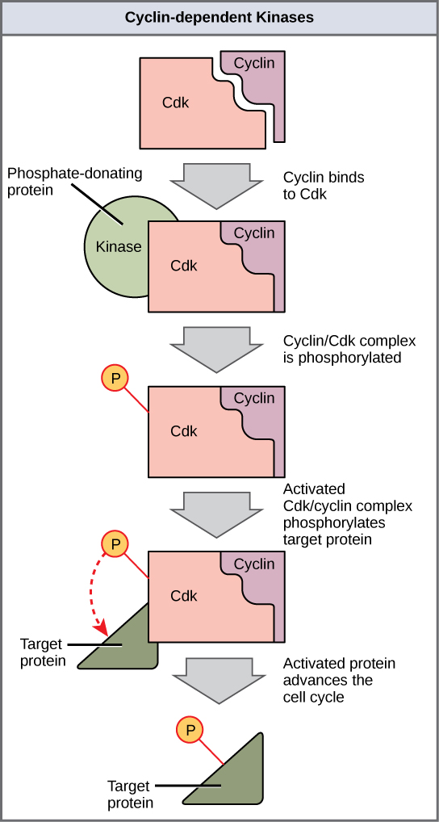
Figure 10.13
Cyclin-dependent kinases (Cdks) are protein kinases that, when fully activated, can phosphorylate and thus activate other proteins that advance the cell cycle past a checkpoint. To become fully activated, a Cdk must bind to a cyclin protein and then be phosphorylated by another kinase.
This OpenStax ancillary resource is © Rice University under a CC-BY 4.0 International license; it may be reproduced or modified but must be attributed to OpenStax, Rice University and any changes must be noted. Any images credited to other sources are similarly available for reproduction, but must be attributed to their sources.

Slide 15
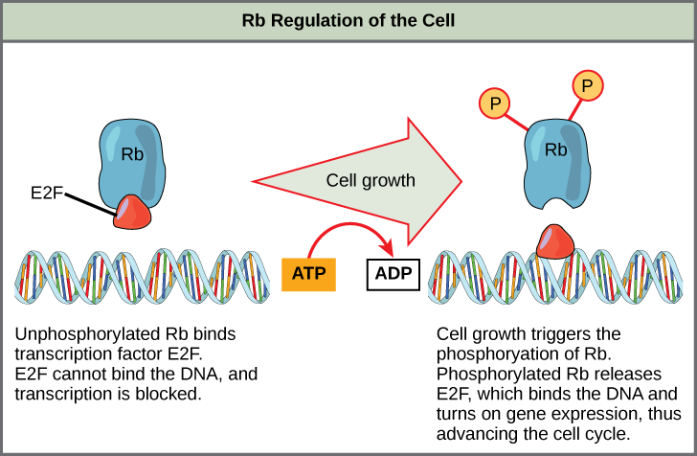
Figure 10.14
Rb halts the cell cycle and releases its hold in response to cell growth.
This OpenStax ancillary resource is © Rice University under a CC-BY 4.0 International license; it may be reproduced or modified but must be attributed to OpenStax, Rice University and any changes must be noted. Any images credited to other sources are similarly available for reproduction, but must be attributed to their sources.

Slide 16
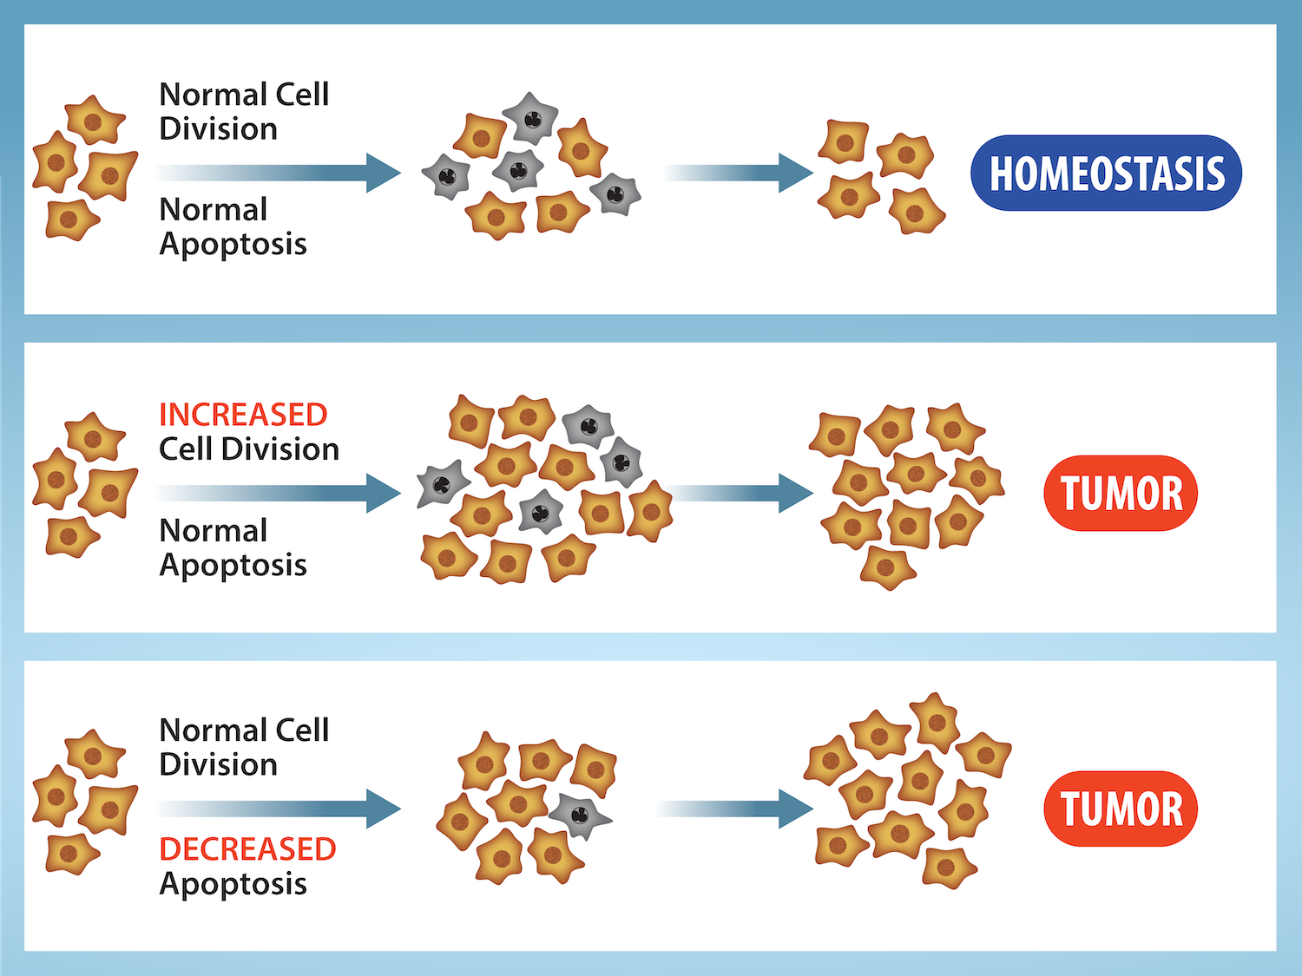
Figure 10.15
(credit: Rao, A. and Ryan, K. Department of Biology, Texas A&M University)
This OpenStax ancillary resource is © Rice University under a CC-BY 4.0 International license; it may be reproduced or modified but must be attributed to OpenStax, Rice University and any changes must be noted. Any images credited to other sources are similarly available for reproduction, but must be attributed to their sources.
Notes:
Cell Division and Apoptosis. In an adult organism, normal cell division is balanced by apoptosis (programmed cell death) to maintain a constant cell number in homeostasis. Either an increase in cell division or a decrease in apo ptosis leads an increase in the number of cells and tumor formation.

Slide 17
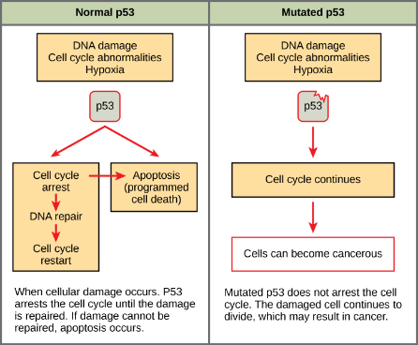
Figure 10.16
The role of normal p53 is to monitor DNA and the supply of oxygen (hypoxia is a condition of reduced oxygen supply). If damage is detected, p53 triggers repair mechanisms. If repairs are unsuccessful, p53 signals apoptosis. A cell with an abnormal p53 protein cannot repair damaged DNA and thus cannot signal apoptosis. Cells with abnormal p53 can become cancerous.
(credit: modification of work by Thierry Soussi)
This OpenStax ancillary resource is © Rice University under a CC-BY 4.0 International license; it may be reproduced or modified but must be attributed to OpenStax, Rice University and any changes must be noted. Any images credited to other sources are similarly available for reproduction, but must be attributed to their sources.

Slide 18
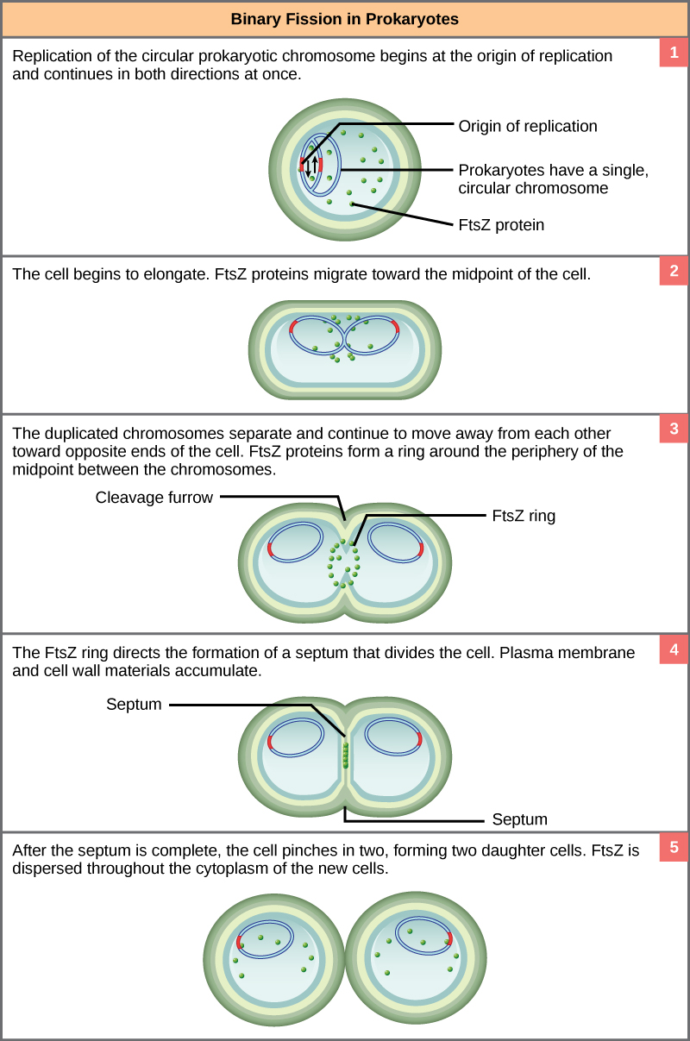
Figure 10.17
These images show the steps of binary fission in prokaryotes.
(credit: modification of work by “Mcstrother”/Wikimedia Commons)
This OpenStax ancillary resource is © Rice University under a CC-BY 4.0 International license; it may be reproduced or modified but must be attributed to OpenStax, Rice University and any changes must be noted. Any images credited to other sources are similarly available for reproduction, but must be attributed to their sources.

