Slide 1

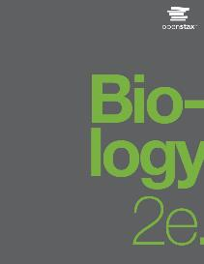
Biology 2e
Chapter 11 MEIOSIS AND SEXUAL REPRODUCTION
PowerPoint Image Slide Show

Slide 2
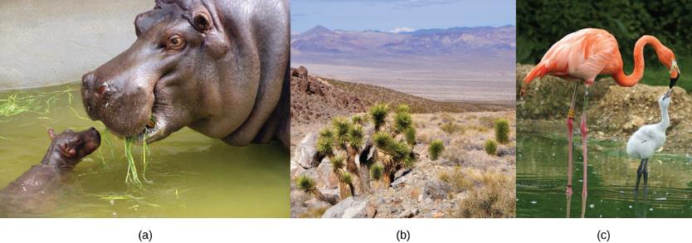
Figure 11.1
Each of us, like these other large multicellular organisms, begins life as a fertilized egg. After trillions of cell divisions, each of us develops into a complex, multicellular organism.
(credit a: modification of work by Frank Wouters; credit b: modification of work by Ken Cole, USGS; credit c: modification of work by Martin Pettitt)
This OpenStax ancillary resource is © Rice University under a CC-BY 4.0 International license; it may be reproduced or modified but must be attributed to OpenStax, Rice University and any changes must be noted. Any images credited to other sources are similarly available for reproduction, but must be attributed to their sources.

Slide 3
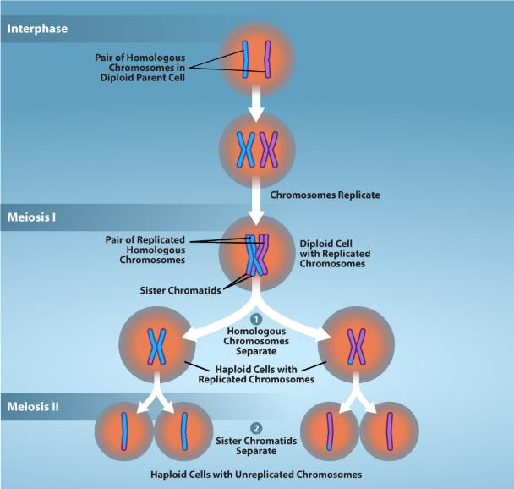
Figure 11.2
Overview of Meiosis
(credit: Rao, A., Tag, A, Fletcher, S., and Ryan, K. Department of Biology, Texas A&M University)
This OpenStax ancillary resource is © Rice University under a CC-BY 4.0 International license; it may be reproduced or modified but must be attributed to OpenStax, Rice University and any changes must be noted. Any images credited to other sources are similarly available for reproduction, but must be attributed to their sources.
Notes:
The production of gametes is a crucial process for sexually reproducing organisms. Meiosis is the mechanism used to reduce diploid cells to haploid gametes while introducing genetic diversity. Prior to meiosis, chromosomes are replicated in S-phase to ensure proper number of chromosomes in the resulting gametes. During meiosis, two successive rounds of division reduces the number of chromosomes (ploidy) of the cell by half. going from diploid cells to haploid gametes.

Slide 4
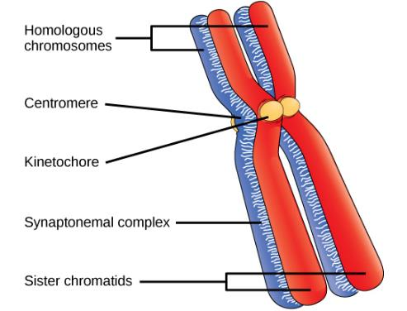
Figure 11.3
Early in prophase I, homologous chromosomes come together to form a synapse. The chromosomes are bound tightly together and in perfect alignment by a protein lattice called a synaptonemal complex and by cohesin proteins at the centromere.
This OpenStax ancillary resource is © Rice University under a CC-BY 4.0 International license; it may be reproduced or modified but must be attributed to OpenStax, Rice University and any changes must be noted. Any images credited to other sources are similarly available for reproduction, but must be attributed to their sources.

Slide 5
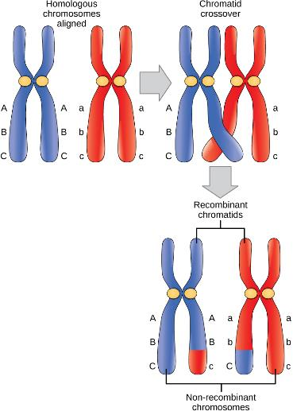
Figure 11.4
Crossover occurs between non-sister chromatids of homologous chromosomes. The result is an exchange of genetic material between homologous chromosomes.
This OpenStax ancillary resource is © Rice University under a CC-BY 4.0 International license; it may be reproduced or modified but must be attributed to OpenStax, Rice University and any changes must be noted. Any images credited to other sources are similarly available for reproduction, but must be attributed to their sources.

Slide 6
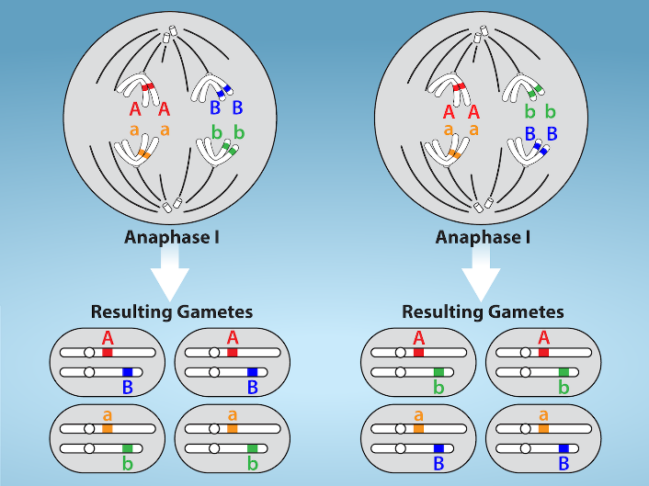
Figure 11.5
(credit: Rao, A. and Fletcher, S. Department of Biology, Texas A&M University)
This OpenStax ancillary resource is © Rice University under a CC-BY 4.0 International license; it may be reproduced or modified but must be attributed to OpenStax, Rice University and any changes must be noted. Any images credited to other sources are similarly available for reproduction, but must be attributed to their sources.
Notes:
Random, independent assortment during metaphase I is demonstrated by considering a cell with a set of two chromosomes (n = 2). There are two possible homologous chromosome arrangements at the equatorial plane in metaphase I, that are then separated during anaphase I. The total possible number of different gametes is 2^{n}, where n equals the number of chromosomes in a set. In this example, there are four possible genetic combinations for the gametes. With n = 23 in human cells, there are over eight million possible combinations of paternal and maternal chromosomes.

Slide 7
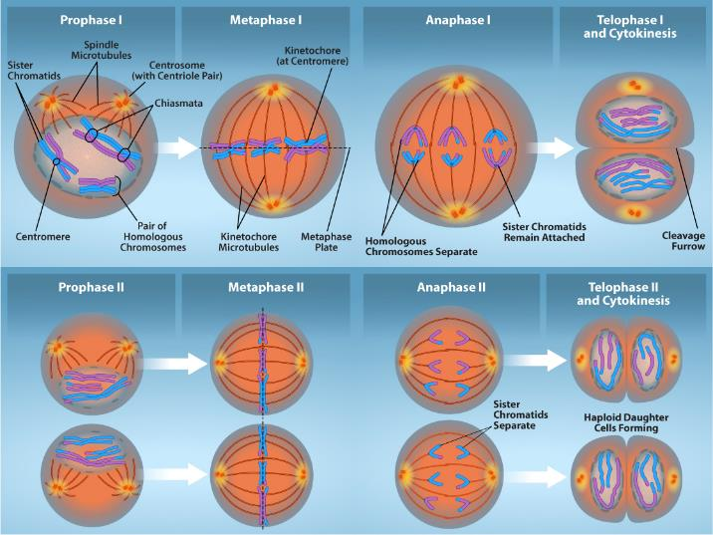
Figure 11.6
(credit: Rao, A., Ryan, K., Fletcher, S. and Tag, A. Department of Biology, Texas A&M University)
This OpenStax ancillary resource is © Rice University under a CC-BY 4.0 International license; it may be reproduced or modified but must be attributed to OpenStax, Rice University and any changes must be noted. Any images credited to other sources are similarly available for reproduction, but must be attributed to their sources.
Notes:
Random, independent assortment during metaphase I is demonstrated by considering a cell with a set of two chromosomes (n = 2). There are two possible homologous chromosome arrangements at the equatorial plane in metaphase I, that are then separated during anaphase I. The total possible number of different gametes is 2^{n}, where n equals the number of chromosomes in a set. In this example, there are four possible genetic combinations for the gametes. With n = 23 in human cells, there are over eight million possible combinations of paternal and maternal chromosomes.

Slide 8
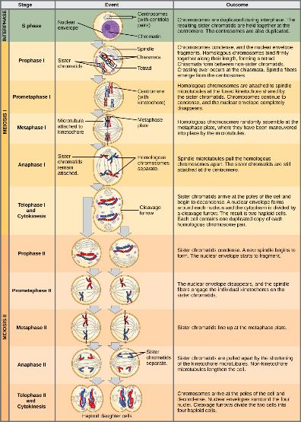
Figure 11.7
An animal cell with a diploid number of four (2n = 4) proceeds through the stages of meiosis to form four haploid daughter cells.
This OpenStax ancillary resource is © Rice University under a CC-BY 4.0 International license; it may be reproduced or modified but must be attributed to OpenStax, Rice University and any changes must be noted. Any images credited to other sources are similarly available for reproduction, but must be attributed to their sources.

Slide 9
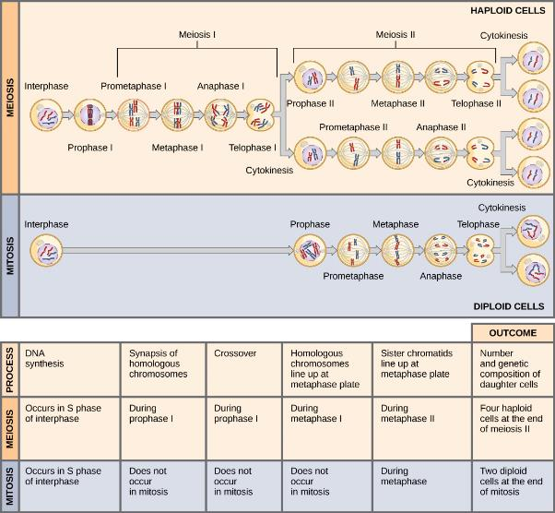
Figure 11.8
This OpenStax ancillary resource is © Rice University under a CC-BY 4.0 International license; it may be reproduced or modified but must be attributed to OpenStax, Rice University and any changes must be noted. Any images credited to other sources are similarly available for reproduction, but must be attributed to their sources.
Notes:
Meiosis and mitosis are both preceded by one cycle of DNA replication; however, meiosis includes two nuclear divisions. The four daughter cells resulting from meiosis are haploid and genetically distinct. The daughter cells resulting from mitosis are diploid and identical to the parent cell.

Slide 10
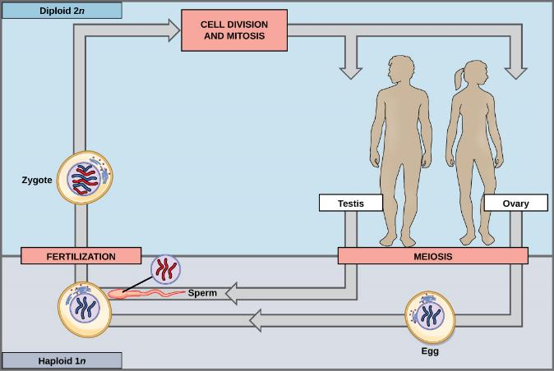
Figure 11.9
In animals, sexually reproducing adults form haploid gametes from diploid germ cells. Fusion of the gametes gives rise to a fertilized egg cell, or zygote. The zygote will undergo multiple rounds of mitosis to produce a multicellular offspring. The germ cells are generated early in the development of the zygote.
This OpenStax ancillary resource is © Rice University under a CC-BY 4.0 International license; it may be reproduced or modified but must be attributed to OpenStax, Rice University and any changes must be noted. Any images credited to other sources are similarly available for reproduction, but must be attributed to their sources.

Slide 11
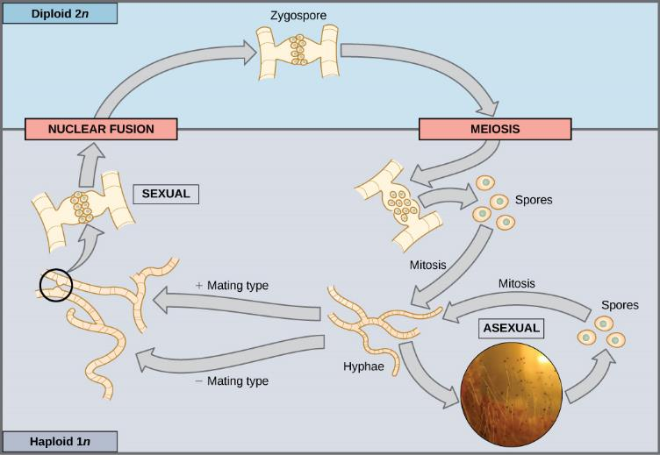
Figure 11.10
Fungi, such as black bread mold (Rhizopus nigricans), have haploid-dominant life cycles. The haploid multicellular stage produces specialized haploid cells by mitosis that fuse to form a diploid zygote. The zygote undergoes meiosis to produce haploid spores. Each spore gives rise to a multicellular haploid organism by mitosis. (credit “zygomycota” micrograph: modification of work by “Fanaberka”/Wikimedia Commons)
(credit “zygomycota” micrograph: modification of work by “Fanaberka”/Wikimedia Commons)
This OpenStax ancillary resource is © Rice University under a CC-BY 4.0 International license; it may be reproduced or modified but must be attributed to OpenStax, Rice University and any changes must be noted. Any images credited to other sources are similarly available for reproduction, but must be attributed to their sources.
Notes:
Fungi, such as black bread mold (Rhizopus nigricans), have haploid-dominant life cycles. The haploid multicellular stage produces specialized haploid cells by mitosis that fuse to form a diploid zygote. The zygote undergoes meiosis to produce haploid spores. Each spore gives rise to a multicellular haploid organism by mitosis.

Slide 12
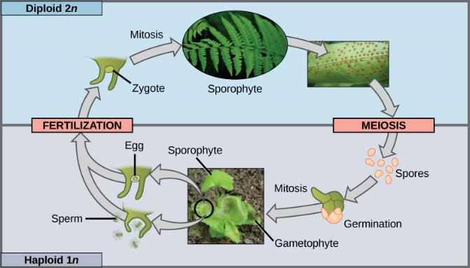
Figure 11.11
Plants have a life cycle that alternates between a multicellular haploid organism and a multicellular diploid organism.
(credit “fern”: modification of work by Cory Zanker; credit “sporangia”: modification of work by "Obsidian Soul"/Wikimedia Commons; credit “gametophyte and sporophyte”: modification of work by “Vlmastra”/Wikimedia Commons)
This OpenStax ancillary resource is © Rice University under a CC-BY 4.0 International license; it may be reproduced or modified but must be attributed to OpenStax, Rice University and any changes must be noted. Any images credited to other sources are similarly available for reproduction, but must be attributed to their sources.
Notes:
In some plants, such as ferns, both the haploid and diploid plant stages are free-living. The diploid plant is called a sporophyte because it produces haploid spores by meiosis. The spores develop into multicellular, haploid plants called gametophytes because they produce gametes. The gametes of two individuals will fuse to form a diploid zygote that becomes the sporophyte.

