Slide 1


Biology 2e
Chapter 13 MODERN UNDERSTANDINGS OF INHERITANCE
PowerPoint Image Slide Show

Slide 2
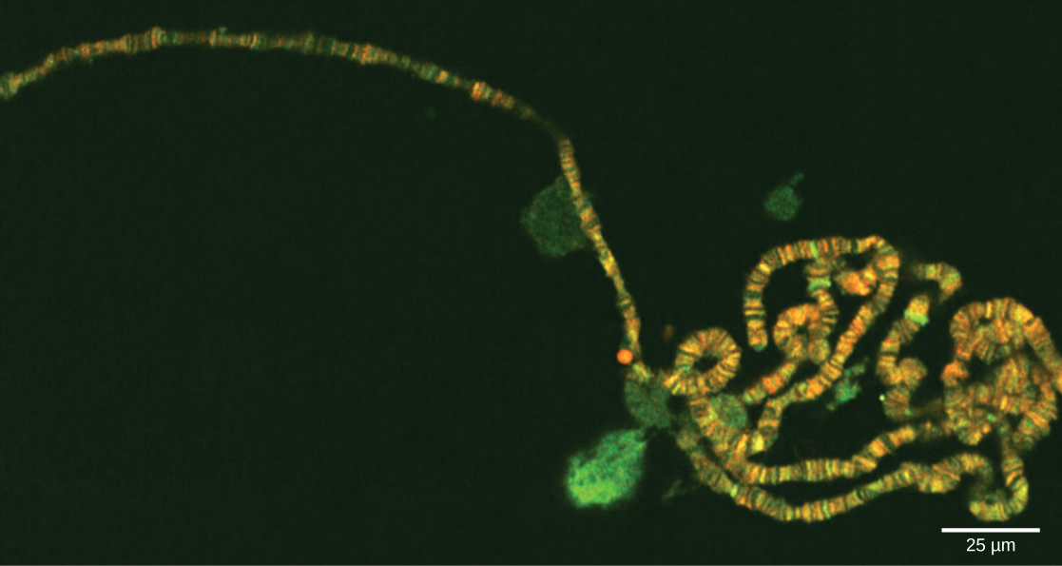
Figure 13.1
Chromosomes are threadlike nuclear structures consisting of DNA and proteins that serve as the repositories for genetic information. The chromosomes depicted here were isolated from a fruit fly’s salivary gland, stained with dye, and visualized under a microscope. Akin to miniature bar codes, chromosomes absorb different dyes to produce characteristic banding patterns, which allows for their routine identification.
(credit: modification of work by “LPLT”/Wikimedia Commons; scale-bar data from Matt Russell)
This OpenStax ancillary resource is © Rice University under a CC-BY 4.0 International license; it may be reproduced or modified but must be attributed to OpenStax, Rice University and any changes must be noted. Any images credited to other sources are similarly available for reproduction, but must be attributed to their sources.

Slide 3
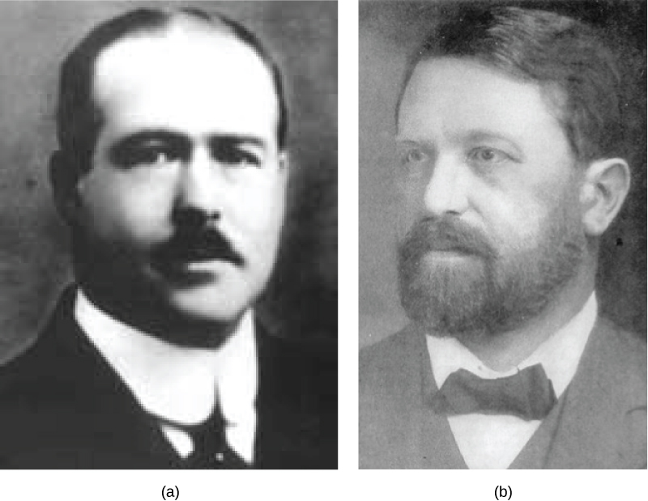
Figure 13.2
(a) Walter Sutton and (b) Theodor Boveri are credited with developing the Chromosomal Theory of Inheritance, which states that chromosomes carry the unit of heredity (genes).
This OpenStax ancillary resource is © Rice University under a CC-BY 4.0 International license; it may be reproduced or modified but must be attributed to OpenStax, Rice University and any changes must be noted. Any images credited to other sources are similarly available for reproduction, but must be attributed to their sources.

Slide 4
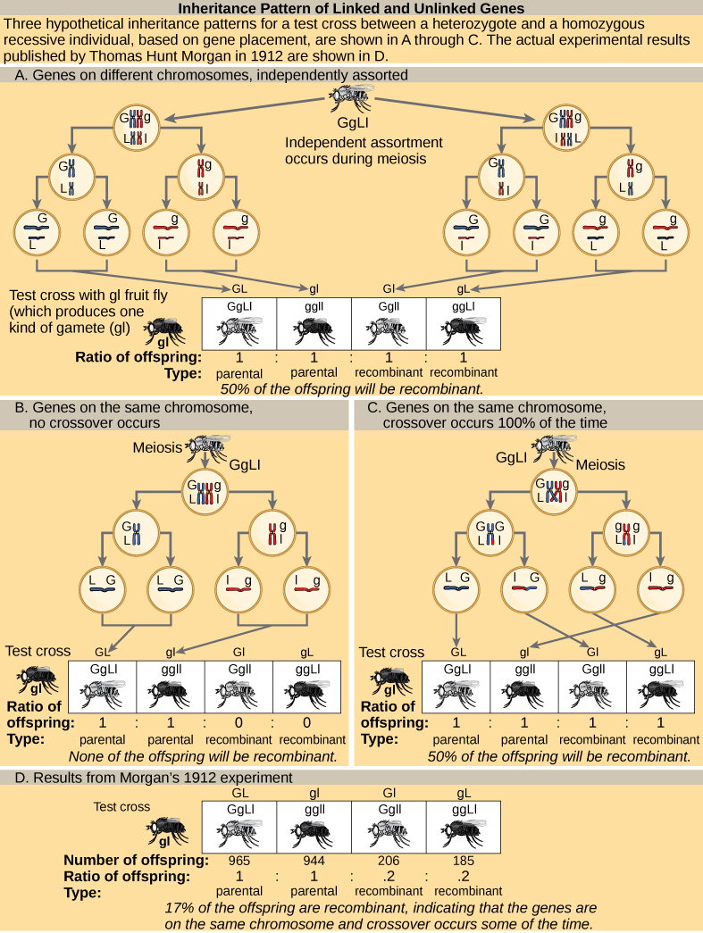
Figure 13.3
Inheritance patterns of unlinked and linked genes are shown. In (a), two genes are located on different chromosomes so independent assortment occurs during meiosis. The offspring have an equal chance of being the parental type (inheriting the same combination of traits as the parents) or a nonparental type (inheriting a different combination of traits than the parents). In (b), two genes are very close together on the same chromosome so that no crossing over occurs between them. The genes are therefore always inherited together and all of the offspring are the parental type. In (c), two genes are far apart on the chromosome such that crossing over occurs during every meiotic event. The recombination frequency will be the same as if the genes were on separate chromosomes. In (d), the actual recombination frequency of fruit fly wing length and body color that Thomas Morgan observed in 1912 was 17 percent. A crossover frequency between 0 percent and 50 percent indicates that the genes are on the same chromosome and crossover occurs some of the time.
This OpenStax ancillary resource is © Rice University under a CC-BY 4.0 International license; it may be reproduced or modified but must be attributed to OpenStax, Rice University and any changes must be noted. Any images credited to other sources are similarly available for reproduction, but must be attributed to their sources.

Slide 5
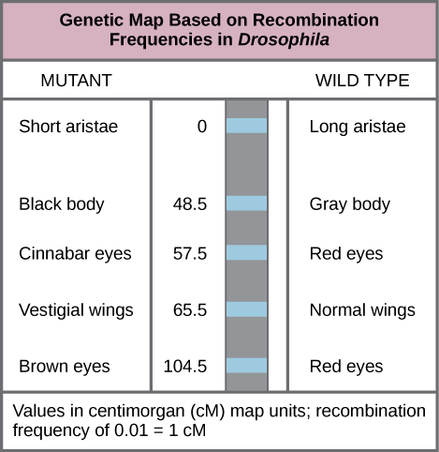
Figure 13.4
This genetic map orders Drosophila genes on the basis of recombination frequency.
This OpenStax ancillary resource is © Rice University under a CC-BY 4.0 International license; it may be reproduced or modified but must be attributed to OpenStax, Rice University and any changes must be noted. Any images credited to other sources are similarly available for reproduction, but must be attributed to their sources.

Slide 6
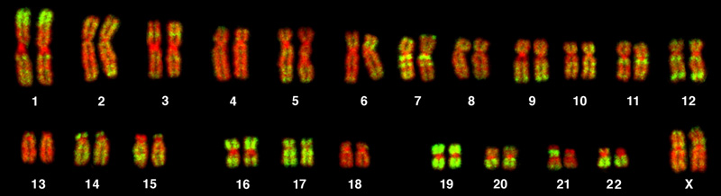
Figure 13.5
This karyotype is of a female human. Notice that homologous chromosomes are the same size, and have the same centromere positions and banding patterns. A human male would have an XY chromosome pair instead of the XX pair shown.
(credit: Andreas Blozer et al)
This OpenStax ancillary resource is © Rice University under a CC-BY 4.0 International license; it may be reproduced or modified but must be attributed to OpenStax, Rice University and any changes must be noted. Any images credited to other sources are similarly available for reproduction, but must be attributed to their sources.

Slide 7
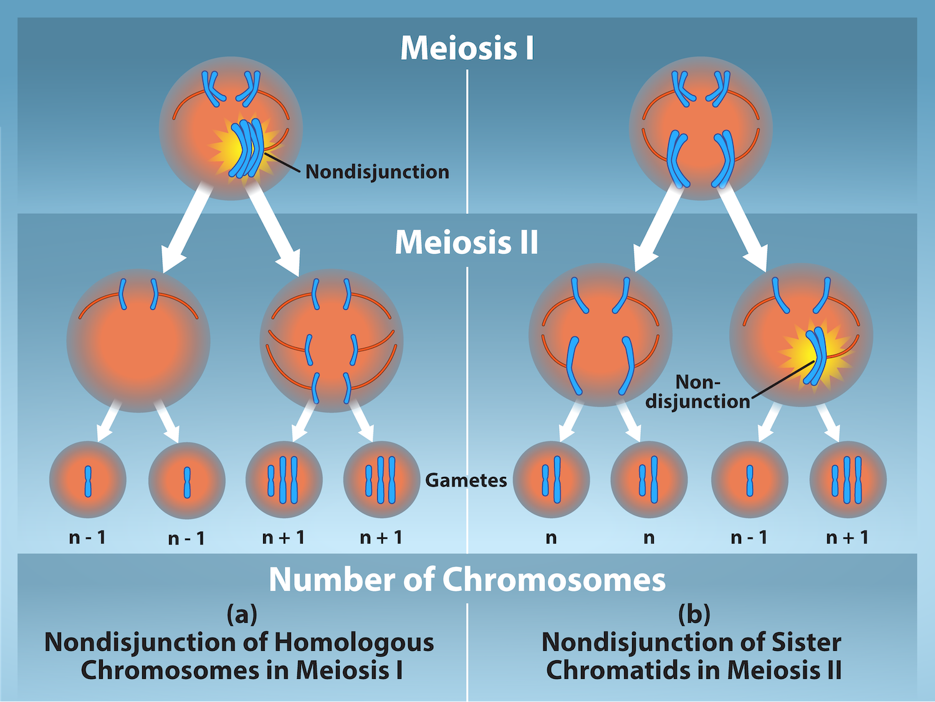
Figure 13.6
(credit: Rao, A. and Tag, A. Department of Biology, Texas A&M University)
This OpenStax ancillary resource is © Rice University under a CC-BY 4.0 International license; it may be reproduced or modified but must be attributed to OpenStax, Rice University and any changes must be noted. Any images credited to other sources are similarly available for reproduction, but must be attributed to their sources.
Notes:
Nondisjunction occurs when homologous chromosomes or sister chromatids fail to separate during meiosis, resulting in an abnormal chromosome number. Nondisjunction may occur during meiosis I or meiosis II.

Slide 8
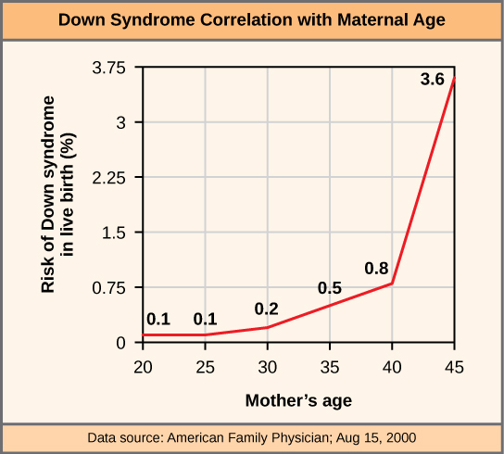
Figure 13.7
The incidence of having a fetus with trisomy 21 increases dramatically with maternal age.
This OpenStax ancillary resource is © Rice University under a CC-BY 4.0 International license; it may be reproduced or modified but must be attributed to OpenStax, Rice University and any changes must be noted. Any images credited to other sources are similarly available for reproduction, but must be attributed to their sources.

Slide 9
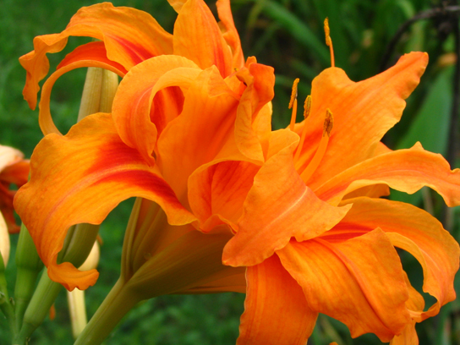
Figure 13.8
As with many polyploid plants, this triploid orange daylily (Hemerocallis fulva) is particularly large and robust, and grows flowers with triple the number of petals of its diploid counterparts.
(credit: Steve Karg)
This OpenStax ancillary resource is © Rice University under a CC-BY 4.0 International license; it may be reproduced or modified but must be attributed to OpenStax, Rice University and any changes must be noted. Any images credited to other sources are similarly available for reproduction, but must be attributed to their sources.

Slide 10
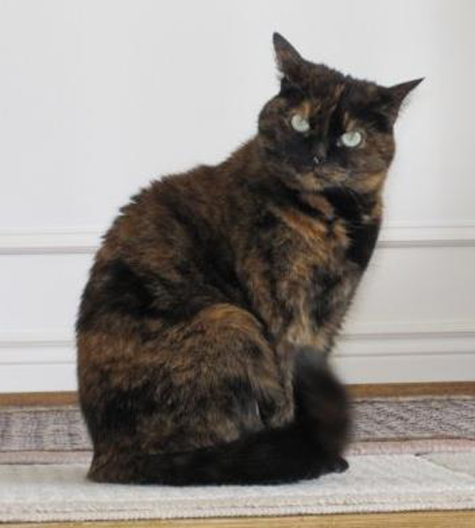
Figure 13.9
In cats, the gene for coat color is located on the X chromosome. In the embryonic development of female cats, one of the two X chromosomes is randomly inactivated in each cell, resulting in a tortoiseshell pattern if the cat has two different alleles for coat color. Male cats, having only one X chromosome, never exhibit a tortoiseshell coat color.
(credit: Michael Bodega)
This OpenStax ancillary resource is © Rice University under a CC-BY 4.0 International license; it may be reproduced or modified but must be attributed to OpenStax, Rice University and any changes must be noted. Any images credited to other sources are similarly available for reproduction, but must be attributed to their sources.

Slide 11
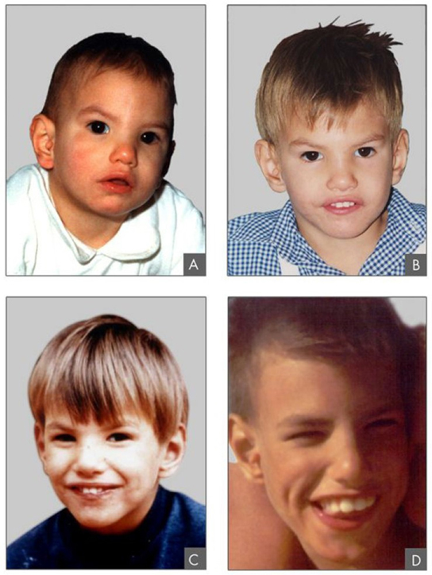
Figure 13.10
This individual with cri-du-chat syndrome is shown at two, four, nine, and 12 years of age.
(credit: Paola Cerruti Mainardi)
This OpenStax ancillary resource is © Rice University under a CC-BY 4.0 International license; it may be reproduced or modified but must be attributed to OpenStax, Rice University and any changes must be noted. Any images credited to other sources are similarly available for reproduction, but must be attributed to their sources.

Slide 12
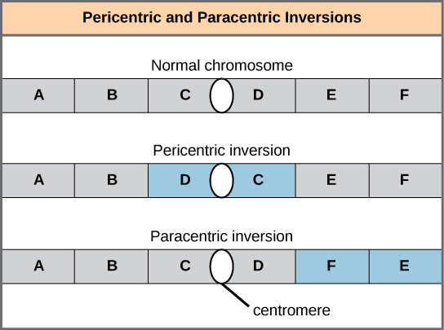
Figure 13.11
Pericentric inversions include the centromere, and paracentric inversions do not. A pericentric inversion can change the relative lengths of the chromosome arms; a paracentric inversion cannot.
This OpenStax ancillary resource is © Rice University under a CC-BY 4.0 International license; it may be reproduced or modified but must be attributed to OpenStax, Rice University and any changes must be noted. Any images credited to other sources are similarly available for reproduction, but must be attributed to their sources.

Slide 13
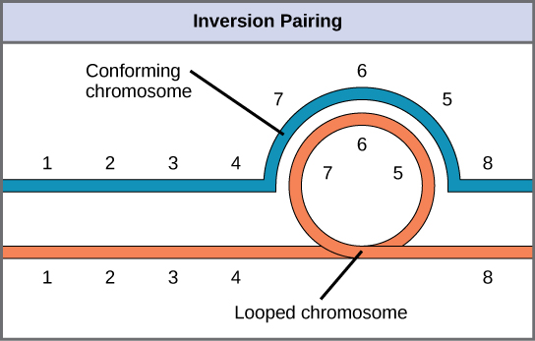
Figure 13.12
When one chromosome undergoes an inversion but the other does not, one chromosome must form an inverted loop to retain point-for-point interaction during synapsis. This inversion pairing is essential to maintaining gene alignment during meiosis and to allow for recombination.
This OpenStax ancillary resource is © Rice University under a CC-BY 4.0 International license; it may be reproduced or modified but must be attributed to OpenStax, Rice University and any changes must be noted. Any images credited to other sources are similarly available for reproduction, but must be attributed to their sources.

Slide 14
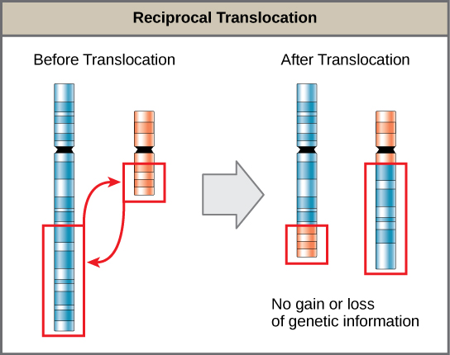
Figure 13.13
A reciprocal translocation occurs when a segment of DNA is transferred from one chromosome to another, nonhomologous chromosome.
(credit: modification of work by National Human Genome Research/USA)
This OpenStax ancillary resource is © Rice University under a CC-BY 4.0 International license; it may be reproduced or modified but must be attributed to OpenStax, Rice University and any changes must be noted. Any images credited to other sources are similarly available for reproduction, but must be attributed to their sources.

