Slide 1

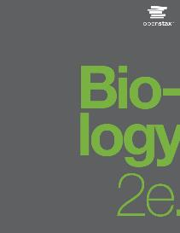
Biology 2e
Chapter 14 DNA STRUCTURE AND FUNCTION
PowerPoint Image Slide Show

Slide 2
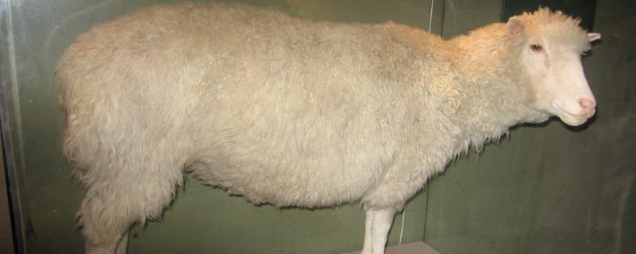
Figure 14.1
Dolly the sheep was the first large mammal to be cloned.
This OpenStax ancillary resource is © Rice University under a CC-BY 4.0 International license; it may be reproduced or modified but must be attributed to OpenStax, Rice University and any changes must be noted. Any images credited to other sources are similarly available for reproduction, but must be attributed to their sources.

Slide 3
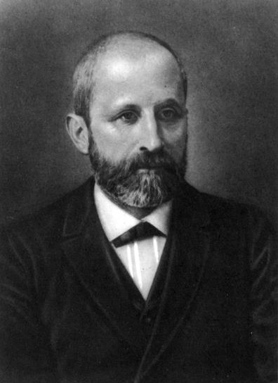
Figure 14.2
Friedrich Miescher (1844–1895) discovered nucleic acids.
This OpenStax ancillary resource is © Rice University under a CC-BY 4.0 International license; it may be reproduced or modified but must be attributed to OpenStax, Rice University and any changes must be noted. Any images credited to other sources are similarly available for reproduction, but must be attributed to their sources.

Slide 4
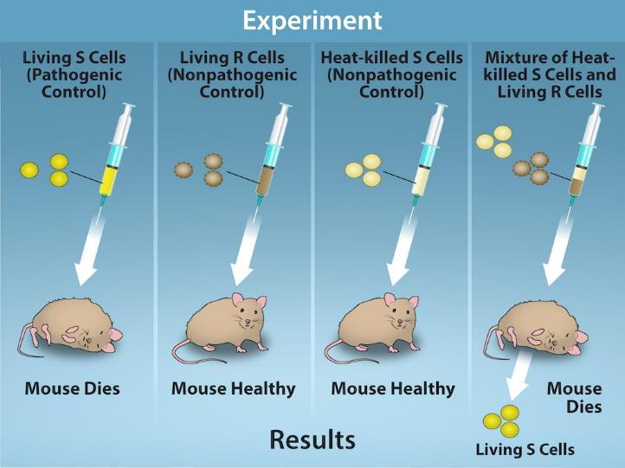
Figure 14.3
(credit: Rao, A., Ryan, K. and Tag, A. Department of Biology, Texas A&M University)
This OpenStax ancillary resource is © Rice University under a CC-BY 4.0 International license; it may be reproduced or modified but must be attributed to OpenStax, Rice University and any changes must be noted. Any images credited to other sources are similarly available for reproduction, but must be attributed to their sources.
Notes:
Two strains of S. pneumoniae were used in Griffith’s transformation experiments. The R strain is non-pathogenic, whereas the S strain is pathogenic and causes death. When Griffith injected a mouse with the heat-killed S strain and a live R strain, the mouse died. The S strain was recovered from the dead mouse. Griffith concluded that something had passed from the heat-killed S strain to the R strain, transforming the R strain into the S strain in the process.

Slide 5
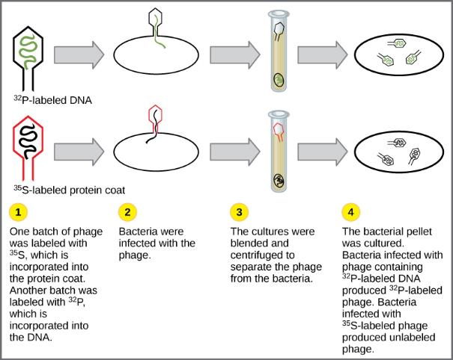
Figure 14.4
In Hershey and Chase's experiments, bacteria were infected with phage radiolabeled with either ³⁵S, which labels protein, or ³²P, which labels DNA. Only ³²P entered the bacterial cells, indicating that DNA is the genetic material.
This OpenStax ancillary resource is © Rice University under a CC-BY 4.0 International license; it may be reproduced or modified but must be attributed to OpenStax, Rice University and any changes must be noted. Any images credited to other sources are similarly available for reproduction, but must be attributed to their sources.

Slide 6
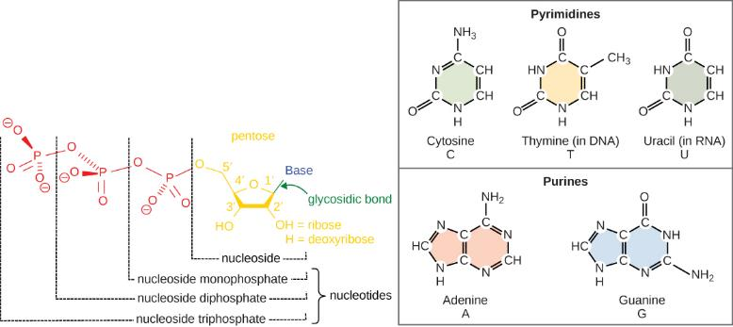
Figure 14.5
The purines have a double ring structure with a six-membered ring fused to a five-membered ring. Pyrimidines are smaller in size; they have a single six-membered ring structure.
This OpenStax ancillary resource is © Rice University under a CC-BY 4.0 International license; it may be reproduced or modified but must be attributed to OpenStax, Rice University and any changes must be noted. Any images credited to other sources are similarly available for reproduction, but must be attributed to their sources.

Slide 7
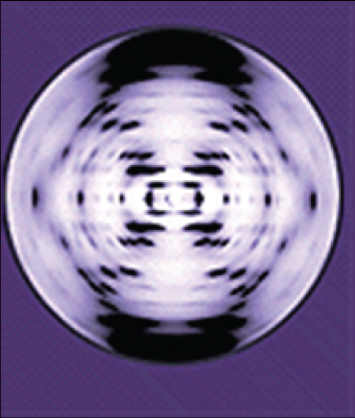
Figure 14.6
The X-ray diffraction pattern of DNA, which helped to elucidate its double-helix structure.
This OpenStax ancillary resource is © Rice University under a CC-BY 4.0 International license; it may be reproduced or modified but must be attributed to OpenStax, Rice University and any changes must be noted. Any images credited to other sources are similarly available for reproduction, but must be attributed to their sources.

Slide 8
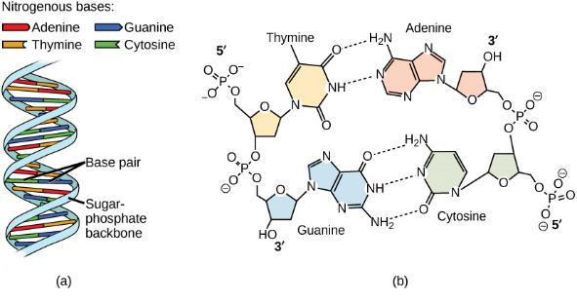
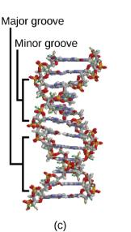
Figure 14.7
DNA has (a) a double helix structure and (b) phosphodiester bonds. The (c) major and minor grooves are binding sites for DNA binding proteins during processes such as transcription (the copying of RNA from DNA) and replication.
This OpenStax ancillary resource is © Rice University under a CC-BY 4.0 International license; it may be reproduced or modified but must be attributed to OpenStax, Rice University and any changes must be noted. Any images credited to other sources are similarly available for reproduction, but must be attributed to their sources.

Slide 9
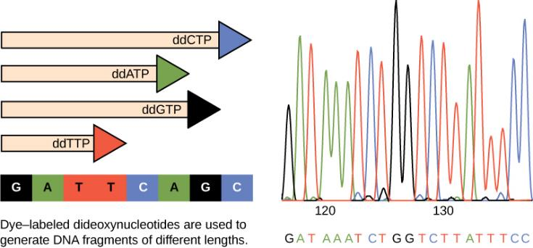
Figure 14.8
In Frederick Sanger's dideoxy chain termination method, dye-labeled dideoxynucleotides are used to generate DNA fragments that terminate at different points. The DNA is separated by capillary electrophoresis (not defined) on the basis of size, and from the order of fragments formed, the DNA sequence can be read. The DNA sequence readout is shown on an electropherogram (not defined) that is generated by a laser scanner.
This OpenStax ancillary resource is © Rice University under a CC-BY 4.0 International license; it may be reproduced or modified but must be attributed to OpenStax, Rice University and any changes must be noted. Any images credited to other sources are similarly available for reproduction, but must be attributed to their sources.

Slide 10
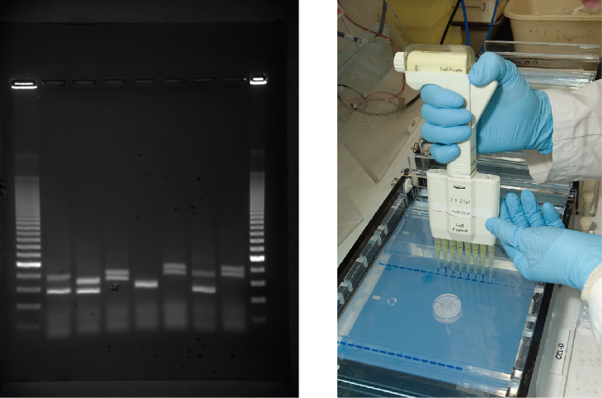
Figure 14.9
DNA can be separated on the basis of size using gel electrophoresis.
(credit: James Jacob, Tompkins Cortland Community College)
This OpenStax ancillary resource is © Rice University under a CC-BY 4.0 International license; it may be reproduced or modified but must be attributed to OpenStax, Rice University and any changes must be noted. Any images credited to other sources are similarly available for reproduction, but must be attributed to their sources.

Slide 11
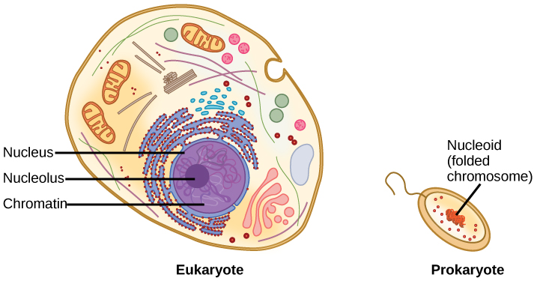
Figure 14.10
A eukaryote contains a well-defined nucleus, whereas in prokaryotes, the chromosome lies in the cytoplasm in an area called the nucleoid.
This OpenStax ancillary resource is © Rice University under a CC-BY 4.0 International license; it may be reproduced or modified but must be attributed to OpenStax, Rice University and any changes must be noted. Any images credited to other sources are similarly available for reproduction, but must be attributed to their sources.

Slide 12
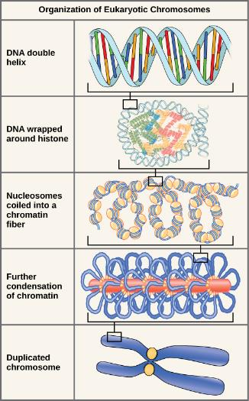
Figure 14.11
These figures illustrate the compaction of the eukaryotic chromosome.
This OpenStax ancillary resource is © Rice University under a CC-BY 4.0 International license; it may be reproduced or modified but must be attributed to OpenStax, Rice University and any changes must be noted. Any images credited to other sources are similarly available for reproduction, but must be attributed to their sources.

Slide 13
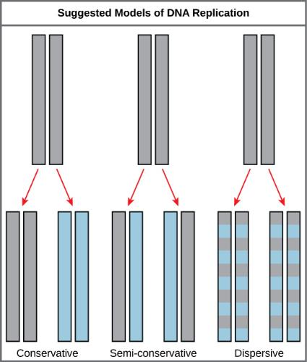
Figure 14.12
The three suggested models of DNA replication. Gray indicates the original DNA strands, and blue indicates newly synthesized DNA.
This OpenStax ancillary resource is © Rice University under a CC-BY 4.0 International license; it may be reproduced or modified but must be attributed to OpenStax, Rice University and any changes must be noted. Any images credited to other sources are similarly available for reproduction, but must be attributed to their sources.

Slide 14
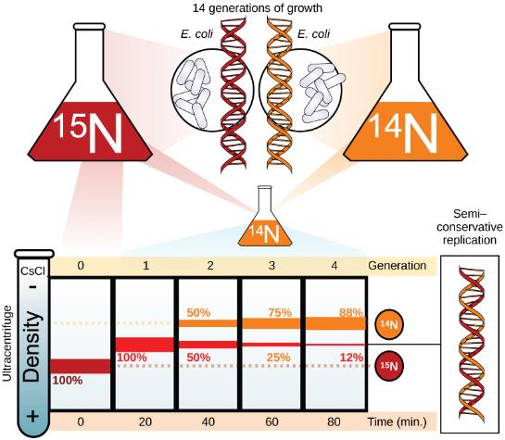
Figure 14.13
Meselson and Stahl experimented with E. coli grown first in heavy nitrogen (¹⁵N) then in ¹⁴N. DNA grown in ¹⁵N (red band) is heavier than DNA grown in ¹⁴N (orange band), and sediments to a lower level in cesium chloride solution in an ultracentrifuge. When DNA grown in ¹⁵N is switched to media containing ¹⁴N, after one round of cell division the DNA sediments halfway between the ¹⁵N and ¹⁴N levels, indicating that it now contains fifty percent ¹⁴N. In subsequent cell divisions, an increasing amount of DNA contains ¹⁴N only. This data supports the semi-conservative replication model.
(credit: modification of work by Mariana Ruiz Villareal)
This OpenStax ancillary resource is © Rice University under a CC-BY 4.0 International license; it may be reproduced or modified but must be attributed to OpenStax, Rice University and any changes must be noted. Any images credited to other sources are similarly available for reproduction, but must be attributed to their sources.

Slide 15
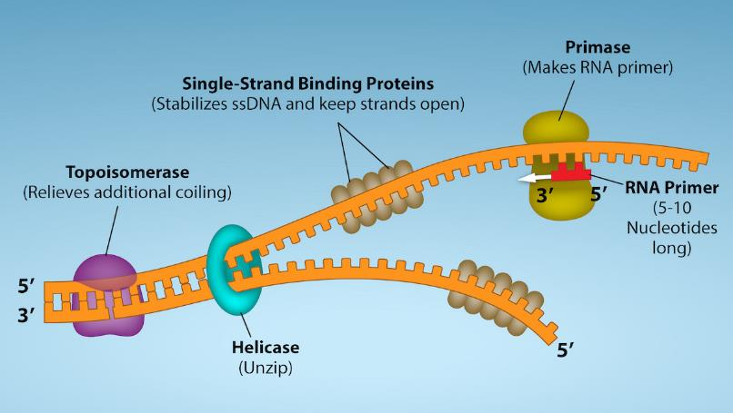
Figure 14.14
First Components of DNA Replication.
(credit: Rao, A., Ryan, K. Fletcher, S. and Tag, A. Department of Biology, Texas A&M University)
This OpenStax ancillary resource is © Rice University under a CC-BY 4.0 International license; it may be reproduced or modified but must be attributed to OpenStax, Rice University and any changes must be noted. Any images credited to other sources are similarly available for reproduction, but must be attributed to their sources.
Notes:
As DNA replication begins, DNA Helicase, a large enzyme, separates the two strands of DNA so that they can act as templates for replication. Single-strand binding proteins bind to each strand to stabilize and prevent them from reforming the double helix. Primase, an RNA polymerase, binds to the single stranded DNA and synthesizes a short RNA primer in the 5’ to 3’ direction that is antiparallel to the parental strand. This RNA primer allows for DNA polymerase to begin replicating the DNA. Topoisomerase binds to the double helix upstream of the replication fork to prevent additional coiling by making small cuts in one of the DNA strands. Credit: Rao, A., Ryan, K. Fletcher, S. and Tag, A. Department of Biology, Texas A&M University.

Slide 16
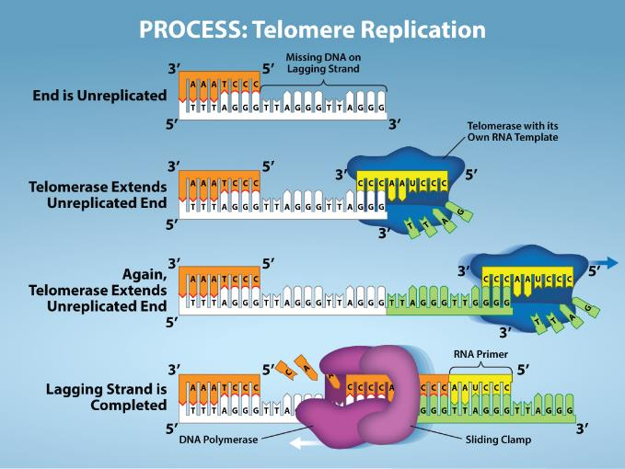
Figure 14.15
The ends of linear chromosomes are maintained by the action of the telomerase enzyme.
(credit: Rao, A. and Fletcher, S. Department of Biology, Texas A&M University)
This OpenStax ancillary resource is © Rice University under a CC-BY 4.0 International license; it may be reproduced or modified but must be attributed to OpenStax, Rice University and any changes must be noted. Any images credited to other sources are similarly available for reproduction, but must be attributed to their sources.

Slide 17
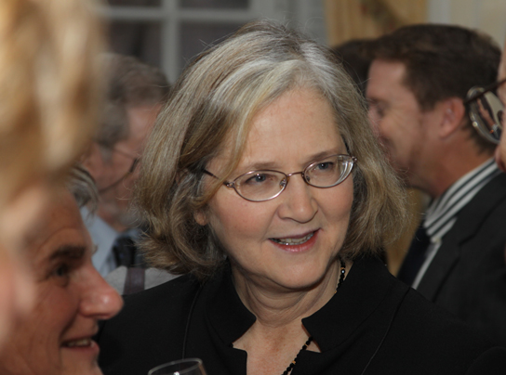
Figure 14.16
Elizabeth Blackburn, 2009 Nobel Laureate, is the scientist who discovered how telomerase works.
(credit: US Embassy Sweden)
This OpenStax ancillary resource is © Rice University under a CC-BY 4.0 International license; it may be reproduced or modified but must be attributed to OpenStax, Rice University and any changes must be noted. Any images credited to other sources are similarly available for reproduction, but must be attributed to their sources.

Slide 18
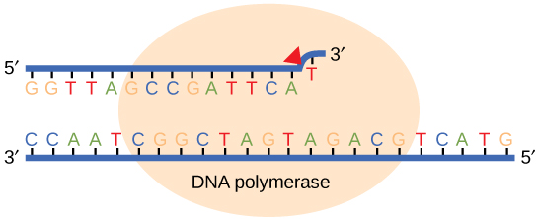
Figure 14.17
Proofreading by DNA polymerase corrects errors during replication.
This OpenStax ancillary resource is © Rice University under a CC-BY 4.0 International license; it may be reproduced or modified but must be attributed to OpenStax, Rice University and any changes must be noted. Any images credited to other sources are similarly available for reproduction, but must be attributed to their sources.

Slide 19
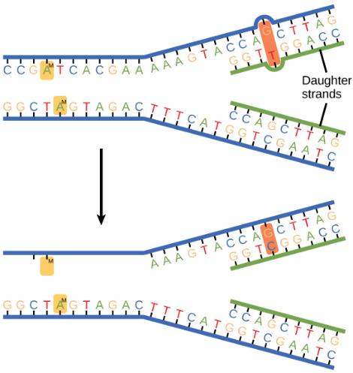
Figure 14.18
In mismatch repair, the incorrectly added base is detected after replication. The mismatch repair proteins detect this base and remove it from the newly synthesized strand by nuclease action. The gap is now filled with the correctly paired base.
This OpenStax ancillary resource is © Rice University under a CC-BY 4.0 International license; it may be reproduced or modified but must be attributed to OpenStax, Rice University and any changes must be noted. Any images credited to other sources are similarly available for reproduction, but must be attributed to their sources.

Slide 20
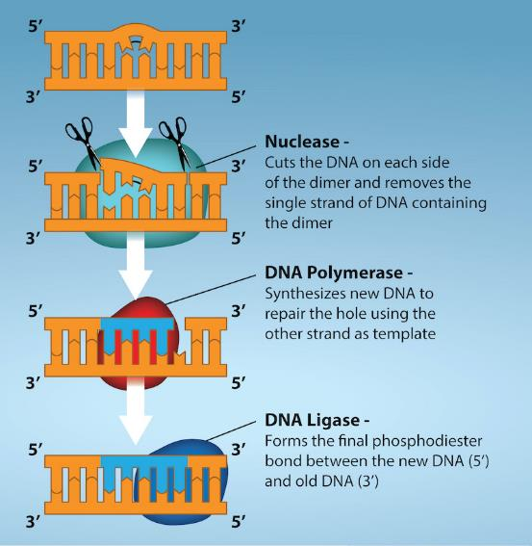
Figure 14.19
Nucleotide excision repairs thymine dimers. When exposed to UV, thymines lying adjacent to each other can form thymine dimers. In normal cells, they are excised and replaced.
(credit: Rao, A., Fletcher, S. and Tag, A. Department of Biology, Texas A&M University)
This OpenStax ancillary resource is © Rice University under a CC-BY 4.0 International license; it may be reproduced or modified but must be attributed to OpenStax, Rice University and any changes must be noted. Any images credited to other sources are similarly available for reproduction, but must be attributed to their sources.

Slide 21
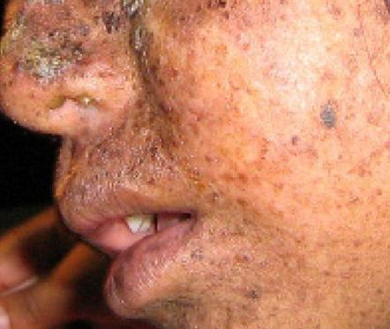
Figure 14.20
Xeroderma pigmentosa is a condition in which thymine dimerization from exposure to UV is not repaired. Exposure to sunlight results in skin lesions.
(credit: James Halpern et al.)
This OpenStax ancillary resource is © Rice University under a CC-BY 4.0 International license; it may be reproduced or modified but must be attributed to OpenStax, Rice University and any changes must be noted. Any images credited to other sources are similarly available for reproduction, but must be attributed to their sources.

Slide 22
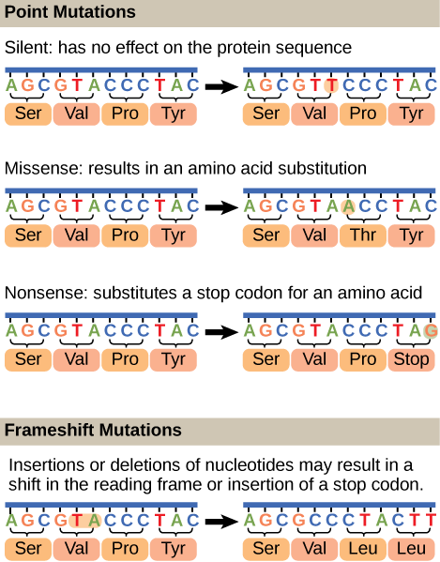
Figure 14.21
Mutations can lead to changes in the protein sequence encoded by the DNA.
This OpenStax ancillary resource is © Rice University under a CC-BY 4.0 International license; it may be reproduced or modified but must be attributed to OpenStax, Rice University and any changes must be noted. Any images credited to other sources are similarly available for reproduction, but must be attributed to their sources.

