Slide 1


Biology 2e
Chapter 15 GENES AND PROTEINS
PowerPoint Image Slide Show

Slide 2
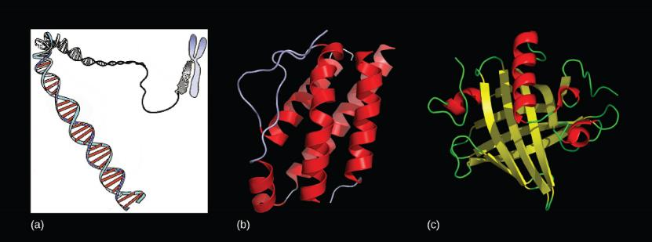
Figure 15.1
Genes, which are carried on (a) chromosomes, are linearly organized instructions for making the RNA and protein molecules that are necessary for all of processes of life. The (b) interleukin-2 protein and (c) alpha-2u-globulin protein are just two examples of the array of different molecular structures that are encoded by genes.
(credit “chromosome: National Human Genome Research Institute; credit “interleukin-2”: Ramin Herati/Created from PDB 1M47 and rendered with Pymol; credit “alpha-2u-globulin”: Darren Logan/rendered with AISMIG)
This OpenStax ancillary resource is © Rice University under a CC-BY 4.0 International license; it may be reproduced or modified but must be attributed to OpenStax, Rice University and any changes must be noted. Any images credited to other sources are similarly available for reproduction, but must be attributed to their sources.

Slide 3
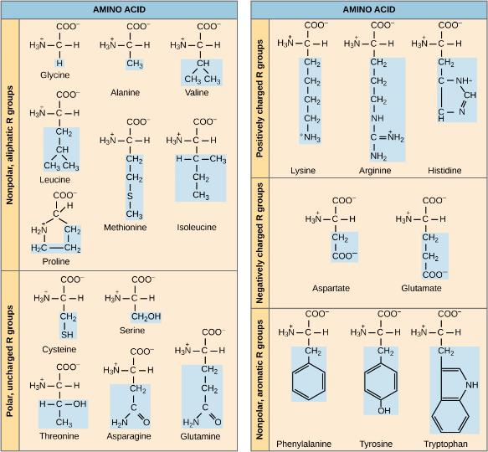
Figure 15.2
Structures of the 20 amino acids found in proteins are shown. Each amino acid is composed of an amino group (NH+3NH3+), a carboxyl group (COO⁻), and a side chain (blue). The side chain may be nonpolar, polar, or charged, as well as large or small. It is the variety of amino acid side chains that gives rise to the incredible variation of protein structure and function.
This OpenStax ancillary resource is © Rice University under a CC-BY 4.0 International license; it may be reproduced or modified but must be attributed to OpenStax, Rice University and any changes must be noted. Any images credited to other sources are similarly available for reproduction, but must be attributed to their sources.

Slide 4
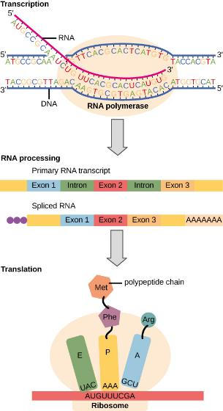
Figure 15.3
Instructions on DNA are transcribed onto messenger RNA. Ribosomes are able to read the genetic information inscribed on a strand of messenger RNA and use this information to string amino acids together into a protein.
This OpenStax ancillary resource is © Rice University under a CC-BY 4.0 International license; it may be reproduced or modified but must be attributed to OpenStax, Rice University and any changes must be noted. Any images credited to other sources are similarly available for reproduction, but must be attributed to their sources.

Slide 5
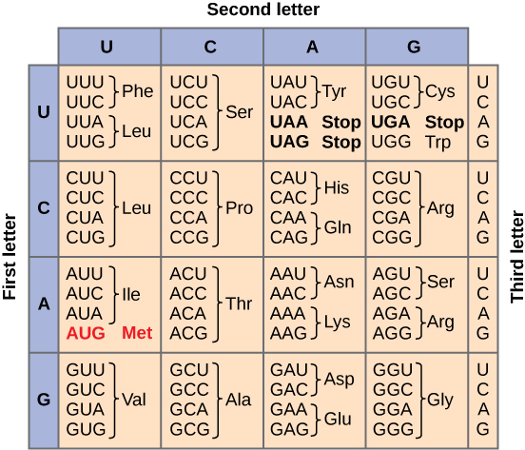
Figure 15.4
This figure shows the genetic code for translating each nucleotide triplet in mRNA into an amino acid or a termination signal in a nascent protein.
(credit: modification of work by NIH)
This OpenStax ancillary resource is © Rice University under a CC-BY 4.0 International license; it may be reproduced or modified but must be attributed to OpenStax, Rice University and any changes must be noted. Any images credited to other sources are similarly available for reproduction, but must be attributed to their sources.

Slide 6
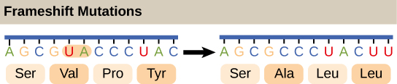
Figure 15.5
The deletion of two nucleotides shifts the reading frame of an mRNA and changes the entire protein message, creating a nonfunctional protein or terminating protein synthesis altogether.
This OpenStax ancillary resource is © Rice University under a CC-BY 4.0 International license; it may be reproduced or modified but must be attributed to OpenStax, Rice University and any changes must be noted. Any images credited to other sources are similarly available for reproduction, but must be attributed to their sources.

Slide 7
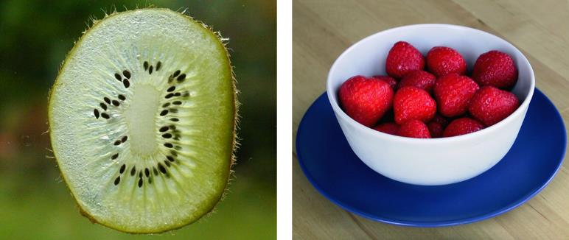
Figure 15.6
Do you think that a kiwi or a strawberry has more DNA per fruit?
(credit “kiwi”: "Kelbv"/Flickr; credit: “strawberry”: Alisdair McDiarmid)
This OpenStax ancillary resource is © Rice University under a CC-BY 4.0 International license; it may be reproduced or modified but must be attributed to OpenStax, Rice University and any changes must be noted. Any images credited to other sources are similarly available for reproduction, but must be attributed to their sources.

Slide 8
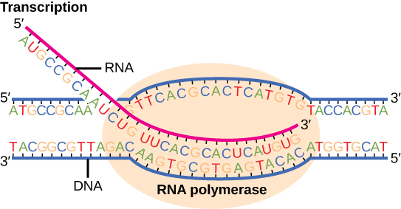
Figure 15.7
Messenger RNA is a copy of protein-coding information in the coding strand of DNA, with the substitution of U in the RNA for T in the coding sequence. However, new RNA nucleotides base pair with the nucleotides of the template strand. RNA is synthesized in its 5'-3' direction, using the enzyme RNA polymerase. As the template is read, the DNA unwinds ahead of the polymerase and then rewinds behind it.
This OpenStax ancillary resource is © Rice University under a CC-BY 4.0 International license; it may be reproduced or modified but must be attributed to OpenStax, Rice University and any changes must be noted. Any images credited to other sources are similarly available for reproduction, but must be attributed to their sources.

Slide 9
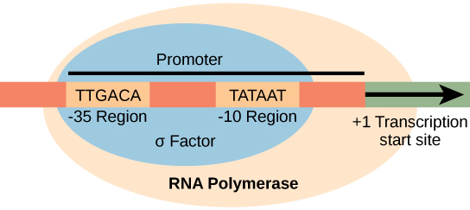
Figure 15.8
The σ subunit of prokaryotic RNA polymerase recognizes consensus sequences found in the promoter region upstream of the transcription start sight. The σ subunit dissociates from the polymerase after transcription has been initiated.
This OpenStax ancillary resource is © Rice University under a CC-BY 4.0 International license; it may be reproduced or modified but must be attributed to OpenStax, Rice University and any changes must be noted. Any images credited to other sources are similarly available for reproduction, but must be attributed to their sources.

Slide 10
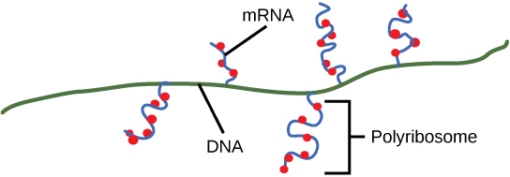
Figure 15.9
Multiple polymerases can transcribe a single bacterial gene while numerous ribosomes concurrently translate the mRNA transcripts into polypeptides. In this way, a specific protein can rapidly reach a high concentration in the bacterial cell.
This OpenStax ancillary resource is © Rice University under a CC-BY 4.0 International license; it may be reproduced or modified but must be attributed to OpenStax, Rice University and any changes must be noted. Any images credited to other sources are similarly available for reproduction, but must be attributed to their sources.

Slide 11
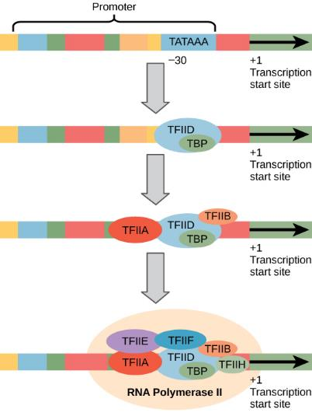
Figure 15.10
A generalized promoter of a gene transcribed by RNA polymerase II is shown. Transcription factors recognize the promoter. RNA polymerase II then binds and forms the transcription initiation complex.
This OpenStax ancillary resource is © Rice University under a CC-BY 4.0 International license; it may be reproduced or modified but must be attributed to OpenStax, Rice University and any changes must be noted. Any images credited to other sources are similarly available for reproduction, but must be attributed to their sources.

Slide 12
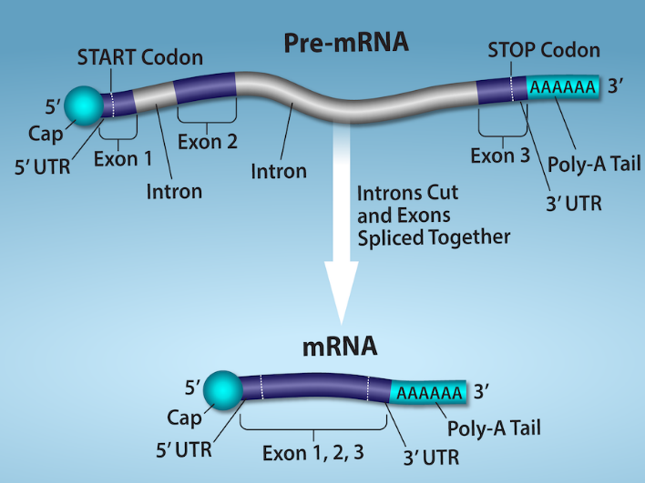
Figure 15.11
(credit: Rao, A., Ryan, K. Fletcher, S. and Tag, A. Department of Biology, Texas A&M University)
This OpenStax ancillary resource is © Rice University under a CC-BY 4.0 International license; it may be reproduced or modified but must be attributed to OpenStax, Rice University and any changes must be noted. Any images credited to other sources are similarly available for reproduction, but must be attributed to their sources.
Notes:
Eukaryotic pre-mRNA processing. In addition to 5’ Cap and 3’ Poly-A Tail addition, introns must be precisely removed and exons joined to generate a functional mRNA. Nucleotides upstream (towards the 5’cap) of the translation START codon are part of the 5’ untranslated region (5’ UTR). Nucleotides downstream (towards 3’end) of the STOP codon form the 3’ UTR. Both 5’ and 3’ UTRs are important for regulating translation initiation and mRNA stability.

Slide 13
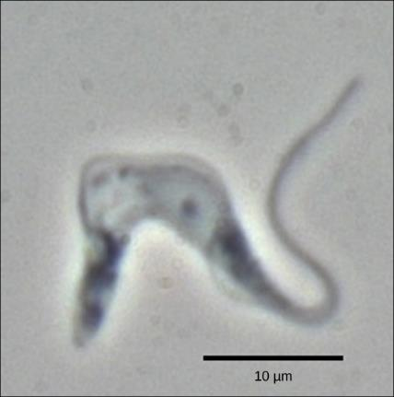
Figure 15.12
Trypanosoma brucei is the causative agent of sleeping sickness in humans. The mRNAs of this pathogen must be modified by the addition of nucleotides before protein synthesis can occur.
(credit: modification of work by Torsten Ochsenreiter)
This OpenStax ancillary resource is © Rice University under a CC-BY 4.0 International license; it may be reproduced or modified but must be attributed to OpenStax, Rice University and any changes must be noted. Any images credited to other sources are similarly available for reproduction, but must be attributed to their sources.

Slide 14
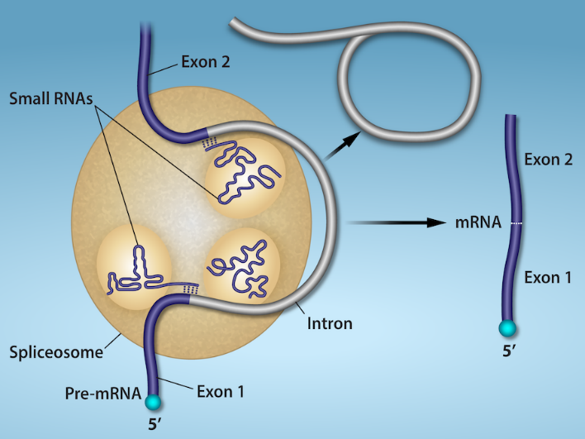
Figure 15.13
(credit: Rao, A., Ryan, K. Fletcher, S. and Tag, A. Department of Biology, Texas A&M University)
This OpenStax ancillary resource is © Rice University under a CC-BY 4.0 International license; it may be reproduced or modified but must be attributed to OpenStax, Rice University and any changes must be noted. Any images credited to other sources are similarly available for reproduction, but must be attributed to their sources.
Notes:
Pre-mRNA splicing involves the precise removal of introns from the primary RNA transcript. The splicing process is catalyzed by protein complexes called spliceosomes that are composed of proteins and RNA molecules called small nuclear RNAs (snRNAs). Spliceosomes recognize sequences at the 5' and 3' end of the intron.

Slide 15
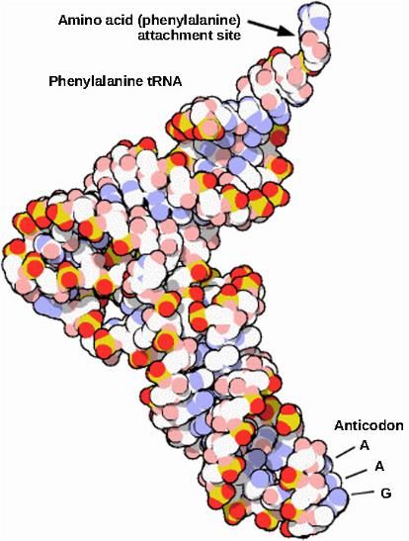
Figure 15.14
This is a space-filling model of a tRNA molecule that adds the amino acid phenylalanine to a growing polypeptide chain. The anticodon AAG binds the Codon UUC on the mRNA. The amino acid phenylalanine is attached to the other end of the tRNA.
This OpenStax ancillary resource is © Rice University under a CC-BY 4.0 International license; it may be reproduced or modified but must be attributed to OpenStax, Rice University and any changes must be noted. Any images credited to other sources are similarly available for reproduction, but must be attributed to their sources.

Slide 16
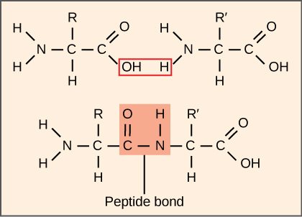
Figure 15.15
A peptide bond links the carboxyl end of one amino acid with the amino end of another, expelling one water molecule. For simplicity in this image, only the functional groups involved in the peptide bond are shown. The R and R' designations refer to the rest of each amino acid structure.
This OpenStax ancillary resource is © Rice University under a CC-BY 4.0 International license; it may be reproduced or modified but must be attributed to OpenStax, Rice University and any changes must be noted. Any images credited to other sources are similarly available for reproduction, but must be attributed to their sources.

Slide 17
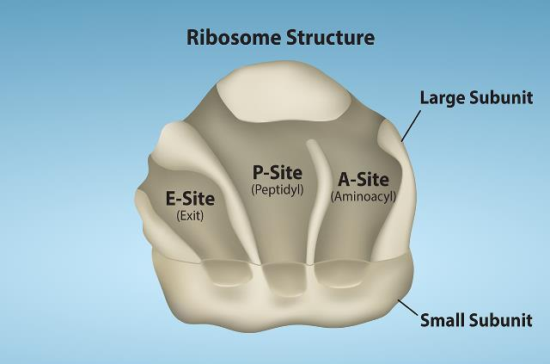
Figure 15.16A
The ribosome is responsible for translating the mRNA into protein. The ribosome consists of a large and small ribosomal subunit. Assembly of the subunits on the mRNA forms three tRNA binding sites.
(credit: Rao, A., Ryan, K. Fletcher, S. and Tag, A. Department of Biology, Texas A&M University)
This OpenStax ancillary resource is © Rice University under a CC-BY 4.0 International license; it may be reproduced or modified but must be attributed to OpenStax, Rice University and any changes must be noted. Any images credited to other sources are similarly available for reproduction, but must be attributed to their sources.

Slide 18
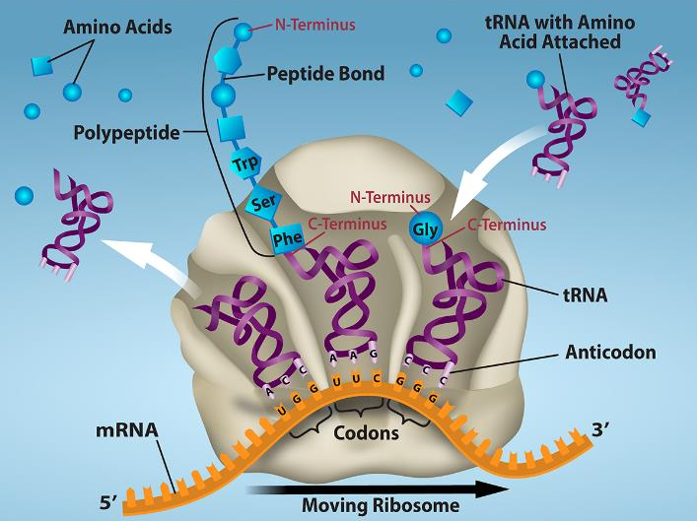
Figure 15.16B
(credit: Rao, A., Ryan, K. Fletcher, S. and Tag, A. Department of Biology, Texas A&M University)
This OpenStax ancillary resource is © Rice University under a CC-BY 4.0 International license; it may be reproduced or modified but must be attributed to OpenStax, Rice University and any changes must be noted. Any images credited to other sources are similarly available for reproduction, but must be attributed to their sources.
Notes:
During translation, charged tRNAs enter the Acceptor site, and the anticodon on the tRNA base pairs with the codon in the mRNA. After the incoming amino acid forms a peptide bond with the growing polypeptide chain, the ribosome will move three nucleotides toward the 3’ end of the mRNA. This movement will transfer the tRNA with the growing polypeptide to the Peptidyl-tRNA binding site and allow the empty tRNA to exit at the Exit site.

Slide 19
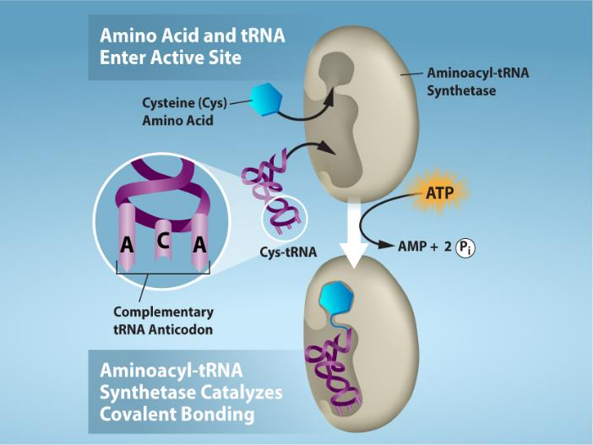
Figure 15.17
(credit: Rao, A., Ryan, K. Fletcher, S. and Tag, A. Department of Biology, Texas A&M University)
This OpenStax ancillary resource is © Rice University under a CC-BY 4.0 International license; it may be reproduced or modified but must be attributed to OpenStax, Rice University and any changes must be noted. Any images credited to other sources are similarly available for reproduction, but must be attributed to their sources.
Notes:
Charging of tRNAs with correct amino acids. Aminoacyl-tRNA synthetases catalyze covalent bond formation between the tRNA and the correct amino acid in preparation for translation. Because there are multiple amino acids, there are multiple different tRNA synthetases. All of the synthetases require energy, in the form of ATP, to make sure the correct amino acid is attached to the tRNA with the correct anticodon sequence.

Slide 20
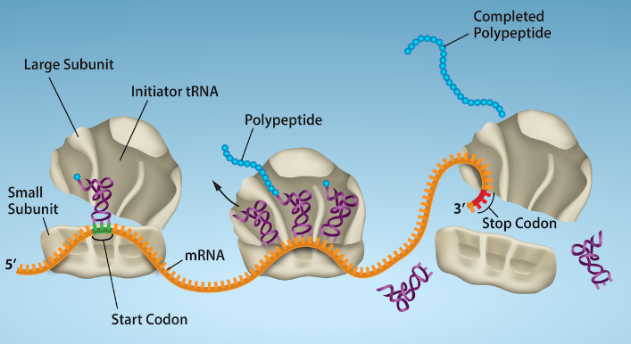
Figure 15.18
Translation begins when an initiator tRNA anticodon recognizes a start codon on mRNA bound to a small ribosomal subunit. The large ribosomal subunit joins the small subunit, and a second tRNA is recruited. As the mRNA moves relative to the ribosome, successive tRNAs move through the ribosome and the polypeptide chain is formed. Entry of a release factor into the A site terminates translation and the components dissociate.
(credit: Rao, A., Ryan, K. Fletcher, S. and Tag, A. Department of Biology, Texas A&M University)
This OpenStax ancillary resource is © Rice University under a CC-BY 4.0 International license; it may be reproduced or modified but must be attributed to OpenStax, Rice University and any changes must be noted. Any images credited to other sources are similarly available for reproduction, but must be attributed to their sources.

Slide 21
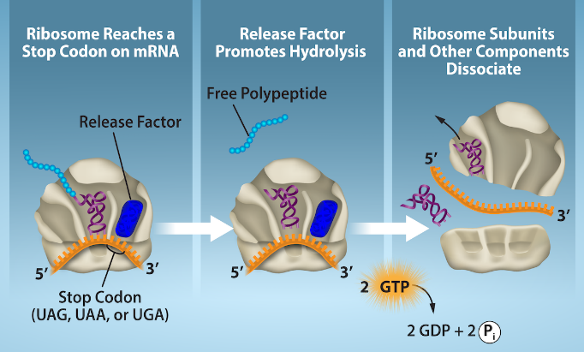
Figure 15.19
Translation is terminated when a STOP codon is in the A-site of the ribosome. Since there are no tRNAs corresponding to the STOP codons, the Release Factor protein enters and catalyzes the hydrolysis between the last amino acid and its tRNA. This hydrolysis releases the free carboxyl terminus (C-term) of the protein. Additional factors use the energy in GTP hydrolysis to disassemble the large and small ribosomal subunits and mRNA.
(credit: Rao, A., Ryan, K. Fletcher, S. and Tag, A. Department of Biology, Texas A&M University)
This OpenStax ancillary resource is © Rice University under a CC-BY 4.0 International license; it may be reproduced or modified but must be attributed to OpenStax, Rice University and any changes must be noted. Any images credited to other sources are similarly available for reproduction, but must be attributed to their sources.

Slide 22
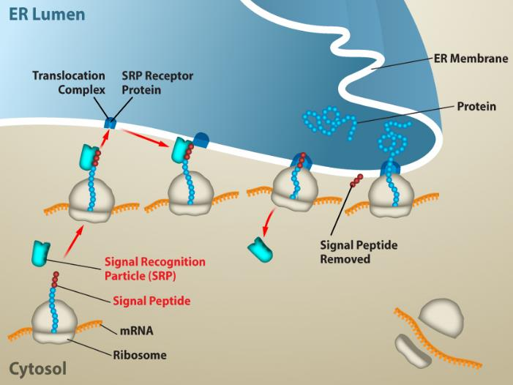
Figure 15.20
(credit: Rao, A., Ryan, K. Fletcher, S. and Tag, A. Department of Biology, Texas A&M University)
This OpenStax ancillary resource is © Rice University under a CC-BY 4.0 International license; it may be reproduced or modified but must be attributed to OpenStax, Rice University and any changes must be noted. Any images credited to other sources are similarly available for reproduction, but must be attributed to their sources.
Notes:
Proteins are co-translationally targeted into the ER for secretion. Proteins that will be secreted from the cell will contain a signal sequence at the N-terminus. The signal will be recognized by SRP as soon as the amino acids emerge from the ribosome, and the ribosome will be targeted to the translocation channel in the ER membrane. The rest of the protein will go directly from the ribosome, across the ER membrane and into the ER lumen. From the ER, proteins can be secreted from the cell via vesicle trafficking.

