Slide 1

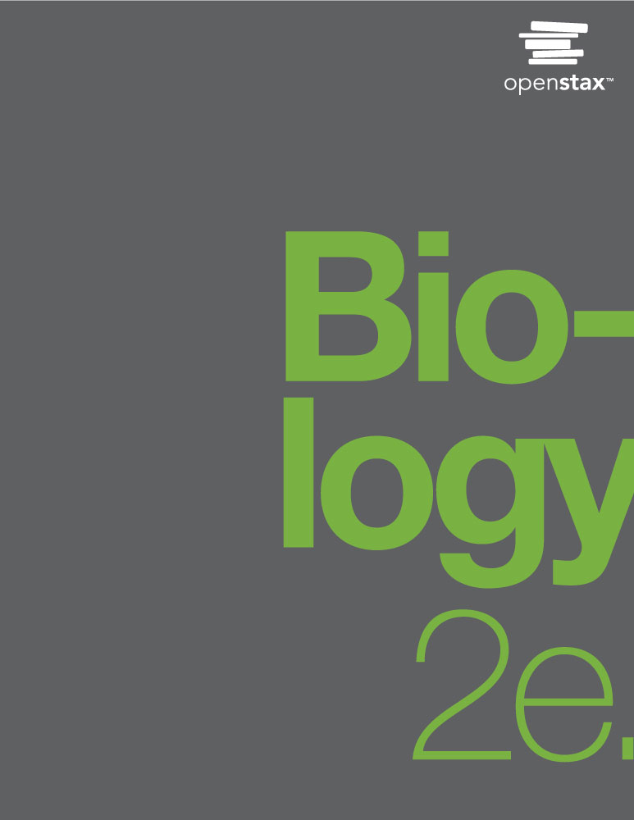
Biology 2e
Chapter 19 THE EVOLUTION OF POPULATIONS
PowerPoint Image Slide Show

Slide 2
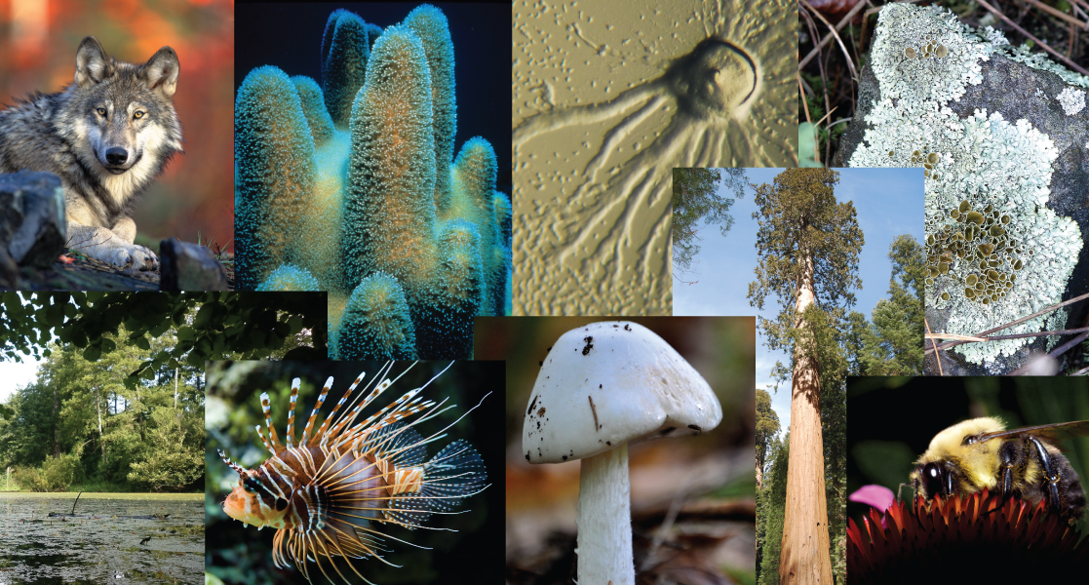
Figure 19.1
Living things may be single-celled or complex, multicellular organisms. They may be plants, animals, fungi, bacteria, or archaea. This diversity results from evolution.
(credit "wolf": modification of work by Gary Kramer; credit "coral": modification of work by William Harrigan, NOAA; credit "river": modification of work by Vojtěch Dostál; credit "fish" modification of work by Christian Mehlführer; credit "mushroom": modification of work by Cory Zanker; credit "tree": modification of work by Joseph Kranak; credit "bee": modification of work by Cory Zanker)
This OpenStax ancillary resource is © Rice University under a CC-BY 4.0 International license; it may be reproduced or modified but must be attributed to OpenStax, Rice University and any changes must be noted. Any images credited to other sources are similarly available for reproduction, but must be attributed to their sources.

Slide 3
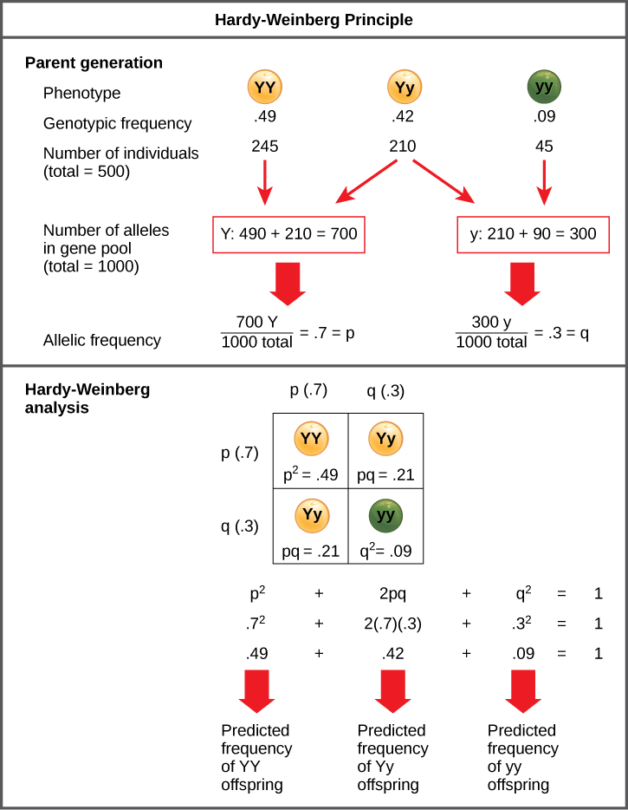
Figure 19.2
When populations are in the Hardy–Weinberg equilibrium, the allelic frequency is stable from generation to generation and the distribution of alleles can be determined from the Hardy–Weinberg equation. If the allelic frequency measured in the field differs from the predicted value, scientists can make inferences about what evolutionary forces are at play.
This OpenStax ancillary resource is © Rice University under a CC-BY 4.0 International license; it may be reproduced or modified but must be attributed to OpenStax, Rice University and any changes must be noted. Any images credited to other sources are similarly available for reproduction, but must be attributed to their sources.

Slide 4
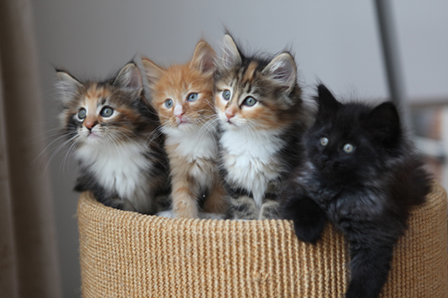
Figure 19.3
The distribution of phenotypes in this litter of kittens illustrates population variation.
(credit: Pieter Lanser)
This OpenStax ancillary resource is © Rice University under a CC-BY 4.0 International license; it may be reproduced or modified but must be attributed to OpenStax, Rice University and any changes must be noted. Any images credited to other sources are similarly available for reproduction, but must be attributed to their sources.

Slide 5
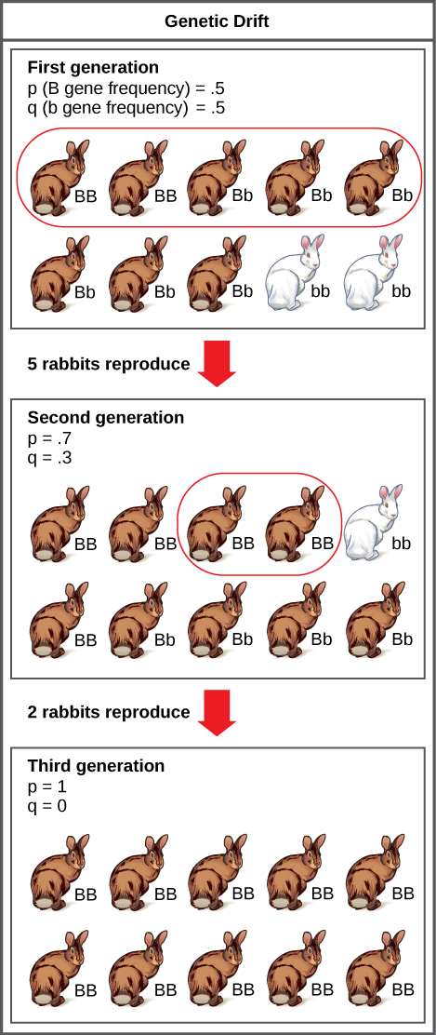
Figure 19.4
Genetic drift occurs when the gene frequency of a population shifts by random chance (i.e. without a selective pressure). Over time, genetic drift can completely eliminate an allele from the population. For example, in the first generation here, the two alleles B and b occur with equal frequency, so p = q = 0.5. If only half the individuals reproduce, and by chance most of the reproducing alleles of are of B, then the second generation results in p = 0.7 and q = 0.3. In the second generation, only two individuals, both of whom are homozygote in B, reproduce. This leads to a loss of b from the third generation.
This OpenStax ancillary resource is © Rice University under a CC-BY 4.0 International license; it may be reproduced or modified but must be attributed to OpenStax, Rice University and any changes must be noted. Any images credited to other sources are similarly available for reproduction, but must be attributed to their sources.

Slide 6
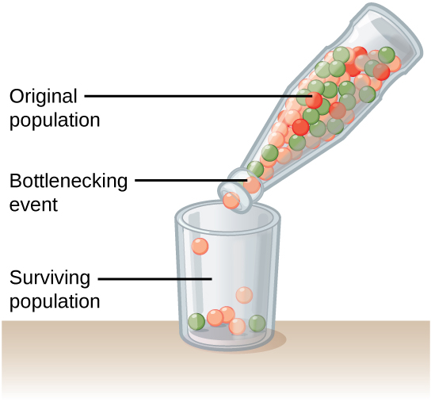
Figure 19.5
A chance event or catastrophe can reduce the genetic variability within a population.
This OpenStax ancillary resource is © Rice University under a CC-BY 4.0 International license; it may be reproduced or modified but must be attributed to OpenStax, Rice University and any changes must be noted. Any images credited to other sources are similarly available for reproduction, but must be attributed to their sources.

Slide 7
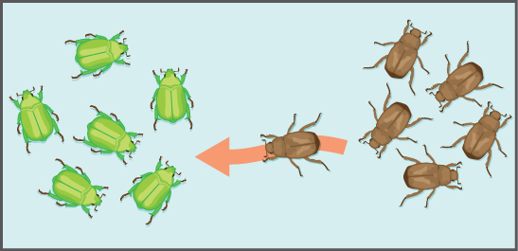
Figure 19.6
Gene flow can occur when an individual travels from one geographic location to another.
This OpenStax ancillary resource is © Rice University under a CC-BY 4.0 International license; it may be reproduced or modified but must be attributed to OpenStax, Rice University and any changes must be noted. Any images credited to other sources are similarly available for reproduction, but must be attributed to their sources.

Slide 8
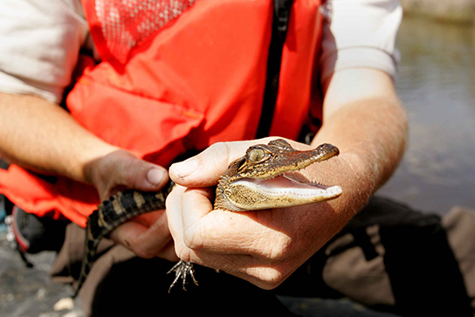
Figure 19.7
The sex of the American alligator (Alligator mississippiensis) is determined by the temperature at which the eggs are incubated. Eggs incubated at 30°C produce females, and eggs incubated at 33°C produce males.
(credit: Steve Hillebrand, USFWS)
This OpenStax ancillary resource is © Rice University under a CC-BY 4.0 International license; it may be reproduced or modified but must be attributed to OpenStax, Rice University and any changes must be noted. Any images credited to other sources are similarly available for reproduction, but must be attributed to their sources.

Slide 9
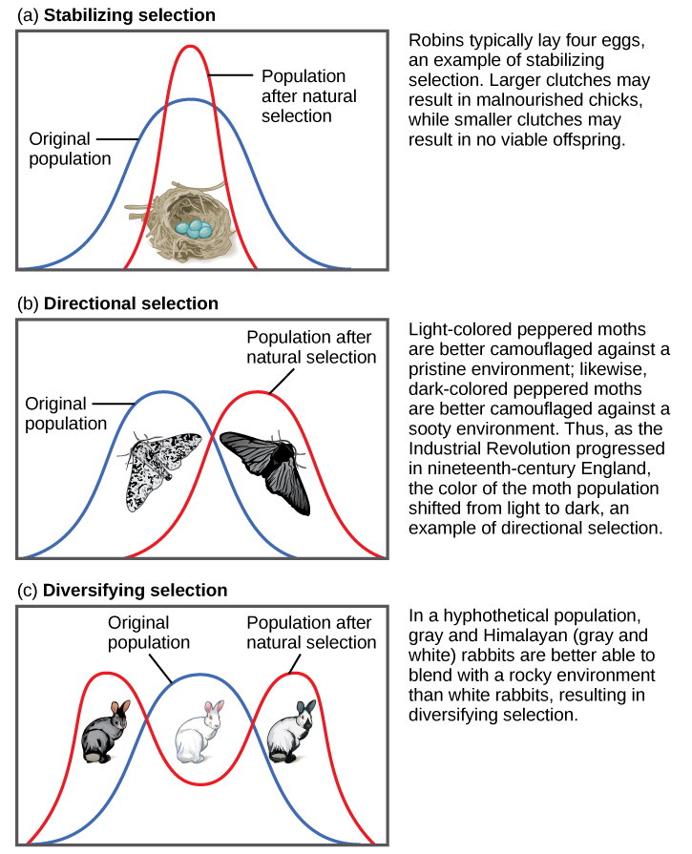
Figure 19.8
Different types of natural selection can impact the distribution of phenotypes within a population. In (a) stabilizing selection, an average phenotype is favored. In (b) directional selection, a change in the environment shifts the spectrum of phenotypes observed. In (c) diversifying selection, two or more extreme phenotypes are selected for, while the average phenotype is selected against.
This OpenStax ancillary resource is © Rice University under a CC-BY 4.0 International license; it may be reproduced or modified but must be attributed to OpenStax, Rice University and any changes must be noted. Any images credited to other sources are similarly available for reproduction, but must be attributed to their sources.

Slide 10
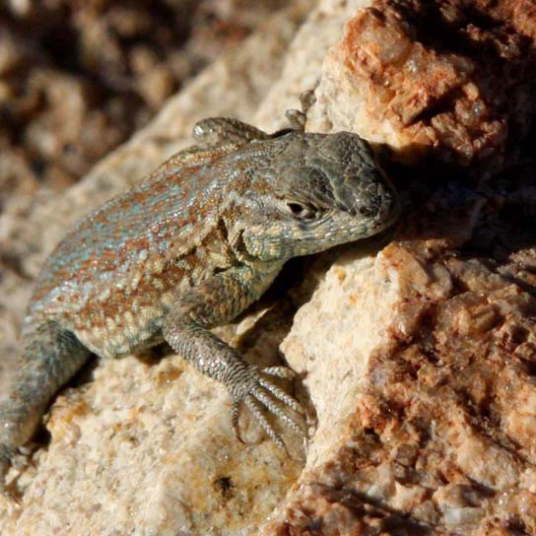
Figure 19.9
A yellow-throated side-blotched lizard is smaller than either the blue-throated or orange-throated males and appears a bit like the females of the species, allowing it to sneak copulations.
(credit: “tinyfroglet”/Flickr)
This OpenStax ancillary resource is © Rice University under a CC-BY 4.0 International license; it may be reproduced or modified but must be attributed to OpenStax, Rice University and any changes must be noted. Any images credited to other sources are similarly available for reproduction, but must be attributed to their sources.

Slide 11
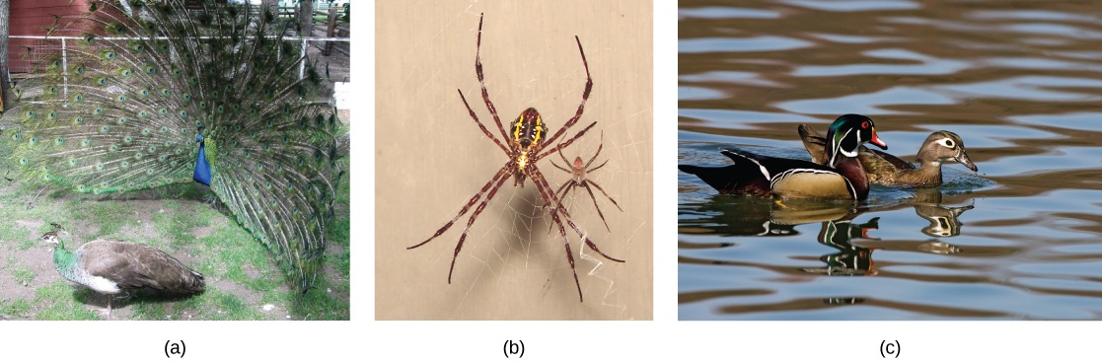
Figure 19.10
Sexual dimorphism is observed in (a) peacocks and peahens, (b) Argiope appensa spiders (the female spider is the large one), and in (c) wood ducks.
(credit “spiders”: modification of work by “Sanba38”/Wikimedia Commons; credit “duck”: modification of work by Kevin Cole)
This OpenStax ancillary resource is © Rice University under a CC-BY 4.0 International license; it may be reproduced or modified but must be attributed to OpenStax, Rice University and any changes must be noted. Any images credited to other sources are similarly available for reproduction, but must be attributed to their sources.

