Slide 1


Biology 2e
Chapter 21 VIRUSES
PowerPoint Image Slide Show

Slide 2
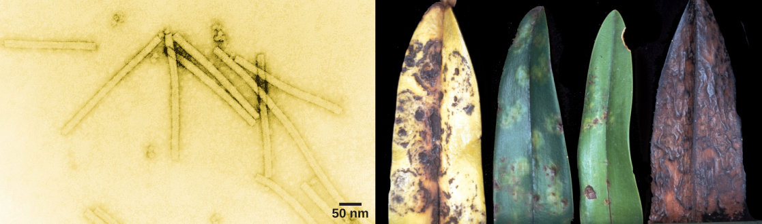
Figure 21.1
The tobacco mosaic virus (left), seen here by transmission electron microscopy, was the first virus to be discovered. The virus causes disease in tobacco and other plants, such as the orchid (right).
(credit a: USDA ARS; credit b: modification of work by USDA Forest Service, Department of Plant Pathology Archive North Carolina State University; scale-bar data from Matt Russell)
This OpenStax ancillary resource is © Rice University under a CC-BY 4.0 International license; it may be reproduced or modified but must be attributed to OpenStax, Rice University and any changes must be noted. Any images credited to other sources are similarly available for reproduction, but must be attributed to their sources.

Slide 3
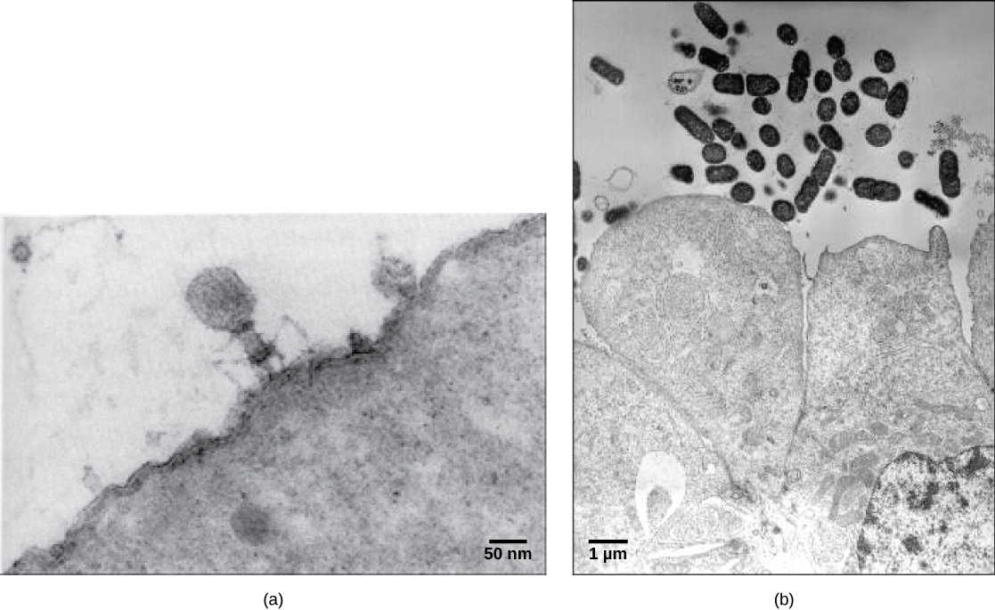
Figure 21.2
In these transmission electron micrographs, (a) a virus is dwarfed by the bacterial cell it infects, while (b) these E. coli cells are dwarfed by cultured colon cells.
(credit a: modification of work by U.S. Dept. of Energy, Office of Science, LBL, PBD; credit b: modification of work by J.P. Nataro and S. Sears, unpub. data, CDC; scale-bar data from Matt Russell)
This OpenStax ancillary resource is © Rice University under a CC-BY 4.0 International license; it may be reproduced or modified but must be attributed to OpenStax, Rice University and any changes must be noted. Any images credited to other sources are similarly available for reproduction, but must be attributed to their sources.

Slide 4
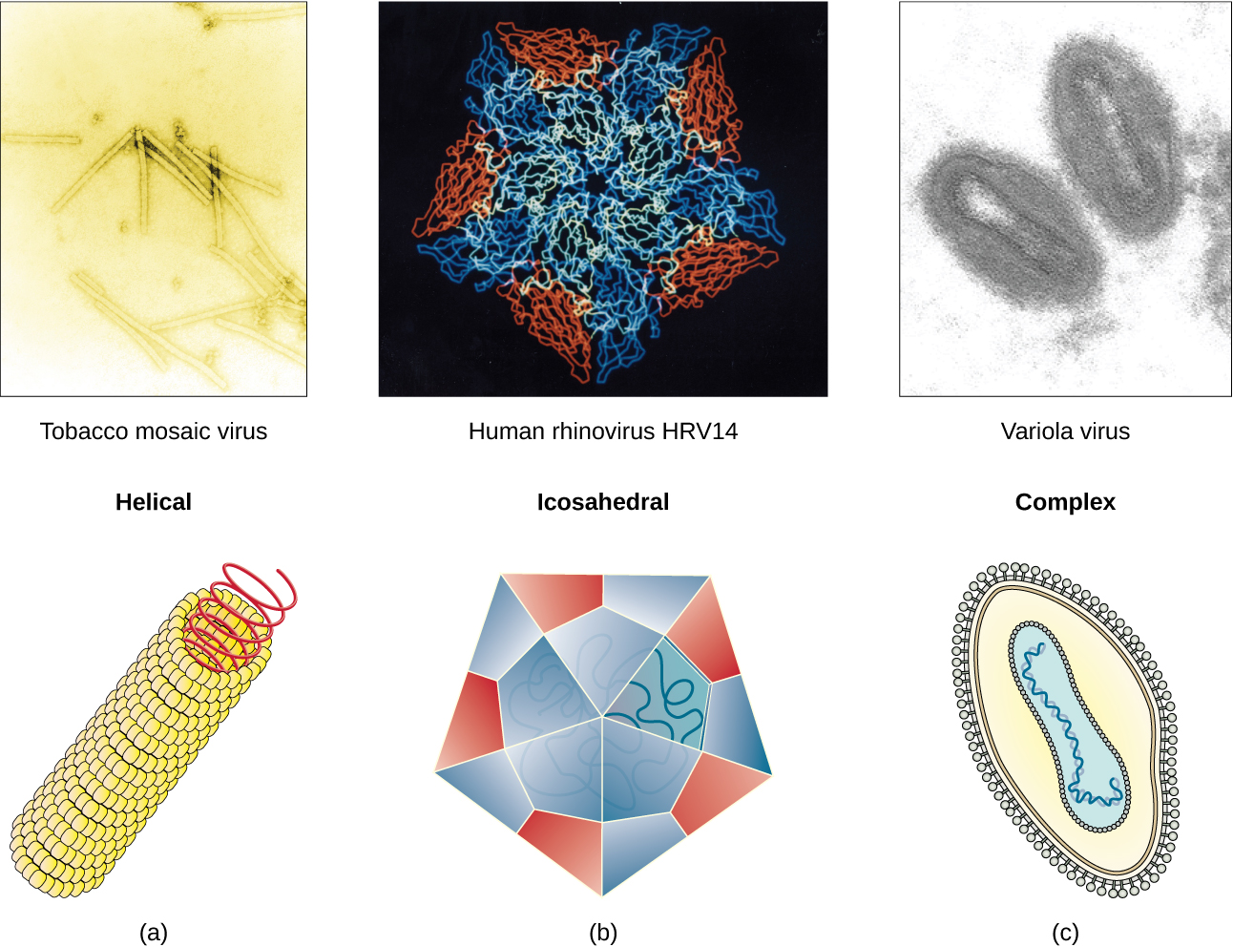
Figure 21.3
Viral capsids can be (a) helical, (b) polyhedral, or (c) have a complex shape.
(credit a “micrograph”: modification of work by USDA ARS; credit b “micrograph”: modification of work by U.S. Department of Energy)
This OpenStax ancillary resource is © Rice University under a CC-BY 4.0 International license; it may be reproduced or modified but must be attributed to OpenStax, Rice University and any changes must be noted. Any images credited to other sources are similarly available for reproduction, but must be attributed to their sources.

Slide 5
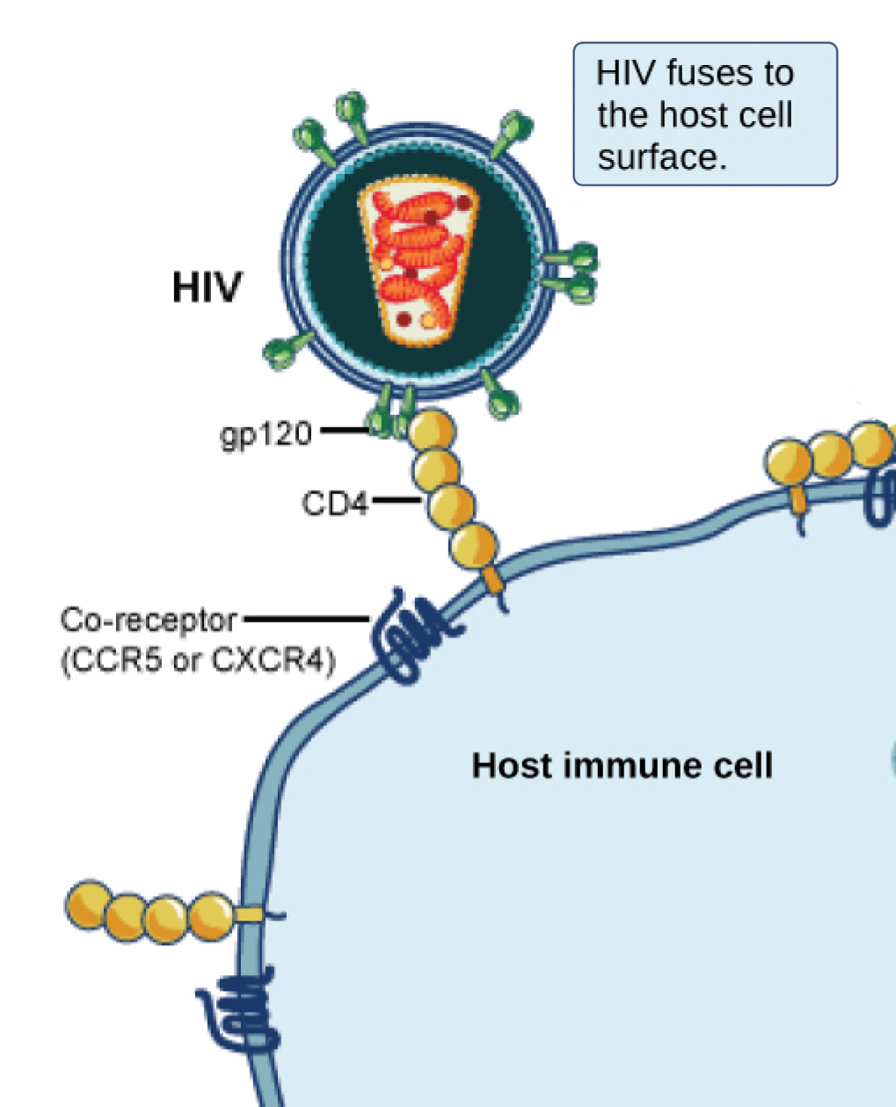
Figure 21.4
A virus and its host receptor protein. The HIV virus binds the CD4 receptor on the surface of human cells. CD4 receptors help white blood cells to communicate with other cells of the immune system when producing an immune response.
(credit: modification of work by NIAID, NIH)
This OpenStax ancillary resource is © Rice University under a CC-BY 4.0 International license; it may be reproduced or modified but must be attributed to OpenStax, Rice University and any changes must be noted. Any images credited to other sources are similarly available for reproduction, but must be attributed to their sources.

Slide 6
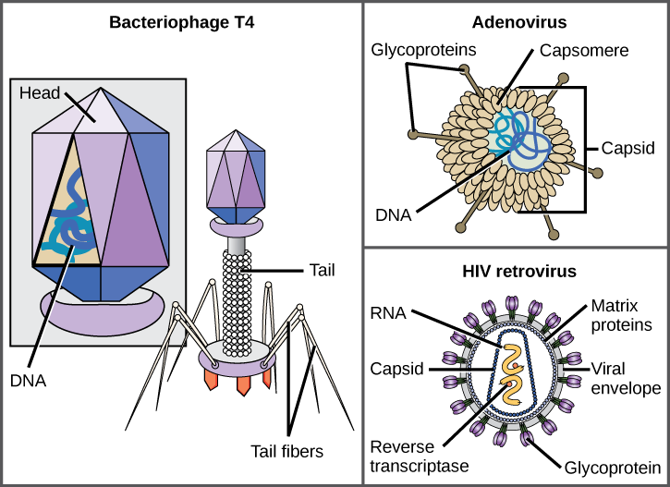
Figure 21.5
Viruses can be either complex in shape or relatively simple. This figure shows three relatively complex virions: the bacteriophage T4, with its DNA-containing head group and tail fibers that attach to host cells; adenovirus, which uses spikes from its capsid to bind to host cells; and HIV, which uses glycoproteins embedded in its envelope to bind to host cells. Notice that HIV has proteins called matrix proteins, internal to the envelope, which help stabilize virion shape.
(credit “bacteriophage, adenovirus”: modification of work by NCBI, NIH; credit “HIV retrovirus”: modification of work by NIAID, NIH)
This OpenStax ancillary resource is © Rice University under a CC-BY 4.0 International license; it may be reproduced or modified but must be attributed to OpenStax, Rice University and any changes must be noted. Any images credited to other sources are similarly available for reproduction, but must be attributed to their sources.

Slide 7
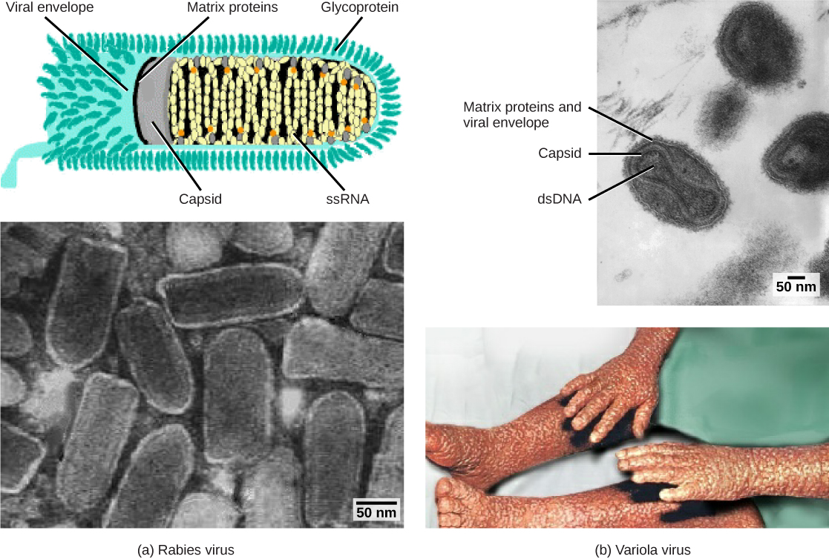
Figure 21.6
Viruses are classified based on their core genetic material and capsid design.
(credit “rabies diagram”: modification of work by CDC; “rabies micrograph”: modification of work by Dr. Fred Murphy, CDC; credit “small pox micrograph”: modification of work by Dr. Fred Murphy, Sylvia Whitfield, CDC; credit “smallpox photo”: modification of work by CDC; scale-bar data from Matt Russell)
This OpenStax ancillary resource is © Rice University under a CC-BY 4.0 International license; it may be reproduced or modified but must be attributed to OpenStax, Rice University and any changes must be noted. Any images credited to other sources are similarly available for reproduction, but must be attributed to their sources.

Slide 8
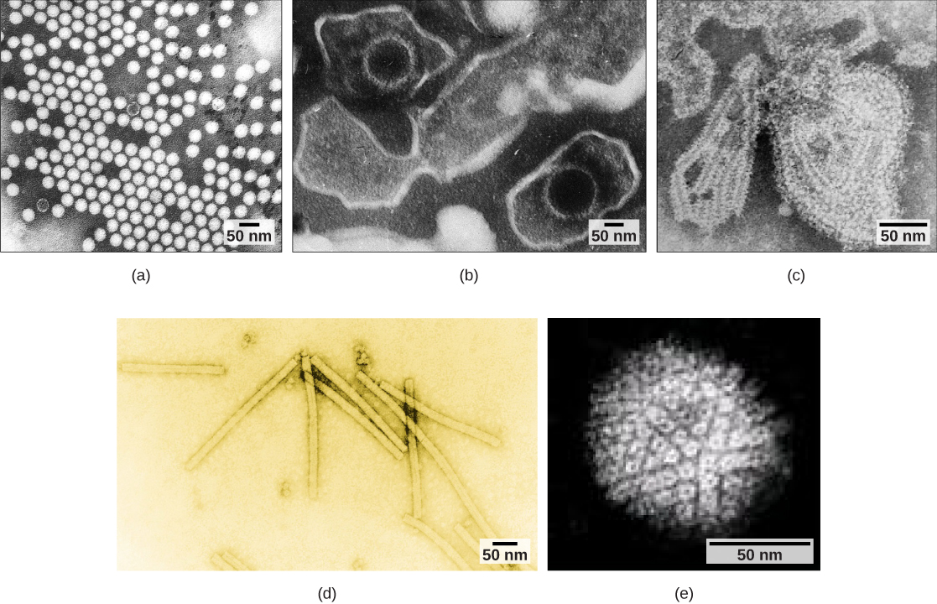
Figure 21.7
Transmission electron micrographs of various viruses show their structures.
(credit a: modification of work by Dr. Fred Murphy, Sylvia Whitfield; credit b: modification of work by Liza Gross; credit c: modification of work by Dr. F. A. Murphy, CDC; credit d: modification of work by USDA ARS; credit e: modification of work by Linda Stannard, Department of Medical Microbiology, University of Cape Town, South Africa, NASA; scale-bar data from Matt Russell)
This OpenStax ancillary resource is © Rice University under a CC-BY 4.0 International license; it may be reproduced or modified but must be attributed to OpenStax, Rice University and any changes must be noted. Any images credited to other sources are similarly available for reproduction, but must be attributed to their sources.

Slide 9
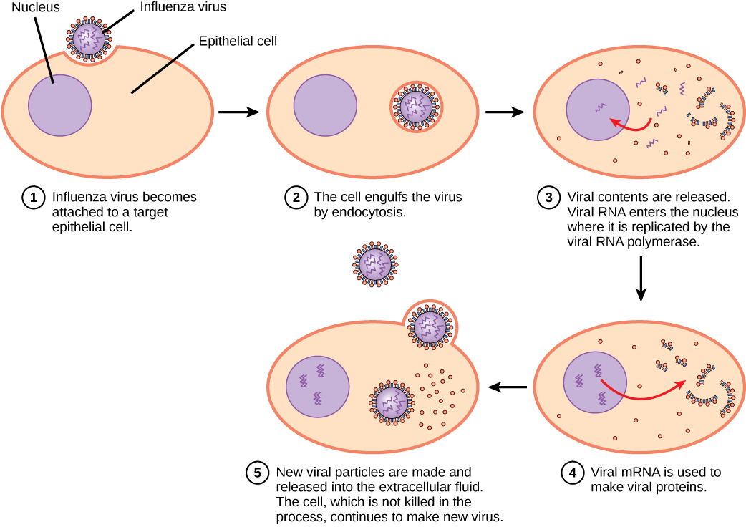
Figure 21.8
In influenza virus infection, glycoproteins attach to a host epithelial cell. As a result, the virus is engulfed. RNA and proteins are made and assembled into new virions.
This OpenStax ancillary resource is © Rice University under a CC-BY 4.0 International license; it may be reproduced or modified but must be attributed to OpenStax, Rice University and any changes must be noted. Any images credited to other sources are similarly available for reproduction, but must be attributed to their sources.

Slide 10
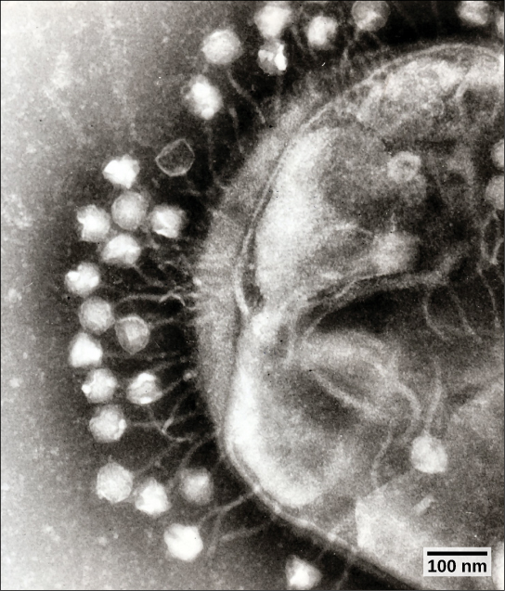
Figure 21.9
This transmission electron micrograph shows bacteriophages attached to a bacterial cell.
(credit: modification of work by Dr. Graham Beards; scale-bar data from Matt Russell)
This OpenStax ancillary resource is © Rice University under a CC-BY 4.0 International license; it may be reproduced or modified but must be attributed to OpenStax, Rice University and any changes must be noted. Any images credited to other sources are similarly available for reproduction, but must be attributed to their sources.

Slide 11
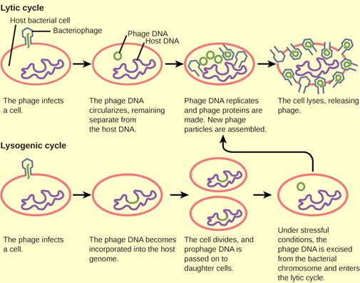
Figure 21.10
A temperate bacteriophage has both lytic and lysogenic cycles. In the lytic cycle, the phage replicates and lyses the host cell. In the lysogenic cycle, phage DNA is incorporated into the host genome, where it is passed on to subsequent generations. Environmental stressors such as starvation or exposure to toxic chemicals may cause the prophage to excise and enter the lytic cycle.
This OpenStax ancillary resource is © Rice University under a CC-BY 4.0 International license; it may be reproduced or modified but must be attributed to OpenStax, Rice University and any changes must be noted. Any images credited to other sources are similarly available for reproduction, but must be attributed to their sources.

Slide 12
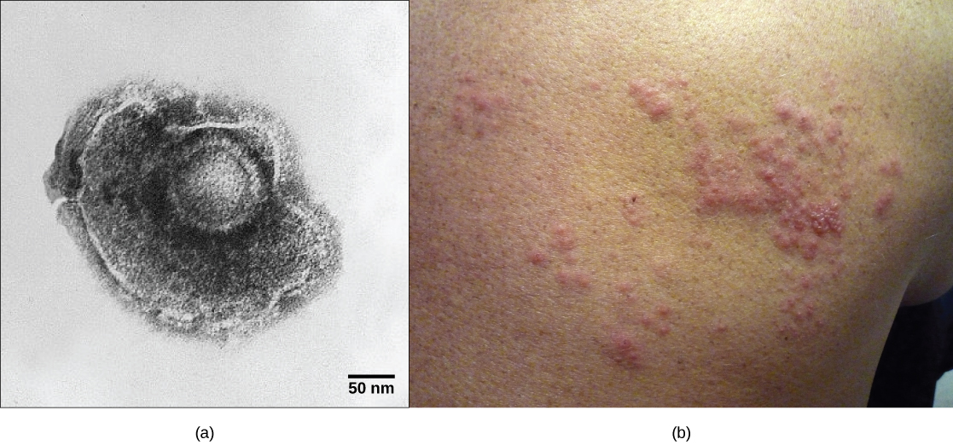
Figure 21.11
(a) Varicella-zoster, the virus that causes chickenpox, has an enveloped icosahedral capsid visible in this transmission electron micrograph. Its double-stranded DNA genome becomes incorporated in the host DNA and can reactivate after latency in the form of (b) shingles, often exhibiting a rash.
(credit a: modification of work by Dr. Erskine Palmer, B. G. Martin, CDC; credit b: modification of work by “rosmary”/Flickr; scale-bar data from Matt Russell)
This OpenStax ancillary resource is © Rice University under a CC-BY 4.0 International license; it may be reproduced or modified but must be attributed to OpenStax, Rice University and any changes must be noted. Any images credited to other sources are similarly available for reproduction, but must be attributed to their sources.

Slide 13
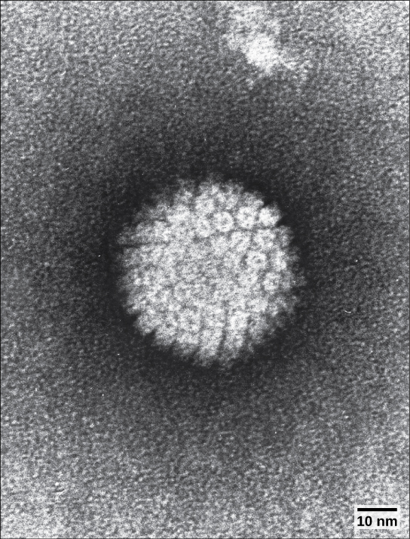
Figure 21.12
HPV, or human papillomavirus, has a naked icosahedral capsid visible in this transmission electron micrograph and a double-stranded DNA genome that is incorporated into the host DNA. The virus, is oncogenic and can lead to cervical cancer.
(credit: modification of work by NCI, NIH; scale-bar data from Matt Russell)
This OpenStax ancillary resource is © Rice University under a CC-BY 4.0 International license; it may be reproduced or modified but must be attributed to OpenStax, Rice University and any changes must be noted. Any images credited to other sources are similarly available for reproduction, but must be attributed to their sources.

Slide 14
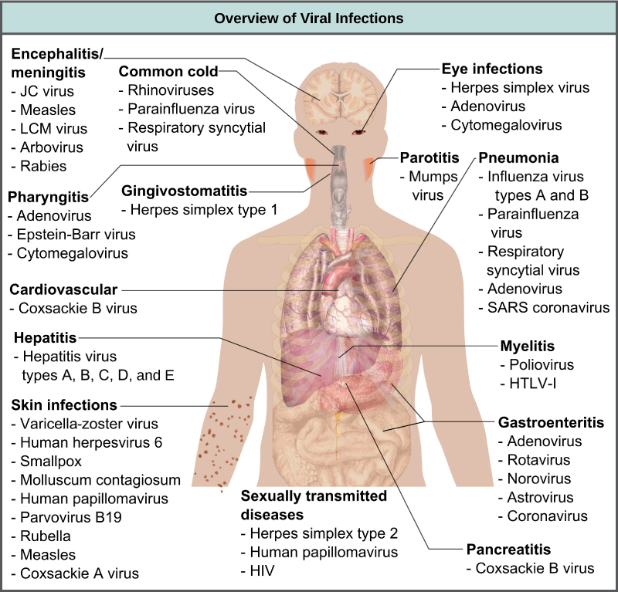
Figure 21.13
Viruses can cause dozens of ailments in humans, ranging from mild illnesses to serious diseases.
(credit: modification of work by Mikael Häggström)
This OpenStax ancillary resource is © Rice University under a CC-BY 4.0 International license; it may be reproduced or modified but must be attributed to OpenStax, Rice University and any changes must be noted. Any images credited to other sources are similarly available for reproduction, but must be attributed to their sources.

Slide 15
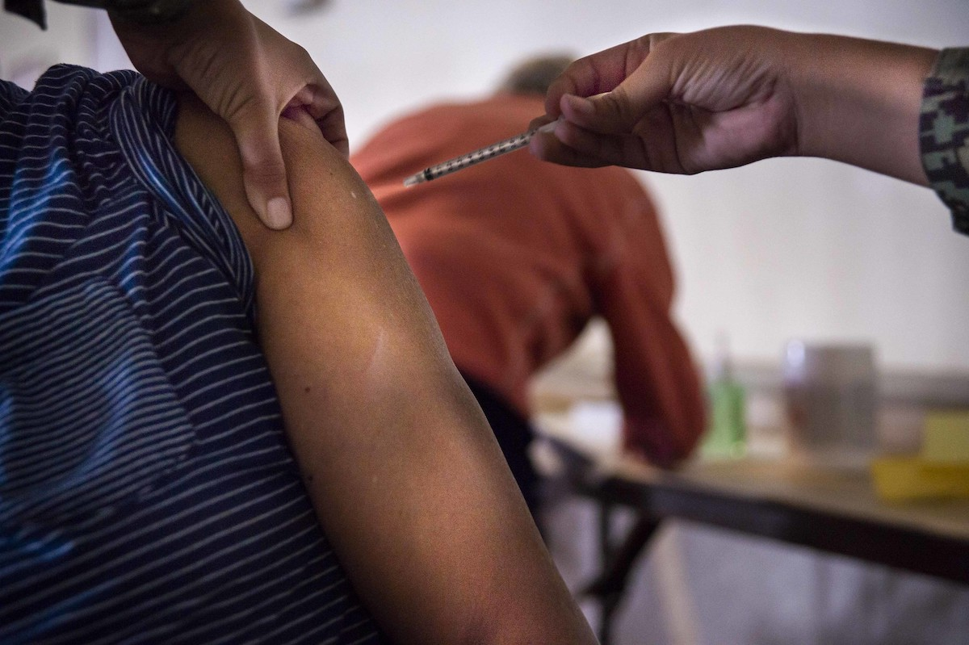
Figure 21.14
Vaccinations are designed to boost immunity to a virus to prevent infection.
(credit: USACE Europe District)
This OpenStax ancillary resource is © Rice University under a CC-BY 4.0 International license; it may be reproduced or modified but must be attributed to OpenStax, Rice University and any changes must be noted. Any images credited to other sources are similarly available for reproduction, but must be attributed to their sources.

Slide 16
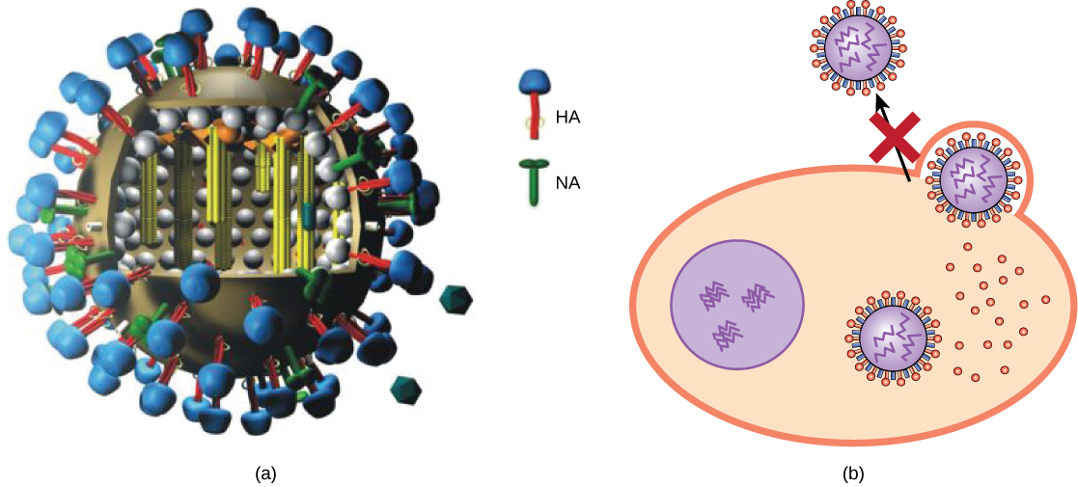
Figure 21.15
Action of an antiviral drug. (a) Tamiflu inhibits a viral enzyme called neuraminidase (NA) found in the influenza viral envelope. (b) Neuraminidase cleaves the connection between viral hemagglutinin (HA), also found in the viral envelope, and glycoproteins on the host cell surface. Inhibition of neuraminidase prevents the virus from detaching from the host cell, thereby blocking further infection.
(credit a: modification of work by M. Eickmann)
This OpenStax ancillary resource is © Rice University under a CC-BY 4.0 International license; it may be reproduced or modified but must be attributed to OpenStax, Rice University and any changes must be noted. Any images credited to other sources are similarly available for reproduction, but must be attributed to their sources.

Slide 17
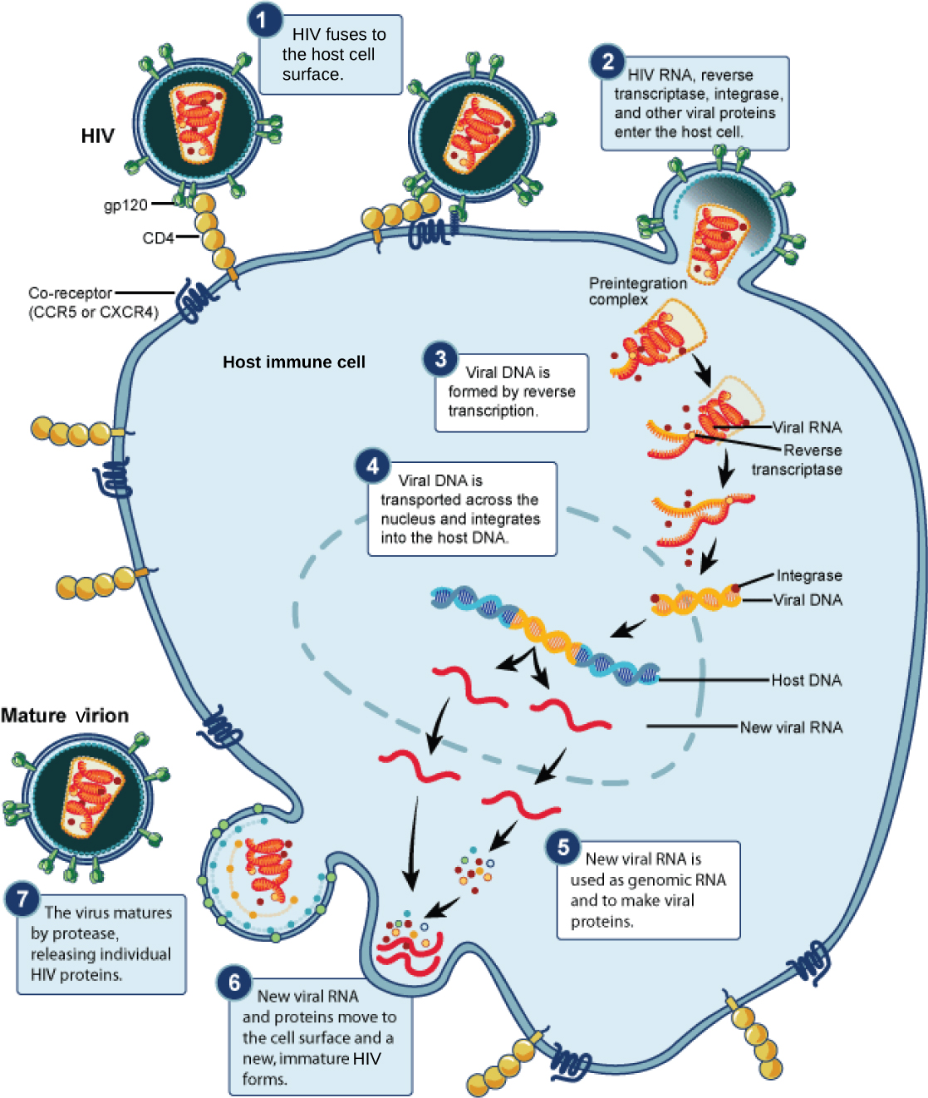
Figure 21.16
HIV, an enveloped, icosahedral virus, attaches to the CD4 receptor of an immune cell and fuses with the cell membrane. Viral contents are released into the cell, where viral enzymes convert the single-stranded RNA genome into DNA and incorporate it into the host genome.
(credit: NIAID, NIH)
This OpenStax ancillary resource is © Rice University under a CC-BY 4.0 International license; it may be reproduced or modified but must be attributed to OpenStax, Rice University and any changes must be noted. Any images credited to other sources are similarly available for reproduction, but must be attributed to their sources.

Slide 18
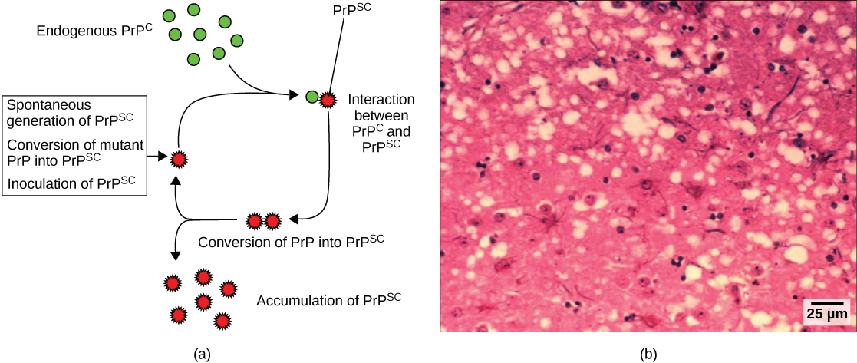
Figure 21.17
(a) Endogenous normal prion protein (PrP^{c}) is converted into the disease-causing form (PrP^{sc}) when it encounters this variant form of the protein. PrP^{sc} may arise spontaneously in brain tissue, especially if a mutant form of the protein is present, or it may occur via the spread of misfolded prions consumed in food into brain tissue. (b) This prion-infected brain tissue, visualized using light microscopy, shows the vacuoles that give it a spongy texture, typical of transmissible spongiform encephalopathies.
(credit b: modification of work by Dr. Al Jenny, USDA APHIS; scale-bar data from Matt Russell)
This OpenStax ancillary resource is © Rice University under a CC-BY 4.0 International license; it may be reproduced or modified but must be attributed to OpenStax, Rice University and any changes must be noted. Any images credited to other sources are similarly available for reproduction, but must be attributed to their sources.

Slide 19
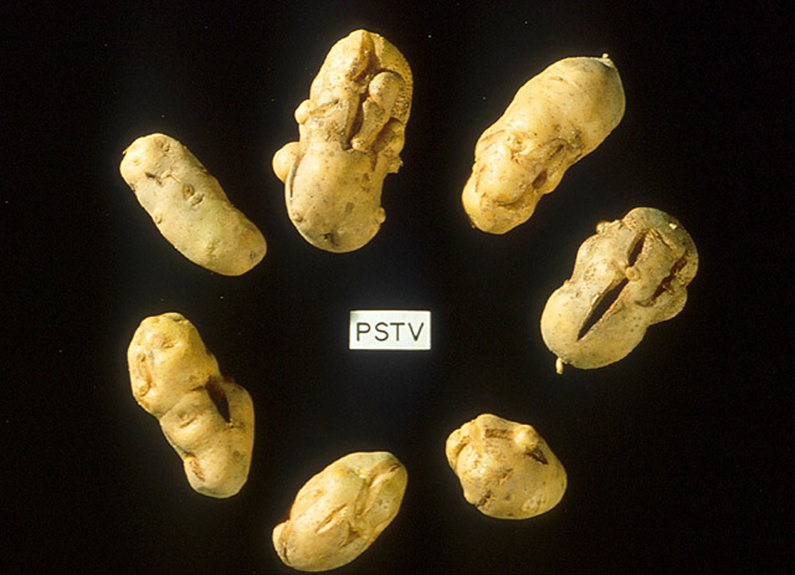
Figure 21.18
These potatoes have been infected by the potato spindle tuber viroid (PSTV), which is typically spread when infected knives are used to cut healthy potatoes, which are then planted.
(credit: Pamela Roberts, University of Florida Institute of Food and Agricultural Sciences, USDA ARS)
This OpenStax ancillary resource is © Rice University under a CC-BY 4.0 International license; it may be reproduced or modified but must be attributed to OpenStax, Rice University and any changes must be noted. Any images credited to other sources are similarly available for reproduction, but must be attributed to their sources.

Slide 20
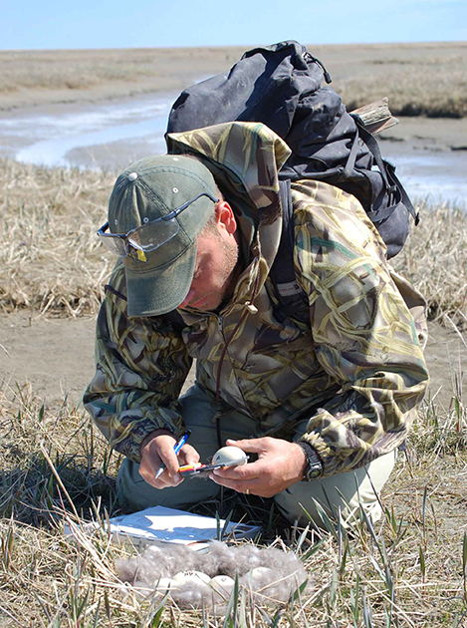
Figure 21.19
This virologist is engaged in fieldwork, sampling eggs from this nest for avian influenza.
(credit: Don Becker, USGS EROS, U.S. Fish and Wildlife Service)
This OpenStax ancillary resource is © Rice University under a CC-BY 4.0 International license; it may be reproduced or modified but must be attributed to OpenStax, Rice University and any changes must be noted. Any images credited to other sources are similarly available for reproduction, but must be attributed to their sources.

