Slide 1


Biology 2e
Chapter 22 PROKARYOTES: BACTERIA AND ARCHAEA
PowerPoint Image Slide Show

Slide 2
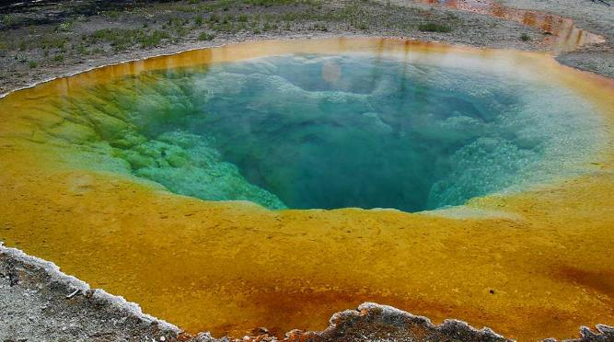
Figure 22.1
Certain prokaryotes can live in extreme environments such as the Morning Glory pool, a hot spring in Yellowstone National Park. The spring’s vivid blue color is from the prokaryotes that thrive in its very hot waters.
(credit: modification of work by Jon Sullivan)
This OpenStax ancillary resource is © Rice University under a CC-BY 4.0 International license; it may be reproduced or modified but must be attributed to OpenStax, Rice University and any changes must be noted. Any images credited to other sources are similarly available for reproduction, but must be attributed to their sources.

Slide 3
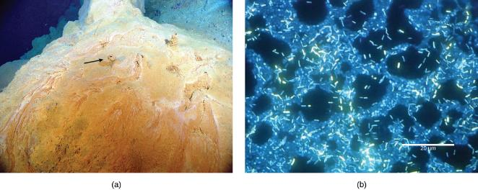
Figure 22.2
This (a) microbial mat, about one meter in diameter, grows over a hydrothermal vent in the Pacific Ocean in a region known as the “Pacific Ring of Fire.” The mat helps retain microbial nutrients. Chimneys such as the one indicated by the arrow allow gases to escape. (b) In this micrograph, bacteria are visualized using fluorescence microscopy.
(credit a: modification of work by Dr. Bob Embley, NOAA PMEL, Chief Scientist; credit b: modification of work by Ricardo Murga, Rodney Donlan, CDC; scale-bar data from Matt Russell)
This OpenStax ancillary resource is © Rice University under a CC-BY 4.0 International license; it may be reproduced or modified but must be attributed to OpenStax, Rice University and any changes must be noted. Any images credited to other sources are similarly available for reproduction, but must be attributed to their sources.

Slide 4
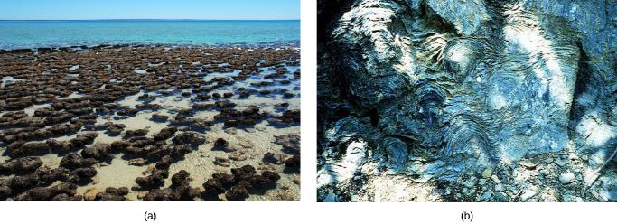
Figure 22.3
(a) These living stromatolites are located in Shark Bay, Australia. (b) These fossilized stromatolites, found in Glacier National Park, Montana, are nearly 1.5 billion years old.
(credit a: Robert Young; credit b: P. Carrara, NPS)
This OpenStax ancillary resource is © Rice University under a CC-BY 4.0 International license; it may be reproduced or modified but must be attributed to OpenStax, Rice University and any changes must be noted. Any images credited to other sources are similarly available for reproduction, but must be attributed to their sources.

Slide 5
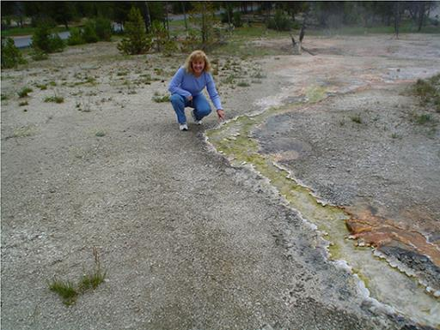
Figure 22.4
This hot spring in Yellowstone National Park flows toward the foreground. Cyanobacteria in the spring are green, and as water flows down the gradient, the intensity of the color increases as cell density increases. The water is cooler at the edges of the stream than in the center, causing the edges to appear greener.
(credit: Graciela Brelles-Mariño)
This OpenStax ancillary resource is © Rice University under a CC-BY 4.0 International license; it may be reproduced or modified but must be attributed to OpenStax, Rice University and any changes must be noted. Any images credited to other sources are similarly available for reproduction, but must be attributed to their sources.

Slide 6
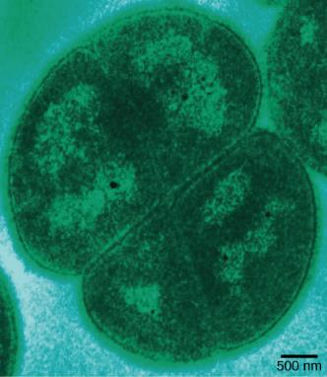
Figure 22.5
Deinococcus radiodurans, visualized in this false color transmission electron micrograph, is a prokaryote that can tolerate very high doses of ionizing radiation. It has developed DNA repair mechanisms that allow it to reconstruct its chromosome even if it has been broken into hundreds of pieces by radiation or heat.
(credit: modification of work by Michael Daly; scale-bar data from Matt Russell)
This OpenStax ancillary resource is © Rice University under a CC-BY 4.0 International license; it may be reproduced or modified but must be attributed to OpenStax, Rice University and any changes must be noted. Any images credited to other sources are similarly available for reproduction, but must be attributed to their sources.

Slide 7
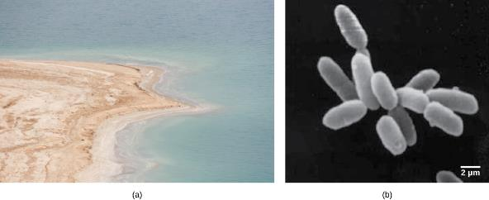
Figure 22.6
(a) The Dead Sea is hypersaline. Nevertheless, salt-tolerant bacteria thrive in this sea. (b) These halobacteria cells can form salt-tolerant bacterial mats.
(credit a: Julien Menichini; credit b: NASA; scale-bar data from Matt Russell)
This OpenStax ancillary resource is © Rice University under a CC-BY 4.0 International license; it may be reproduced or modified but must be attributed to OpenStax, Rice University and any changes must be noted. Any images credited to other sources are similarly available for reproduction, but must be attributed to their sources.

Slide 8
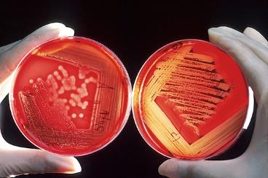
Figure 22.7
In these agar plates, the growth medium is supplemented with red blood cells. Blood agar becomes transparent in the presence of hemolytic Streptococcus, which destroys red blood cells and is used to diagnose Streptococcus infections. The plate on the left is inoculated with non-hemolytic Staphylococcus (large white colonies), and the plate on the right is inoculated with hemolytic Streptococcus (tiny clear colonies). If you look closely at the right plate, you can see that the agar surrounding the bacteria has turned clear.
(credit: Bill Branson, NCI)
This OpenStax ancillary resource is © Rice University under a CC-BY 4.0 International license; it may be reproduced or modified but must be attributed to OpenStax, Rice University and any changes must be noted. Any images credited to other sources are similarly available for reproduction, but must be attributed to their sources.

Slide 9
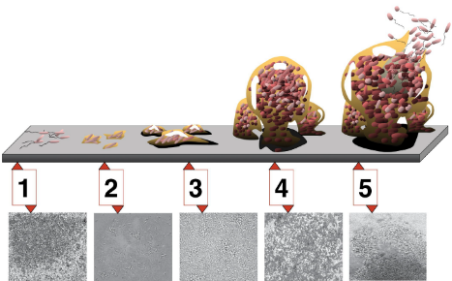
Figure 22.8
Five stages of biofilm development are shown. During stage 1, initial attachment, bacteria adhere to a solid surface via weak van der Waals interactions. During stage 2, irreversible attachment, hairlike appendages called pili permanently anchor the bacteria to the surface. During stage 3, maturation I, the biofilm grows through cell division and recruitment of other bacteria. An extracellular matrix composed primarily of polysaccharides holds the biofilm together. During stage 4, maturation II, the biofilm continues to grow and takes on a more complex shape. During stage 5, dispersal, the biofilm matrix is partly broken down, allowing some bacteria to escape and colonize another surface. Micrographs of a Pseudomonas aeruginosa biofilm in each of the stages of development are shown.
(credit: D. Davis, Don Monroe, PLoS)
This OpenStax ancillary resource is © Rice University under a CC-BY 4.0 International license; it may be reproduced or modified but must be attributed to OpenStax, Rice University and any changes must be noted. Any images credited to other sources are similarly available for reproduction, but must be attributed to their sources.

Slide 10
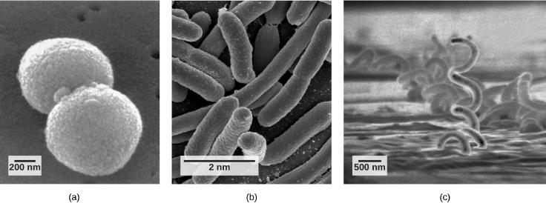
Figure 22.9
Prokaryotes fall into three basic categories based on their shape, visualized here using scanning electron microscopy: (a) cocci, or spherical (a pair is shown); (b) bacilli, or rod-shaped; and (c) spirilli, or spiral-shaped.
(credit a: modification of work by Janice Haney Carr, Dr. Richard Facklam, CDC; credit c: modification of work by Dr. David Cox; scale-bar data from Matt Russell)
This OpenStax ancillary resource is © Rice University under a CC-BY 4.0 International license; it may be reproduced or modified but must be attributed to OpenStax, Rice University and any changes must be noted. Any images credited to other sources are similarly available for reproduction, but must be attributed to their sources.

Slide 11
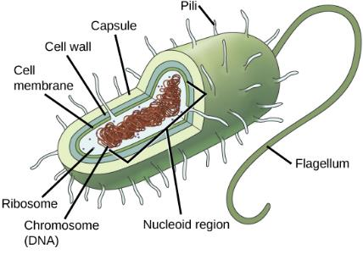
Figure 22.10
The features of a typical prokaryotic cell are shown.
This OpenStax ancillary resource is © Rice University under a CC-BY 4.0 International license; it may be reproduced or modified but must be attributed to OpenStax, Rice University and any changes must be noted. Any images credited to other sources are similarly available for reproduction, but must be attributed to their sources.

Slide 12
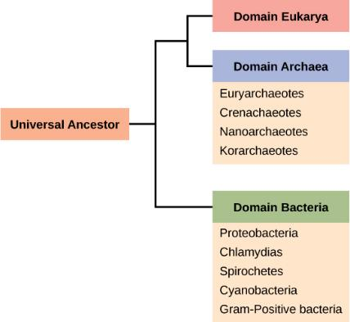
Figure 22.11
The three domains of living organisms. Bacteria and Archaea are both prokaryotes but differ enough to be placed in separate domains. An ancestor of modern Archaea is believed to have given rise to Eukarya, the third domain of life. Major groups of Archaea and Bacteria are shown.
This OpenStax ancillary resource is © Rice University under a CC-BY 4.0 International license; it may be reproduced or modified but must be attributed to OpenStax, Rice University and any changes must be noted. Any images credited to other sources are similarly available for reproduction, but must be attributed to their sources.

Slide 13
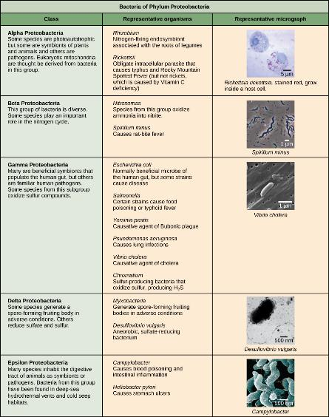
Figure 22.12
Phylum Proteobacteria is one of up to 52 bacteria phyla. Proteobacteria is further subdivided into five classes, Alpha through Epsilon.
(credit “Rickettsia rickettsia”: modification of work by CDC; credit “Spirillum minus”: modification of work by Wolframm Adlassnig; credit “Vibrio cholera”: modification of work by Janice Haney Carr, CDC; credit “Desulfovibrio vulgaris”: modification of work by Graham Bradley; credit “Campylobacter”: modification of work by De Wood, Pooley, USDA, ARS, EMU; scale-bar data from Matt Russell)
This OpenStax ancillary resource is © Rice University under a CC-BY 4.0 International license; it may be reproduced or modified but must be attributed to OpenStax, Rice University and any changes must be noted. Any images credited to other sources are similarly available for reproduction, but must be attributed to their sources.

Slide 14
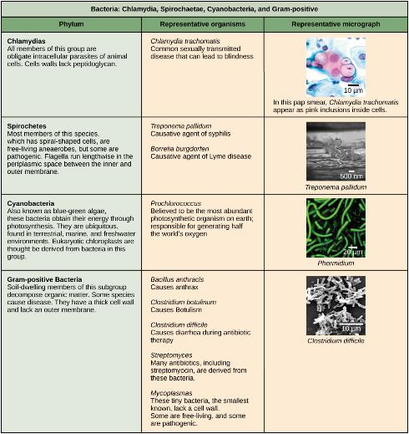
Figure 22.13
Chlamydia, Spirochetes, Cyanobacteria, and Gram-positive bacteria are described in this table. Note that bacterial shape is not phylum-dependent; bacteria within a phylum may be cocci, rod-shaped, or spiral.
(credit “Chlamydia trachomatis”: modification of work by Dr. Lance Liotta Laboratory, NCI; credit “Treponema pallidum”: modification of work by Dr. David Cox, CDC; credit “Phormidium”: modification of work by USGS; credit “Clostridium difficile”: modification of work by Lois S. Wiggs, CDC; scale-bar data from Matt Russell)
This OpenStax ancillary resource is © Rice University under a CC-BY 4.0 International license; it may be reproduced or modified but must be attributed to OpenStax, Rice University and any changes must be noted. Any images credited to other sources are similarly available for reproduction, but must be attributed to their sources.

Slide 15
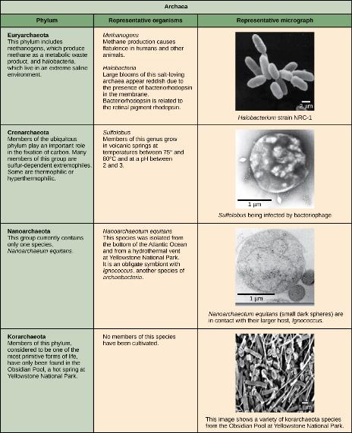
Figure 22.14
Archaea are separated into four phyla: the Korarchaeota, Euryarchaeota, Crenarchaeota, and Nanoarchaeota.
(credit “Halobacterium”: modification of work by NASA; credit “Nanoarchaeotum equitans”: modification of work by Karl O. Stetter; credit “korarchaeota”: modification of work by Office of Science of the U.S. Dept. of Energy; scale-bar data from Matt Russell)
This OpenStax ancillary resource is © Rice University under a CC-BY 4.0 International license; it may be reproduced or modified but must be attributed to OpenStax, Rice University and any changes must be noted. Any images credited to other sources are similarly available for reproduction, but must be attributed to their sources.

Slide 16
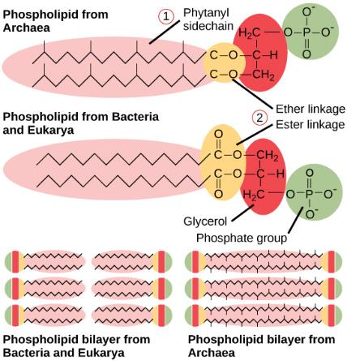
Figure 22.15
Archaeal phospholipids differ from those found in Bacteria and Eukarya in two ways. First, they have branched phytanyl sidechains instead of linear ones. Second, an ether bond instead of an ester bond connects the lipid to the glycerol.
This OpenStax ancillary resource is © Rice University under a CC-BY 4.0 International license; it may be reproduced or modified but must be attributed to OpenStax, Rice University and any changes must be noted. Any images credited to other sources are similarly available for reproduction, but must be attributed to their sources.

Slide 17
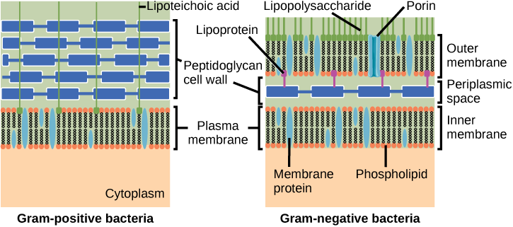
Figure 22.16
Bacteria are divided into two major groups: Gram positive and Gram negative. Both groups have a cell wall composed of peptidoglycan: in Gram-positive bacteria, the wall is thick, whereas in Gram-negative bacteria, the wall is thin. In Gram-negative bacteria, the cell wall is surrounded by an outer membrane that contains lipopolysaccharides and lipoproteins. Porins are proteins in this cell membrane that allow substances to pass through the outer membrane of Gram-negative bacteria. In Gram-positive bacteria, lipoteichoic acid anchors the cell wall to the cell membrane.
(credit: modification of work by "Franciscosp2"/Wikimedia Commons)
This OpenStax ancillary resource is © Rice University under a CC-BY 4.0 International license; it may be reproduced or modified but must be attributed to OpenStax, Rice University and any changes must be noted. Any images credited to other sources are similarly available for reproduction, but must be attributed to their sources.

Slide 18
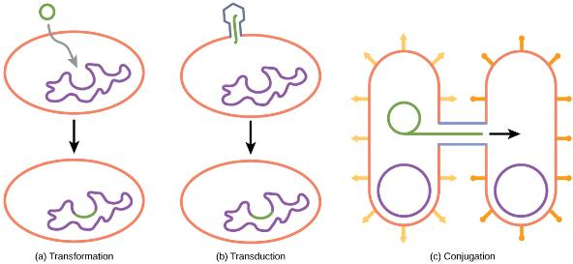
Figure 22.17
Besides binary fission, there are three other mechanisms by which prokaryotes can exchange DNA. In (a) transformation, the cell takes up prokaryotic DNA directly from the environment. The DNA may remain separate as plasmid DNA or be incorporated into the host genome. In (b) transduction, a bacteriophage injects DNA into the cell that contains a small fragment of DNA from a different prokaryote. In (c) conjugation, DNA is transferred from one cell to another via a mating bridge that connects the two cells after the sex pilus draws the two bacteria close enough to form the bridge.
This OpenStax ancillary resource is © Rice University under a CC-BY 4.0 International license; it may be reproduced or modified but must be attributed to OpenStax, Rice University and any changes must be noted. Any images credited to other sources are similarly available for reproduction, but must be attributed to their sources.

Slide 19
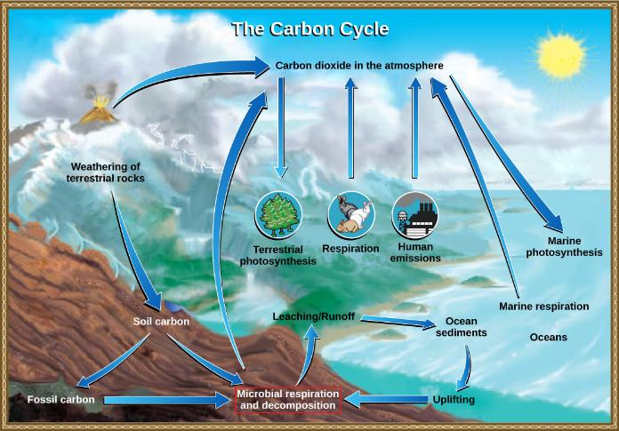
Figure 22.18
Prokaryotes play a significant role in continuously moving carbon through the biosphere.
(credit: modification of work by John M. Evans and Howard Perlman, USGS)
This OpenStax ancillary resource is © Rice University under a CC-BY 4.0 International license; it may be reproduced or modified but must be attributed to OpenStax, Rice University and any changes must be noted. Any images credited to other sources are similarly available for reproduction, but must be attributed to their sources.

Slide 20
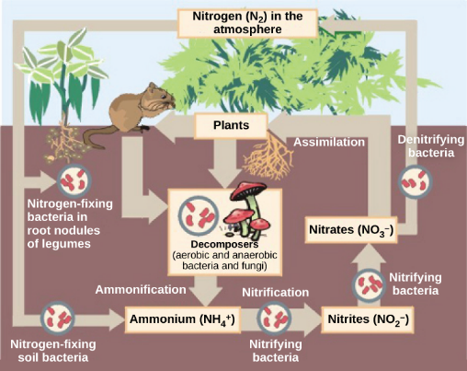
Figure 22.19
Prokaryotes play a key role in the nitrogen cycle.
(credit: Environmental Protection Agency)
This OpenStax ancillary resource is © Rice University under a CC-BY 4.0 International license; it may be reproduced or modified but must be attributed to OpenStax, Rice University and any changes must be noted. Any images credited to other sources are similarly available for reproduction, but must be attributed to their sources.

Slide 21
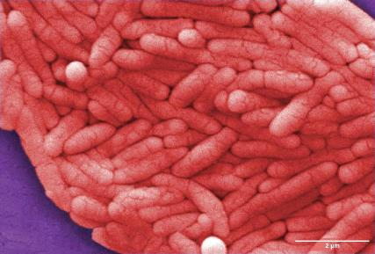
Figure 22.20
Salmonella enterica serovar Typhi, the causative agent of Typhoid fever, is a Gram-negative, rod-shaped gamma protobacterium. Typhoid fever, which is spread through feces, causes intestinal hemorrhage, high fever, delirium and dehydration. Today, between 16 and 33 million cases of this re-emerging disease occur annually, resulting in over 200,000 deaths. Carriers of the disease can be asymptomatic. In a famous case in the early 1900s, a cook named Mary Mallon unknowingly spread the disease to over fifty people, three of whom died. Other Salmonella serotypes cause food poisoning.
(credit: modification of work by NCI, CDC)
This OpenStax ancillary resource is © Rice University under a CC-BY 4.0 International license; it may be reproduced or modified but must be attributed to OpenStax, Rice University and any changes must be noted. Any images credited to other sources are similarly available for reproduction, but must be attributed to their sources.

Slide 22
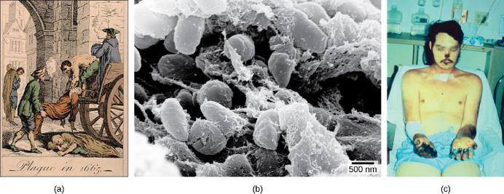
Figure 22.21
The (a) Great Plague of London killed an estimated 200,000 people, or about twenty percent of the city’s population. The causative agent, the (b) bacterium Yersinia pestis, is a Gram-negative, rod-shaped bacterium from the class Gamma Proteobacteria. The disease is transmitted through the bite of an infected flea, which is infected by a rodent. Symptoms include swollen lymph nodes, fever, seizure, vomiting of blood, and (c) gangrene.
(credit b: Rocky Mountain Laboratories, NIAID, NIH; scale-bar data from Matt Russell; credit c: Textbook of Military Medicine, Washington, D.C., U.S. Dept. of the Army, Office of the Surgeon General, Borden Institute)
This OpenStax ancillary resource is © Rice University under a CC-BY 4.0 International license; it may be reproduced or modified but must be attributed to OpenStax, Rice University and any changes must be noted. Any images credited to other sources are similarly available for reproduction, but must be attributed to their sources.

Slide 23
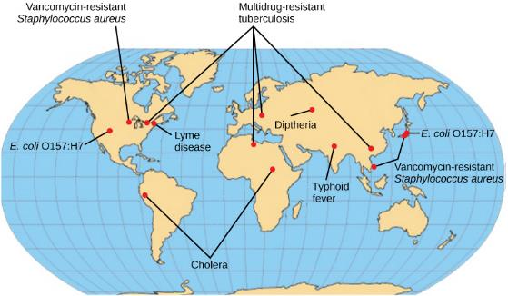
Figure 22.22
The map shows regions where bacterial diseases are emerging or reemerging.
(credit: modification of work by NIH)
This OpenStax ancillary resource is © Rice University under a CC-BY 4.0 International license; it may be reproduced or modified but must be attributed to OpenStax, Rice University and any changes must be noted. Any images credited to other sources are similarly available for reproduction, but must be attributed to their sources.

Slide 24
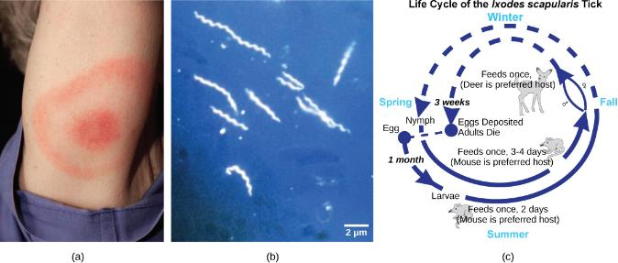
Figure 22.23
Lyme disease often, but not always, results in (a) a characteristic bullseye rash. The disease is caused by a (b) Gram-negative spirochete bacterium of the genus Borrelia. The bacteria (c) infect ticks, which in turns infect mice. Deer are the preferred secondary host, but the ticks also may feed on humans. Untreated, the disease causes chronic disorders in the nervous system, eyes, joints, and heart. The disease is named after Lyme, Connecticut, where an outbreak occurred in 1995 and has subsequently spread. The disease is not new, however. Genetic evidence suggests that Ötzi the Iceman, a 5,300-year-old mummy found in the Alps, was infected with Borrelia.
(credit a: James Gathany, CDC; credit b: CDC; scale-bar data from Matt Russell)
This OpenStax ancillary resource is © Rice University under a CC-BY 4.0 International license; it may be reproduced or modified but must be attributed to OpenStax, Rice University and any changes must be noted. Any images credited to other sources are similarly available for reproduction, but must be attributed to their sources.

Slide 25
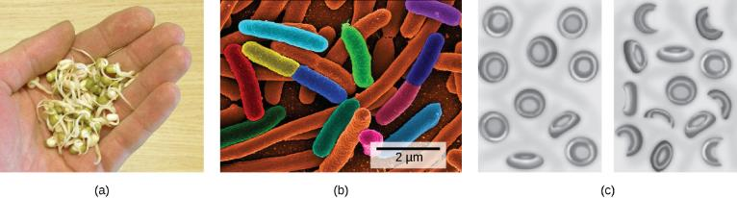
Figure 22.24
(a) Vegetable sprouts grown at an organic farm were the cause of an (b) E. coli outbreak that killed 32 people and sickened 3,800 in Germany in 2011. The strain responsible, E. coli O104:H4, produces Shiga toxin, a substance that inhibits protein synthesis in the host cell. The toxin (c) destroys red blood cells resulting in bloody diarrhea. Deformed red blood cells clog the capillaries of the kidney, which can lead to kidney failure, as happened to 845 patients in the 2011 outbreak. Kidney failure is usually reversible, but some patients experience kidney problems years later.
(credit c: NIDDK, NIH)
This OpenStax ancillary resource is © Rice University under a CC-BY 4.0 International license; it may be reproduced or modified but must be attributed to OpenStax, Rice University and any changes must be noted. Any images credited to other sources are similarly available for reproduction, but must be attributed to their sources.

Slide 26
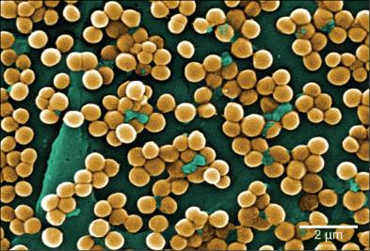
Figure 22.25
This scanning electron micrograph shows methicillin-resistant Staphylococcus aureus bacteria, commonly known as MRSA. S. aureus is not always pathogenic, but can cause diseases such as food poisoning and skin and respiratory infections.
(credit: modification of work by Janice Haney Carr; scale-bar data from Matt Russell)
This OpenStax ancillary resource is © Rice University under a CC-BY 4.0 International license; it may be reproduced or modified but must be attributed to OpenStax, Rice University and any changes must be noted. Any images credited to other sources are similarly available for reproduction, but must be attributed to their sources.

Slide 27
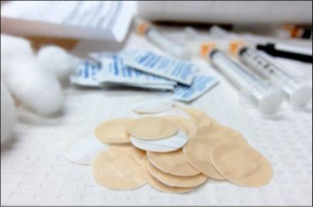
Figure 22.26
Vaccinations can slow the spread of communicable diseases.
(credit: modification of work by Daniel Paquet)
This OpenStax ancillary resource is © Rice University under a CC-BY 4.0 International license; it may be reproduced or modified but must be attributed to OpenStax, Rice University and any changes must be noted. Any images credited to other sources are similarly available for reproduction, but must be attributed to their sources.

Slide 28
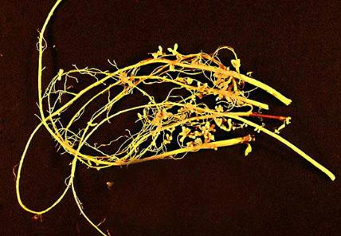
Figure 22.27
Soybean (Glycine max) is a legume that interacts symbiotically with the soil bacterium Bradyrhizobium japonicum to form specialized structures on the roots called nodules where nitrogen fixation occurs.
(credit: USDA)
This OpenStax ancillary resource is © Rice University under a CC-BY 4.0 International license; it may be reproduced or modified but must be attributed to OpenStax, Rice University and any changes must be noted. Any images credited to other sources are similarly available for reproduction, but must be attributed to their sources.

Slide 29
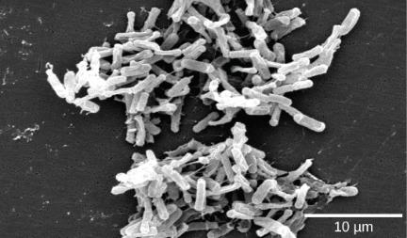
Figure 22.28
Clostridium difficile is a Gram-positive, rod-shaped bacterium that causes severe diarrhea.
(credit: modification of work by CDC, HHS; scale-bar data from Matt Russell)
This OpenStax ancillary resource is © Rice University under a CC-BY 4.0 International license; it may be reproduced or modified but must be attributed to OpenStax, Rice University and any changes must be noted. Any images credited to other sources are similarly available for reproduction, but must be attributed to their sources.

Slide 30
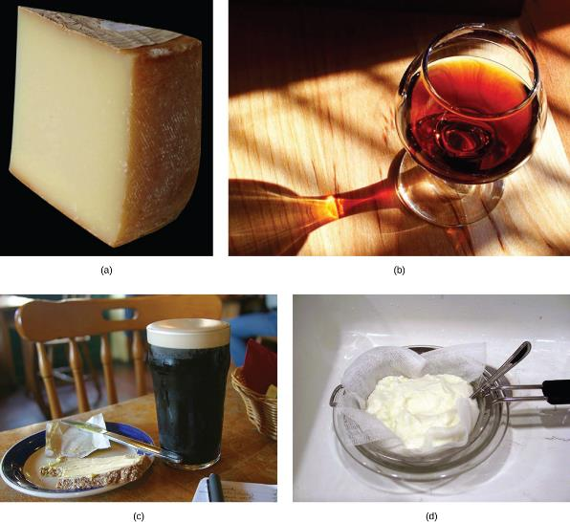
Figure 22.29
Some of the products derived from the use of prokaryotes in early biotechnology include (a) cheese, (b) wine, (c) beer and bread, and (d) yogurt.
(credit bread: modification of work by F. Rodrigo/Wikimedia Commons; credit wine: modification of work by Jon Sullivan; credit beer and bread: modification of work by Kris Miller; credit yogurt: modification of work by Jon Sullivan)
This OpenStax ancillary resource is © Rice University under a CC-BY 4.0 International license; it may be reproduced or modified but must be attributed to OpenStax, Rice University and any changes must be noted. Any images credited to other sources are similarly available for reproduction, but must be attributed to their sources.

Slide 31
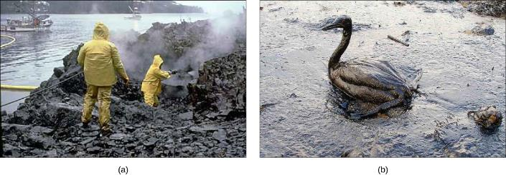
Figure 22.30
(a) Cleaning up oil after the Valdez spill in Alaska, workers hosed oil from beaches and then used a floating boom to corral the oil, which was finally skimmed from the water surface. Some species of bacteria are able to solubilize and degrade the oil. (b) One of the most catastrophic consequences of oil spills is the damage to fauna.
(credit a: modification of work by NOAA; credit b: modification of work by GOLUBENKOV, NGO: Saving Taman)
This OpenStax ancillary resource is © Rice University under a CC-BY 4.0 International license; it may be reproduced or modified but must be attributed to OpenStax, Rice University and any changes must be noted. Any images credited to other sources are similarly available for reproduction, but must be attributed to their sources.

