Slide 1

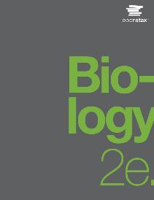
Biology 2e
Chapter 23 PROTISTS
PowerPoint Image Slide Show

Slide 2
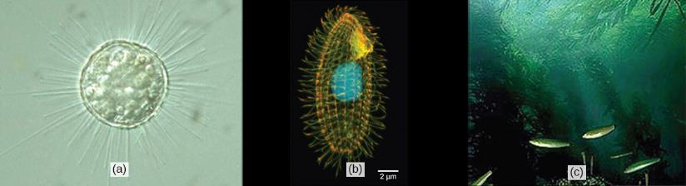
Figure 23.1
Protists range from the microscopic, single-celled (a) Acanthocystis turfacea and the (b) ciliate Tetrahymena thermophila, both visualized here using light microscopy, to the enormous, multicellular (c) kelps (Chromalveolata) that extend for hundreds of feet in underwater “forests.”
(credit a: modification of work by Yuiuji Tsukii; credit b: modification of work by Richard Robinson, Public Library of Science; credit c: modification of work by Kip Evans, NOAA; scale-bar data from Matt Russell)
This OpenStax ancillary resource is © Rice University under a CC-BY 4.0 International license; it may be reproduced or modified but must be attributed to OpenStax, Rice University and any changes must be noted. Any images credited to other sources are similarly available for reproduction, but must be attributed to their sources.

Slide 3
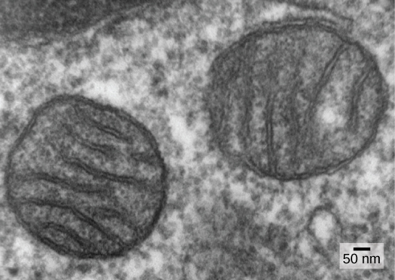
Figure 23.2
Mitochondria. In this transmission electron micrograph of mitochondria in a mammalian lung cell, the cristae, infoldings of the mitochondrial inner membrane, can be seen in cross-section.
(credit: Louise Howard)
This OpenStax ancillary resource is © Rice University under a CC-BY 4.0 International license; it may be reproduced or modified but must be attributed to OpenStax, Rice University and any changes must be noted. Any images credited to other sources are similarly available for reproduction, but must be attributed to their sources.

Slide 4
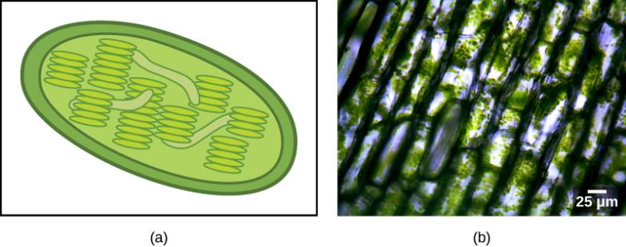
Figure 23.3
(a) This chloroplast cross-section illustrates its elaborate inner membrane organization. Stacks of thylakoid membranes compartmentalize photosynthetic enzymes and provide scaffolding for chloroplast DNA. (b) In this micrograph of Elodea sp., the chloroplasts can be seen as small green spheres.
(credit b: modification of work by Brandon Zierer; scale-bar data from Matt Russell)
This OpenStax ancillary resource is © Rice University under a CC-BY 4.0 International license; it may be reproduced or modified but must be attributed to OpenStax, Rice University and any changes must be noted. Any images credited to other sources are similarly available for reproduction, but must be attributed to their sources.

Slide 5
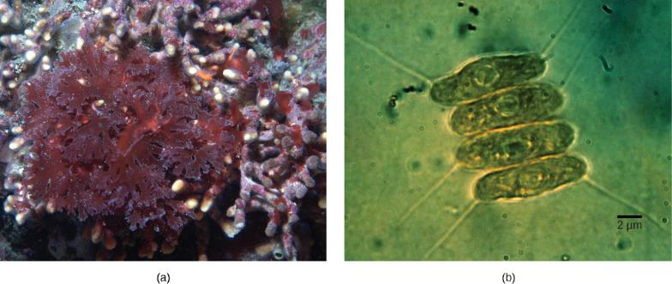
Figure 23.4
(a) Red algae and (b) green algae (seen here by light microscopy) share similar DNA sequences with photosynthetic cyanobacteria. Scientists speculate that, in a process called endosymbiosis, an ancestral prokaryote engulfed a photosynthetic cyanobacterium that evolved into modern-day chloroplasts.
(credit a: modification of work by Ed Bierman; credit b: modification of work by G. Fahnenstiel, NOAA; scale-bar data from Matt Russell)
This OpenStax ancillary resource is © Rice University under a CC-BY 4.0 International license; it may be reproduced or modified but must be attributed to OpenStax, Rice University and any changes must be noted. Any images credited to other sources are similarly available for reproduction, but must be attributed to their sources.

Slide 6
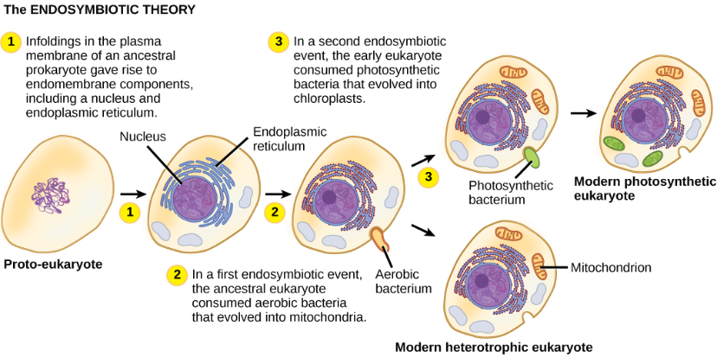
Figure 23.5
The first eukaryote may have originated from an ancestral prokaryote that had undergone membrane proliferation, compartmentalization of cellular function (into a nucleus, lysosomes, and an endoplasmic reticulum), and the establishment of endosymbiotic relationships with an aerobic prokaryote, and, in some cases, a photosynthetic prokaryote, to form mitochondria and chloroplasts, respectively.
This OpenStax ancillary resource is © Rice University under a CC-BY 4.0 International license; it may be reproduced or modified but must be attributed to OpenStax, Rice University and any changes must be noted. Any images credited to other sources are similarly available for reproduction, but must be attributed to their sources.

Slide 7
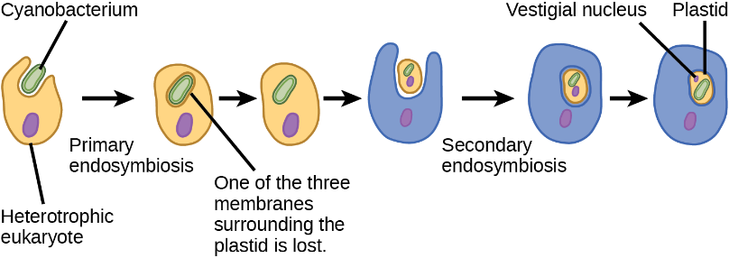
Figure 23.6
The hypothesized process of several endosymbiotic events leading to the evolution of chlorarachniophytes is shown. In a primary endosymbiotic event, a heterotrophic eukaryote consumed a cyanobacterium. In a secondary endosymbiotic event, the cell resulting from primary endosymbiosis was consumed by a second cell. The resulting organelle became a plastid in modern chlorarachniophytes.
This OpenStax ancillary resource is © Rice University under a CC-BY 4.0 International license; it may be reproduced or modified but must be attributed to OpenStax, Rice University and any changes must be noted. Any images credited to other sources are similarly available for reproduction, but must be attributed to their sources.

Slide 8
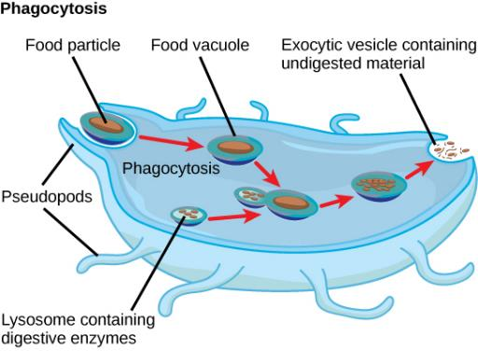
Figure 23.7
The stages of phagocytosis include the engulfment of a food particle, the digestion of the particle using hydrolytic enzymes contained within a lysosome, and the expulsion of undigested materials from the cell.
This OpenStax ancillary resource is © Rice University under a CC-BY 4.0 International license; it may be reproduced or modified but must be attributed to OpenStax, Rice University and any changes must be noted. Any images credited to other sources are similarly available for reproduction, but must be attributed to their sources.

Slide 9
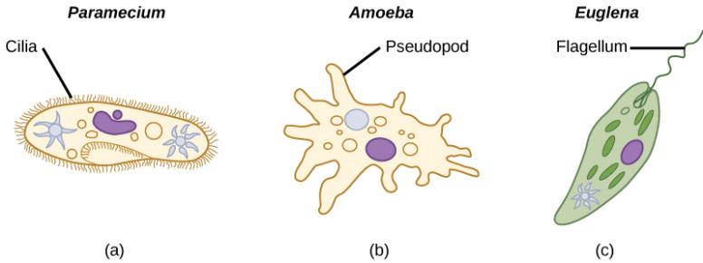
Figure 23.8
Protists use various methods for transportation. (a) Paramecium waves hair-like appendages called cilia to propel itself. (b) Amoeba uses lobe-like pseudopodia to anchor itself to a solid surface and pull itself forward. (c) Euglena uses a whip-like tail called a flagellum to propel itself.
This OpenStax ancillary resource is © Rice University under a CC-BY 4.0 International license; it may be reproduced or modified but must be attributed to OpenStax, Rice University and any changes must be noted. Any images credited to other sources are similarly available for reproduction, but must be attributed to their sources.

Slide 10
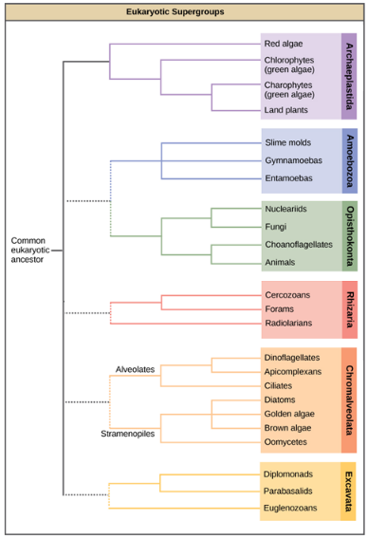
Figure 23.9
This diagram shows a proposed classification of the domain Eukarya. Currently, the domain Eukarya is divided into six supergroups. Within each supergroup are multiple kingdoms. Although each supergroup is believed to be monophyletic, the dotted lines suggest evolutionary relationships among the supergroups that continue to be debated.
This OpenStax ancillary resource is © Rice University under a CC-BY 4.0 International license; it may be reproduced or modified but must be attributed to OpenStax, Rice University and any changes must be noted. Any images credited to other sources are similarly available for reproduction, but must be attributed to their sources.

Slide 11
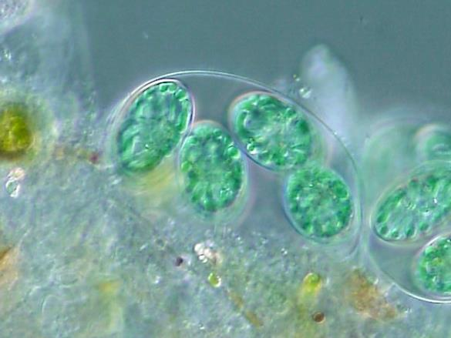
Figure 23.10
Glaucocystis.
(credit: By ja:User:NEON / commons:User:NEON_ja - Own work, CC BY-SA 2.5, https://commons.wikimedia.org/w/index.php?curid=1706641)
This OpenStax ancillary resource is © Rice University under a CC-BY 4.0 International license; it may be reproduced or modified but must be attributed to OpenStax, Rice University and any changes must be noted. Any images credited to other sources are similarly available for reproduction, but must be attributed to their sources.

Slide 12
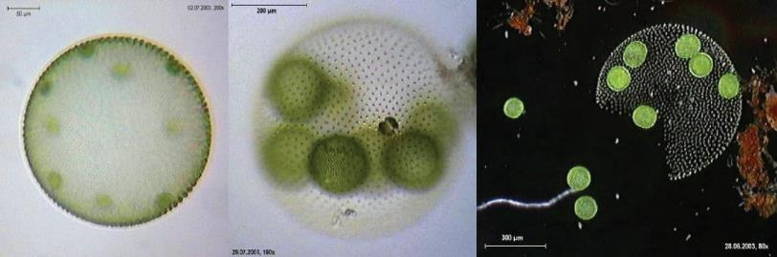
Figure 23.11
Volvox aureus is a green alga in the supergroup Archaeplastida. This species exists as a colony, consisting of cells immersed in a gel-like matrix and intertwined with each other via hair-like cytoplasmic extensions.
(credit: Dr. Ralf Wagner)
This OpenStax ancillary resource is © Rice University under a CC-BY 4.0 International license; it may be reproduced or modified but must be attributed to OpenStax, Rice University and any changes must be noted. Any images credited to other sources are similarly available for reproduction, but must be attributed to their sources.

Slide 13
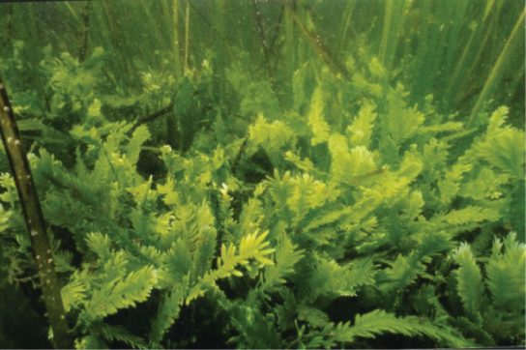
Figure 23.12
Caulerpa taxifolia is a chlorophyte consisting of a single cell containing potentially thousands of nuclei.
(credit: NOAA)
This OpenStax ancillary resource is © Rice University under a CC-BY 4.0 International license; it may be reproduced or modified but must be attributed to OpenStax, Rice University and any changes must be noted. Any images credited to other sources are similarly available for reproduction, but must be attributed to their sources.

Slide 14
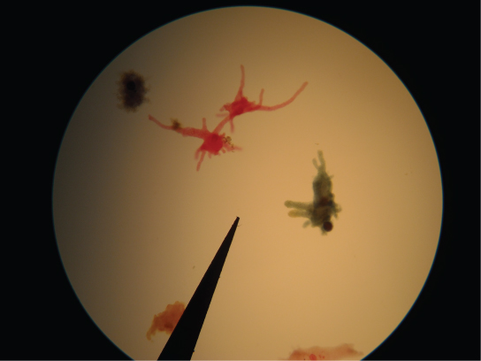
Figure 23.13
Amoebae with tubular and lobe-shaped pseudopodia are seen under a microscope. These isolates would be morphologically classified as amoebozoans.
This OpenStax ancillary resource is © Rice University under a CC-BY 4.0 International license; it may be reproduced or modified but must be attributed to OpenStax, Rice University and any changes must be noted. Any images credited to other sources are similarly available for reproduction, but must be attributed to their sources.

Slide 15
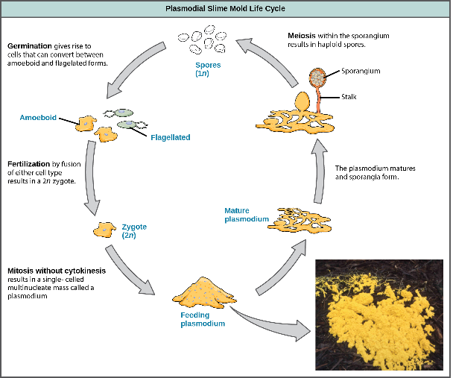
Figure 23.14
(credit: modification of work by Dr. Jonatha Gott and the Center for RNA Molecular Biology, Case Western Reserve University)
This OpenStax ancillary resource is © Rice University under a CC-BY 4.0 International license; it may be reproduced or modified but must be attributed to OpenStax, Rice University and any changes must be noted. Any images credited to other sources are similarly available for reproduction, but must be attributed to their sources.
Notes:
The life cycle of the plasmodial slime mold is shown. The brightly colored plasmodium in the inset photo is a single-celled, multinucleate mass.

Slide 16
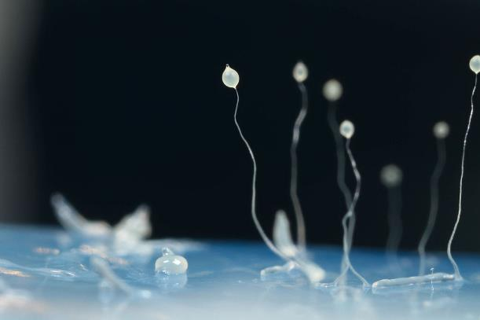
Figure 23.15
The image shows several stages in the life cycle of Dictyostelium discoideum, including aggregated cells, mobile slugs and their transformation into fruiting bodies with a cluster of spores supported by a stalk.
(credit: By Usman Bashir (Own work) [CC BY-SA 4.0 (http://creativecommons.org/licenses/by-sa/4.0)], via Wikimedia Commons)
This OpenStax ancillary resource is © Rice University under a CC-BY 4.0 International license; it may be reproduced or modified but must be attributed to OpenStax, Rice University and any changes must be noted. Any images credited to other sources are similarly available for reproduction, but must be attributed to their sources.

Slide 17
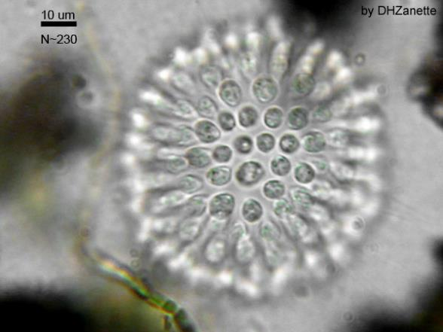
Figure 23.16
A Colonial Choanoflagellate.
(credit: By Dhzanette (http://en.wikipedia.org/wiki/Choanoflagellate) [Public domain], via Wikimedia Commons)
This OpenStax ancillary resource is © Rice University under a CC-BY 4.0 International license; it may be reproduced or modified but must be attributed to OpenStax, Rice University and any changes must be noted. Any images credited to other sources are similarly available for reproduction, but must be attributed to their sources.

Slide 18
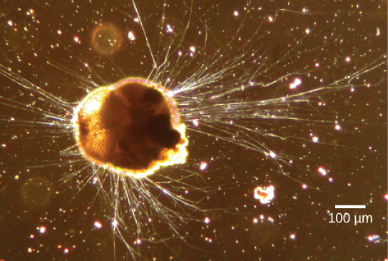
Figure 23.17
Ammonia tepida, a Rhizaria species viewed here using phase contrast light microscopy, exhibits many threadlike pseudopodia. It also has a chambered calcium carbonate shell or test.
(credit: modification of work by Scott Fay, UC Berkeley; scale-bar data from Matt Russell)
This OpenStax ancillary resource is © Rice University under a CC-BY 4.0 International license; it may be reproduced or modified but must be attributed to OpenStax, Rice University and any changes must be noted. Any images credited to other sources are similarly available for reproduction, but must be attributed to their sources.

Slide 19
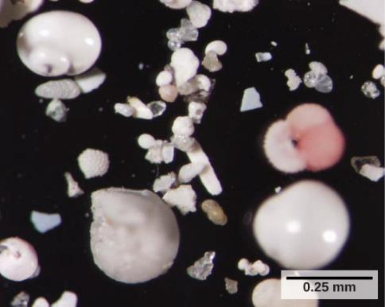
Figure 23.18
These shells from foraminifera sank to the sea floor.
(credit: Deep East 2001, NOAA/OER)
This OpenStax ancillary resource is © Rice University under a CC-BY 4.0 International license; it may be reproduced or modified but must be attributed to OpenStax, Rice University and any changes must be noted. Any images credited to other sources are similarly available for reproduction, but must be attributed to their sources.

Slide 20
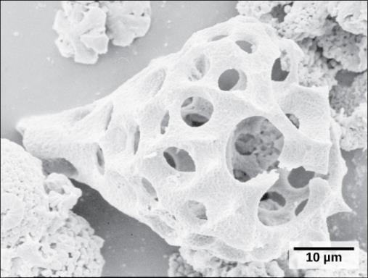
Figure 23.19
This fossilized radiolarian shell was imaged using a scanning electron microscope.
(credit: modification of work by Hannes Grobe, Alfred Wegener Institute; scale-bar data from Matt Russell)
This OpenStax ancillary resource is © Rice University under a CC-BY 4.0 International license; it may be reproduced or modified but must be attributed to OpenStax, Rice University and any changes must be noted. Any images credited to other sources are similarly available for reproduction, but must be attributed to their sources.

Slide 21
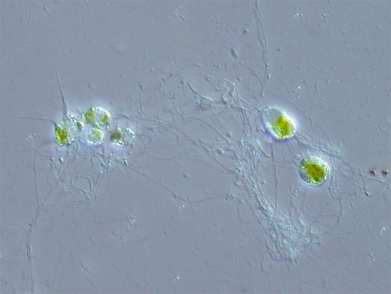
Figure 23.20
This rhizarian is mixotrophic, and can obtain nutrients both by photosynthesis and by trapping various microorganisms with its network of pseudopodia.
(credit: By ja:User:NEON / commons:User:NEON_ja (Own work) [CC BY-SA 2.5 (http://creativecommons.org/licenses/by-sa/2.5) or CC BY-SA 2.5 (http://creativecommons.org/licenses/by-sa/2.5)], via Wikimedia Commons)
This OpenStax ancillary resource is © Rice University under a CC-BY 4.0 International license; it may be reproduced or modified but must be attributed to OpenStax, Rice University and any changes must be noted. Any images credited to other sources are similarly available for reproduction, but must be attributed to their sources.

Slide 22
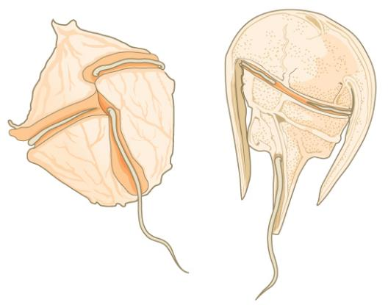
Figure 23.21
The dinoflagellates exhibit great diversity in shape. Many are encased in cellulose armor and have two flagella that fit in grooves between the plates. Movement of these two perpendicular flagella causes a spinning motion.
This OpenStax ancillary resource is © Rice University under a CC-BY 4.0 International license; it may be reproduced or modified but must be attributed to OpenStax, Rice University and any changes must be noted. Any images credited to other sources are similarly available for reproduction, but must be attributed to their sources.

Slide 23
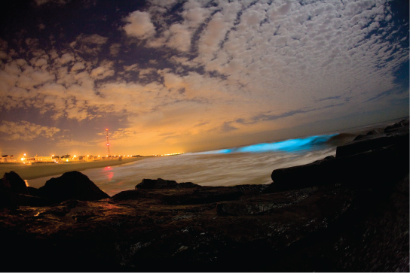
Figure 23.22
Bioluminescence is emitted from dinoflagellates in a breaking wave, as seen from the New Jersey coast.
(credit: “catalano82”/Flickr)
This OpenStax ancillary resource is © Rice University under a CC-BY 4.0 International license; it may be reproduced or modified but must be attributed to OpenStax, Rice University and any changes must be noted. Any images credited to other sources are similarly available for reproduction, but must be attributed to their sources.

Slide 24
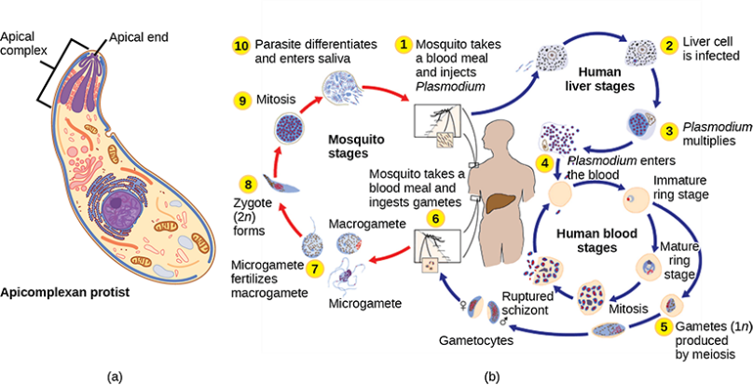
Figure 23.23
(a) Apicomplexans are parasitic protists. They have a characteristic apical complex that enables them to infect host cells. (b) Plasmodium, the causative agent of malaria, has a complex life cycle typical of apicomplexans.
(credit b: modification of work by CDC)
This OpenStax ancillary resource is © Rice University under a CC-BY 4.0 International license; it may be reproduced or modified but must be attributed to OpenStax, Rice University and any changes must be noted. Any images credited to other sources are similarly available for reproduction, but must be attributed to their sources.

Slide 25
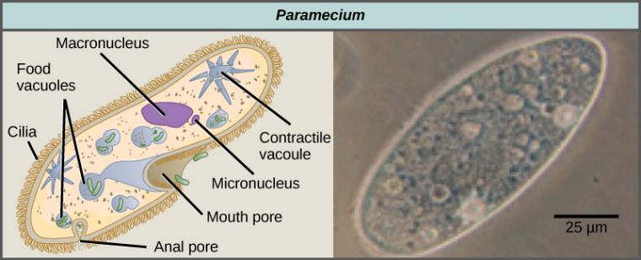
Figure 23.24
Paramecium has a primitive mouth (called an oral groove) to ingest food, and an anal pore to eliminate waste. Contractile vacuoles allow the organism to excrete excess water. Cilia enable the organism to move.
(credit “paramecium micrograph”: modification of work by NIH; scale-bar data from Matt Russell)
This OpenStax ancillary resource is © Rice University under a CC-BY 4.0 International license; it may be reproduced or modified but must be attributed to OpenStax, Rice University and any changes must be noted. Any images credited to other sources are similarly available for reproduction, but must be attributed to their sources.

Slide 26
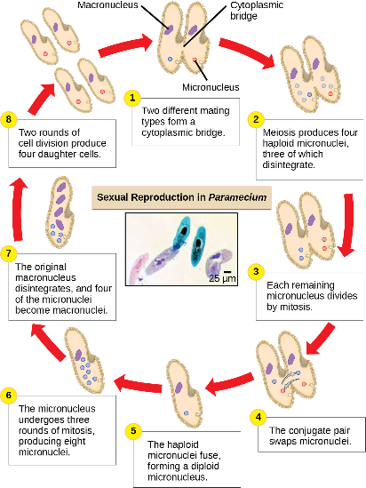
Figure 23.25
The complex process of sexual reproduction in Paramecium creates eight daughter cells from two original cells. Each cell has a macronucleus and a micronucleus. During sexual reproduction, the macronucleus dissolves and is replaced by a micronucleus.
(credit “micrograph”: modification of work by Ian Sutton; scale-bar data from Matt Russell)
This OpenStax ancillary resource is © Rice University under a CC-BY 4.0 International license; it may be reproduced or modified but must be attributed to OpenStax, Rice University and any changes must be noted. Any images credited to other sources are similarly available for reproduction, but must be attributed to their sources.

Slide 27
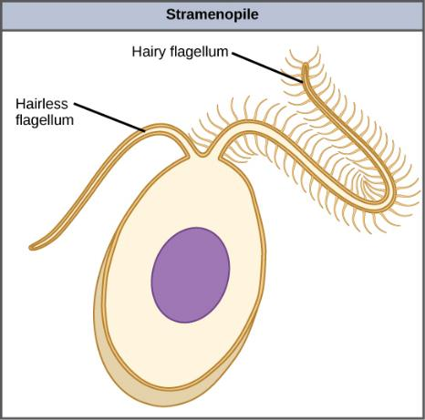
Figure 23.26
This stramenopile cell has a single hairy flagellum and a secondary smooth flagellum.
This OpenStax ancillary resource is © Rice University under a CC-BY 4.0 International license; it may be reproduced or modified but must be attributed to OpenStax, Rice University and any changes must be noted. Any images credited to other sources are similarly available for reproduction, but must be attributed to their sources.

Slide 28
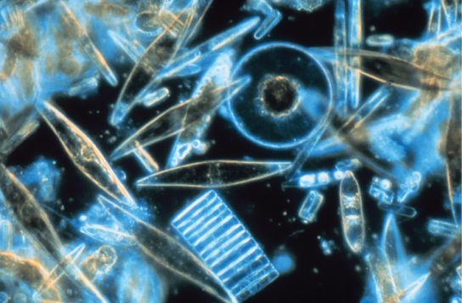
Figure 23.27
Assorted diatoms, visualized here using light microscopy, live among annual sea ice in McMurdo Sound, Antarctica. Diatoms range in size from 2 to 200 µm.
(credit: Prof. Gordon T. Taylor, Stony Brook University, NSF, NOAA)
This OpenStax ancillary resource is © Rice University under a CC-BY 4.0 International license; it may be reproduced or modified but must be attributed to OpenStax, Rice University and any changes must be noted. Any images credited to other sources are similarly available for reproduction, but must be attributed to their sources.

Slide 29
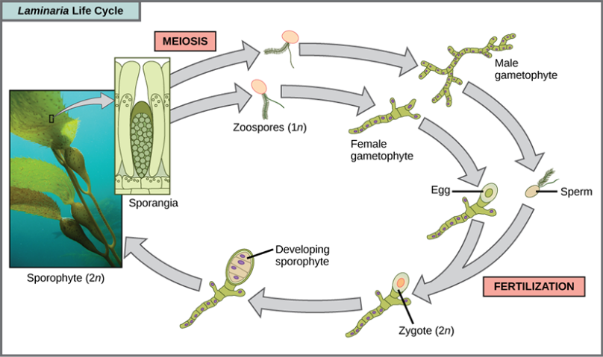
Figure 23.28
(credit “laminaria photograph”: modification of work by Claire Fackler, CINMS, NOAA Photo Library)
This OpenStax ancillary resource is © Rice University under a CC-BY 4.0 International license; it may be reproduced or modified but must be attributed to OpenStax, Rice University and any changes must be noted. Any images credited to other sources are similarly available for reproduction, but must be attributed to their sources.
Notes:
Alternation of generations in a brown alga. Several species of brown algae, such as the Laminaria shown here, have evolved life cycles in which both the haploid (gametophyte) and diploid (sporophyte) forms are multicellular. The gametophyte is different in structure than the sporophyte.

Slide 30
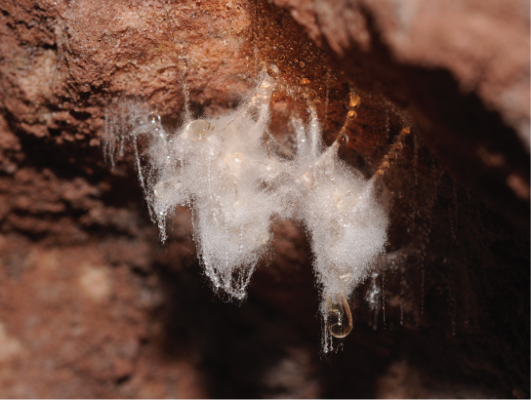
Figure 23.29
A saprobic oomycete engulfs a dead insect.
(credit: modification of work by Thomas Bresson)
This OpenStax ancillary resource is © Rice University under a CC-BY 4.0 International license; it may be reproduced or modified but must be attributed to OpenStax, Rice University and any changes must be noted. Any images credited to other sources are similarly available for reproduction, but must be attributed to their sources.

Slide 31
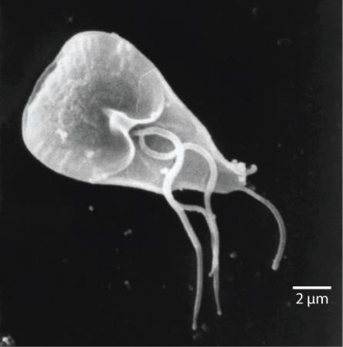
Figure 23.30
The mammalian intestinal parasite Giardia lamblia, visualized here using scanning electron microscopy, is a waterborne protist that causes severe diarrhea when ingested.
(credit: modification of work by Janice Carr, CDC; scale-bar data from Matt Russell)
This OpenStax ancillary resource is © Rice University under a CC-BY 4.0 International license; it may be reproduced or modified but must be attributed to OpenStax, Rice University and any changes must be noted. Any images credited to other sources are similarly available for reproduction, but must be attributed to their sources.

Slide 32
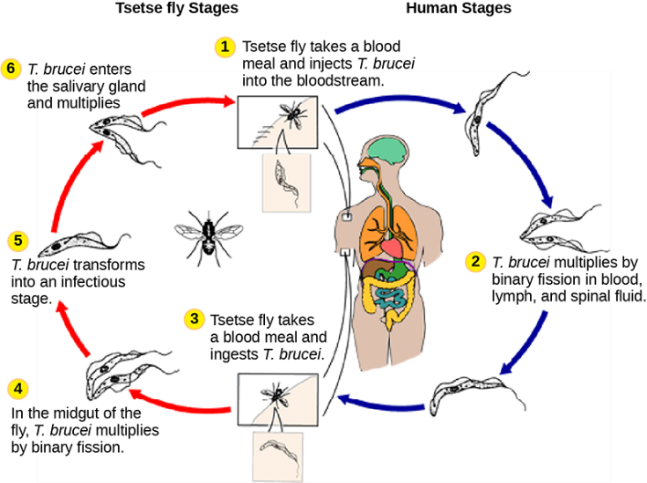
Figure 23.31
(credit: modification of work by CDC)
This OpenStax ancillary resource is © Rice University under a CC-BY 4.0 International license; it may be reproduced or modified but must be attributed to OpenStax, Rice University and any changes must be noted. Any images credited to other sources are similarly available for reproduction, but must be attributed to their sources.
Notes:
Trypanosoma brucei, the causative agent of sleeping sickness, spends part of its life cycle in the tsetse fly and part in humans.

Slide 33
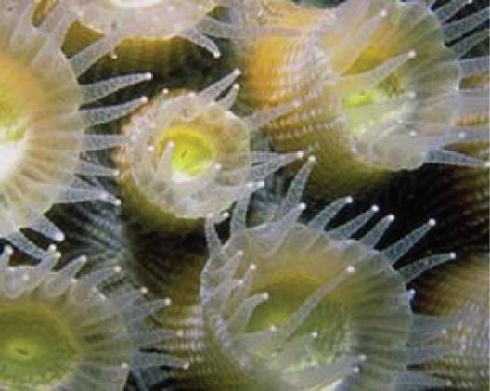
Figure 23.32
Coral polyps obtain nutrition through a symbiotic relationship with dinoflagellates.
This OpenStax ancillary resource is © Rice University under a CC-BY 4.0 International license; it may be reproduced or modified but must be attributed to OpenStax, Rice University and any changes must be noted. Any images credited to other sources are similarly available for reproduction, but must be attributed to their sources.

Slide 34
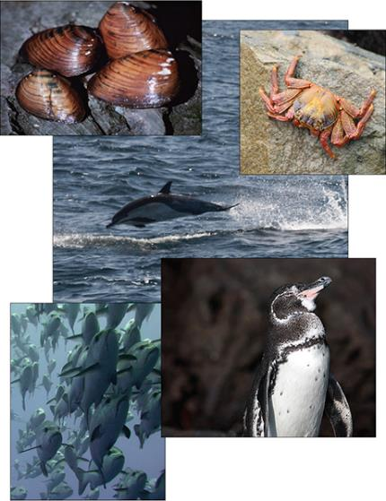
Figure 23.33
Virtually all aquatic organisms depend directly or indirectly on protists for food.
(credit “mollusks”: modification of work by Craig Stihler, USFWS; credit “crab”: modification of work by David Berkowitz; credit “dolphin”: modification of work by Mike Baird; credit “fish”: modification of work by Tim Sheerman-Chase; credit “penguin”: modification of work by Aaron Logan)
This OpenStax ancillary resource is © Rice University under a CC-BY 4.0 International license; it may be reproduced or modified but must be attributed to OpenStax, Rice University and any changes must be noted. Any images credited to other sources are similarly available for reproduction, but must be attributed to their sources.

Slide 35
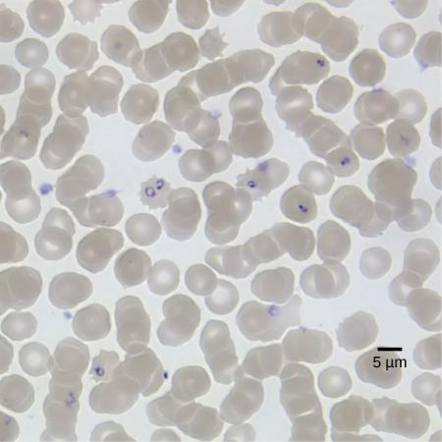
Figure 23.34
Red blood cells are shown to be infected with P. falciparum, the causative agent of malaria. In this light microscopic image taken using a 100× oil immersion lens, the ring-shaped P. falciparum stains purple.
(credit: modification of work by Michael Zahniser; scale-bar data from Matt Russell)
This OpenStax ancillary resource is © Rice University under a CC-BY 4.0 International license; it may be reproduced or modified but must be attributed to OpenStax, Rice University and any changes must be noted. Any images credited to other sources are similarly available for reproduction, but must be attributed to their sources.

Slide 36
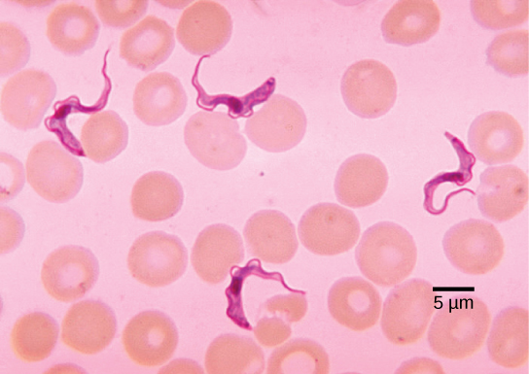
Figure 23.35
Trypanosomes are shown among red blood cells.
(credit: modification of work by Dr. Myron G. Shultz; scale-bar data from Matt Russell)
This OpenStax ancillary resource is © Rice University under a CC-BY 4.0 International license; it may be reproduced or modified but must be attributed to OpenStax, Rice University and any changes must be noted. Any images credited to other sources are similarly available for reproduction, but must be attributed to their sources.

Slide 37
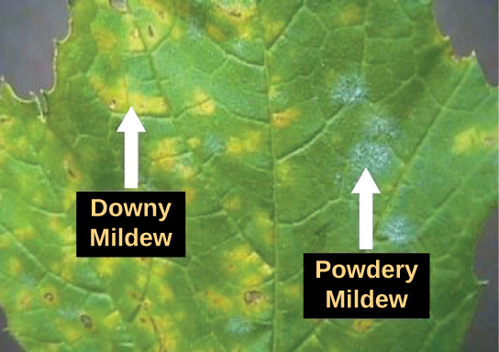
Figure 23.36
Both downy and powdery mildews on this grape leaf are caused by an infection of
P. viticola.
(credit: modification of work by USDA)
This OpenStax ancillary resource is © Rice University under a CC-BY 4.0 International license; it may be reproduced or modified but must be attributed to OpenStax, Rice University and any changes must be noted. Any images credited to other sources are similarly available for reproduction, but must be attributed to their sources.

Slide 38
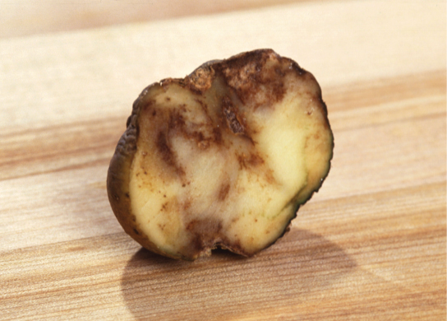
Figure 23.37
These unappetizing remnants result from an infection with P. infestans, the causative agent of potato late blight.
(credit: USDA)
This OpenStax ancillary resource is © Rice University under a CC-BY 4.0 International license; it may be reproduced or modified but must be attributed to OpenStax, Rice University and any changes must be noted. Any images credited to other sources are similarly available for reproduction, but must be attributed to their sources.

