Slide 1


Biology 2e
Chapter 24 FUNGI
PowerPoint Image Slide Show

Slide 2
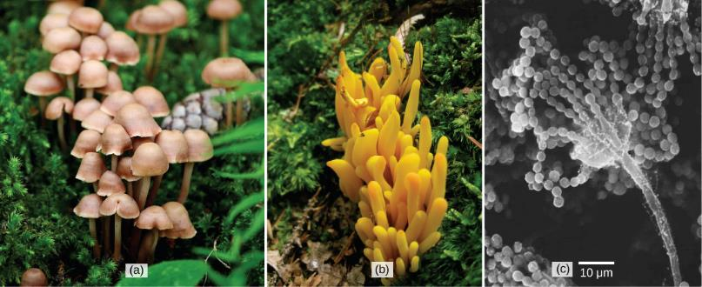
Figure 24.1
Many species of fungus produce the familiar mushroom (a) which is a reproductive structure. This (b) coral fungus displays brightly colored fruiting bodies. This electron micrograph shows (c) the spore-bearing structures of Aspergillus, a type of toxic fungus found mostly in soil and plants.
(credit “mushroom”: modification of work by Chris Wee; credit “coral fungus”: modification of work by Cory Zanker; credit “Aspergillus”: modification of work by Janice Haney Carr, Robert Simmons, CDC; scale-bar data from Matt Russell)
This OpenStax ancillary resource is © Rice University under a CC-BY 4.0 International license; it may be reproduced or modified but must be attributed to OpenStax, Rice University and any changes must be noted. Any images credited to other sources are similarly available for reproduction, but must be attributed to their sources.

Slide 3
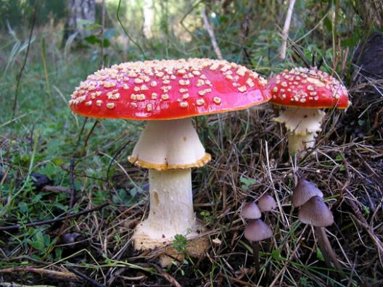
Figure 24.2
The poisonous Amanita muscaria is native to temperate and boreal regions of North America.
(credit: Christine Majul)
This OpenStax ancillary resource is © Rice University under a CC-BY 4.0 International license; it may be reproduced or modified but must be attributed to OpenStax, Rice University and any changes must be noted. Any images credited to other sources are similarly available for reproduction, but must be attributed to their sources.

Slide 4
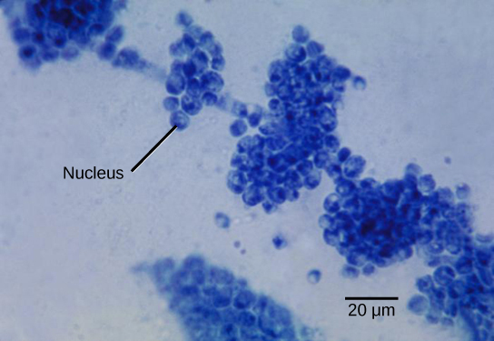
Figure 24.3
Candida albicans is a yeast cell and the agent of candidiasis and thrush. This organism has a similar morphology to coccus bacteria; however, yeast is a eukaryotic organism (note the nucleus).
(credit: modification of work by Dr. Godon Roberstad, CDC; scale-bar data from Matt Russell)
This OpenStax ancillary resource is © Rice University under a CC-BY 4.0 International license; it may be reproduced or modified but must be attributed to OpenStax, Rice University and any changes must be noted. Any images credited to other sources are similarly available for reproduction, but must be attributed to their sources.

Slide 5
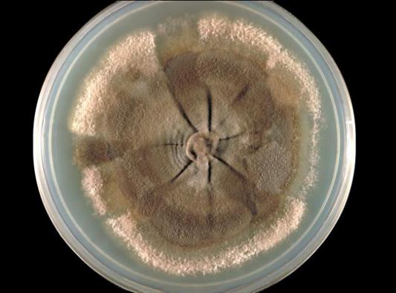
Figure 24.4
The mycelium of the fungus Neotestudina rosati can be pathogenic to humans. The fungus enters through a cut or scrape and develops a mycetoma, a chronic subcutaneous infection.
(credit: CDC)
This OpenStax ancillary resource is © Rice University under a CC-BY 4.0 International license; it may be reproduced or modified but must be attributed to OpenStax, Rice University and any changes must be noted. Any images credited to other sources are similarly available for reproduction, but must be attributed to their sources.

Slide 6
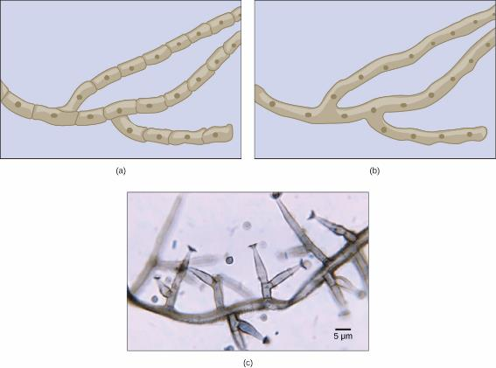
Figure 24.5
Fungal hyphae may be (a) septated or (b) coenocytic (coeno- = “common”; -cytic = “cell”) with many nuclei present in a single hypha. A bright field light micrograph of (c) Phialophora richardsiae shows septa that divide the hyphae.
(credit c: modification of work by Dr. Lucille Georg, CDC; scale-bar data from Matt Russell)
This OpenStax ancillary resource is © Rice University under a CC-BY 4.0 International license; it may be reproduced or modified but must be attributed to OpenStax, Rice University and any changes must be noted. Any images credited to other sources are similarly available for reproduction, but must be attributed to their sources.

Slide 7
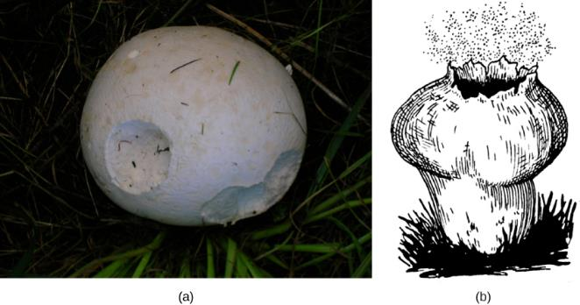
Figure 24.6
The (a) giant puffball mushroom releases (b) a cloud of spores when it reaches maturity.
(credit a: modification of work by Roger Griffith; credit b: modification of work by Pearson Scott Foresman, donated to the Wikimedia Foundation)
This OpenStax ancillary resource is © Rice University under a CC-BY 4.0 International license; it may be reproduced or modified but must be attributed to OpenStax, Rice University and any changes must be noted. Any images credited to other sources are similarly available for reproduction, but must be attributed to their sources.

Slide 8
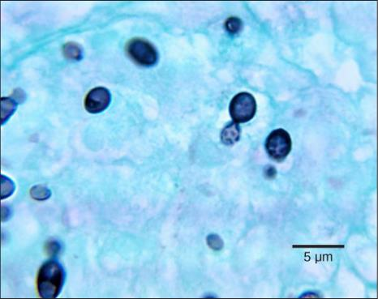
Figure 24.7
The dark cells in this bright field light micrograph are the pathogenic yeast Histoplasma capsulatum, seen against a backdrop of light blue tissue. Histoplasma primarily infects lungs but can spread to other tissues, causing histoplasmosis, a potentially fatal disease.
(credit: modification of work by Dr. Libero Ajello, CDC; scale-bar data from Matt Russell)
This OpenStax ancillary resource is © Rice University under a CC-BY 4.0 International license; it may be reproduced or modified but must be attributed to OpenStax, Rice University and any changes must be noted. Any images credited to other sources are similarly available for reproduction, but must be attributed to their sources.

Slide 9
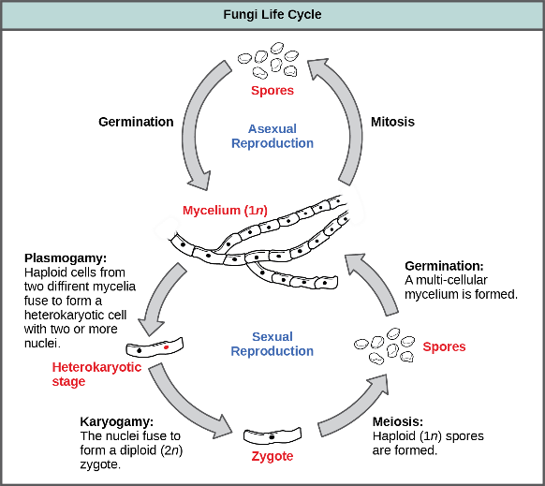
Figure 24.8
Fungi may have both asexual and sexual stages of reproduction.
This OpenStax ancillary resource is © Rice University under a CC-BY 4.0 International license; it may be reproduced or modified but must be attributed to OpenStax, Rice University and any changes must be noted. Any images credited to other sources are similarly available for reproduction, but must be attributed to their sources.

Slide 10
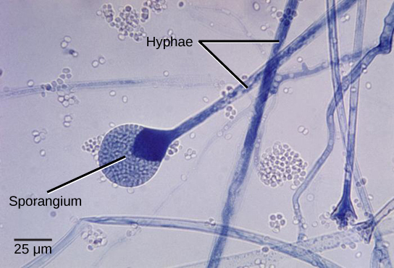
Figure 24.9
This bright field light micrograph shows the release of spores from a sporangium at the end of a hypha called a sporangiophore. The organism is a Mucor sp. fungus, a mold often found indoors.
(credit: modification of work by Dr. Lucille Georg, CDC; scale-bar data from Matt Russell)
This OpenStax ancillary resource is © Rice University under a CC-BY 4.0 International license; it may be reproduced or modified but must be attributed to OpenStax, Rice University and any changes must be noted. Any images credited to other sources are similarly available for reproduction, but must be attributed to their sources.

Slide 11
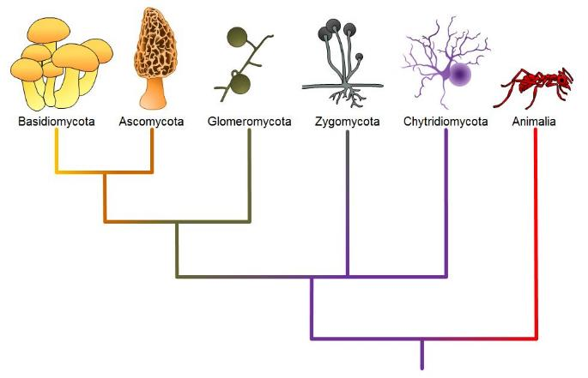
Figure 24.10
Fungal phyla. Note: “-mycota” is used to designate a phylum, while “-mycetes” formally denotes a class or is used informally to refer to all members of the phylum.
This OpenStax ancillary resource is © Rice University under a CC-BY 4.0 International license; it may be reproduced or modified but must be attributed to OpenStax, Rice University and any changes must be noted. Any images credited to other sources are similarly available for reproduction, but must be attributed to their sources.

Slide 12
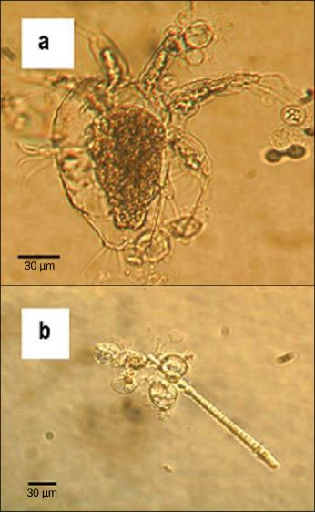
Figure 24.11
The chytrid Batrachochytrium dendrobatidis is seen in these light micrographs as transparent spheres growing on (a) a freshwater arthropod (water mite) and (b) algae. This chytrid causes skin diseases in many species of amphibians, resulting in species decline and extinction.
(credit: modification of work by Johnson ML, Speare R., CDC)
This OpenStax ancillary resource is © Rice University under a CC-BY 4.0 International license; it may be reproduced or modified but must be attributed to OpenStax, Rice University and any changes must be noted. Any images credited to other sources are similarly available for reproduction, but must be attributed to their sources.

Slide 13
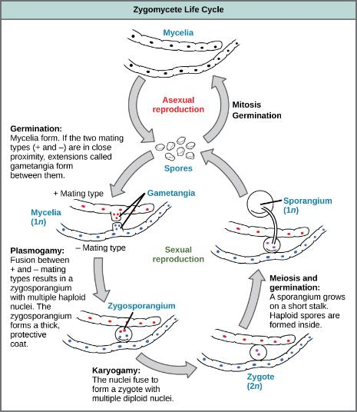
Figure 24.12
Zygomycetes have asexual and sexual phases in their life cycles. In the asexual phase, spores are produced from haploid sporangia by mitosis (not shown). In the sexual phase, plus and minus haploid mating types conjugate to form a heterokaryotic zygosporangium. Karyogamy then produces a diploid zygote. Diploid cells in the zygote undergo meiosis and germinate to form a haploid sporangium, which releases the next generation of haploid spores.
This OpenStax ancillary resource is © Rice University under a CC-BY 4.0 International license; it may be reproduced or modified but must be attributed to OpenStax, Rice University and any changes must be noted. Any images credited to other sources are similarly available for reproduction, but must be attributed to their sources.

Slide 14
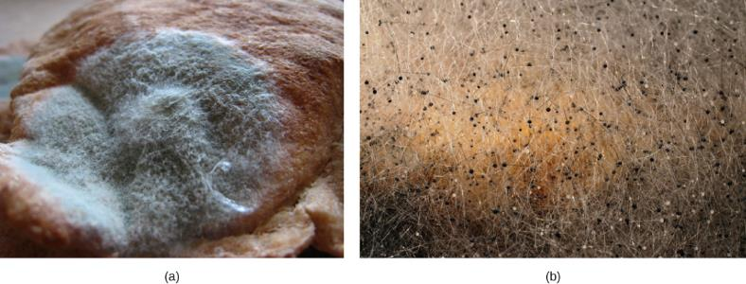
Figure 24.13
Asexual sporangia grow at the end of stalks, which appear as (a) white fuzz seen on this bread mold, Rhizopus stolonifer. The black tips (b) of bread mold are the spore-containing sporangia.
(credit b: modification of work by "polandeze"/Flickr)
This OpenStax ancillary resource is © Rice University under a CC-BY 4.0 International license; it may be reproduced or modified but must be attributed to OpenStax, Rice University and any changes must be noted. Any images credited to other sources are similarly available for reproduction, but must be attributed to their sources.

Slide 15
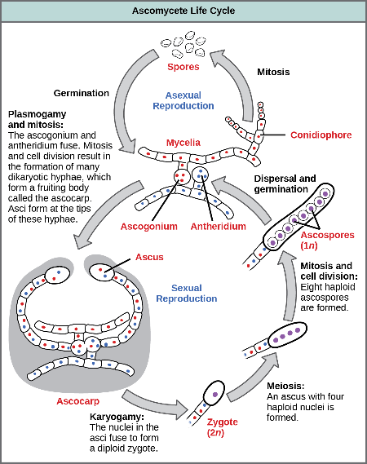
Figure 24.14
The lifecycle of an ascomycete is characterized by the production of asci during the sexual phase. In each ascus, the four nuclei produced by meiosis divide once mitotically for a total of eight haploid ascospores. The haploid phase is the predominant phase of the life cycle in Ascomycetes.
This OpenStax ancillary resource is © Rice University under a CC-BY 4.0 International license; it may be reproduced or modified but must be attributed to OpenStax, Rice University and any changes must be noted. Any images credited to other sources are similarly available for reproduction, but must be attributed to their sources.

Slide 16
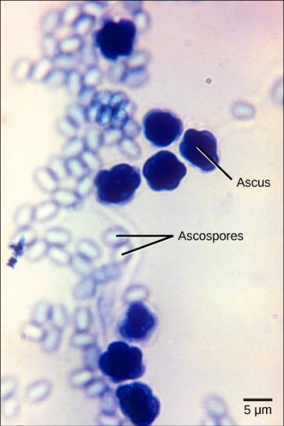
Figure 24.15
The bright field light micrograph shows ascospores being released from asci in the fungus Talaromyces flavus var. flavus.
(credit: modification of work by Dr. Lucille Georg, CDC; scale-bar data from Matt Russell)
This OpenStax ancillary resource is © Rice University under a CC-BY 4.0 International license; it may be reproduced or modified but must be attributed to OpenStax, Rice University and any changes must be noted. Any images credited to other sources are similarly available for reproduction, but must be attributed to their sources.

Slide 17
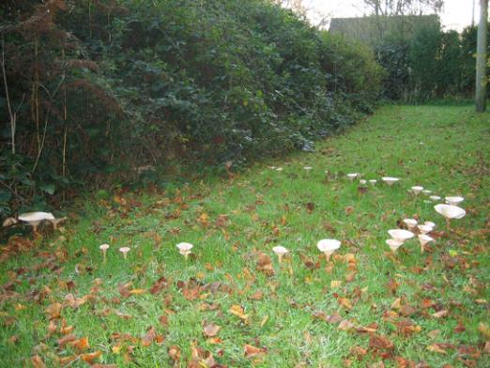
Figure 24.16
The fruiting bodies of a basidiomycete form a ring in a meadow, commonly called “fairy ring.” The best-known fairy ring fungus has the scientific name Marasmius oreades. The body of this fungus, its mycelium, is underground and grows outward in a circle. As it grows, the mycelium depletes the soil of nitrogen, causing the mycelia to grow away from the center and leading to the “fairy ring” of fruiting bodies where there is adequate soil nitrogen.
(credit: "Cropcircles"/Wikipedia Commons)
This OpenStax ancillary resource is © Rice University under a CC-BY 4.0 International license; it may be reproduced or modified but must be attributed to OpenStax, Rice University and any changes must be noted. Any images credited to other sources are similarly available for reproduction, but must be attributed to their sources.

Slide 18
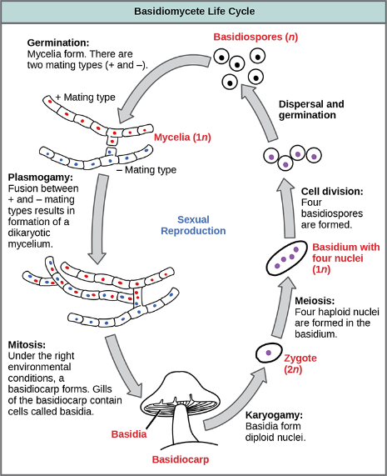
Figure 24.17
The lifecycle of a basidiomycete has sexual and asexual reproduction with haploid and dikaryotic mycelia. Haploid primary mycelia fuse to form a dikaryotic secondary mycelium, which is the dominant stage of the life cycle, and produces the basidiocarp.
This OpenStax ancillary resource is © Rice University under a CC-BY 4.0 International license; it may be reproduced or modified but must be attributed to OpenStax, Rice University and any changes must be noted. Any images credited to other sources are similarly available for reproduction, but must be attributed to their sources.

Slide 19
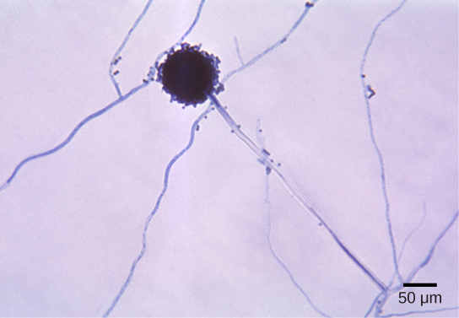
Figure 24.18
Aspergillus niger is an asexually reproducing fungus (phylum Ascomycota) commonly found as a food contaminant. The spherical structure in this light micrograph is an asexual conidiophore. Molecular studies have placed Aspergillus with the ascomycetes and sexual cycles have been identified in some species.
(credit: modification of work by Dr. Lucille Georg, CDC; scale-bar data from Matt Russell)
This OpenStax ancillary resource is © Rice University under a CC-BY 4.0 International license; it may be reproduced or modified but must be attributed to OpenStax, Rice University and any changes must be noted. Any images credited to other sources are similarly available for reproduction, but must be attributed to their sources.

Slide 20
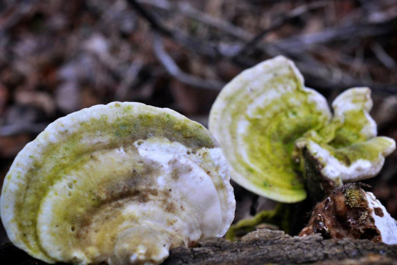
Figure 24.19
Fungi are an important part of ecosystem nutrient cycles. These bracket fungi growing on the side of a tree are the fruiting structures of a basidiomycete. They receive their nutrients through their hyphae, which invade and decay the tree trunk.
(credit: Cory Zanker)
This OpenStax ancillary resource is © Rice University under a CC-BY 4.0 International license; it may be reproduced or modified but must be attributed to OpenStax, Rice University and any changes must be noted. Any images credited to other sources are similarly available for reproduction, but must be attributed to their sources.

Slide 21
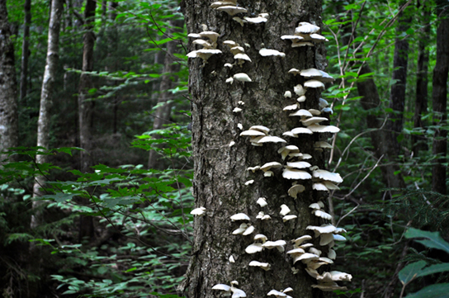
Figure 24.20
Shelf fungi, so called because they grow on trees in a stack, attack and digest the trunk or branches of a tree. While some shelf fungi are found only on dead trees, others can parasitize living trees and cause eventual death, so they are considered serious tree pathogens.
(credit: Cory Zanker)
This OpenStax ancillary resource is © Rice University under a CC-BY 4.0 International license; it may be reproduced or modified but must be attributed to OpenStax, Rice University and any changes must be noted. Any images credited to other sources are similarly available for reproduction, but must be attributed to their sources.

Slide 22
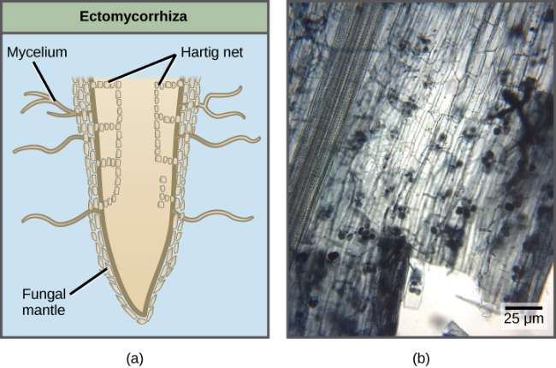
Figure 24.21
(a) Ectomycorrhizae and (b) arbuscular or endomycorrhizae have different mechanisms for interacting with the roots of plants.
(credit b: MS Turmel, University of Manitoba, Plant Science Department)
This OpenStax ancillary resource is © Rice University under a CC-BY 4.0 International license; it may be reproduced or modified but must be attributed to OpenStax, Rice University and any changes must be noted. Any images credited to other sources are similarly available for reproduction, but must be attributed to their sources.

Slide 23
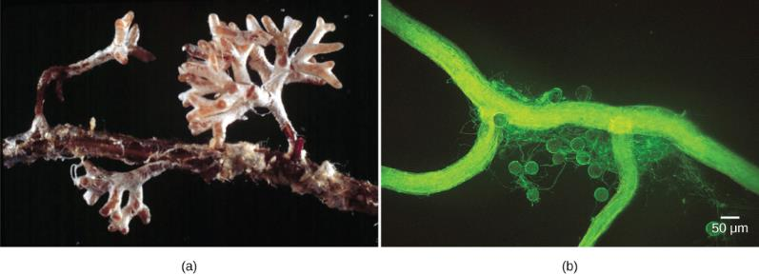
Figure 24.22
The (a) infection of Pinus radiata (Monterey pine) roots by the hyphae of Amanita muscaria (fly amanita) causes the pine tree to produce many small, branched rootlets. The Amanita hyphae cover these small roots with a white mantle. (b) Spores (the round bodies) and hyphae (thread-like structures) are evident in this light micrograph of an arbuscular mycorrhiza by a fungus on the root of a corn plant.
(credit a: modification of work by Randy Molina, USDA; credit b: modification of work by Sara Wright, USDA-ARS; scale-bar data from Matt Russell)
This OpenStax ancillary resource is © Rice University under a CC-BY 4.0 International license; it may be reproduced or modified but must be attributed to OpenStax, Rice University and any changes must be noted. Any images credited to other sources are similarly available for reproduction, but must be attributed to their sources.

Slide 24
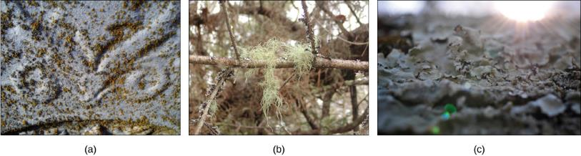
Figure 24.23
Lichens have many forms. They may be (a) crust-like, (b) hair-like, or (c) leaf-like.
(credit a: modification of work by Jo Naylor; credit b: modification of work by "djpmapleferryman"/Flickr; credit c: modification of work by Cory Zanker)
This OpenStax ancillary resource is © Rice University under a CC-BY 4.0 International license; it may be reproduced or modified but must be attributed to OpenStax, Rice University and any changes must be noted. Any images credited to other sources are similarly available for reproduction, but must be attributed to their sources.

Slide 25
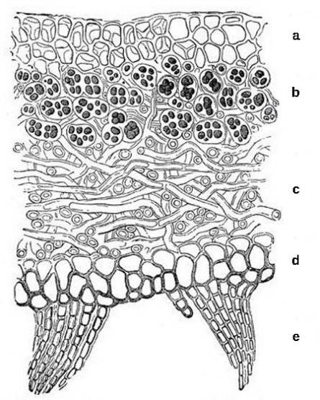
Figure 24.24
This cross-section of a lichen thallus shows the (a) upper cortex of fungal hyphae, which provides protection; the (b) algal zone where photosynthesis occurs, the (c) medulla of fungal hyphae, and the (d) lower cortex, which also provides protection and may have (e) rhizines to anchor the thallus to the substrate.
This OpenStax ancillary resource is © Rice University under a CC-BY 4.0 International license; it may be reproduced or modified but must be attributed to OpenStax, Rice University and any changes must be noted. Any images credited to other sources are similarly available for reproduction, but must be attributed to their sources.

Slide 26
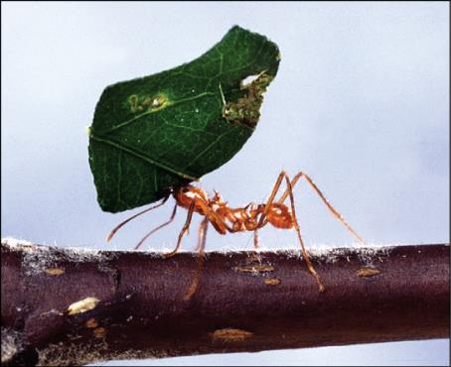
Figure 24.25
A leaf-cutter ant transports a leaf that will feed a farmed fungus.
(credit: Scott Bauer, USDA-ARS)
This OpenStax ancillary resource is © Rice University under a CC-BY 4.0 International license; it may be reproduced or modified but must be attributed to OpenStax, Rice University and any changes must be noted. Any images credited to other sources are similarly available for reproduction, but must be attributed to their sources.

Slide 27
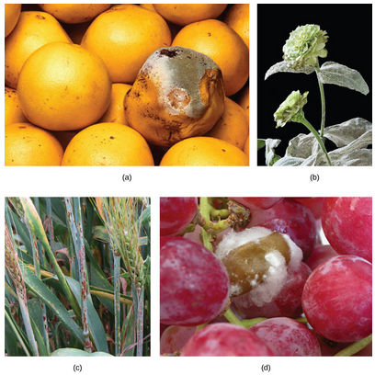
Figure 24.26
Some fungal pathogens include (a) green mold on grapefruit, (b) powdery mildew on a zinnia, (c) stem rust on a sheaf of barley, and (d) grey rot on grapes. In wet conditions Botrytis cinerea, the fungus that causes grey rot, can destroy a grape crop. However, controlled infection of grapes by Botrytis results in noble rot, a condition that produces strong and much-prized dessert wines.
(credit a: modification of work by Scott Bauer, USDA-ARS; credit b: modification of work by Stephen Ausmus, USDA-ARS; credit c: modification of work by David Marshall, USDA-ARS; credit d: modification of work by Joseph Smilanick, USDA-ARS)
This OpenStax ancillary resource is © Rice University under a CC-BY 4.0 International license; it may be reproduced or modified but must be attributed to OpenStax, Rice University and any changes must be noted. Any images credited to other sources are similarly available for reproduction, but must be attributed to their sources.

Slide 28
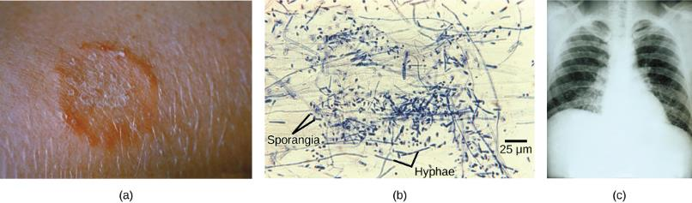
Figure 24.27
(a) Ringworm presents as a red ring on skin; (b) Trichophyton violaceum, shown in this bright field light micrograph, causes superficial mycoses on the scalp; (c) Histoplasma capsulatum is an ascomycete that infects airways and causes symptoms similar to influenza.
(credit a: modification of work by Dr. Lucille K. Georg, CDC; credit b: modification of work by Dr. Lucille K. Georg, CDC; credit c: modification of work by M. Renz, CDC; scale-bar data from Matt Russell)
This OpenStax ancillary resource is © Rice University under a CC-BY 4.0 International license; it may be reproduced or modified but must be attributed to OpenStax, Rice University and any changes must be noted. Any images credited to other sources are similarly available for reproduction, but must be attributed to their sources.
Notes:
Alternation of generations in a brown alga. Several species of brown algae, such as the Laminaria shown here, have evolved life cycles in which both the haploid (gametophyte) and diploid (sporophyte) forms are multicellular. The gametophyte is different in structure than the sporophyte.

Slide 29
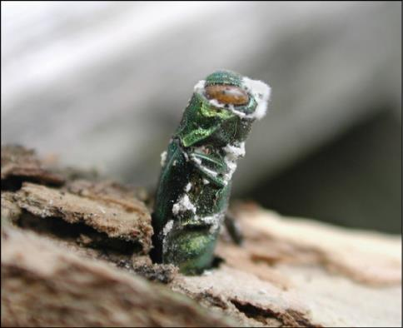
Figure 24.28
The emerald ash borer (Agrilus planipennis) is an insect that attacks ash trees. It is in turn parasitized by a pathogenic fungus (Beauveria bassiana) that holds promise as a biological insecticide. The parasitic fungus appears as white fuzz on the body of the insect.
(credit: Houping Liu, USDA Agricultural Research Service)
This OpenStax ancillary resource is © Rice University under a CC-BY 4.0 International license; it may be reproduced or modified but must be attributed to OpenStax, Rice University and any changes must be noted. Any images credited to other sources are similarly available for reproduction, but must be attributed to their sources.

Slide 30
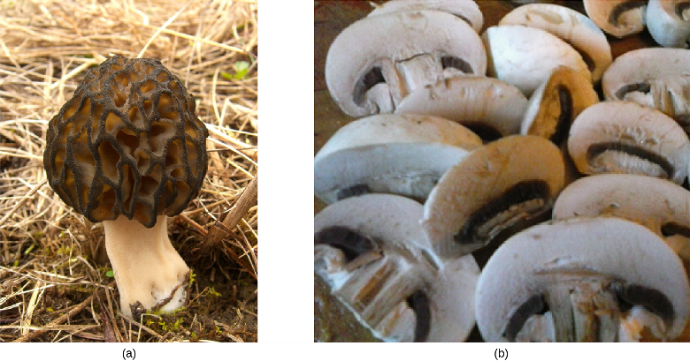
Figure 24.29
(a) The morel mushroom is an ascomycete greatly appreciated for its delicate taste. (b) Basidiocarps of Agaricus ready for an omelet.
(credit a: Jason Hollinger; credit b: Mary Anne Clark)
This OpenStax ancillary resource is © Rice University under a CC-BY 4.0 International license; it may be reproduced or modified but must be attributed to OpenStax, Rice University and any changes must be noted. Any images credited to other sources are similarly available for reproduction, but must be attributed to their sources.

