Slide 1


Biology 2e
Chapter 25 SEEDLESS PLANTS
PowerPoint Image Slide Show

Slide 2
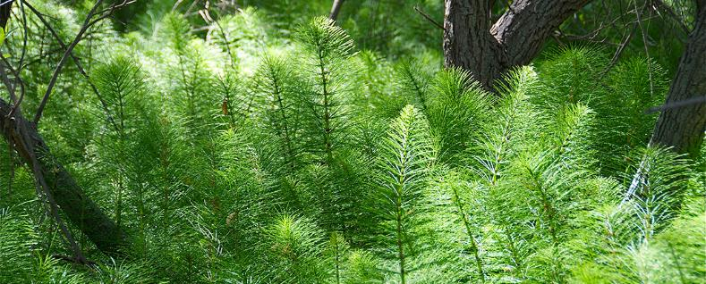
Figure 25.1
Seedless plants, like these horsetails (Equisetum sp.), thrive in damp, shaded environments under a tree canopy where dryness is rare.
(credit: modification of work by Jerry Kirkhart)
This OpenStax ancillary resource is © Rice University under a CC-BY 4.0 International license; it may be reproduced or modified but must be attributed to OpenStax, Rice University and any changes must be noted. Any images credited to other sources are similarly available for reproduction, but must be attributed to their sources.

Slide 3
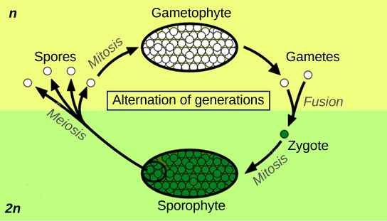
Figure 25.2
Alternation of generations between the 1n gametophyte and 2n sporophyte is shown. Mitosis occurs in both gametophyte and sporophyte generations. Diploid sporophytes produce haploid spores by meiosis, while haploid gametophytes produce gametes by mitosis.
(credit: Peter Coxhead)
This OpenStax ancillary resource is © Rice University under a CC-BY 4.0 International license; it may be reproduced or modified but must be attributed to OpenStax, Rice University and any changes must be noted. Any images credited to other sources are similarly available for reproduction, but must be attributed to their sources.

Slide 4
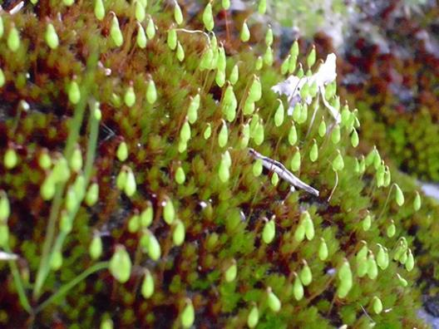
Figure 25.3
Spore-producing sacs called sporangia grow at the ends of long, thin stalks in this photo of the moss Bryum capillare.
(credit: Javier Martin)
This OpenStax ancillary resource is © Rice University under a CC-BY 4.0 International license; it may be reproduced or modified but must be attributed to OpenStax, Rice University and any changes must be noted. Any images credited to other sources are similarly available for reproduction, but must be attributed to their sources.

Slide 5
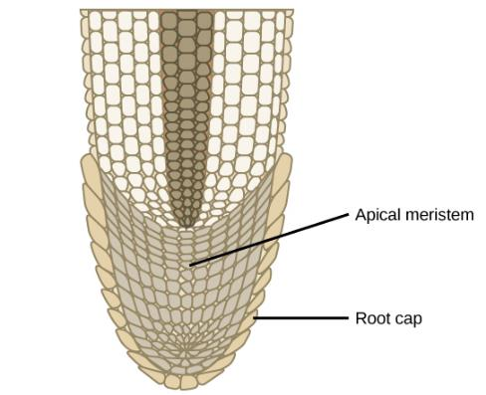
Figure 25.4
Addition of new cells in a root occurs at the apical meristem. Subsequent enlargement of these cells causes the organ to grow and elongate. The root cap protects the fragile apical meristem as the root tip is pushed through the soil by cell elongation.
This OpenStax ancillary resource is © Rice University under a CC-BY 4.0 International license; it may be reproduced or modified but must be attributed to OpenStax, Rice University and any changes must be noted. Any images credited to other sources are similarly available for reproduction, but must be attributed to their sources.

Slide 6
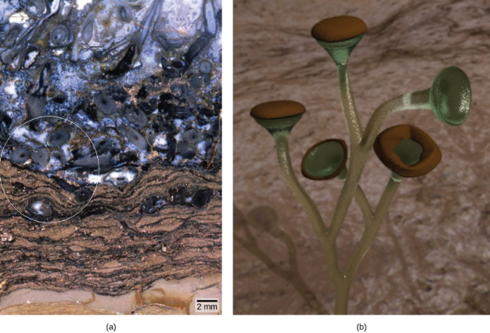
Figure 25.5
This Rhynie chert (a) contains fossilized material from vascular plants. Reconstruction of Cooksonia (b), is shown based upon the fossilized remains inside the circle in (a).
(credit b: modification of work by Peter Coxhead based on original image by “Smith609”/Wikimedia Commons; scale-bar data from Matt Russell)
This OpenStax ancillary resource is © Rice University under a CC-BY 4.0 International license; it may be reproduced or modified but must be attributed to OpenStax, Rice University and any changes must be noted. Any images credited to other sources are similarly available for reproduction, but must be attributed to their sources.

Slide 7
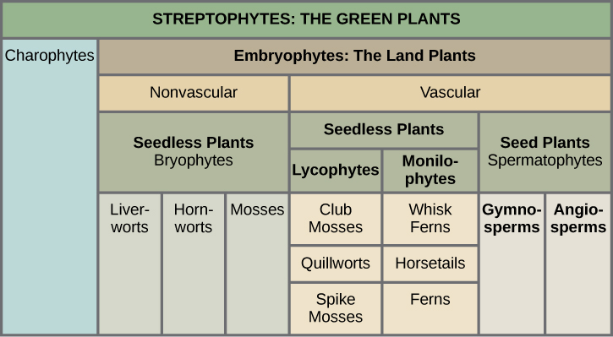
Figure 25.6
This table shows the major divisions of green plants.
This OpenStax ancillary resource is © Rice University under a CC-BY 4.0 International license; it may be reproduced or modified but must be attributed to OpenStax, Rice University and any changes must be noted. Any images credited to other sources are similarly available for reproduction, but must be attributed to their sources.

Slide 8
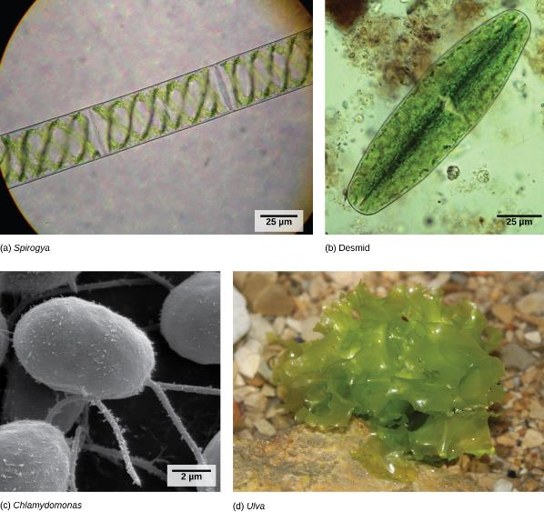
Figure 25.7
(credit b: modification of work by Derek Keats; credit c: modification of work by Dartmouth Electron Microscope Facility, Dartmouth College; credit d: modification of work by Holger Krisp; scale-bar data from Matt Russell)
This OpenStax ancillary resource is © Rice University under a CC-BY 4.0 International license; it may be reproduced or modified but must be attributed to OpenStax, Rice University and any changes must be noted. Any images credited to other sources are similarly available for reproduction, but must be attributed to their sources.
Notes:
Charophyta include (a) Spirogyra and (b) desmids. Chlorophyta include (c) Chlamydomonas, and (d) Ulva. Desmids and Chlamydomonas are single-celled organisms, Spirogyra forms chains of cells, and Ulva forms multicellular structures resembling leaves, although the cells are not differentiated as they are in higher plants

Slide 9
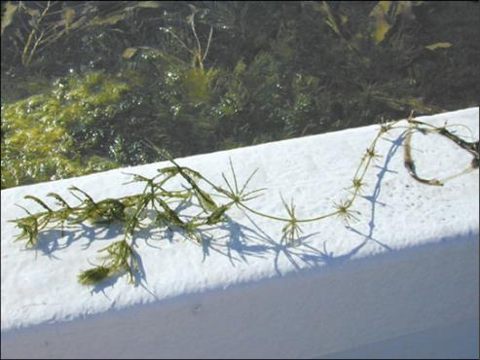
Figure 25.8
The representative alga, Chara, is a noxious weed in Florida, where it clogs waterways.
(credit: South Florida Information Access, U.S. Geological Survey)
This OpenStax ancillary resource is © Rice University under a CC-BY 4.0 International license; it may be reproduced or modified but must be attributed to OpenStax, Rice University and any changes must be noted. Any images credited to other sources are similarly available for reproduction, but must be attributed to their sources.

Slide 10
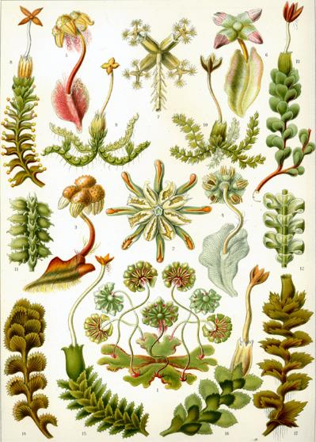
Figure 25.9
This 1904 drawing shows the variety of forms of Marchantiophyta.
This OpenStax ancillary resource is © Rice University under a CC-BY 4.0 International license; it may be reproduced or modified but must be attributed to OpenStax, Rice University and any changes must be noted. Any images credited to other sources are similarly available for reproduction, but must be attributed to their sources.

Slide 11
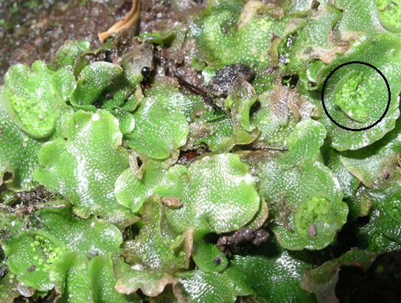
Figure 25.10
A liverwort, Lunularia cruciata, displays its lobate, flat thallus. The organism in the photograph is in the gametophyte stage, but has not yet produced gametangia. Lunularia gametophytes produce crescent-shaped gemmae (circled), which contain asexual spores. The tiny white dots on the surface of the thallus are air pores.
This OpenStax ancillary resource is © Rice University under a CC-BY 4.0 International license; it may be reproduced or modified but must be attributed to OpenStax, Rice University and any changes must be noted. Any images credited to other sources are similarly available for reproduction, but must be attributed to their sources.

Slide 12
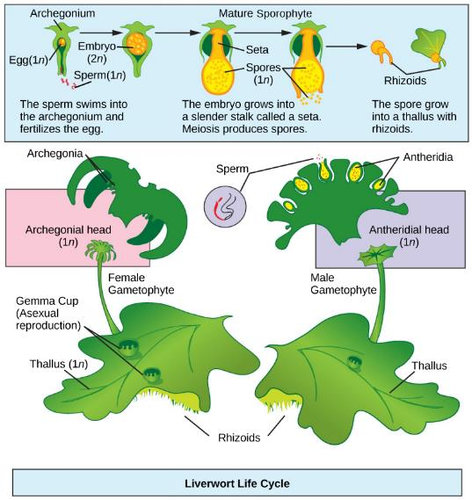
Figure 25.11
The life cycle of a typical lobate liverwort is shown. This image shows a liverwort in which antheridia and archegonia are produced on separate gametophytes.
(credit: modification of work by Mariana Ruiz Villareal)
This OpenStax ancillary resource is © Rice University under a CC-BY 4.0 International license; it may be reproduced or modified but must be attributed to OpenStax, Rice University and any changes must be noted. Any images credited to other sources are similarly available for reproduction, but must be attributed to their sources.

Slide 13
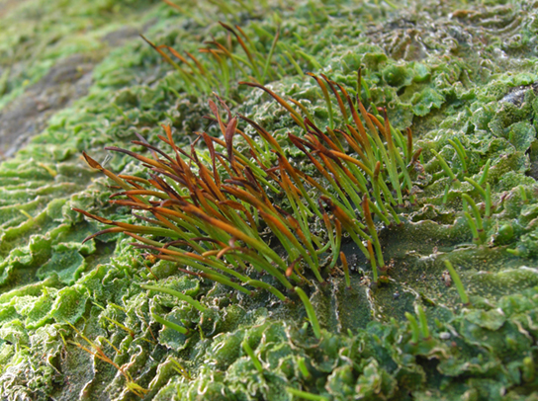
Figure 25.12
Hornworts grow a tall and slender sporophyte.
(credit: modification of work by Jason Hollinger)
This OpenStax ancillary resource is © Rice University under a CC-BY 4.0 International license; it may be reproduced or modified but must be attributed to OpenStax, Rice University and any changes must be noted. Any images credited to other sources are similarly available for reproduction, but must be attributed to their sources.

Slide 14
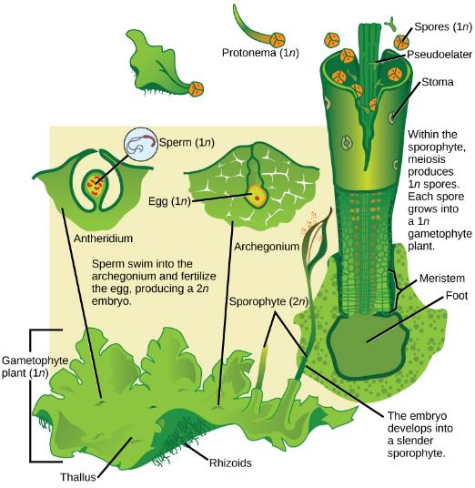
Figure 25.13
The alternation of generation in hornworts is shown.
(credit: modification of work by “Smith609”/Wikimedia Commons based on original work by Mariana Ruiz Villareal)
This OpenStax ancillary resource is © Rice University under a CC-BY 4.0 International license; it may be reproduced or modified but must be attributed to OpenStax, Rice University and any changes must be noted. Any images credited to other sources are similarly available for reproduction, but must be attributed to their sources.

Slide 15
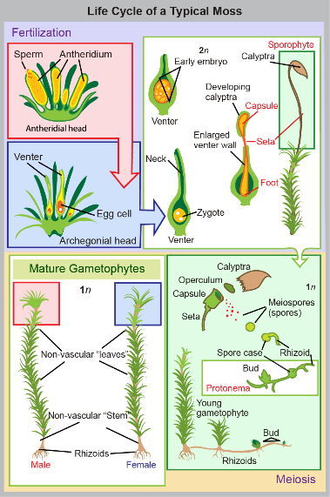
Figure 25.14
This illustration shows the life cycle of mosses.
(credit: modification of work by Mariana Ruiz Villareal)
This OpenStax ancillary resource is © Rice University under a CC-BY 4.0 International license; it may be reproduced or modified but must be attributed to OpenStax, Rice University and any changes must be noted. Any images credited to other sources are similarly available for reproduction, but must be attributed to their sources.

Slide 16
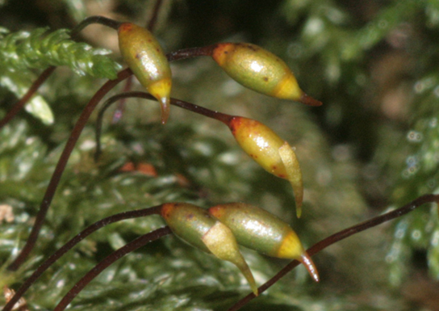
Figure 25.15
This photograph shows the long slender stems, called setae, connected to capsules of the moss Thamnobryum alopecurum. The operculum and remnants of the calyptra are visible in some capsules.
(credit: modification of work by Hermann Schachner)
This OpenStax ancillary resource is © Rice University under a CC-BY 4.0 International license; it may be reproduced or modified but must be attributed to OpenStax, Rice University and any changes must be noted. Any images credited to other sources are similarly available for reproduction, but must be attributed to their sources.

Slide 17
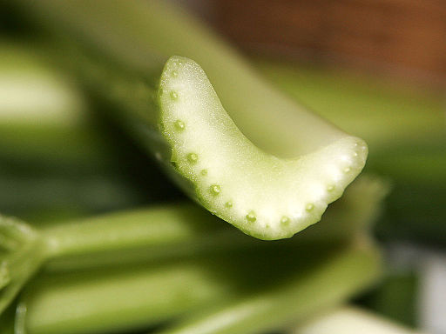
Figure 25.16
This cross section of a celery stalk shows a number of vascular bundles. The xylem is on the inner part of each bundle.
(credit: fir0002 | flagstaffotos.com.au [GFDL 1.2 (http://www.gnu.org/licenses/old-licenses/fdl-1.2.html)], via Wikimedia Commons. Image modified from source.)
This OpenStax ancillary resource is © Rice University under a CC-BY 4.0 International license; it may be reproduced or modified but must be attributed to OpenStax, Rice University and any changes must be noted. Any images credited to other sources are similarly available for reproduction, but must be attributed to their sources.

Slide 18
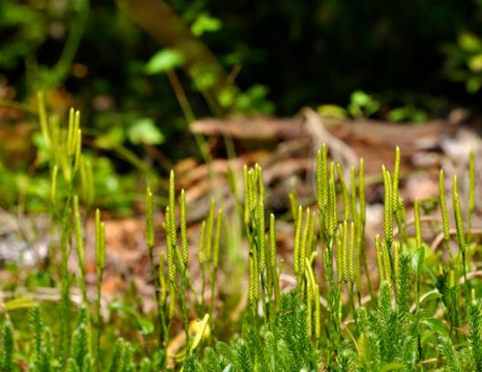
Figure 25.17
In the club mosses such as Lycopodium clavatum, sporangia are arranged in clusters called strobili. The generic name means “wolf-foot” from the resemblance of the branched sporophyte to a paw. The specific epithet clavatum refers to the club-shaped strobilus, and reflects the common name of the phylum.
(credit: Cory Zanker)
This OpenStax ancillary resource is © Rice University under a CC-BY 4.0 International license; it may be reproduced or modified but must be attributed to OpenStax, Rice University and any changes must be noted. Any images credited to other sources are similarly available for reproduction, but must be attributed to their sources.

Slide 19
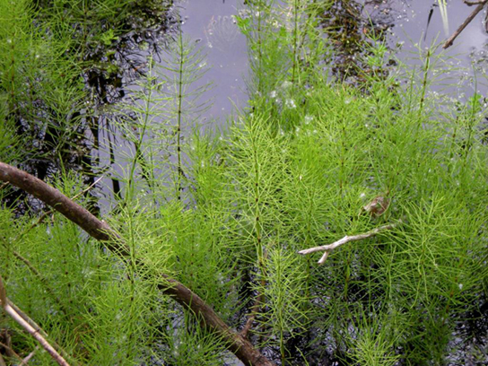
Figure 25.18
Horsetails, named for the brushy appearance of the sporophyte, thrive in a marsh.
(credit: Myriam Feldman)
This OpenStax ancillary resource is © Rice University under a CC-BY 4.0 International license; it may be reproduced or modified but must be attributed to OpenStax, Rice University and any changes must be noted. Any images credited to other sources are similarly available for reproduction, but must be attributed to their sources.

Slide 20
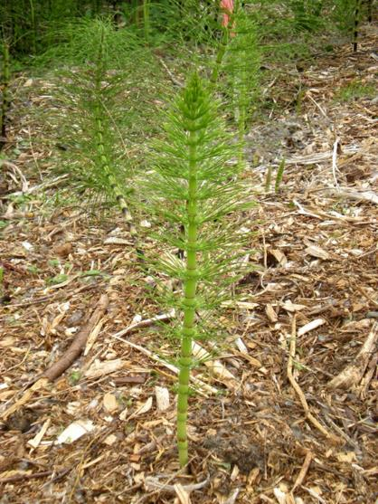
Figure 25.19
The jointed stem of a horsetail. Thin leaves originating at the joints are noticeable on the horsetail plant. Because silica deposited in the cell walls made these plants abrasive, horsetails were once used as scrubbing brushes and were nicknamed scouring rushes.
(credit: Myriam Feldman)
This OpenStax ancillary resource is © Rice University under a CC-BY 4.0 International license; it may be reproduced or modified but must be attributed to OpenStax, Rice University and any changes must be noted. Any images credited to other sources are similarly available for reproduction, but must be attributed to their sources.

Slide 21
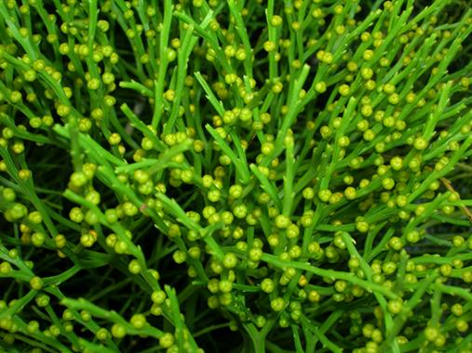
Figure 25.20
The whisk fern Psilotum nudum has conspicuous green stems with knob-shaped sporangia.
(credit: Forest & Kim Starr)
This OpenStax ancillary resource is © Rice University under a CC-BY 4.0 International license; it may be reproduced or modified but must be attributed to OpenStax, Rice University and any changes must be noted. Any images credited to other sources are similarly available for reproduction, but must be attributed to their sources.

Slide 22
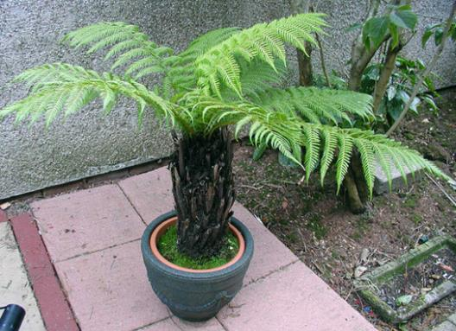
Figure 25.21
Some specimens of this short tree-fern species can grow very tall.
(credit: Adrian Pingstone)
This OpenStax ancillary resource is © Rice University under a CC-BY 4.0 International license; it may be reproduced or modified but must be attributed to OpenStax, Rice University and any changes must be noted. Any images credited to other sources are similarly available for reproduction, but must be attributed to their sources.

Slide 23
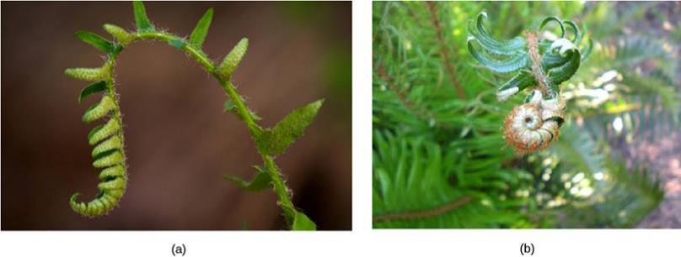
Figure 25.22
Croziers, or fiddleheads, are the tips of fern fronds.
(credit a: modification of work by Cory Zanker; credit b: modification of work by Myriam Feldman)
This OpenStax ancillary resource is © Rice University under a CC-BY 4.0 International license; it may be reproduced or modified but must be attributed to OpenStax, Rice University and any changes must be noted. Any images credited to other sources are similarly available for reproduction, but must be attributed to their sources.

Slide 24
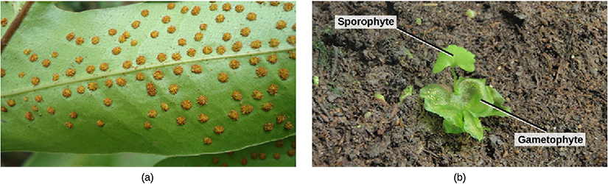
Figure 25.23
Sori (a) appear as small bumps on the underside of a fern frond. (b) Fern gametophyte and young sporophyte. The sporophyte and gametophyte are labeled.
(credit a: Myriam Feldman; credit b: modification of work by "Vlmastra"/Wikimedia Commons)
This OpenStax ancillary resource is © Rice University under a CC-BY 4.0 International license; it may be reproduced or modified but must be attributed to OpenStax, Rice University and any changes must be noted. Any images credited to other sources are similarly available for reproduction, but must be attributed to their sources.

Slide 25
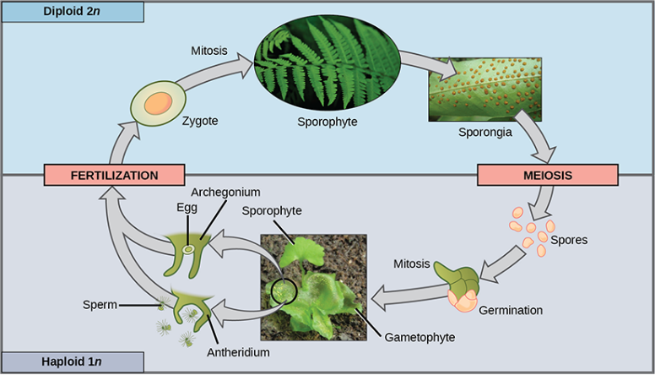
Figure 25.24
This life cycle of a fern shows alternation of generations with a dominant sporophyte stage.
(credit "fern": modification of work by Cory Zanker; credit "gametophyte": modification of work by "Vlmastra"/Wikimedia Commons)
This OpenStax ancillary resource is © Rice University under a CC-BY 4.0 International license; it may be reproduced or modified but must be attributed to OpenStax, Rice University and any changes must be noted. Any images credited to other sources are similarly available for reproduction, but must be attributed to their sources.

Slide 26
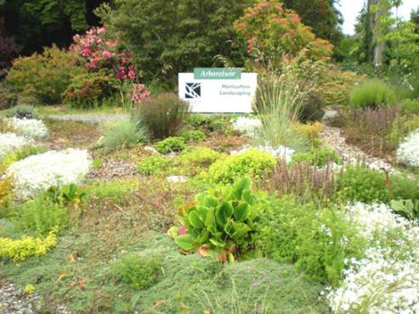
Figure 25.25
This landscaped border at a college campus was designed by students in the horticulture and landscaping department of the college.
(credit: Myriam Feldman)
This OpenStax ancillary resource is © Rice University under a CC-BY 4.0 International license; it may be reproduced or modified but must be attributed to OpenStax, Rice University and any changes must be noted. Any images credited to other sources are similarly available for reproduction, but must be attributed to their sources.

Slide 27
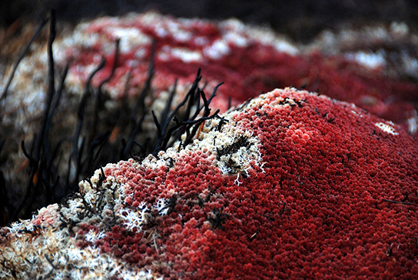
Figure 25.26
Sphagnum acutifolium is dried peat moss and can be used as fuel.
(credit: Ken Goulding)
This OpenStax ancillary resource is © Rice University under a CC-BY 4.0 International license; it may be reproduced or modified but must be attributed to OpenStax, Rice University and any changes must be noted. Any images credited to other sources are similarly available for reproduction, but must be attributed to their sources.

