Slide 1

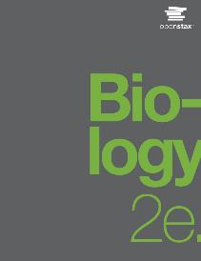
BIOLOGY 2e
Chapter 27 INTRODUCTION TO ANIMAL DIVERSITY
PowerPoint Image Slideshow

Slide 2
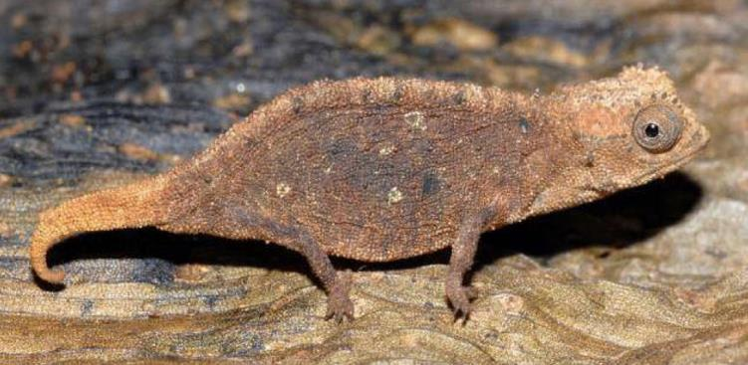
Figure 27.1
The leaf chameleon (Brookesia micra) was discovered in northern Madagascar in 2012. At just over one inch long, it is the smallest known chameleon.
(credit: modification of work by Frank Glaw, et al., PLOS)
This OpenStax ancillary resource is © Rice University under a CC-BY 4.0 International license; it may be reproduced or modified but must be attributed to OpenStax, Rice University and any changes must be noted. Any images credited to other sources are similarly available for reproduction, but must be attributed to their sources.

Slide 3
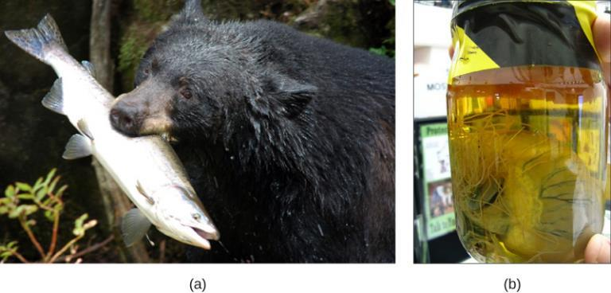
Figure 27.2
All animals that derive energy from food are heterotrophs. The (a) black bear is an omnivore, eating both plants and animals. The (b) heartworm Dirofilaria immitis is a parasite that derives energy from its hosts. It spends its larval stage in mosquitos and its adult stage infesting the hearts of dogs and other mammals, as shown here.
(credit a: modification of work by USDA Forest Service; credit b: modification of work by Clyde Robinson)
This OpenStax ancillary resource is © Rice University under a CC-BY 4.0 International license; it may be reproduced or modified but must be attributed to OpenStax, Rice University and any changes must be noted. Any images credited to other sources are similarly available for reproduction, but must be attributed to their sources.

Slide 4
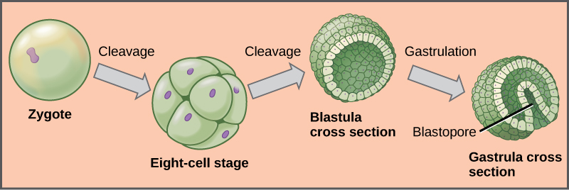
Figure 27.3
During embryonic development, the zygote undergoes a series of mitotic cell divisions, or cleavages, that subdivide the egg into smaller and smaller blastomeres. Note that the 8-cell stage and the blastula are about the same size as the original zygote. In many invertebrates, the blastula consists of a single layer of cells around a hollow space. During a process called gastrulation, the cells from the blastula move inward on one side to form an inner cavity. This inner cavity becomes the primitive gut (archenteron) of the gastrula (“little gut”) stage. The opening into this cavity is called the blastopore, and in some invertebrates it is destined to form the mouth.
This OpenStax ancillary resource is © Rice University under a CC-BY 4.0 International license; it may be reproduced or modified but must be attributed to OpenStax, Rice University and any changes must be noted. Any images credited to other sources are similarly available for reproduction, but must be attributed to their sources.

Slide 5
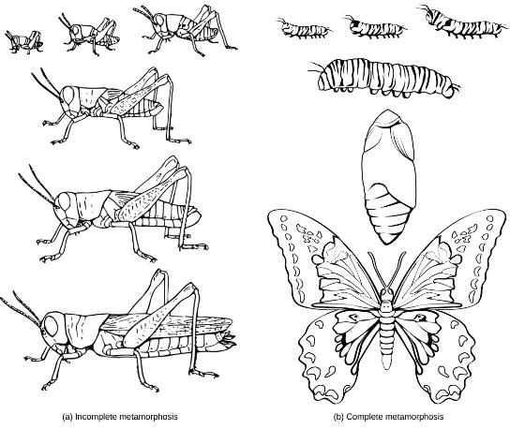
Figure 27.4
(a) The grasshopper undergoes incomplete metamorphosis. (b) The butterfly undergoes complete metamorphosis.
(credit: S.E. Snodgrass, USDA)
This OpenStax ancillary resource is © Rice University under a CC-BY 4.0 International license; it may be reproduced or modified but must be attributed to OpenStax, Rice University and any changes must be noted. Any images credited to other sources are similarly available for reproduction, but must be attributed to their sources.

Slide 6
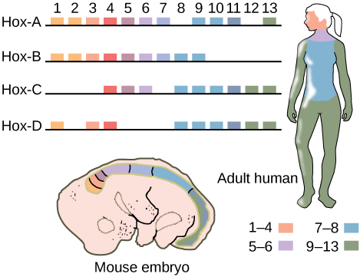
Figure 27.5
Hox genes are highly conserved genes encoding transcription factors that determine the course of embryonic development in animals. In vertebrates, the genes have been duplicated into four clusters on different chromosomes: Hox-A, Hox-B, Hox-C, and Hox-D. Genes within these clusters are expressed in certain body segments at certain stages of development. Shown here is the homology between Hox genes in mice and humans. Note how Hox gene expression, as indicated with orange, pink, blue,
and green shading, occurs in the same body segments in both the mouse and the human. While at least one copy of each Hox gene is present in humans and other vertebrates, some Hox genes are missing in some chromosomal sets.
This OpenStax ancillary resource is © Rice University under a CC-BY 4.0 International license; it may be reproduced or modified but must be attributed to OpenStax, Rice University and any changes must be noted. Any images credited to other sources are similarly available for reproduction, but must be attributed to their sources.

Slide 7
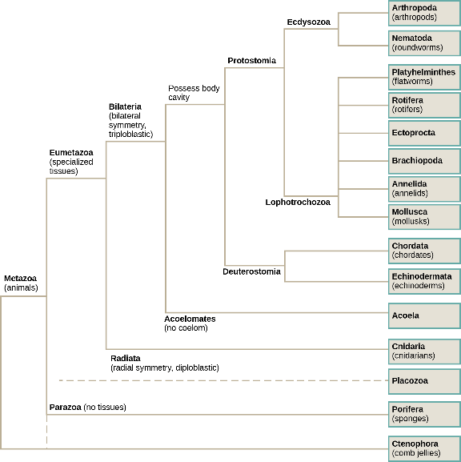
Figure 27.6
The phylogenetic tree of animals is based on morphological, fossil, and genetic evidence. The Ctenophora and Porifera are both considered to be basal because of the absence of Hox genes in this group, but how they are related to the “Parahoxozoa” (Placozoa + Eumetazoa) or to each other, continues to be a matter of debate.
This OpenStax ancillary resource is © Rice University under a CC-BY 4.0 International license; it may be reproduced or modified but must be attributed to OpenStax, Rice University and any changes must be noted. Any images credited to other sources are similarly available for reproduction, but must be attributed to their sources.

Slide 8
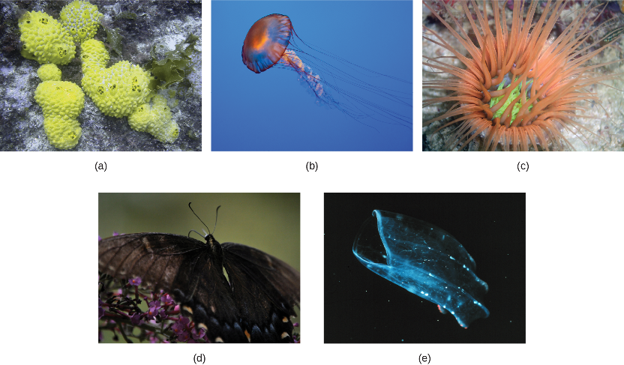
Figure 27.7a
The (a) sponge is asymmetrical, and the (b) jellyfish and (c) anemone are radially symmetrical.
(credit a: modification of work by Andrew Turner; credit b: modification of work by Robert Freiburger; credit c: modification of work by Samuel Chow)
This OpenStax ancillary resource is © Rice University under a CC-BY 4.0 International license; it may be reproduced or modified but must be attributed to OpenStax, Rice University and any changes must be noted. Any images credited to other sources are similarly available for reproduction, but must be attributed to their sources.

Slide 9
Figure 27.7B
The (d) butterfly is bilaterally symmetrical. Rotational symmetry (e) is seen in the ctenophore Beroe, shown swimming open-mouthed.
(credit d: modification of work by Cory Zanker; credit e: modification of work by NOAA)
This OpenStax ancillary resource is © Rice University under a CC-BY 4.0 International license; it may be reproduced or modified but must be attributed to OpenStax, Rice University and any changes must be noted. Any images credited to other sources are similarly available for reproduction, but must be attributed to their sources.

Slide 10
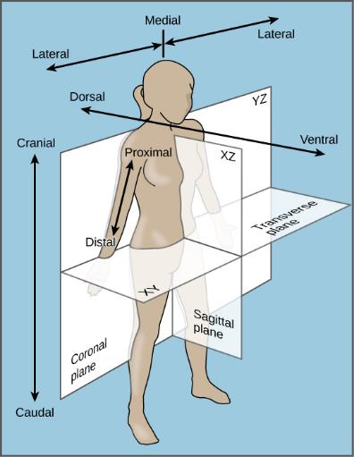
Figure 27.8
The bilaterally symmetrical human body can be divided by several planes.
This OpenStax ancillary resource is © Rice University under a CC-BY 4.0 International license; it may be reproduced or modified but must be attributed to OpenStax, Rice University and any changes must be noted. Any images credited to other sources are similarly available for reproduction, but must be attributed to their sources.

Slide 11
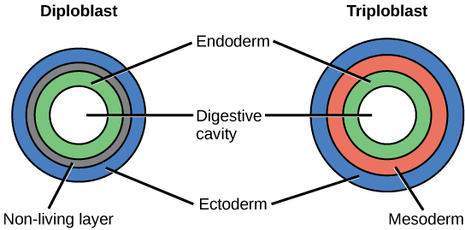
Figure 27.9
During embryogenesis, diploblasts develop two embryonic germ layers: an ectoderm and an endoderm. Triploblasts develop a third layer—the mesoderm—between the endoderm and ectoderm.
This OpenStax ancillary resource is © Rice University under a CC-BY 4.0 International license; it may be reproduced or modified but must be attributed to OpenStax, Rice University and any changes must be noted. Any images credited to other sources are similarly available for reproduction, but must be attributed to their sources.

Slide 12
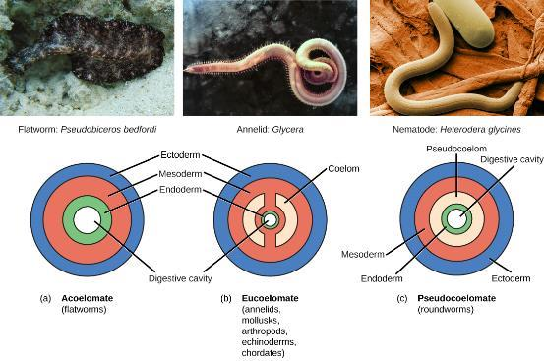
Figure 27.10
Triploblasts may be acoelomates, eucoelomates, or pseudocoelomates. Eucoelomates have a body cavity within the mesoderm, called a coelom, which is lined with mesoderm tissue. Pseudocoelomates have a similar body cavity, but it is lined with mesoderm and endoderm tissue.
(credit a: modification of work by Jan Derk; credit b: modification of work by NOAA; credit c: modification of work by USDA, ARS)
This OpenStax ancillary resource is © Rice University under a CC-BY 4.0 International license; it may be reproduced or modified but must be attributed to OpenStax, Rice University and any changes must be noted. Any images credited to other sources are similarly available for reproduction, but must be attributed to their sources.

Slide 13
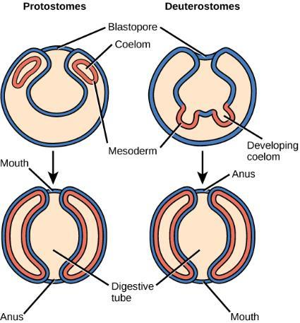
Figure 27.11
Eucoelomates can be divided into two groups based on their early embryonic development. In protostomes, the mouth forms at or near the site of the blastopore and the body cavity forms by splitting the mesodermal mass during the process of schizocoely. In deuterostomes, the mouth forms at a site opposite the blastopore end of the embryo and the mesoderm pinches off to form the coelom during the process of enterocoely.
This OpenStax ancillary resource is © Rice University under a CC-BY 4.0 International license; it may be reproduced or modified but must be attributed to OpenStax, Rice University and any changes must be noted. Any images credited to other sources are similarly available for reproduction, but must be attributed to their sources.

Slide 14
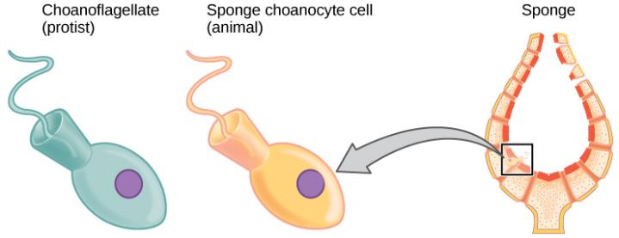
Figure 27.12
Cells of the protist choanoflagellate clade closely resemble sponge choanocyte cells. Beating of choanocyte flagella draws water through the sponge so that nutrients can be extracted and waste removed.
This OpenStax ancillary resource is © Rice University under a CC-BY 4.0 International license; it may be reproduced or modified but must be attributed to OpenStax, Rice University and any changes must be noted. Any images credited to other sources are similarly available for reproduction, but must be attributed to their sources.

Slide 15
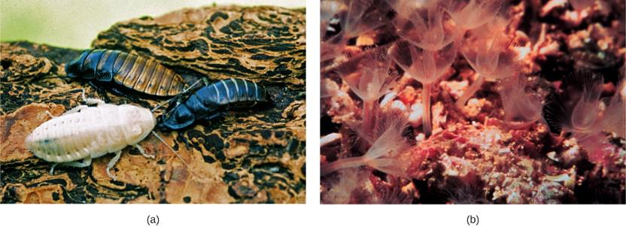
Figure 27.13
Animals that molt their exoskeletons, such as these (a) Madagascar hissing cockroaches, are in the clade Ecdysozoa. (b) Phoronids are in the clade Lophotrochozoa. The tentacles are part of a feeding structure called a lophophore.
(credit a: modification of work by Whitney Cranshaw, Colorado State University, Bugwood.org; credit b: modification of work by NOAA)
This OpenStax ancillary resource is © Rice University under a CC-BY 4.0 International license; it may be reproduced or modified but must be attributed to OpenStax, Rice University and any changes must be noted. Any images credited to other sources are similarly available for reproduction, but must be attributed to their sources.

Slide 16
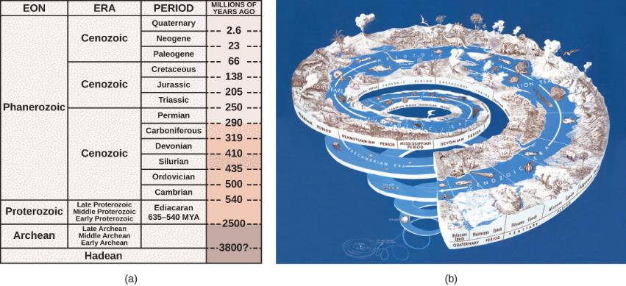
Figure 27.14
(a) Earth’s history is divided into eons, eras, and periods. Note that the Ediacaran period starts in the Proterozoic eon and ends at the start of the Cambrian period of the Phanerozoic eon. (b) Stages on the geological time scale are represented as a spiral.
(credit: modification of work by USGS)
This OpenStax ancillary resource is © Rice University under a CC-BY 4.0 International license; it may be reproduced or modified but must be attributed to OpenStax, Rice University and any changes must be noted. Any images credited to other sources are similarly available for reproduction, but must be attributed to their sources.

Slide 17
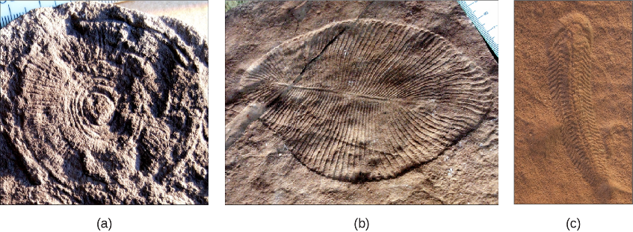
Figure 27.15
Fossils of (a) Cyclomedusa (up to 20 cm), (b) Dickinsonia (up to 1.4 m), (and (c) Spriggina (up to 5 cm) date to the Ediacaran period (543–635 MYA).
(credit: modification of work by “Smith609”/Wikimedia Commons)
This OpenStax ancillary resource is © Rice University under a CC-BY 4.0 International license; it may be reproduced or modified but must be attributed to OpenStax, Rice University and any changes must be noted. Any images credited to other sources are similarly available for reproduction, but must be attributed to their sources.

Slide 18
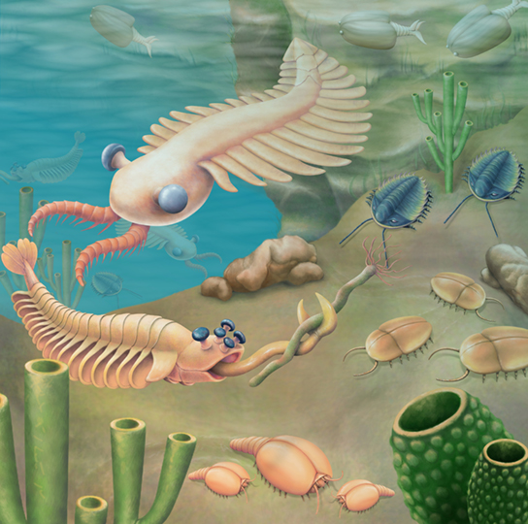
Figure 27.16
An artist’s rendition, “Fauna of the Burgess Shale,” depicts some organisms from the Cambrian period. Anomalocaris is seen in the upper left quadrant of the picture.
This OpenStax ancillary resource is © Rice University under a CC-BY 4.0 International license; it may be reproduced or modified but must be attributed to OpenStax, Rice University and any changes must be noted. Any images credited to other sources are similarly available for reproduction, but must be attributed to their sources.

Slide 19
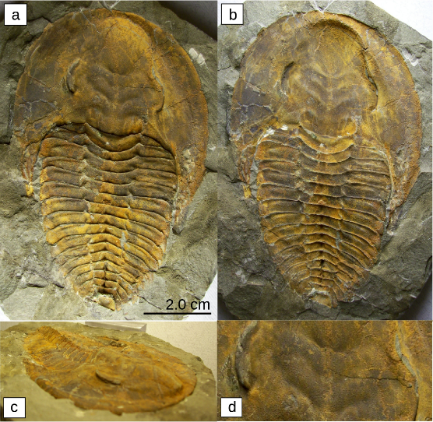
Figure 27.17
These fossils belong to trilobites, extinct arthropods that appeared in the early Cambrian period, 525 million years ago. They disappeared from the fossil record during a mass extinction at the end of the Permian period, about 250 million years ago.
This OpenStax ancillary resource is © Rice University under a CC-BY 4.0 International license; it may be reproduced or modified but must be attributed to OpenStax, Rice University and any changes must be noted. Any images credited to other sources are similarly available for reproduction, but must be attributed to their sources.

Slide 20
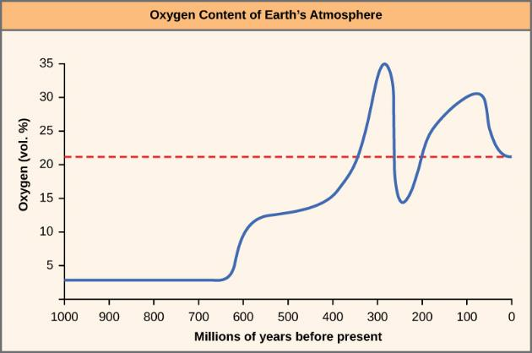
Figure 27.18
The oxygen concentration in Earth’s atmosphere rose sharply around 300 million years ago.
This OpenStax ancillary resource is © Rice University under a CC-BY 4.0 International license; it may be reproduced or modified but must be attributed to OpenStax, Rice University and any changes must be noted. Any images credited to other sources are similarly available for reproduction, but must be attributed to their sources.

Slide 21
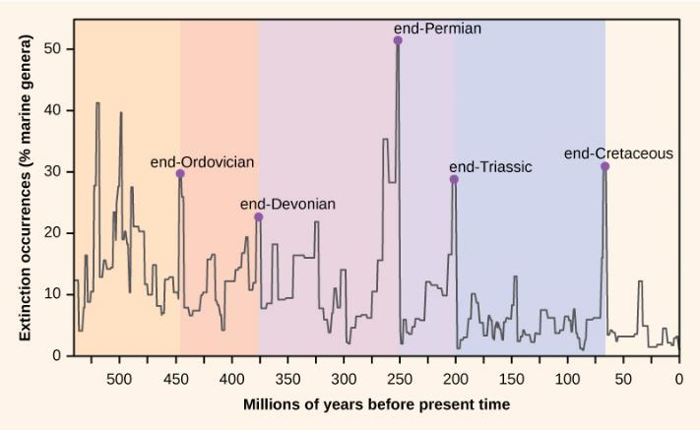
Figure 27.19
Mass extinctions have occurred repeatedly over geological time.
This OpenStax ancillary resource is © Rice University under a CC-BY 4.0 International license; it may be reproduced or modified but must be attributed to OpenStax, Rice University and any changes must be noted. Any images credited to other sources are similarly available for reproduction, but must be attributed to their sources.

