Slide 1


Biology 2e
Chapter 31 SOIL AND PLANT NUTRITION
PowerPoint Image Slide Show

Slide 2
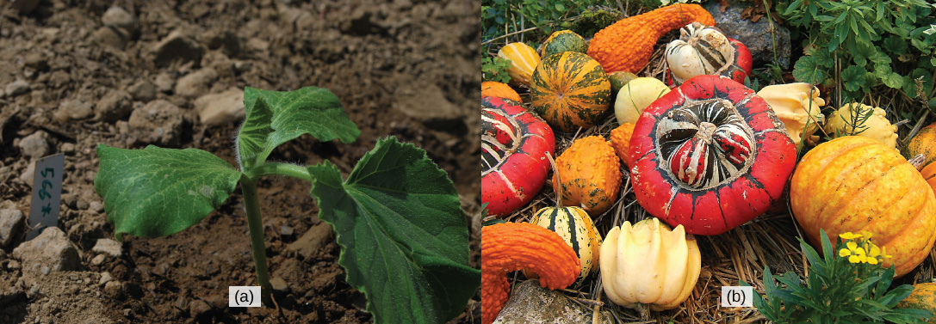
Figure 31.1
For this (a) squash seedling (Cucurbita maxima) to develop into a mature plant bearing its (b) fruit, numerous nutritional requirements must be met.
(credit a: modification of work by Julian Colton; credit b: modification of work by "Wildfeuer"/Wikimedia Commons)
This OpenStax ancillary resource is © Rice University under a CC-BY 4.0 International license; it may be reproduced or modified but must be attributed to OpenStax, Rice University and any changes must be noted. Any images credited to other sources are similarly available for reproduction, but must be attributed to their sources.

Slide 3
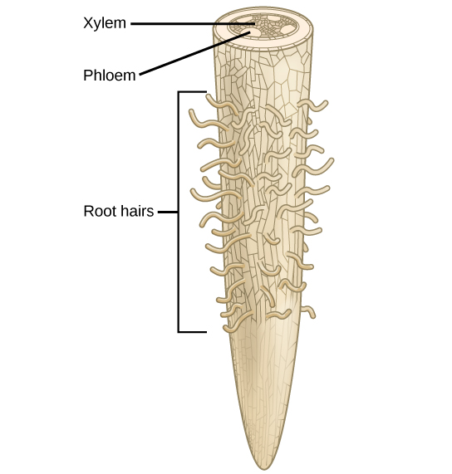
Figure 31.2
Water is absorbed through the root hairs and moves up the xylem to the leaves.
This OpenStax ancillary resource is © Rice University under a CC-BY 4.0 International license; it may be reproduced or modified but must be attributed to OpenStax, Rice University and any changes must be noted. Any images credited to other sources are similarly available for reproduction, but must be attributed to their sources.

Slide 4
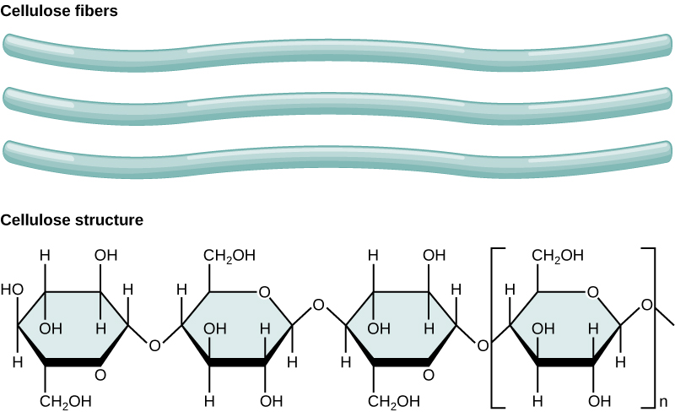
Figure 31.3
Cellulose, the main structural component of the plant cell wall, makes up over thirty percent of plant matter. It is the most abundant organic compound on earth.
This OpenStax ancillary resource is © Rice University under a CC-BY 4.0 International license; it may be reproduced or modified but must be attributed to OpenStax, Rice University and any changes must be noted. Any images credited to other sources are similarly available for reproduction, but must be attributed to their sources.

Slide 5
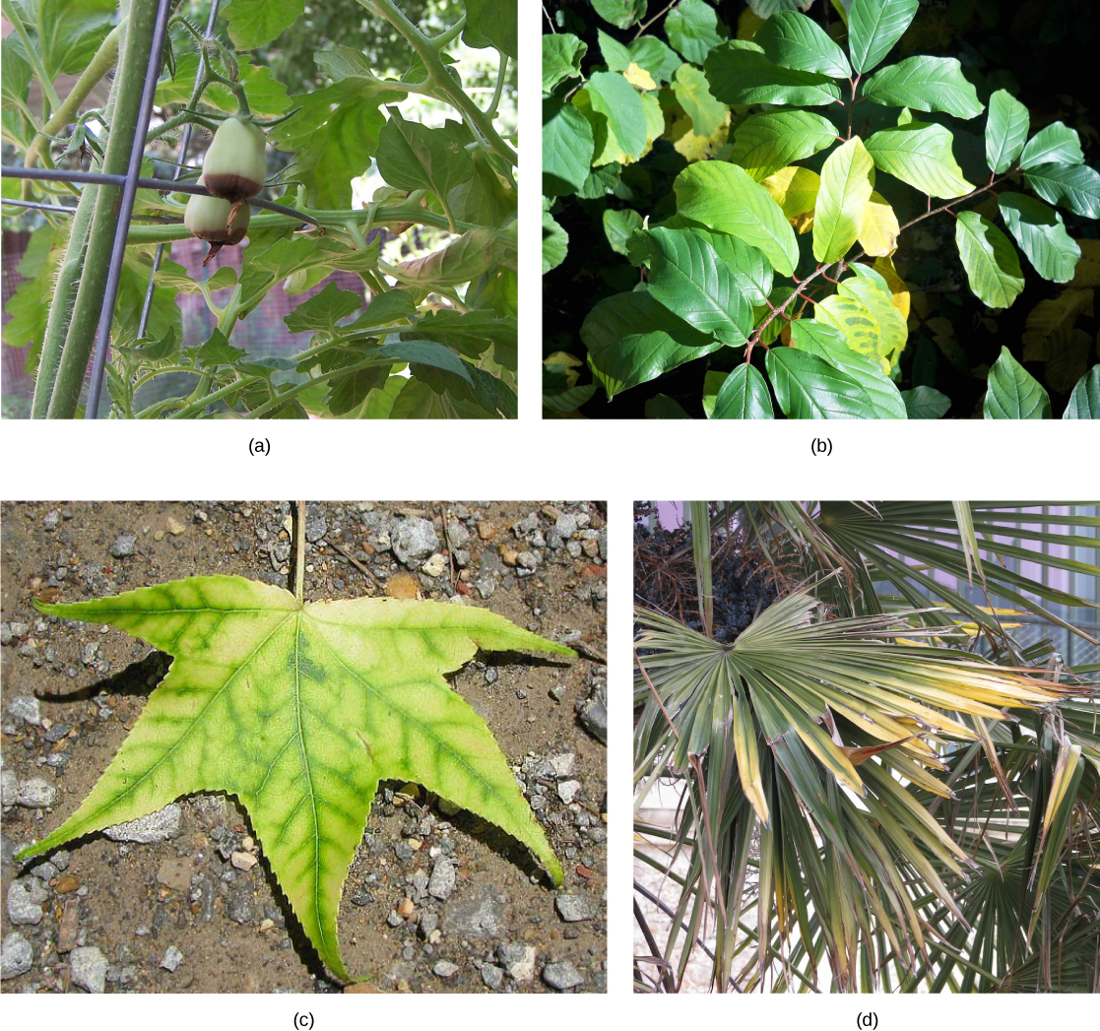
Figure 31.4a
Nutrient deficiency is evident in the symptoms these plants show. This (a) grape tomato suffers from blossom end rot caused by calcium deficiency. The yellowing in this (b) Frangula alnus results from magnesium deficiency.
This OpenStax ancillary resource is © Rice University under a CC-BY 4.0 International license; it may be reproduced or modified but must be attributed to OpenStax, Rice University and any changes must be noted. Any images credited to other sources are similarly available for reproduction, but must be attributed to their sources.

Slide 6
Figure 31.4b
Inadequate magnesium also leads to (c) interveinal chlorosis, seen here in a sweetgum leaf. This (d) palm is affected by potassium deficiency.
(credit c: modification of work by Jim Conrad; credit d: modification of work by Malcolm Manners)
This OpenStax ancillary resource is © Rice University under a CC-BY 4.0 International license; it may be reproduced or modified but must be attributed to OpenStax, Rice University and any changes must be noted. Any images credited to other sources are similarly available for reproduction, but must be attributed to their sources.

Slide 7
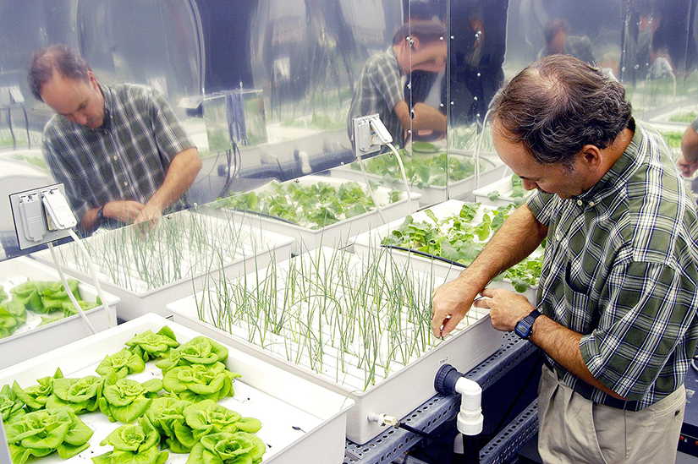
Figure 31.5
Plant physiologist Ray Wheeler checks onions being grown using hydroponic techniques. The other plants are Bibb lettuce (left) and radishes (right).
(credit: NASA)
This OpenStax ancillary resource is © Rice University under a CC-BY 4.0 International license; it may be reproduced or modified but must be attributed to OpenStax, Rice University and any changes must be noted. Any images credited to other sources are similarly available for reproduction, but must be attributed to their sources.

Slide 8
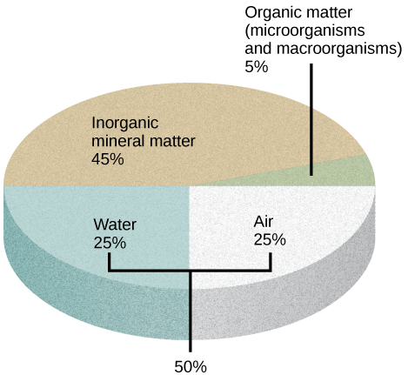
Figure 31.6
The four major components of soil are shown: inorganic minerals, organic matter, water, and air.
This OpenStax ancillary resource is © Rice University under a CC-BY 4.0 International license; it may be reproduced or modified but must be attributed to OpenStax, Rice University and any changes must be noted. Any images credited to other sources are similarly available for reproduction, but must be attributed to their sources.

Slide 9
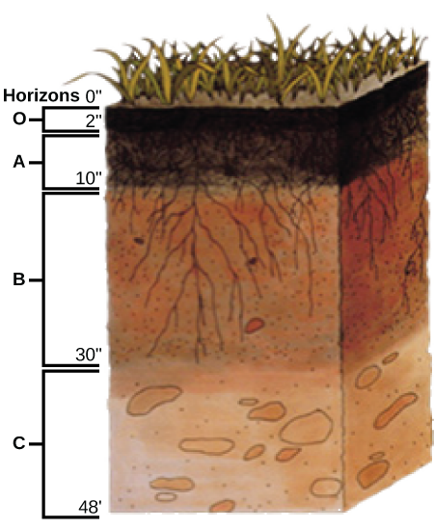
Figure 31.7
This soil profile shows the different soil layers (O horizon, A horizon, B horizon, and C horizon) found in typical soils.
(credit: modification of work by USDA)
This OpenStax ancillary resource is © Rice University under a CC-BY 4.0 International license; it may be reproduced or modified but must be attributed to OpenStax, Rice University and any changes must be noted. Any images credited to other sources are similarly available for reproduction, but must be attributed to their sources.

Slide 10
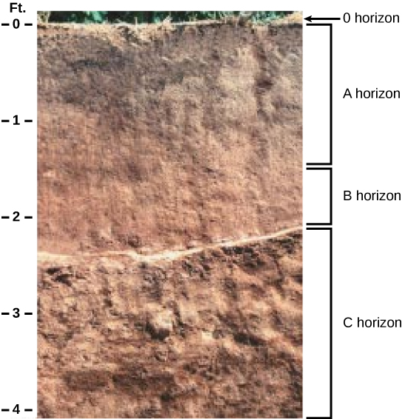
Figure 31.8
The San Joaquin soil profile has an O horizon, A horizon, B horizon, and C horizon.
(credit: modification of work by USDA)
This OpenStax ancillary resource is © Rice University under a CC-BY 4.0 International license; it may be reproduced or modified but must be attributed to OpenStax, Rice University and any changes must be noted. Any images credited to other sources are similarly available for reproduction, but must be attributed to their sources.

Slide 11
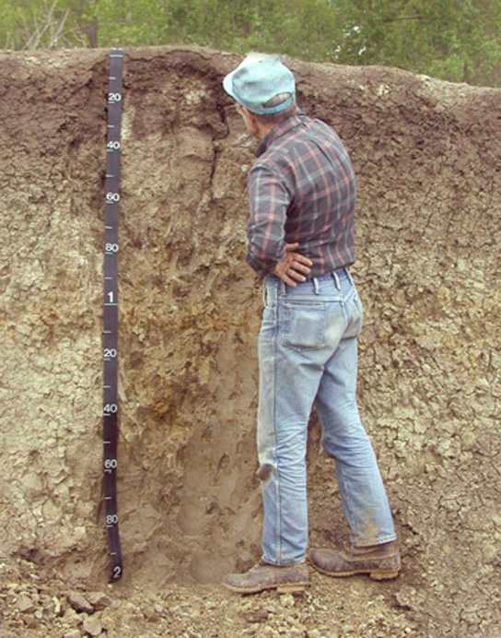
Figure 31.9
This soil scientist is studying the horizons and composition of soil at a research site.
(credit: USDA)
This OpenStax ancillary resource is © Rice University under a CC-BY 4.0 International license; it may be reproduced or modified but must be attributed to OpenStax, Rice University and any changes must be noted. Any images credited to other sources are similarly available for reproduction, but must be attributed to their sources.

Slide 12
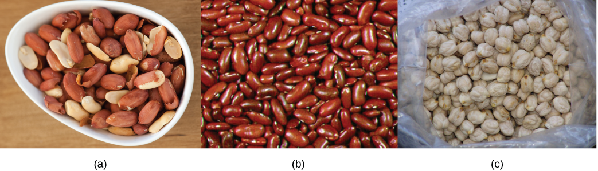
Figure 31.10
Some common edible legumes—like (a) peanuts, (b) beans, and (c) chickpeas—are able to interact symbiotically with soil bacteria that fix nitrogen.
(credit a: modification of work by Jules Clancy; credit b: modification of work by USDA)
This OpenStax ancillary resource is © Rice University under a CC-BY 4.0 International license; it may be reproduced or modified but must be attributed to OpenStax, Rice University and any changes must be noted. Any images credited to other sources are similarly available for reproduction, but must be attributed to their sources.

Slide 13
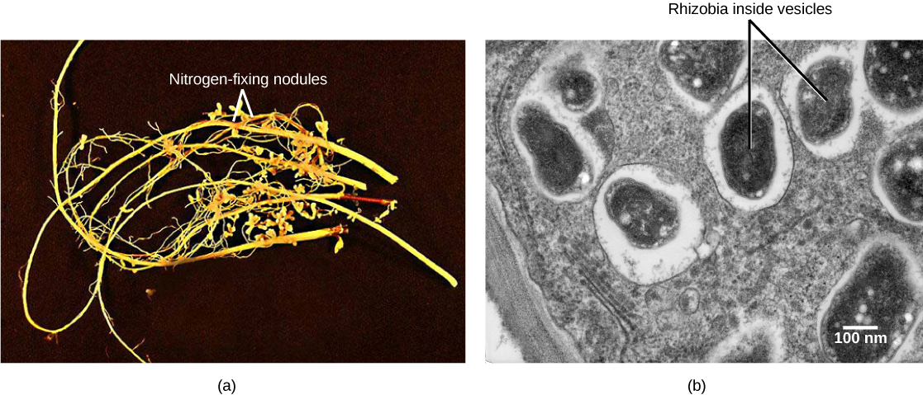
Figure 31.11
Soybean roots contain (a) nitrogen-fixing nodules. Cells within the nodules are infected with Bradyrhyzobium japonicum, a rhizobia or “root-loving” bacterium. The bacteria are encased in (b) vesicles inside the cell, as can be seen in this transmission electron micrograph.
(credit a: modification of work by USDA; credit b: modification of work by Louisa Howard, Dartmouth Electron Microscope Facility; scale-bar data from Matt Russell)
This OpenStax ancillary resource is © Rice University under a CC-BY 4.0 International license; it may be reproduced or modified but must be attributed to OpenStax, Rice University and any changes must be noted. Any images credited to other sources are similarly available for reproduction, but must be attributed to their sources.

Slide 14
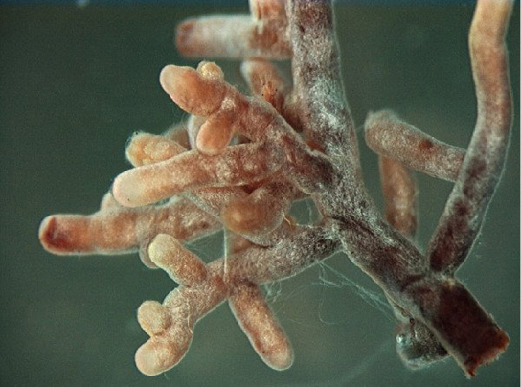
Figure 31.12
Root tips proliferate in the presence of mycorrhizal infection, which appears as off-white fuzz in this image.
(credit: modification of work by Nilsson et al., BMC Bioinformatics 2005)
This OpenStax ancillary resource is © Rice University under a CC-BY 4.0 International license; it may be reproduced or modified but must be attributed to OpenStax, Rice University and any changes must be noted. Any images credited to other sources are similarly available for reproduction, but must be attributed to their sources.

Slide 15
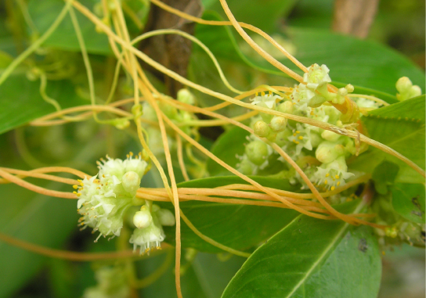
Figure 31.13
The dodder is a holoparasite that penetrates the host’s vascular tissue and diverts nutrients for its own growth. Note that the vines of the dodder, which has white flowers, are beige. The dodder has no chlorophyll and cannot produce its own food.
(credit: "Lalithamba"/Flickr)
This OpenStax ancillary resource is © Rice University under a CC-BY 4.0 International license; it may be reproduced or modified but must be attributed to OpenStax, Rice University and any changes must be noted. Any images credited to other sources are similarly available for reproduction, but must be attributed to their sources.

Slide 16
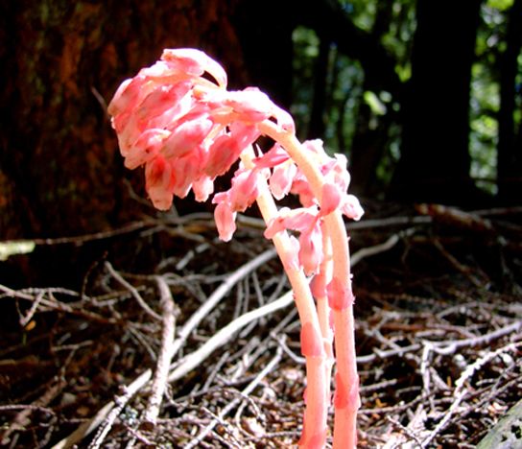
Figure 31.14
Saprophytes, like this Dutchmen’s pipe (Monotropa hypopitys), obtain their food from dead matter and do not have chlorophyll.
(credit: modification of work by Iwona Erskine-Kellie)
This OpenStax ancillary resource is © Rice University under a CC-BY 4.0 International license; it may be reproduced or modified but must be attributed to OpenStax, Rice University and any changes must be noted. Any images credited to other sources are similarly available for reproduction, but must be attributed to their sources.

Slide 17
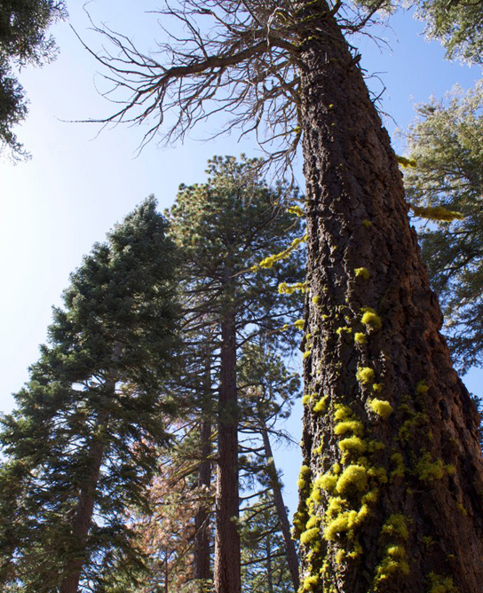
Figure 31.15
Lichens, which often have symbiotic relationships with other plants, can sometimes be found growing on trees.
(credit: "benketaro"/Flickr)
This OpenStax ancillary resource is © Rice University under a CC-BY 4.0 International license; it may be reproduced or modified but must be attributed to OpenStax, Rice University and any changes must be noted. Any images credited to other sources are similarly available for reproduction, but must be attributed to their sources.

Slide 18
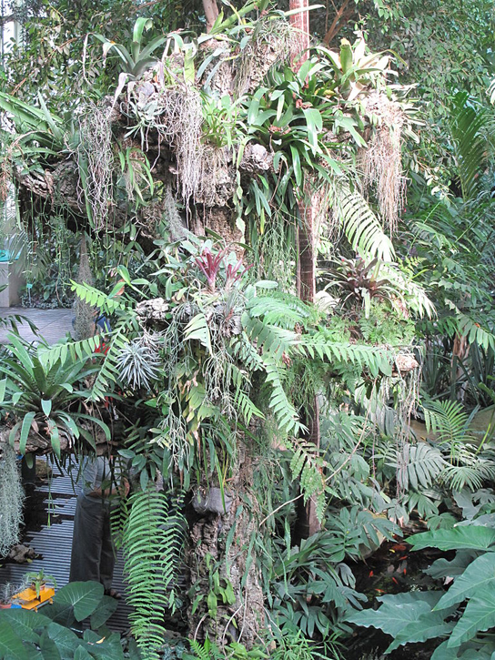
Figure 31.16
These epiphyte plants grow in the main greenhouse of the Jardin des Plantes in Paris.
This OpenStax ancillary resource is © Rice University under a CC-BY 4.0 International license; it may be reproduced or modified but must be attributed to OpenStax, Rice University and any changes must be noted. Any images credited to other sources are similarly available for reproduction, but must be attributed to their sources.

Slide 19
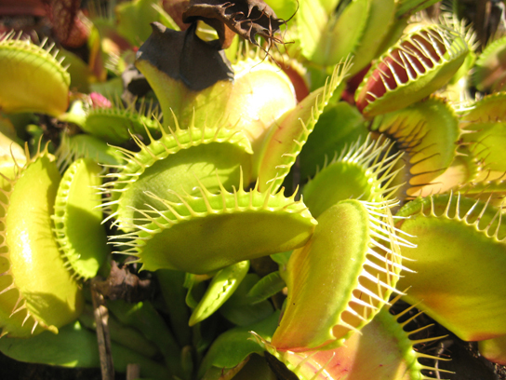
Figure 31.17
A Venus flytrap has specialized leaves to trap insects.
(credit: "Selena N. B. H."/Flickr)
This OpenStax ancillary resource is © Rice University under a CC-BY 4.0 International license; it may be reproduced or modified but must be attributed to OpenStax, Rice University and any changes must be noted. Any images credited to other sources are similarly available for reproduction, but must be attributed to their sources.

