Slide 1


Biology 2e
Chapter 33 THE ANIMAL BODY: BASIC FORM AND FUNCTION
PowerPoint Image Slide Show

Slide 2
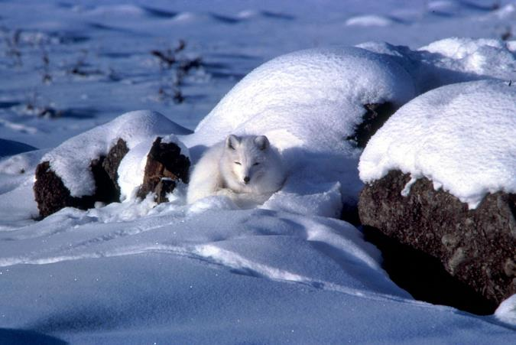
Figure 33.1
An arctic fox is a complex animal, well adapted to its environment. It changes coat color with the seasons, and has longer fur in winter to trap heat.
(credit: modification of work by Keith Morehouse, USFWS)
This OpenStax ancillary resource is © Rice University under a CC-BY 4.0 International license; it may be reproduced or modified but must be attributed to OpenStax, Rice University and any changes must be noted. Any images credited to other sources are similarly available for reproduction, but must be attributed to their sources.

Slide 3
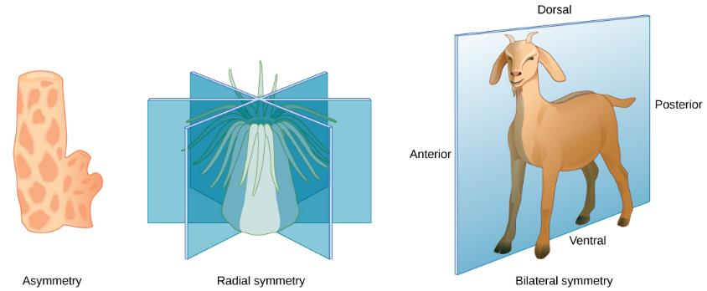
Figure 33.2
Animals exhibit different types of body symmetry. The sponge is asymmetrical, the sea anemone has radial symmetry, and the goat has bilateral symmetry.
This OpenStax ancillary resource is © Rice University under a CC-BY 4.0 International license; it may be reproduced or modified but must be attributed to OpenStax, Rice University and any changes must be noted. Any images credited to other sources are similarly available for reproduction, but must be attributed to their sources.

Slide 4
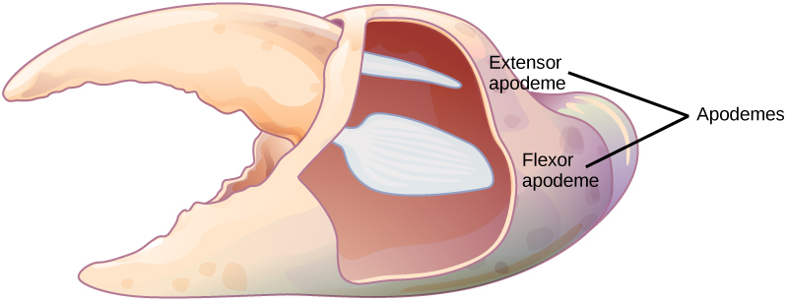
Figure 33.3
Apodemes are ingrowths on arthropod exoskeletons to which muscles attach. The apodemes on this crab leg are located above and below the fulcrum of the claw. Contraction of muscles attached to the apodemes pulls the claw closed.
This OpenStax ancillary resource is © Rice University under a CC-BY 4.0 International license; it may be reproduced or modified but must be attributed to OpenStax, Rice University and any changes must be noted. Any images credited to other sources are similarly available for reproduction, but must be attributed to their sources.

Slide 5
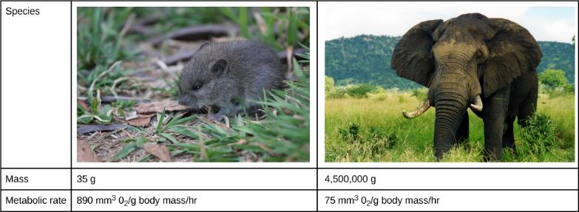
Figure 33.4
The mouse has a much higher metabolic rate than the elephant.
(credit “mouse”: modification of work by Magnus Kjaergaard; credit “elephant”: modification of work by “TheLizardQueen”/Flickr)
This OpenStax ancillary resource is © Rice University under a CC-BY 4.0 International license; it may be reproduced or modified but must be attributed to OpenStax, Rice University and any changes must be noted. Any images credited to other sources are similarly available for reproduction, but must be attributed to their sources.

Slide 6
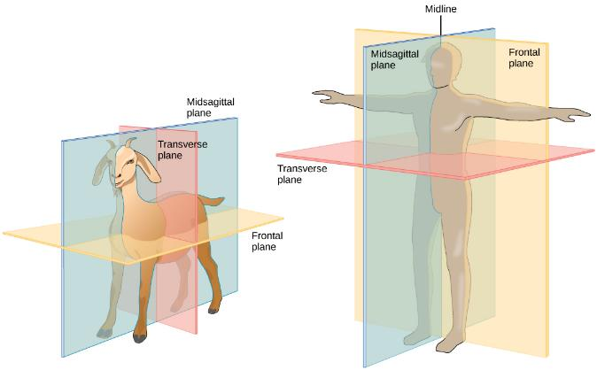
Figure 33.5
Shown are the planes of a quadruped goat and a bipedal human. The midsagittal plane divides the body exactly in half, into right and left portions. The frontal plane divides the front and back, and the transverse plane divides the body into upper and lower portions.
This OpenStax ancillary resource is © Rice University under a CC-BY 4.0 International license; it may be reproduced or modified but must be attributed to OpenStax, Rice University and any changes must be noted. Any images credited to other sources are similarly available for reproduction, but must be attributed to their sources.

Slide 7
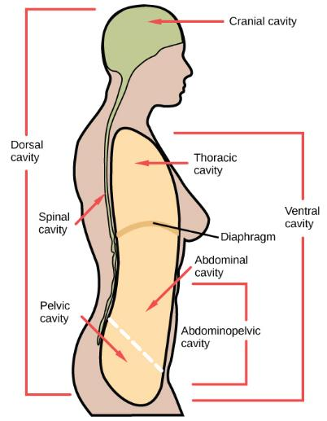
Figure 33.6
Vertebrate animals have two major body cavities. The dorsal cavity, indicated in green, contains the cranial and the spinal cavity. The ventral cavity, indicated in yellow, contains the thoracic cavity and the abdominopelvic cavity. The thoracic cavity is separated from the abdominopelvic cavity by the diaphragm. The thoracic cavity is separated into the abdominal cavity and the pelvic cavity by an imaginary line parallel to the pelvis bones.
(credit: modification of work by NCI)
This OpenStax ancillary resource is © Rice University under a CC-BY 4.0 International license; it may be reproduced or modified but must be attributed to OpenStax, Rice University and any changes must be noted. Any images credited to other sources are similarly available for reproduction, but must be attributed to their sources.

Slide 8
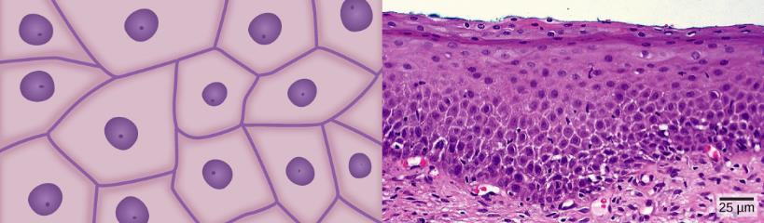
Figure 33.7
Squamous epithelia cells (a) have a slightly irregular shape, and a small, centrally located nucleus. These cells can be stratified into layers, as in (b) this human cervix specimen.
(credit b: modification of work by Ed Uthman; scale-bar data from Matt Russell)
This OpenStax ancillary resource is © Rice University under a CC-BY 4.0 International license; it may be reproduced or modified but must be attributed to OpenStax, Rice University and any changes must be noted. Any images credited to other sources are similarly available for reproduction, but must be attributed to their sources.

Slide 9
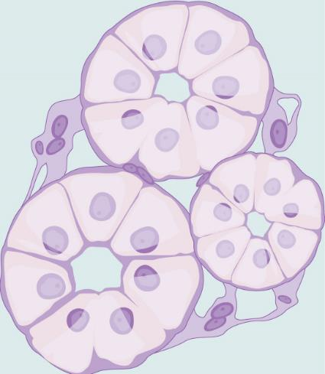
Figure 33.8
Simple cuboidal epithelial cells line tubules in the mammalian kidney, where they are involved in filtering the blood.
This OpenStax ancillary resource is © Rice University under a CC-BY 4.0 International license; it may be reproduced or modified but must be attributed to OpenStax, Rice University and any changes must be noted. Any images credited to other sources are similarly available for reproduction, but must be attributed to their sources.

Slide 10
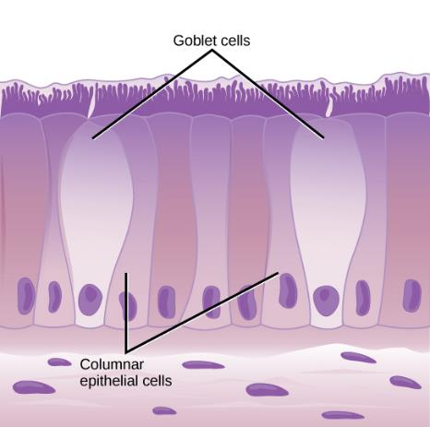
Figure 33.9
Simple columnar epithelial cells absorb material from the digestive tract. Goblet cells secret mucous into the digestive tract lumen.
This OpenStax ancillary resource is © Rice University under a CC-BY 4.0 International license; it may be reproduced or modified but must be attributed to OpenStax, Rice University and any changes must be noted. Any images credited to other sources are similarly available for reproduction, but must be attributed to their sources.

Slide 11
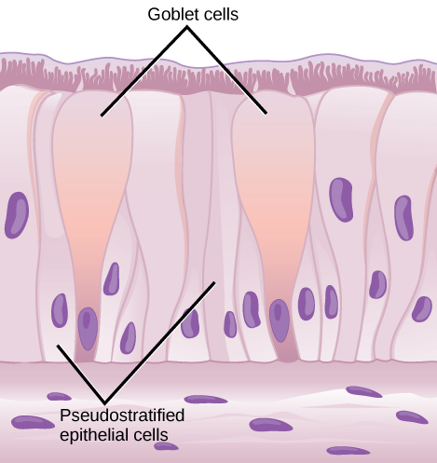
Figure 33.10
Pseudostratified columnar epithelia line the respiratory tract. They exist in one layer, but the arrangement of nuclei at different levels makes it appear that there is more than one layer. Goblet cells interspersed between the columnar epithelial cells secrete mucous into the respiratory tract.
This OpenStax ancillary resource is © Rice University under a CC-BY 4.0 International license; it may be reproduced or modified but must be attributed to OpenStax, Rice University and any changes must be noted. Any images credited to other sources are similarly available for reproduction, but must be attributed to their sources.

Slide 12
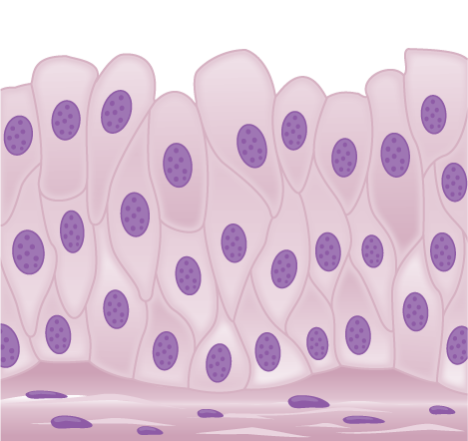
Figure 33.11
Transitional epithelia of the urinary bladder undergo changes in thickness depending on how full the bladder is.
This OpenStax ancillary resource is © Rice University under a CC-BY 4.0 International license; it may be reproduced or modified but must be attributed to OpenStax, Rice University and any changes must be noted. Any images credited to other sources are similarly available for reproduction, but must be attributed to their sources.

Slide 13
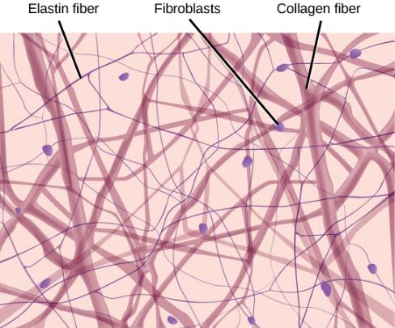
Figure 33.12
Loose connective tissue is composed of loosely woven collagen and elastic fibers. The fibers and other components of the connective tissue matrix are secreted by fibroblasts.
This OpenStax ancillary resource is © Rice University under a CC-BY 4.0 International license; it may be reproduced or modified but must be attributed to OpenStax, Rice University and any changes must be noted. Any images credited to other sources are similarly available for reproduction, but must be attributed to their sources.

Slide 14
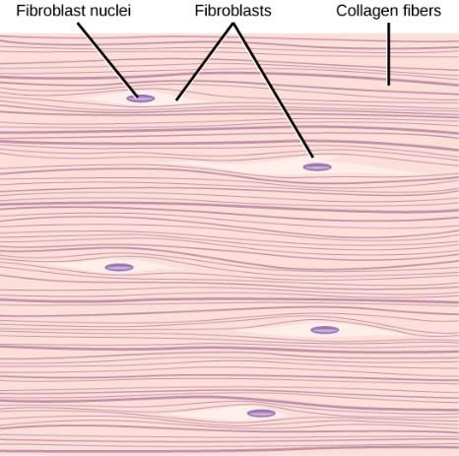
Figure 33.13
Fibrous connective tissue from the tendon has strands of collagen fibers lined up in parallel.
This OpenStax ancillary resource is © Rice University under a CC-BY 4.0 International license; it may be reproduced or modified but must be attributed to OpenStax, Rice University and any changes must be noted. Any images credited to other sources are similarly available for reproduction, but must be attributed to their sources.

Slide 15
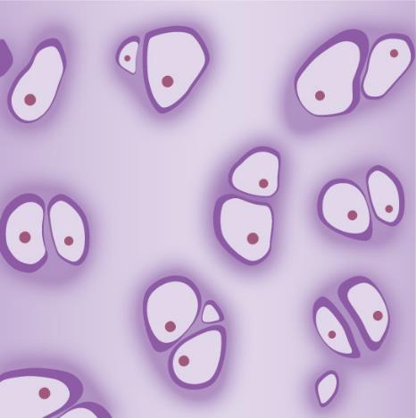
Figure 33.14
Hyaline cartilage consists of a matrix with cells called chondrocytes embedded in it. The chondrocytes exist in cavities in the matrix called lacunae.
This OpenStax ancillary resource is © Rice University under a CC-BY 4.0 International license; it may be reproduced or modified but must be attributed to OpenStax, Rice University and any changes must be noted. Any images credited to other sources are similarly available for reproduction, but must be attributed to their sources.

Slide 16
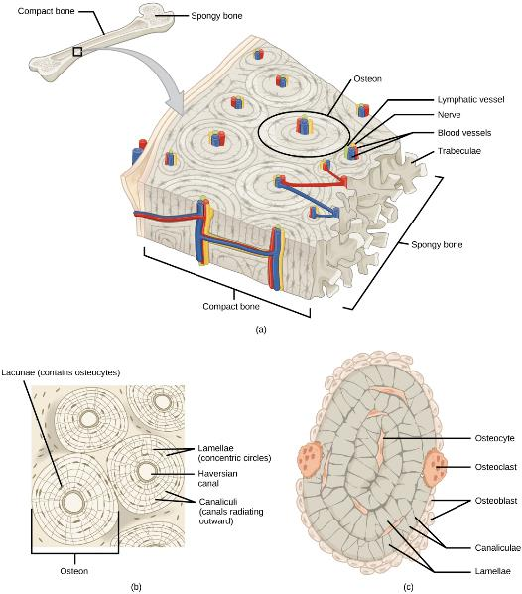
Figure 33.15
(a) Compact bone is a dense matrix on the outer surface of bone. Spongy bone, inside the compact bone, is porous with web-like trabeculae. (b) Compact bone is organized into rings called osteons. Blood vessels, nerves, and lymphatic vessels are found in the central Haversian canal. Rings of lamellae surround the Haversian canal. Between the lamellae are cavities called lacunae. Canaliculi are microchannels connecting the lacunae together. (c) Osteoblasts surround the exterior of the bone. Osteoclasts bore tunnels into the bone and osteocytes are found in the lacunae.
This OpenStax ancillary resource is © Rice University under a CC-BY 4.0 International license; it may be reproduced or modified but must be attributed to OpenStax, Rice University and any changes must be noted. Any images credited to other sources are similarly available for reproduction, but must be attributed to their sources.

Slide 17
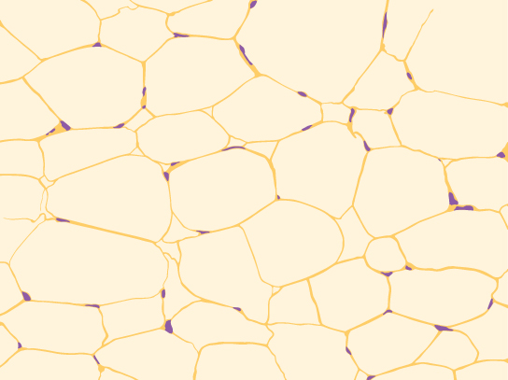
Figure 33.16
Adipose is a connective tissue is made up of cells called adipocytes. Adipocytes have small nuclei localized at the cell edge.
This OpenStax ancillary resource is © Rice University under a CC-BY 4.0 International license; it may be reproduced or modified but must be attributed to OpenStax, Rice University and any changes must be noted. Any images credited to other sources are similarly available for reproduction, but must be attributed to their sources.

Slide 18
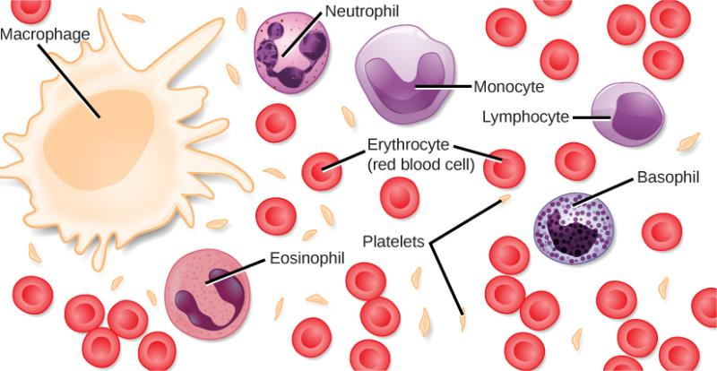
Figure 33.17
Blood is a connective tissue that has a fluid matrix, called plasma, and no fibers. Erythrocytes (red blood cells), the predominant cell type, are involved in the transport of oxygen and carbon dioxide. Also present are various leukocytes (white blood cells) involved in immune response.
This OpenStax ancillary resource is © Rice University under a CC-BY 4.0 International license; it may be reproduced or modified but must be attributed to OpenStax, Rice University and any changes must be noted. Any images credited to other sources are similarly available for reproduction, but must be attributed to their sources.

Slide 19
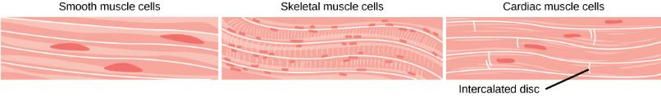
Figure 33.18
Smooth muscle cells do not have striations, while skeletal muscle cells do. Cardiac muscle cells have striations, but, unlike the multinucleate skeletal cells, they have only one nucleus. Cardiac muscle tissue also has intercalated discs, specialized regions running along the plasma membrane that join adjacent cardiac muscle cells and assist in passing an electrical impulse from cell to cell.
This OpenStax ancillary resource is © Rice University under a CC-BY 4.0 International license; it may be reproduced or modified but must be attributed to OpenStax, Rice University and any changes must be noted. Any images credited to other sources are similarly available for reproduction, but must be attributed to their sources.

Slide 20
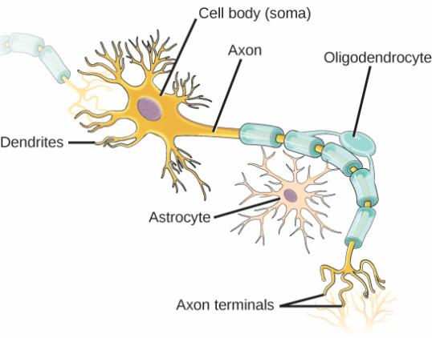
Figure 33.19
The neuron has projections called dendrites that receive signals and projections called axons that send signals. Also shown are two types of glial cells: astrocytes regulate the chemical environment of the nerve cell, and oligodendrocytes insulate the axon so the electrical nerve impulse is transferred more efficiently.
This OpenStax ancillary resource is © Rice University under a CC-BY 4.0 International license; it may be reproduced or modified but must be attributed to OpenStax, Rice University and any changes must be noted. Any images credited to other sources are similarly available for reproduction, but must be attributed to their sources.

Slide 21
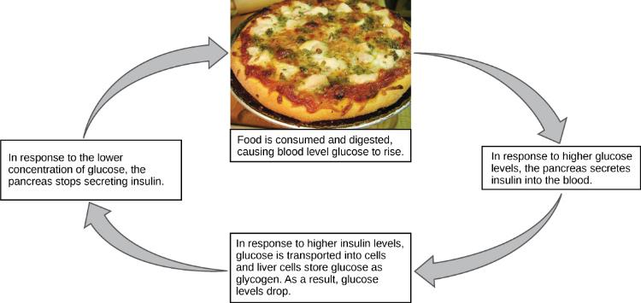
Figure 33.20
Blood sugar levels are controlled by a negative feedback loop.
(credit: modification of work by Jon Sullivan)
This OpenStax ancillary resource is © Rice University under a CC-BY 4.0 International license; it may be reproduced or modified but must be attributed to OpenStax, Rice University and any changes must be noted. Any images credited to other sources are similarly available for reproduction, but must be attributed to their sources.

Slide 22
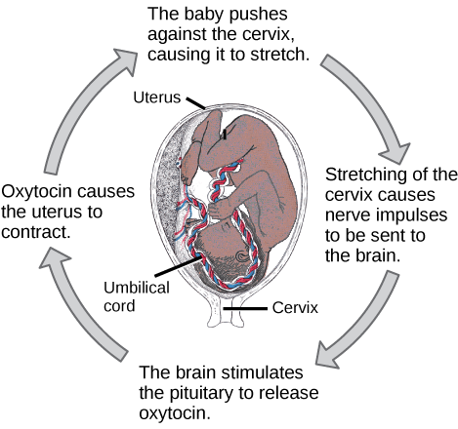
Figure 33.21
The birth of a human infant is the result of positive feedback.
This OpenStax ancillary resource is © Rice University under a CC-BY 4.0 International license; it may be reproduced or modified but must be attributed to OpenStax, Rice University and any changes must be noted. Any images credited to other sources are similarly available for reproduction, but must be attributed to their sources.

Slide 23
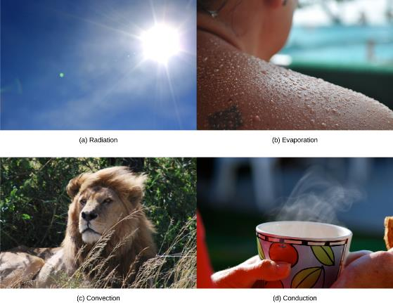
Figure 33.22
Heat can be exchanged by four mechanisms: (a) radiation, (b) evaporation, (c) convection, or (d) conduction.
(credit b: modification of work by “Kullez”/Flickr; credit c: modification of work by Chad Rosenthal; credit d: modification of work by “stacey.d”/Flickr)
This OpenStax ancillary resource is © Rice University under a CC-BY 4.0 International license; it may be reproduced or modified but must be attributed to OpenStax, Rice University and any changes must be noted. Any images credited to other sources are similarly available for reproduction, but must be attributed to their sources.

Slide 24
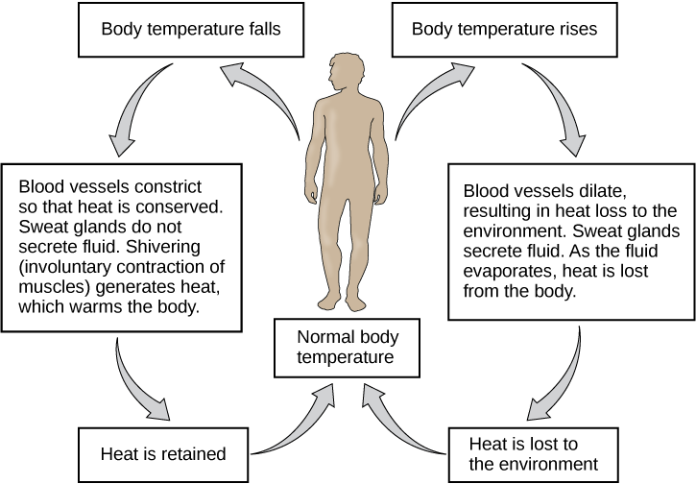
Figure 33.23
The body is able to regulate temperature in response to signals from the nervous system.
This OpenStax ancillary resource is © Rice University under a CC-BY 4.0 International license; it may be reproduced or modified but must be attributed to OpenStax, Rice University and any changes must be noted. Any images credited to other sources are similarly available for reproduction, but must be attributed to their sources.

