Slide 1

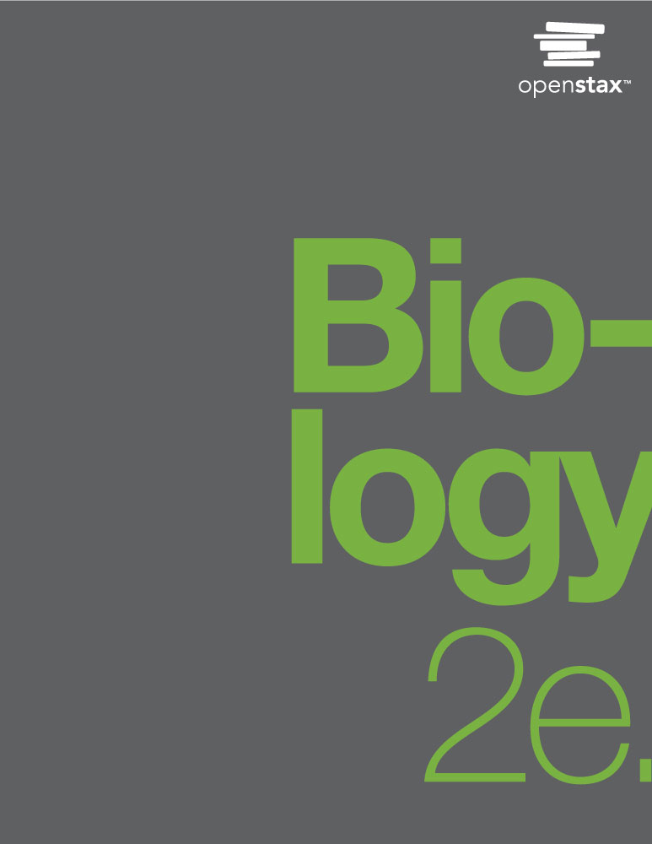
Biology 2e
Chapter 34 ANIMAL NUTRITION AND THE DIGESTIVE SYSTEM
PowerPoint Image Slide Show

Slide 2
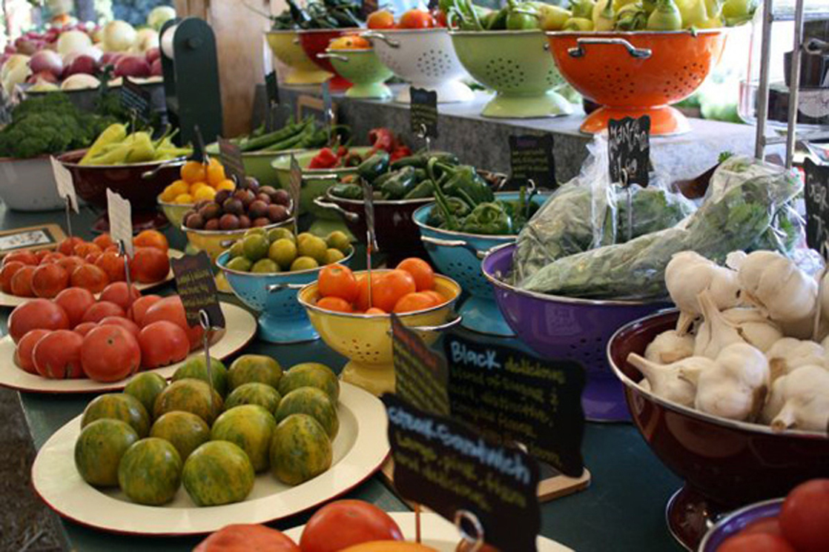
Figure 34.1
For humans, fruits and vegetables are important in maintaining a balanced diet.
(credit: modification of work by Julie Rybarczyk)
This OpenStax ancillary resource is © Rice University under a CC-BY 4.0 International license; it may be reproduced or modified but must be attributed to OpenStax, Rice University and any changes must be noted. Any images credited to other sources are similarly available for reproduction, but must be attributed to their sources.

Slide 3
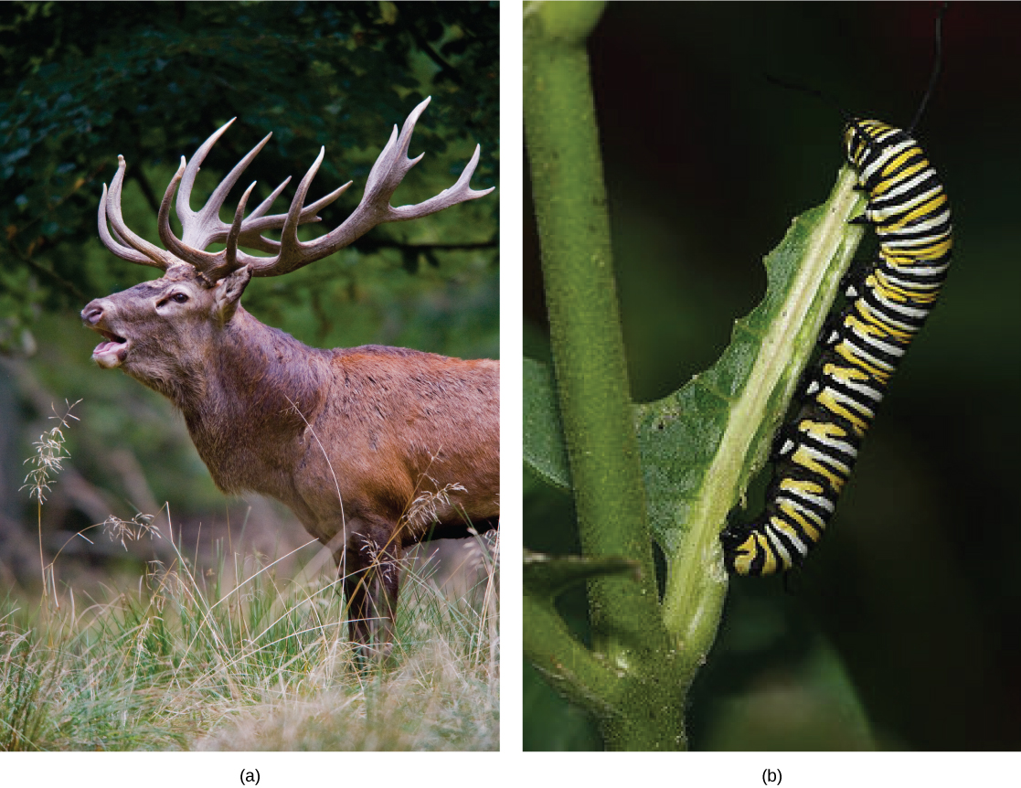
Figure 34.2
Herbivores, like this (a) mule deer and (b) monarch caterpillar, eat primarily plant material.
(credit a: modification of work by Bill Ebbesen; credit b: modification of work by Doug Bowman)
This OpenStax ancillary resource is © Rice University under a CC-BY 4.0 International license; it may be reproduced or modified but must be attributed to OpenStax, Rice University and any changes must be noted. Any images credited to other sources are similarly available for reproduction, but must be attributed to their sources.

Slide 4
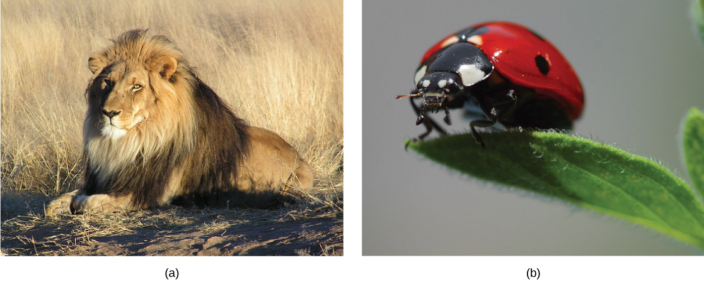
Figure 34.3
Carnivores like the (a) lion eat primarily meat. The (b) ladybug is also a carnivore that consumes small insects called aphids.
(credit a: modification of work by Kevin Pluck; credit b: modification of work by Jon Sullivan)
This OpenStax ancillary resource is © Rice University under a CC-BY 4.0 International license; it may be reproduced or modified but must be attributed to OpenStax, Rice University and any changes must be noted. Any images credited to other sources are similarly available for reproduction, but must be attributed to their sources.

Slide 5
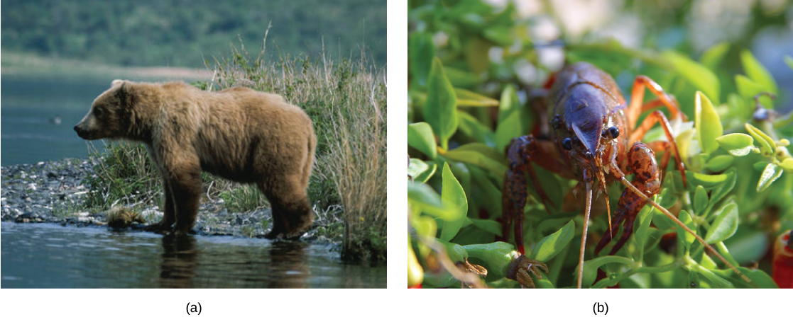
Figure 34.4
Omnivores like the (a) bear and (b) crayfish eat both plant and animal based food.
(credit a: modification of work by Dave Menke; credit b: modification of work by Jon Sullivan)
This OpenStax ancillary resource is © Rice University under a CC-BY 4.0 International license; it may be reproduced or modified but must be attributed to OpenStax, Rice University and any changes must be noted. Any images credited to other sources are similarly available for reproduction, but must be attributed to their sources.

Slide 6
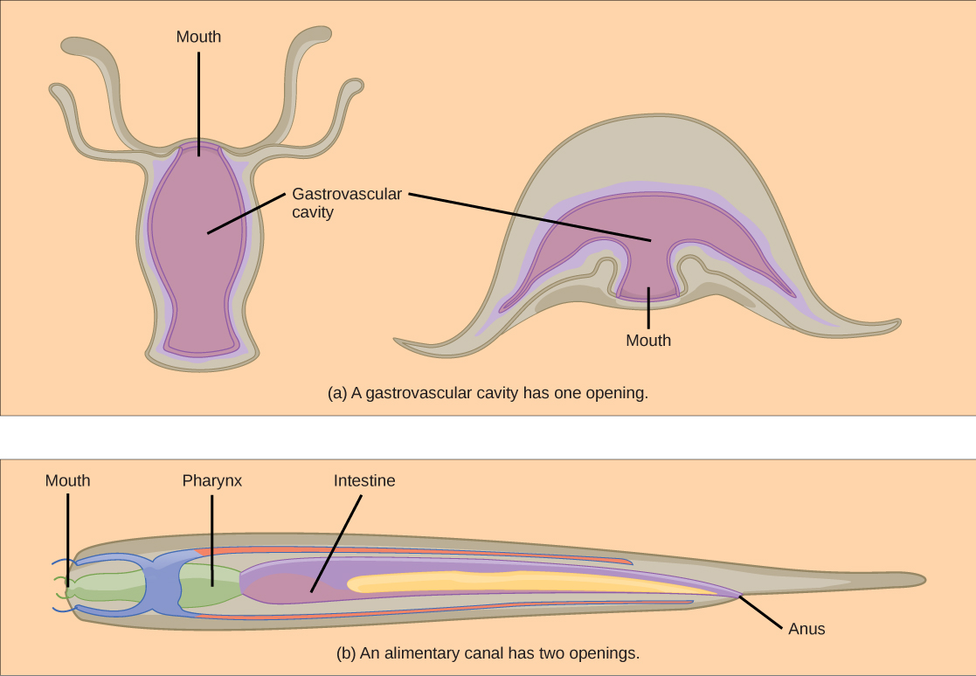
Figure 34.5
(a) A gastrovascular cavity has a single opening through which food is ingested and waste is excreted, as shown in this hydra and in this jellyfish medusa. (b) An alimentary canal has two openings: a mouth for ingesting food, and an anus for eliminating waste, as shown in this nematode.
This OpenStax ancillary resource is © Rice University under a CC-BY 4.0 International license; it may be reproduced or modified but must be attributed to OpenStax, Rice University and any changes must be noted. Any images credited to other sources are similarly available for reproduction, but must be attributed to their sources.

Slide 7
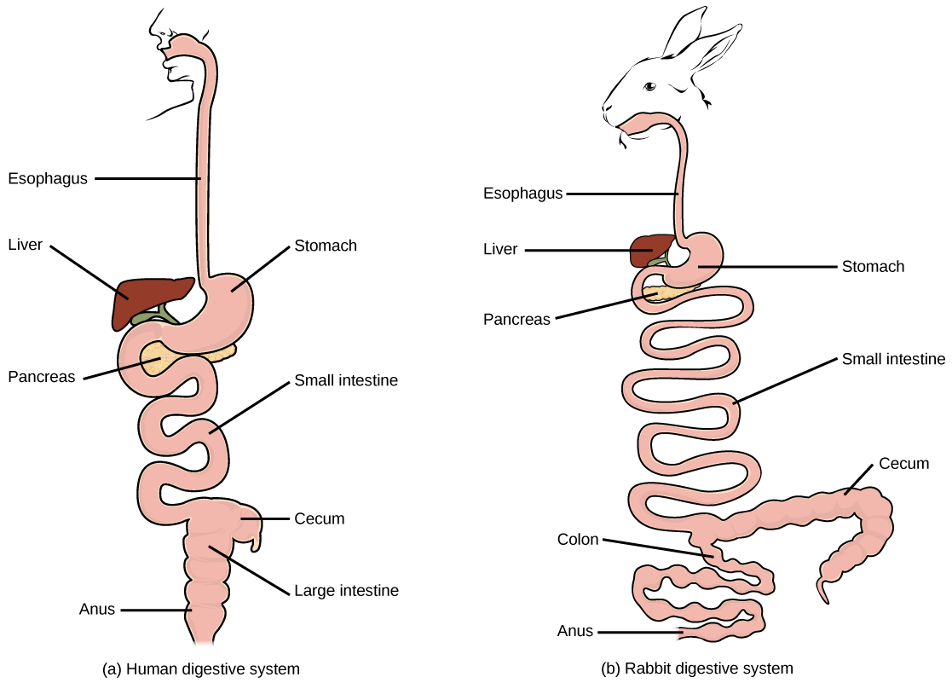
Figure 34.6
(a) Humans and herbivores, such as the (b) rabbit, have a monogastric digestive system. However, in the rabbit the small intestine and cecum are enlarged to allow more time to digest plant material. The enlarged organ provides more surface area for absorption of nutrients. Rabbits digest their food twice: the first time food passes through the digestive system, it collects in the cecum, and then it passes through the anus as soft feces called cecotrophes. The rabbit re-ingests these cecotrophes to further digest them.
This OpenStax ancillary resource is © Rice University under a CC-BY 4.0 International license; it may be reproduced or modified but must be attributed to OpenStax, Rice University and any changes must be noted. Any images credited to other sources are similarly available for reproduction, but must be attributed to their sources.

Slide 8
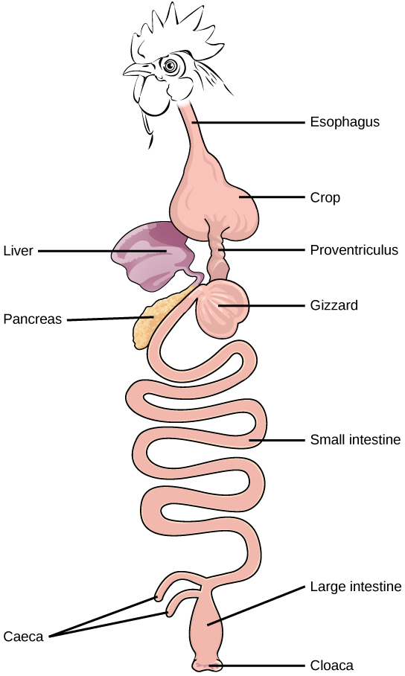
Figure 34.7
The avian esophagus has a pouch, called a crop, which stores food. Food passes from the crop to the first of two stomachs, called the proventriculus, which contains digestive juices that break down food. From the proventriculus, the food enters the second stomach, called the gizzard, which grinds food. Some birds swallow stones or grit, which are stored in the gizzard, to aid the grinding process. Birds do not have separate openings to excrete urine and feces. Instead, uric acid from the kidneys is secreted into the large intestine and combined with waste from the digestive process. This waste is excreted through an opening called the cloaca.
This OpenStax ancillary resource is © Rice University under a CC-BY 4.0 International license; it may be reproduced or modified but must be attributed to OpenStax, Rice University and any changes must be noted. Any images credited to other sources are similarly available for reproduction, but must be attributed to their sources.

Slide 9
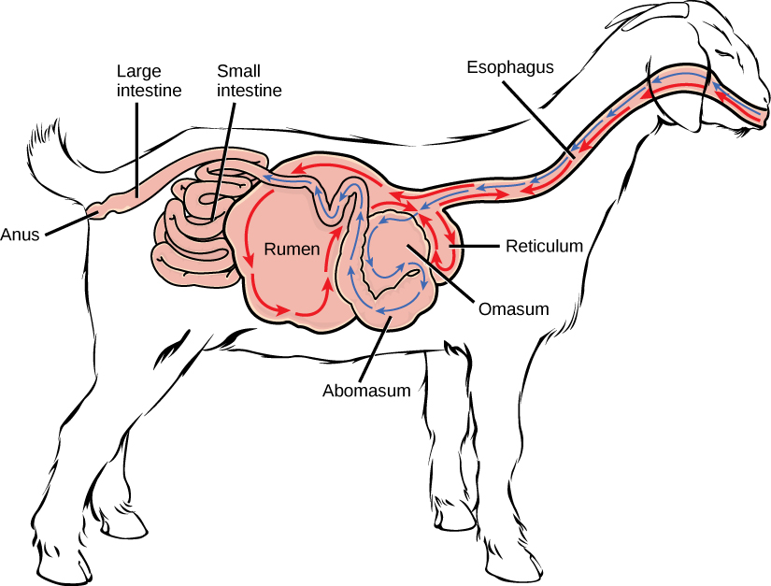
Figure 34.8
Ruminant animals, such as goats and cows, have four stomachs. The first two stomachs, the rumen and the reticulum, contain prokaryotes and protists that are able to digest cellulose fiber. The ruminant regurgitates cud from the reticulum, chews it, and swallows it into a third stomach, the omasum, which removes water. The cud then passes onto the fourth stomach, the abomasum, where it is digested by enzymes produced by the ruminant.
This OpenStax ancillary resource is © Rice University under a CC-BY 4.0 International license; it may be reproduced or modified but must be attributed to OpenStax, Rice University and any changes must be noted. Any images credited to other sources are similarly available for reproduction, but must be attributed to their sources.

Slide 10
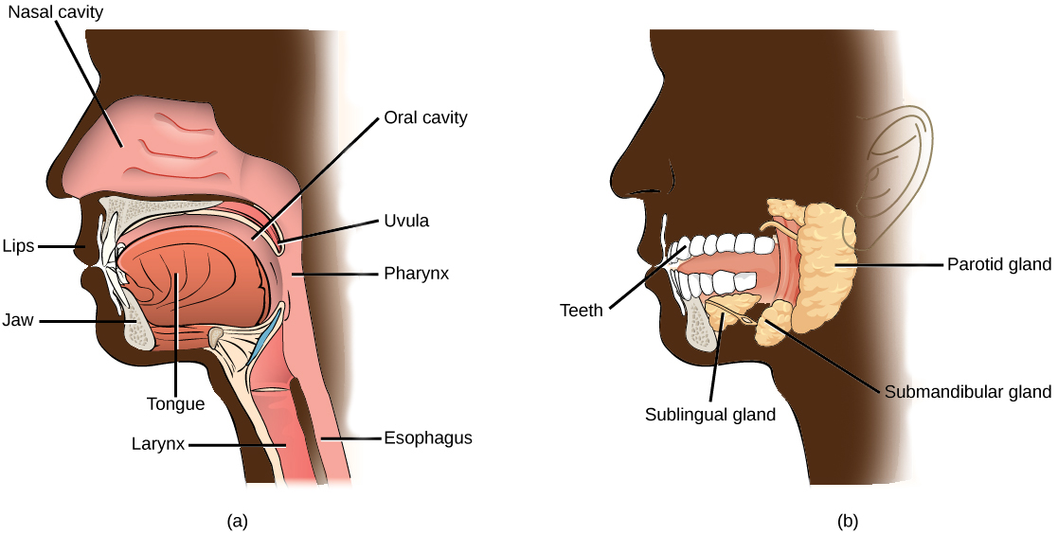
Figure 34.9
Digestion of food begins in the (a) oral cavity. Food is masticated by teeth and moistened by saliva secreted from the (b) salivary glands. Enzymes in the saliva begin to digest starches and fats. With the help of the tongue, the resulting bolus is moved into the esophagus by swallowing.
(credit: modification of work by the National Cancer Institute)
This OpenStax ancillary resource is © Rice University under a CC-BY 4.0 International license; it may be reproduced or modified but must be attributed to OpenStax, Rice University and any changes must be noted. Any images credited to other sources are similarly available for reproduction, but must be attributed to their sources.

Slide 11
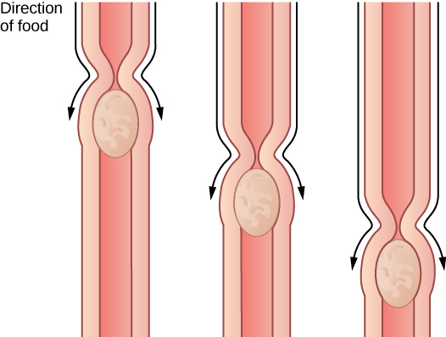
Figure 34.10
The esophagus transfers food from the mouth to the stomach through peristaltic movements.
This OpenStax ancillary resource is © Rice University under a CC-BY 4.0 International license; it may be reproduced or modified but must be attributed to OpenStax, Rice University and any changes must be noted. Any images credited to other sources are similarly available for reproduction, but must be attributed to their sources.

Slide 12
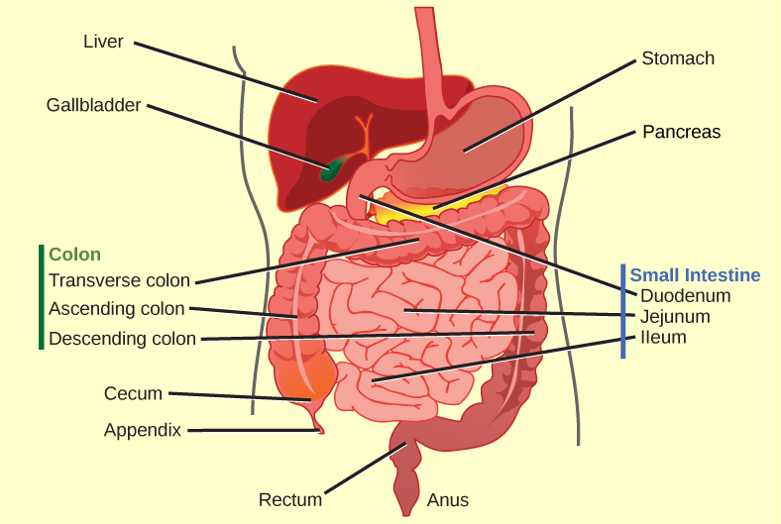
Figure 34.11
The human stomach has an extremely acidic environment where most of the protein gets digested.
(credit: modification of work by Mariana Ruiz Villareal)
This OpenStax ancillary resource is © Rice University under a CC-BY 4.0 International license; it may be reproduced or modified but must be attributed to OpenStax, Rice University and any changes must be noted. Any images credited to other sources are similarly available for reproduction, but must be attributed to their sources.

Slide 13
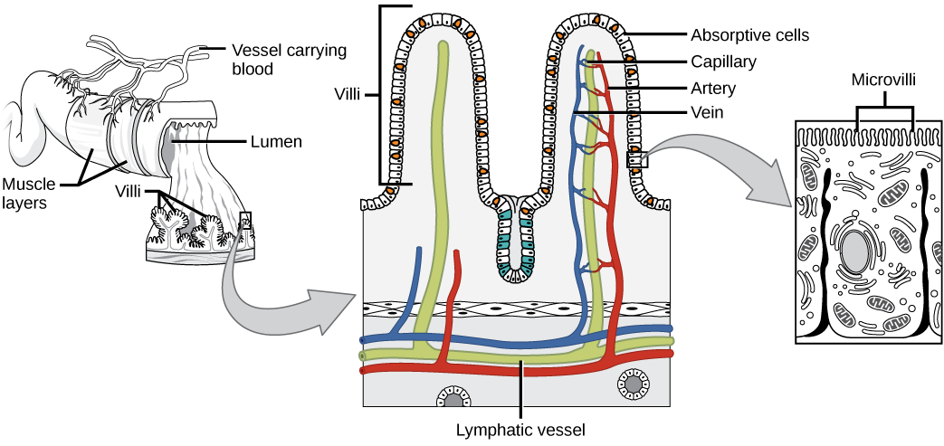
Figure 34.12
Villi are folds on the small intestine lining that increase the surface area to facilitate the absorption of nutrients.
This OpenStax ancillary resource is © Rice University under a CC-BY 4.0 International license; it may be reproduced or modified but must be attributed to OpenStax, Rice University and any changes must be noted. Any images credited to other sources are similarly available for reproduction, but must be attributed to their sources.

Slide 14
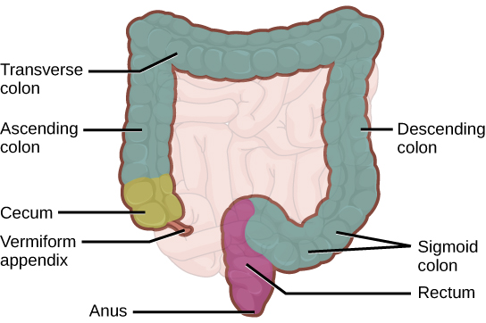
Figure 34.13
The large intestine reabsorbs water from undigested food and stores waste material until it is eliminated.
This OpenStax ancillary resource is © Rice University under a CC-BY 4.0 International license; it may be reproduced or modified but must be attributed to OpenStax, Rice University and any changes must be noted. Any images credited to other sources are similarly available for reproduction, but must be attributed to their sources.

Slide 15
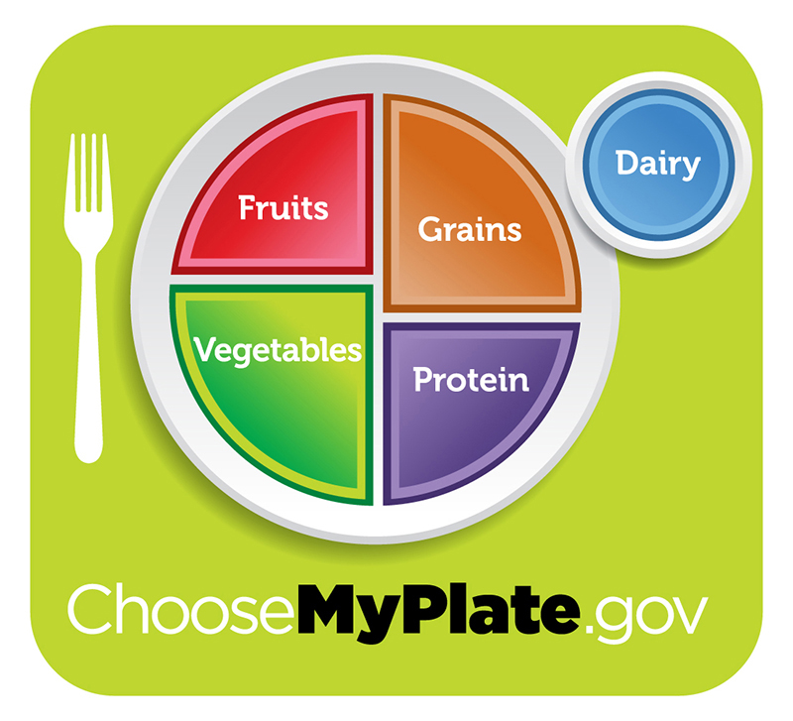
Figure 34.14
For humans, a balanced diet includes fruits, vegetables, grains, and protein.
(credit: USDA)
This OpenStax ancillary resource is © Rice University under a CC-BY 4.0 International license; it may be reproduced or modified but must be attributed to OpenStax, Rice University and any changes must be noted. Any images credited to other sources are similarly available for reproduction, but must be attributed to their sources.

Slide 16
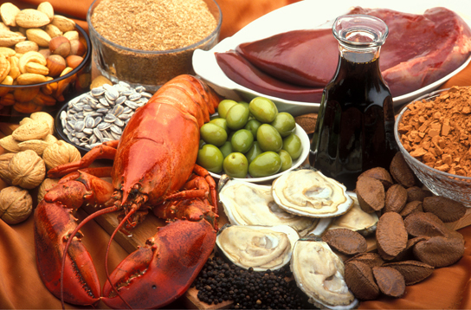
Figure 34.15
A healthy diet should include a variety of foods to ensure that needs for essential nutrients are met.
(credit: Keith Weller, USDA ARS)
This OpenStax ancillary resource is © Rice University under a CC-BY 4.0 International license; it may be reproduced or modified but must be attributed to OpenStax, Rice University and any changes must be noted. Any images credited to other sources are similarly available for reproduction, but must be attributed to their sources.

Slide 17
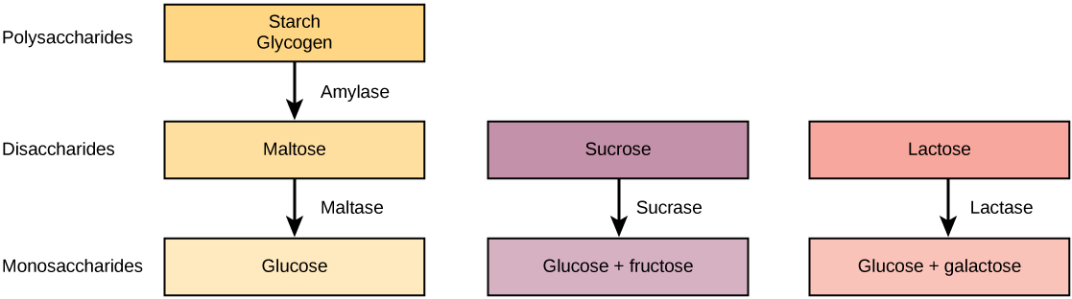
Figure 34.16
Digestion of carbohydrates is performed by several enzymes. Starch and glycogen are broken down into glucose by amylase and maltase. Sucrose (table sugar) and lactose (milk sugar) are broken down by sucrase and lactase, respectively.
This OpenStax ancillary resource is © Rice University under a CC-BY 4.0 International license; it may be reproduced or modified but must be attributed to OpenStax, Rice University and any changes must be noted. Any images credited to other sources are similarly available for reproduction, but must be attributed to their sources.

Slide 18
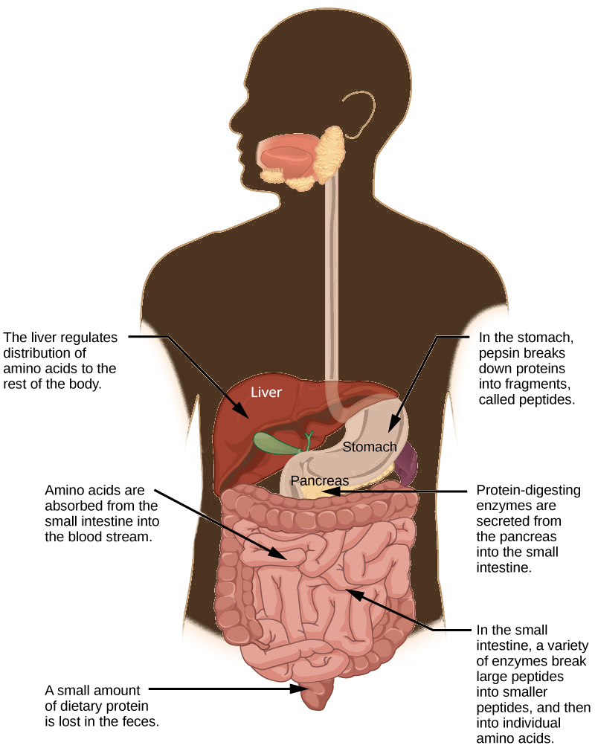
Figure 34.17
Protein digestion is a multistep process that begins in the stomach and continues through the intestines.
This OpenStax ancillary resource is © Rice University under a CC-BY 4.0 International license; it may be reproduced or modified but must be attributed to OpenStax, Rice University and any changes must be noted. Any images credited to other sources are similarly available for reproduction, but must be attributed to their sources.

Slide 19
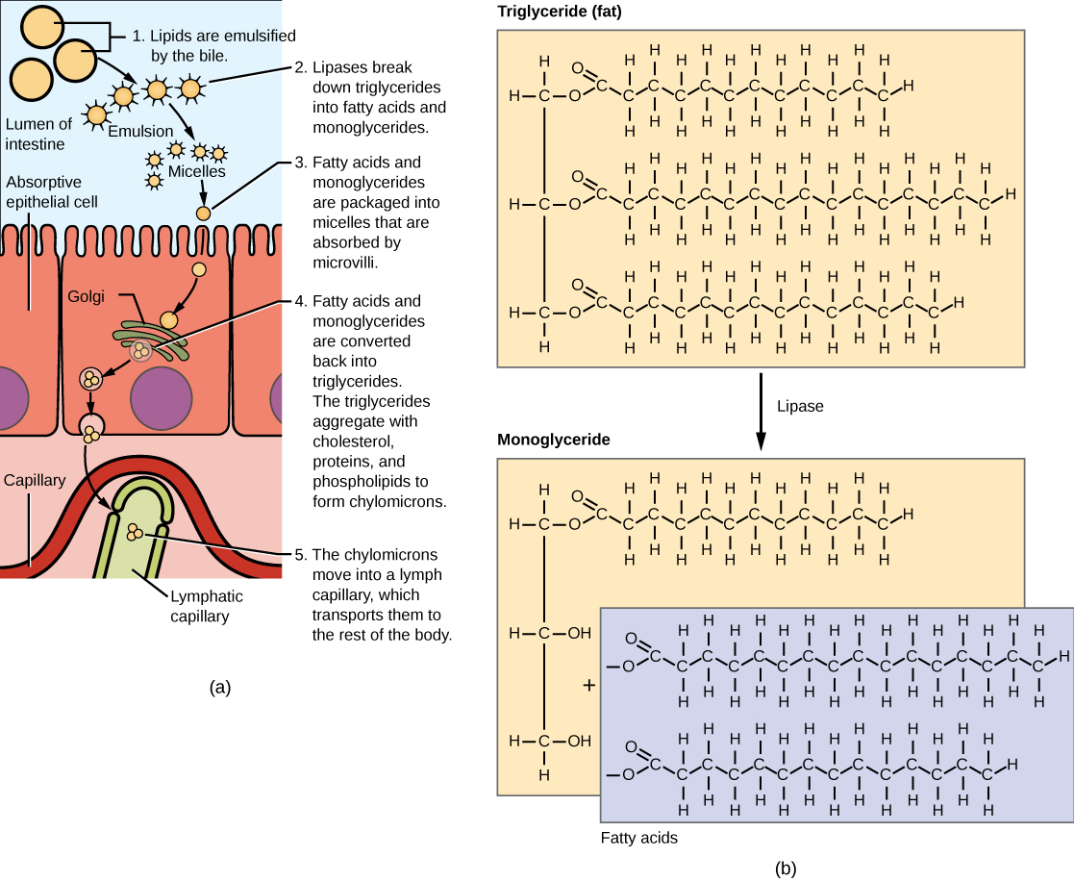
Figure 34.18
Lipids are digested and absorbed in the small intestine.
This OpenStax ancillary resource is © Rice University under a CC-BY 4.0 International license; it may be reproduced or modified but must be attributed to OpenStax, Rice University and any changes must be noted. Any images credited to other sources are similarly available for reproduction, but must be attributed to their sources.

Slide 20
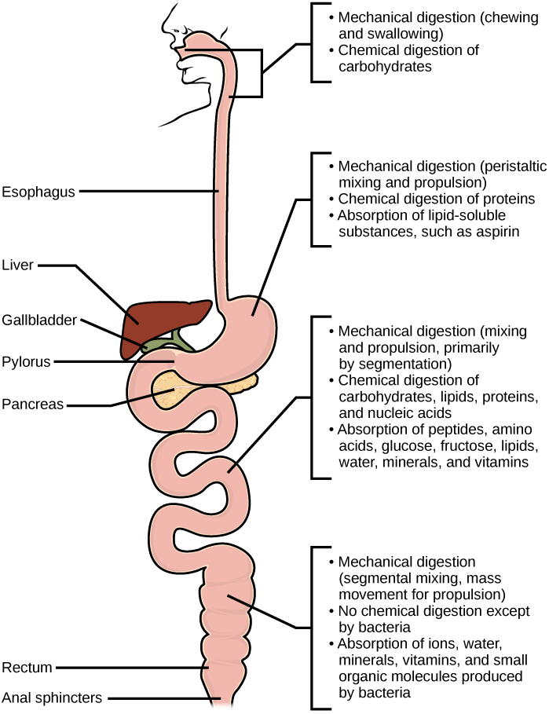
Figure 34.19
Mechanical and chemical digestion of food takes place in many steps, beginning in the mouth and ending in the rectum.
This OpenStax ancillary resource is © Rice University under a CC-BY 4.0 International license; it may be reproduced or modified but must be attributed to OpenStax, Rice University and any changes must be noted. Any images credited to other sources are similarly available for reproduction, but must be attributed to their sources.

Slide 21
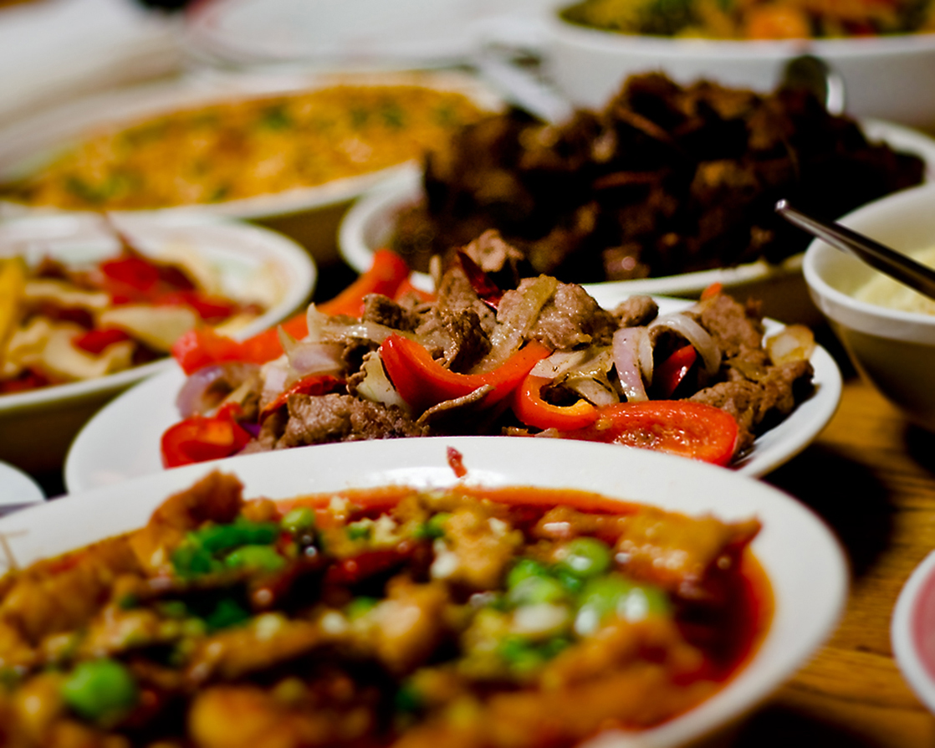
Figure 34.20
Seeing a plate of food triggers the secretion of saliva in the mouth and the production of HCL in the stomach.
(credit: Kelly Bailey)
This OpenStax ancillary resource is © Rice University under a CC-BY 4.0 International license; it may be reproduced or modified but must be attributed to OpenStax, Rice University and any changes must be noted. Any images credited to other sources are similarly available for reproduction, but must be attributed to their sources.

