Slide 1


Biology 2e
Chapter 35 THE NERVOUS SYSTEM
PowerPoint Image Slide Show

Slide 2

Figure 35.1
An athlete’s nervous system is hard at work during the planning and execution of a movement as precise as a high jump. Parts of the nervous system are involved in determining how hard to push off and when to turn, as well as controlling the muscles throughout the body that make this complicated movement possible without knocking the bar down—all in just a few seconds.
(credit: Steven Pisano)
This OpenStax ancillary resource is © Rice University under a CC-BY 4.0 International license; it may be reproduced or modified but must be attributed to OpenStax, Rice University and any changes must be noted. Any images credited to other sources are similarly available for reproduction, but must be attributed to their sources.

Slide 3
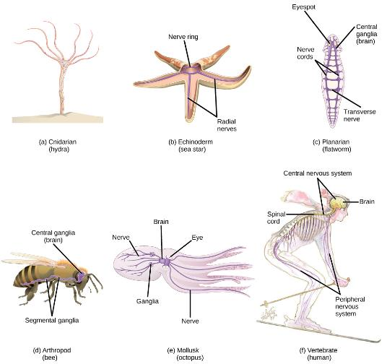
Figure 35.2
Nervous systems vary in structure and complexity. In (a) cnidarians, nerve cells form a decentralized nerve net. In (b) echinoderms, nerve cells are bundled into fibers called nerves. In animals exhibiting bilateral symmetry such as (c) planarians, neurons cluster into an anterior brain that processes information. In addition to a brain, (d) arthropods have clusters of nerve cell bodies, called peripheral ganglia, located along the ventral nerve cord. Mollusks such as squid and (e) octopi, which must hunt to survive, have complex brains containing millions of neurons. In (f) vertebrates, the brain and spinal cord comprise the central nervous system, while neurons extending into the rest of the body comprise the peripheral nervous system.
(credit e: modification of work by Michael Vecchione, Clyde F.E. Roper, and Michael J. Sweeney, NOAA; credit f: modification of work by NIH)
This OpenStax ancillary resource is © Rice University under a CC-BY 4.0 International license; it may be reproduced or modified but must be attributed to OpenStax, Rice University and any changes must be noted. Any images credited to other sources are similarly available for reproduction, but must be attributed to their sources.

Slide 4
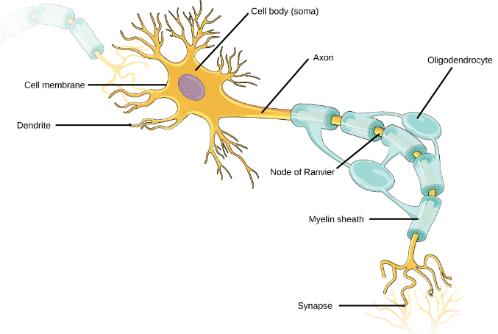
Figure 35.3
Neurons contain organelles common to many other cells, such as a nucleus and mitochondria. They also have more specialized structures, including dendrites and axons.
This OpenStax ancillary resource is © Rice University under a CC-BY 4.0 International license; it may be reproduced or modified but must be attributed to OpenStax, Rice University and any changes must be noted. Any images credited to other sources are similarly available for reproduction, but must be attributed to their sources.

Slide 5
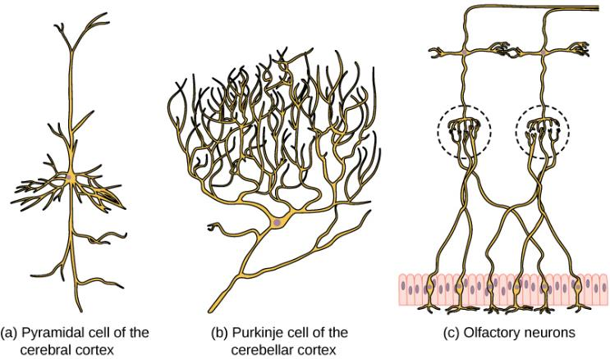
Figure 35.4
There is great diversity in the size and shape of neurons throughout the nervous system. Examples include (a) a pyramidal cell from the cerebral cortex, (b) a Purkinje cell from the cerebellar cortex, and (c) olfactory cells from the olfactory epithelium and olfactory bulb.
This OpenStax ancillary resource is © Rice University under a CC-BY 4.0 International license; it may be reproduced or modified but must be attributed to OpenStax, Rice University and any changes must be noted. Any images credited to other sources are similarly available for reproduction, but must be attributed to their sources.

Slide 6
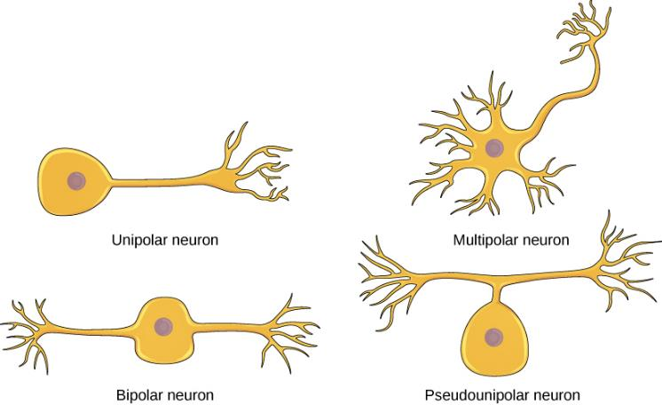
Figure 35.5
Neurons are broadly divided into four main types based on the number and placement of axons: (1) unipolar, (2) bipolar, (3) multipolar, and (4) pseudounipolar.
This OpenStax ancillary resource is © Rice University under a CC-BY 4.0 International license; it may be reproduced or modified but must be attributed to OpenStax, Rice University and any changes must be noted. Any images credited to other sources are similarly available for reproduction, but must be attributed to their sources.

Slide 7
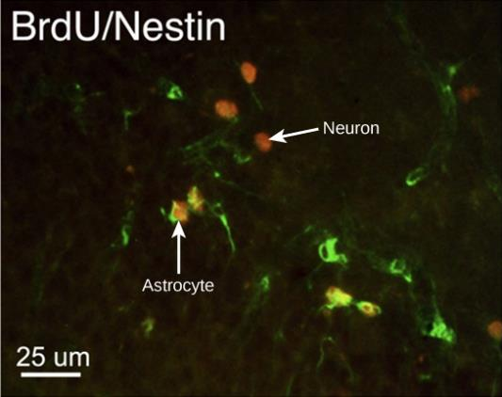
Figure 35.6
This micrograph shows fluorescently labeled new neurons in a rat hippocampus. Cells that are actively dividing have bromodoxyuridine (BrdU) incorporated into their DNA and are labeled in red. Cells that express glial fibrillary acidic protein (GFAP) are labeled in green. Astrocytes, but not neurons, express GFAP. Thus, cells that are labeled both red and green are actively dividing astrocytes, whereas cells labeled red only are actively dividing neurons.
(credit: modification of work by Dr. Maryam Faiz, et. al., University of Barcelona; scale-bar data from Matt Russell)
This OpenStax ancillary resource is © Rice University under a CC-BY 4.0 International license; it may be reproduced or modified but must be attributed to OpenStax, Rice University and any changes must be noted. Any images credited to other sources are similarly available for reproduction, but must be attributed to their sources.

Slide 8
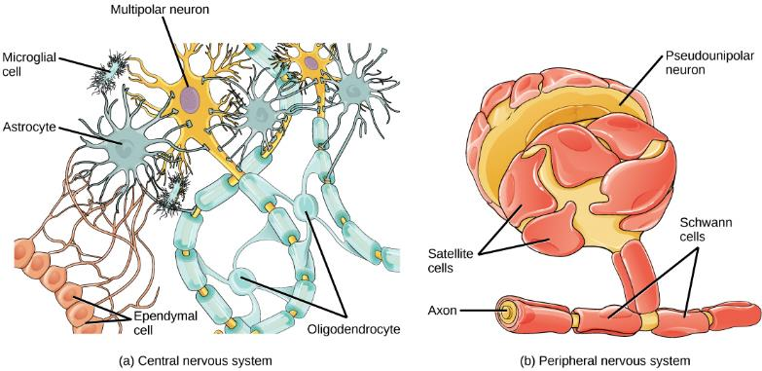
Figure 35.7
Glial cells support neurons and maintain their environment. Glial cells of the (a) central nervous system include oligodendrocytes, astrocytes, ependymal cells, and microglial cells. Oligodendrocytes form the myelin sheath around axons. Astrocytes provide nutrients to neurons, maintain their extracellular environment, and provide structural support. Microglia scavenge pathogens and dead cells. Ependymal cells produce cerebrospinal fluid that cushions the neurons. Glial cells of the (b) peripheral nervous system include Schwann cells, which form the myelin sheath, and satellite cells, which provide nutrients and structural support to neurons.
This OpenStax ancillary resource is © Rice University under a CC-BY 4.0 International license; it may be reproduced or modified but must be attributed to OpenStax, Rice University and any changes must be noted. Any images credited to other sources are similarly available for reproduction, but must be attributed to their sources.

Slide 9
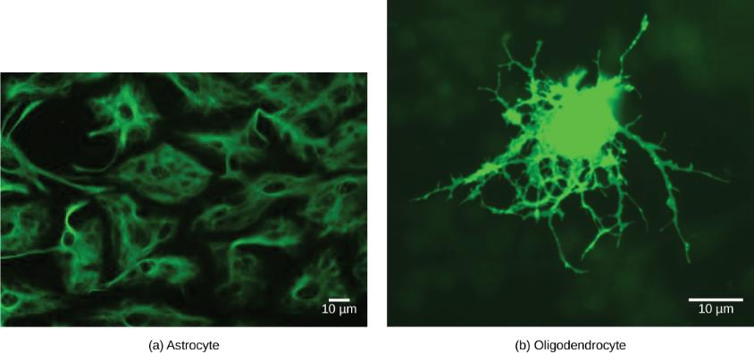
Figure 35.8
(a) Astrocytes and (b) oligodendrocytes are glial cells of the central nervous system.
(credit a: modification of work by Uniformed Services University; credit b: modification of work by Jurjen Broeke; scale-bar data from Matt Russell)
This OpenStax ancillary resource is © Rice University under a CC-BY 4.0 International license; it may be reproduced or modified but must be attributed to OpenStax, Rice University and any changes must be noted. Any images credited to other sources are similarly available for reproduction, but must be attributed to their sources.

Slide 10
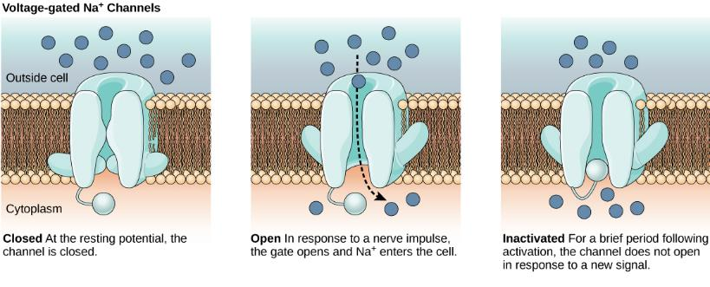
Figure 35.9
Voltage-gated ion channels open in response to changes in membrane voltage. After activation, they become inactivated for a brief period and will no longer open in response to a signal.
This OpenStax ancillary resource is © Rice University under a CC-BY 4.0 International license; it may be reproduced or modified but must be attributed to OpenStax, Rice University and any changes must be noted. Any images credited to other sources are similarly available for reproduction, but must be attributed to their sources.

Slide 11
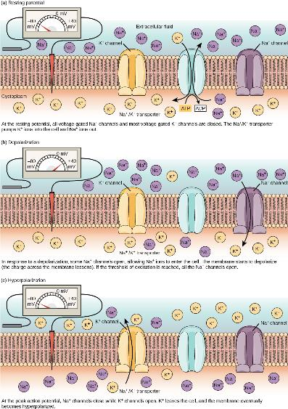
Figure 35.10
The (a) resting membrane potential is a result of different concentrations of Na+ and K+ ions inside and outside the cell. A nerve impulse causes Na+ to enter the cell, resulting in (b) depolarization. At the peak action potential, K+ channels open and the cell becomes (c) hyperpolarized.
This OpenStax ancillary resource is © Rice University under a CC-BY 4.0 International license; it may be reproduced or modified but must be attributed to OpenStax, Rice University and any changes must be noted. Any images credited to other sources are similarly available for reproduction, but must be attributed to their sources.

Slide 12
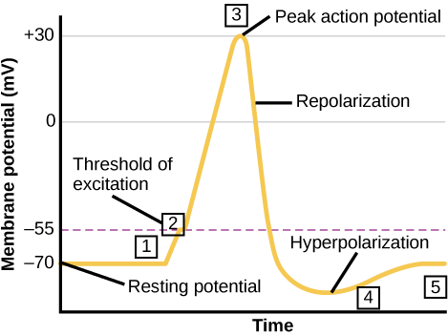
Figure 35.11
The formation of an action potential can be divided into five steps: (1) A stimulus from a sensory cell or another neuron causes the target cell to depolarize toward the threshold potential. (2) If the threshold of excitation is reached, all Na+ channels open and the membrane depolarizes. (3) At the peak action potential, K+ channels open and K+ begins to leave the cell. At the same time, Na+ channels close. (4) The membrane becomes hyperpolarized as K+ ions continue to leave the cell. The hyperpolarized membrane is in a refractory period and cannot fire. (5) The K+ channels close and the Na+/K+ transporter restores the resting potential.
This OpenStax ancillary resource is © Rice University under a CC-BY 4.0 International license; it may be reproduced or modified but must be attributed to OpenStax, Rice University and any changes must be noted. Any images credited to other sources are similarly available for reproduction, but must be attributed to their sources.

Slide 13
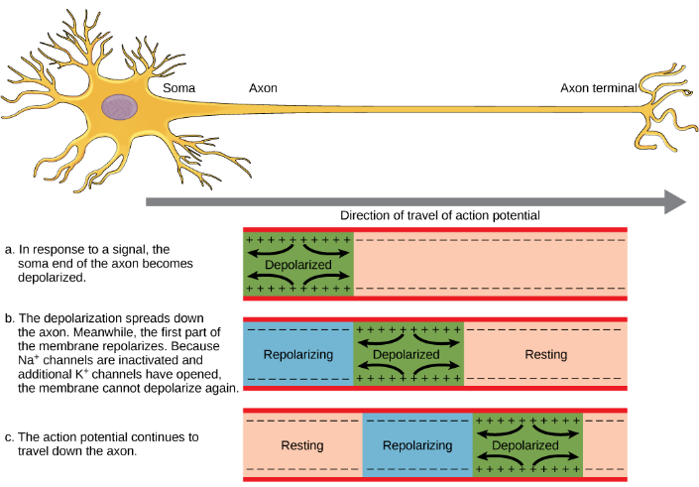
Figure 35.12
The action potential is conducted down the axon as the axon membrane depolarizes, then repolarizes.
This OpenStax ancillary resource is © Rice University under a CC-BY 4.0 International license; it may be reproduced or modified but must be attributed to OpenStax, Rice University and any changes must be noted. Any images credited to other sources are similarly available for reproduction, but must be attributed to their sources.

Slide 14
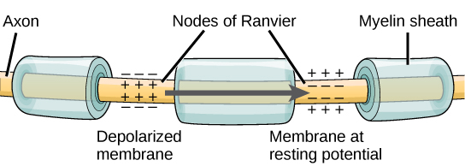
Figure 35.13
Nodes of Ranvier are gaps in myelin coverage along axons. Nodes contain voltage-gated K+ and Na+ channels. Action potentials travel down the axon by jumping from one node to the next.
This OpenStax ancillary resource is © Rice University under a CC-BY 4.0 International license; it may be reproduced or modified but must be attributed to OpenStax, Rice University and any changes must be noted. Any images credited to other sources are similarly available for reproduction, but must be attributed to their sources.

Slide 15
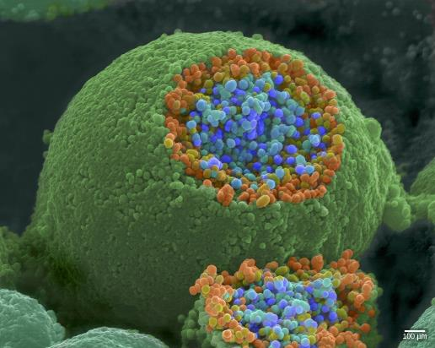
Figure 35.14
This pseudocolored image taken with a scanning electron microscope shows an axon terminal that was broken open to reveal synaptic vesicles (blue and orange) inside the neuron.
(credit: modification of work by Tina Carvalho, NIH-NIGMS; scale-bar data from Matt Russell)
This OpenStax ancillary resource is © Rice University under a CC-BY 4.0 International license; it may be reproduced or modified but must be attributed to OpenStax, Rice University and any changes must be noted. Any images credited to other sources are similarly available for reproduction, but must be attributed to their sources.

Slide 16
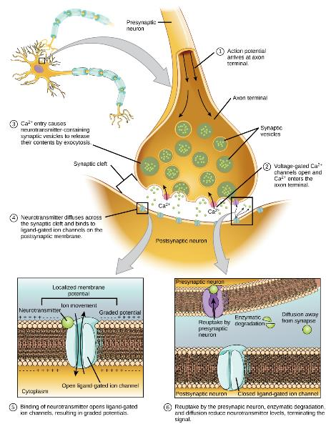
Figure 35.15
Communication at chemical synapses requires release of neurotransmitters. When the presynaptic membrane is depolarized, voltage-gated Ca2+ channels open and allow Ca2+ to enter the cell. The calcium entry causes synaptic vesicles to fuse with the membrane and release neurotransmitter molecules into the synaptic cleft. The neurotransmitter diffuses across the synaptic cleft and binds to ligand-gated ion channels in the postsynaptic membrane, resulting in a localized depolarization or hyperpolarization of the postsynaptic neuron.
This OpenStax ancillary resource is © Rice University under a CC-BY 4.0 International license; it may be reproduced or modified but must be attributed to OpenStax, Rice University and any changes must be noted. Any images credited to other sources are similarly available for reproduction, but must be attributed to their sources.

Slide 17
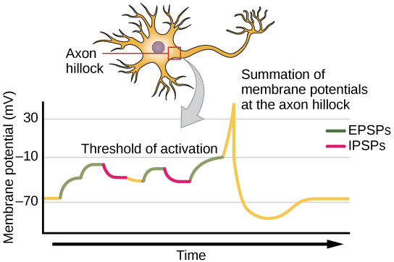
Figure 35.16
A single neuron can receive both excitatory and inhibitory inputs from multiple neurons, resulting in local membrane depolarization (EPSP input) and hyperpolarization (IPSP input). All these inputs are added together at the axon hillock. If the EPSPs are strong enough to overcome the IPSPs and reach the threshold of excitation, the neuron will fire.
This OpenStax ancillary resource is © Rice University under a CC-BY 4.0 International license; it may be reproduced or modified but must be attributed to OpenStax, Rice University and any changes must be noted. Any images credited to other sources are similarly available for reproduction, but must be attributed to their sources.

Slide 18
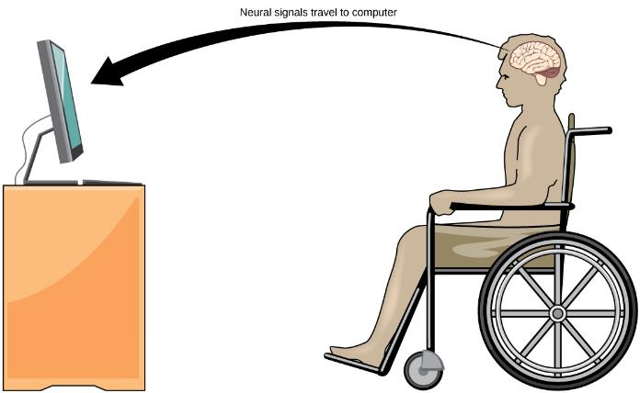
Figure 35.17
With brain-computer interface technology, neural signals from a paralyzed patient are collected, decoded, and then fed to a tool, such as a computer, a wheelchair, or a robotic arm.
This OpenStax ancillary resource is © Rice University under a CC-BY 4.0 International license; it may be reproduced or modified but must be attributed to OpenStax, Rice University and any changes must be noted. Any images credited to other sources are similarly available for reproduction, but must be attributed to their sources.

Slide 19
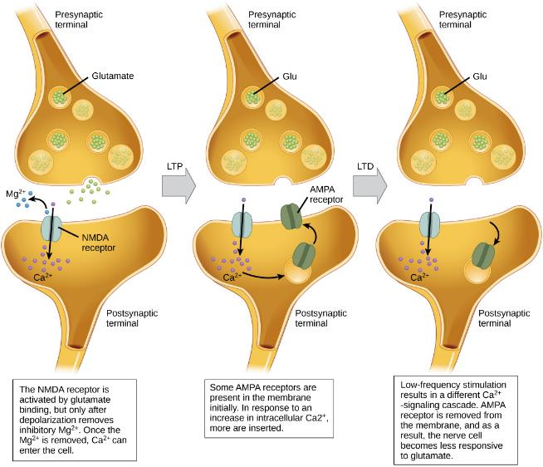
Figure 35.18
This OpenStax ancillary resource is © Rice University under a CC-BY 4.0 International license; it may be reproduced or modified but must be attributed to OpenStax, Rice University and any changes must be noted. Any images credited to other sources are similarly available for reproduction, but must be attributed to their sources.

Slide 20
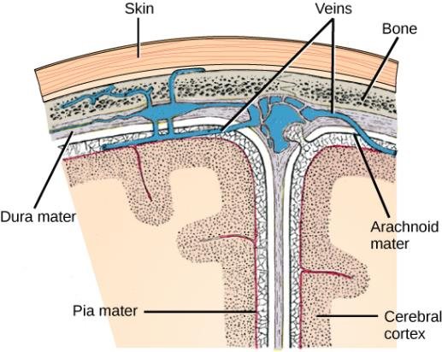
Figure 35.19
The cerebral cortex is covered by three layers of meninges: the dura, arachnoid, and pia maters.
(credit: modification of work by Gray’s Anatomy)
This OpenStax ancillary resource is © Rice University under a CC-BY 4.0 International license; it may be reproduced or modified but must be attributed to OpenStax, Rice University and any changes must be noted. Any images credited to other sources are similarly available for reproduction, but must be attributed to their sources.

Slide 21
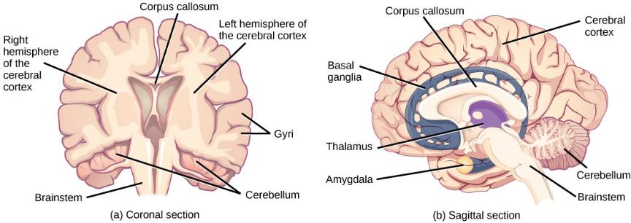
Figure 35.20
These illustrations show the (a) coronal and (b) sagittal sections of the human brain.
This OpenStax ancillary resource is © Rice University under a CC-BY 4.0 International license; it may be reproduced or modified but must be attributed to OpenStax, Rice University and any changes must be noted. Any images credited to other sources are similarly available for reproduction, but must be attributed to their sources.

Slide 22
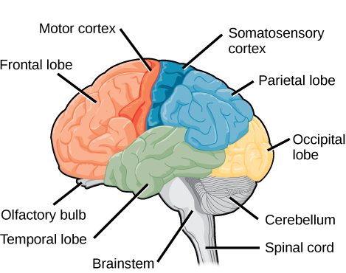
Figure 35.21
The human cerebral cortex includes the frontal, parietal, temporal, and occipital lobes.
This OpenStax ancillary resource is © Rice University under a CC-BY 4.0 International license; it may be reproduced or modified but must be attributed to OpenStax, Rice University and any changes must be noted. Any images credited to other sources are similarly available for reproduction, but must be attributed to their sources.

Slide 23
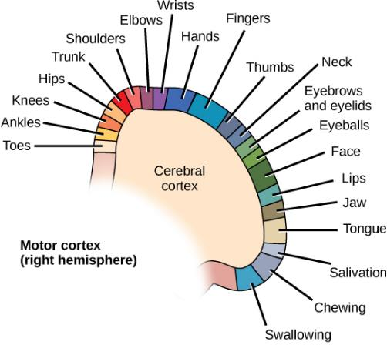
Figure 35.22
Different parts of the motor cortex control different muscle groups. Muscle groups that are neighbors in the body are generally controlled by neighboring regions of the motor cortex as well. For example, the neurons that control finger movement are near the neurons that control hand movement.
This OpenStax ancillary resource is © Rice University under a CC-BY 4.0 International license; it may be reproduced or modified but must be attributed to OpenStax, Rice University and any changes must be noted. Any images credited to other sources are similarly available for reproduction, but must be attributed to their sources.

Slide 24
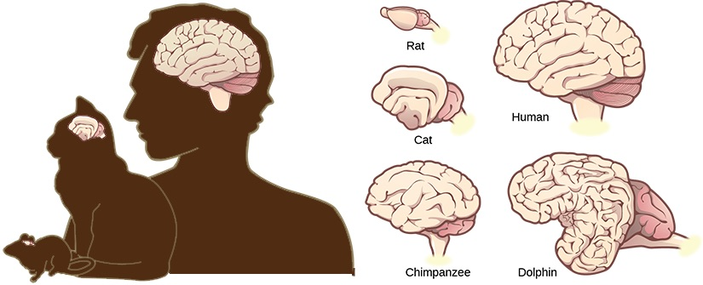
Figure 35.23
Mammals have larger brain-to-body ratios than other vertebrates. Within mammals, increased cortical folding and surface area is correlated with complex behavior.
This OpenStax ancillary resource is © Rice University under a CC-BY 4.0 International license; it may be reproduced or modified but must be attributed to OpenStax, Rice University and any changes must be noted. Any images credited to other sources are similarly available for reproduction, but must be attributed to their sources.

Slide 25
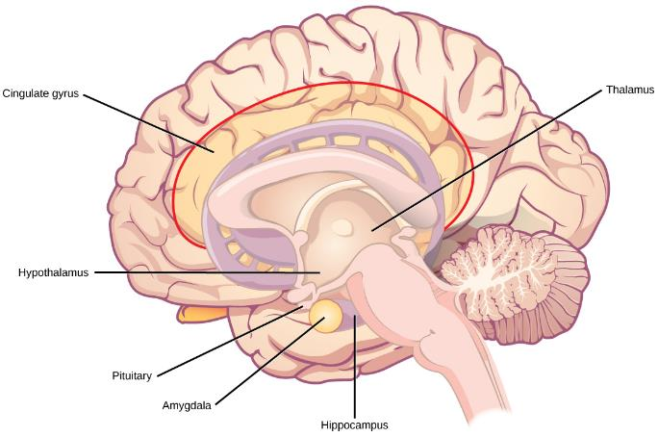
Figure 35.24
The limbic system regulates emotion and other behaviors. It includes parts of the cerebral cortex located near the center of the brain, including the cingulate gyrus and the hippocampus as well as the thalamus, hypothalamus and amygdala.
This OpenStax ancillary resource is © Rice University under a CC-BY 4.0 International license; it may be reproduced or modified but must be attributed to OpenStax, Rice University and any changes must be noted. Any images credited to other sources are similarly available for reproduction, but must be attributed to their sources.

Slide 26
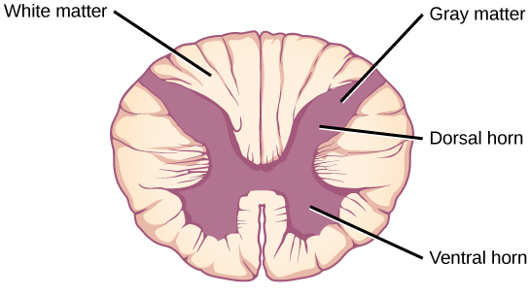
Figure 35.25
A cross-section of the spinal cord shows gray matter (containing cell bodies and interneurons) and white matter (containing axons).
This OpenStax ancillary resource is © Rice University under a CC-BY 4.0 International license; it may be reproduced or modified but must be attributed to OpenStax, Rice University and any changes must be noted. Any images credited to other sources are similarly available for reproduction, but must be attributed to their sources.

Slide 27
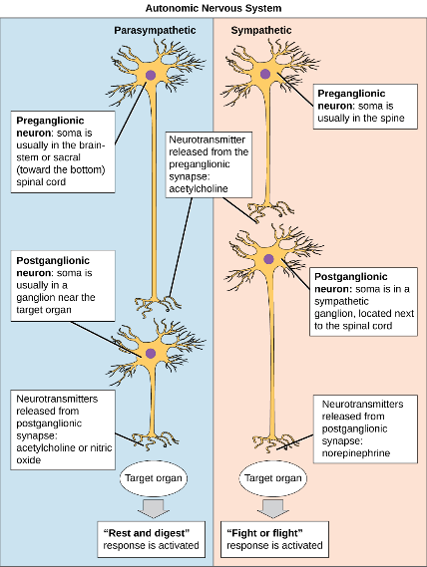
Figure 35.26
In the autonomic nervous system, a preganglionic neuron of the CNS synapses with a postganglionic neuron of the PNS. The postganglionic neuron, in turn, acts on a target organ. Autonomic responses are mediated by the sympathetic and the parasympathetic systems, which are antagonistic to one another. The sympathetic system activates the “fight or flight” response, while the parasympathetic system activates the “rest and digest” response.
This OpenStax ancillary resource is © Rice University under a CC-BY 4.0 International license; it may be reproduced or modified but must be attributed to OpenStax, Rice University and any changes must be noted. Any images credited to other sources are similarly available for reproduction, but must be attributed to their sources.

Slide 28
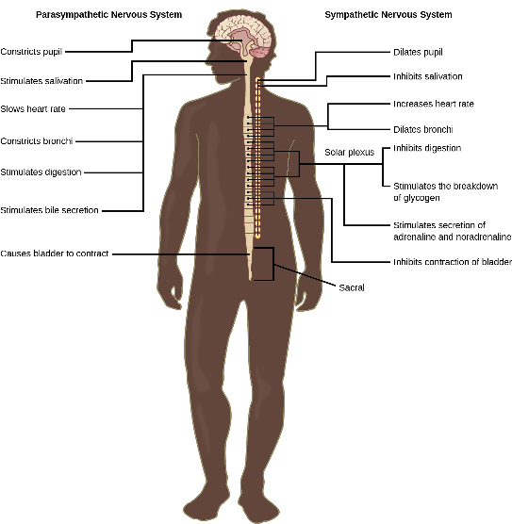
Figure 35.27
The sympathetic and parasympathetic nervous systems often have opposing effects on target organs.
This OpenStax ancillary resource is © Rice University under a CC-BY 4.0 International license; it may be reproduced or modified but must be attributed to OpenStax, Rice University and any changes must be noted. Any images credited to other sources are similarly available for reproduction, but must be attributed to their sources.

Slide 29
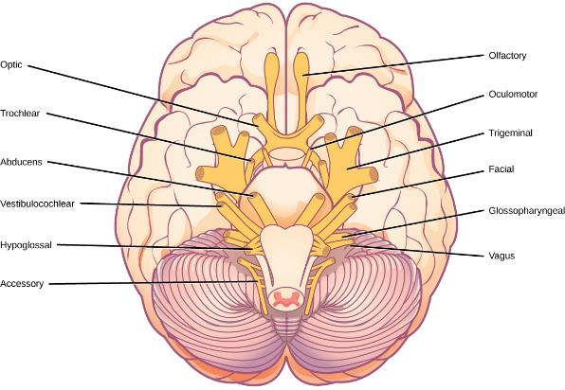
Figure 35.28
The human brain contains 12 cranial nerves that receive sensory input and control motor output for the head and neck.
This OpenStax ancillary resource is © Rice University under a CC-BY 4.0 International license; it may be reproduced or modified but must be attributed to OpenStax, Rice University and any changes must be noted. Any images credited to other sources are similarly available for reproduction, but must be attributed to their sources.

Slide 30
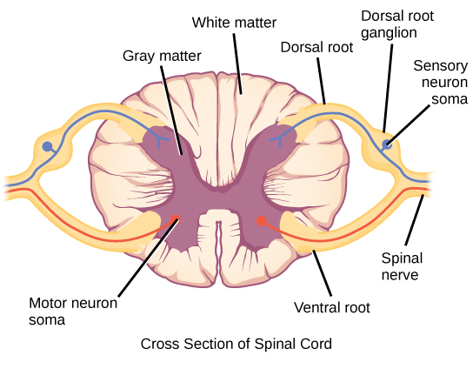
Figure 35.29
Spinal nerves contain both sensory and motor axons. The somas of sensory neurons are located in dorsal root ganglia. The somas of motor neurons are found in the ventral portion of the gray matter of the spinal cord.
This OpenStax ancillary resource is © Rice University under a CC-BY 4.0 International license; it may be reproduced or modified but must be attributed to OpenStax, Rice University and any changes must be noted. Any images credited to other sources are similarly available for reproduction, but must be attributed to their sources.

Slide 31
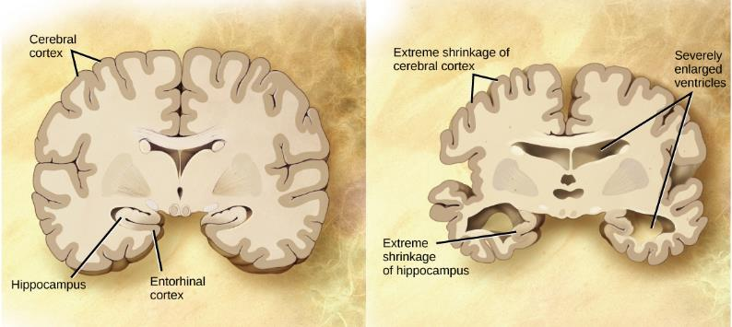
Figure 35.30
Compared to a normal brain (left), the brain from a patient with Alzheimer’s disease (right) shows a dramatic neurodegeneration, particularly within the ventricles and hippocampus.
(credit: modification of work by “Garrando”/Wikimedia Commons based on original images by ADEAR: "Alzheimer's Disease Education and Referral Center, a service of the National Institute on Aging”)
This OpenStax ancillary resource is © Rice University under a CC-BY 4.0 International license; it may be reproduced or modified but must be attributed to OpenStax, Rice University and any changes must be noted. Any images credited to other sources are similarly available for reproduction, but must be attributed to their sources.

Slide 32
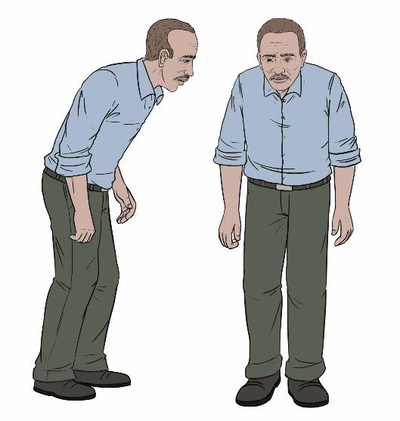
Figure 35.31
Parkinson’s patients often have a characteristic hunched walk.
This OpenStax ancillary resource is © Rice University under a CC-BY 4.0 International license; it may be reproduced or modified but must be attributed to OpenStax, Rice University and any changes must be noted. Any images credited to other sources are similarly available for reproduction, but must be attributed to their sources.

Slide 33
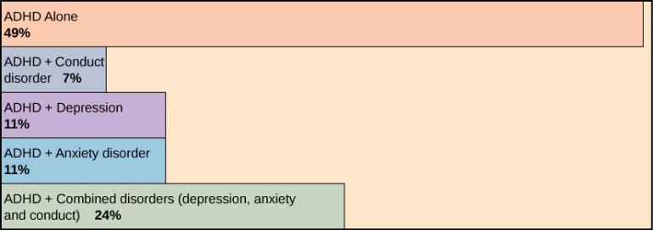
Figure 35.32
Many people with ADHD have one or more other neurological disorders.
(credit “chart design and illustration”: modification of work by Leigh Coriale; credit “data”: Drs. Biederman and Faraone, Massachusetts General Hospital).
This OpenStax ancillary resource is © Rice University under a CC-BY 4.0 International license; it may be reproduced or modified but must be attributed to OpenStax, Rice University and any changes must be noted. Any images credited to other sources are similarly available for reproduction, but must be attributed to their sources.

