Slide 1


Biology 2e
Chapter 36 SENSORY SYSTEMS
PowerPoint Image Slide Show

Slide 2
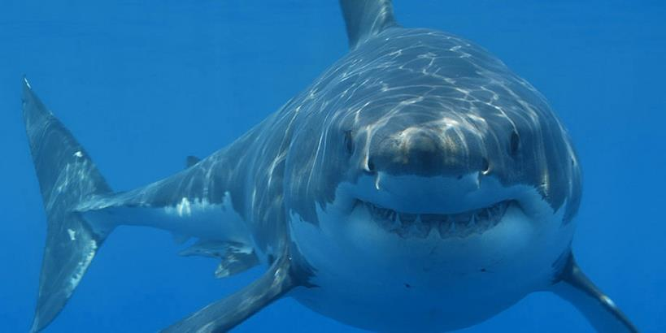
Figure 36.1
This shark uses its senses of sight, vibration (lateral-line system), and smell to hunt, but it also relies on its ability to sense the electric fields of prey, a sense not present in most land animals.
(credit: modification of work by Hermanus Backpackers Hostel, South Africa)
This OpenStax ancillary resource is © Rice University under a CC-BY 4.0 International license; it may be reproduced or modified but must be attributed to OpenStax, Rice University and any changes must be noted. Any images credited to other sources are similarly available for reproduction, but must be attributed to their sources.

Slide 3
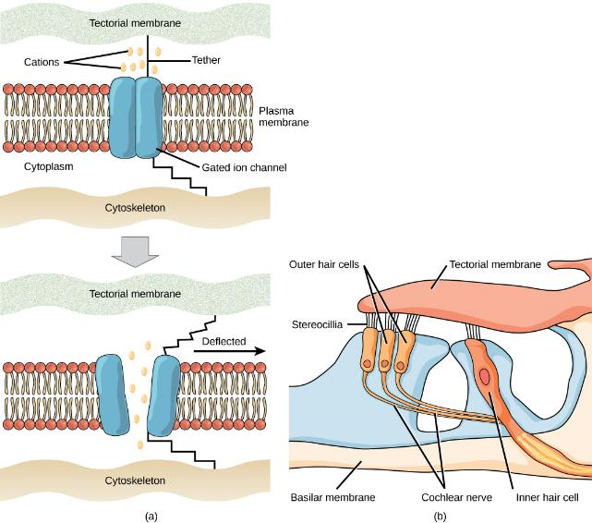
Figure 36.2
(a) Mechanosensitive ion channels are gated ion channels that respond to mechanical deformation of the plasma membrane. A mechanosensitive channel is connected to the plasma membrane and the cytoskeleton by hair-like tethers. When pressure causes the extracellular matrix to move, the channel opens, allowing ions to enter or exit the cell. (b) Stereocilia in the human ear are connected to mechanosensitive ion channels.
When a sound causes the stereocilia to move, mechanosensitive ion channels transduce the signal to the cochlear nerve.
This OpenStax ancillary resource is © Rice University under a CC-BY 4.0 International license; it may be reproduced or modified but must be attributed to OpenStax, Rice University and any changes must be noted. Any images credited to other sources are similarly available for reproduction, but must be attributed to their sources.

Slide 4
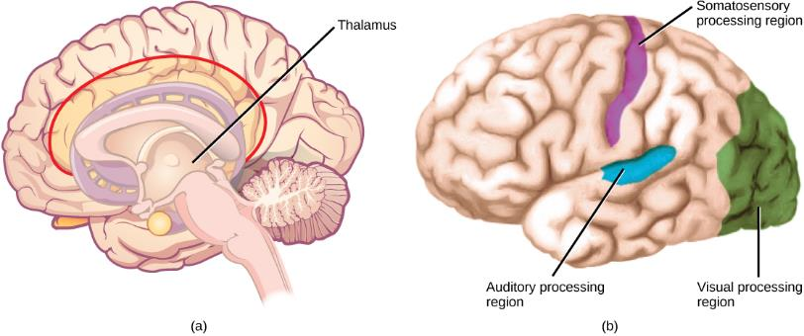
Figure 36.3
In humans, with the exception of olfaction, all sensory signals are routed from the (a) thalamus to (b) final processing regions in the cortex of the brain.
(credit b: modification of work by Polina Tishina)
This OpenStax ancillary resource is © Rice University under a CC-BY 4.0 International license; it may be reproduced or modified but must be attributed to OpenStax, Rice University and any changes must be noted. Any images credited to other sources are similarly available for reproduction, but must be attributed to their sources.

Slide 5
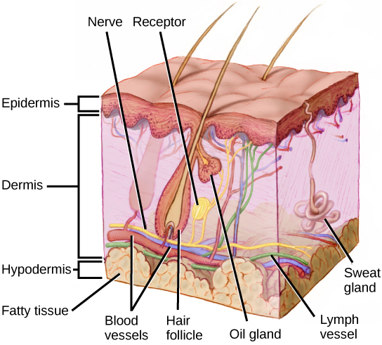
Figure 36.4
Mammalian skin has three layers: an epidermis, a dermis, and a hypodermis.
(credit: modification of work by Don Bliss, National Cancer Institute)
This OpenStax ancillary resource is © Rice University under a CC-BY 4.0 International license; it may be reproduced or modified but must be attributed to OpenStax, Rice University and any changes must be noted. Any images credited to other sources are similarly available for reproduction, but must be attributed to their sources.

Slide 6
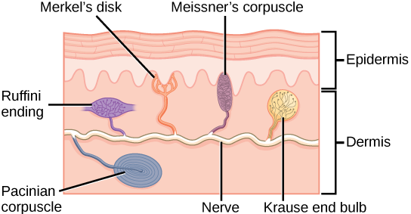
Figure 36.5
Four of the primary mechanoreceptors in human skin are shown. Merkel’s disks, which are unencapsulated, respond to light touch. Meissner’s corpuscles, Ruffini endings, and Pacinian corpuscles are all encapsulated. Meissner’s corpuscles respond to touch and low-frequency vibration. Ruffini endings detect stretch, deformation within joints, and warmth. Pacinian corpuscles detect transient pressure and high-frequency vibration. Krause end bulbs are encapsulated thermo receptors that detect cold.
This OpenStax ancillary resource is © Rice University under a CC-BY 4.0 International license; it may be reproduced or modified but must be attributed to OpenStax, Rice University and any changes must be noted. Any images credited to other sources are similarly available for reproduction, but must be attributed to their sources.

Slide 7
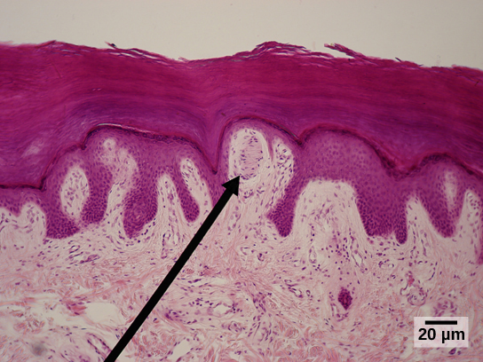
Figure 36.6
Meissner corpuscles in the fingertips, such as the one viewed here using bright field light microscopy, allow for touch discrimination of fine detail.
(credit: modification of work by "Wbensmith"/Wikimedia Commons; scale-bar data from Matt Russell)
This OpenStax ancillary resource is © Rice University under a CC-BY 4.0 International license; it may be reproduced or modified but must be attributed to OpenStax, Rice University and any changes must be noted. Any images credited to other sources are similarly available for reproduction, but must be attributed to their sources.

Slide 8
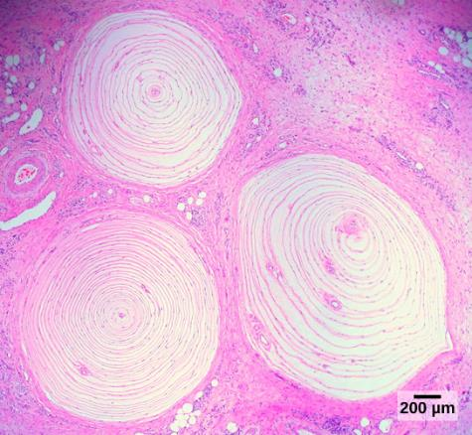
Figure 36.7
Pacinian corpuscles, such as these visualized using bright field light microscopy, detect pressure (touch) and high-frequency vibration.
(credit: modification of work by Ed Uthman; scale-bar data from Matt Russell)
This OpenStax ancillary resource is © Rice University under a CC-BY 4.0 International license; it may be reproduced or modified but must be attributed to OpenStax, Rice University and any changes must be noted. Any images credited to other sources are similarly available for reproduction, but must be attributed to their sources.

Slide 9
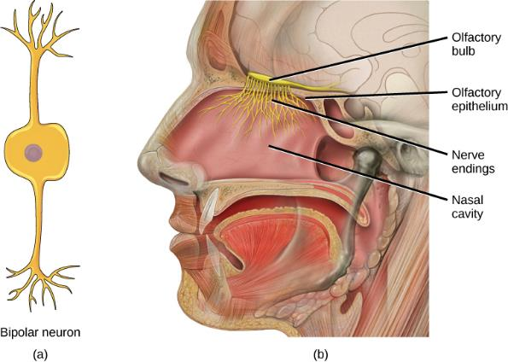
Figure 36.8
In the human olfactory system, (a) bipolar olfactory neurons extend from (b) the olfactory epithelium, where olfactory receptors are located, to the olfactory bulb.
(credit: modification of work by Patrick J. Lynch, medical illustrator; C. Carl Jaffe, MD, cardiologist)
This OpenStax ancillary resource is © Rice University under a CC-BY 4.0 International license; it may be reproduced or modified but must be attributed to OpenStax, Rice University and any changes must be noted. Any images credited to other sources are similarly available for reproduction, but must be attributed to their sources.

Slide 10

Figure 36.9
The flehmen response in this tiger results in the curling of the upper lip and helps airborne pheromone molecules enter the vomeronasal organ.
(credit: modification of work by "chadh"/Flickr)
This OpenStax ancillary resource is © Rice University under a CC-BY 4.0 International license; it may be reproduced or modified but must be attributed to OpenStax, Rice University and any changes must be noted. Any images credited to other sources are similarly available for reproduction, but must be attributed to their sources.

Slide 11
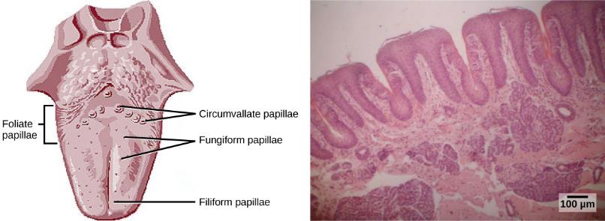
Figure 36.10
(a) Foliate, circumvallate, and fungiform papillae are located on different regions of the tongue. (b) Foliate papillae are prominent protrusions on this light micrograph.
(credit a: modification of work by NCI; scale-bar data from Matt Russell)
This OpenStax ancillary resource is © Rice University under a CC-BY 4.0 International license; it may be reproduced or modified but must be attributed to OpenStax, Rice University and any changes must be noted. Any images credited to other sources are similarly available for reproduction, but must be attributed to their sources.

Slide 12
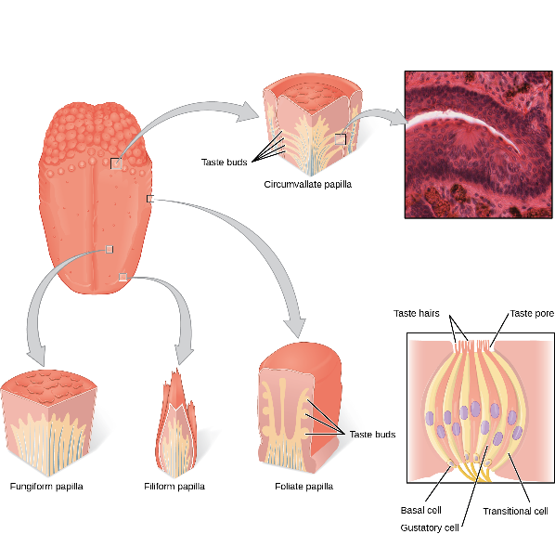
Figure 36.11
Pores in the tongue allow tastants to enter taste pores in the tongue.
(credit: modification of work by Vincenzo Rizzo)
This OpenStax ancillary resource is © Rice University under a CC-BY 4.0 International license; it may be reproduced or modified but must be attributed to OpenStax, Rice University and any changes must be noted. Any images credited to other sources are similarly available for reproduction, but must be attributed to their sources.

Slide 13
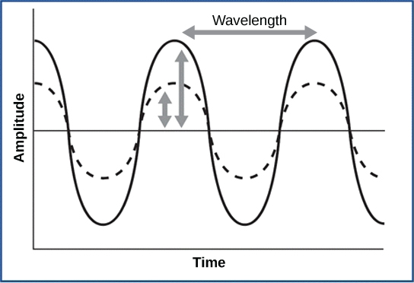
Figure 36.12
For sound waves, wavelength corresponds to pitch. Amplitude of the wave corresponds to volume. The sound wave shown with a dashed line is softer in volume than the sound wave shown with a solid line.
(credit: NIH)
This OpenStax ancillary resource is © Rice University under a CC-BY 4.0 International license; it may be reproduced or modified but must be attributed to OpenStax, Rice University and any changes must be noted. Any images credited to other sources are similarly available for reproduction, but must be attributed to their sources.

Slide 14
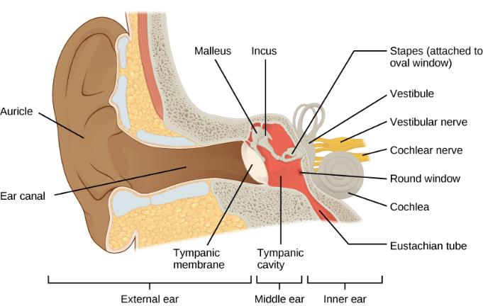
Figure 36.13
Sound travels through the outer ear to the middle ear, which is bounded on its exterior by the tympanic membrane. The middle ear contains three bones called ossicles that transfer the sound wave to the oval window, the exterior boundary of the inner ear. The organ of Corti, which is the organ of sound transduction, lies inside the cochlea.
This OpenStax ancillary resource is © Rice University under a CC-BY 4.0 International license; it may be reproduced or modified but must be attributed to OpenStax, Rice University and any changes must be noted. Any images credited to other sources are similarly available for reproduction, but must be attributed to their sources.

Slide 15
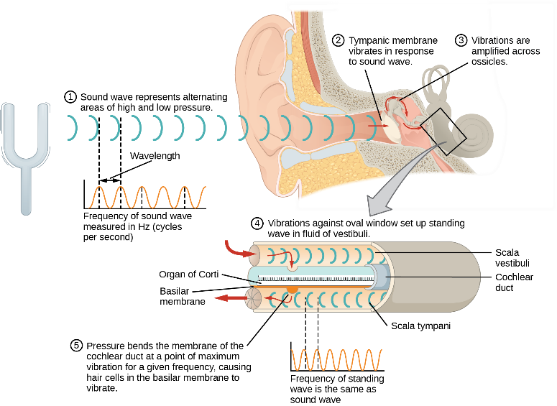
Figure 36.14
This OpenStax ancillary resource is © Rice University under a CC-BY 4.0 International license; it may be reproduced or modified but must be attributed to OpenStax, Rice University and any changes must be noted. Any images credited to other sources are similarly available for reproduction, but must be attributed to their sources.
Notes:
A sound wave causes the tympanic membrane to vibrate. This vibration is amplified as it moves across the malleus, incus, and stapes. The amplified vibration is picked up by the oval window causing pressure waves in the fluid of the scala vestibuli and scala tympani. The complexity of the pressure waves is determined by the changes in amplitude and frequency of the sound waves entering the ear.

Slide 16
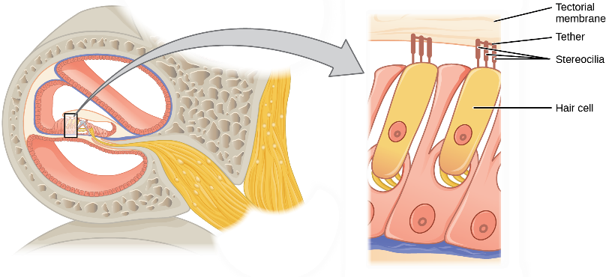
Figure 36.15
The hair cell is a mechanoreceptor with an array of stereocilia emerging from its apical surface. The stereocilia are tethered together by proteins that open ion channels when the array is bent toward the tallest member of their array, and closed when the array is bent toward the shortest member of their array.
This OpenStax ancillary resource is © Rice University under a CC-BY 4.0 International license; it may be reproduced or modified but must be attributed to OpenStax, Rice University and any changes must be noted. Any images credited to other sources are similarly available for reproduction, but must be attributed to their sources.

Slide 17
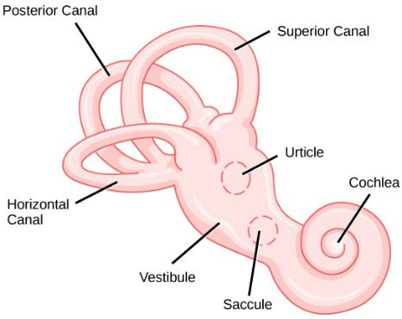
Figure 36.16
The structure of the vestibular labyrinth is shown.
(credit: modification of work by NIH)
This OpenStax ancillary resource is © Rice University under a CC-BY 4.0 International license; it may be reproduced or modified but must be attributed to OpenStax, Rice University and any changes must be noted. Any images credited to other sources are similarly available for reproduction, but must be attributed to their sources.

Slide 18
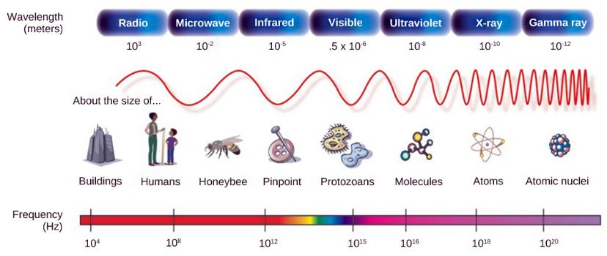
Figure 36.17
In the electromagnetic spectrum, visible light lies between 380 nm and 740 nm.
(credit: modification of work by NASA)
This OpenStax ancillary resource is © Rice University under a CC-BY 4.0 International license; it may be reproduced or modified but must be attributed to OpenStax, Rice University and any changes must be noted. Any images credited to other sources are similarly available for reproduction, but must be attributed to their sources.

Slide 19
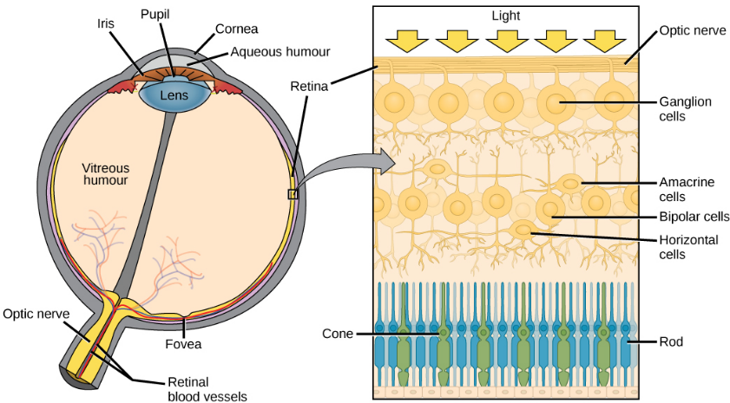
Figure 36.18
(a) The human eye is shown in cross section. (b) A blowup shows the layers of the retina.
This OpenStax ancillary resource is © Rice University under a CC-BY 4.0 International license; it may be reproduced or modified but must be attributed to OpenStax, Rice University and any changes must be noted. Any images credited to other sources are similarly available for reproduction, but must be attributed to their sources.

Slide 20
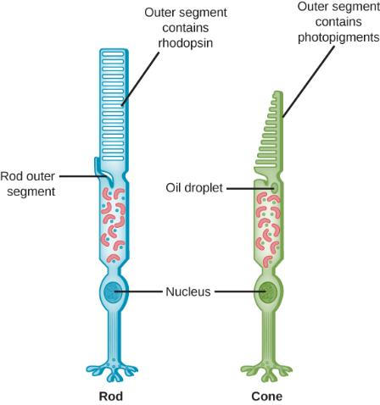
Figure 36.19
Rods and cones are photoreceptors in the retina. Rods respond in low light and can detect only shades of gray. Cones respond in intense light and are responsible for color vision.
This OpenStax ancillary resource is © Rice University under a CC-BY 4.0 International license; it may be reproduced or modified but must be attributed to OpenStax, Rice University and any changes must be noted. Any images credited to other sources are similarly available for reproduction, but must be attributed to their sources.

Slide 21
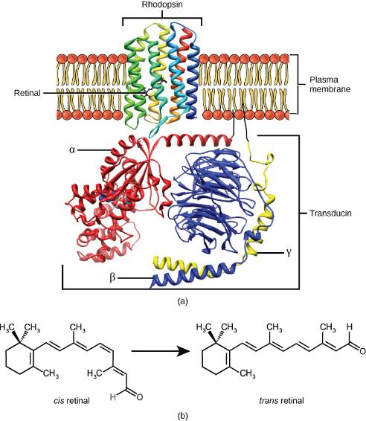
Figure 36.20
(a) Rhodopsin, the photoreceptor in vertebrates, has two parts: the trans-membrane protein opsin, and retinal. When light strikes retinal, it changes shape from (b) a cis to a trans form. The signal is passed to a G-protein called transducin, triggering a series of downstream events.
This OpenStax ancillary resource is © Rice University under a CC-BY 4.0 International license; it may be reproduced or modified but must be attributed to OpenStax, Rice University and any changes must be noted. Any images credited to other sources are similarly available for reproduction, but must be attributed to their sources.

Slide 22
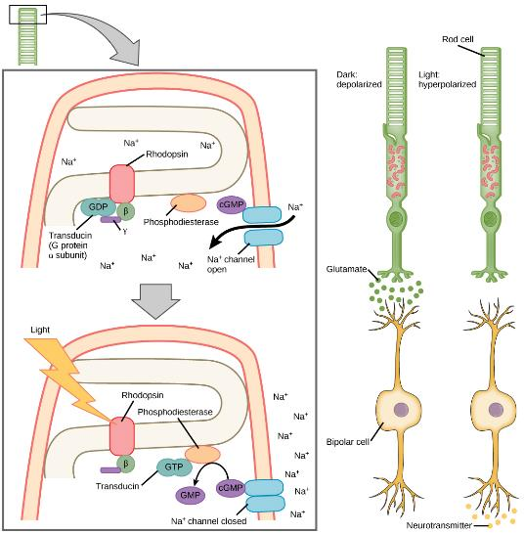
Figure 36.21
When light strikes rhodopsin, the G-protein transducin is activated, which in turn activates phosphodiesterase. Phosphodiesterase converts cGMP to GMP, thereby closing sodium channels. As a result, the membrane becomes hyperpolarized. The hyperpolarized membrane does not release glutamate to the bipolar cell.
This OpenStax ancillary resource is © Rice University under a CC-BY 4.0 International license; it may be reproduced or modified but must be attributed to OpenStax, Rice University and any changes must be noted. Any images credited to other sources are similarly available for reproduction, but must be attributed to their sources.

Slide 23
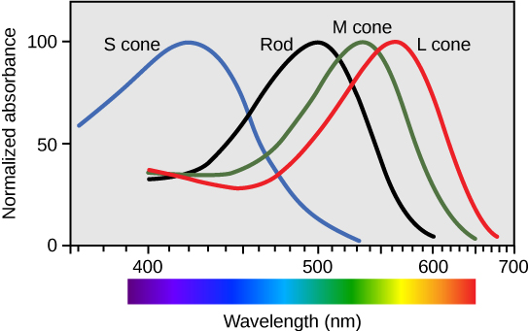
Figure 36.22
Human rod cells and the different types of cone cells each have an optimal wavelength. However, there is considerable overlap in the wavelengths of light detected.
This OpenStax ancillary resource is © Rice University under a CC-BY 4.0 International license; it may be reproduced or modified but must be attributed to OpenStax, Rice University and any changes must be noted. Any images credited to other sources are similarly available for reproduction, but must be attributed to their sources.

Slide 24

Figure 36.23
View this flag to understand how retinal processing works. Stare at the center of the flag (indicated by the white dot) for 45 seconds, and then quickly look at a white background, noticing how colors appear.
This OpenStax ancillary resource is © Rice University under a CC-BY 4.0 International license; it may be reproduced or modified but must be attributed to OpenStax, Rice University and any changes must be noted. Any images credited to other sources are similarly available for reproduction, but must be attributed to their sources.

