Slide 1


Biology 2e
Chapter 37 THE ENDOCRINE SYSTEM
PowerPoint Image Slide Show

Slide 2
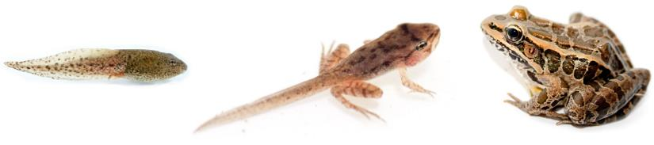
Figure 37.1
The process of amphibian metamorphosis, as seen in the tadpole-to-frog stages shown here, is driven by hormones.
(credit "tadpole": modification of work by Brian Gratwicke)
This OpenStax ancillary resource is © Rice University under a CC-BY 4.0 International license; it may be reproduced or modified but must be attributed to OpenStax, Rice University and any changes must be noted. Any images credited to other sources are similarly available for reproduction, but must be attributed to their sources.

Slide 3
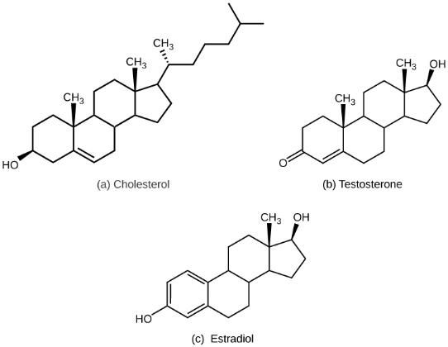
Figure 37.2
The structures shown here represent (a) cholesterol, plus the steroid hormones (b) testosterone and (c) estradiol.
This OpenStax ancillary resource is © Rice University under a CC-BY 4.0 International license; it may be reproduced or modified but must be attributed to OpenStax, Rice University and any changes must be noted. Any images credited to other sources are similarly available for reproduction, but must be attributed to their sources.

Slide 4
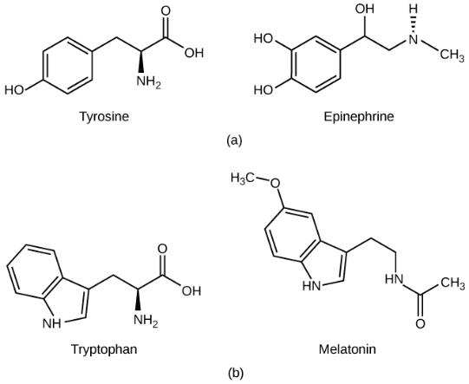
Figure 37.3
(a) The hormone epinephrine, which triggers the fight-or-flight response, is derived from the amino acid tyrosine. (b) The hormone melatonin, which regulates circadian rhythms, is derived from the amino acid tryptophan.
This OpenStax ancillary resource is © Rice University under a CC-BY 4.0 International license; it may be reproduced or modified but must be attributed to OpenStax, Rice University and any changes must be noted. Any images credited to other sources are similarly available for reproduction, but must be attributed to their sources.

Slide 5
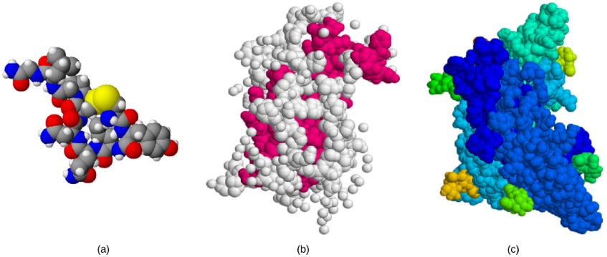
Figure 37.4
The structures of peptide hormones (a) oxytocin, (b) growth hormone, and (c) follicle-stimulating hormone are shown. These peptide hormones are much larger than those derived from cholesterol or amino acids.
This OpenStax ancillary resource is © Rice University under a CC-BY 4.0 International license; it may be reproduced or modified but must be attributed to OpenStax, Rice University and any changes must be noted. Any images credited to other sources are similarly available for reproduction, but must be attributed to their sources.

Slide 6
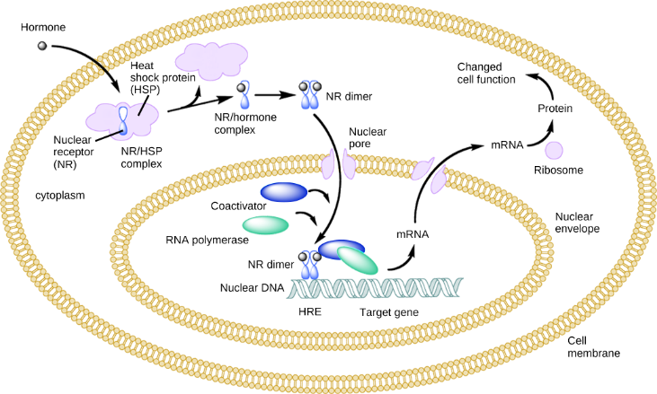
Figure 37.5
An intracellular nuclear receptor (NR) is located in the cytoplasm bound to a heat shock protein (HSP). Upon hormone binding, the receptor dissociates from the heat shock protein and translocates to the nucleus. In the nucleus, the hormone-receptor complex binds to a DNA sequence called a hormone response element (HRE), which triggers gene transcription and translation. The corresponding protein product can then mediate changes in cell function.
This OpenStax ancillary resource is © Rice University under a CC-BY 4.0 International license; it may be reproduced or modified but must be attributed to OpenStax, Rice University and any changes must be noted. Any images credited to other sources are similarly available for reproduction, but must be attributed to their sources.

Slide 7
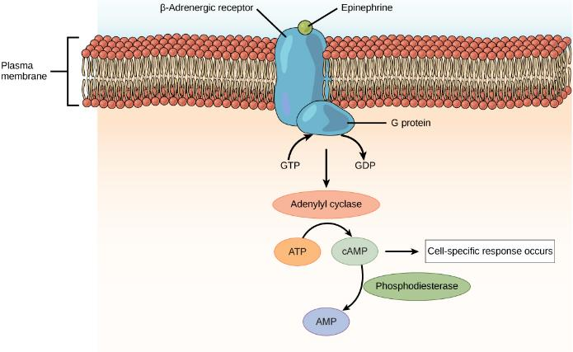
Figure 37.6
The amino acid-derived hormones epinephrine and norepinephrine bind to beta-adrenergic receptors on the plasma membrane of cells. Hormone binding to receptor activates a G-protein, which in turn activates adenylyl cyclase, converting ATP to cAMP. cAMP is a second messenger that mediates a cell-specific response. An enzyme called phosphodiesterase breaks down cAMP, terminating the signal.
This OpenStax ancillary resource is © Rice University under a CC-BY 4.0 International license; it may be reproduced or modified but must be attributed to OpenStax, Rice University and any changes must be noted. Any images credited to other sources are similarly available for reproduction, but must be attributed to their sources.

Slide 8
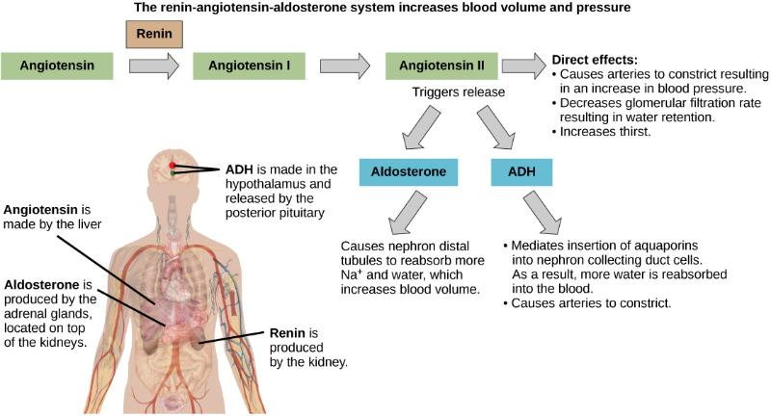
Figure 37.7
ADH and aldosterone increase blood pressure and volume. Angiotensin II stimulates release of these hormones. Angiotensin II, in turn, is formed when renin cleaves angiotensinogen.
(credit: modification of work by Mikael Häggström)
This OpenStax ancillary resource is © Rice University under a CC-BY 4.0 International license; it may be reproduced or modified but must be attributed to OpenStax, Rice University and any changes must be noted. Any images credited to other sources are similarly available for reproduction, but must be attributed to their sources.

Slide 9

Figure 37.8
Professional baseball player Jason Giambi publicly admitted to, and apologized for, his use of anabolic steroids supplied by a trainer.
(credit: Bryce Edwards)
This OpenStax ancillary resource is © Rice University under a CC-BY 4.0 International license; it may be reproduced or modified but must be attributed to OpenStax, Rice University and any changes must be noted. Any images credited to other sources are similarly available for reproduction, but must be attributed to their sources.

Slide 10
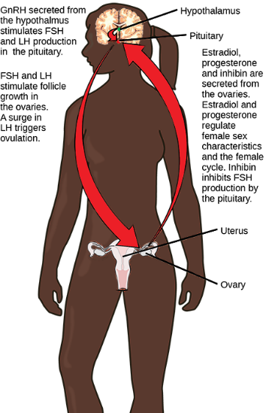
Figure 37.9
Hormonal regulation of the female reproductive system involves hormones from the hypothalamus, pituitary, and ovaries.
This OpenStax ancillary resource is © Rice University under a CC-BY 4.0 International license; it may be reproduced or modified but must be attributed to OpenStax, Rice University and any changes must be noted. Any images credited to other sources are similarly available for reproduction, but must be attributed to their sources.

Slide 11
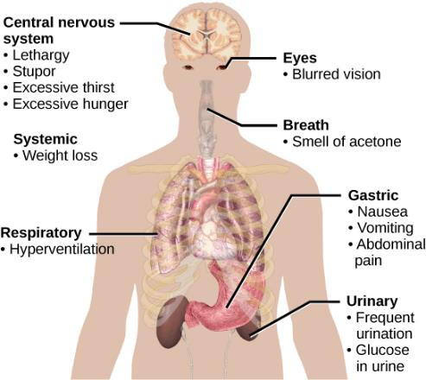
Figure 37.10
The main symptoms of diabetes are shown.
(credit: modification of work by Mikael Häggström)
This OpenStax ancillary resource is © Rice University under a CC-BY 4.0 International license; it may be reproduced or modified but must be attributed to OpenStax, Rice University and any changes must be noted. Any images credited to other sources are similarly available for reproduction, but must be attributed to their sources.

Slide 12
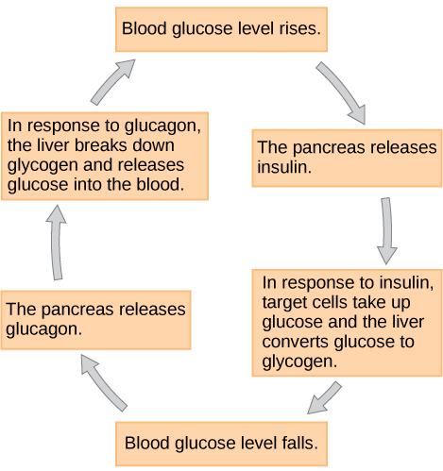
Figure 37.11
Insulin and glucagon regulate blood glucose levels.
This OpenStax ancillary resource is © Rice University under a CC-BY 4.0 International license; it may be reproduced or modified but must be attributed to OpenStax, Rice University and any changes must be noted. Any images credited to other sources are similarly available for reproduction, but must be attributed to their sources.

Slide 13
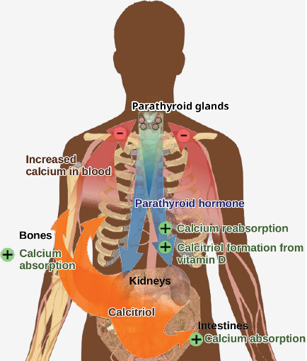
Figure 37.12
Parathyroid hormone (PTH) is released in response to low blood calcium levels. It increases blood calcium levels by targeting the skeleton, the kidneys, and the intestine.
(credit: modification of work by Mikael Häggström)
This OpenStax ancillary resource is © Rice University under a CC-BY 4.0 International license; it may be reproduced or modified but must be attributed to OpenStax, Rice University and any changes must be noted. Any images credited to other sources are similarly available for reproduction, but must be attributed to their sources.

Slide 14
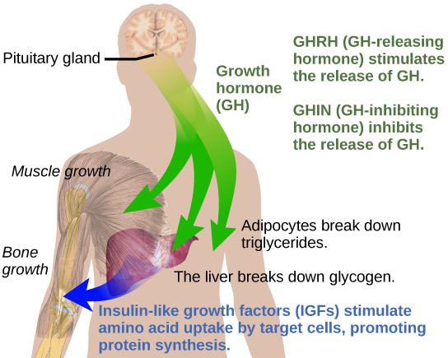
Figure 37.13
Growth hormone directly accelerates the rate of protein synthesis in skeletal muscle and bones. Insulin-like growth factor 1 (IGF-1) is activated by growth hormone and also allows formation of new proteins in muscle cells and bone.
(credit: modification of work by Mikael Häggström)
This OpenStax ancillary resource is © Rice University under a CC-BY 4.0 International license; it may be reproduced or modified but must be attributed to OpenStax, Rice University and any changes must be noted. Any images credited to other sources are similarly available for reproduction, but must be attributed to their sources.

Slide 15
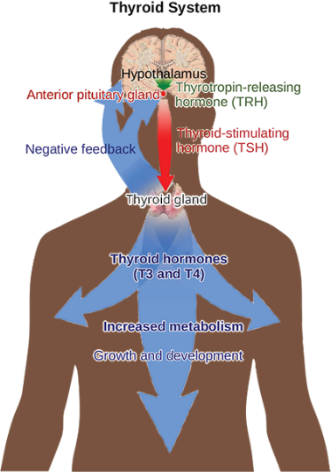
Figure 37.14
The anterior pituitary stimulates the thyroid gland to release thyroid hormones T3 and T4. Increasing levels of these hormones in the blood results in feedback to the hypothalamus and anterior pituitary to inhibit further signaling to the thyroid gland.
(credit: modification of work by Mikael Häggström)
This OpenStax ancillary resource is © Rice University under a CC-BY 4.0 International license; it may be reproduced or modified but must be attributed to OpenStax, Rice University and any changes must be noted. Any images credited to other sources are similarly available for reproduction, but must be attributed to their sources.

Slide 16
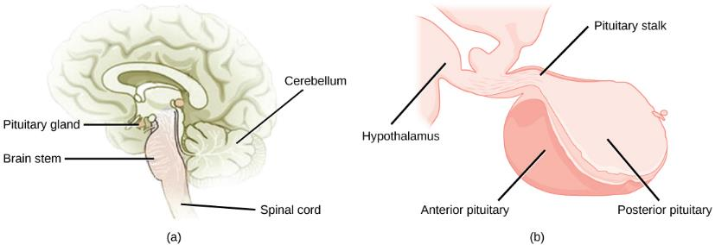
Figure 37.15
The pituitary gland is located at (a) the base of the brain and (b) connected to the hypothalamus by the pituitary stalk.
(credit a: modification of work by NCI; credit b: modification of work by Gray’s Anatomy)
This OpenStax ancillary resource is © Rice University under a CC-BY 4.0 International license; it may be reproduced or modified but must be attributed to OpenStax, Rice University and any changes must be noted. Any images credited to other sources are similarly available for reproduction, but must be attributed to their sources.

Slide 17
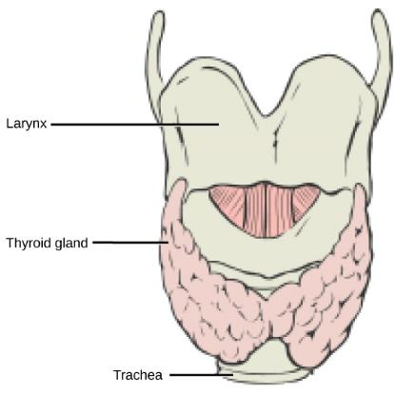
Figure 37.16
This illustration shows the location of the thyroid gland.
This OpenStax ancillary resource is © Rice University under a CC-BY 4.0 International license; it may be reproduced or modified but must be attributed to OpenStax, Rice University and any changes must be noted. Any images credited to other sources are similarly available for reproduction, but must be attributed to their sources.

Slide 18
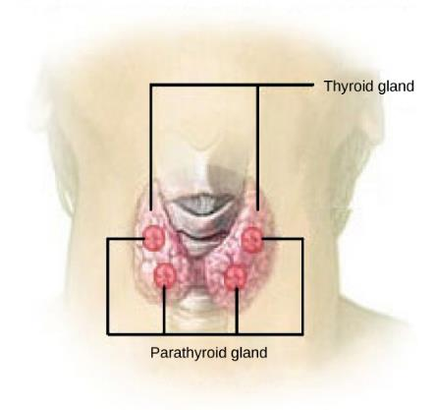
Figure 37.17
The parathyroid glands are located on the posterior of the thyroid gland.
(credit: modification of work by NCI)
This OpenStax ancillary resource is © Rice University under a CC-BY 4.0 International license; it may be reproduced or modified but must be attributed to OpenStax, Rice University and any changes must be noted. Any images credited to other sources are similarly available for reproduction, but must be attributed to their sources.

Slide 19
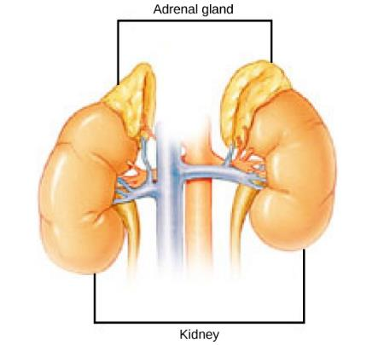
Figure 37.18
The location of the adrenal glands on top of the kidneys is shown.
(credit: modification of work by NCI)
This OpenStax ancillary resource is © Rice University under a CC-BY 4.0 International license; it may be reproduced or modified but must be attributed to OpenStax, Rice University and any changes must be noted. Any images credited to other sources are similarly available for reproduction, but must be attributed to their sources.

Slide 20
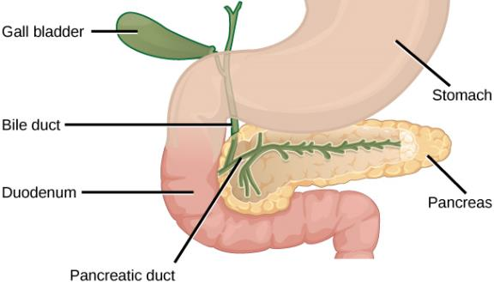
Figure 37.19
The pancreas is found underneath the stomach and points toward the spleen.
(credit: modification of work by NCI)
This OpenStax ancillary resource is © Rice University under a CC-BY 4.0 International license; it may be reproduced or modified but must be attributed to OpenStax, Rice University and any changes must be noted. Any images credited to other sources are similarly available for reproduction, but must be attributed to their sources.

Slide 21
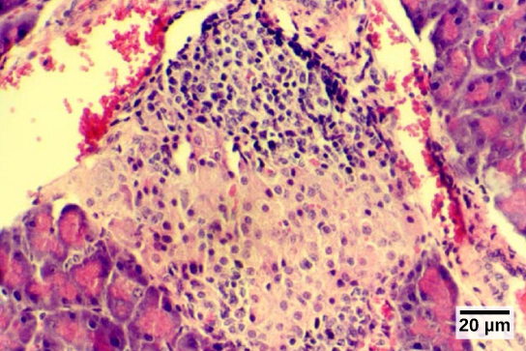
Figure 37.20
The islets of Langerhans are clusters of endocrine cells found in the pancreas; they stain lighter than surrounding cells.
(credit: modification of work by Muhammad T. Tabiin, Christopher P. White, Grant Morahan, and Bernard E. Tuch; scale-bar data from Matt Russell)
This OpenStax ancillary resource is © Rice University under a CC-BY 4.0 International license; it may be reproduced or modified but must be attributed to OpenStax, Rice University and any changes must be noted. Any images credited to other sources are similarly available for reproduction, but must be attributed to their sources.

