Slide 1


Biology 2e
Chapter 38 THE MUSCULOSKELETAL SYSTEM
PowerPoint Image Slide Show

Slide 2
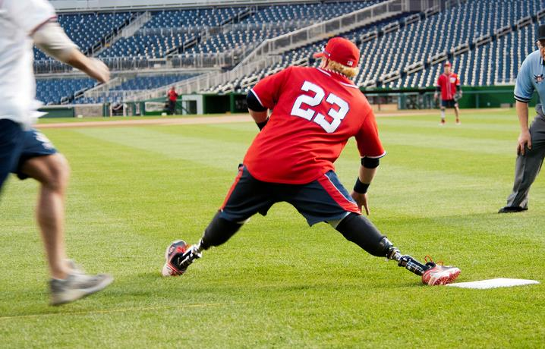
Figure 38.1
Improvements in the design of prostheses have allowed for a wider range of activities in recipients.
(credit: modification of work by Stuart Grout)
This OpenStax ancillary resource is © Rice University under a CC-BY 4.0 International license; it may be reproduced or modified but must be attributed to OpenStax, Rice University and any changes must be noted. Any images credited to other sources are similarly available for reproduction, but must be attributed to their sources.

Slide 3
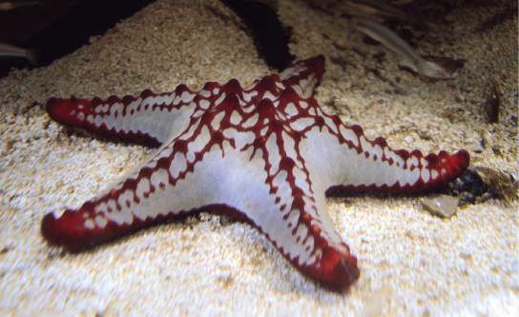
Figure 38.2
The skeleton of the red-knobbed sea star (Protoreaster linckii) is an example of a hydrostatic skeleton.
(credit: “Amada44”/Wikimedia Commons)
This OpenStax ancillary resource is © Rice University under a CC-BY 4.0 International license; it may be reproduced or modified but must be attributed to OpenStax, Rice University and any changes must be noted. Any images credited to other sources are similarly available for reproduction, but must be attributed to their sources.

Slide 4
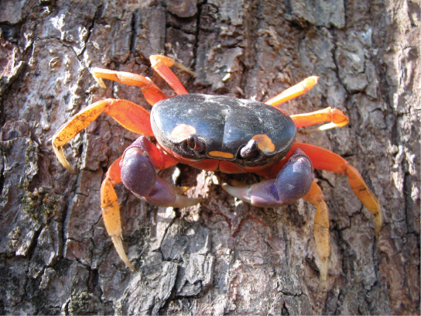
Figure 38.3
Muscles attached to the exoskeleton of the Halloween crab (Gecarcinus quadratus) allow it to move.
This OpenStax ancillary resource is © Rice University under a CC-BY 4.0 International license; it may be reproduced or modified but must be attributed to OpenStax, Rice University and any changes must be noted. Any images credited to other sources are similarly available for reproduction, but must be attributed to their sources.

Slide 5
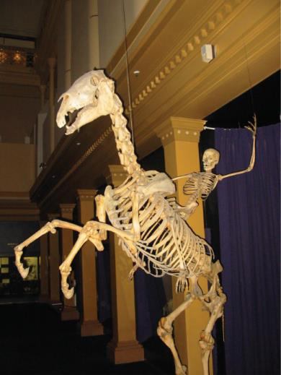
Figure 38.4
The skeletons of humans and horses are examples of endoskeletons.
(credit: Ross Murphy)
This OpenStax ancillary resource is © Rice University under a CC-BY 4.0 International license; it may be reproduced or modified but must be attributed to OpenStax, Rice University and any changes must be noted. Any images credited to other sources are similarly available for reproduction, but must be attributed to their sources.

Slide 6
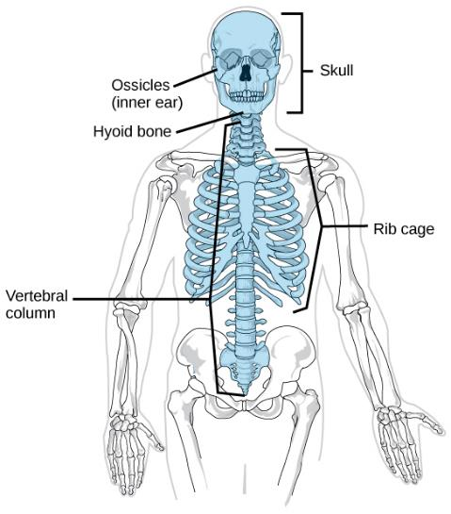
Figure 38.5
The axial skeleton consists of the bones of the skull, ossicles of the middle ear, hyoid bone, vertebral column, and rib cage.
(credit: modification of work by Mariana Ruiz Villareal)
This OpenStax ancillary resource is © Rice University under a CC-BY 4.0 International license; it may be reproduced or modified but must be attributed to OpenStax, Rice University and any changes must be noted. Any images credited to other sources are similarly available for reproduction, but must be attributed to their sources.

Slide 7
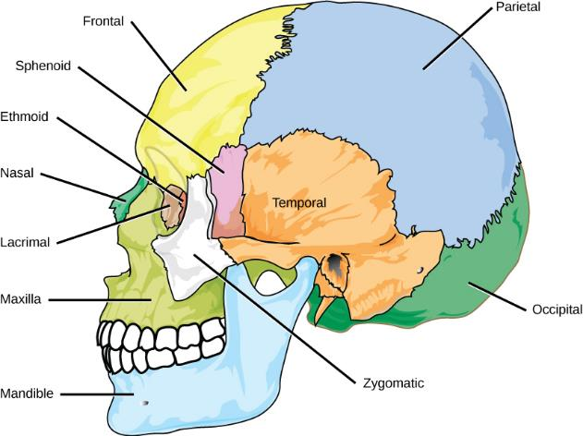
Figure 38.6
The bones of the skull support the structures of the face and protect the brain.
(credit: modification of work by Mariana Ruiz Villareal)
This OpenStax ancillary resource is © Rice University under a CC-BY 4.0 International license; it may be reproduced or modified but must be attributed to OpenStax, Rice University and any changes must be noted. Any images credited to other sources are similarly available for reproduction, but must be attributed to their sources.

Slide 8
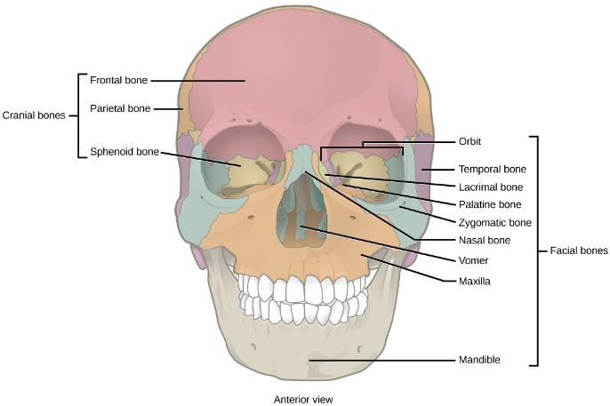
Figure 38.7
The cranial bones, including the frontal, parietal, and sphenoid bones, cover the top of the head. The facial bones of the skull form the face and provide cavities for the eyes, nose, and mouth.
This OpenStax ancillary resource is © Rice University under a CC-BY 4.0 International license; it may be reproduced or modified but must be attributed to OpenStax, Rice University and any changes must be noted. Any images credited to other sources are similarly available for reproduction, but must be attributed to their sources.

Slide 9
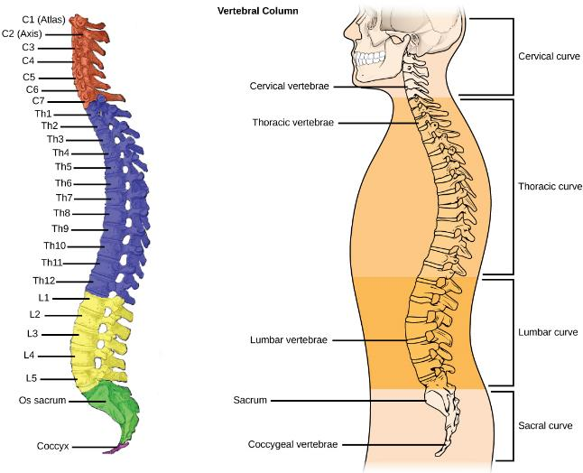
Figure 38.8
(a) The vertebral column consists of seven cervical vertebrae (C1–7) twelve thoracic vertebrae (Th1–12), five lumbar vertebrae (L1–5), the os sacrum, and the coccyx. (b) Spinal curves increase the strength and flexibility of the spine.
(credit a: modification of work by Uwe Gille based on original work by Gray's Anatomy; credit b: modification of work by NCI, NIH)
This OpenStax ancillary resource is © Rice University under a CC-BY 4.0 International license; it may be reproduced or modified but must be attributed to OpenStax, Rice University and any changes must be noted. Any images credited to other sources are similarly available for reproduction, but must be attributed to their sources.

Slide 10
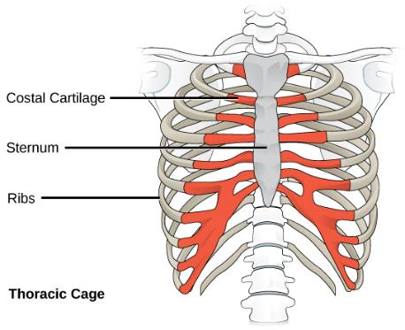
Figure 38.9
The thoracic cage, or rib cage, protects the heart and the lungs.
(credit: modification of work by NCI, NIH)
This OpenStax ancillary resource is © Rice University under a CC-BY 4.0 International license; it may be reproduced or modified but must be attributed to OpenStax, Rice University and any changes must be noted. Any images credited to other sources are similarly available for reproduction, but must be attributed to their sources.

Slide 11
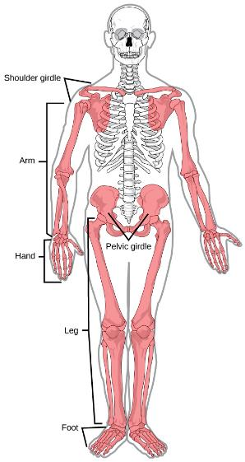
Figure 38.10
The appendicular skeleton is composed of the bones of the pectoral limbs (arm, forearm, hand), the pelvic limbs (thigh, leg, foot), the pectoral girdle, and the pelvic girdle.
(credit: modification of work by Mariana Ruiz Villareal)
This OpenStax ancillary resource is © Rice University under a CC-BY 4.0 International license; it may be reproduced or modified but must be attributed to OpenStax, Rice University and any changes must be noted. Any images credited to other sources are similarly available for reproduction, but must be attributed to their sources.

Slide 12
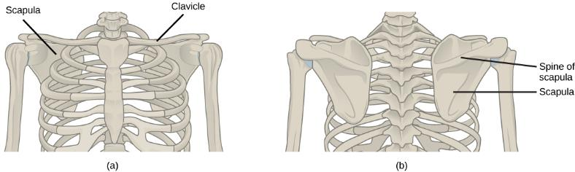
Figure 38.11
(a) The pectoral girdle in primates consists of the clavicles and scapulae. (b) The posterior view reveals the spine of the scapula to which muscle attaches.
This OpenStax ancillary resource is © Rice University under a CC-BY 4.0 International license; it may be reproduced or modified but must be attributed to OpenStax, Rice University and any changes must be noted. Any images credited to other sources are similarly available for reproduction, but must be attributed to their sources.

Slide 13
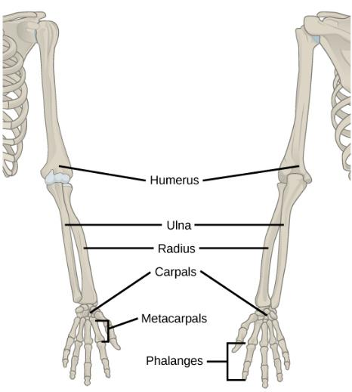
Figure 38.12
The upper limb consists of the humerus of the upper arm, the radius and ulna of the forearm, eight bones of the carpus, five bones of the metacarpus, and 14 bones of the phalanges.
This OpenStax ancillary resource is © Rice University under a CC-BY 4.0 International license; it may be reproduced or modified but must be attributed to OpenStax, Rice University and any changes must be noted. Any images credited to other sources are similarly available for reproduction, but must be attributed to their sources.

Slide 14
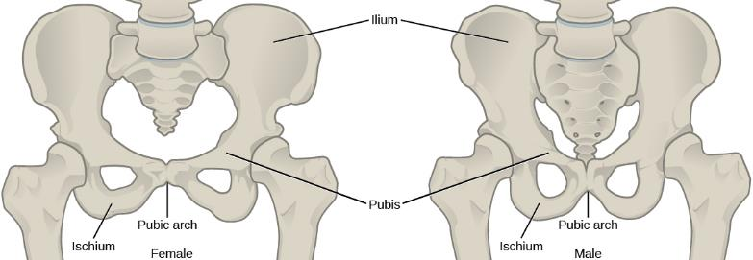
Figure 38.13
To adapt to reproductive fitness, the female pelvis is lighter, wider, shallower, and has a broader angle between the pubic bones than the male pelvis.
This OpenStax ancillary resource is © Rice University under a CC-BY 4.0 International license; it may be reproduced or modified but must be attributed to OpenStax, Rice University and any changes must be noted. Any images credited to other sources are similarly available for reproduction, but must be attributed to their sources.

Slide 15
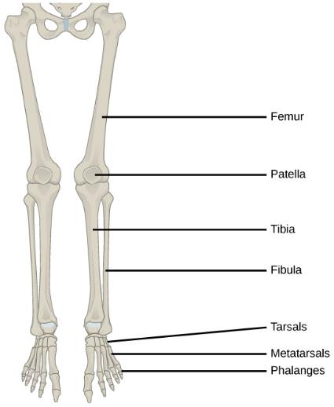
Figure 38.14
The lower limb consists of the thigh (femur), kneecap (patella), leg (tibia and fibula), ankle (tarsals), and foot (metatarsals and phalanges) bones.
This OpenStax ancillary resource is © Rice University under a CC-BY 4.0 International license; it may be reproduced or modified but must be attributed to OpenStax, Rice University and any changes must be noted. Any images credited to other sources are similarly available for reproduction, but must be attributed to their sources.

Slide 16
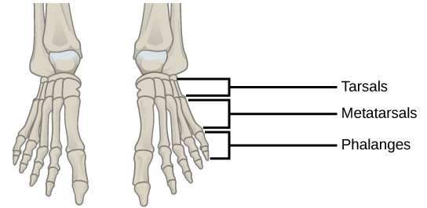
Figure 38.15
This drawing shows the bones of the human foot and ankle, including the metatarsals and the phalanges.
This OpenStax ancillary resource is © Rice University under a CC-BY 4.0 International license; it may be reproduced or modified but must be attributed to OpenStax, Rice University and any changes must be noted. Any images credited to other sources are similarly available for reproduction, but must be attributed to their sources.

Slide 17
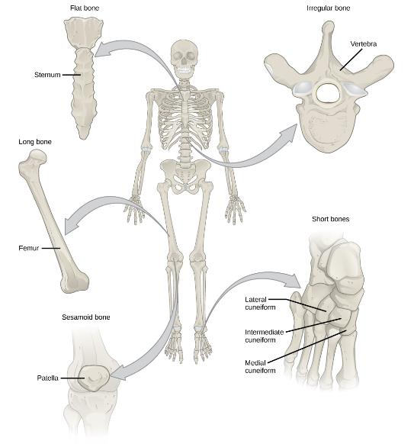
Figure 38.16
Shown are different types of bones: flat, irregular, long, short, and sesamoid.
This OpenStax ancillary resource is © Rice University under a CC-BY 4.0 International license; it may be reproduced or modified but must be attributed to OpenStax, Rice University and any changes must be noted. Any images credited to other sources are similarly available for reproduction, but must be attributed to their sources.

Slide 18
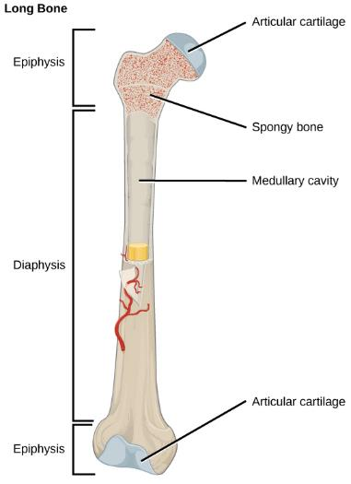
Figure 38.17
The long bone is covered by articular cartilage at either end and contains bone marrow (shown in yellow in this illustration) in the medullary cavity.
This OpenStax ancillary resource is © Rice University under a CC-BY 4.0 International license; it may be reproduced or modified but must be attributed to OpenStax, Rice University and any changes must be noted. Any images credited to other sources are similarly available for reproduction, but must be attributed to their sources.

Slide 19
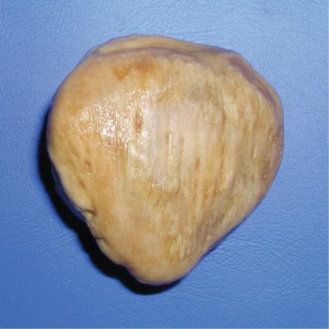
Figure 38.18
The patella of the knee is an example of a sesamoid bone.
This OpenStax ancillary resource is © Rice University under a CC-BY 4.0 International license; it may be reproduced or modified but must be attributed to OpenStax, Rice University and any changes must be noted. Any images credited to other sources are similarly available for reproduction, but must be attributed to their sources.

Slide 20
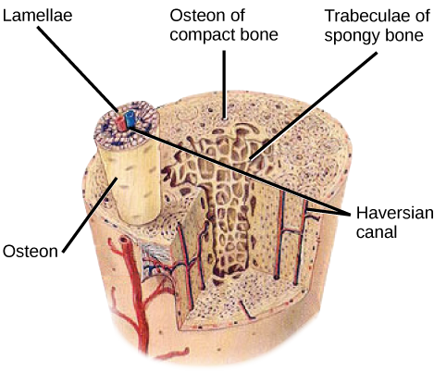
Figure 38.19
Compact bone tissue consists of osteons that are aligned parallel to the long axis of the bone, and the Haversian canal that contains the bone’s blood vessels and nerve fibers. The inner layer of bones consists of spongy bone tissue. The small dark ovals in the osteon represent the living osteocytes.
(credit: modification of work by NCI, NIH)
This OpenStax ancillary resource is © Rice University under a CC-BY 4.0 International license; it may be reproduced or modified but must be attributed to OpenStax, Rice University and any changes must be noted. Any images credited to other sources are similarly available for reproduction, but must be attributed to their sources.

Slide 21
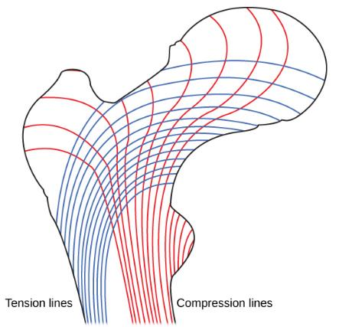
Figure 38.20
Trabeculae in spongy bone are arranged such that one side of the bone bears tension and the other withstands compression.
This OpenStax ancillary resource is © Rice University under a CC-BY 4.0 International license; it may be reproduced or modified but must be attributed to OpenStax, Rice University and any changes must be noted. Any images credited to other sources are similarly available for reproduction, but must be attributed to their sources.

Slide 22
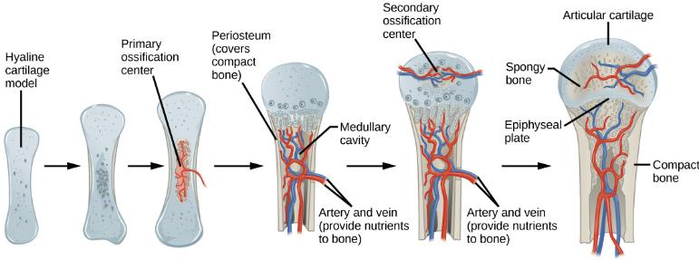
Figure 38.21
Endochondral ossification is the process of bone development from hyaline cartilage. The periosteum is the connective tissue on the outside of bone that acts as the interface between bone, blood vessels, tendons, and ligaments.
This OpenStax ancillary resource is © Rice University under a CC-BY 4.0 International license; it may be reproduced or modified but must be attributed to OpenStax, Rice University and any changes must be noted. Any images credited to other sources are similarly available for reproduction, but must be attributed to their sources.

Slide 23
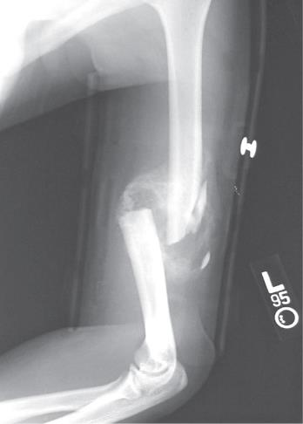
Figure 38.22
After this bone is set, a callus will knit the two ends together.
(credit: Bill Rhodes)
This OpenStax ancillary resource is © Rice University under a CC-BY 4.0 International license; it may be reproduced or modified but must be attributed to OpenStax, Rice University and any changes must be noted. Any images credited to other sources are similarly available for reproduction, but must be attributed to their sources.

Slide 24
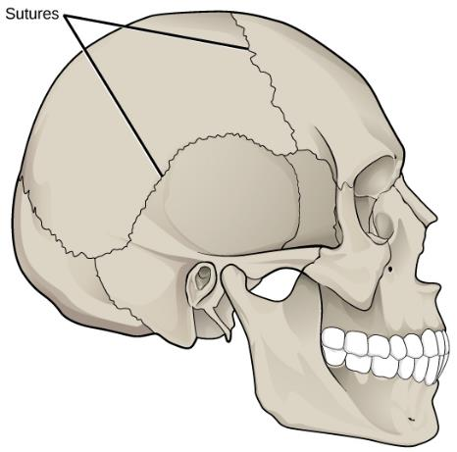
Figure 38.23
Sutures are fibrous joints found only in the skull.
This OpenStax ancillary resource is © Rice University under a CC-BY 4.0 International license; it may be reproduced or modified but must be attributed to OpenStax, Rice University and any changes must be noted. Any images credited to other sources are similarly available for reproduction, but must be attributed to their sources.

Slide 25
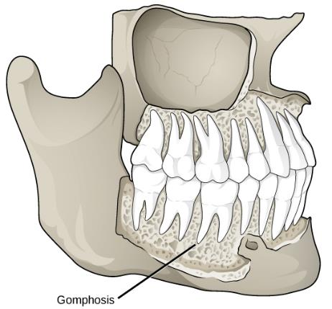
Figure 38.24
Gomphoses are fibrous joints between the teeth and their sockets.
(credit: modification of work by Gray's Anatomy)
This OpenStax ancillary resource is © Rice University under a CC-BY 4.0 International license; it may be reproduced or modified but must be attributed to OpenStax, Rice University and any changes must be noted. Any images credited to other sources are similarly available for reproduction, but must be attributed to their sources.

Slide 26
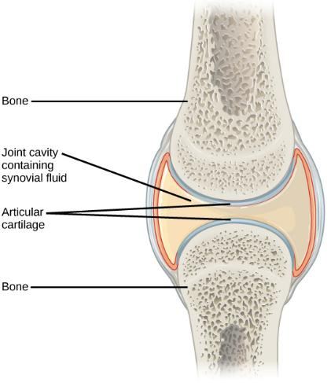
Figure 38.25
Synovial joints are the only joints that have a space or “synovial cavity” in the joint.
This OpenStax ancillary resource is © Rice University under a CC-BY 4.0 International license; it may be reproduced or modified but must be attributed to OpenStax, Rice University and any changes must be noted. Any images credited to other sources are similarly available for reproduction, but must be attributed to their sources.

Slide 27
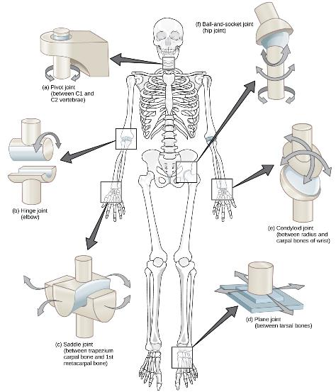
Figure 38.26
Different types of joints allow different types of movement. Planar, hinge, pivot, condyloid, saddle, and ball-and-socket are all types of synovial joints.
This OpenStax ancillary resource is © Rice University under a CC-BY 4.0 International license; it may be reproduced or modified but must be attributed to OpenStax, Rice University and any changes must be noted. Any images credited to other sources are similarly available for reproduction, but must be attributed to their sources.

Slide 28
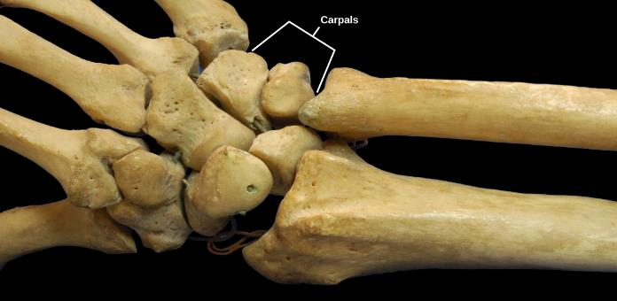
Figure 38.27
The joints of the carpal bones in the wrist are examples of planar joints.
(credit: modification of work by Brian C. Goss)
This OpenStax ancillary resource is © Rice University under a CC-BY 4.0 International license; it may be reproduced or modified but must be attributed to OpenStax, Rice University and any changes must be noted. Any images credited to other sources are similarly available for reproduction, but must be attributed to their sources.

Slide 29
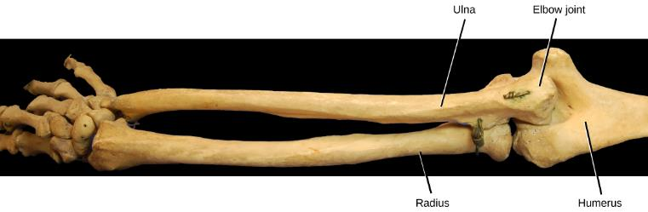
Figure 38.28
The elbow joint, where the radius articulates with the humerus, is an example of a hinge joint.
(credit: modification of work by Brian C. Goss)
This OpenStax ancillary resource is © Rice University under a CC-BY 4.0 International license; it may be reproduced or modified but must be attributed to OpenStax, Rice University and any changes must be noted. Any images credited to other sources are similarly available for reproduction, but must be attributed to their sources.

Slide 30
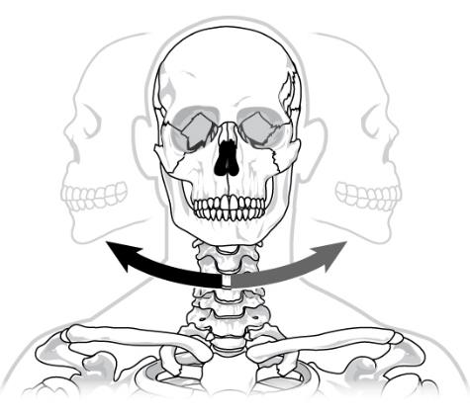
Figure 38.29
The joint in the neck that allows the head to move back and forth is an example of a pivot joint.
This OpenStax ancillary resource is © Rice University under a CC-BY 4.0 International license; it may be reproduced or modified but must be attributed to OpenStax, Rice University and any changes must be noted. Any images credited to other sources are similarly available for reproduction, but must be attributed to their sources.

Slide 31
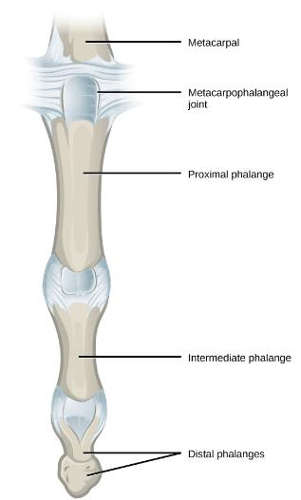
Figure 38.30
The metacarpophalangeal joints in the finger is an example of a condyloid joint.
(credit: modification of work by Gray's Anatomy)
This OpenStax ancillary resource is © Rice University under a CC-BY 4.0 International license; it may be reproduced or modified but must be attributed to OpenStax, Rice University and any changes must be noted. Any images credited to other sources are similarly available for reproduction, but must be attributed to their sources.

Slide 32
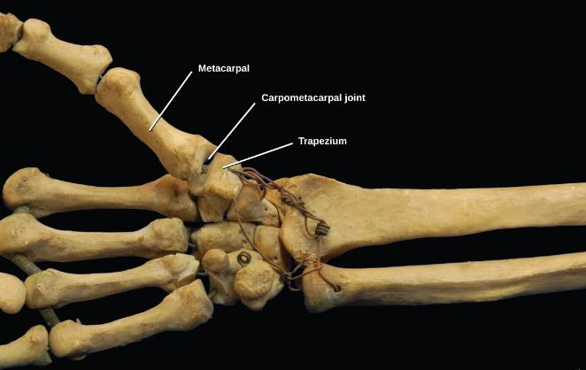
Figure 38.31
The carpometacarpal joints in the thumb are examples of saddle joints.
(credit: modification of work by Brian C. Goss)
This OpenStax ancillary resource is © Rice University under a CC-BY 4.0 International license; it may be reproduced or modified but must be attributed to OpenStax, Rice University and any changes must be noted. Any images credited to other sources are similarly available for reproduction, but must be attributed to their sources.

Slide 33
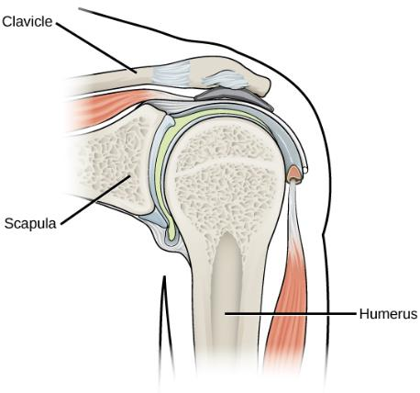
Figure 38.32
The shoulder joint is an example of a ball-and-socket joint.
This OpenStax ancillary resource is © Rice University under a CC-BY 4.0 International license; it may be reproduced or modified but must be attributed to OpenStax, Rice University and any changes must be noted. Any images credited to other sources are similarly available for reproduction, but must be attributed to their sources.

Slide 34
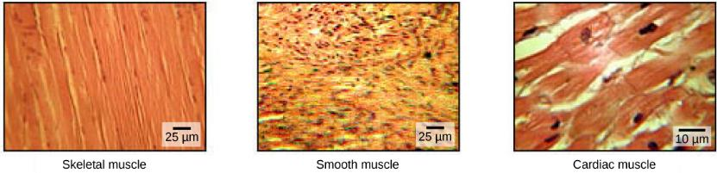
Figure 38.33
The body contains three types of muscle tissue: skeletal muscle, smooth muscle, and cardiac muscle, visualized here using light microscopy. Skeletal muscle cells are long, cylindrical cells with multiple nuclei. Smooth muscle cells are short, tapered at each end, and have only one plump nucleus in each. Cardiac muscle cells are branched and striated, but short. The cytoplasm may branch, and they have one nucleus in the center of the cell.
(credit: modification of work by NCI, NIH; scale-bar data from Matt Russell)
This OpenStax ancillary resource is © Rice University under a CC-BY 4.0 International license; it may be reproduced or modified but must be attributed to OpenStax, Rice University and any changes must be noted. Any images credited to other sources are similarly available for reproduction, but must be attributed to their sources.

Slide 35
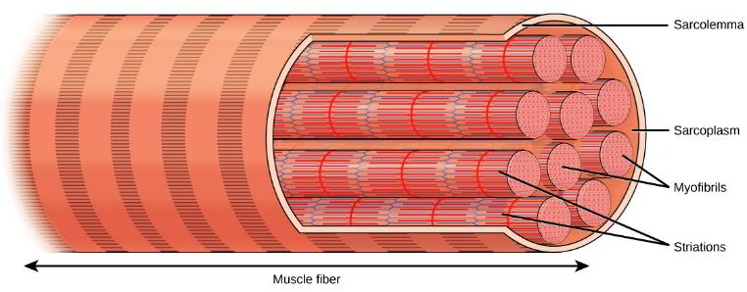
Figure 38.34
A skeletal muscle cell is surrounded by a plasma membrane called the sarcolemma with a cytoplasm called the sarcoplasm. A muscle fiber is composed of many fibrils, packaged into orderly units.
This OpenStax ancillary resource is © Rice University under a CC-BY 4.0 International license; it may be reproduced or modified but must be attributed to OpenStax, Rice University and any changes must be noted. Any images credited to other sources are similarly available for reproduction, but must be attributed to their sources.

Slide 36
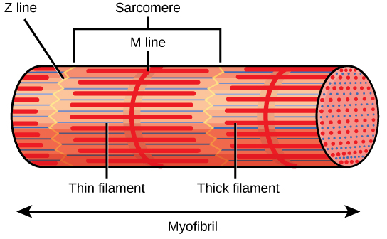
Figure 38.35
A sarcomere is the region from one Z line to the next Z line. Many sarcomeres are present in a myofibril, resulting in the striation pattern characteristic of skeletal muscle.
This OpenStax ancillary resource is © Rice University under a CC-BY 4.0 International license; it may be reproduced or modified but must be attributed to OpenStax, Rice University and any changes must be noted. Any images credited to other sources are similarly available for reproduction, but must be attributed to their sources.

Slide 37
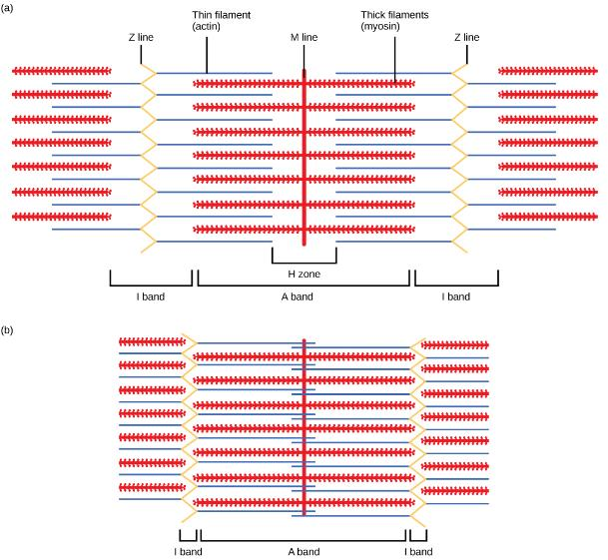
Figure 38.36
When (a) a sarcomere (b) contracts, the Z lines move closer together and the I band gets smaller. The A band stays the same width and, at full contraction, the thin filaments overlap.
This OpenStax ancillary resource is © Rice University under a CC-BY 4.0 International license; it may be reproduced or modified but must be attributed to OpenStax, Rice University and any changes must be noted. Any images credited to other sources are similarly available for reproduction, but must be attributed to their sources.

Slide 38
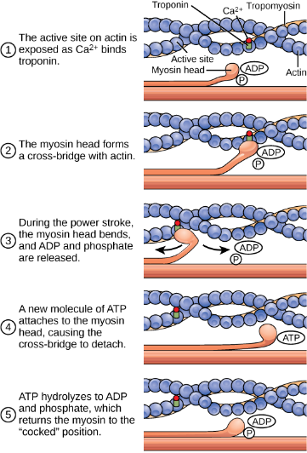
Figure 38.37
The cross-bridge muscle contraction cycle, which is triggered by Ca²⁺ binding to the actin active site, is shown. With each contraction cycle, actin moves relative to myosin.
This OpenStax ancillary resource is © Rice University under a CC-BY 4.0 International license; it may be reproduced or modified but must be attributed to OpenStax, Rice University and any changes must be noted. Any images credited to other sources are similarly available for reproduction, but must be attributed to their sources.

Slide 39
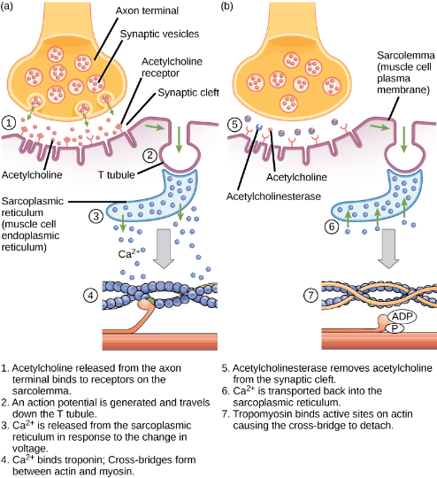
Figure 38.38
This diagram shows excitation-contraction coupling in a skeletal muscle contraction. The sarcoplasmic reticulum is a specialized endoplasmic reticulum found in muscle cells.
This OpenStax ancillary resource is © Rice University under a CC-BY 4.0 International license; it may be reproduced or modified but must be attributed to OpenStax, Rice University and any changes must be noted. Any images credited to other sources are similarly available for reproduction, but must be attributed to their sources.

