Slide 1


Biology 2e
Chapter 39 THE RESPIRATORY SYSTEM
PowerPoint Image Slide Show

Slide 2
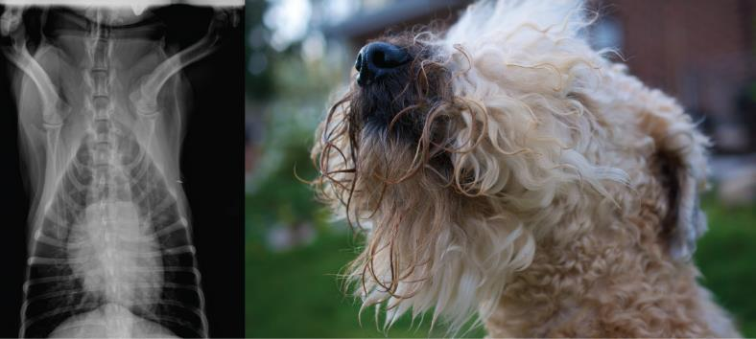
Figure 39.1
Lungs, which appear as nearly transparent tissue surrounding the heart in this X-ray of a dog (left), are the central organs of the respiratory system. The left lung is smaller than the right lung to accommodate space for the heart. A dog’s nose (right) has a slit on the side of each nostril. When tracking a scent, the slits open, blocking the front of the nostrils. This allows the dog to exhale though the now-open area on the side of the nostrils without losing the scent that is being followed.
(credit left: modification of work by Geoff Stearns; credit right: modification of work by Cory Zanker)
This OpenStax ancillary resource is © Rice University under a CC-BY 4.0 International license; it may be reproduced or modified but must be attributed to OpenStax, Rice University and any changes must be noted. Any images credited to other sources are similarly available for reproduction, but must be attributed to their sources.

Slide 3
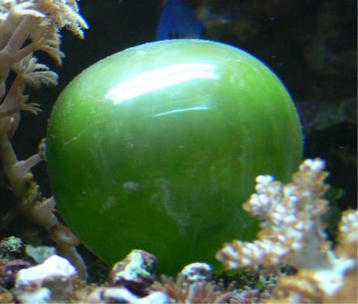
Figure 39.2
The cell of the unicellular algae Ventricaria ventricosa is one of the largest known, reaching one to five centimeters in diameter. Like all single-celled organisms, V. ventricosa exchanges gases across the cell membrane.
This OpenStax ancillary resource is © Rice University under a CC-BY 4.0 International license; it may be reproduced or modified but must be attributed to OpenStax, Rice University and any changes must be noted. Any images credited to other sources are similarly available for reproduction, but must be attributed to their sources.

Slide 4
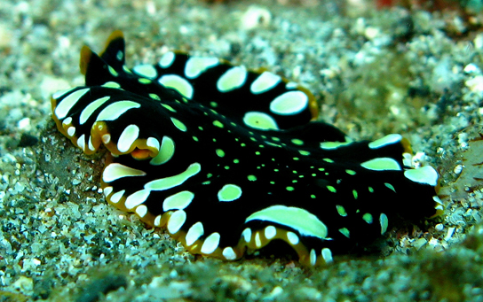
Figure 39.3
This flatworm’s process of respiration works by diffusion across the outer membrane.
(credit: Stephen Childs)
This OpenStax ancillary resource is © Rice University under a CC-BY 4.0 International license; it may be reproduced or modified but must be attributed to OpenStax, Rice University and any changes must be noted. Any images credited to other sources are similarly available for reproduction, but must be attributed to their sources.

Slide 5
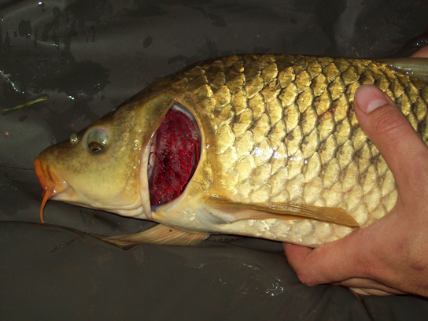
Figure 39.4
This common carp, like many other aquatic organisms, has gills that allow it to obtain oxygen from water.
(credit: "Guitardude012"/Wikimedia Commons)
This OpenStax ancillary resource is © Rice University under a CC-BY 4.0 International license; it may be reproduced or modified but must be attributed to OpenStax, Rice University and any changes must be noted. Any images credited to other sources are similarly available for reproduction, but must be attributed to their sources.

Slide 6
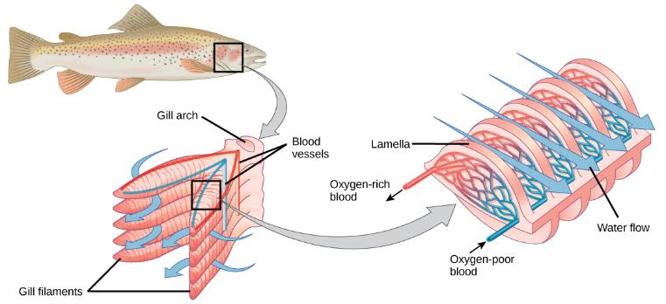
Figure 39.5
As water flows over the gills, oxygen is transferred to blood via the capillaries in the lamellae.
(credit "fish": modification of work by Duane Raver, NOAA)
This OpenStax ancillary resource is © Rice University under a CC-BY 4.0 International license; it may be reproduced or modified but must be attributed to OpenStax, Rice University and any changes must be noted. Any images credited to other sources are similarly available for reproduction, but must be attributed to their sources.

Slide 7
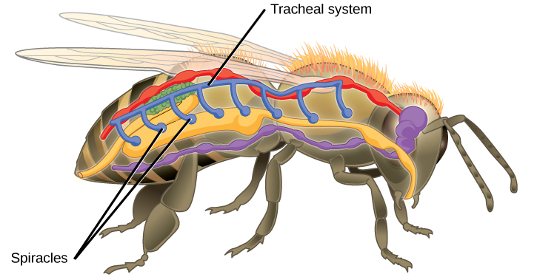
Figure 39.6
Insects perform respiration via a tracheal system.
This OpenStax ancillary resource is © Rice University under a CC-BY 4.0 International license; it may be reproduced or modified but must be attributed to OpenStax, Rice University and any changes must be noted. Any images credited to other sources are similarly available for reproduction, but must be attributed to their sources.

Slide 8
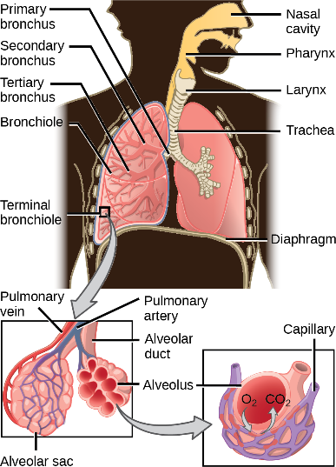
Figure 39.7
Air enters the respiratory system through the nasal cavity and pharynx, and then passes through the trachea and into the bronchi, which bring air into the lungs.
(credit: modification of work by NCI)
This OpenStax ancillary resource is © Rice University under a CC-BY 4.0 International license; it may be reproduced or modified but must be attributed to OpenStax, Rice University and any changes must be noted. Any images credited to other sources are similarly available for reproduction, but must be attributed to their sources.

Slide 9
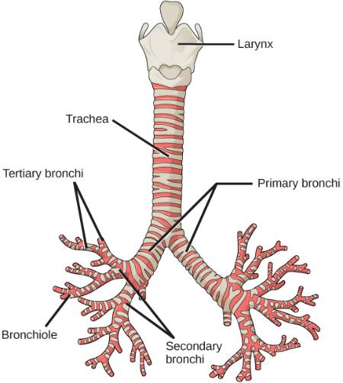
Figure 39.8
The trachea and bronchi are made of incomplete rings of cartilage.
(credit: modification of work by Gray's Anatomy)
This OpenStax ancillary resource is © Rice University under a CC-BY 4.0 International license; it may be reproduced or modified but must be attributed to OpenStax, Rice University and any changes must be noted. Any images credited to other sources are similarly available for reproduction, but must be attributed to their sources.

Slide 10
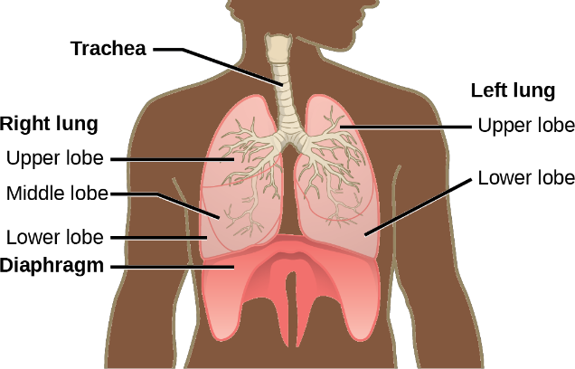
Figure 39.9
The trachea bifurcates into the right and left bronchi in the lungs. The right lung is made of three lobes and is larger. To accommodate the heart, the left lung is smaller and has only two lobes.
This OpenStax ancillary resource is © Rice University under a CC-BY 4.0 International license; it may be reproduced or modified but must be attributed to OpenStax, Rice University and any changes must be noted. Any images credited to other sources are similarly available for reproduction, but must be attributed to their sources.

Slide 11
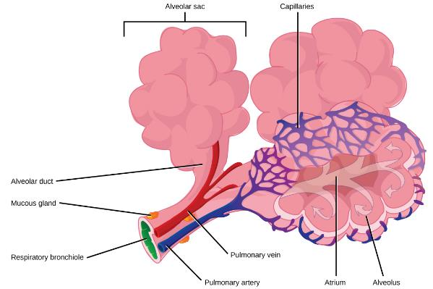
Figure 39.10
Terminal bronchioles are connected by respiratory bronchioles to alveolar ducts and alveolar sacs. Each alveolar sac contains 20 to 30 spherical alveoli and has the appearance of a bunch of grapes. Air flows into the atrium of the alveolar sac, then circulates into alveoli where gas exchange occurs with the capillaries. Mucous glands secrete mucous into the airways, keeping them moist and flexible.
(credit: modification of work by Mariana Ruiz Villareal)
This OpenStax ancillary resource is © Rice University under a CC-BY 4.0 International license; it may be reproduced or modified but must be attributed to OpenStax, Rice University and any changes must be noted. Any images credited to other sources are similarly available for reproduction, but must be attributed to their sources.

Slide 12
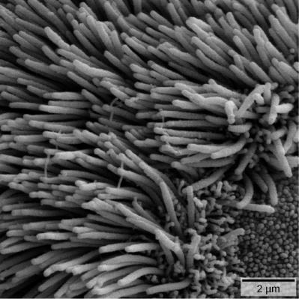
Figure 39.11
The bronchi and bronchioles contain cilia that help move mucus and other particles out of the lungs.
(credit: Louisa Howard, modification of work by Dartmouth Electron Microscope Facility)
This OpenStax ancillary resource is © Rice University under a CC-BY 4.0 International license; it may be reproduced or modified but must be attributed to OpenStax, Rice University and any changes must be noted. Any images credited to other sources are similarly available for reproduction, but must be attributed to their sources.

Slide 13
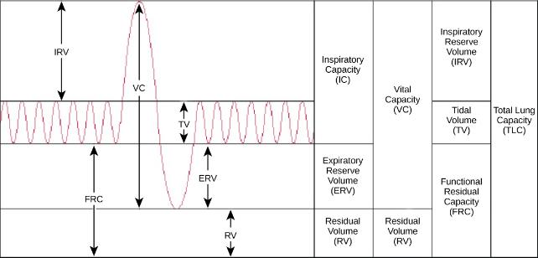
Figure 39.12
Human lung volumes and capacities are shown. The total lung capacity of the adult male is six liters. Tidal volume is the volume of air inhaled in a single, normal breath. Inspiratory capacity is the amount of air taken in during a deep breath, and residual volume is the amount of air left in the lungs after forceful respiration.
This OpenStax ancillary resource is © Rice University under a CC-BY 4.0 International license; it may be reproduced or modified but must be attributed to OpenStax, Rice University and any changes must be noted. Any images credited to other sources are similarly available for reproduction, but must be attributed to their sources.

Slide 14
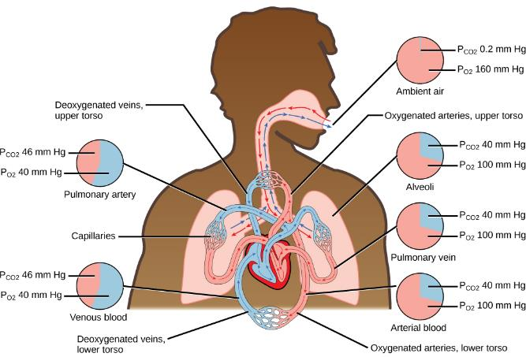
Figure 39.13
The partial pressures of oxygen and carbon dioxide change as blood moves through the body.
This OpenStax ancillary resource is © Rice University under a CC-BY 4.0 International license; it may be reproduced or modified but must be attributed to OpenStax, Rice University and any changes must be noted. Any images credited to other sources are similarly available for reproduction, but must be attributed to their sources.

Slide 15
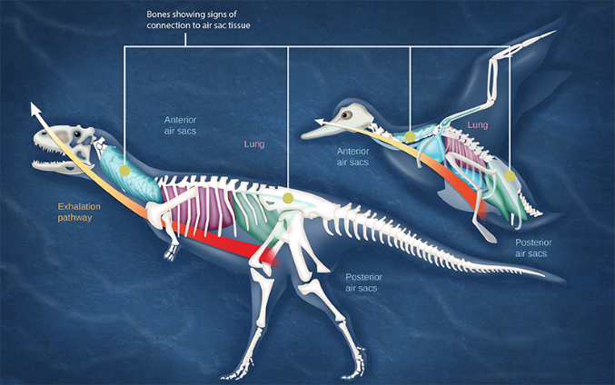
Figure 39.14
Dinosaurs, from which birds descended, have similar hollow bones and are believed to have had a similar respiratory system.
(credit: modification of work by Zina Deretsky, National Science Foundation)
This OpenStax ancillary resource is © Rice University under a CC-BY 4.0 International license; it may be reproduced or modified but must be attributed to OpenStax, Rice University and any changes must be noted. Any images credited to other sources are similarly available for reproduction, but must be attributed to their sources.

Slide 16
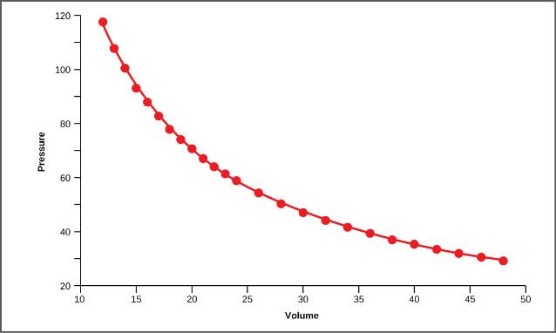
Figure 39.15
This graph shows data from Boyle’s original 1662 experiment, which shows that pressure and volume are inversely related. No units are given as Boyle used arbitrary units in his experiments.
This OpenStax ancillary resource is © Rice University under a CC-BY 4.0 International license; it may be reproduced or modified but must be attributed to OpenStax, Rice University and any changes must be noted. Any images credited to other sources are similarly available for reproduction, but must be attributed to their sources.

Slide 17
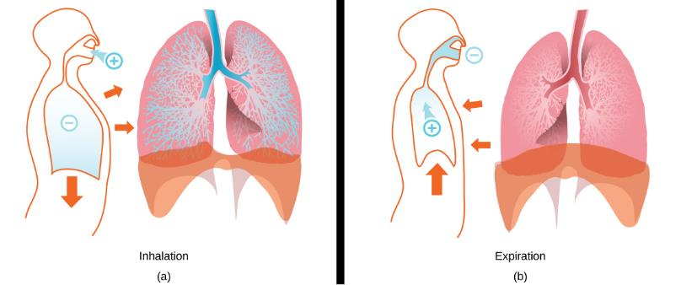
Figure 39.16
The lungs, chest wall, and diaphragm are all involved in respiration, both (a) inhalation and (b) expiration.
(credit: modification of work by Mariana Ruiz Villareal)
This OpenStax ancillary resource is © Rice University under a CC-BY 4.0 International license; it may be reproduced or modified but must be attributed to OpenStax, Rice University and any changes must be noted. Any images credited to other sources are similarly available for reproduction, but must be attributed to their sources.

Slide 18
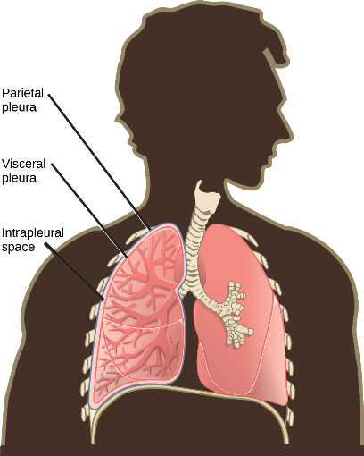
Figure 39.17
A tissue layer called pleura surrounds the lung and interior of the thoracic cavity.
(credit: modification of work by NCI)
This OpenStax ancillary resource is © Rice University under a CC-BY 4.0 International license; it may be reproduced or modified but must be attributed to OpenStax, Rice University and any changes must be noted. Any images credited to other sources are similarly available for reproduction, but must be attributed to their sources.

Slide 19
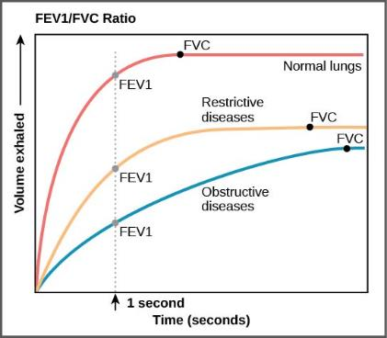
Figure 39.18
The ratio of FEV1 (the amount of air that can be forcibly exhaled in one second after taking a deep breath) to FVC (the total amount of air that can be forcibly exhaled) can be used to diagnose whether a person has restrictive or obstructive lung disease. In restrictive lung disease, FVC is reduced but airways are not obstructed, so the person is able to expel air reasonably fast. In obstructive lung disease, airway obstruction results in slow exhalation as well as reduced FVC. Thus, the FEV1/FVC ratio is lower in persons with obstructive lung disease (less than 69 percent) than in persons with restrictive disease (88 to 90 percent).
This OpenStax ancillary resource is © Rice University under a CC-BY 4.0 International license; it may be reproduced or modified but must be attributed to OpenStax, Rice University and any changes must be noted. Any images credited to other sources are similarly available for reproduction, but must be attributed to their sources.

Slide 20
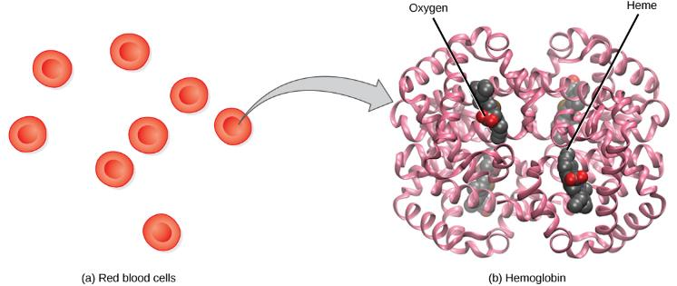
Figure 39.19
The protein inside (a) red blood cells that carries oxygen to cells and carbon dioxide to the lungs is (b) hemoglobin. Hemoglobin is made up of four symmetrical subunits and four heme groups. Iron associated with the heme binds oxygen. It is the iron in hemoglobin that gives blood its red color.
This OpenStax ancillary resource is © Rice University under a CC-BY 4.0 International license; it may be reproduced or modified but must be attributed to OpenStax, Rice University and any changes must be noted. Any images credited to other sources are similarly available for reproduction, but must be attributed to their sources.

Slide 21
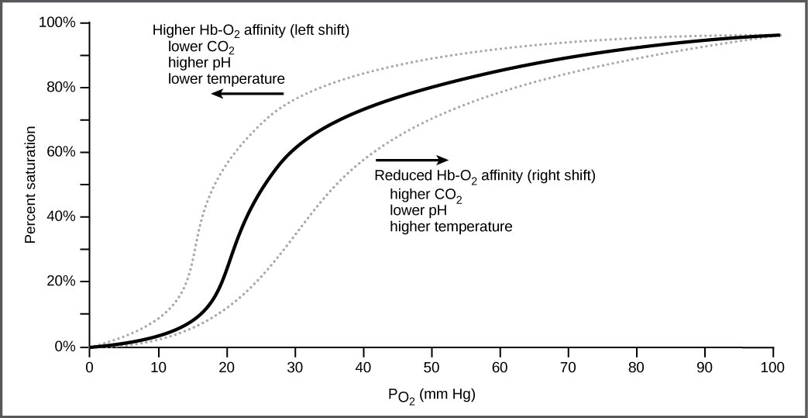
Figure 39.20
The oxygen dissociation curve demonstrates that, as the partial pressure of oxygen increases, more oxygen binds hemoglobin. However, the affinity of hemoglobin for oxygen may shift to the left or the right depending on environmental conditions.
This OpenStax ancillary resource is © Rice University under a CC-BY 4.0 International license; it may be reproduced or modified but must be attributed to OpenStax, Rice University and any changes must be noted. Any images credited to other sources are similarly available for reproduction, but must be attributed to their sources.

Slide 22
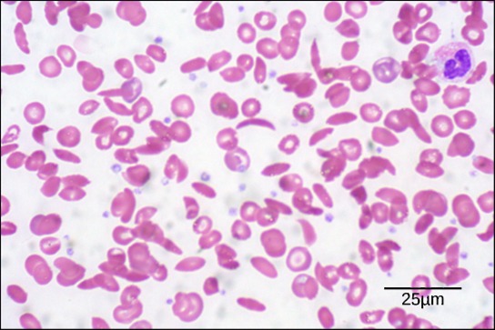
Figure 39.21
Individuals with sickle cell anemia have crescent-shaped red blood cells.
(credit: modification of work by Ed Uthman; scale-bar data from Matt Russell)
This OpenStax ancillary resource is © Rice University under a CC-BY 4.0 International license; it may be reproduced or modified but must be attributed to OpenStax, Rice University and any changes must be noted. Any images credited to other sources are similarly available for reproduction, but must be attributed to their sources.

Slide 23
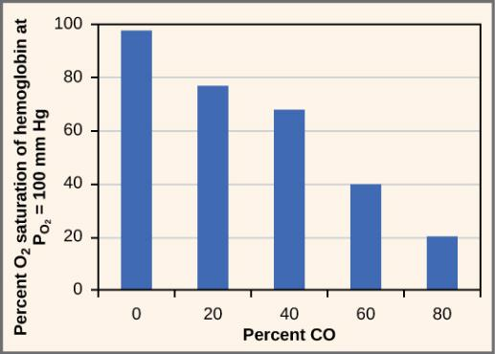
Figure 39.22
As percent CO increases, the oxygen saturation of hemoglobin decreases.
This OpenStax ancillary resource is © Rice University under a CC-BY 4.0 International license; it may be reproduced or modified but must be attributed to OpenStax, Rice University and any changes must be noted. Any images credited to other sources are similarly available for reproduction, but must be attributed to their sources.

