Slide 1


Biology 2e
Chapter 40 THE CIRCULATORY SYSTEM
PowerPoint Image Slide Show

Slide 2
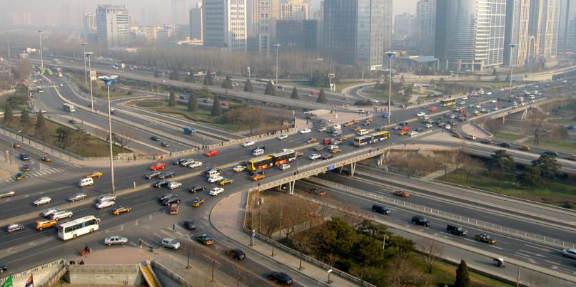
Figure 40.1
Just as highway systems transport people and goods through a complex network, the circulatory system transports nutrients, gases, and wastes throughout the animal body.
(credit: modification of work by Andrey Belenko)
This OpenStax ancillary resource is © Rice University under a CC-BY 4.0 International license; it may be reproduced or modified but must be attributed to OpenStax, Rice University and any changes must be noted. Any images credited to other sources are similarly available for reproduction, but must be attributed to their sources.

Slide 3
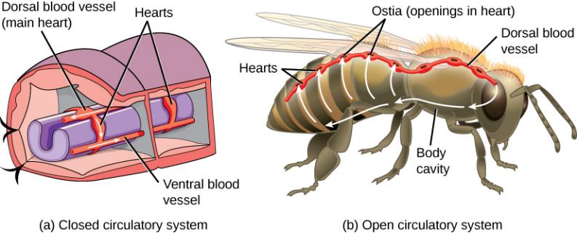
Figure 40.2
In (a) closed circulatory systems, the heart pumps blood through vessels that are separate from the interstitial fluid of the body. Most vertebrates and some invertebrates, like this annelid earthworm, have a closed circulatory system. In (b) open circulatory systems, a fluid called hemolymph is pumped through a blood vessel that empties into the body cavity. Hemolymph returns to the blood vessel through openings called ostia. Arthropods like this bee and most mollusks have open circulatory systems.
This OpenStax ancillary resource is © Rice University under a CC-BY 4.0 International license; it may be reproduced or modified but must be attributed to OpenStax, Rice University and any changes must be noted. Any images credited to other sources are similarly available for reproduction, but must be attributed to their sources.

Slide 4
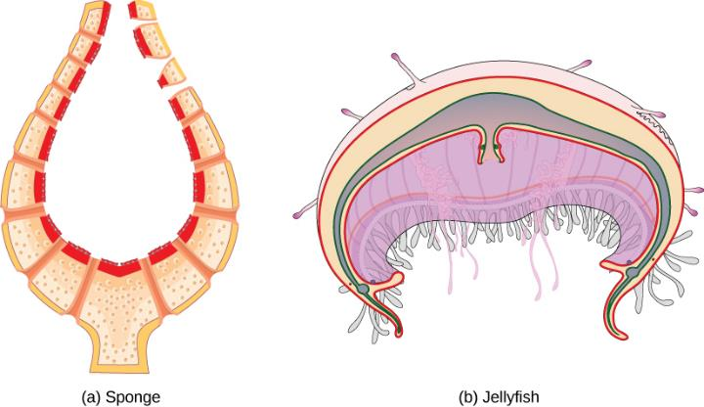
Figure 40.3
Simple animals consisting of a single cell layer such as the (a) sponge or only a few cell layers such as the (b) jellyfish do not have a circulatory system. Instead, gases, nutrients, and wastes are exchanged by diffusion.
This OpenStax ancillary resource is © Rice University under a CC-BY 4.0 International license; it may be reproduced or modified but must be attributed to OpenStax, Rice University and any changes must be noted. Any images credited to other sources are similarly available for reproduction, but must be attributed to their sources.

Slide 5
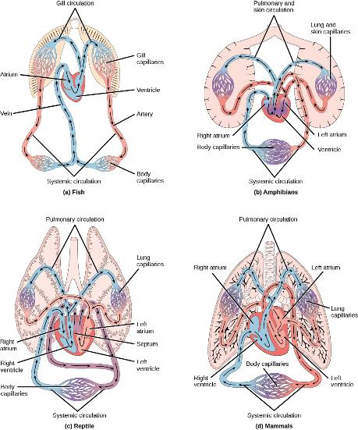
Figure 40.4
(a) Fish have the simplest circulatory systems of the vertebrates: blood flows unidirectionally from the two-chambered heart through the gills and then the rest of the body. (b) Amphibians have two circulatory routes: one for oxygenation of the blood through the lungs and skin, and the other to take oxygen to the rest of the body. The blood is pumped from a three-chambered heart with two atria and a single ventricle. (c) Reptiles also have two circulatory routes; however, blood is only oxygenated through the lungs. The heart is three chambered, but the ventricles are partially separated so some mixing of oxygenated and deoxygenated blood occurs except in crocodilians and birds. (d) Mammals and birds have the most efficient heart with four chambers that completely separate the oxygenated and deoxygenated blood; it pumps only oxygenated blood through the body and deoxygenated blood to the lungs.
This OpenStax ancillary resource is © Rice University under a CC-BY 4.0 International license; it may be reproduced or modified but must be attributed to OpenStax, Rice University and any changes must be noted. Any images credited to other sources are similarly available for reproduction, but must be attributed to their sources.

Slide 6
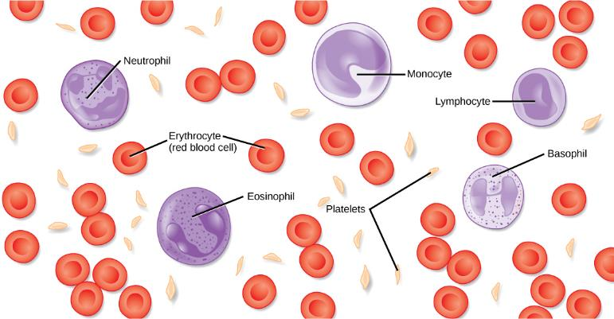
Figure 40.5
The cells and cellular components of human blood are shown. Red blood cells deliver oxygen to the cells and remove carbon dioxide. White blood cells—including neutrophils, monocytes, lymphocytes, eosinophils, and basophils—are involved in the immune response. Platelets form clots that prevent blood loss after injury.
This OpenStax ancillary resource is © Rice University under a CC-BY 4.0 International license; it may be reproduced or modified but must be attributed to OpenStax, Rice University and any changes must be noted. Any images credited to other sources are similarly available for reproduction, but must be attributed to their sources.

Slide 7
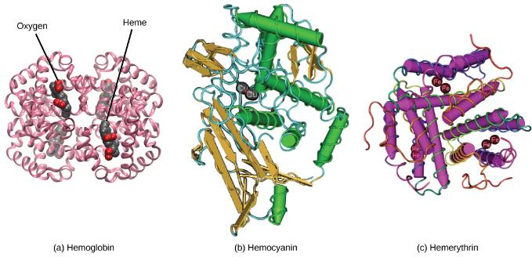
Figure 40.6
In most vertebrates, (a) hemoglobin delivers oxygen to the body and removes some carbon dioxide. Hemoglobin is composed of four protein subunits, two alpha chains and two beta chains, and a heme group that has iron associated with it. The iron reversibly associates with oxygen, and in so doing is oxidized from Fe²⁺ to Fe³⁺. In most mollusks and some arthropods, (b) hemocyanin delivers oxygen. Unlike hemoglobin, hemocyanin is not carried in blood cells, but floats free in the hemolymph. Copper instead of iron binds the oxygen, giving the hemolymph a blue-green color. In annelids, such as the earthworm, and some other invertebrates, (c) hemerythrin carries oxygen. Like hemoglobin, hemerythrin is carried in blood cells and has iron associated with it, but despite its name, hemerythrin does not contain heme.
This OpenStax ancillary resource is © Rice University under a CC-BY 4.0 International license; it may be reproduced or modified but must be attributed to OpenStax, Rice University and any changes must be noted. Any images credited to other sources are similarly available for reproduction, but must be attributed to their sources.

Slide 8
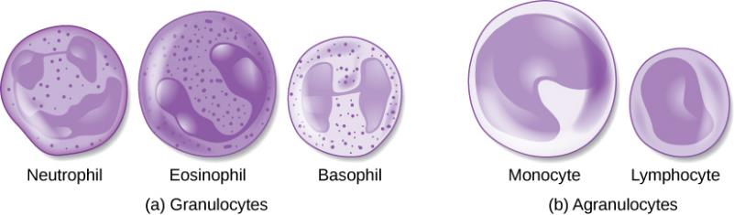
Figure 40.7
(a) Granulocytes—including neutrophils, eosinophils and basophils—are characterized by a lobed nucleus and granular inclusions in the cytoplasm. Granulocytes are typically first-responders during injury or infection. (b) Agranulocytes include lymphocytes and monocytes. Lymphocytes, including B and T cells, are responsible for adaptive immune response. Monocytes differentiate into macrophages and dendritic cells, which in turn respond to infection or injury.
This OpenStax ancillary resource is © Rice University under a CC-BY 4.0 International license; it may be reproduced or modified but must be attributed to OpenStax, Rice University and any changes must be noted. Any images credited to other sources are similarly available for reproduction, but must be attributed to their sources.

Slide 9
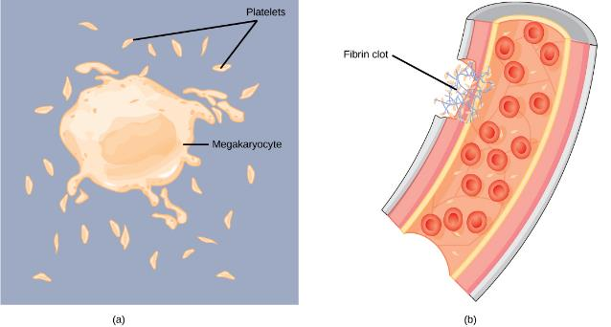
Figure 40.8
(a) Platelets are formed from large cells called megakaryocytes. The megakaryocyte breaks up into thousands of fragments that become platelets. (b) Platelets are required for clotting of the blood. The platelets collect at a wound site in conjunction with other clotting factors, such as fibrinogen, to form a fibrin clot that prevents blood loss and allows the wound to heal.
This OpenStax ancillary resource is © Rice University under a CC-BY 4.0 International license; it may be reproduced or modified but must be attributed to OpenStax, Rice University and any changes must be noted. Any images credited to other sources are similarly available for reproduction, but must be attributed to their sources.

Slide 10
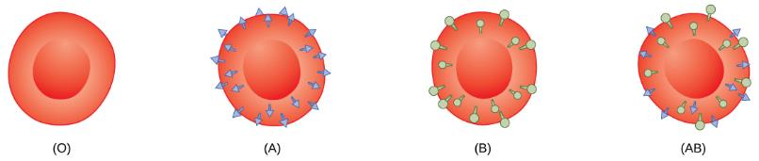
Figure 40.9
Human red blood cells may have either type A or B glycoproteins on their surface, both glycoproteins combined (AB), or neither (O). The glycoproteins serve as antigens and can elicit an immune response in a person who receives a transfusion containing unfamiliar antigens. Type O blood, which has no A or B antigens, does not elicit an immune response when injected into a person of any blood type. Thus, O is considered the universal donor. Persons with type AB blood can accept blood from any blood type, and type AB is considered the universal acceptor.
This OpenStax ancillary resource is © Rice University under a CC-BY 4.0 International license; it may be reproduced or modified but must be attributed to OpenStax, Rice University and any changes must be noted. Any images credited to other sources are similarly available for reproduction, but must be attributed to their sources.

Slide 11
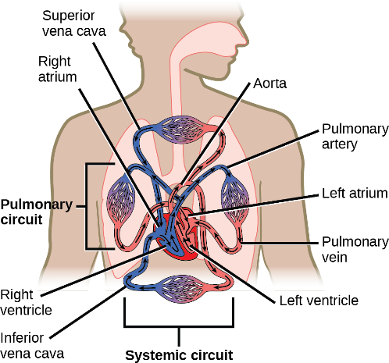
Figure 40.10
The mammalian circulatory system is divided into three circuits: the systemic circuit, the pulmonary circuit, and the coronary circuit. Blood is pumped from veins of the systemic circuit into the right atrium of the heart, then into the right ventricle. Blood then enters the pulmonary circuit, and is oxygenated by the lungs. From the pulmonary circuit, blood re-enters the heart through the left atrium. From the left ventricle, blood re-enters the systemic circuit through the aorta and is distributed to the rest of the body. The coronary circuit, which provides blood to the heart, is not shown.
This OpenStax ancillary resource is © Rice University under a CC-BY 4.0 International license; it may be reproduced or modified but must be attributed to OpenStax, Rice University and any changes must be noted. Any images credited to other sources are similarly available for reproduction, but must be attributed to their sources.

Slide 12
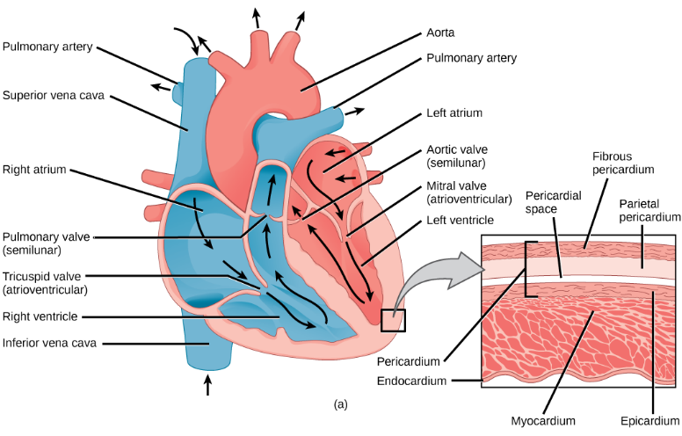
Figure 40.11a
The heart is primarily made of a thick muscle layer, called the myocardium, surrounded by membranes. One-way valves separate the four chambers.
This OpenStax ancillary resource is © Rice University under a CC-BY 4.0 International license; it may be reproduced or modified but must be attributed to OpenStax, Rice University and any changes must be noted. Any images credited to other sources are similarly available for reproduction, but must be attributed to their sources.

Slide 13

Figure 40.11b
Blood vessels of the coronary system, including the coronary arteries and veins, keep the heart musculature oxygenated.
This OpenStax ancillary resource is © Rice University under a CC-BY 4.0 International license; it may be reproduced or modified but must be attributed to OpenStax, Rice University and any changes must be noted. Any images credited to other sources are similarly available for reproduction, but must be attributed to their sources.

Slide 14
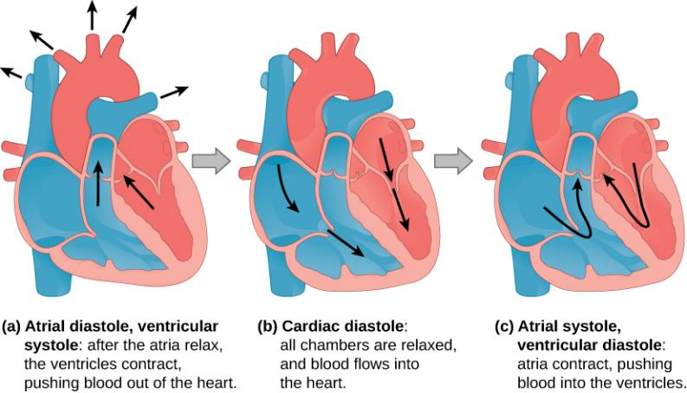
Figure 40.12
During (a) atrial diastole, the ventricles contract, forcing blood out of the heart. During (b) cardiac diastole, the heart muscle is relaxed and blood flows into the heart. During (c) atrial systole, the atria contract, pushing blood into the ventricles.
This OpenStax ancillary resource is © Rice University under a CC-BY 4.0 International license; it may be reproduced or modified but must be attributed to OpenStax, Rice University and any changes must be noted. Any images credited to other sources are similarly available for reproduction, but must be attributed to their sources.

Slide 15
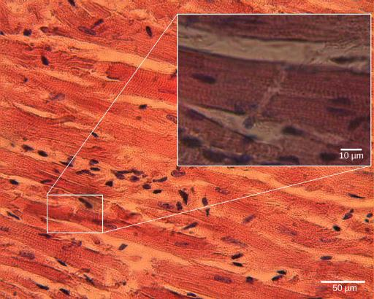
Figure 40.13
Cardiomyocytes are striated muscle cells found in cardiac tissue.
(credit: modification of work by Dr. S. Girod, Anton Becker; scale-bar data from Matt Russell)
This OpenStax ancillary resource is © Rice University under a CC-BY 4.0 International license; it may be reproduced or modified but must be attributed to OpenStax, Rice University and any changes must be noted. Any images credited to other sources are similarly available for reproduction, but must be attributed to their sources.

Slide 16
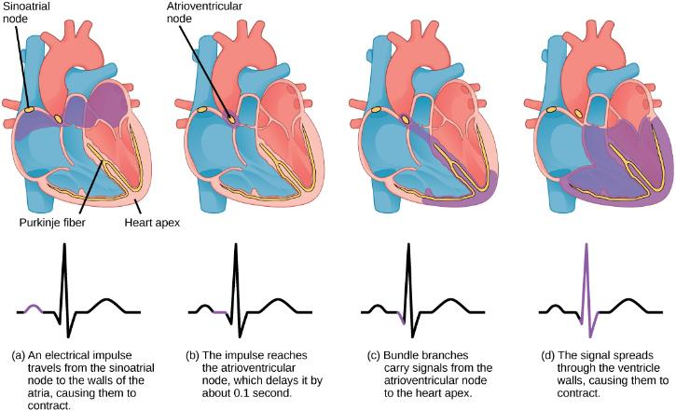
Figure 40.14
The beating of the heart is regulated by an electrical impulse that causes the characteristic reading of an ECG. The signal is initiated at the sinoatrial node. The signal then (a) spreads to the atria, causing them to contract. The signal is (b) delayed at the atrioventricular node before it is passed on to the (c) heart apex. The delay allows the atria to relax before the (d) ventricles contract. The final part of the ECG cycle prepares the heart for the next beat.
This OpenStax ancillary resource is © Rice University under a CC-BY 4.0 International license; it may be reproduced or modified but must be attributed to OpenStax, Rice University and any changes must be noted. Any images credited to other sources are similarly available for reproduction, but must be attributed to their sources.

Slide 17
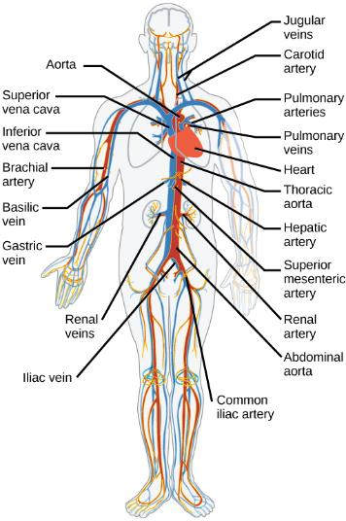
Figure 40.15
The major human arteries and veins are shown.
(credit: modification of work by Mariana Ruiz Villareal)
This OpenStax ancillary resource is © Rice University under a CC-BY 4.0 International license; it may be reproduced or modified but must be attributed to OpenStax, Rice University and any changes must be noted. Any images credited to other sources are similarly available for reproduction, but must be attributed to their sources.

Slide 18
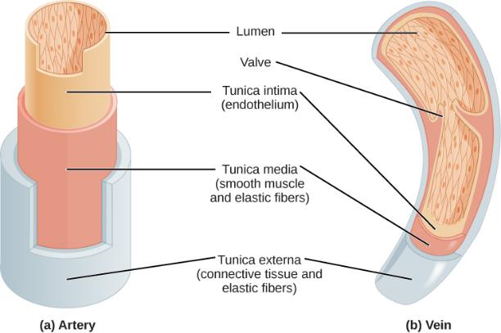
Figure 40.16
Arteries and veins consist of three layers: an outer tunica externa, a middle tunica media, and an inner tunica intima. Capillaries consist of a single layer of epithelial cells, the tunica intima.
(credit: modification of work by NCI, NIH)
This OpenStax ancillary resource is © Rice University under a CC-BY 4.0 International license; it may be reproduced or modified but must be attributed to OpenStax, Rice University and any changes must be noted. Any images credited to other sources are similarly available for reproduction, but must be attributed to their sources.

Slide 19
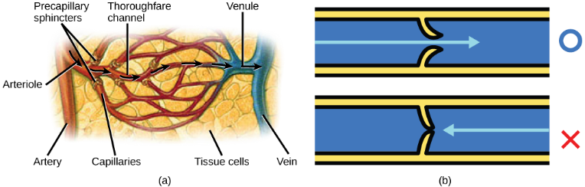
Figure 40.17
(a) Precapillary sphincters are rings of smooth muscle that regulate the flow of blood through capillaries; they help control the location of blood flow to where it is needed. (b) Valves in the veins prevent blood from moving backward.
(credit a: modification of work by NCI)
This OpenStax ancillary resource is © Rice University under a CC-BY 4.0 International license; it may be reproduced or modified but must be attributed to OpenStax, Rice University and any changes must be noted. Any images credited to other sources are similarly available for reproduction, but must be attributed to their sources.

Slide 20
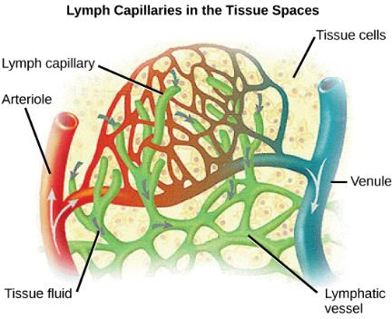
Figure 40.18
Fluid from the capillaries moves into the interstitial space and lymph capillaries by diffusion down a pressure gradient and also by osmosis. Out of 7,200 liters of fluid pumped by the average heart in a day, over 1,500 liters is filtered.
(credit: modification of work by NCI, NIH)
This OpenStax ancillary resource is © Rice University under a CC-BY 4.0 International license; it may be reproduced or modified but must be attributed to OpenStax, Rice University and any changes must be noted. Any images credited to other sources are similarly available for reproduction, but must be attributed to their sources.

Slide 21
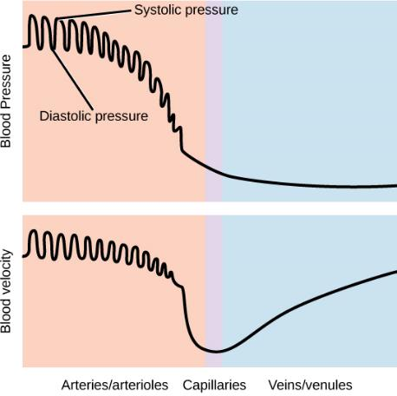
Figure 40.19
Blood pressure is related to the blood velocity in the arteries and arterioles. In the capillaries and veins, the blood pressure continues to decease but velocity increases.
This OpenStax ancillary resource is © Rice University under a CC-BY 4.0 International license; it may be reproduced or modified but must be attributed to OpenStax, Rice University and any changes must be noted. Any images credited to other sources are similarly available for reproduction, but must be attributed to their sources.

