Slide 1

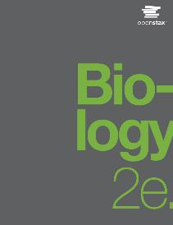
Biology 2e
Chapter 41 OSMOTIC REGULATION AND EXCRETION
PowerPoint Image Slide Show

Slide 2
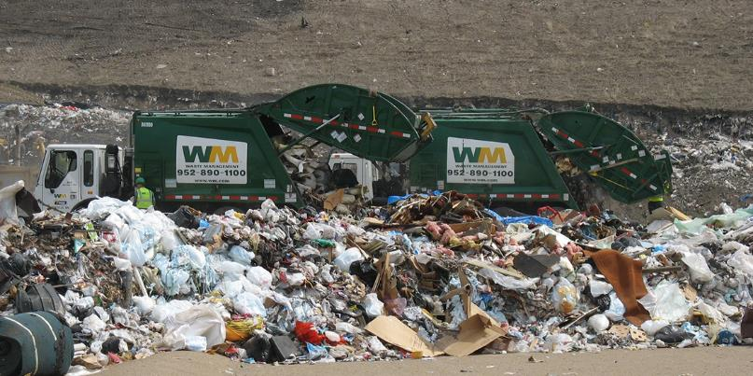
Figure 41.1
Just as humans recycle what we can and dump the remains into landfills, our bodies use and recycle what they can and excrete the remaining waste products. Our bodies’ complex systems have developed ways to treat waste and maintain a balanced internal environment.
(credit: modification of work by Redwin Law)
This OpenStax ancillary resource is © Rice University under a CC-BY 4.0 International license; it may be reproduced or modified but must be attributed to OpenStax, Rice University and any changes must be noted. Any images credited to other sources are similarly available for reproduction, but must be attributed to their sources.

Slide 3
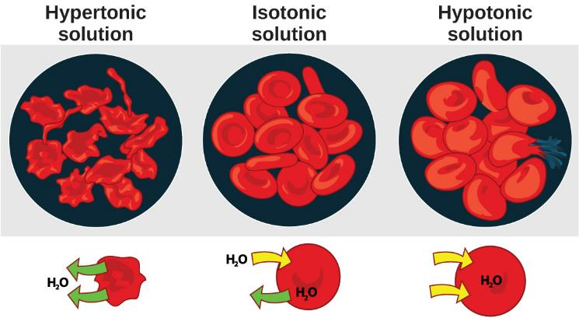
Figure 41.2
Cells placed in a hypertonic environment tend to shrink due to loss of water. In a hypotonic environment, cells tend to swell due to intake of water. The blood maintains an isotonic environment so that cells neither shrink nor swell.
(credit: Mariana Ruiz Villareal)
This OpenStax ancillary resource is © Rice University under a CC-BY 4.0 International license; it may be reproduced or modified but must be attributed to OpenStax, Rice University and any changes must be noted. Any images credited to other sources are similarly available for reproduction, but must be attributed to their sources.

Slide 4
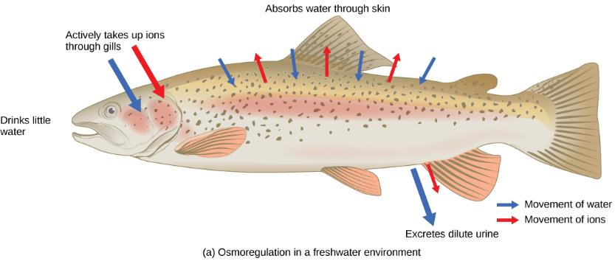
Figure 41.3a
Fish are osmoregulators, but must use different mechanisms to survive in freshwater or saltwater environments.
(credit: modification of work by Duane Raver, NOAA)
This OpenStax ancillary resource is © Rice University under a CC-BY 4.0 International license; it may be reproduced or modified but must be attributed to OpenStax, Rice University and any changes must be noted. Any images credited to other sources are similarly available for reproduction, but must be attributed to their sources.

Slide 5

Figure 41.3b
Fish are osmoregulators, but must use different mechanisms to survive in freshwater or saltwater environments.
(credit: modification of work by Duane Raver, NOAA)
This OpenStax ancillary resource is © Rice University under a CC-BY 4.0 International license; it may be reproduced or modified but must be attributed to OpenStax, Rice University and any changes must be noted. Any images credited to other sources are similarly available for reproduction, but must be attributed to their sources.

Slide 6
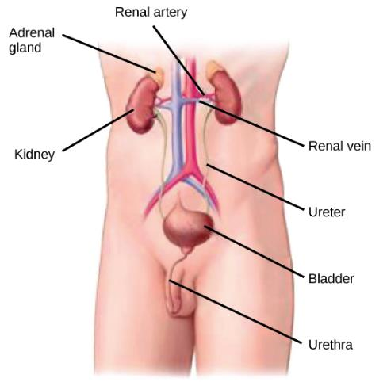
Figure 41.4
Kidneys filter the blood, producing urine that is stored in the bladder prior to elimination through the urethra.
(credit: modification of work by NCI)
This OpenStax ancillary resource is © Rice University under a CC-BY 4.0 International license; it may be reproduced or modified but must be attributed to OpenStax, Rice University and any changes must be noted. Any images credited to other sources are similarly available for reproduction, but must be attributed to their sources.

Slide 7
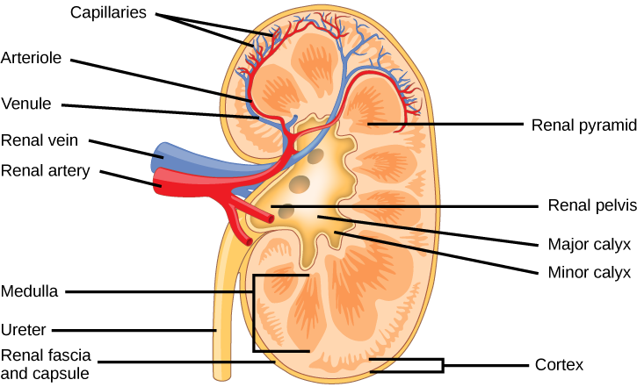
Figure 41.5
The internal structure of the kidney is shown.
(credit: modification of work by NCI)
This OpenStax ancillary resource is © Rice University under a CC-BY 4.0 International license; it may be reproduced or modified but must be attributed to OpenStax, Rice University and any changes must be noted. Any images credited to other sources are similarly available for reproduction, but must be attributed to their sources.

Slide 8
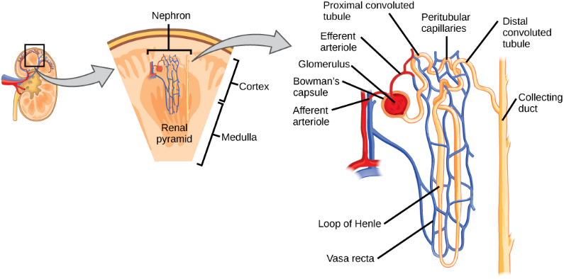
Figure 41.6
The nephron is the functional unit of the kidney. The glomerulus and convoluted tubules are located in the kidney cortex, while collecting ducts are located in the pyramids of the medulla.
(credit: modification of work by NIDDK)
This OpenStax ancillary resource is © Rice University under a CC-BY 4.0 International license; it may be reproduced or modified but must be attributed to OpenStax, Rice University and any changes must be noted. Any images credited to other sources are similarly available for reproduction, but must be attributed to their sources.

Slide 9
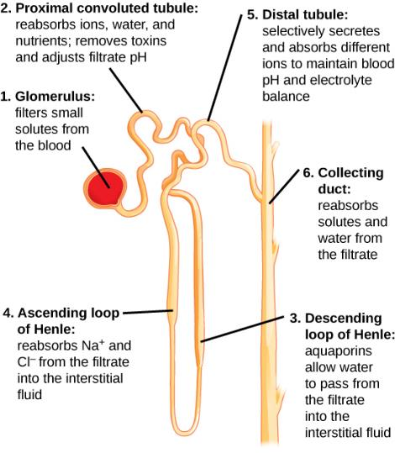
Figure 41.7
Each part of the nephron performs a different function in filtering waste and maintaining homeostatic balance.
(credit: modification of work by NIDDK)
This OpenStax ancillary resource is © Rice University under a CC-BY 4.0 International license; it may be reproduced or modified but must be attributed to OpenStax, Rice University and any changes must be noted. Any images credited to other sources are similarly available for reproduction, but must be attributed to their sources.
Notes:
(1) The glomerulus forces small solutes out of the blood by pressure. (2) The proximal convoluted tubule reabsorbs ions, water, and nutrients from the filtrate into the interstitial fluid, and actively transports toxins and drugs from the interstitial fluid into the filtrate. The proximal convoluted tubule also adjusts blood pH by selectively secreting ammonia (NH₃) into the filtrate, where it reacts with H⁺ to form NH₄⁺. The more acidic the filtrate, the more ammonia is secreted. (3) The descending loop of Henle is lined with cells containing aquaporins that allow water to pass from the filtrate into the interstitial fluid. (4) In the thin part of the ascending loop of Henle, Na⁺ and Cl⁻ ions diffuse into the interstitial fluid. In the thick part, these same ions are actively transported into the interstitial fluid. Because salt but not water is lost, the filtrate becomes more dilute as it travels up the limb. (5) In the distal convoluted tubule, K⁺ and H⁺ ions are selectively secreted into the filtrate, while Na⁺, Cl⁻, and HCO₃⁻ ions are reabsorbed to maintain pH and electrolyte balance in the blood. (6) The collecting duct reabsorbs solutes and water from the filtrate, forming dilute urine.

Slide 10
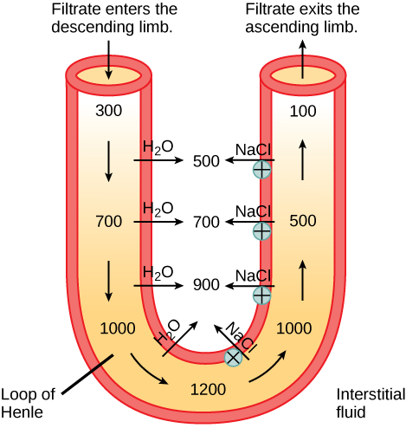
Figure 41.8
The loop of Henle acts as a countercurrent multiplier that uses energy to create concentration gradients. The descending limb is water permeable. Water flows from the filtrate to the interstitial fluid, so osmolality inside the limb increases as it descends into the renal medulla. At the bottom, the osmolality is higher inside the loop than in the interstitial fluid. Thus, as filtrate enters the ascending limb, Na⁺ and Cl– ions exit through ion channels present in the cell membrane. Further up, Na⁺ is actively transported out of the filtrate and Cl– follows. Osmolarity is given in units of milliosmoles per liter (mOsm/L).
This OpenStax ancillary resource is © Rice University under a CC-BY 4.0 International license; it may be reproduced or modified but must be attributed to OpenStax, Rice University and any changes must be noted. Any images credited to other sources are similarly available for reproduction, but must be attributed to their sources.

Slide 11
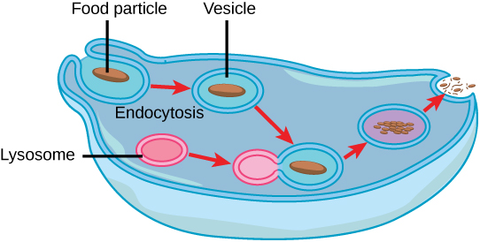
Figure 41.9
Some unicellular organisms, such as the amoeba, ingest food by endocytosis. The food vesicle fuses with a lysosome, which digests the food. Waste is excreted by exocytosis.
This OpenStax ancillary resource is © Rice University under a CC-BY 4.0 International license; it may be reproduced or modified but must be attributed to OpenStax, Rice University and any changes must be noted. Any images credited to other sources are similarly available for reproduction, but must be attributed to their sources.

Slide 12
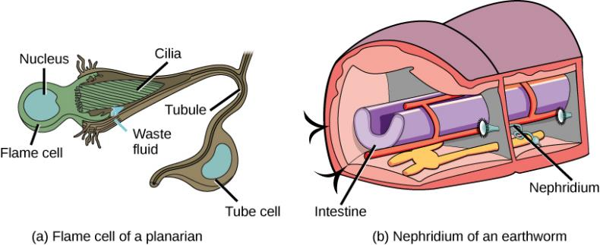
Figure 41.10
In the excretory system of the (a) planaria, cilia of flame cells propel waste through a tubule formed by a tube cell. Tubules are connected into branched structures that lead to pores located all along the sides of the body. The filtrate is secreted through these pores. In (b) annelids such as earthworms, nephridia filter fluid from the coelom, or body cavity. Beating cilia at the opening of the nephridium draw water from the coelom into a tubule. As the filtrate passes down the tubules, nutrients and other solutes are reabsorbed by capillaries. Filtered fluid containing nitrogenous and other wastes is stored in a bladder and then secreted through a pore in the side of the body.
This OpenStax ancillary resource is © Rice University under a CC-BY 4.0 International license; it may be reproduced or modified but must be attributed to OpenStax, Rice University and any changes must be noted. Any images credited to other sources are similarly available for reproduction, but must be attributed to their sources.

Slide 13
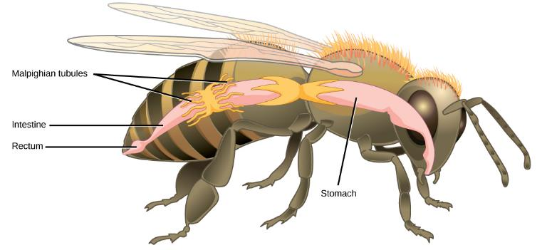
Figure 41.11
Malpighian tubules of insects and other terrestrial arthropods remove nitrogenous wastes and other solutes from the hemolymph. Na⁺ and/or K⁺ ions are actively transported into the lumen of the tubules. Water then enters the tubules via osmosis, forming urine. The urine passes through the intestine, and into the rectum. There, nutrients diffuse back into the hemolymph. Na⁺ and/or K⁺ ions are pumped into the hemolymph, and water follows. The concentrated waste is then excreted.
This OpenStax ancillary resource is © Rice University under a CC-BY 4.0 International license; it may be reproduced or modified but must be attributed to OpenStax, Rice University and any changes must be noted. Any images credited to other sources are similarly available for reproduction, but must be attributed to their sources.

Slide 14
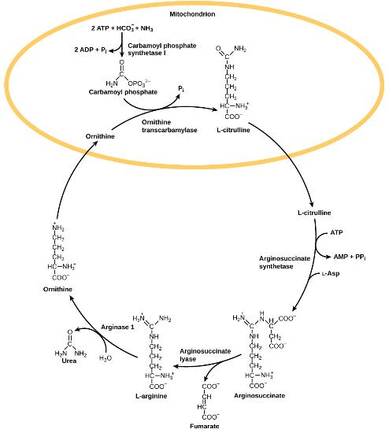
Figure 41.12
The urea cycle converts ammonia to urea.
This OpenStax ancillary resource is © Rice University under a CC-BY 4.0 International license; it may be reproduced or modified but must be attributed to OpenStax, Rice University and any changes must be noted. Any images credited to other sources are similarly available for reproduction, but must be attributed to their sources.

Slide 15
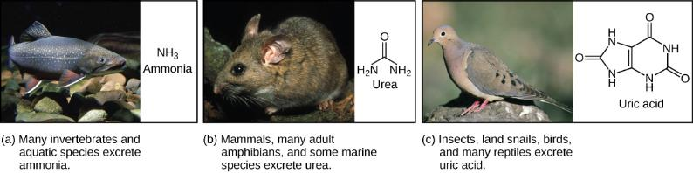
Figure 41.13
Nitrogenous waste is excreted in different forms by different species. These include (a) ammonia, (b) urea, and (c) uric acid.
(credit a: modification of work by Eric Engbretson, USFWS; credit b: modification of work by B. "Moose" Peterson, USFWS; credit c: modification of work by Dave Menke, USFWS)
This OpenStax ancillary resource is © Rice University under a CC-BY 4.0 International license; it may be reproduced or modified but must be attributed to OpenStax, Rice University and any changes must be noted. Any images credited to other sources are similarly available for reproduction, but must be attributed to their sources.

Slide 16
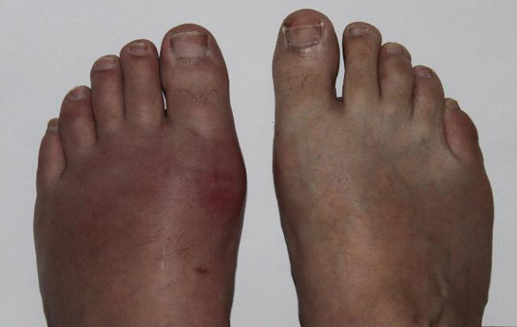
Figure 41.14
Gout causes the inflammation visible in this person’s left big toe joint.
(credit: "Gonzosft"/Wikimedia Commons)
This OpenStax ancillary resource is © Rice University under a CC-BY 4.0 International license; it may be reproduced or modified but must be attributed to OpenStax, Rice University and any changes must be noted. Any images credited to other sources are similarly available for reproduction, but must be attributed to their sources.

Slide 17
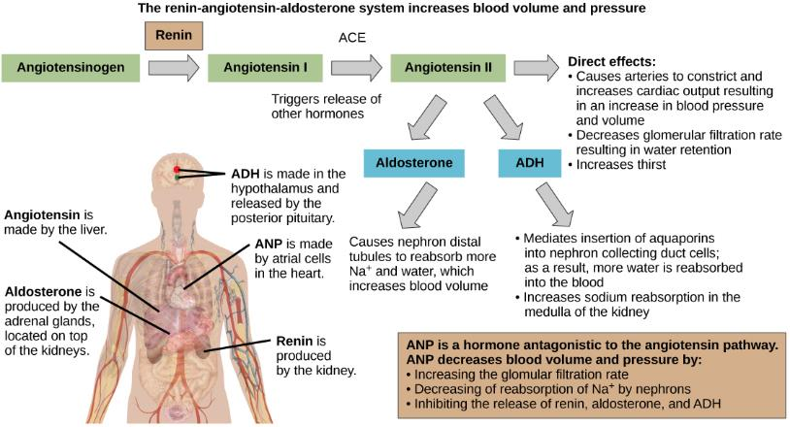
Figure 41.15
The renin-angiotensin-aldosterone system increases blood pressure and volume. The hormone ANP has antagonistic effects.
(credit: modification of work by Mikael Häggström)
This OpenStax ancillary resource is © Rice University under a CC-BY 4.0 International license; it may be reproduced or modified but must be attributed to OpenStax, Rice University and any changes must be noted. Any images credited to other sources are similarly available for reproduction, but must be attributed to their sources.

