Slide 1


Biology 2e
Chapter 44 ECOLOGY AND THE BIOSPHERE
PowerPoint Image Slide Show

Slide 2
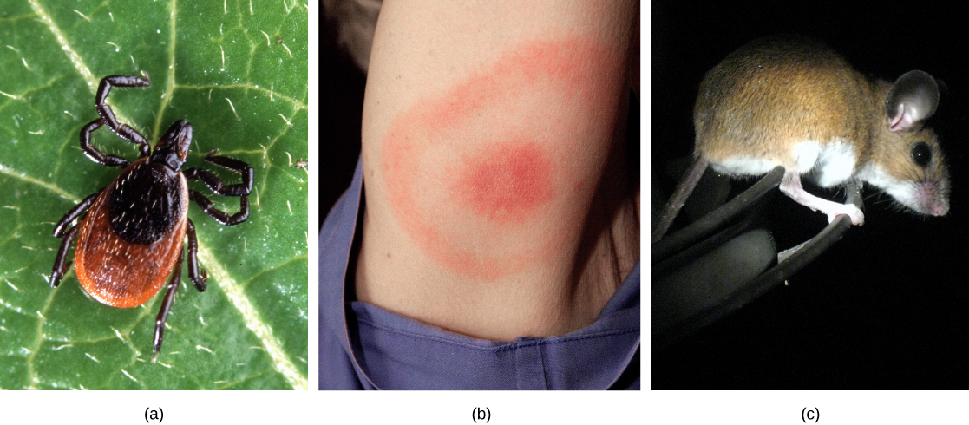
Figure 44.1
The (a) deer tick carries the bacterium that produces Lyme disease in humans, often evident in (b) a symptomatic bull’s eye rash. The (c) white-footed mouse is one well-known host to deer ticks carrying the Lyme disease bacterium.
(credit a: modification of work by Scott Bauer, USDA ARS; credit b: modification of work by James Gathany, CDC; credit c: modification of work by Rob Ireton)
This OpenStax ancillary resource is © Rice University under a CC-BY 4.0 International license; it may be reproduced or modified but must be attributed to OpenStax, Rice University and any changes must be noted. Any images credited to other sources are similarly available for reproduction, but must be attributed to their sources.

Slide 3
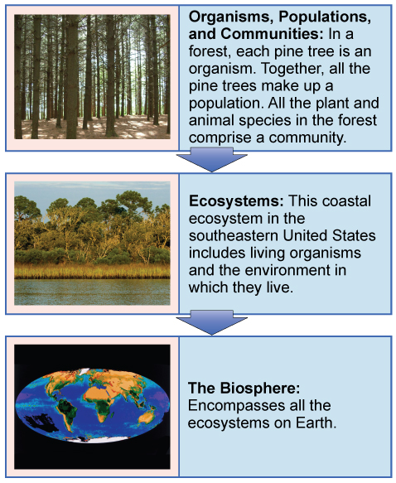
Figure 44.2
Ecologists study within several biological levels of organization.
(credit “organisms”: modification of work by "Crystl"/Flickr; credit “ecosystems”: modification of work by Tom Carlisle, US Fish and Wildlife Service Headquarters; credit “biosphere”: NASA)
This OpenStax ancillary resource is © Rice University under a CC-BY 4.0 International license; it may be reproduced or modified but must be attributed to OpenStax, Rice University and any changes must be noted. Any images credited to other sources are similarly available for reproduction, but must be attributed to their sources.

Slide 4
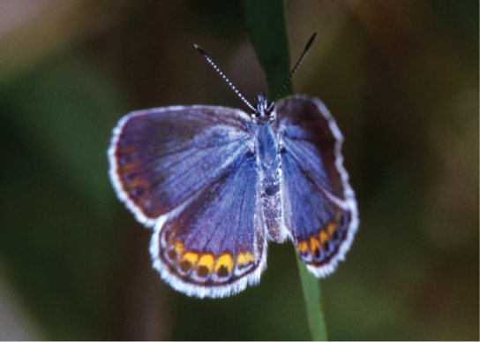
Figure 44.3
The Karner blue butterfly (Lycaeides melissa samuelis) is a rare butterfly that lives only in open areas with few trees or shrubs, such as pine barrens and oak savannas. It can only lay its eggs on lupine plants.
(credit: modification of work by J & K Hollingsworth, USFWS)
This OpenStax ancillary resource is © Rice University under a CC-BY 4.0 International license; it may be reproduced or modified but must be attributed to OpenStax, Rice University and any changes must be noted. Any images credited to other sources are similarly available for reproduction, but must be attributed to their sources.

Slide 5
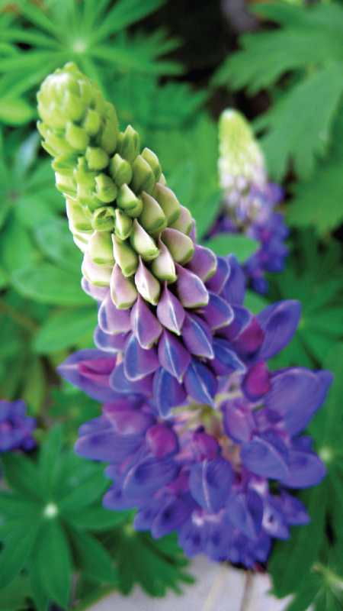
Figure 44.4
The wild lupine (Lupinus perennis) is the host plant for the Karner blue butterfly.
This OpenStax ancillary resource is © Rice University under a CC-BY 4.0 International license; it may be reproduced or modified but must be attributed to OpenStax, Rice University and any changes must be noted. Any images credited to other sources are similarly available for reproduction, but must be attributed to their sources.

Slide 6
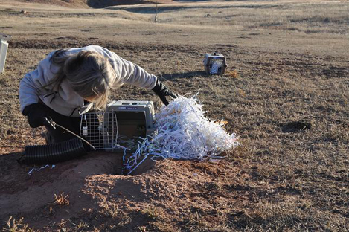
Figure 44.5
This landscape ecologist is releasing a black-footed ferret into its native habitat as part of a study.
(credit: USFWS Mountain Prairie Region, NPS)
This OpenStax ancillary resource is © Rice University under a CC-BY 4.0 International license; it may be reproduced or modified but must be attributed to OpenStax, Rice University and any changes must be noted. Any images credited to other sources are similarly available for reproduction, but must be attributed to their sources.

Slide 7
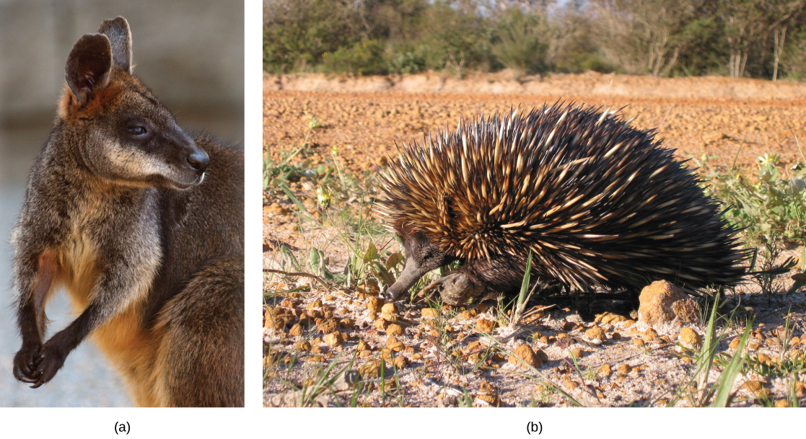
Figure 44.6
Australia is home to many endemic species. The (a) wallaby (Wallabia bicolor), a medium-sized member of the kangaroo family, is a pouched mammal, or marsupial. The (b) echidna (Tachyglossus aculeatus) is an egg-laying mammal.
(credit a: modification of work by Derrick Coetzee; credit b: modification of work by Allan Whittome)
This OpenStax ancillary resource is © Rice University under a CC-BY 4.0 International license; it may be reproduced or modified but must be attributed to OpenStax, Rice University and any changes must be noted. Any images credited to other sources are similarly available for reproduction, but must be attributed to their sources.

Slide 8
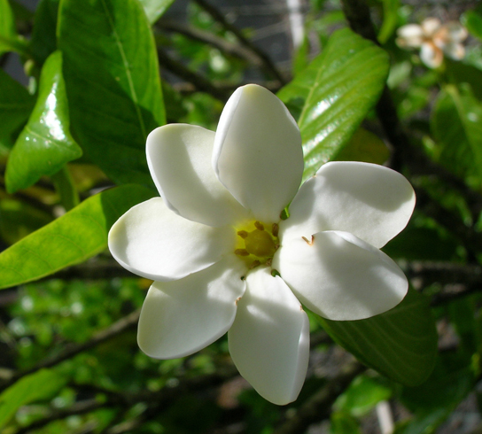
Figure 44.7
Listed as federally endangered, the forest gardenia is a small tree with distinctive flowers. It is found only in five of the Hawaiian Islands in small populations consisting of a few individual specimens.
(credit: Forest & Kim Starr)
This OpenStax ancillary resource is © Rice University under a CC-BY 4.0 International license; it may be reproduced or modified but must be attributed to OpenStax, Rice University and any changes must be noted. Any images credited to other sources are similarly available for reproduction, but must be attributed to their sources.

Slide 9
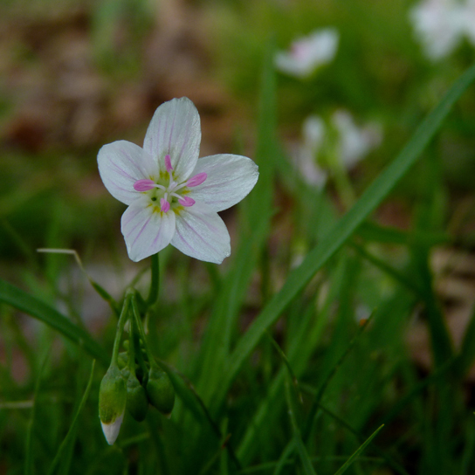
Figure 44.8
The spring beauty is an ephemeral spring plant that flowers early in the spring to avoid competing with larger forest trees for sunlight.
(credit: John Beetham)
This OpenStax ancillary resource is © Rice University under a CC-BY 4.0 International license; it may be reproduced or modified but must be attributed to OpenStax, Rice University and any changes must be noted. Any images credited to other sources are similarly available for reproduction, but must be attributed to their sources.

Slide 10
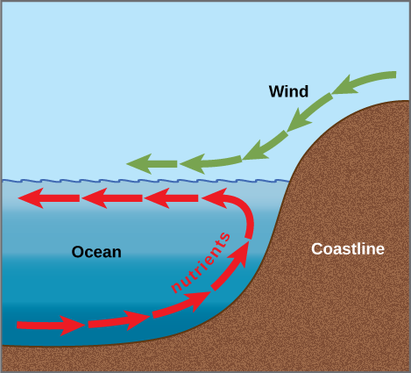
Figure 44.9
Ocean upwelling is an important process that recycles nutrients and energy in the ocean. As wind (green arrows) pushes offshore, it causes water from the ocean bottom (red arrows) to move to the surface, bringing up nutrients from the ocean depths.
This OpenStax ancillary resource is © Rice University under a CC-BY 4.0 International license; it may be reproduced or modified but must be attributed to OpenStax, Rice University and any changes must be noted. Any images credited to other sources are similarly available for reproduction, but must be attributed to their sources.

Slide 11
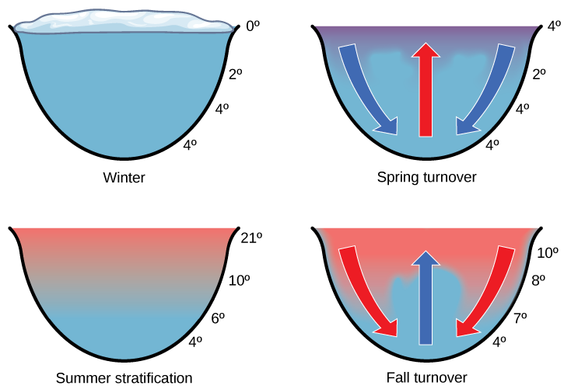
Figure 44.10
The spring and fall turnovers are important processes in freshwater lakes that act to move the nutrients and oxygen at the bottom of deep lakes to the top. Turnover occurs because water has a maximum density at 4 °C. Surface water temperature changes as the seasons progress, and denser water sinks.
This OpenStax ancillary resource is © Rice University under a CC-BY 4.0 International license; it may be reproduced or modified but must be attributed to OpenStax, Rice University and any changes must be noted. Any images credited to other sources are similarly available for reproduction, but must be attributed to their sources.

Slide 12
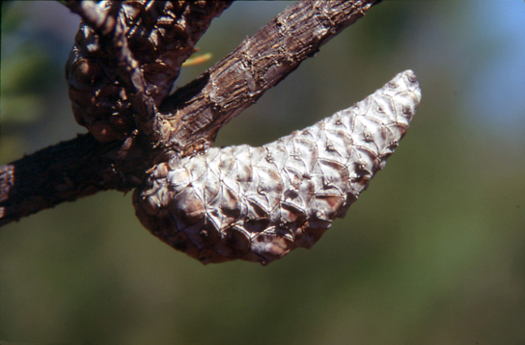
Figure 44.11
The mature cones of the jack pine (Pinus banksiana) open only when exposed to high temperatures, such as during a forest fire. A fire is likely to kill most vegetation, so a seedling that germinates after a fire is more likely to receive ample sunlight than one that germinates under normal conditions.
(credit: USDA)
This OpenStax ancillary resource is © Rice University under a CC-BY 4.0 International license; it may be reproduced or modified but must be attributed to OpenStax, Rice University and any changes must be noted. Any images credited to other sources are similarly available for reproduction, but must be attributed to their sources.

Slide 13
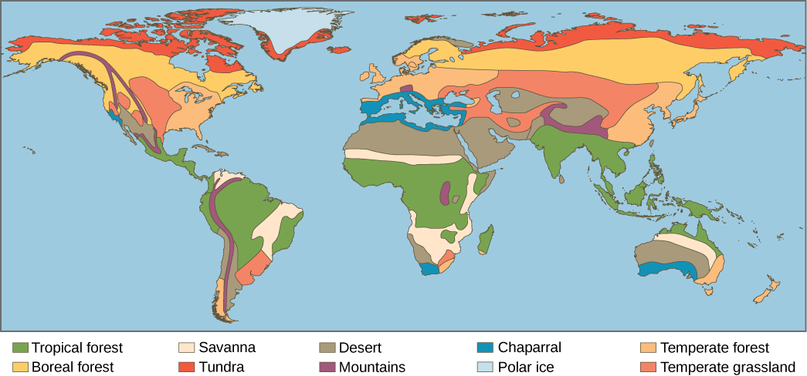
Figure 44.12
Each of the world’s major biomes is distinguished by characteristic temperatures and amounts of precipitation. Polar ice and mountains are also shown.
This OpenStax ancillary resource is © Rice University under a CC-BY 4.0 International license; it may be reproduced or modified but must be attributed to OpenStax, Rice University and any changes must be noted. Any images credited to other sources are similarly available for reproduction, but must be attributed to their sources.

Slide 14
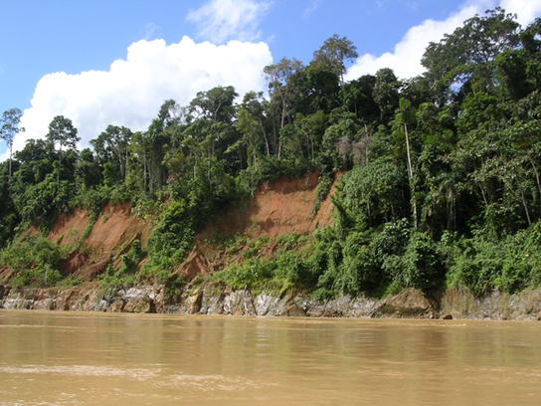
Figure 44.13
Tropical wet forests, such as these forests of Madre de Dios, Peru, near the Amazon River, have high species diversity.
(credit: Roosevelt Garcia)
This OpenStax ancillary resource is © Rice University under a CC-BY 4.0 International license; it may be reproduced or modified but must be attributed to OpenStax, Rice University and any changes must be noted. Any images credited to other sources are similarly available for reproduction, but must be attributed to their sources.

Slide 15
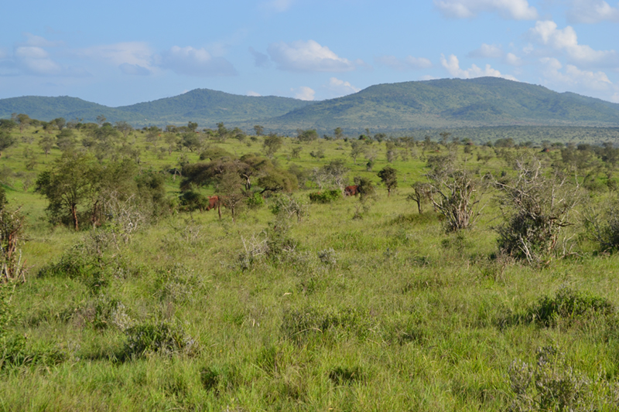
Figure 44.14
Savannas, like this one in Taita Hills Wildlife Sanctuary in Kenya, are dominated by grasses.
(credit: Christopher T. Cooper)
This OpenStax ancillary resource is © Rice University under a CC-BY 4.0 International license; it may be reproduced or modified but must be attributed to OpenStax, Rice University and any changes must be noted. Any images credited to other sources are similarly available for reproduction, but must be attributed to their sources.

Slide 16
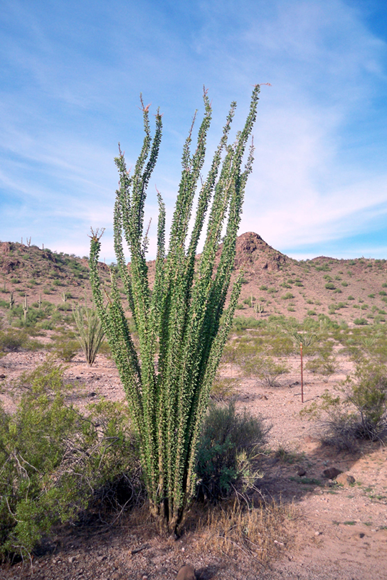
Figure 44.15
To reduce water loss, many desert plants have tiny leaves or no leaves at all. The leaves of ocotillo (Fouquieria splendens), shown here in the Sonora Desert near Gila Bend, Arizona, appear only after rainfall, and then are shed.
This OpenStax ancillary resource is © Rice University under a CC-BY 4.0 International license; it may be reproduced or modified but must be attributed to OpenStax, Rice University and any changes must be noted. Any images credited to other sources are similarly available for reproduction, but must be attributed to their sources.

Slide 17
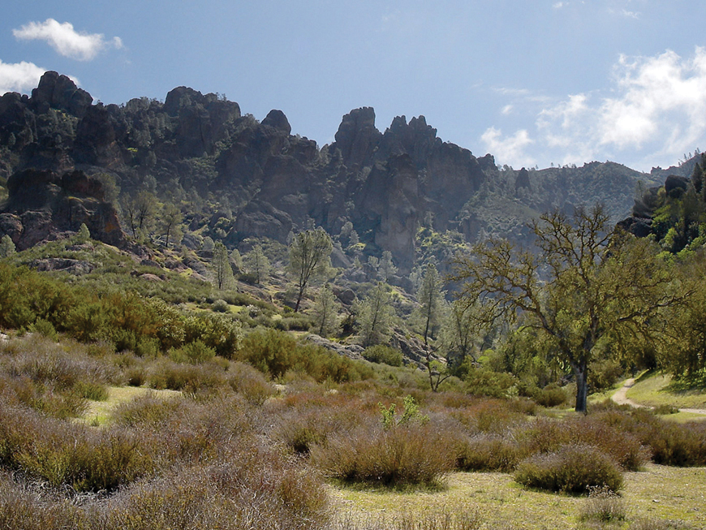
Figure 44.16
The chaparral is dominated by shrubs.
(credit: Miguel Vieira)
This OpenStax ancillary resource is © Rice University under a CC-BY 4.0 International license; it may be reproduced or modified but must be attributed to OpenStax, Rice University and any changes must be noted. Any images credited to other sources are similarly available for reproduction, but must be attributed to their sources.

Slide 18
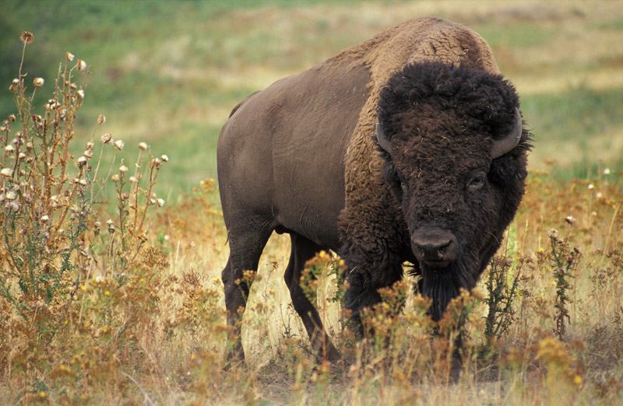
Figure 44.17
The American bison (Bison bison), more commonly called the buffalo, is a grazing mammal that once populated American prairies in huge numbers.
(credit: Jack Dykinga, USDA Agricultural Research Service)
This OpenStax ancillary resource is © Rice University under a CC-BY 4.0 International license; it may be reproduced or modified but must be attributed to OpenStax, Rice University and any changes must be noted. Any images credited to other sources are similarly available for reproduction, but must be attributed to their sources.

Slide 19
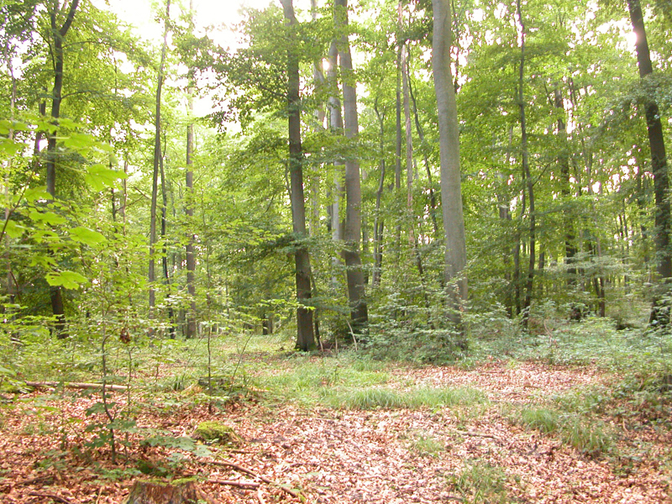
Figure 44.18
Deciduous trees are the dominant plant in the temperate forest.
(credit: Oliver Herold)
This OpenStax ancillary resource is © Rice University under a CC-BY 4.0 International license; it may be reproduced or modified but must be attributed to OpenStax, Rice University and any changes must be noted. Any images credited to other sources are similarly available for reproduction, but must be attributed to their sources.

Slide 20
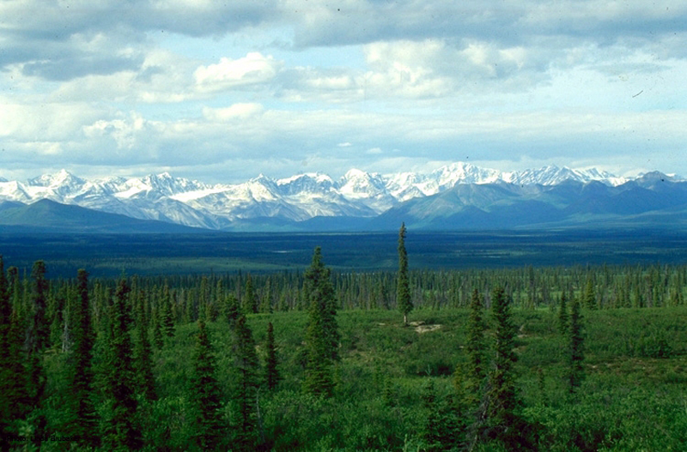
Figure 44.19
The boreal forest (taiga) has low lying plants and conifer trees.
(credit: L.B. Brubaker)
This OpenStax ancillary resource is © Rice University under a CC-BY 4.0 International license; it may be reproduced or modified but must be attributed to OpenStax, Rice University and any changes must be noted. Any images credited to other sources are similarly available for reproduction, but must be attributed to their sources.

Slide 21
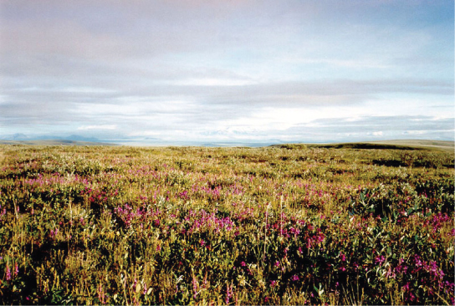
Figure 44.20
Low-growing plants such as shrub willow dominate the tundra landscape, shown here in the Arctic National Wildlife Refuge.
(credit: USFWS Arctic National Wildlife Refuge)
This OpenStax ancillary resource is © Rice University under a CC-BY 4.0 International license; it may be reproduced or modified but must be attributed to OpenStax, Rice University and any changes must be noted. Any images credited to other sources are similarly available for reproduction, but must be attributed to their sources.

Slide 22
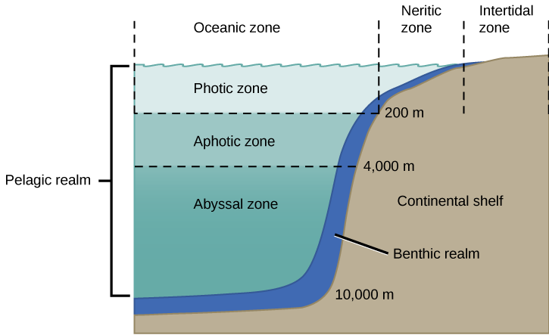
Figure 44.21
The ocean is divided into different zones based on water depth and distance from the shoreline.
This OpenStax ancillary resource is © Rice University under a CC-BY 4.0 International license; it may be reproduced or modified but must be attributed to OpenStax, Rice University and any changes must be noted. Any images credited to other sources are similarly available for reproduction, but must be attributed to their sources.

Slide 23
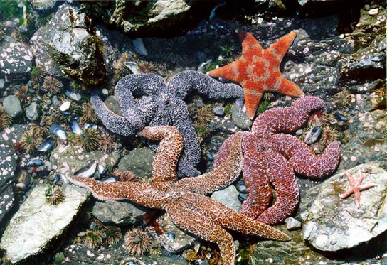
Figure 44.22
Sea urchins, mussel shells, and starfish are often found in the intertidal zone, shown here in Kachemak Bay, Alaska.
(credit: NOAA)
This OpenStax ancillary resource is © Rice University under a CC-BY 4.0 International license; it may be reproduced or modified but must be attributed to OpenStax, Rice University and any changes must be noted. Any images credited to other sources are similarly available for reproduction, but must be attributed to their sources.

Slide 24
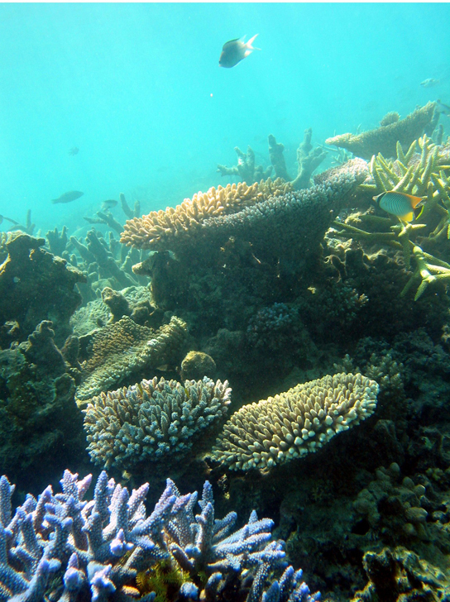
Figure 44.23
Coral reefs are formed by the calcium carbonate skeletons of coral organisms, which are marine invertebrates in the phylum Cnidaria.
(credit: Terry Hughes)
This OpenStax ancillary resource is © Rice University under a CC-BY 4.0 International license; it may be reproduced or modified but must be attributed to OpenStax, Rice University and any changes must be noted. Any images credited to other sources are similarly available for reproduction, but must be attributed to their sources.

Slide 25
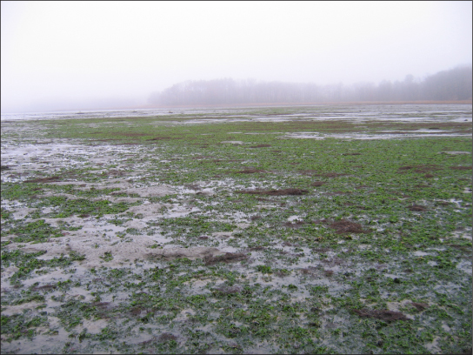
Figure 44.24
The uncontrolled growth of algae in this lake has resulted in an algal bloom.
(credit: Jeremy Nettleton)
This OpenStax ancillary resource is © Rice University under a CC-BY 4.0 International license; it may be reproduced or modified but must be attributed to OpenStax, Rice University and any changes must be noted. Any images credited to other sources are similarly available for reproduction, but must be attributed to their sources.

Slide 26
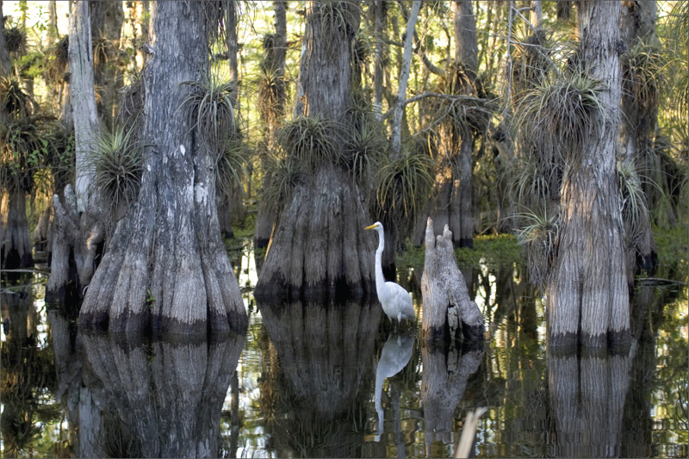
Figure 44.25
Located in southern Florida, Everglades National Park is vast array of wetland environments, including sawgrass marshes, cypress swamps, and estuarine mangrove forests. Here, a great egret walks among cypress trees.
(credit: NPS)
This OpenStax ancillary resource is © Rice University under a CC-BY 4.0 International license; it may be reproduced or modified but must be attributed to OpenStax, Rice University and any changes must be noted. Any images credited to other sources are similarly available for reproduction, but must be attributed to their sources.

Slide 27
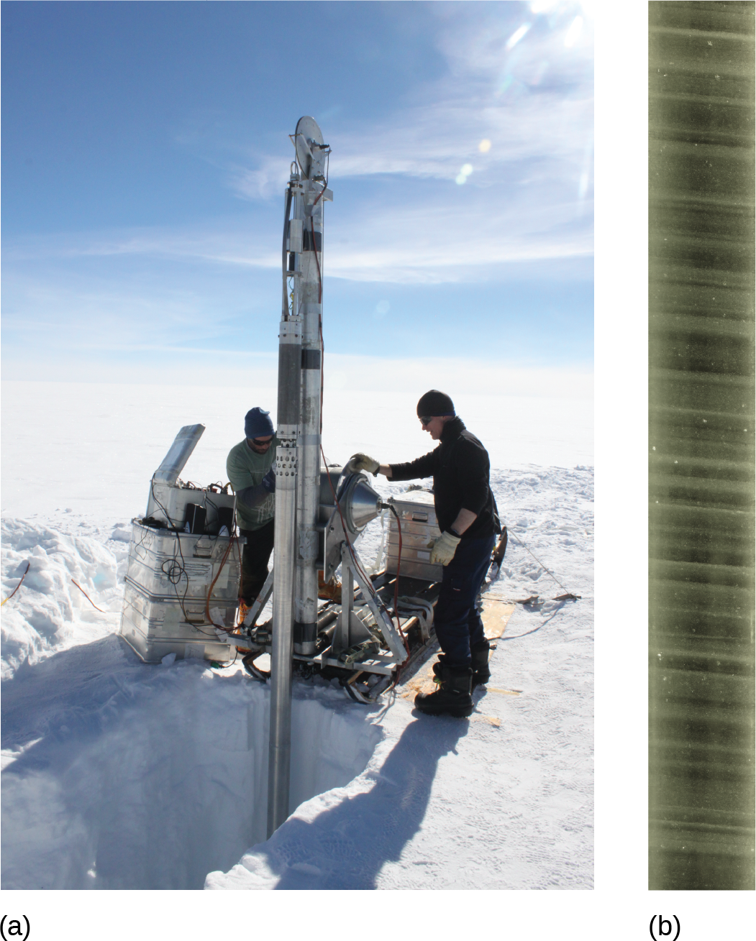
Figure 44.26
Scientists drill for ice cores in polar regions. The ice contains air bubbles and biological substances that provide important information for researchers.
(credit: a: Helle Astrid Kjær; b: National Ice Core Laboratory, USGS)
This OpenStax ancillary resource is © Rice University under a CC-BY 4.0 International license; it may be reproduced or modified but must be attributed to OpenStax, Rice University and any changes must be noted. Any images credited to other sources are similarly available for reproduction, but must be attributed to their sources.

Slide 28
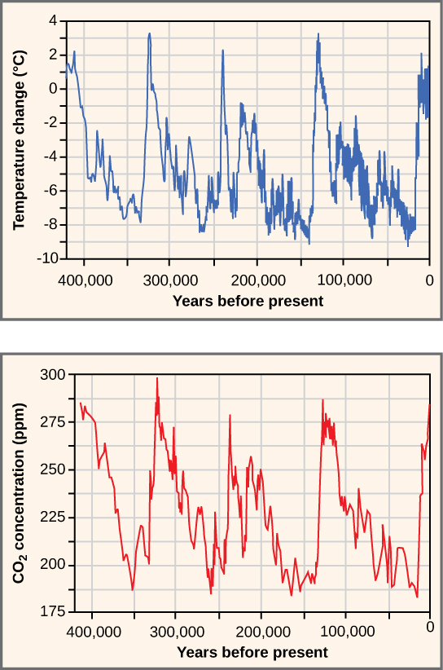
Figure 44.27
Ice at the Russian Vostok station in East Antarctica was laid down over the course 420,000 years and reached a depth of over 3,000 m. By measuring the amount of CO₂ trapped in the ice, scientists have determined past atmospheric CO₂ concentrations. Temperatures relative to modern day were determined from the amount of deuterium (an isotope of hydrogen) present.
This OpenStax ancillary resource is © Rice University under a CC-BY 4.0 International license; it may be reproduced or modified but must be attributed to OpenStax, Rice University and any changes must be noted. Any images credited to other sources are similarly available for reproduction, but must be attributed to their sources.

Slide 29
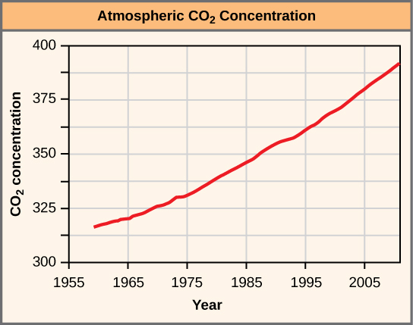
Figure 44.28
The atmospheric concentration of CO₂ has risen steadily since the beginning of industrialization.
This OpenStax ancillary resource is © Rice University under a CC-BY 4.0 International license; it may be reproduced or modified but must be attributed to OpenStax, Rice University and any changes must be noted. Any images credited to other sources are similarly available for reproduction, but must be attributed to their sources.

Slide 30
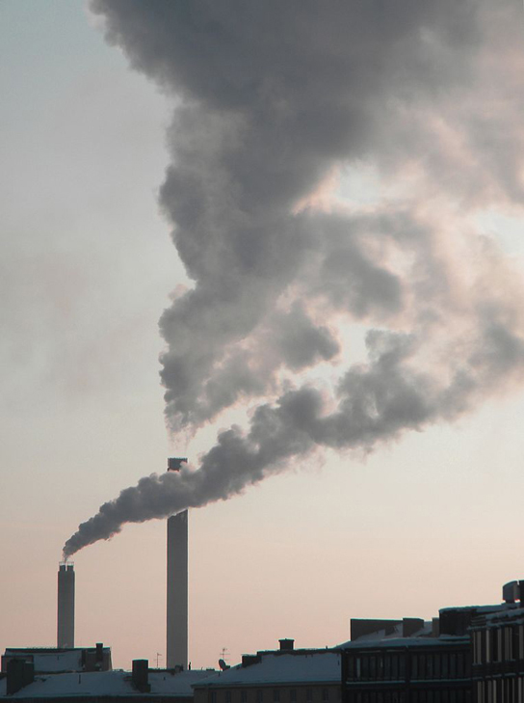
Figure 44.29
The burning of fossil fuels in industry and by vehicles releases carbon dioxide and other greenhouse gases into the atmosphere.
(credit: “Pöllö”/Wikimedia Commons)
This OpenStax ancillary resource is © Rice University under a CC-BY 4.0 International license; it may be reproduced or modified but must be attributed to OpenStax, Rice University and any changes must be noted. Any images credited to other sources are similarly available for reproduction, but must be attributed to their sources.

Slide 31
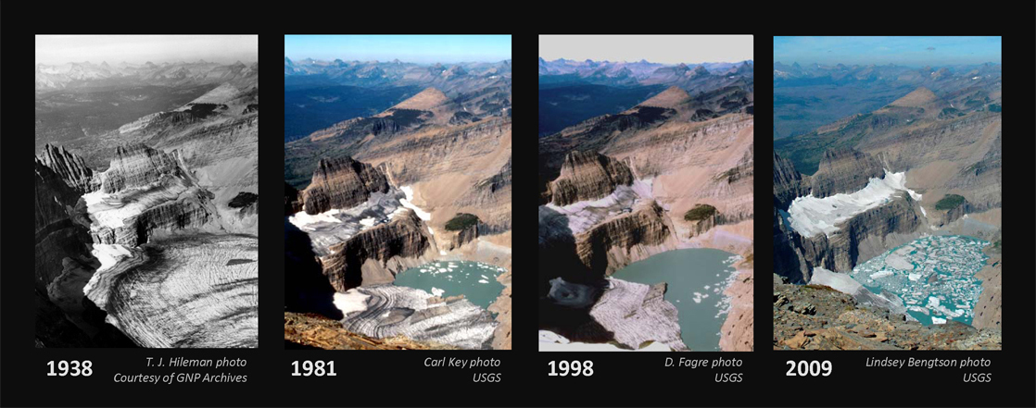
Figure 44.30
The effect of global warming can be seen in the continuing retreat of Grinnel Glacier. The mean annual temperature in the park has increased 1.33 °C since 1900. The loss of a glacier results in the loss of summer meltwaters, sharply reducing seasonal water supplies and severely affecting local ecosystems.
(credit: modification of work by USGS)
This OpenStax ancillary resource is © Rice University under a CC-BY 4.0 International license; it may be reproduced or modified but must be attributed to OpenStax, Rice University and any changes must be noted. Any images credited to other sources are similarly available for reproduction, but must be attributed to their sources.

